Slide 1


The phytoextraction potential of selected vegetable plants on Kosovo contaminated soils
T. Miano^{1*}, H. Voca¹, L. Piscitelli², A.D. Malerba¹, D. Mondelli¹, & V. D’Orazio¹
¹Dip. Scienze del Suolo, della Pianta e degli Alimenti, Univ. Studi Bari Aldo Moro, Bari, Italy
²C.I.H.E.M-I.A.M.B-Istituto Agronomico Mediterraneo di Bari, Italy
*E-mail: teodoro.miano@uniba.it

Slide 2
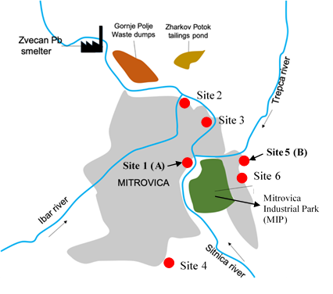
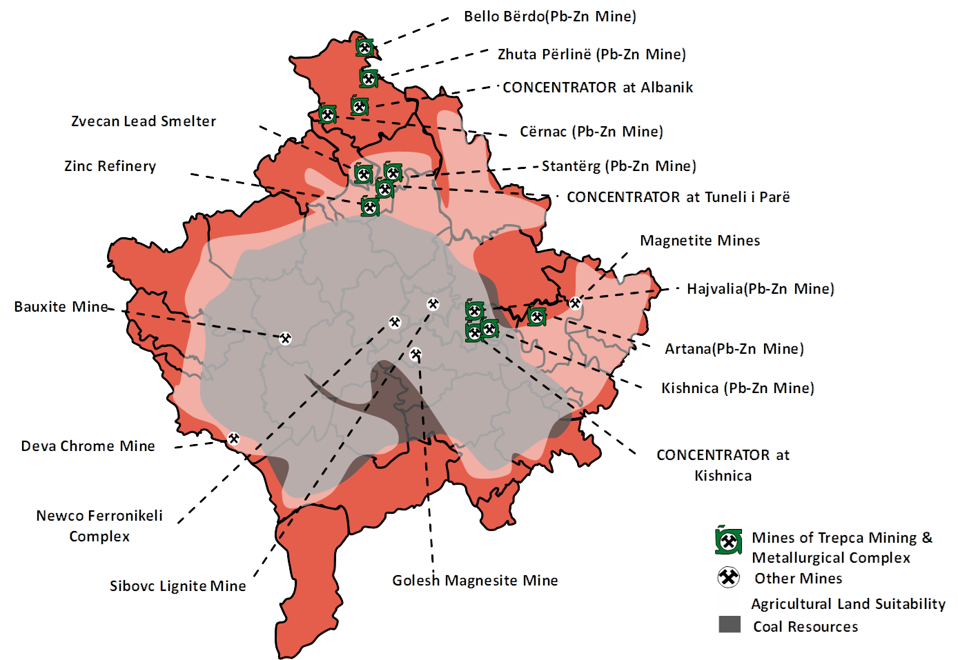
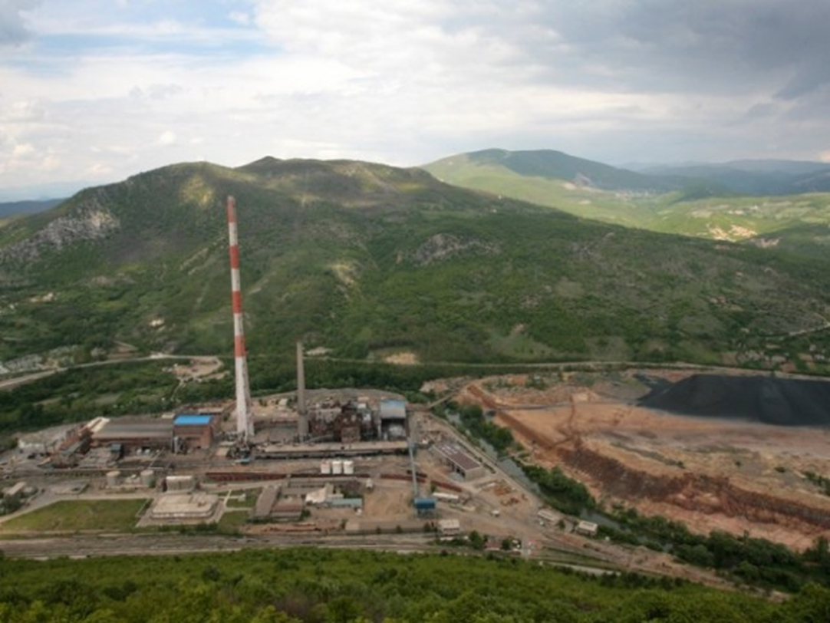
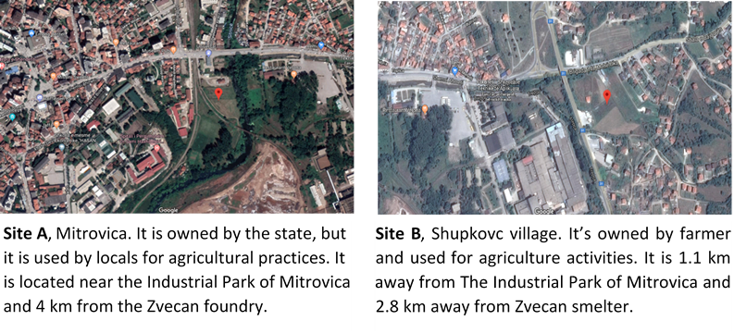
Trepca Mining & Metallurgical Complex
Mitrovica area, northern Kosovo
    Soils
Sampled sites
300 kg of soil from each sampling sites
Soil analysis
Pb and Zn analyses
Texture
pH
Total Carbonate
Electrical Conductivity
Total Nitrogen
Org. Carbon and Org. Matter
Available Phosphorus
Exchangeable Ca, K, Mg, Na
Acid digestion
Inductively coupled Plasma Optical Emission Spectrometry (ICP-OES)

Slide 3
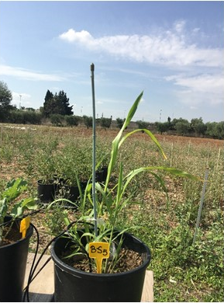
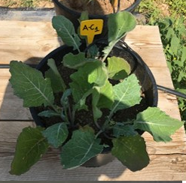
Experimental design
5 replication/treatment
Plant analysis
    Plants
Sorghum (Sorghum bicolor, L. Moench)
Measurements
Length
Node
Stem
Ear
Leaf
Root
Pb and Zn in aboveground biomass
Pb and Zn in belowground biomass
Canola (Brassica napus L. cv. Westar)
Measurements
Length
Stem
Leaf
Root
Pb and Zn in aboveground biomass
Pb and Zn in belowground biomass

Slide 4
Plant indexes
Tolerance Index (TI)
ratio of biomass for plants grown in contaminated soil to plants grown in non-contaminated control soil, for roots and shoots separately
TI values < 1 → net decrease in biomass → plants are stressed
TI values = 1 → no difference relative to uncontaminated control treatments
TI values > 1 → net increase in biomass → plants express a growth dilution effect (tolerant)
Biological Accumulation Coefficient (BAC)
ratio between the concentration of the metal in the aboveground biomass and that in the soil
Biological Transfer Coefficient (BTC)
ratio between the concentration of metal of aboveground tissues and that of the metal in the roots
BAC and BTC > 1 → high ability to store the metals in their tissues → plants are suitable for phytoextraction

Slide 5
    Statistics
Soils
Pb and Zn content: acid digestion and ICP-OES analysis
Data subjected to t-test at level of 0.05% significance.
Data presented as means of six replicates.
Plants
All biometric data (on dried weight) of sorghum and canola as well as the Pb and Zn content in shoots and roots subjected to a one-way ANOVA, and Tukey honest significant difference (HSD) test for pair-wise comparisons of all treatments.
Pb and Zn content in above- and below-ground biomass: acid digestion and ICP MS analysis
Statistical significance tested at the level of 0.05 of significance.
Data are presented as means of four replicates.

Slide 6
Threshold values of heavy metals in soils with different uses according to DLgs 152/2006, All. 5
Soils
Average values of Pb and Zn concentration (mg kg⁻¹) in the soils A and B

Slide 7
Sorghum
Sorghum plants poorly tolerate the presence of Pb and Zn at the concentrations measured in the selected soils, especially in the case of the most polluted soil B.

Slide 8
Sorghum
Both coefficients are < 1, thus sorghum is not suitable for phytoextraction

Slide 9
Canola
Good ability of canola plants to grow also in contaminated soils.

Slide 10
Canola
Both coefficients are < 1, thus canola is not suitable for phytoextraction.
Anyway, canola plants grew up in presence of high level of Pb and Zn, thus they could be used for phytostabilisation process, therefore metals will be relatively stabilized in the rhizosphere zone, reducing their mobility and, consequently, both its availability for plants (less metal in food chain) and its leaching into groundwater.

