Slide 1
V.E. ZUEV INSTITUTE OF ATMOSPHERIC OPTICS
RUSSIAN ACADEMY OF SCIENCES, SIBERIAN BRANCH
Variation of the surface ozone concentration during precipitation
Igor V. Ptashnik, Boris D. Belan, Denis E. Savkin, Gennadii N. Tolmachev, Tatayana K. Sklyadneva, Tatayana M. Rasskazchikova, Victoria Arshinova, and Alexandr V. Fofonov
V.E. Zuev Institute of Atmospheric Optics, SB RAS, Tomsk, Russian Federation
(bbd@iao.ru)
Online | 4–8 May 2020

Slide 2
V.E. ZUEV INSTITUTE OF ATMOSPHERIC OPTICS
RUSSIAN ACADEMY OF SCIENCES, SIBERIAN BRANCH
Purpose:
The aim of this work is to identify the physical mechanism of interaction of ozone with precipitation, regardless of the period and geographical location of the measurement site.
Measurements site:
For the study, the data on the air composition from the TOR-station and the Karadag background environmental monitoring station were used.
Station | Coordinates
TOR-station (Tomsk) | 56°28' N, 85°03' E
KARADAG (Feodosia) | 44°55′ N, 35°14′ E
APOA-370 optical gas analyzer (HORIBA, Jupan)

Slide 3
V.E. ZUEV INSTITUTE OF ATMOSPHERIC OPTICS
RUSSIAN ACADEMY OF SCIENCES, SIBERIAN BRANCH
Equipment
Concentration of ozone at TOR-Station is measured with a TEI model 49C UV photometric ozone analyzer, and with a HORIBA APOA-370 UV photometric ozone analyzer at KARADAG site.
HORIBA APOA-370 | Ozone analyzer | TEI model 49c
KARADAG | Measurement site | TOR-station (TOMSK)
4 ranges selectable from 0-10 ppm | Measure range | Low 0-0,2 ppm High 0-0,5 ppm
± 1% of F.S. (Full scale) | Accuracy | ± 0,5% of F. S. (Full scale)
Japan | Place of Origin | USA
UV | Method | UV

Slide 4
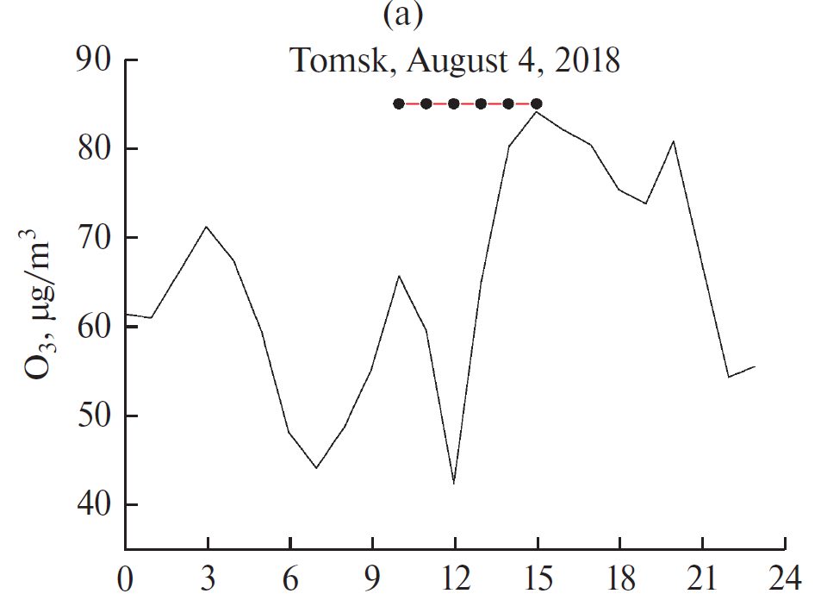
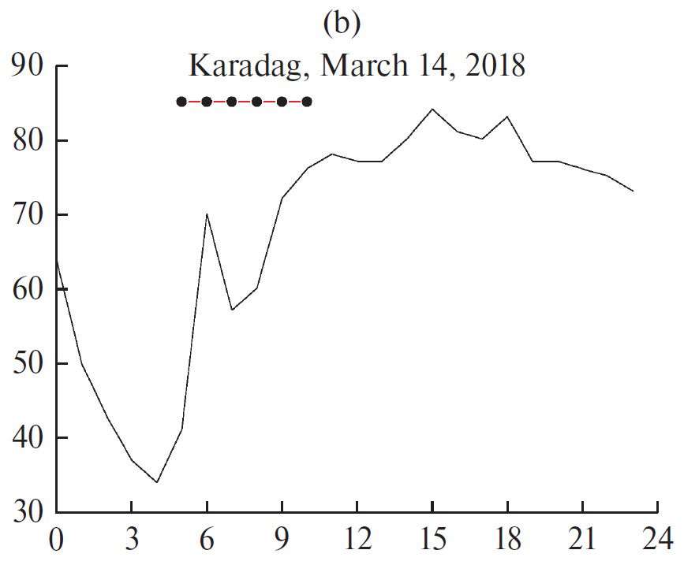
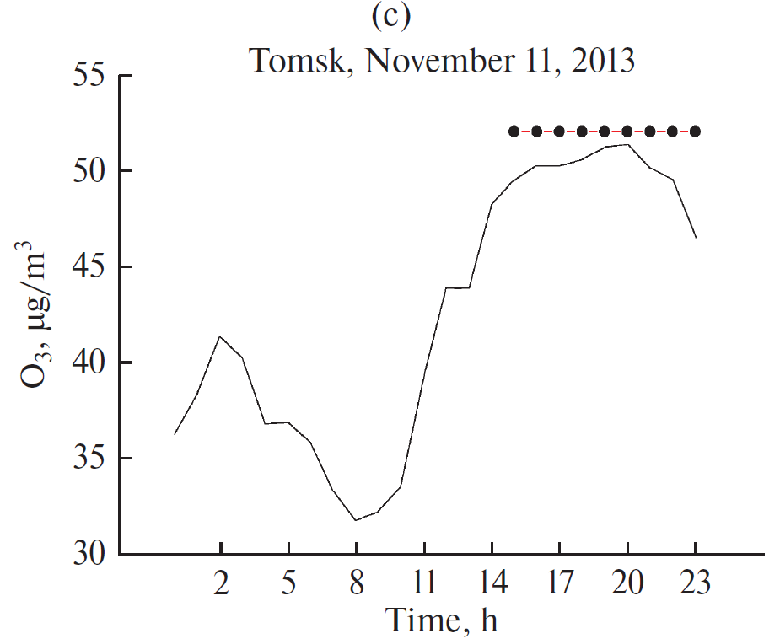
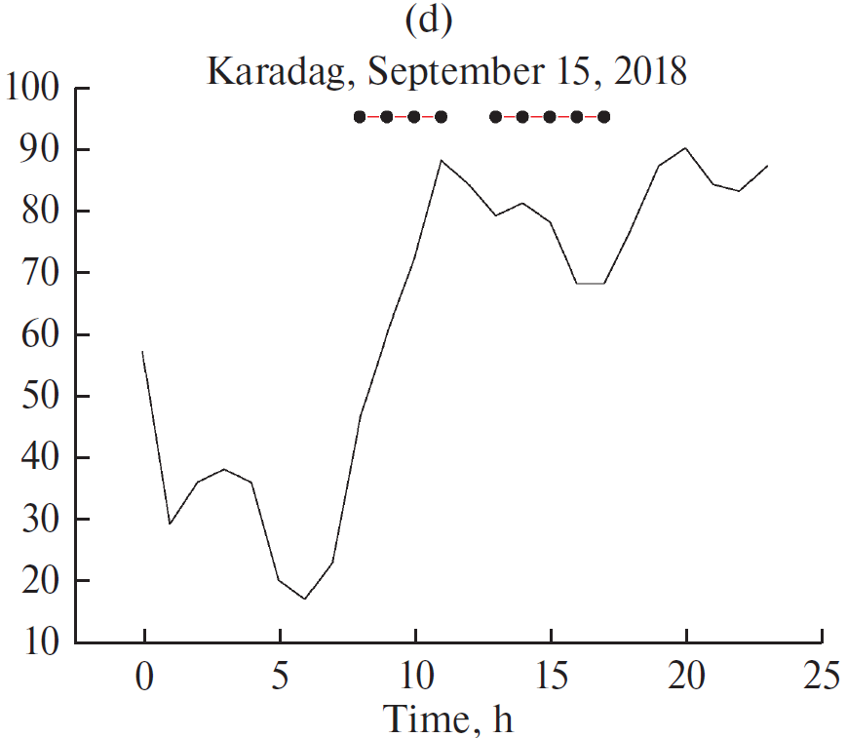
V.E. ZUEV INSTITUTE OF ATMOSPHERIC OPTICS
RUSSIAN ACADEMY OF SCIENCES, SIBERIAN BRANCH
Change in surface ozone concentration in Tomsk (a,c) and Karadag (b,d)
(horizontal line with dots shows the periods of precipitation)
a)
b)

Slide 5
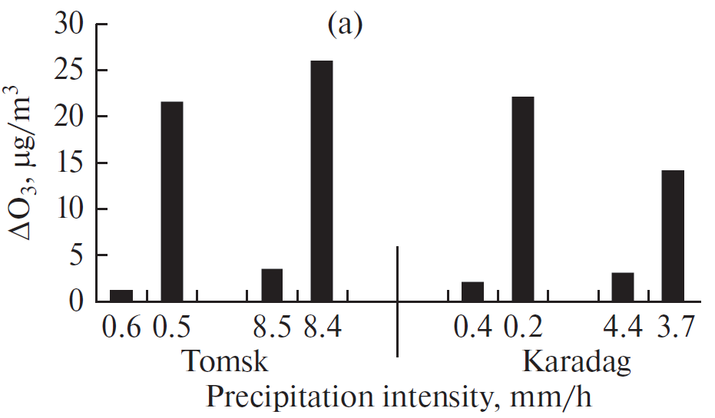
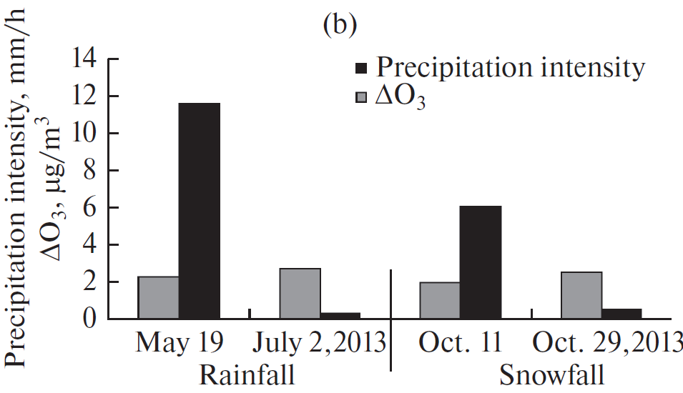
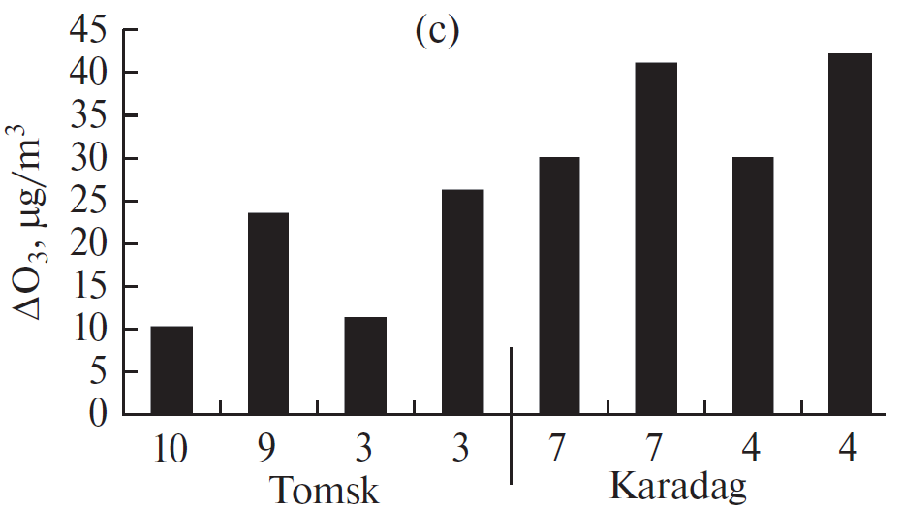
V.E. ZUEV INSTITUTE OF ATMOSPHERIC OPTICS
RUSSIAN ACADEMY OF SCIENCES, SIBERIAN BRANCH
Change in surface ozone concentration depending on the precipitation rate (a), type (b), and dune of precipitation in Tomsk and Karadag (c)
Duration of precipitation, h

Slide 6
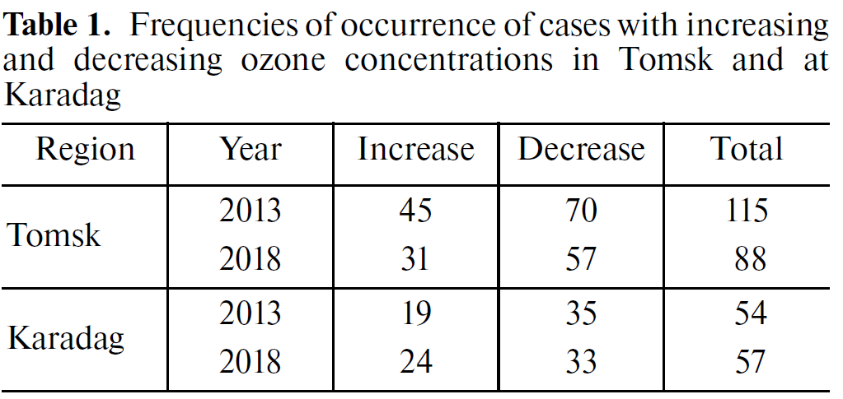
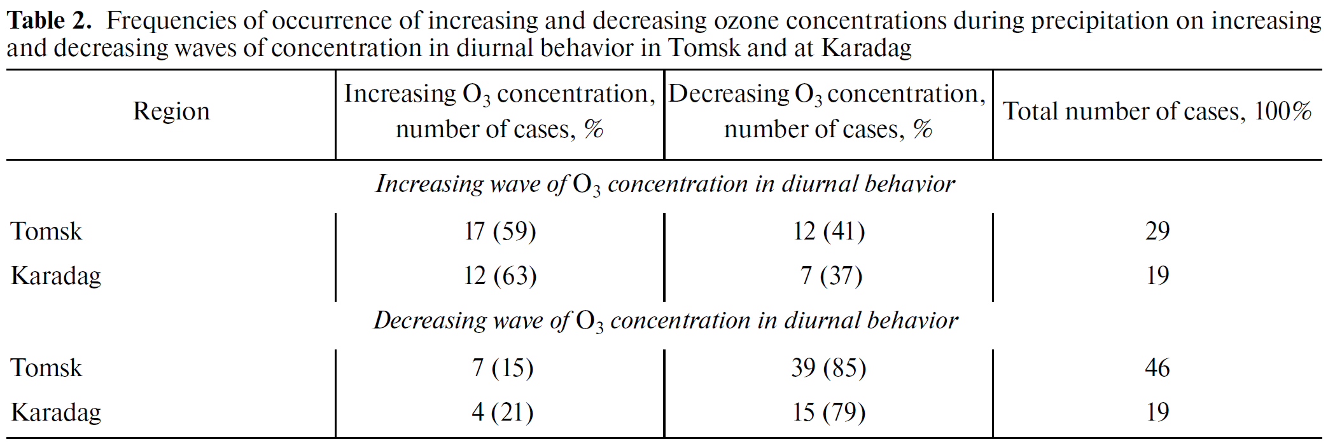
V.E. ZUEV INSTITUTE OF ATMOSPHERIC OPTICS
RUSSIAN ACADEMY OF SCIENCES, SIBERIAN BRANCH
Statistics on surface ozone variation with precipitations

Slide 7
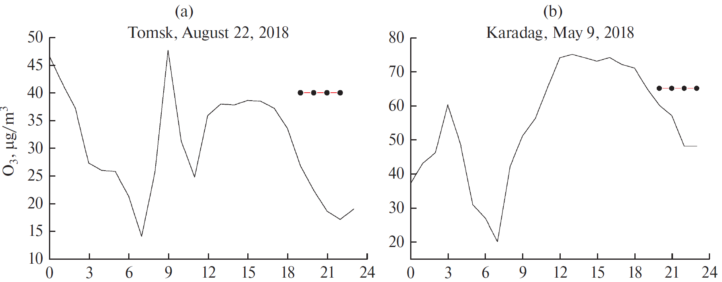
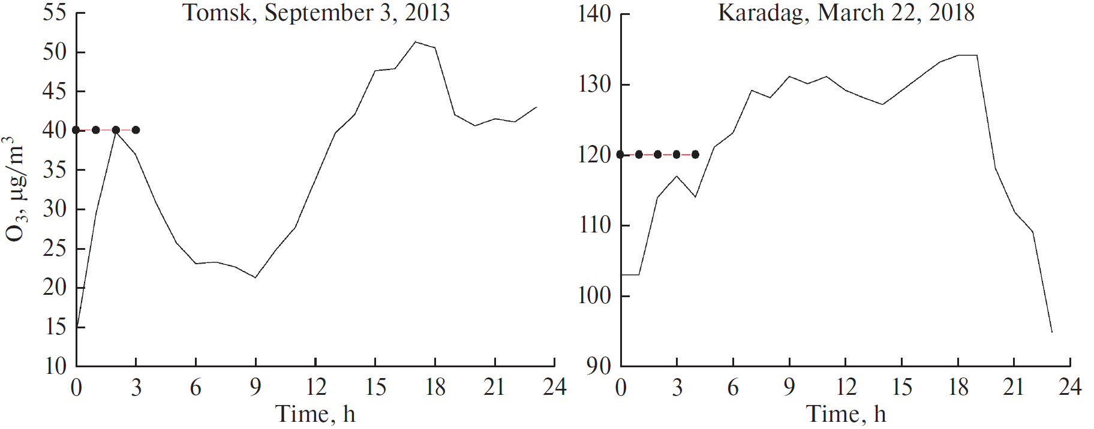
V.E. ZUEV INSTITUTE OF ATMOSPHERIC OPTICS
RUSSIAN ACADEMY OF SCIENCES, SIBERIAN BRANCH
Change in surface ozone concentration in Tomsk (a,c) and Karadag (b,d)
during air-mass precipitation (horizontal line with dots)
a)
b)
c)
d)

Slide 8
V.E. ZUEV INSTITUTE OF ATMOSPHERIC OPTICS
RUSSIAN ACADEMY OF SCIENCES, SIBERIAN BRANCH
Conclusions
The above investigation has shown that:
During atmospheric precipitation, both an increase and a decrease in SOC can occur regardless of their precipitation rate, type, duration of precipitation and area of measurements;
The greatest changes are associated with frontal type precipitation and reflects an ozone concentration discontinuity under a change of air masses
In air-mass precipitation, the sign of a change in ozone concentration depends on the period of the day in which they fall;
With a change in the stratification of the atmospheric boundary layer during the precipitation period, an increase and decrease in ozone concentration can be observed, depending on at what altitude is the concentration higher.

Slide 9
V.E. ZUEV INSTITUTE OF ATMOSPHERIC OPTICS
RUSSIAN ACADEMY OF SCIENCES, SIBERIAN BRANCH
Thank you for attention.

