Slide 1
Does stand age affect methane consumption of forest soil? A study in a chronosequence of sessile oak.
Nicolas Bras - Daniel Epron - Caroline Plain
EGU2020 session BG3.3

Slide 2
Factors influencing the methane consumption :
Stand age
Ageing of forest stands:
soil decompaction,
increase in evapotranspiration,
increase N mineralisation
decrease N demand
Increase in air-filled porosity and mineral nitrogen with stand age (cf diagram)
Inhibition of methane consumption by mineral nitrogen (competitive inhibition of methane monooxygenases by ammonia)
Increase in methane consumption due to high air-filled porosity (enhanced diffusion of CH₄ and O₂)
Evapo
transpiration
Decompaction
Total N
N demand
Soil water content
Porosity
Air filled porosity
AFP = Porosity - SWC
N Mineralisation
Diffusion
Methane consumption
Mineral N
?
EGU2020 session BG3.3

Slide 3
Method
Chronosequence of 16 stands of sessile oaks from 20 to 143 years old
Soil sampling at the end of summer 2018 and 2019 during a period of high air-filled porosity and in early spring 2019 during a period of low air-filled porosity.
12 soil cores (0-5 cm deep) sampled with metal cylinder (8 cm in diameter)
Incubation at 20°C in a climatic chamber
Methane consumption calculated from the decrease in CH4 concentration recorded by a gas analyser (integrated cavity output spectroscopy)
Soil mineral nitrogen concentration measured with a continuous flow spectrometric analyser after KCl extraction
Porosity, soil water content and air-filled porosity measured on a 20 g subsample of sieved soil oven-dried at 105°C
EGU2020 session BG3.3

Slide 4
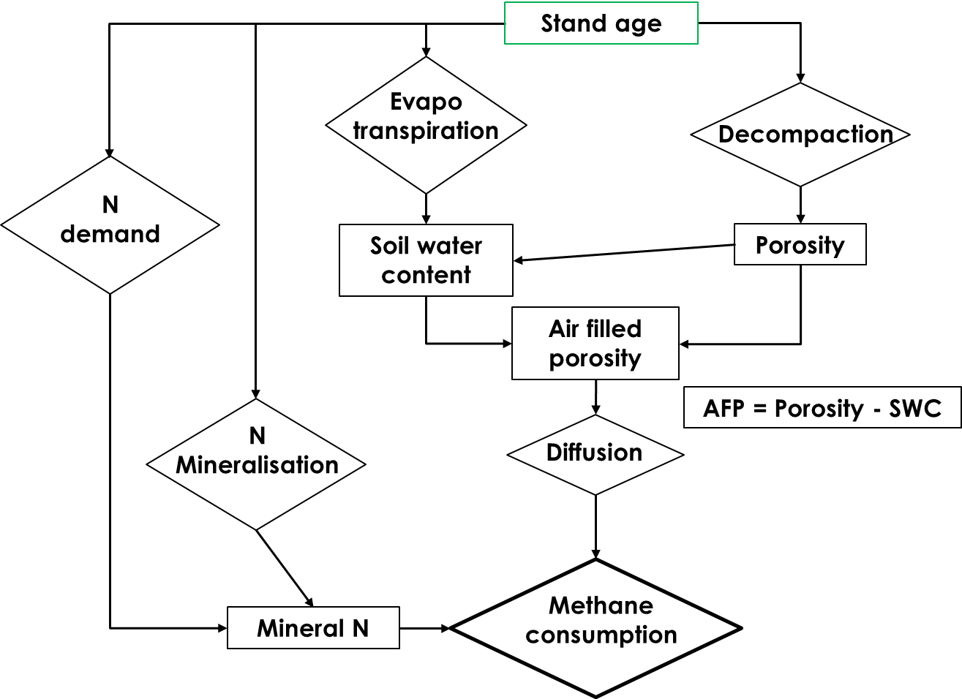
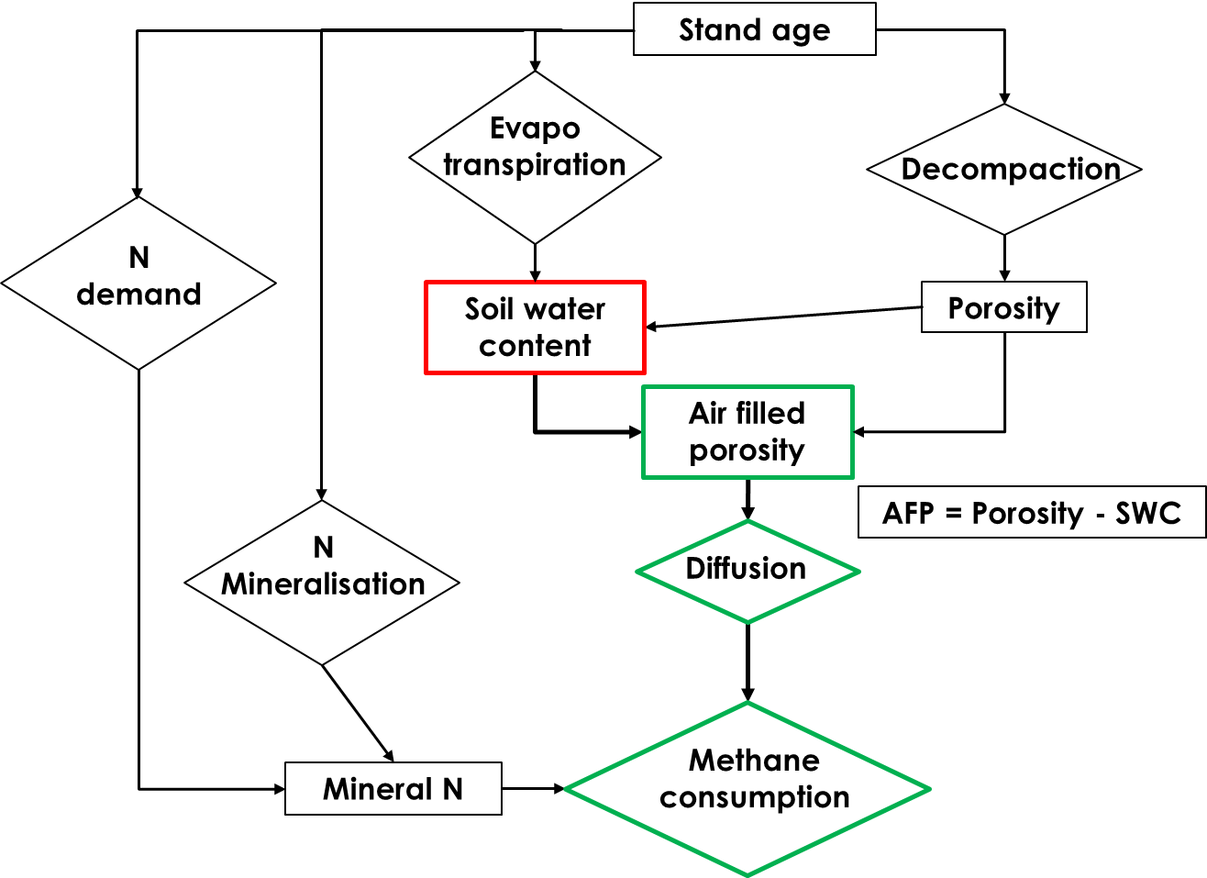
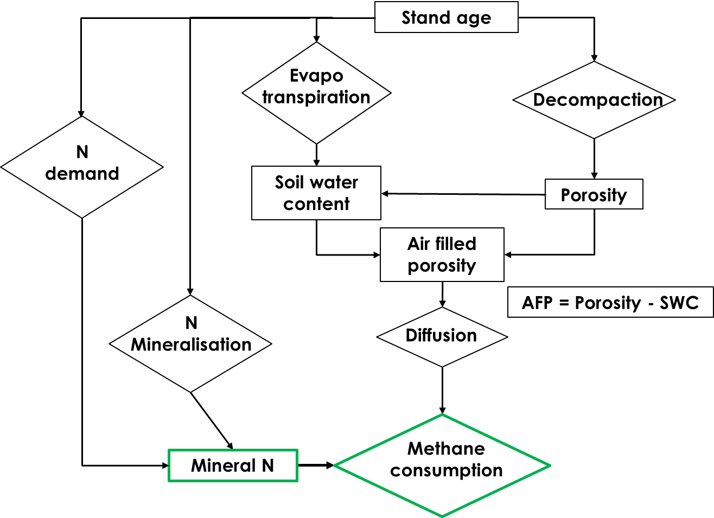
Main results
Air-filled porosity, mineral nitrogen and methane consumption: no significant trend related to stand age
Variation of methane consumption between stands correlated with air-filled porosity in spring 2019 (r = 0.91)
Variation of methane consumption between stands correlated with mineral nitrogen in summer 2019 (r = -0.72)
EGU2020 session BG3.3

Slide 5
Conclusion
No effect of stand age on methane consumption in our oak chronosequence
The positive effect of stand age on methane consumption reported in previous studies cannot be considered as widespread
Spatial variability of methane consumption between stands is related to:
Air-filled porosity when gas diffusion is the limiting factor of methane consumption in spring, due to variations in soil water content
Mineral nitrogen in the 8 youngest stands in summer 2019
EGU2020 session BG3.3

