Slide 1
Drivers of intermediate temperature changes in the North Atlantic Subpolar Gyre
D. G. Desbruyères^{1*}, B. Sinha², E. L. McDonagh^{3,2}, S. A. Josey², N. P. Holliday², D. A. Smeed², A. L. New², A. Megann², B. I. Moat².
1. IFREMER, University of Brest, CNRS, IRD, Laboratoire d'Océanographie Physique et Spatiale, Plouzané, France.
2. National Oceanography Centre, Southampton, United Kingdom.
3. NORCE, Norwegian Research Centre, Bjerknes Centre for Climate Research, Bergen, Norway.
EGU 2020 Sharing Science Online

Slide 2
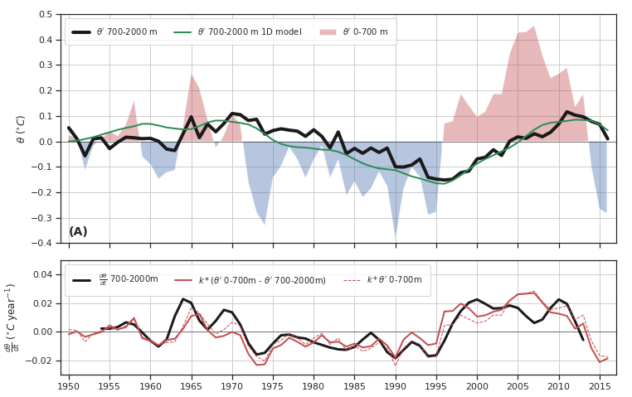
The multidecadal context in observations (EN4)
Sustained increases and decreases of intermediate temperature (black line) in the SPG correlate with the long-lasting warm and cold states of the upper ocean (shadings).
This can be evidenced through a simple two-layer ocean model (Gregory, 2000):
$\frac{dθ_{700−2000m}}{dt}=k(θ_{0−700m}−θ_{700−2000m}$)
Equation 1
The temperature tendency in the intermediate layer (black line, bottom) is proportional to the temperature difference between the two layers (red line) - a linear representation of vertical heat transport by all processes (k = 0.06 year⁻¹). This relationship implies first-order predictability skills of intermediate OHC from upper ocean monitoring.
A: Observed temperature anomalies within the 0-700 m layer (color shadings) and the 700-2000 m layer (thick black) in the SPG (63°W-10°W and 45°N-67°N). Data taken from the gridded EN4.2.1 product. The green line shows temperature anomalies within 700-2000 m as simulated by a 1D diffusive model forced by the observed surface temperature time series (see next slide). B: The observed components of the two-layer ocean model (equation 1 with $k$ = 0.06 year⁻¹).

Slide 3
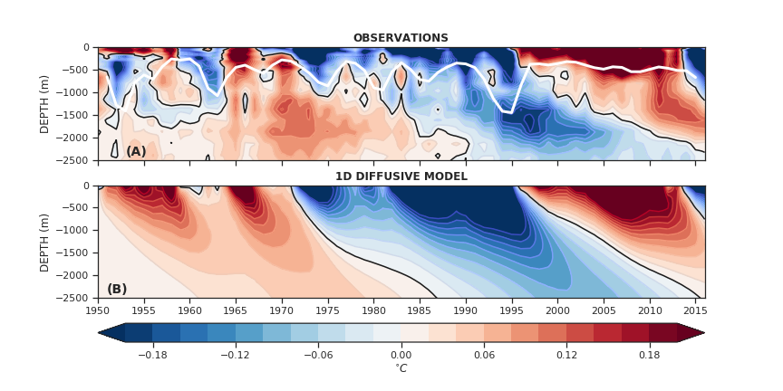
The multidecadal context in observations (EN4)
The connection between the upper and intermediate layers is characterized by the progressive downward propagation of the upper warm-cold-warm cycle down to about 2000 m (Figure 3, top). The physical mechanisms controlling such an apparent downward propagation cannot be explicitly resolved using “low-resolution” observational datasets, but their net effect can be effectively reproduced by a 1D diffusion model:
$\frac{∂θ_{d}(z,t)}{∂t}=κ\frac{∂^{2}θ_{d}(z,t)}{∂z^{2}}$
Equation 2
A: The depth-time diagram of observed temperature anomalies averaged in the SPG (gridded EN4.2.1 product). White line is the aggregate maximum mixed layer depth in the western SPG (55°N-65°N – 40°W-60°W) computed as the 75th percentile of the pycnostad depths. B: The solution of a simple 1D diffusive model initialized with surface anomalies in the SPG and a boundary-like diffusivity coefficient $κ$ = 3x10⁻³ m⁻² s⁻¹ (equation 2)

Slide 4
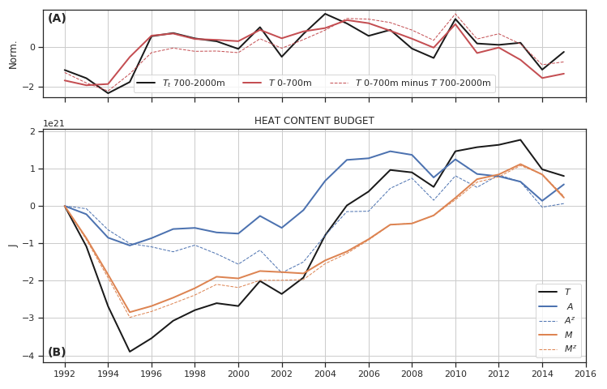
Heat budget 700-2000m in ECCOv4
$\frac{dθ_{700−2000m}}{dt}=k(θ_{0−700m}−θ_{700−2000m}$)
$$C_{p}ρ_{0}\int_{t}{\iiint_{V}{\frac{∂θ}{∂t}{dV}^{∗}}{dt}^{∗}}= C_{p}ρ_{0}\int_{t}{\iiint_{V}{−∇(\vec{u}θ){dV}^{∗}{dt}^{∗}}}+ C_{p}ρ_{0}\int_{t}{\iiint_{V}{D_{θ}{dV}^{∗}{dt}^{∗}}}$$
The basin-average covariance ratio for advective and diffusive heat fluxes, computed as $\frac{σ\left(A_{t}, T_{t}\right)}{{σ\left(T_{t}\right)}^{2}}$ and $\frac{σ\left(M_{t}, T_{t}\right)}{{σ\left(T_{t}\right)}^{2}}$ , respectively amount to 46% and 54%, with those values themselves largely explained by the vertical component of the fluxes.
Two-third of the dominant warming trend of the intermediate layer during 1996-2013 is explained by the vertical component of combined diffusive heat fluxes $M$.
A: The simulated components of the two-layer ocean model (equation 1) in the SPG normalized by their respective standard deviation. B: Cumulated heat budget components within 700-2000m (in J), with the tendency ($T$, black), advection ($A$, blue) and combined diffusion ($M$, orange). The vertical components of advection and diffusion ($A^{z}$ and $M^{z})$ are shown with dashed lines.

Slide 5
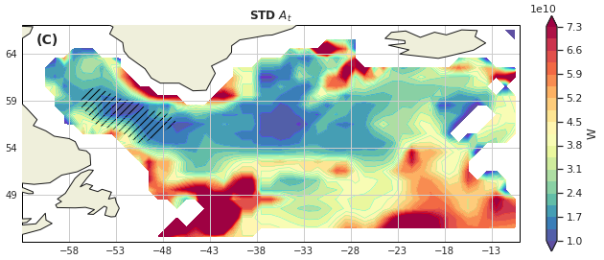
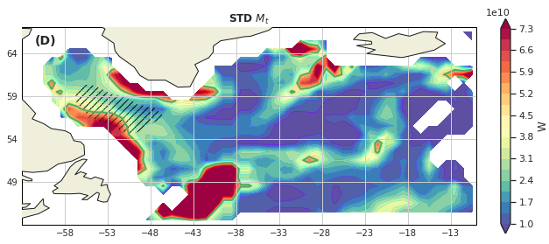
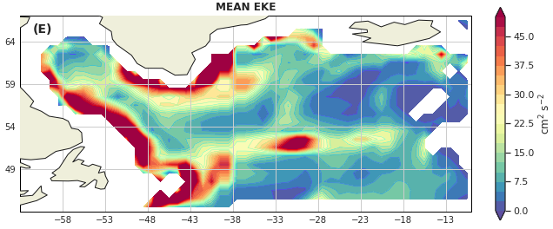
Heat budget 700-2000m in ECCOv4
Standard deviation of advective (left) and diffusive (right) heat flux convergence for the intermediate (700-2000m) layer, with the hatchings showing the region of simulated deepest mixed layer depth (>2000 m). The green contours (5 10¹⁰ W) in (D) is used to delimit the highly-diffusive boundary region from the interior region for further diagnosis (see next slide). (E) Time-mean Eddy Kinetic Energy average within the intermediate 700-2000m layer.
Variability in the advective and diffusive heat flux convergences is most intense along the SPG boundary while being weaker in the basin interiors, including regions of deepest mixed layers. Horizontal patterns of standard deviation in both $A_{t}$ and $M_{t}$ appear linked to the mean distribution of eddy kinetic energy (EKE) in the intermediate layer (Figure 6E), with highest values within the western boundary currents of the SPG, from Greenland to Newfoundland, and along the NAC path.

Slide 6
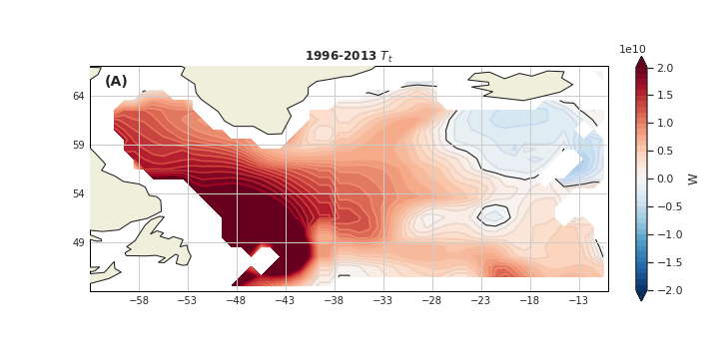
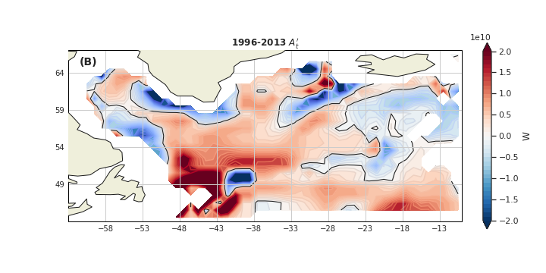
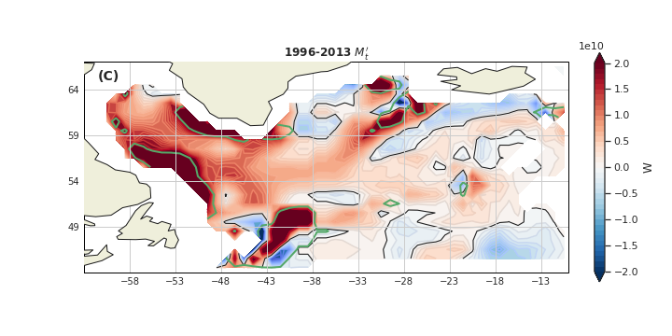
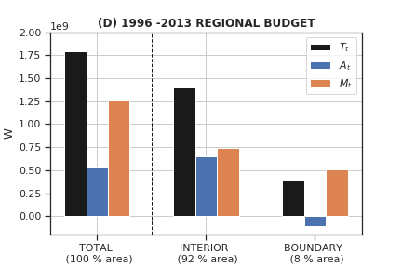
Heat budget 700-2000m in ECCOv4
The spatial distribution of heat budget components within 700-2000m averaged during the latest wamring period 1996-2013, with (A) the total tendency $T_{t}$, (B) anomalous advection $A_{t}′$ and (C) anomalous combined diffusion $M_{t}′$. The green contours (5 10¹⁰ W) in (C) is used to delimit the highly-diffusive boundary region from the interior region. The heat budget is quantified in (D) for the full SPG area and the interior/boundary areas
During 1996-2013, both advective $A_{t}$ and combined diffusive $M_{t}$ fluxes act to warm the domain within the wide (and more quiescent) interior of the SPG, while showing greater and opposing changes within the main dynamical areas of the domain (NAC and DWBC paths). Vertical diffusion accounts for more than 70% of the 1996-2013 warming trend and more than 40% of this contribution occurred in the dynamical boundary region (only 8% of the SPG area).

Slide 7
Take-home messages
Key points #1. There is a direct causal and lagged relationship between upper and intermediate decadal temperature changes in the subpolar North Atlantic (predictability skills of the latter).
Key points #2. Variability in vertical heat transport convergence is important within the energetic boundary currents of the subpolar North Atlantic.
Key points #3. Open-ocean deep convection is not a unique pathway for the slow ventilation of the subpolar North Atlantic.

