Slide 1
EGU General Assembly 2020
AS1.35 Aeolus Data and its application
5th May 2020
Consolidation of Aeolus FMA and FMB datasets in the DSI X-PReSS Consortium: Methodology used to generate Master Datasets and the results that have been achieved
N. Comparetti¹, G. Colamussi¹, M. De Laurentis²,M. Douzal³, P. Fischer³, A. Paciucci¹,
B. Schipperijn⁴, J. Smeets⁴ and M. Veneziani⁴ ¹ Serco Italia S.p.A, Frascati, Italy ² Rhea, Frascati, Italy ³ European Space Agency - ESRIN, Frascati, Italy ⁴ S[&]T, Delft, The Netherlands

Slide 2
Abstract:
We present the methodology and results of the Aeolus VC01 and L0 FM-A and FM-B datasets consolidation performed by the X-PReSS team as part of the ESA (European Space Agency) Data Service Initiative (DSI) managed by ESA’s Ground Segment Operations Division. The goal of this activity is to generate master datasets and gap lists as well as assess data completeness for both future ESA reprocessing campaigns and data preservation activities. The consolidation was carried out first by removing fully overlapping products, products completely covered by other products and black-listed products. Secondly, remaining products HDR and DBL files were scanned to detect filename misalignments with specifications, intra-product and inter-product gaps and corrupted products. Ancillary data from several Aeolus facilities (KSAT, DISC, FOS, PDGS) were used for gaps justification and blacklisted products identification. For FM-A VC01, 4219 products were analysed. Out of these, 3927 were classified as Master, 142 as included in other product, 3 as Duplicates and 147 as Blacklisted. 57 gaps were found. No data corruption was found. No duplicated source packet data was found. Consolidation results are available at ESA and include: list of gaps with metadata and known justification, list of duplicated events with metadata, list of Instrument Function IDs with metadata, master dataset list and a list of discarded products including known justification.

Slide 3
Outline
Project Scope and Objectives
Aeolus FMA and FMB Datasets
Consolidation methodology and approach
Consolidation Results
Data Information System

Slide 4
Project Scope and Objectives (1/2)
Data consolidation:
All the processes and activities focused on identifying a consistent, consolidated and validated set of data records which can be declared as Master, i.e. usable for any future higher level re-processing campaign

Slide 5
Project Scope and Objectives (2/2)
Metadata consistency assessment and harmonization
Exclusion of duplicated, corrupted or blacklisted data
Gaps detection, justification and/or gap filling
Product classification and Master Dataset list generation
Statistics on wind/calibration acquisition modes based on IFID
Instrument parameters extraction (only for Laser B dataset)

Slide 6
Aeolus FMA and FMB Datasets
Telemetry dataset retrieved from KSAT server
Level 0 dataset retrieved from ADDF server (Baselines B05,B06 and B07)
ALADIN instrument switched off from 17/06/2019 to 24/06/2019 due to switch-over operations from FMA to FMB

Slide 7
Methodology and Approach (1/5)
Three main steps:
Products selection and filtering
Metadata consistency assessment
Analysis of TLMX__VC1_ and ALD_U_N_0_ contents:
wind/calibration data changes based on IFID
gap detection
Instrument parameters extraction

Slide 8
Methodology and Approach (2/5)
Products selection and filtering:
Based on the temporal coverage and product versioning. Identification of:
Duplicated: products with fully overlapping coverage (highest version product selected)
Inside: product fully covered by other products (larger coverage product selected)
Blacklisted: product fully covered by a time period with known degraded data content
Metadata consistency assessment:
Header file (HDR) content check against filename (File_Name, File_Type, File_Class, File_Version, Validity_Start, Validity_Stop )

Slide 9
Methodology and Approach (3/5)
Analysis of TLMX__VC1_ and ALD_U_N_0_ contents:
Wind/calibration data changes based on IFIDs
Sort by validity start and then version number
Each datablock file (DBL) is scanned for packets that contain the Instrument Function ID, i.e. packets with FSID=1
The Instrument Function ID is read from the source packet in any of the different datasets (Wind Velocity Measurement, Instrument Response Calibration etc.)
The full IFID sequence is listed in a csv file, with all items listed in chronological order

Slide 10
Methodology and Approach (4/5)
Analysis of TLMX__VC1_ and ALD_U_N_0_ contents:
Gap detection
Satellite on-board time (SOOBS) read from packets and converted to UTC (current_utc)
current_utc is compared to previous_utc using a data gap threshold of one Aeolus observation (11.875 seconds) with 1 second added, i.e. 12.875 seconds.
If (current_utc - previous_utc) is:
> Threshold then data gap is recorded with duration (current_utc-previous_utc)
<= 0 then a duplicate is recorded (if they belong to the same product)
>0 and < Threshold then no data gap or duplicate is recorded

Slide 11
Methodology and Approach (5/5)
Analysis of TLMX__VC1_ and ALD_U_N_0_ contents:
Instrument parameters extraction
Extracted from the Housekeeping packet (source packet ID FSID=2) of each product :
laser power
laser frequency
M1 telescope temperature
ISP errors
RS errors

Slide 12
Consolidation Results (1/2)
Product Classification:
Metadata consistency check:
No misalignment between the HDR and the data files has been found

Slide 13
Consolidation Results (2/2)
Gap Detection:
2 different types of gap are identified:
Inter-product gap: elapsed time between the end and the start of two chronologically consecutive files;
Intra-product gap: time between two consecutive records within the same file larger than the adopted threshold

Slide 14
Consolidation Results: gap justification
1st row: 7 days justified gap, instrument off after an orbit correction manoeuvre
2nd row: 1 hour and half data gap recovered during follow-up activity
Ancillary data from several Aeolus facilities were used for gap justifications and blacklisted products identification:
KSAT data acquisition reporting
Blacklist Data from DISC
FOS list of Aeolus orbits
Known gaps in Aeolus VC1 data extracted from Horus Tool
Weekly and monthly PDGS reports

Slide 15
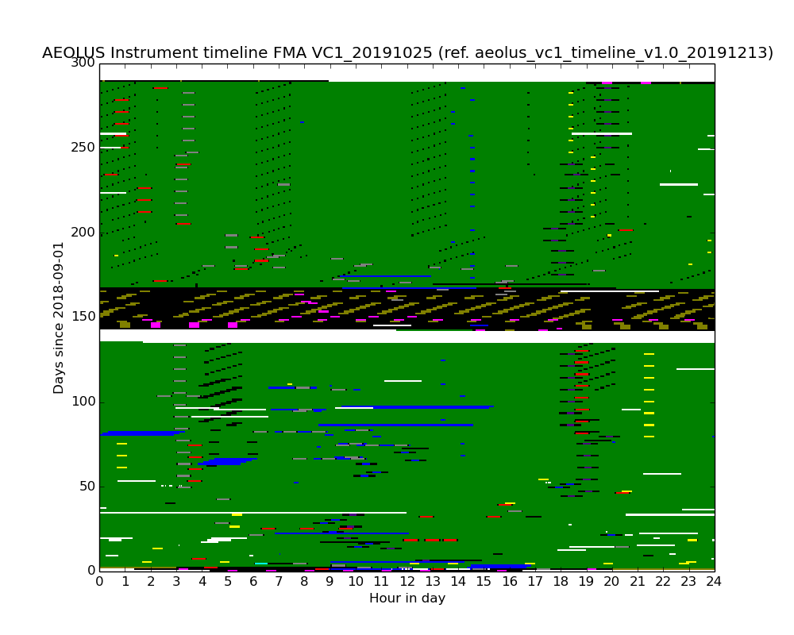
Consolidation Results: FMA IFID Timeline
NOP: black
ISR: red
IAT: cyan
DCC: magenta
IDC: yellow
LCPA:orange
LDTA:brown
IRC: indigo
WVM: green
OWVM:blue
LBM: gray
DCMZ:olive
GAP: white
The white horizontal band at the centre of the image is the 7 days gap showed in the previous slide

Slide 16
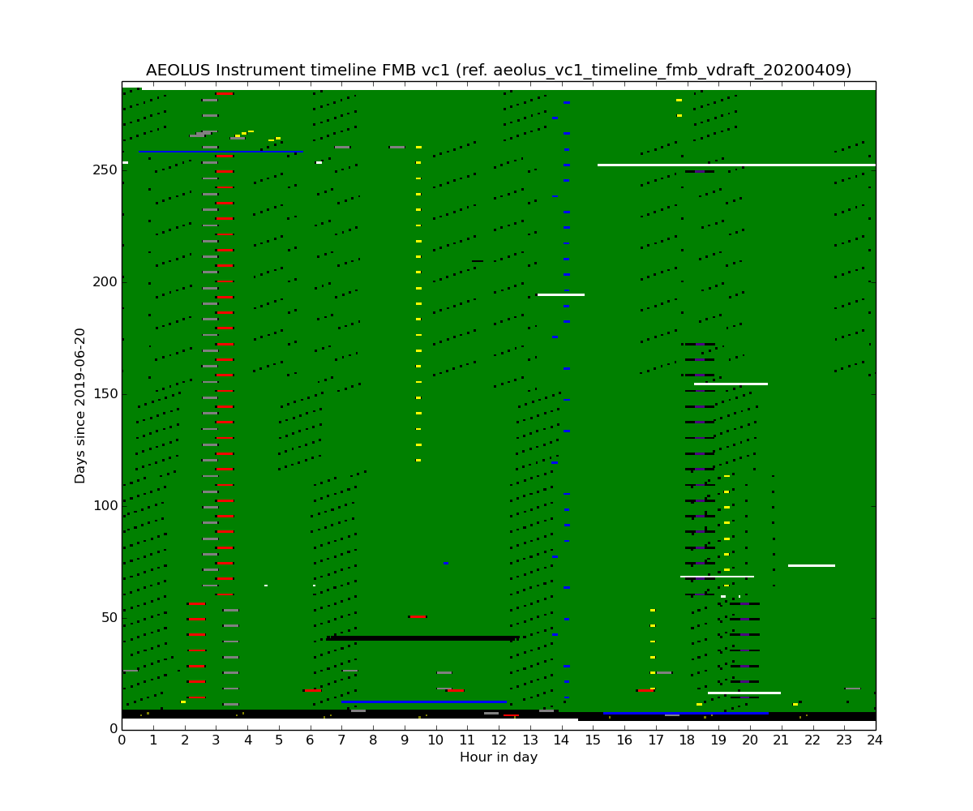
Consolidation Results: FMB IFID Timeline

Slide 17
Consolidation Results: IFID Sequence FMA
IFID | IFID Duration (h) | IFID Percentage (%)
Wind modes
WVM | 5594.9 | 82.21
OWVM | 64.2 | 0.94
Total wind | 5659.1 | 83.15
Calibration modes
DCC | 13.5 | 0.20
DCMZ | 77.7 | 1.14
IDC | 10.4 | 0.15
IRC | 10.5 | 0.15
ISR | 19.1 | 0.28
LBM | 31.7 | 0.47
Total calibration | 162.9 | 2.40
Others
No operation (NOP) | 616.7 | 9.06
Data gap | 366.6 | 5.39
TOTAL IFID sequence | 6805.3 | 100.00
Total time span: 284 days from 06/09/2018 to 17/06/2019

Slide 18
Consolidation Results: IFID Sequence FMB
IFID | IFID Duration (h) | IFID Percentage (%)
Wind modes
WVM | 6440.5 | 95.36
OWVM | 21.7 | 0.32
Total wind | 6462.2 | 95.68
Calibration modes
DCMZ | 0.9 | 0.01
IDC | 7.4 | 0.11
IRC | 7.3 | 0.11
ISR | 21.4 | 0.32
LBM | 25.1 | 0.37
Total calibration | 62.1 | 0.92
Others
No operation (NOP) | 209.7 | 3.11
Data gap | 19.6 | 0.29
TOTAL IFID sequence | 6753.6 | 100.00
Total time span: 281 days from 24/06/2019 to 01/04/2020

Slide 19
Consolidation Results: Instrument Parameters
The source packet data have been extracted once per observation and the information have been stored in a csv file, one csv for each file product.
Information extracted 6 times per observation (measured every 2 seconds):
M1 Telescope temperature
Power Laser Head temperature
Reference Laser Head temperature
Reference Laser Head Frequency
Information extracted 34 time per observation:
number of Transfer Frames in Source Packet which contain a Cyclic Redundancy Check (CRC) error
number of Transfer Frames in source packet for which a Reed Solomon (RS) correction was performed
This information can be reused for Long Trend Analysis Purposes

Slide 20
EO-Data Information System
DIS stores EO metadata, identifying them unequivocally across missions and services, tracking the life-cycle of the data and providing the end-to-end information to final users.

Slide 21
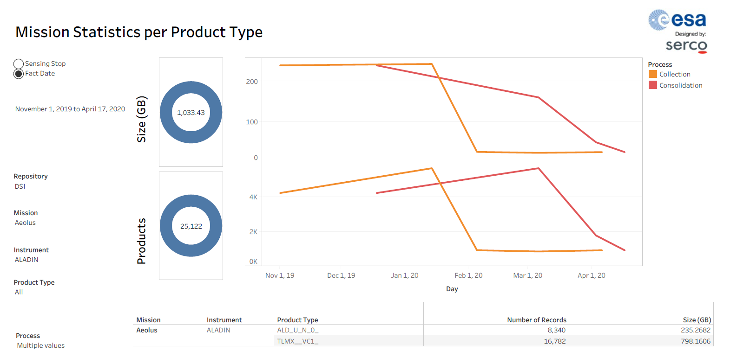
EO-DIS: Aeolus Consolidation
Collected and Consolidated Aeolus products during the Project

Slide 22
Thanks!
Contact: nicola.comparetti@serco.com

