Slide 1
Development of the stochastic approach to groundwater hydrology: a personal account of G. de Marsily contributions.
Jesus Carrera
Groundwater Hydrology Group UPC-CSIC
IDAEA.CSIC
Barcelona, Spain
a personal account is a personal account

Slide 2
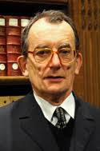
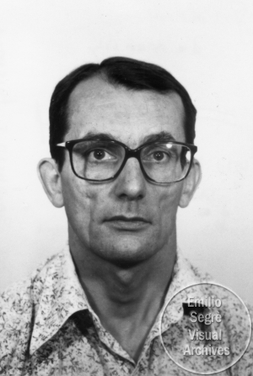
Obviously, Ghislain is not there for his beauty
I devote this presentation to discuss my view on why «he is there». (only 7 slides!)
Gunilla, What did you see in him?

Slide 3
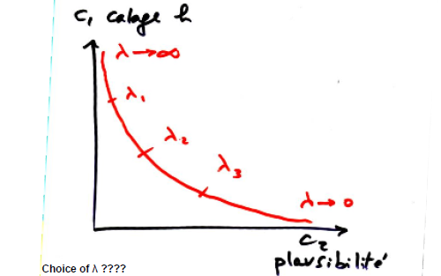
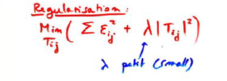
1970’s inverse problem and regularization
Very early in the game, it became apparent that the inverse problem is ill posed
The first to realice the need for regularization were Emsellem and de Marsily in 1971
Picasso had the ability to summarize a big message in a simple sketch

Slide 4
1981: «The pilot point method revisited»
In 1981, as I started my PhD, Shlomo Neuman gave me a note that Ghislain had prepared
20-30 hand written pages
It contained not only the pilot point method, but a full description of geostatistics
Everything in a few pages
Years later, with Javier Samper, we wrote a full book that did not go far beyond
The ability to condensate a lot in a short space (think of “Quantitative hydrogeology”)

Slide 5
1980’s: scale dependent dispersion
The traditional transport equation suffered a problem, dispersion grows with scale.
This became apparent in the 1980’s (remember Gelhar and Axness paper is from 1986)
Matheron and de Marsily provided one of the best explanations to the effect in 1980!!!
They used a stratified flowfiel (often called the “Matheron–de Marsily velocity field”)
The ability to think of the need to solve unresolved issues

Slide 6
1990’s: non-multigaussian geostatistics
By the 1990’s, it became apparent that traditional stationary geostatiscs were not sufficient to represent natural heterogeneity
Traditional stochastic hydrologists resisted to change (remember Jaime Gomez difficulties)
My first encounter with simulation of sedimentation processes was a presentation by Ghislain
Obviously, the great achievement was Gorelick and Kolterman. But, again, Ghislain was already there
The ability to anticipate what is important and share it is a sign of “grandeur”

Slide 7
2000’s Andres Alcolea PhD defense
Andres Alcolea proposed using not one pilot point but as many as possible…
Again, the system resisted
Ghislain, who attended the defense, immediately said that it was a great idea
Ghislain is sober, but graceful

Slide 8
In conclusion…
In the end, I feel it is this «grace» what has made him the european «spiritual leader» of hydrogeology
Now, he is working on the big picture
«Les eaux continentales»
«Demographie, climat et alimentation mondiale»
Watch out… these are probably the future changes

