Slide 1


Variability of Central European Summer Precipitation forced by
Sea Surface Temperature Gradients
¹Klaus Haslinger, ¹Michael Hofstätter, ²Wolfgang Schöner, ³Günter Blöschl
¹Central Institute for Meteorology and Geodynamics (ZAMG), Climate Research Department
²University of Graz, Department of Geography and Regional Science
³Vienna University of Technology, Centre for Water Resource Systems

Slide 2
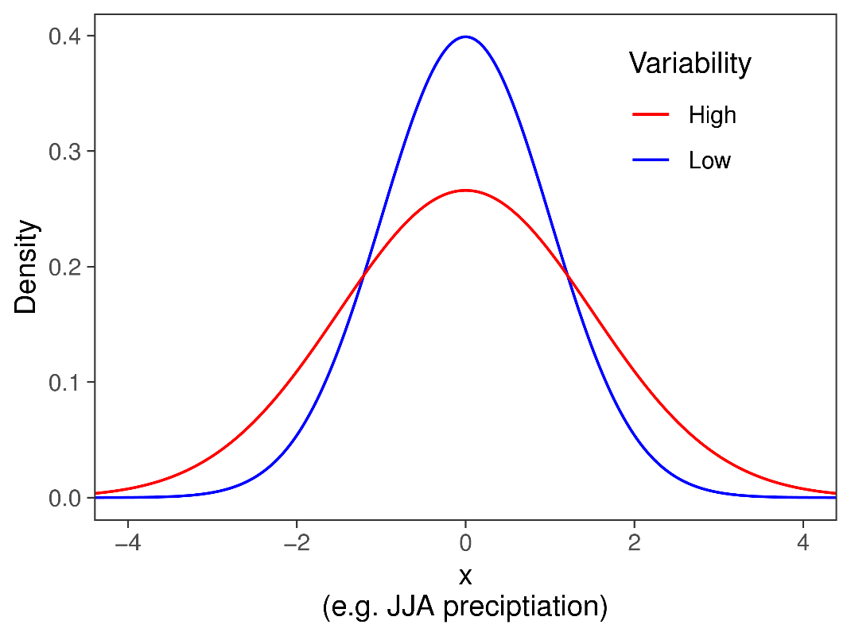
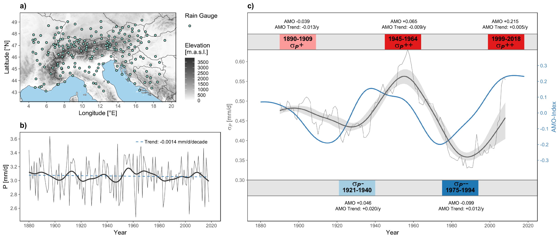
Motivation
Changes in summer precipitation interannual variability
Average summer precipitation 1880-2018, Greater Alpine Region
HIGH
HIGH
LOW
LOW
Higher interannual preciptiation variability
==
Higher probability for droughts and potential flooding
No significant trend from 1880-2018
Decadal-scale variability (wetter and dryer decades)
Changes in interannual variability!

Slide 3
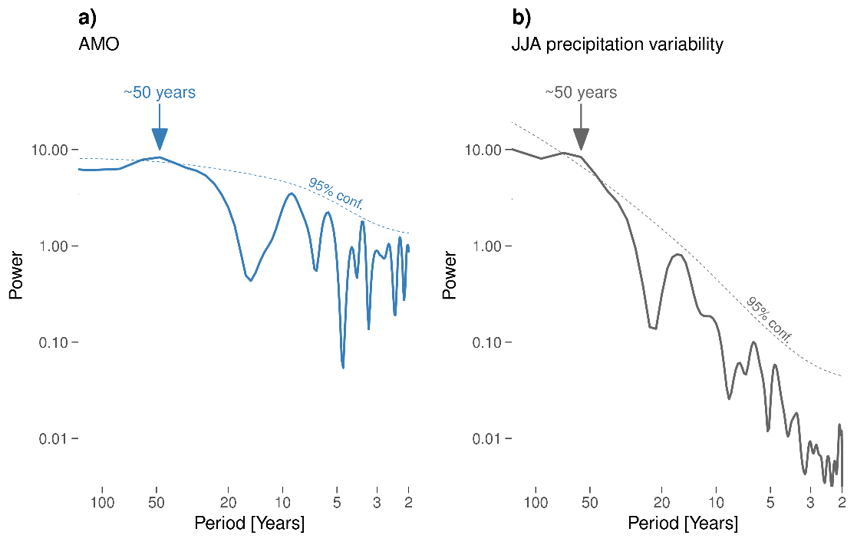
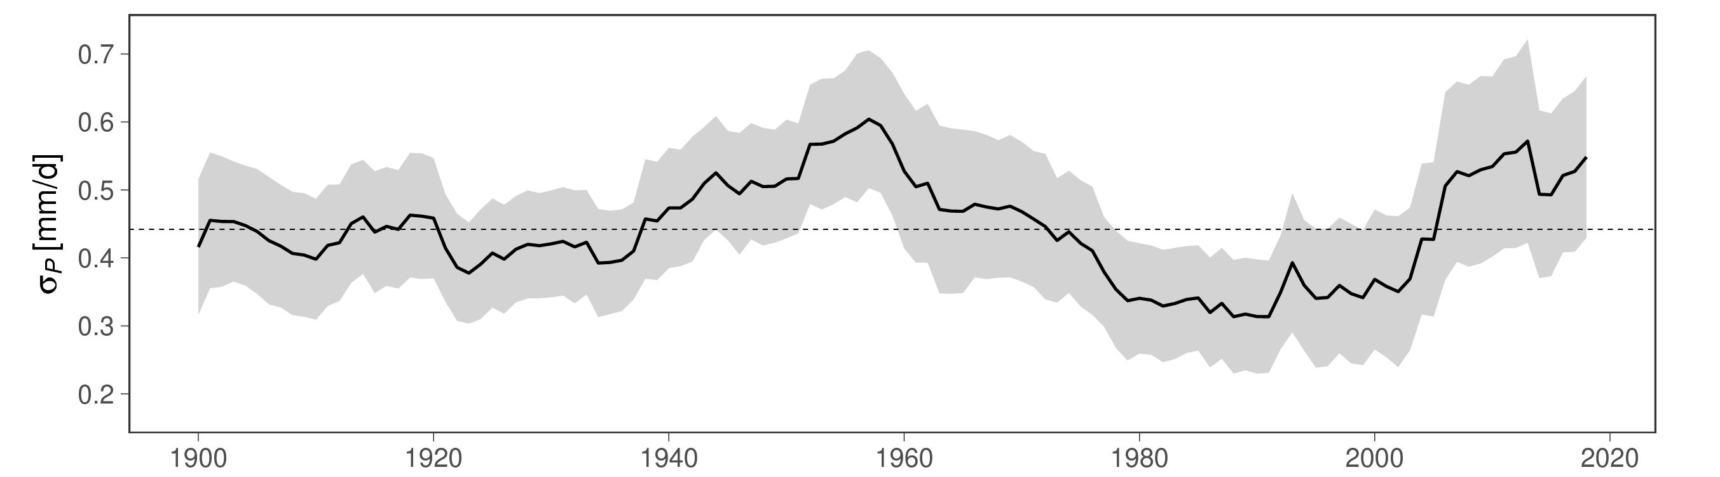
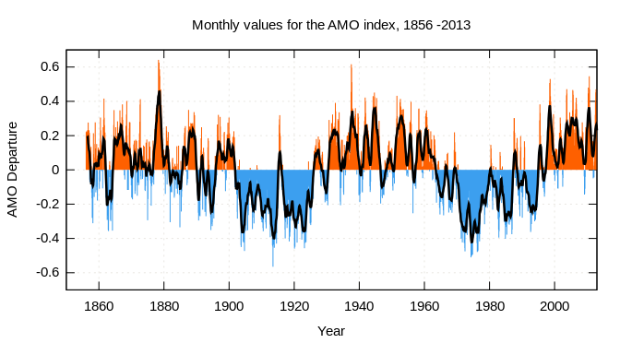
Motivation
Changes in summer precipitation interannual variability
σ_{P} = 20 year moving standard deviation of average summer precipitation
AMO-Index
Multidecadal changes in interannual variability σ_{P}
Same significant frequency peak as the AMO
AMO leading σ_{P} (~17 years)
Is there a link between GAR interannual variability of summer precipitation and the Atlantic Multidecadal Variability?

Slide 4
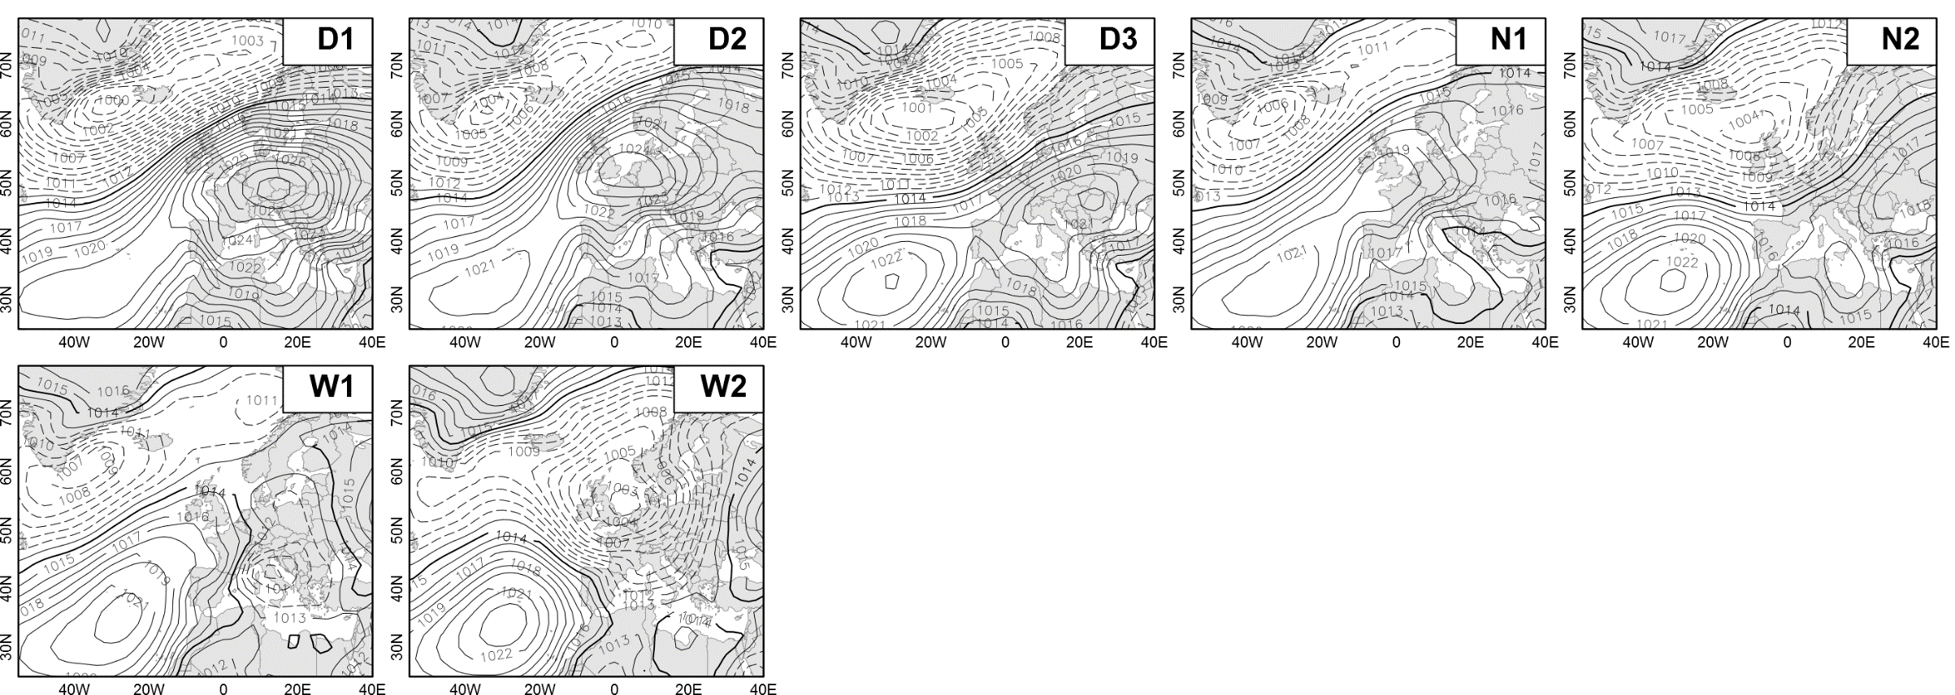

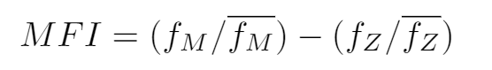
Data and Methods
Precipitation
HISTALP Station Data (~250)
1880-2018
Monthly sums aggregated to seasonal (JJA) averages
Reanalysis
NCEP 20CR (zonal wind speed)
ERSST V5 (sea surface temperature anomalies)
EOBS
Tx, Tn, RR
Meridional
Circulation Types
CAP7 (MeteoSwiss) daily reconstruction from 1760-2009 (Schwander et al. 2017)
Meridional Flow Index:
MFI+ → Enhanced Meridional/weak pressure gradient Flow
MFI- → Enhanced Zonal Flow
Meridional

Slide 5
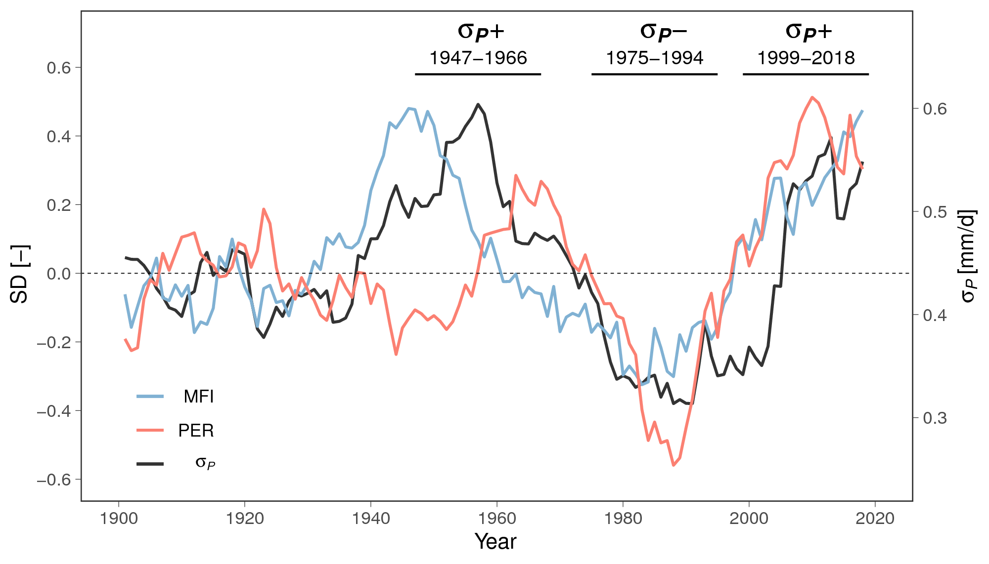
Results
Long-term changes in atmospheric flow conditions
Enhanced Meridional Flow
Multidecadal changes in prevailing flow conditions
From 1920 onwards in-phase relation of σ_{P} and zonal vs. meridional flow
Some co-variability with persistence, particularly from the 1960s onwards
ZON
MER
MER
Enhanced Zonal Flow

Slide 6
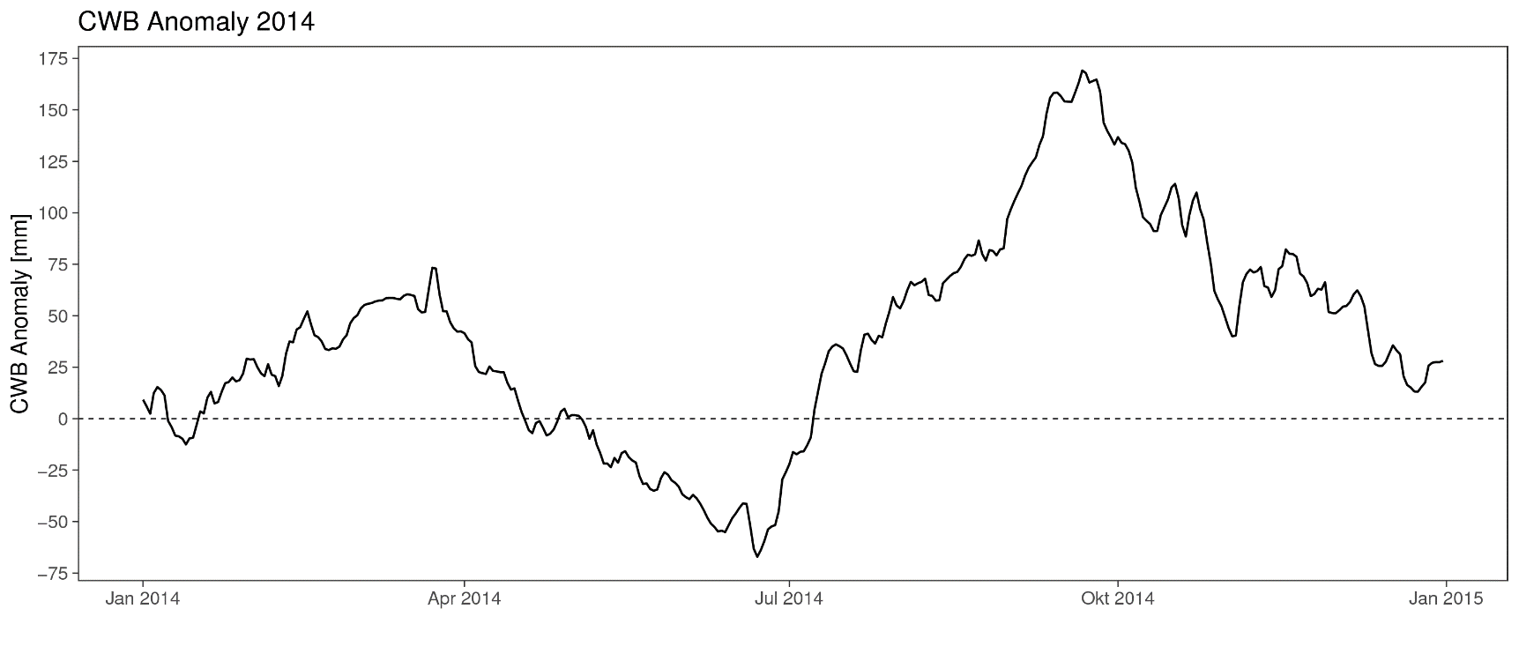
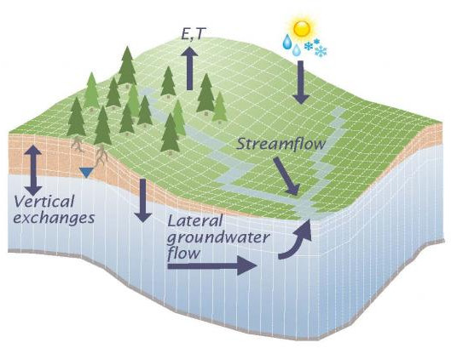
Results
Soil Moisture – Precipitation Feedbacks
Potential
Evapotranspiration
Preciptiation
Maxwell u.
Condon 2016
t
Preciptiation
Assessment of precipitation on timestep t in relation to soil moisture conditions on timestep t-1
Climatic Water Balance as a Soil Moisture Proxy:
CWB = RR – PET
Accumulation Time Scale: 90days, right sided
CWB Anomaly
t-1

Slide 7
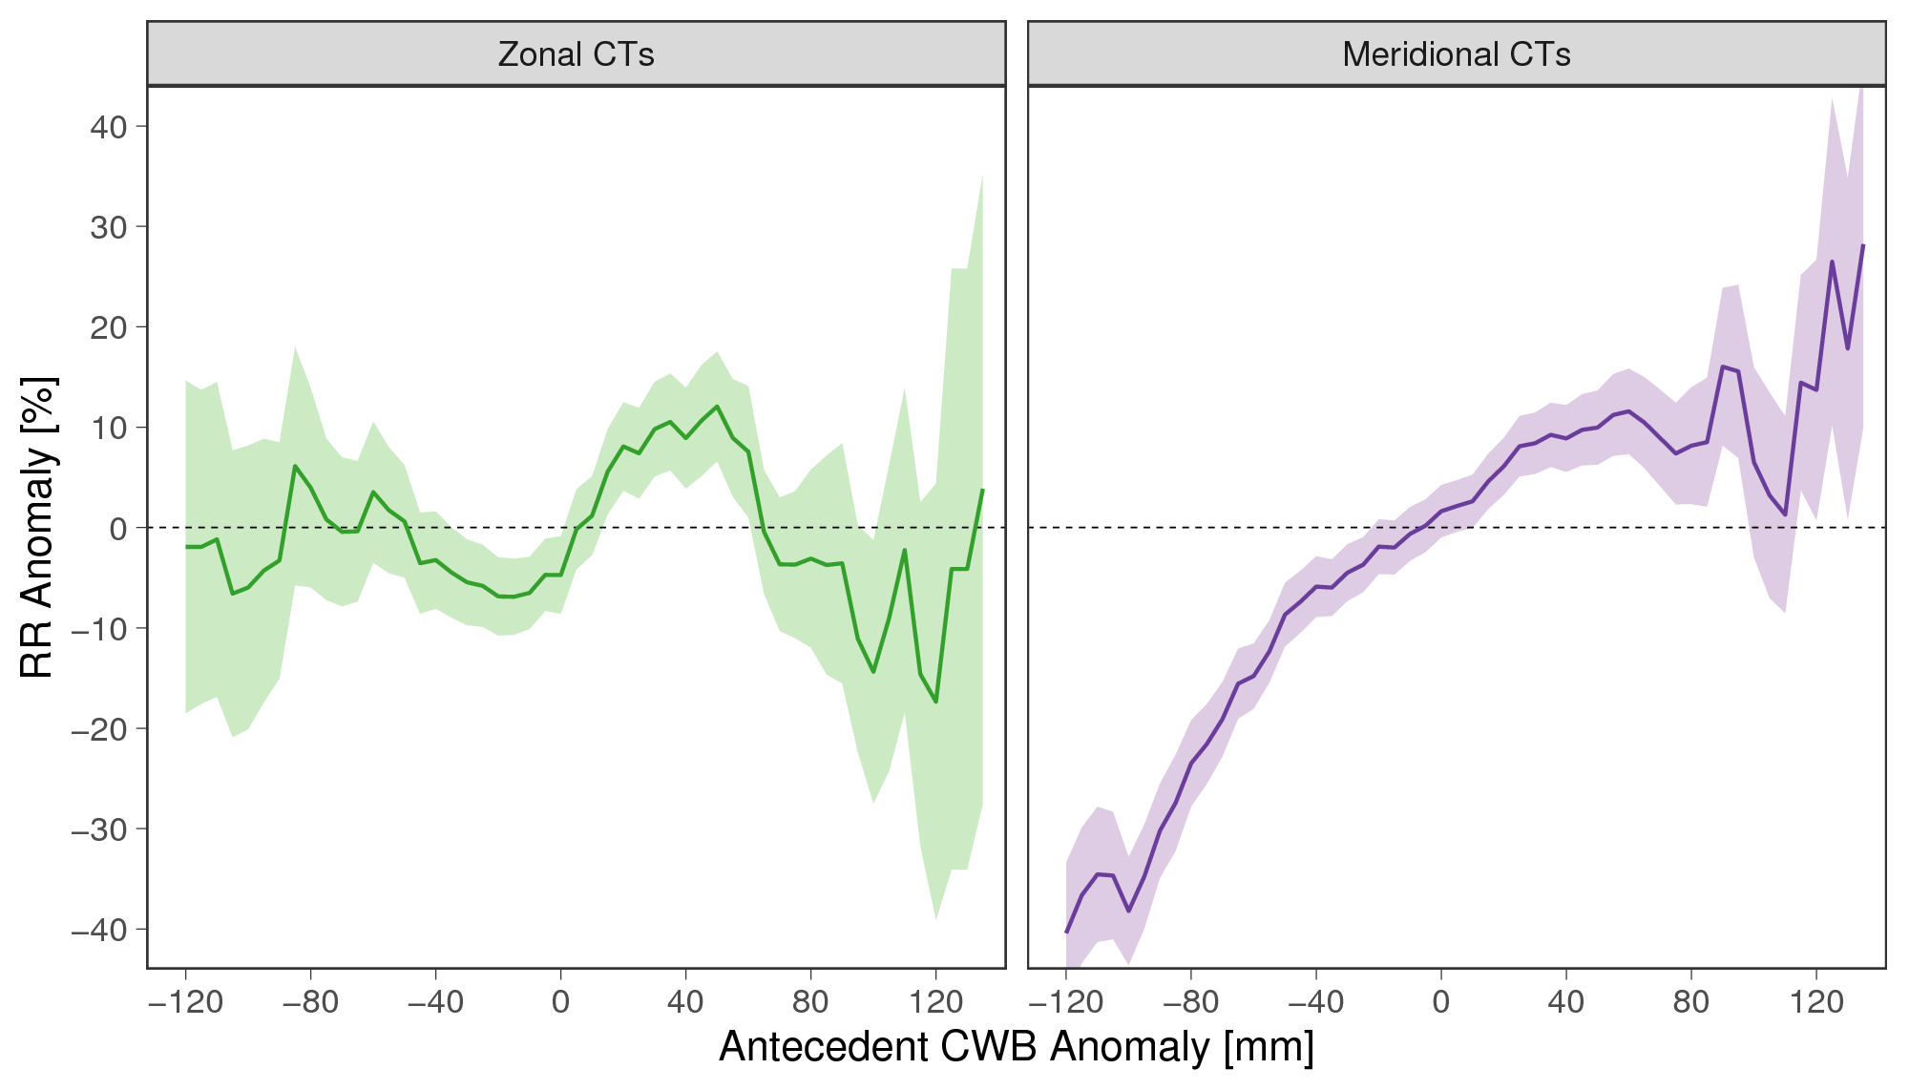
Results
Soil Moisture – Precipitation Feedbacks
Zonal CTs:
  Daily Preciptiation anomaly independent of antecedent soil moisture conditions (+/- 10 %)
  Meridional CTs:
  Daily Preciptiation anomaly dependent on antecedent soil moisture conditions
  Wet conditions +30 %
  Dry conditions -30 %
  Synoptic conditions trigger or surpress soil moisture – precipitation feedbacks

Slide 8
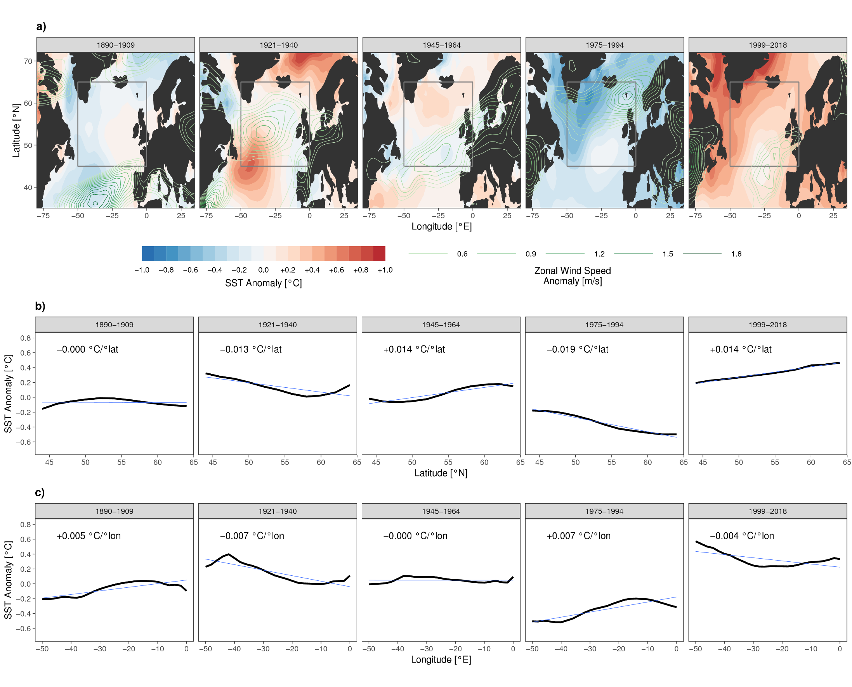


Results
North Atlantic Sea Surface Temperature Patterns and Atmospheric Circulation
σ_{P}++ Periods:
  Positive SST gradient
  → weak meridional temperature differences
  weak jet / southerly shift
σ_{P}-- Periods:
  Negative SST gradient
  → large meridional temperature differences
  strong jet / northerly shift

Slide 9
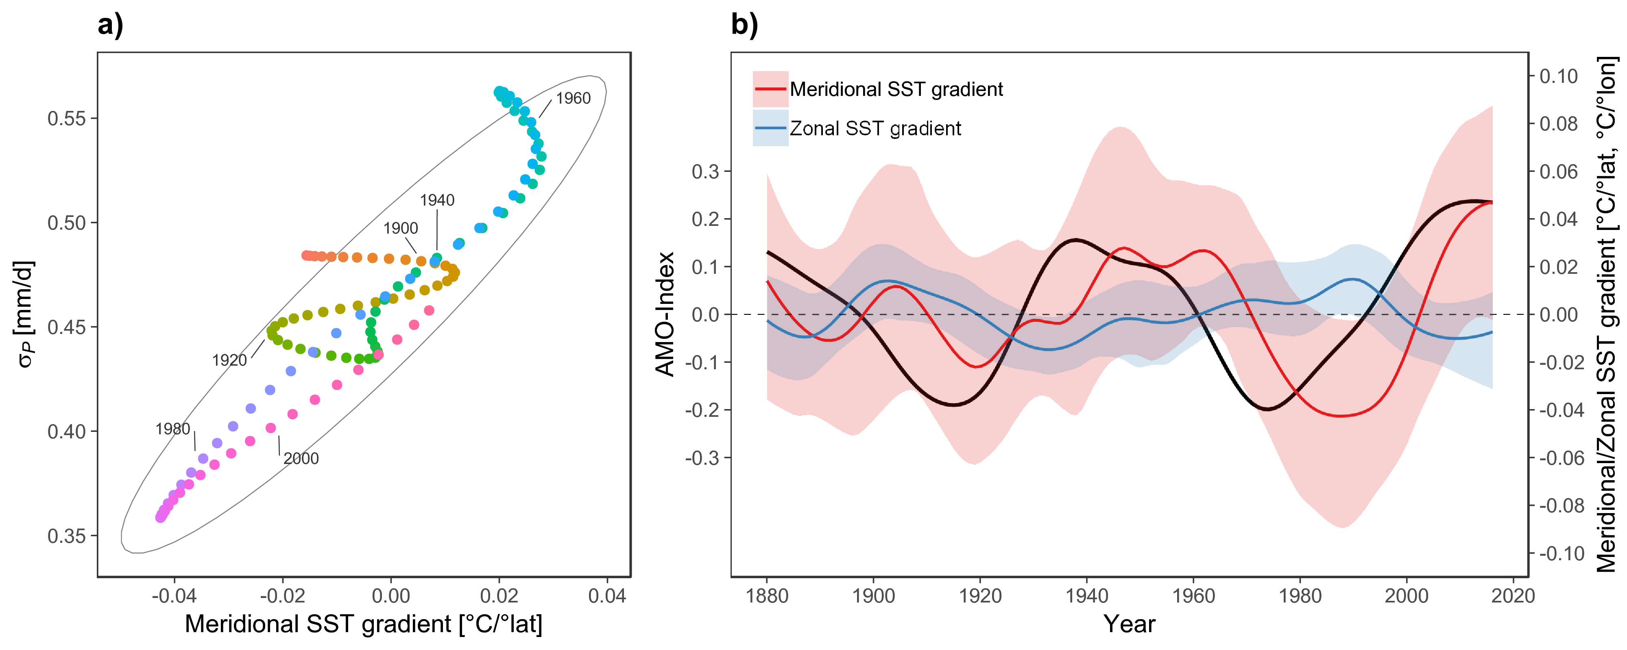
Results
Phase Relations of σ_{P} and Meridional SST Gradients
σ_{P} / Merdidional SST gradient:
  Strong phase relation from 1920 onwards
1980s and 1990s:
  Strongest out of phase period of the meridional and zonal SST gradient

Slide 10
Conclusions
No long term trend of summer precipitation sums over the Greater Alpine Region
Atmospheric flow conditions over the Alpes (Zonal vs. Meridional) shape the interannual variability through triggered or surpressed soil moisture – precipitation feedbacks
Atmospheric flow conditions over the Alps are steered by SST gradients through their effect on jet stream position and speed
Nearly perfect low frequency (multidecadal time scale) in phase relation of interannual variability of summer preciptiation and North Atlantic meridional SST gradients over the last 100 years
The AMO warming and cooling phases seem to strongly the SST anomaly patterns which are driving the circulation anomalies and further more the precipitation characteristics in the GAR
Where do we go from here?
Are Global Climate Models capable of reproducing these processes?
What are the implications for short term (decadal) climate forecasts?
Is the last climate normal period (1961-1990) „normal“ in terms of GAR summer climate?

Slide 11
Thank you very much for your attention!
Haslinger, K., Hofstätter, M., Schöner, W., Blöschl, G. (202x). Central European Interannual Variability of Summer Precipitation forced by Sea Surface Temperature Gradients. In preparation for Climate Dynamics
Haslinger, K., Hofstätter, M., Kroisleitner, C., Schöner, W., Laaha, G., Holawe, F., Blöschl, G. (2019). Disentangling drivers of meteorological droughts in the European Greater Alpine Region during the last two centuries. Journal of Geophysical Research – Atmospheres, https://doi.org/10.1029/2018JD029527
Haslinger, K., Holawe, F., & Blöschl, G. (2018). Spatial characteristics of precipitation shortfalls in the Greater Alpine Region—a data-based analysis from observations. Theoretical and Applied Climatology. https://doi.org/10.1007/s00704-018-2506-5
Haslinger, K., & Blöschl, G. (2017). Space-Time Patterns of Meteorological Drought Events in the European Greater Alpine Region Over the Past 210 Years. Water Resources Research, 53(11), 9807–9823. https://doi.org/10.1002/2017WR020797
Haslinger, K., Koffler, D., Schöner, W., & Laaha, G. (2014). Exploring the link between meteorological drought and streamflow: Effects of climate-catchment interaction. Water Resources Research, 50(3), 2468–2487. https://doi.org/10.1002/2013WR015051

