Slide 1

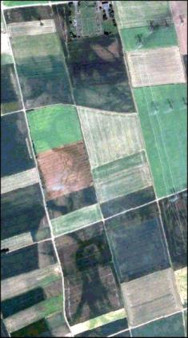
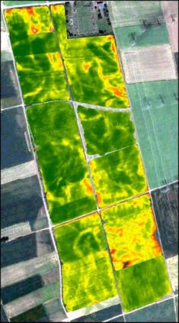
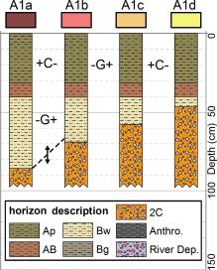
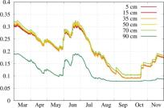
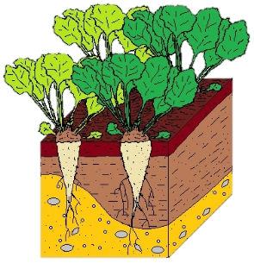
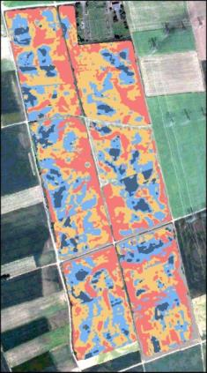
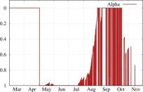
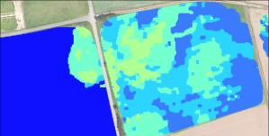













Improved spatial modelling of crop productivity using geophysics-based soil mapping: a case study beyond the field scale
Cosimo Brogi
Sander Huisman
Michael Herbst
Lutz Weihermüller
Transregional Collaborative
Recearc Centre 32 (TR32)
Swedish University of Agricultural Sciences
Anne Klosterhalfen
Carsten Montzka
Heye Bogena
Harry Vereecken
Start checking this PICO!

Slide 2
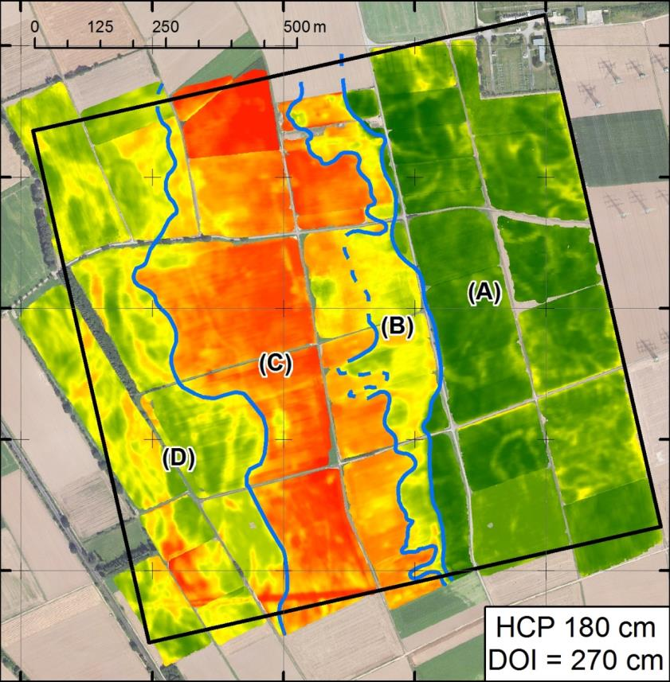
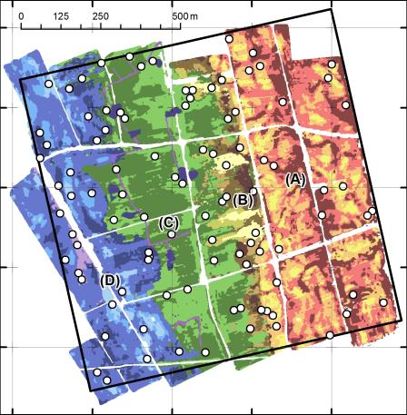
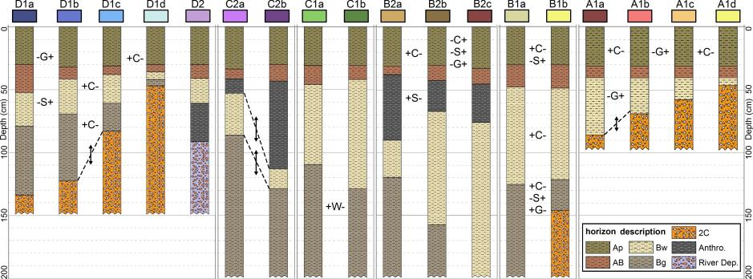
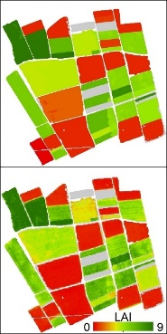
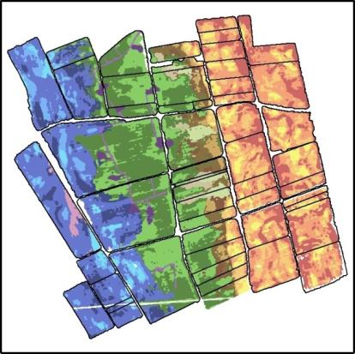
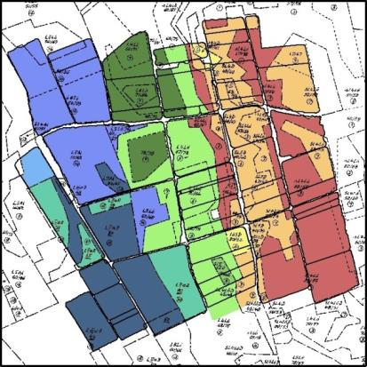
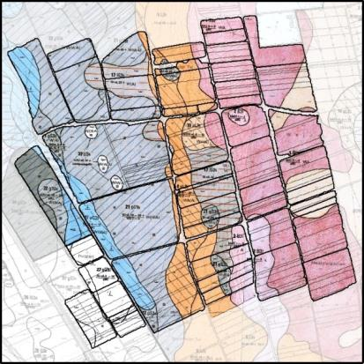
Improved spatial modelling of crop productivity using geophysics-based soil mapping: a case study beyond the field scale
Back to first slide
Motivation
Why is geophysics useful for agricultural applications?
Geophysics!
Electromagnetic induction EMI. A soil mapping tool!
EMI-based Soil mapping
A combination of EMI and direct soil sampling for the creation of management zones (soil units) using a supervised clustering analysis.
Geophysics and modelling
Simulation of spatial variability in crop leaf area index (LAI) and yield using EMI-based soil information.
Comparison with standard maps
A geophysics-based product compared to commonly available soil maps.
Conclusions
Added value of geophysics & crop modelling.
Outlook
Irrigation scheduling and combination with other tools.

Slide 3
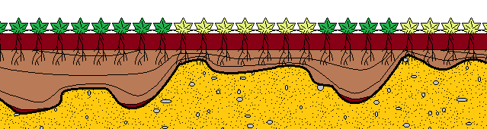

Yield gap is a constant threat in agriculture
Reduction in farmer’s income and can undermine the sustainability of agricultural practices.
Water scarcity in soil is one of the main causes for reduced crop performance
Other causes such as nutrients availability, pests, disease and weeds contribute to further yield gaps
Soil characteristics
0 Yield (%) 100
Yield potential
Atmospheric conditions
Water-limited yield potential
Gap
An accurate soil description is key
Main menu
Previous slide
Next slide

Slide 4
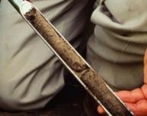
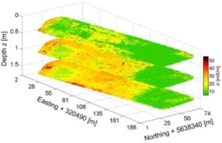

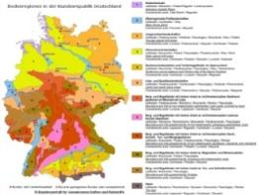
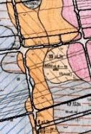
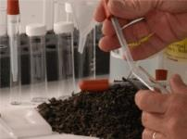

Accurate soil description
Small-scale
(few m²)
Field-scale
(~1 to 5 ha)
Intermediate
(~1 km²)
Large-scale
(~10 km² or more)
?!
?!
- Soil sampling
- Lab analysis
- Geophysics
- EMI inversion
Still challenging!
- Remote sensing
- Soil map
  General-purpose maps are often not detailed enough
Can geophysics-based soil mapping fill this gap?
And what is the added value? For example in:
  Hydrological and agro-ecosystem modelling
  Precision agriculture (management zones)
  Yield prediction
Main menu
Previous slide
Geophysics

Slide 5
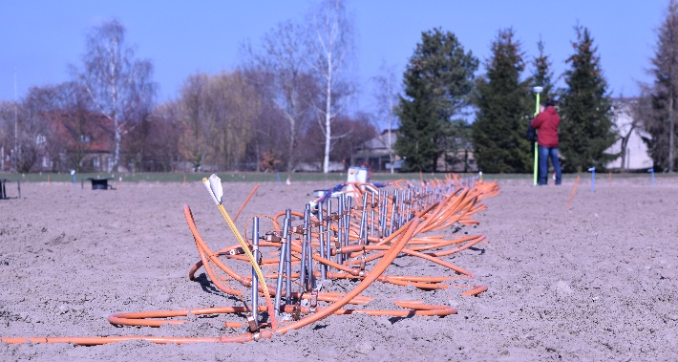
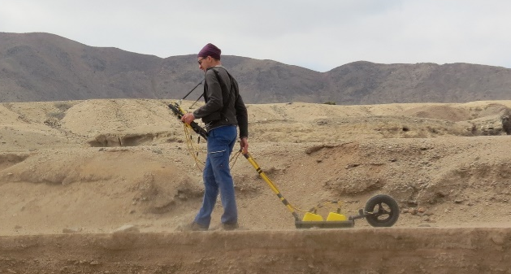
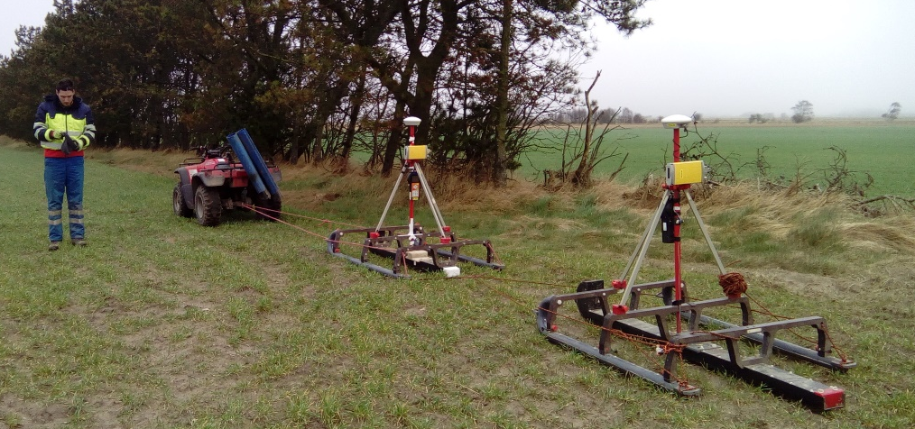
Geophysical techniques for agricultural applications
Geophysical techniques are non-invasive tools with great potential.
The most promising being:
ERT electrical resistivity tomography
GPR ground penetrating radar
EMI electromagnetic induction
ERT measurements
GPR measurements
Why EMI?
Suitable for the investigation of agricultural areas
Highly mobile (vehicle-towed platforms)
EMI measurements using ATV
Main menu
Previous slide
Next slide

Slide 6
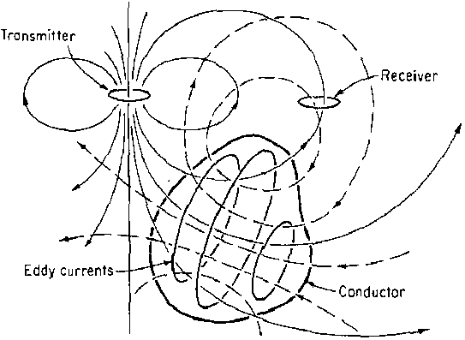

Electromagnetic Induction EMI
Measures the apparent electrical conductivity (ECa) of the ground.
The primary magnetic field arising from the alternating current in the transmitter coil induces very small currents in the ground (conductor)
The currents generate a secondary magnetic field which is sensed by the receiver coil together with the primary magnetic field
ECa is related to texture, layering, water content, temperature, and other characteristics of the soil.
Main menu
Previous slide
Next slide

Slide 7
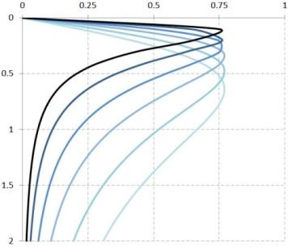
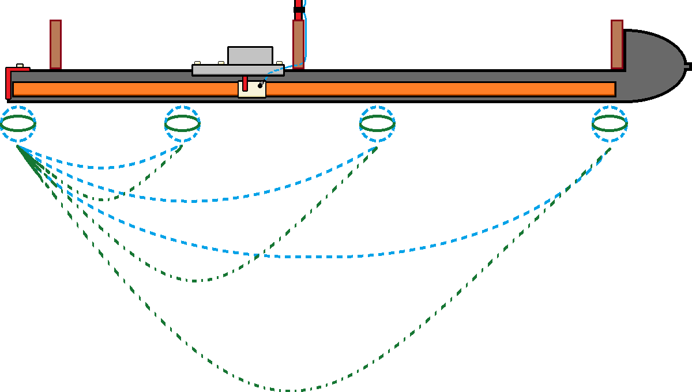
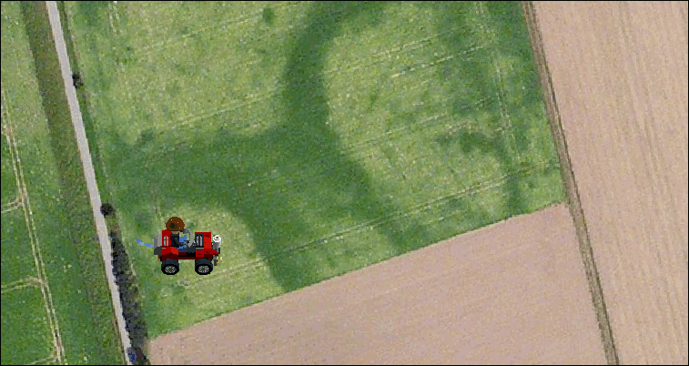
Electromagnetic Induction EMI
Modern multi-configuration instruments can measure multiple depths of investigation simultaneously.
Increased distance between transmitter and receiver results in an increased depth of investigation
Different sensitivity of EMI instrument for six different coil distances
Fast Methodology:
Measure 1 ha in ~1 hour
High Resolution:
In line resolution = ~30 cm
Measurement lines every 2.5 m
Continuous measurement (HCP-130cm ECa values)
Main menu
Previous
EMI-based mapping

Slide 8
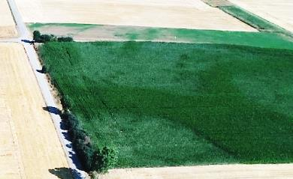
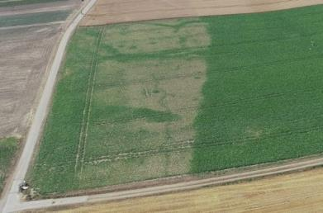
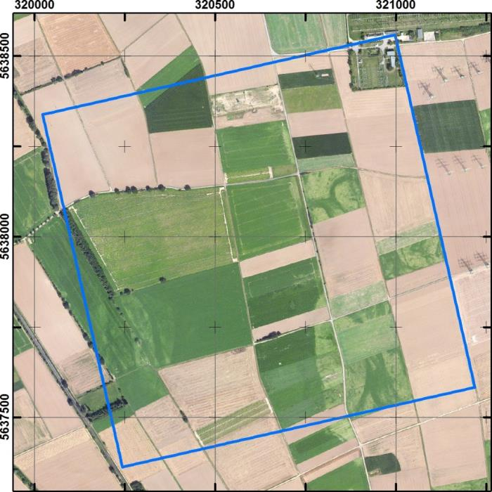
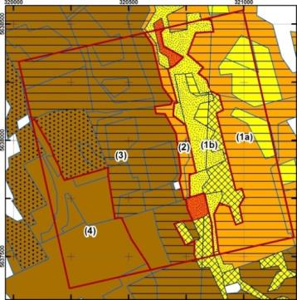
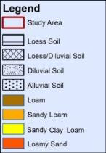
1x1 km study area
Water stress in silage maize and sugar beet
Courtesy of F. Jonard
Soil heterogeneity affects crop development during water scarcity.
The thickness of loess top soil overlying coarse layers and the characteristics of these soils is key to understand and simulate the occurrence of water stress.
Most detailed available soil maps cannot reproduce these patterns
Main menu
Previous slide
Next slide

Slide 9
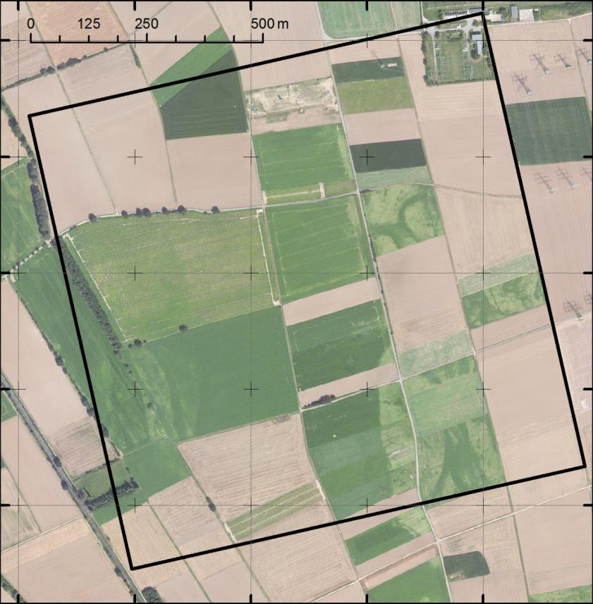
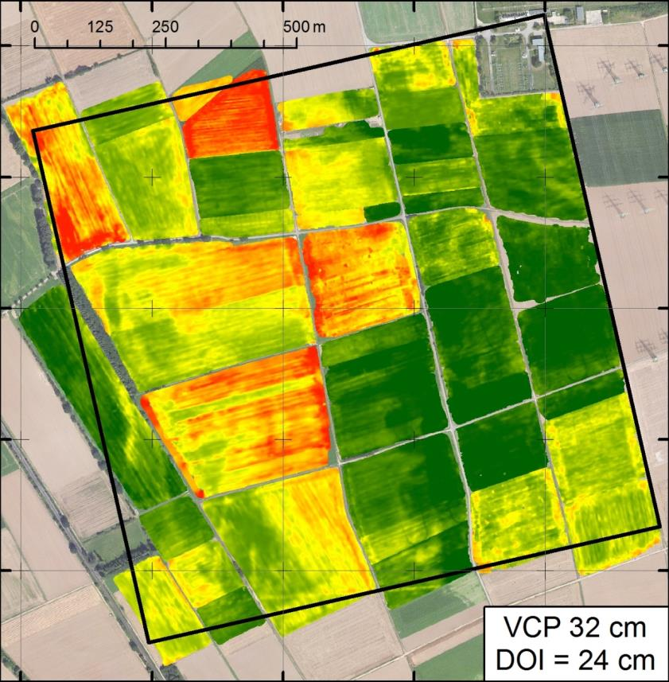
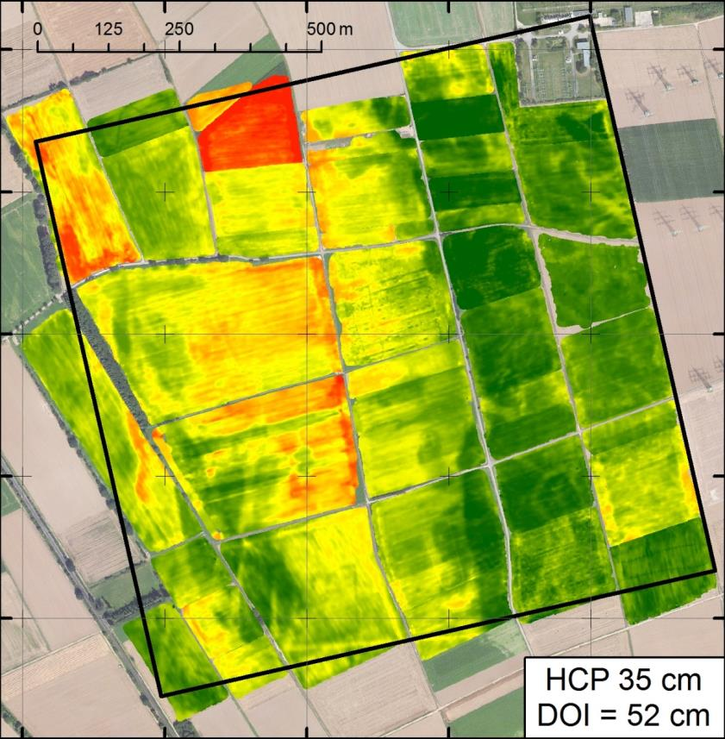
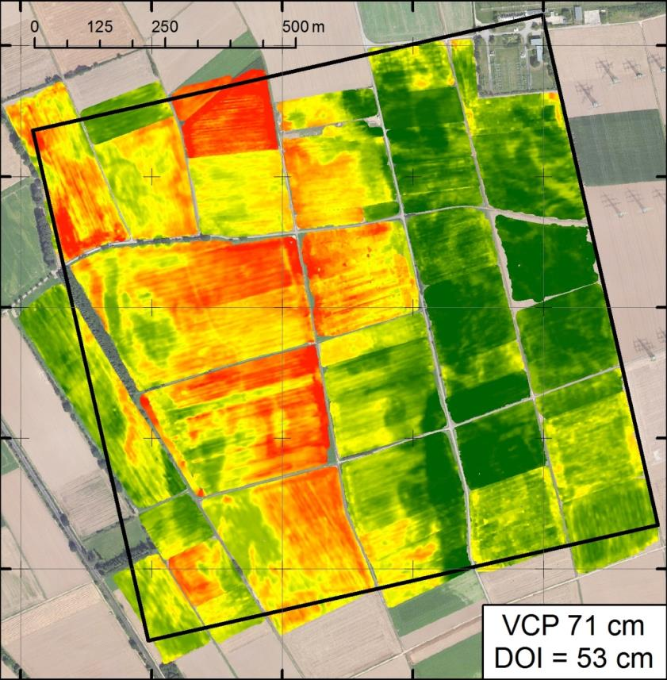
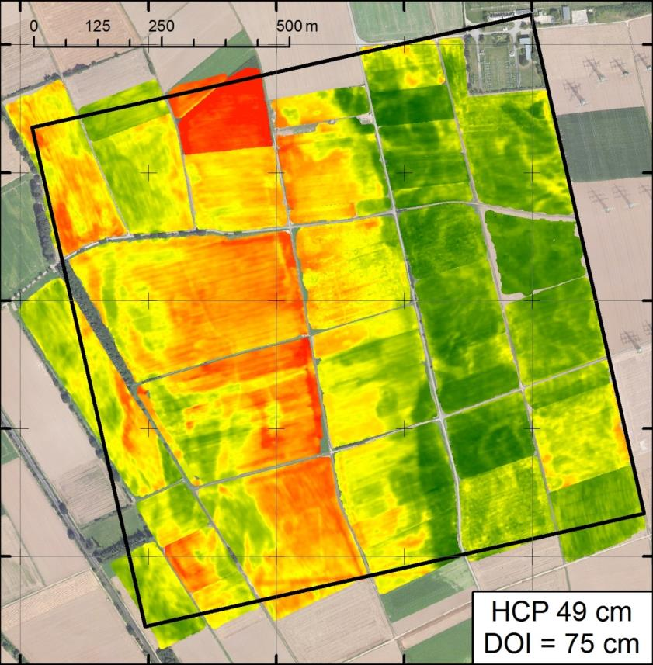
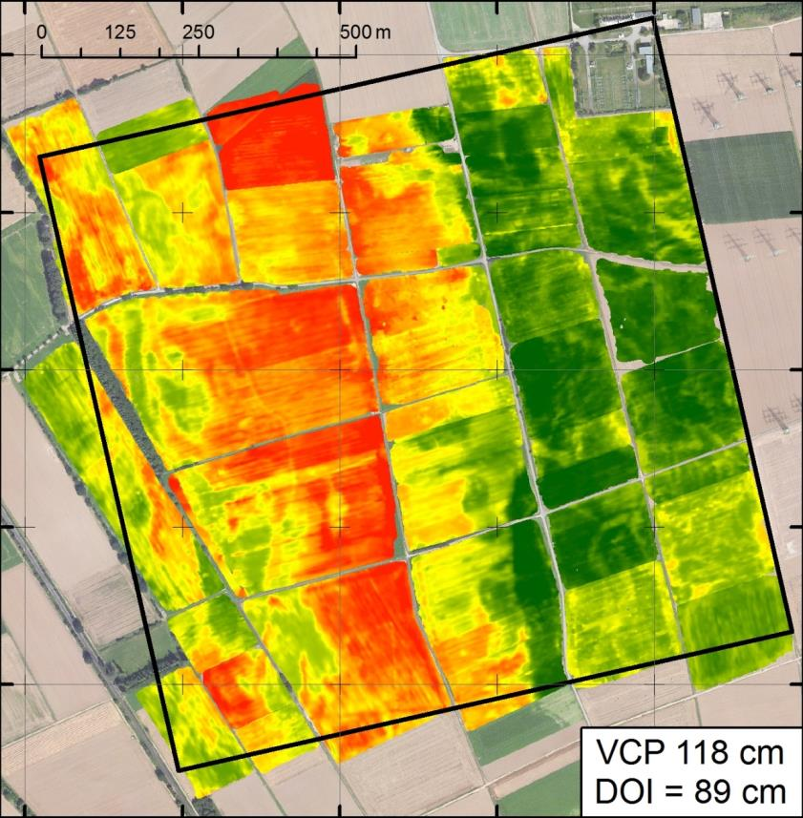
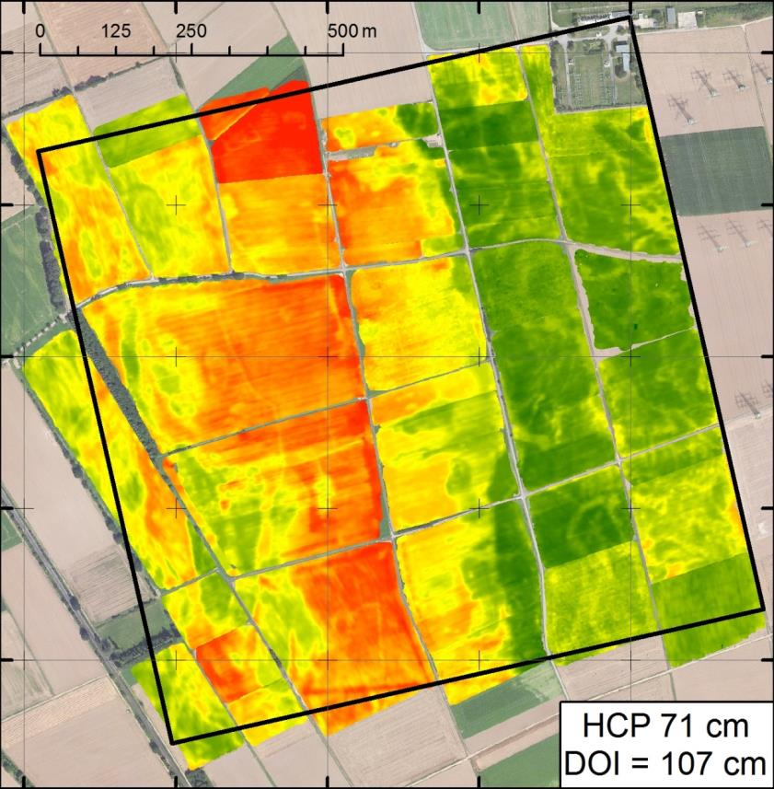
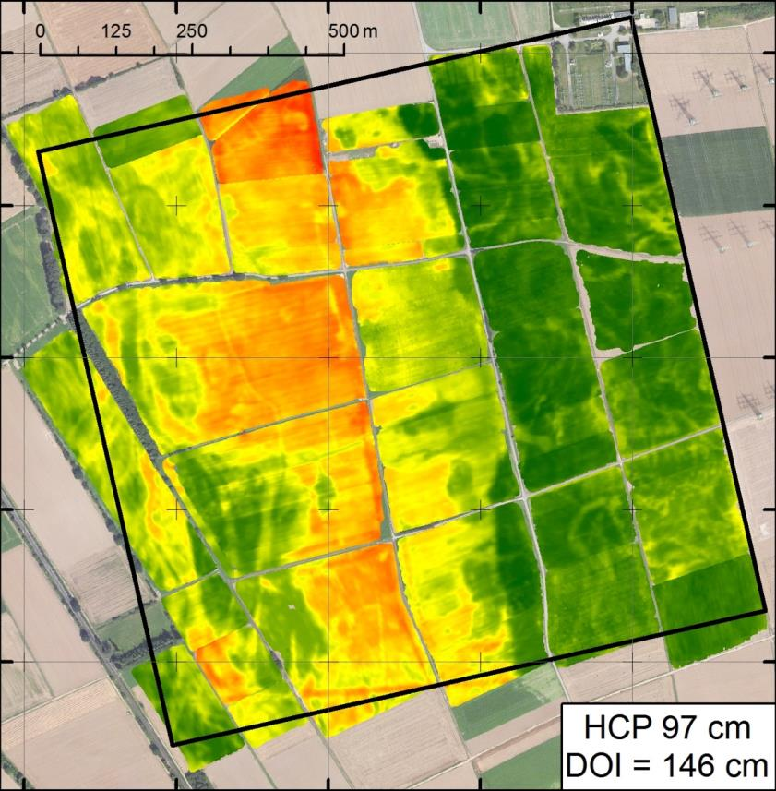
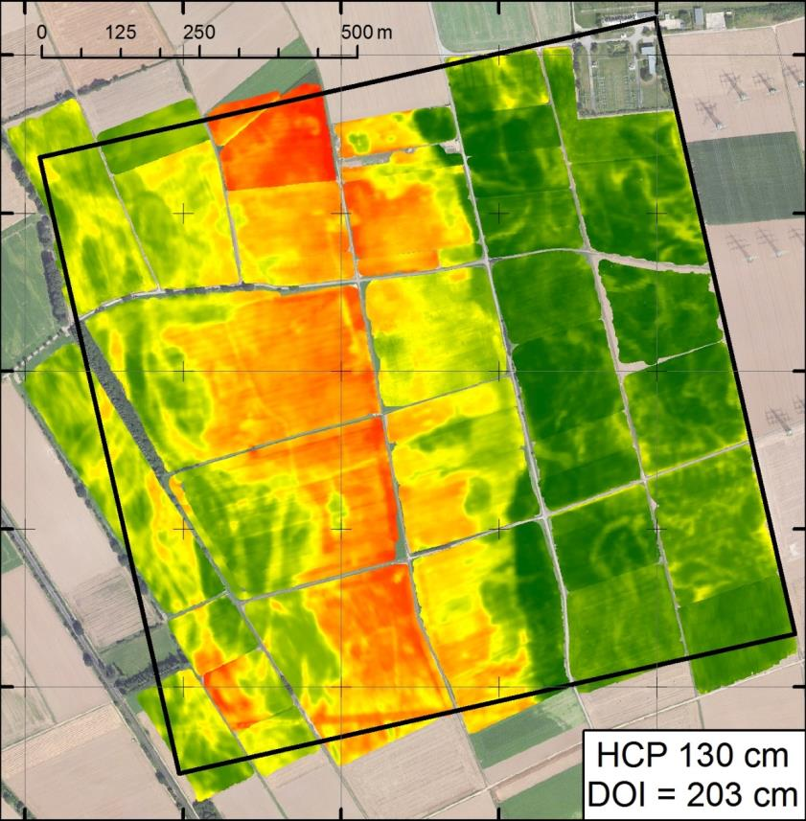
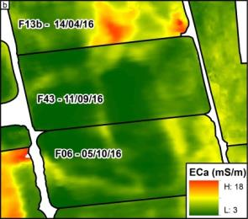
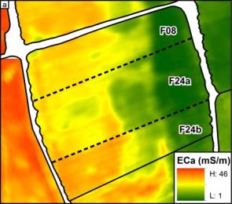

1x1 km EMI measurements
9 ECa maps
4 sub-areas
Confounding factors complicate the analysis of the dataset (not trivial to invert ECa data to EC)
Löss above
Sand & gravels
Löss
Apr 14th
Sep 11th
Oct 5th
Löss above
Sand & gravels
Wheat
Wheat
Barley
ECa (mS/m)
46,6
1,24
Main menu
Previous slide
Next slide

Slide 10
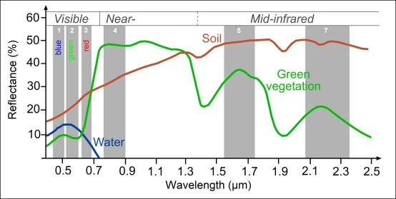
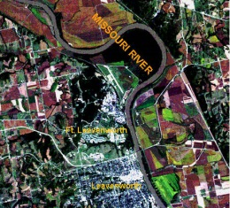
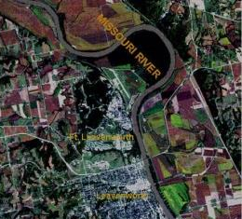
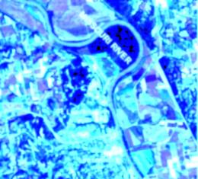
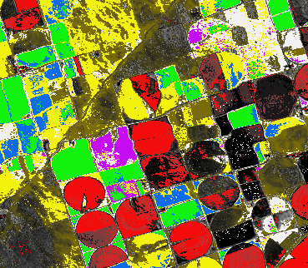
Image classification of satellite data
Land use (LUSE) classification: Different surfaces (land use) have different reflectance spectrum.
A satellite records various bands (different wavelengths) that are stored in a single multiband image.
For a pixel of the image, the variation of the signal between different bands is the signature of that pixel.
It can be used to cluster pixels with the same signature.
Main menu
Previous slide
Next slide

Slide 11
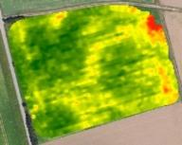











Image classification of EMI data for soil zonation
32
52
Multiband raster visualized in false colors
50
75
71
107
Depth of Investigation (cm)
Coil separation (cm)
97
146
130
203
Coil separation visualized:
Red: 35 cm
Green: 50 cm
Blue: 71 cm
180
270
Creation of a multiband raster image from the ECa interpolated maps on one field. ECa maps are ordered from smaller to larger coil distance.
Create a multiband image that can be analyzed with supervised image classification techniques (cluster soils with similar signatures).
ECa map HCP 97 cm
Multiband ECa map
Training areas
Classified map
Main menu
Previous slide
Next slide

Slide 12















Geophysics-based management zones
A supervised classification is performed in every field.
High-resolution map (1 m):
  4 sub-areas
  18 classes
Well describes patterns in crop stress which are visible from satellite.
Main menu
Previous slide
Next slide

Slide 13
Soil profiles with quantitative information
100 locations were randomly selected to obtain:
  Soil profile description up to a depth of 2 m
  Collect 553 samples for texture analysis
  Average all the profiles within each class
In the 18 profiles, layering or texture are statistically different (t-test).
  Classes are now soil units (or management zones)
Area D
Area C
Area B
Area A
Typical soil profiles of the 18 soil units
Main menu
Previous slide
Next slide

Slide 14


Comparison with patterns in crop stress
Ability of the high resolution soil map to reproduce water stress patterns on sugar beet
Correctly classified cells:
  Upper Terrace = 76.6%
  Lower Terrace = 91.1%
How to valorize and exploit these quantitative information?
Find it out in:
Main
Previous
Geophysics and modelling

Slide 15

Agro-ecosystem modelling using EMI-based data
The agro-ecosystem model AgroC was used to simulate soil-crop interaction and crop growth on the 1km² study area.
Geophysics-based soil map
Land use map (2016)
Unique soil-crop combinations
One AgroC model was set-up in each unique soil-crop combination:
80 different model set-ups (each with one soil unit and one crop)
Meteorological information for 2016 were used:
(e.g. rain, temperature, humidity, solar radiation).
Main menu
Previous slide
Next slide
Notes:
Inverti meteo data all’inzio

Slide 16




Agro-ecosystem model AgroC
AgroC is a 1-D numerical model that couples three modules:
SOILCO2: vertical water, heat, and CO2 fluxes
RothC: turnover of organic carbon
SUCROS: crop growth and organic matter accumulation rates
0
Depth (cm)
50
100
Water content (cm³/cm³)
Pressure head (cm)
Sugar beet water stress
Pressure head influences crop stress (Feddes 1982) and reduces:
Root water uptake
Carbon assimilation and increase of biomass
Main menu
Previous slide
Next slide

Slide 17

Soil hydraulic parameters to feed AgroC model
Soil hydraulic parameters calculated using pedotransfer function (Rawls & Brakensiek 1985) for each horizon.
0
Soil unit A1a (coarse sediments)
Depth (cm)
Horizon | Clay (%) | Silt (%) | Sand (%) | Gravel (%) | BD (g/cm3) | θs | θr | α | n | Ks (cm/h)
Ap | 17.1 | 63.0 | 19.8 | 10.8 | 1.38 | 0.067 | 0.415 | 0.023 | 1.330 | 0.275
Ah | 17.1 | 63.0 | 19.8 | 10.8 | 1.42 | 0.066 | 0.396 | 0.021 | 1.330 | 0.206
Bg | 21.3 | 58.0 | 20.6 | 14.0 | 1.49 | 0.078 | 0.363 | 0.018 | 1.307 | 0.114
2C | 20.3 | 41.7 | 38.0 | 54.4 | 1.99 | 0.078 | 0.195 | 0.009 | 1.302 | 0.002
50
100
Horizonation and soil hydraulic parameters of each horizon are used in AgroC to simulate soil water content variability given an atmospheric input.
Main menu
Previous slide
Next slide

Slide 18







Agro-ecosystem stress simulation
Simulations of sugar beet in 2016 with different soil profiles
0
0
Coarse sediments
Fine sediments
Depth (cm)
50
Depth (cm)
Pressure
head
High Stress
Pressure
head
Low Stress
Lower water and nutrient availability
Lower water and nutrient availability
100
200
Clear difference in leaf area index (LAI) and weight of storage
LAI
Productivity (t/ha)
Simulated LAI
Simulated weight of storage organs
Main menu
Previous slide
Next slide

Slide 19











Field-scale simulation of sugar beet
A1a
A1b
A1c
A1d
Patterns in sugar beet and soil classes
Four soil units present in the analyzed field
Simulated LAI (lines) vs satellite LAI_{NDVI} (dots) and productivity on the four soils
Compared with LAI_{NDVI} obtained from RapidEye satellite images for 2016 (Ali et al. 2014).
5.5
LAI
0
Satellite derived LAI and simulated LAI at two different dates
Simulated LAI well matches observed LAI_{NDVI} from satellite.
Main menu
Previous slide
Next slide

Slide 20






Simulation of LAI (km² scale)
AgroC simulation of six crop types:
Sugar beet
Corn
Potato
Winter barley
Winter raps
Winter wheat
Simulated LAI well match observed LAI_{NDVI}.
Land use in 2016
14th March
20th April
28th May
12th August
8th September
SIMULATED
OBSERVED
Satellite derived LAI and simulated LAI throughout the 2016 growing season
Main menu
Previous slide
Next slide

Slide 21


Maps of simulated yield
100% = not limited by water
Sugar beet and winter barley match well actual harvest data
Corn and winter wheat correspond to literature values
What is the added value of geophysics-based compare to commonly-available maps?
Map of the simulated productivity at harvest of sugar beet
Main
Previous
Comp. with common maps

Slide 22

Added value compared to conventional soil maps
A geophysics-based soil map provides:
Quantitative information allows large-scale simulation
Identify and simulate small-scale patterns
Geophysics-based soil map
Soil taxation map
Soil map 1:5000
Further AgroC simulations were set-up using information from two commonly available soil maps and compared to the EMI-based.
Main menu
Previous slide
Next slide

Slide 23

Added value in simulation of LAI_{NDVI}
AgroC simulations performed using information from the three maps were compared to observed LAI_{NDVI} in 2016.
The extension of a given sub-area is similar in both maps.
Commonly available soil maps do not have the required level of complexity.
Not meaningfully reproduce soil heterogeneity and crop performance within a given sub-area.
Geophysics-based soil map
Satellite image
Soil taxation map
Main menu
Previous slide
Next slide

Slide 24
Added value in simulation of LAI_{NDVI}
 | Geophysics-based |  | 1:5000 Soil map |  | Soil taxation map
Date | RMSE | R² | RMSE | R² | RMSE | R²
March | 0.62 | 0.84 | 0.63 | 0.83 | 0.79 | 0.72
April | 1.07 | 0.72 | 1.09 | 0.72 | 1.84 | 0.45
May | 0.64 | 0.93 | 0.67 | 0.92 | 1.01 | 0.81
June | 0.64 | 0.89 | 0.69 | 0.88 | 0.86 | 0.84
August | 0.64 | 0.47 | 0.89 | 0.39 | 0.70 | 0.38
September | 0.56 | 0.78 | 0.78 | 0.65 | 1087 | 0.50
Winter crops
Summer crops
RMSE and R² of the 1km² simulations of LAI
Slight improvements for winter crops at the km² scale.
Strong improvements in summer and over soil heterogeneities.
Fields | Geophysics-based | 1:5000 map | Taxation map
F-12 | 0.72 | 0.73 | 0.73
F-47 | 0.51 | 0.45 | 0.43
F-01 | 0.45 | 0.53 | 0.88
F-13 | 0.56 | 0.73 | 0.73
F-48 | 0.62 | 0.78 | 0.90
Relatively homogeneous soils
Heterogeneous soils
With Geophysics-based soil map, average reduction of RMSE of 25% and 31% in heterogeneous areas and for summer crops.
Main menu
Previous slide
Conclusions

Slide 25


Added value of geophysics-based soil mapping
Image classification of EMI produces high resolution and large-scale soil maps provided with quantitative layering and texture.
Productivity of each soil-crop unit
Simulate time series of:
Productivity at harvest
Stress (caused by water scarcity)
LAI that matches satellite LAI_{NDVI}
Agricultural applications:
Optimize irrigation
Maximize productivity
Evaluate management practices
Costs/benefits estimation
Environmental applications:
Estimate carbon sequestration
0%
100%
Main menu
Previous slide
Outlook

Slide 26









Optimize irrigation with perfect 7-day forecast
By adding irrigation water, we can increase productivity.
Start the simulation and calculate irrigation!
~2200 m³/ha
=
+23.3 t/ha wet beets
Apply
Irrigation!
Apply
Irrigation!
Stress
reduction
Plus ~27.5%
Add weekly irrigation to keep water stress below a certain level considering seven days of forecasted precipitation
Amount of blue water (irrigation) necessary to compensate the lack of green water (water in the vadose zone)
Economical and environmental irrigation cost (€ & CO₂ emissions)
Main menu
Previous slide
Next slide

Slide 27









ATLAS: real-time optimized irrigation
Ctrl.
Exp.
Combination of:
Near real-time monitoring of soil moisture and matrix potential
Weather forecast
Hydrological modelling
Crop modelling
Optimized irrigation scheduling
Exp.
Ctrl.
Experimental apple orchards plots in Agia (Greece)
+
Digital Soil Mapping
(EMI & ground truth)
Network of:
-SoilNet sensors
-Cosmic Ray Neutron Probes
Make our farmers happy!
Main menu
Previous slide

