Slide 1
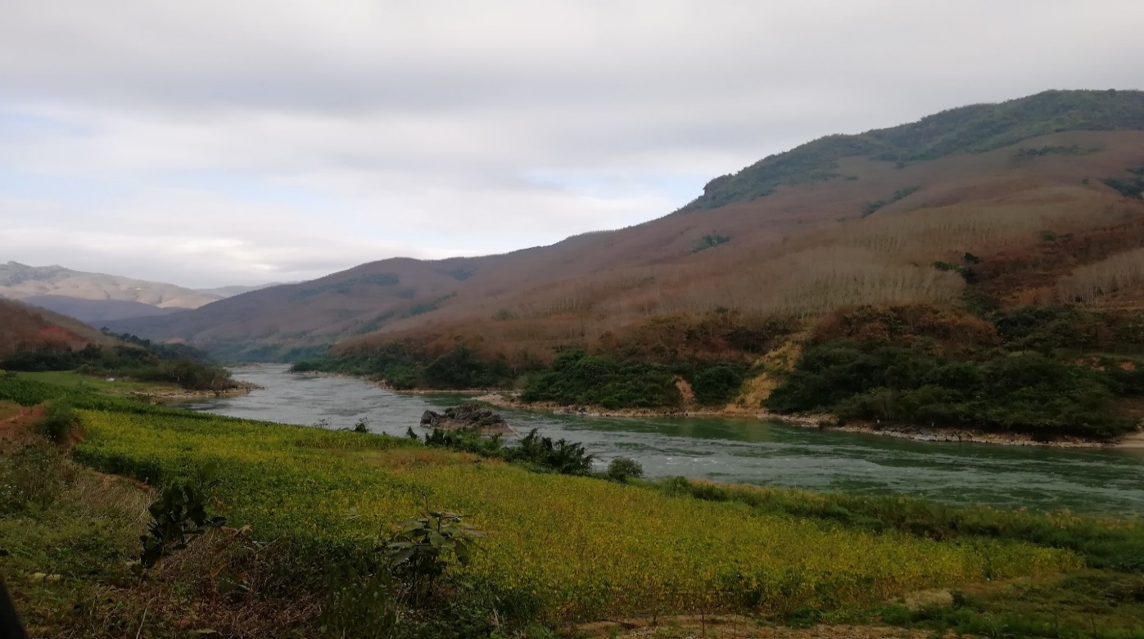
Lost in the waters: contemporary dilemmas in examining transboundary water interaction
Richard Grünwald, Yan Feng, Wenling Wang
Notes:
Abstract:
The presented paper examines current dilemmas in transboundary water interaction and debates about the reconceptualization of the Transboundary Water Interaction Nexus (TWINS). The new TWINS framework provides a theoretical alternative how to (1) evaluate the interstate relations between two or more actors regardless their legal status; (2) calculate the transboundary water interaction based on process tracing analysis rather than milestone analysis; (3) distinguish more intensities of cooperation and conflict, (4) clarify broader hydropolitical context in transboundary water interaction, and (5) debate about dual water event phenomenon where one event may possess both cooperation and conflict features. Currently, the new TWINS model serves as an indicator for evaluating cooperation and conflict intensity of water-related events in the Lancang-Mekong River Basin. The data are then recorded in the Lancang-Mekong Cooperation and Conflict Database (LMCCD) designed by authors which already comprise more than 1600 water-related events in the last 30 years (1990-2020). To proof the viability of the presented concept, we will illustrate the new TWINS model on a case study related to the Xayaburi hydropower dam. Although there are still several methodological limitations, the new TWINS model can be adapted to any interstate water-related issue and be able to fill the information gaps about the interdisciplinary understanding of the transboundary water interaction.

Slide 2



Transboundary water interaction
Examining cooperation and conflict
  Many faces of cooperation and conflict (=subjective judgement about both features)
  Perception paradox (=conflicts are not always bad and cooperations are not necessary good)
  Lack of primary data (=what events are relevant? How to calculate them? Where to find them?)
1

Slide 3
Hydropolitical theories
Traditional hydropolitical theory
Statecentrist
Benefit sharing
Water management optimatization
Contrast between cooperation and conflict
Critical hydropolitical theory
Multi-stakeholders
Conflict of interests
Use of power
Many types of cooperation and conflict
Common ground
Coexistence of cooperation and conflict
Complex entanglement of water issues
2
Notes:
Traditional hydropolitical theory (e.g. Brochmann and Gleditsch 2012, Wegerich and Warner 2010, Earle et al. 2010) vs. Critical hydropolitical theory (e.g. Hussein et al. 2018, Sneddon and Fox 2006, Tayia 2019)
Sources:
Brochmann, M., Gleditsch, N.P. (2012). Shared rivers and conflict – a reconsideration. Political Geography, 31(8), 519-527.
Wegerich, K., Warner, J. F. (2010). The Politics of Water: A Survey. New York: Routledge.
Earle, A., Jägerskog, A., Öjendal, J. (2010). Transboundary Water Management. Principles and Practice. London: Earthscan.
Hussein, H, Menga, F., Greco, F. (2018). Monitoring Transboundary Water Cooperation in SDG 6.5.2: How a Critical Hydropolitics Approach Can Spot Inequitable Outcomes. Sustainability, 8(1), 3640-3649.
Sneddon, C., Fox, C. (2006). Rethinking transboundary waters: A critical hydropolitics of the Mekong basin. Political Geography, 25(2), 181-202.
Tayia, A. (2019). Transboundary Water Conflict Resolution Mechanisms: Substitutes or Complements. Water, 11(7), 7-40.

Slide 4
Cooperation and conflict key aspects
Cooperation
  Normative traits (=good water governance, multi-level governance, soft-power policy)
  Characteristic tools (=legislative bindingness, benefit sharing strategies, code of conduct)
  Wegerich and Warner 2010, SFG 2015, Sadoff and Grey 2005, Wolf 2007, Haefner 2016
Conflict
  Normative traits (=water diplomacy, degree of water insecurity, mutual hostility, distrust)
  Characteristic tools (=conflict resolutions, political agenda, excercise of power)
  Petersen-Pearlman et al. 2017, Tayia 2019, Hussein and Grandi 2017, Warner and Zawahri 2012
Water optimist theories
Win-win cooperation
Enlarging pie of benefits
Adaptation
Utalitarian theories
Incompatible interests
Use of power over water
Risk calculation
Water scarcity theories
Inevitable conflicts over water
Water insecurity
Uncertainty
3
Notes:
Sources:
Wegerich, K., Warner, J. F. (2010). The Politics of Water: A Survey. New York: Routledge.
Strategic Foresight Group (SFG) (2015). Water Cooperation Quotient. Mumbai: SFG.
Sadoff, C. W., Grey, D. (2005). Cooperation on international rivers: a continuum for securing and sharing benefits. Water International, 30(4), 420-427.
Wolf, A. T. (2007). Shared Waters: Conflict and Cooperation. Annual Review of Environment and Resources, 32(3), 241-269.
Haefner, A. (2016). Negotiating for Water Resources. Bridging Transboundary River Basins. New York: Earthscan.
Petersen-Pearlman, J. D., Veilleux, J. C., Wolf, A. T. (2017). International water conflict and cooperation: challenges and opportunities. Water International, 42(2), 105-120.
Tayia, A. (2019). Transboundary Water Conflict Resolution Mechanisms: Substitutes or Complements. Water, 11(7), 7-40.
Hussein, H., Grandi, M. (2017). Dynamics politics contests and power asymmetries: the cases of the Blue Nile and the Yarmouk Rivers. International Environmental Agreements, 17(6), 759-814.
Warner, J. F., Zawahri, N. (2012). Hegemony and asymmetry: multiple-chessboard games on transboundary rivers. International Environmental Agreements: Policies, Law and Economics, 12(3), 215-229.

Slide 5

Dilemmas in examining water interaction
Data collection
  Databases (=comprehensive x specific → annual data? x milestones? x definitions?)
  Type of analysis (=content x discourse x sentiment → purpose? x goal? x comparison?)
  Type of data (=official x secondary x media sources → field research? x interviews?)
Data evaluation
  Actors (=elite decision-makers x multi-stakeholders → hydrocracy? x subversive actors?)
  Events (=water-related events x non-water events → narrowing? x broadening?)
  Calculation (=positivist x post-positivist → guideline? x verification?)
4

Slide 6
TWINS framework
Transboundary Water Interaction Nexus (TWINS)
  Ilustrate the change of interstate relations on various milestones over shared waters
  Grasp the co-evolution of changing intensity of cooperation and conflict in 5x4 matrix contiuum
  Critique (=statecentric, limited multi-stakeholders assesment, bilateral milestone analysis)
Source: Zeitoun and Mirumachi 2008
5
Notes:
Source: Zeitoun, M., Mirumachi, N. (2008). Transboundary water interaction I: reconsidering conflict and cooperation. International Environmental Agreements: Policies, Law and Economics, 8(4), 297-316.

Slide 7
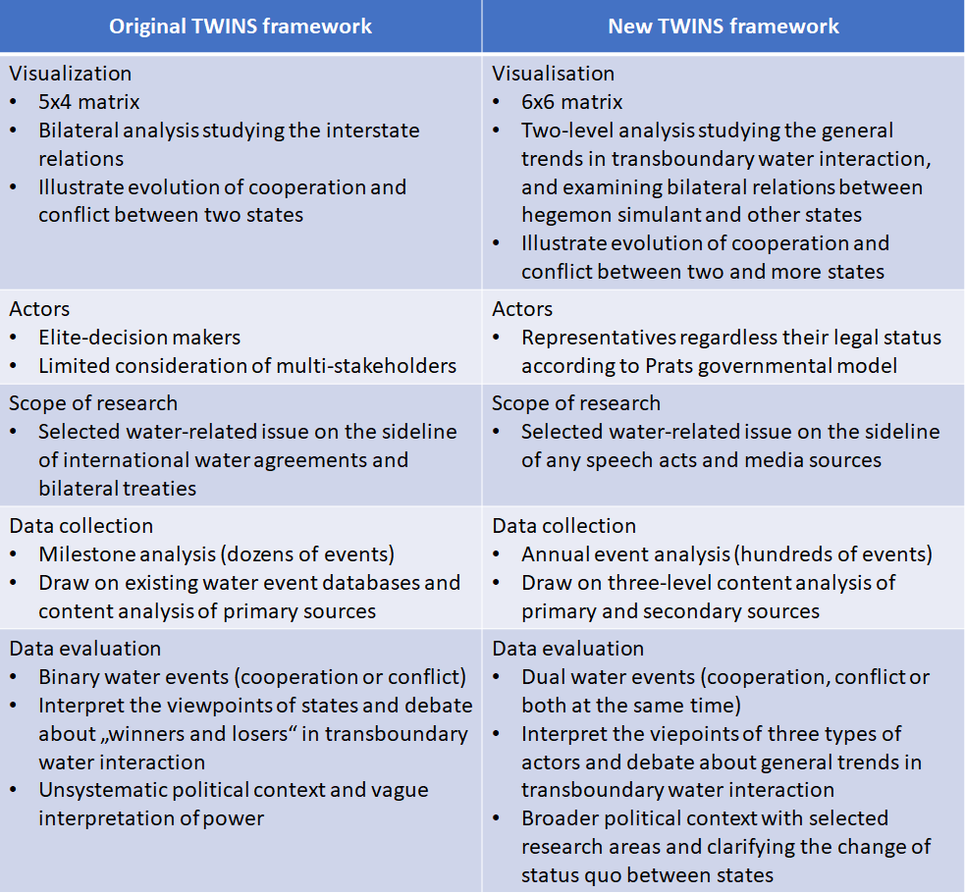
All rights reserved to authors
Notes:
Source: Grünwald, Richard; Wang, Wenling, Feng Yan (2020a). Reconceptualization of the Transboundary Water Interaction Nexus (TWINS): approaches, opportunities and challenges [in Review]. In: Water International. Do not cite or modify without author‘s permission.

Slide 8
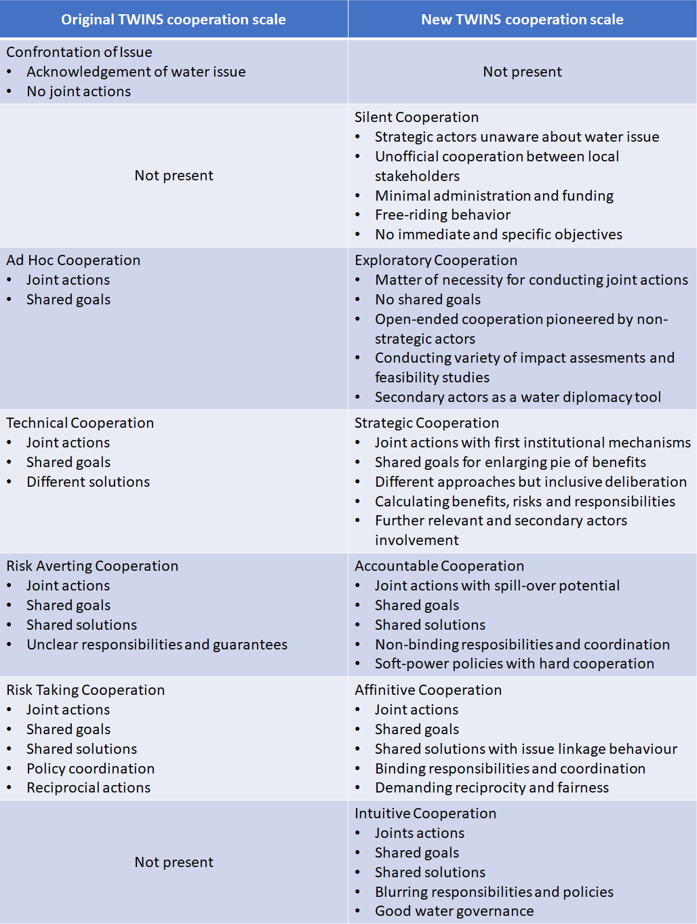
All rights reserved to authors
Notes:
Source: Grünwald, Richard; Wang, Wenling, Feng Yan (2020a). Reconceptualization of the Transboundary Water Interaction Nexus (TWINS): approaches, opportunities and challenges [in Review]. In: Water International. Do not cite or modify without author‘s permission.

Slide 9
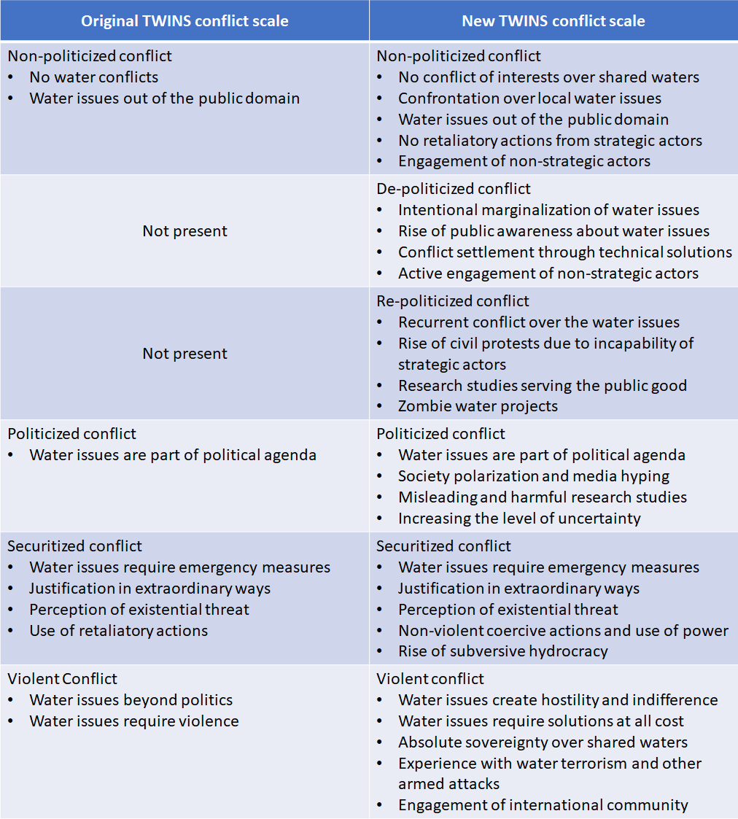
All rights reserved to authors
Notes:
Source: Grünwald, Richard; Wang, Wenling, Feng Yan (2020a). Reconceptualization of the Transboundary Water Interaction Nexus (TWINS): approaches, opportunities and challenges [in Review]. In: Water International. Do not cite or modify without author‘s permission.

Slide 10
Application
New TWINS framework and Xayaburi case study
  Scope: relations between Laos-Thailand, Laos-Cambodia, Laos-Vietnam
  Data: 1440 English-written sources (2000-2019) → 267 water-related events
  Conclusions: cooperation prevails (185 > 153), conflict intensity more severe (-2,96 > +2,66)
Time | Cooperation |  |  |  |  |  |  |  | Conflict
 | 1 | 2 | 3 | 4 | 5 | 6 | Ratio | Total | −1 | −2 | −3 | −4 | −5 | −6 | Ratio | Total
2007 | 1 | 4 | 5 | 0 | 0 | 0 | 2.55 | 9 | 1 | 0 | 0 | 0 | 0 | 0 | −1.00 | 1
2008 | 0 | 2 | 6 | 0 | 0 | 0 | 2.75 | 8 | 0 | 0 | 0 | 0 | 0 | 0 | N/A | 0
2009 | 0 | 22 | 12 | 0 | 0 | 0 | 2.35 | 34 | 0 | 0 | 1 | 0 | 0 | 0 | −3.00 | 1
2010 | 4 | 4 | 11 | 3 | 0 | 0 | 2.59 | 22 | 0 | 2 | 4 | 1 | 0 | 0 | −2.85 | 7
2011 | 5 | 14 | 8 | 4 | 5 | 0 | 2.72 | 36 | 2 | 5 | 17 | 10 | 2 | 0 | −3.13 | 36
2012 | 7 | 14 | 2 | 1 | 3 | 0 | 2.22 | 27 | 2 | 8 | 10 | 13 | 7 | 0 | −3.37 | 40
2013 | 3 | 8 | 2 | 0 | 1 | 0 | 2.14 | 14 | 1 | 3 | 6 | 6 | 1 | 0 | −3.17 | 17
2014 | 1 | 5 | 1 | 1 | 2 | 0 | 2.8 | 10 | 1 | 3 | 9 | 5 | 1 | 0 | −3.10 | 19
2015 | 3 | 0 | 1 | 0 | 0 | 0 | 1.5 | 4 | 0 | 0 | 0 | 4 | 2 | 0 | −4.33 | 6
2016 | 0 | 1 | 2 | 1 | 0 | 0 | 3 | 4 | 0 | 0 | 2 | 1 | 1 | 0 | −3.75 | 4
2017 | 0 | 2 | 0 | 2 | 0 | 0 | 3 | 4 | 0 | 3 | 0 | 1 | 0 | 0 | −2.50 | 4
2018 | 0 | 0 | 1 | 1 | 2 | 0 | 4.25 | 4 | 0 | 1 | 1 | 0 | 0 | 0 | −2.50 | 2
2019 | 2 | 4 | 1 | 2 | 1 | 0 | 2.66 | 10 | 4 | 2 | 5 | 3 | 2 | 0 | −2.81 | 16
Total | 26 | 80 | 52 | 15 | 14 | 0 | 2.66 | 185 | 10 | 27 | 55 | 44 | 16 | 0 | −2.96 | 153
Source: Grünwald et al. 2020b
All rights reserved to authors
9
Notes:
Source: Grünwald, Richard; Wang, Wenling, Feng Yan (2020b). Modified Transboundary Water Interaction Nexus (TWINS): Xayaburi Dam Case Study. In: Water, Iss 12, pp. 710-727.

Slide 11
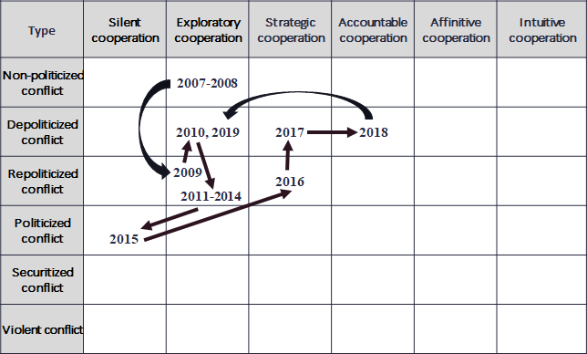
Xayaburi case study
All rights reserved to authors
10
Notes:
Source: Grünwald, Richard; Wang, Wenling, Feng Yan (2020b). Modified Transboundary Water Interaction Nexus (TWINS): Xayaburi Dam Case Study. In: Water, Iss 12, pp. 710-727.

Slide 12
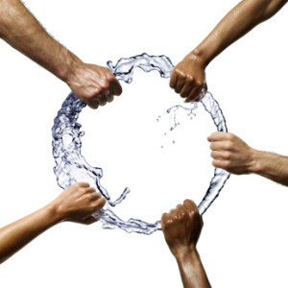
Discussion and conclusions
New TWINS framework
  Provide an alternative guide for calculating six levels of cooperation and conflict (+examples)
  Innovations: hegemon-simulant, three-level content analysis, dual water events
  Improvements: broader political context, annual data, multi-stakeholders involvement
Results
  Lancang-Mekong Cooperation and Conflict Database (LMCCD) (over 2100 sources, 1990-2020)
  Tested on Xayaburi dam and Lancang-Mekong Cooperation case studies (Grünwald et al. 2020)
  Limits: time-consuming, English-written sources, troublesome verification of micro-events
11

Slide 13

Thank you for your attention!
Notes:
http://rethinkingtruth.com/wp-content/uploads/2013/12/water.jpg

