Slide 1
WAVERYS
A CMEMS global wave reanalysis during the altimetry period
Stéphane Law-Chune (1), Lotfi Aouf (2), Alice Dalphinet (2), Bruno Levier (1), Yann Drillet (1)
(1)
(2)

Slide 2
Outline
Motivation
Description of WAVERYS
Coastal validation with buoys
Open ocean validation with HY2-A altimeter
Illustration of swell dissipation and
currents-waves interactions
Comparison with ERA5 waves

Slide 3
Motivation
CMEMS markets/applications that require waves :
Marine navigation
Natural resources and energy
Safety and disaster
Science and climate
Marine conservation
Marine food
→ With 25 years of coverage in the past (1993-2018), WAVERYS (WAVE ReanalYsiS) provides accurate sea state description in need of wave climate studies
Notes:
Coastal monitoring : downscaling of high resolution coastal models
Marine navigation : safer ship routing
Safety and disaster : search and rescue, meteo-ocean dashboards
Natural resources and energy: evaluate ocean energy resources
Science and climate : research
Marine conservation : monitoring of habitats within conservation of areas
Marine Food : aquaculture farms, fisheries

Slide 4
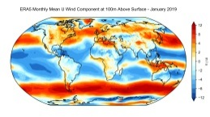
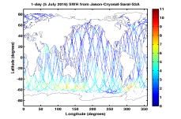
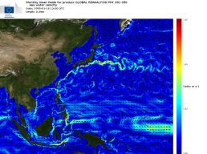
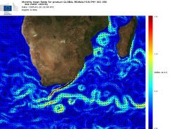
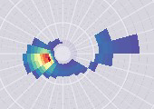
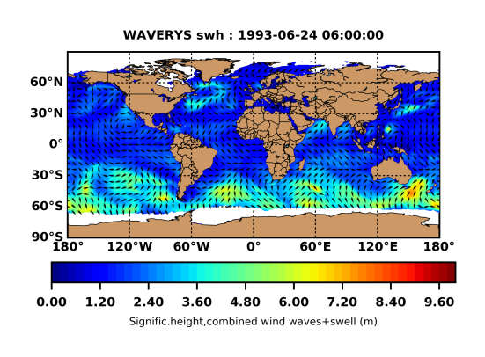
System description
3h ERA5 atmospheric forcing
(winds and sea ice fraction)
3h ASSIMILATION
3h GLORYS12 Surface currents (refraction)
WAVERYS
20 km global grid (ETOPO2), 3 h inputs/outputs
IFS-38R2 computing code (WAM) with
Dissipation source terms from ST4 physics + MFWAM 2018
Correction of high freq. with Phillips’s analytic spectrum (1958)
Altimeter Hs
(ESA/IFREMER Globwave
Data base)
SAR wave spectra from Sentinel-1 (2016-onwards)
3-hourly outputs of 20 wave parameters (including wind-wave and swell partitions)
Notes:
MFWAM uses the computing code of ECWAM-IFS-38R2 with a dissipation term developed by Ardhuin et al. (2010), called in the community the ST4 physics, added with some improvements obtained from the European research project « my wave » (Janssen et al. 2014). In accordance with the latest version of the CMEMS global wave system, the dissipation source term was also adjusted to reduce the surface stress at the air/sea interface for high and intermediate winds (Rainaud et al 2019). Predicting the high frequency part of the spectrum is tricky because these are the frequencies where wind energy is introduced to feed the waves, but also the one subject to the most dissipative processes. WAVERYS corrects the upper part of the spectrum to a Phillips tail (theoretical spectrum) to ensure realistic spectral content.

Slide 5
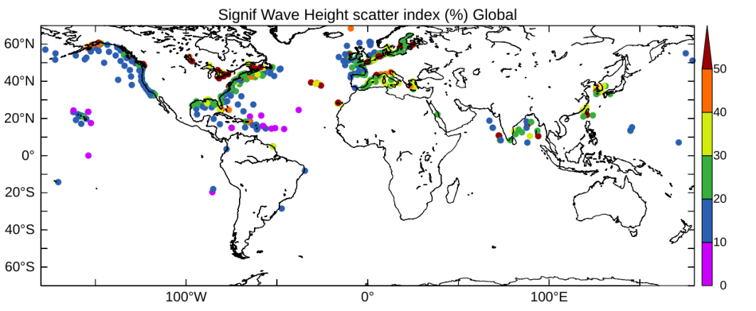
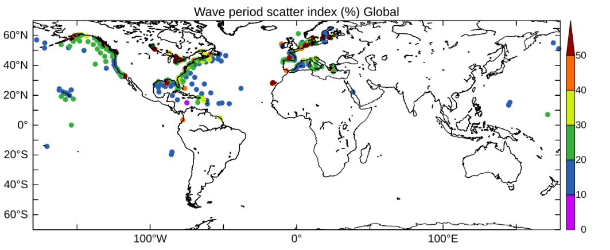
1993-2018 validation with CMEMS buoys(3h)
Hs Scatter Index (SI) (%)
Wave mean period (WMP) SI (%)
DOMAIN | Bias (cm) | SI (%)
Global | -6 | 22.2
High latitudes | -3 | 24.9
Intermediate | -7 | 21.2
Tropics | -3 | 17.8
DOMAIN | Bias (s) | SI (%)
Global | -0.4 | 14.9
High latitudes | -0.33 | 14
Intermediate | -0.42 | 15.3
Tropics | -0.39 | 11.3
Global average SI at coasts ~ 20% for Hs and ~ 15% for WMP
Best results for Tropics in terms of wave magnitude and types (upcoming swells and local trade waves)
$$SI=\frac{RMSD}{{E[Obs\left(t\right)}^{}]}$$
Notes:
Overall good SI for SWG ~10 to 15% that increase 20% in costal areas

Slide 6
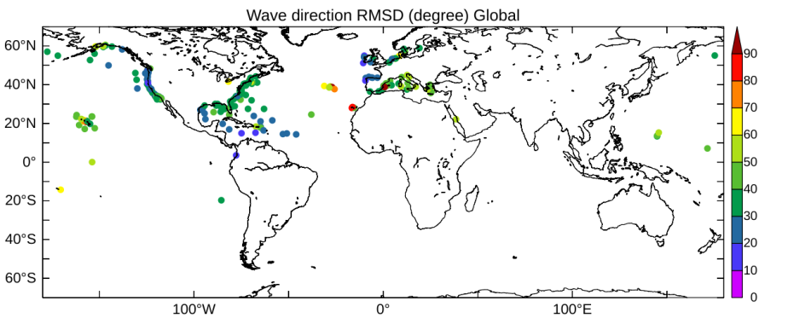
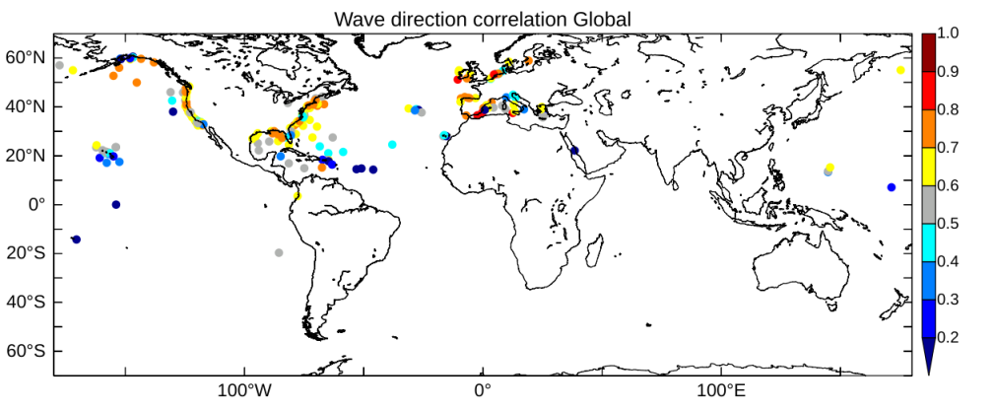
1993-2018 validation with CMEMS buoys(3h)
Mean wave direction RMSD (°)
RMSD in direction are local wave system dependent :
15° Bay of Biscay, Caribbean sea, Western US
35° Eastern US, Med, Hawaii
On a global average, directions are very low biased < 5 ° (not shown)
Mean wave direction correlation
Correlations in direction are good in extra-tropics (strong westerly winds), but less performant in tropics (light trade winds + cyclones)

Slide 7
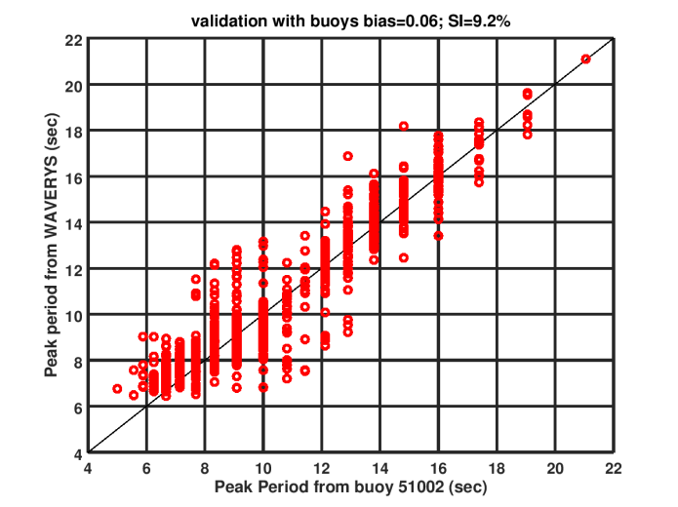
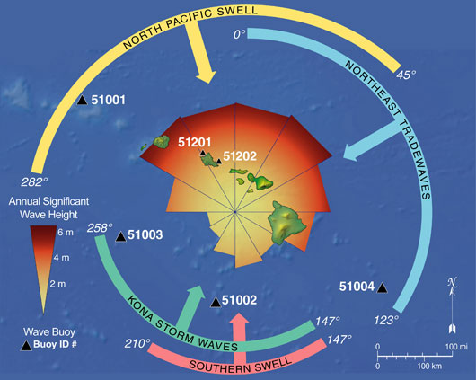
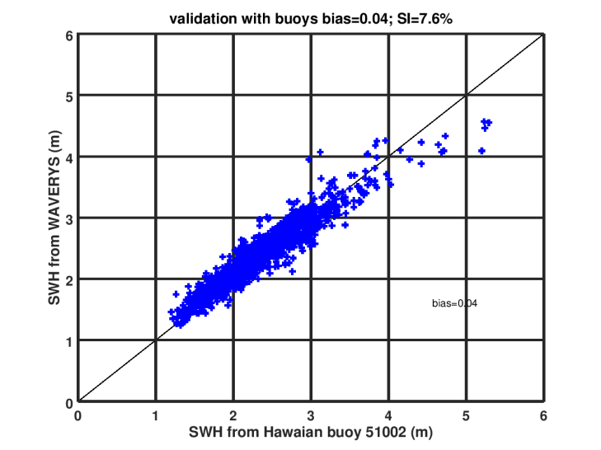
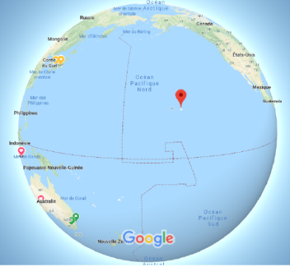
Zoom on Hawaii NDBC/NOAA buoys: 51002
Peak wave period (PWP)
From Vitousek & Fletcher (2008)
YEAR 2010
hawaii
PWP SI = 9.7%
Good capturing of long swell
(Pwp >12 s)
Sig. wave height (Hs)
Hs SI = 7.5%
Good value in open-ocean condition
Hawaii is dominated by 2 large north swells and 2 narrow south swells
Buoy 51002 is to the south and off the archipelago
Hawaii
Notes:
National data buoy center
Hawaii caractérisé par des houles très longues et en dehors du rail des depressions.
http://www.soest.hawaii.edu/coasts/nps/waveClimate.php

Slide 8
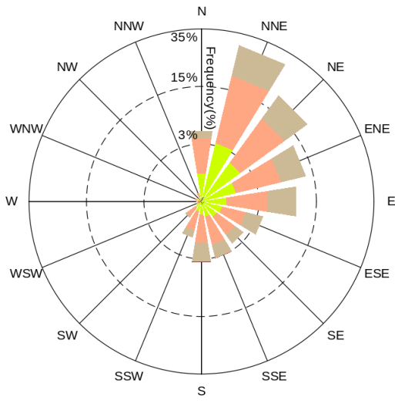
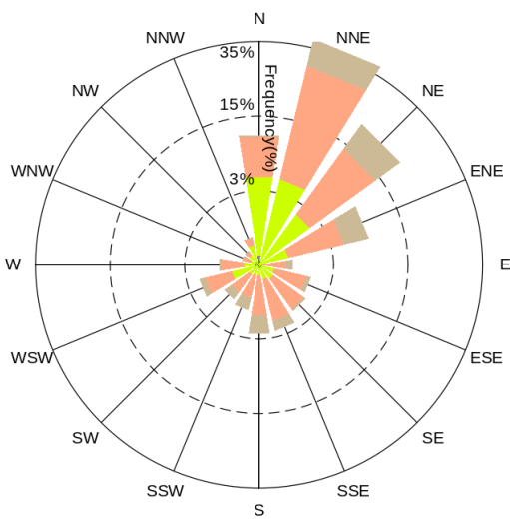
Zoom on Hawaii NDBC/NOAA buoys: 51202
From Vitousek & Fletcher (2008)
Wave roses on 1993-2018
Buoy
WAVERYS
Buoy 51002 is in majority exposed to north-northeast trade regime (70% of occurrence)
Good accordance in terms of directional spread, amplitude and frequency.
but… some misses, like pure east swell that WAVERYS misses. WAVERYS also adds extra-WSW swells. Likely due to the 1/5° resolution which lacks precision
Hawaii
Notes:
for pure east swell and received influence of some wave related to Kona low pressure system (1/5°resolution ?)
The Hawaiian anchorage observes waves from the north-northeast and WAVERYS seems to slightly enhance the occurrence of these events. Occurrences of easterly waves are also slightly less often in favour of west-southwest waves absent in the observation.

Slide 9
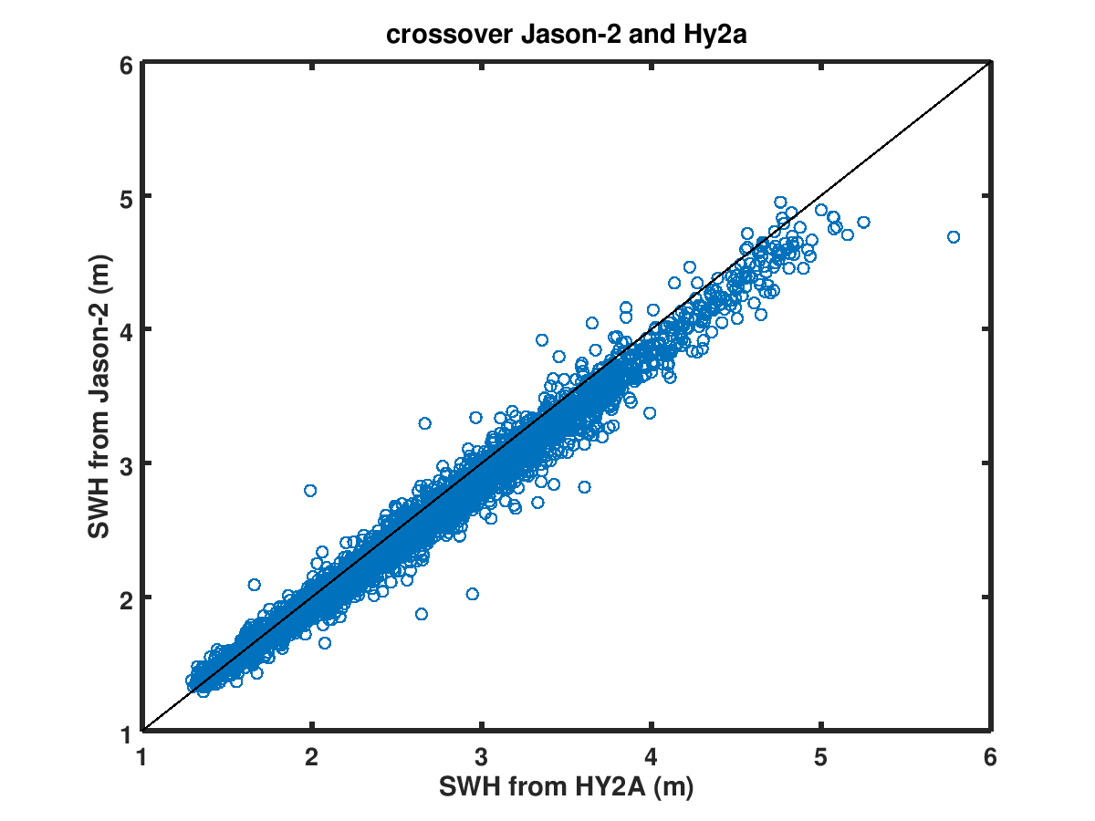
Open ocean validation with HY2A
HY2A altimeter (2011, China) is an independent validation data for WAVERYS (Courtesy of CNES)
Hs from HY2A has been calibrated with Jason-2 following a regression relation (Y=a*X+b)
Open-ocean validation = Colocation of HY2A with WAVERYS model grid points over 2012-2018
ERA5 wave dataset was tested as well for comparison
a=1.058
b=-0.0193
 | Physics for source terms | Coupling with atmosphere model | Current refraction | Horizontal resolution
ERA5 wave | ECWAM-IFS 41R2 | in: air density, 10 m wind and surface roughness out: Charnock parameter | NO | 0.5°
WAVERYS | MFWAM 2018 | NO | 3h GLORYS12V1 currents | 0.2°

Slide 10
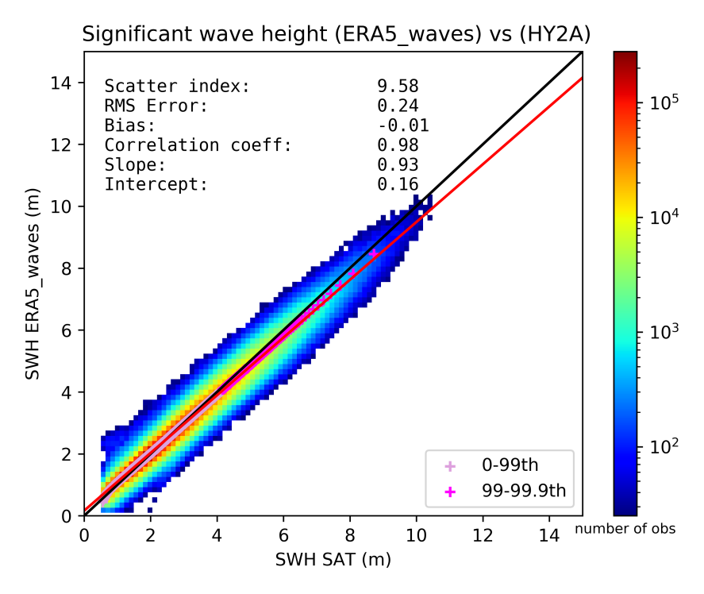
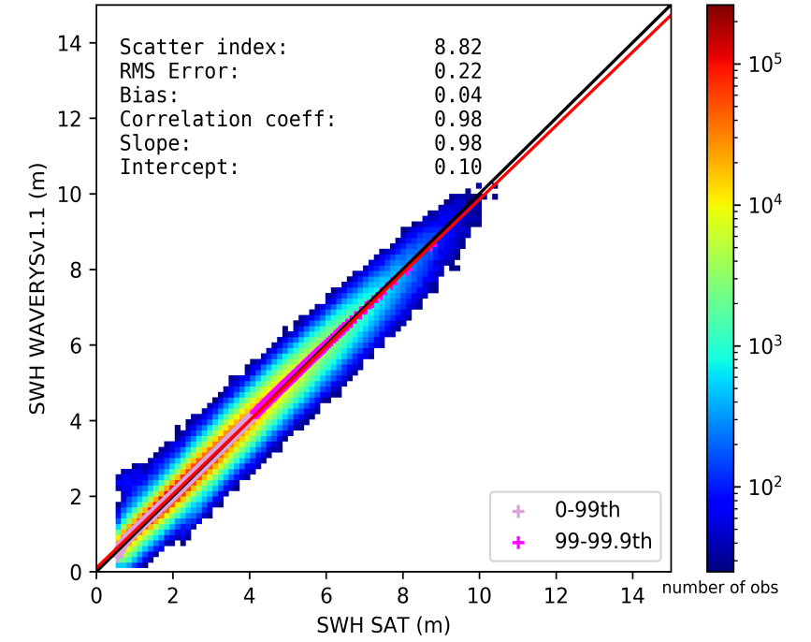
Validation with HY2A(2012-2018): scatter plots
ERA5
WAVERYS
WAVERYS is better of roughly 8% for Hs SI compared to ERA5
4cm of bias for WAVERYS vs -1 cm for ERA5
Slope is clearly better for WAVERYS (98%), underestimation of the highest waves for ERA5 (93%)
Notes:
Slope : maybe better for higher waves (dissipation, analytic tail for HF, etc.)

Slide 11
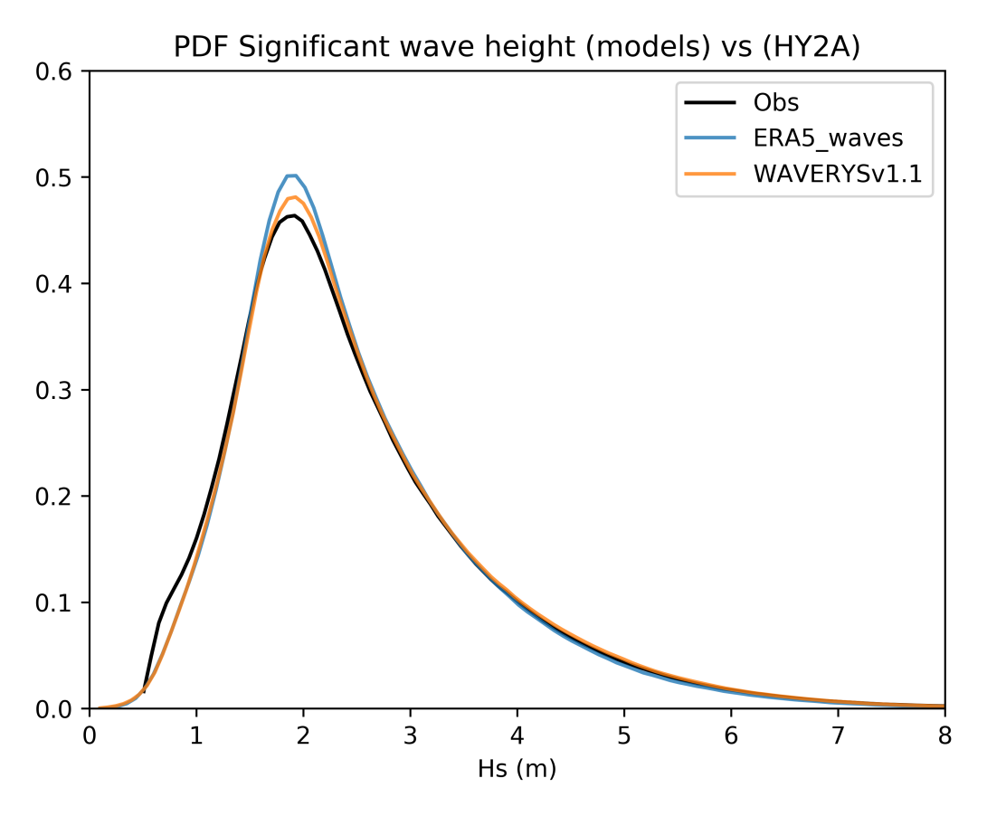
Validation with HY2A(2012-2018):PDFs
In terms of PDF, models overpopulate waves between [1,75 -2,50] m
WAVERYS’ PDF is closer to the observation for this range of waves (better dissipation)
Small waves under 0.5 m are lacking in both models

Slide 12
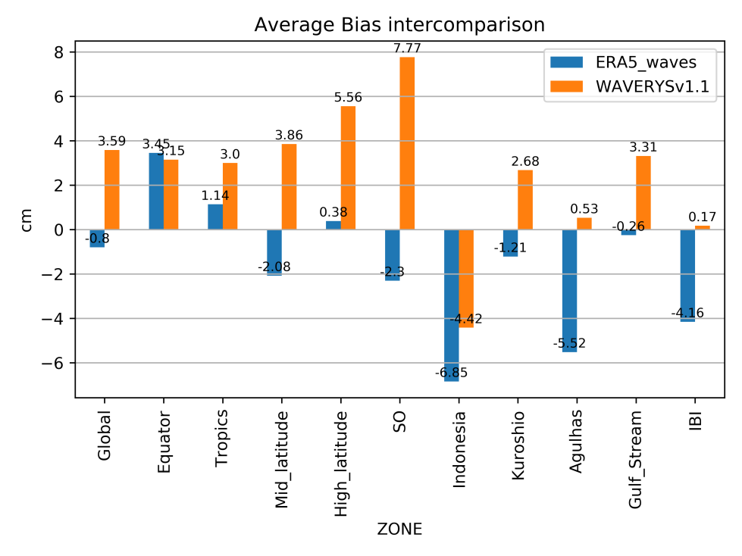
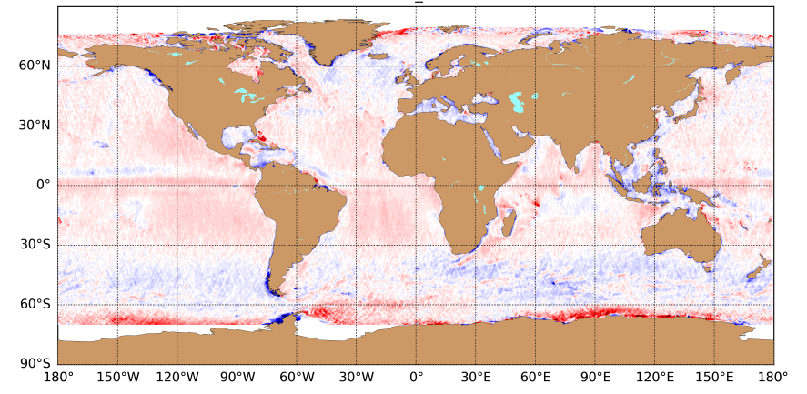
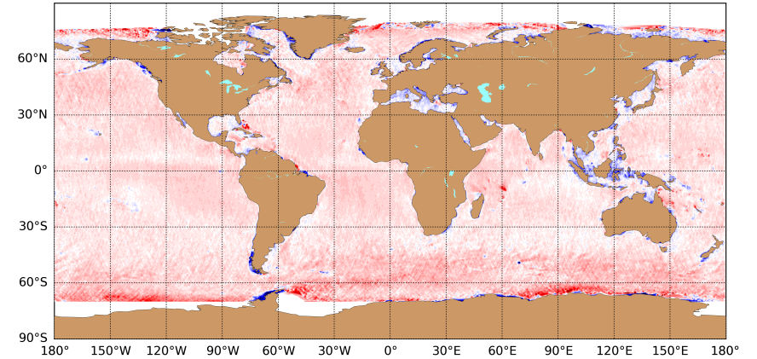
Validation with HY2A(2012-2018):biases
Hs bias (0.5° mapping)
ERA5
WAVERYS
Biases of few cm are clearly negligible for waves of the order of a meter, but:
ERA5 has a reduced global bias (-0.8 cm), due to some negative biases for mid and subpolar latitudes (notably North Atlantic and Southern Ocean (SO)) that compensate basin-scale positive biases.
The Med and Indonesian sea are biased low in both systems

Slide 13
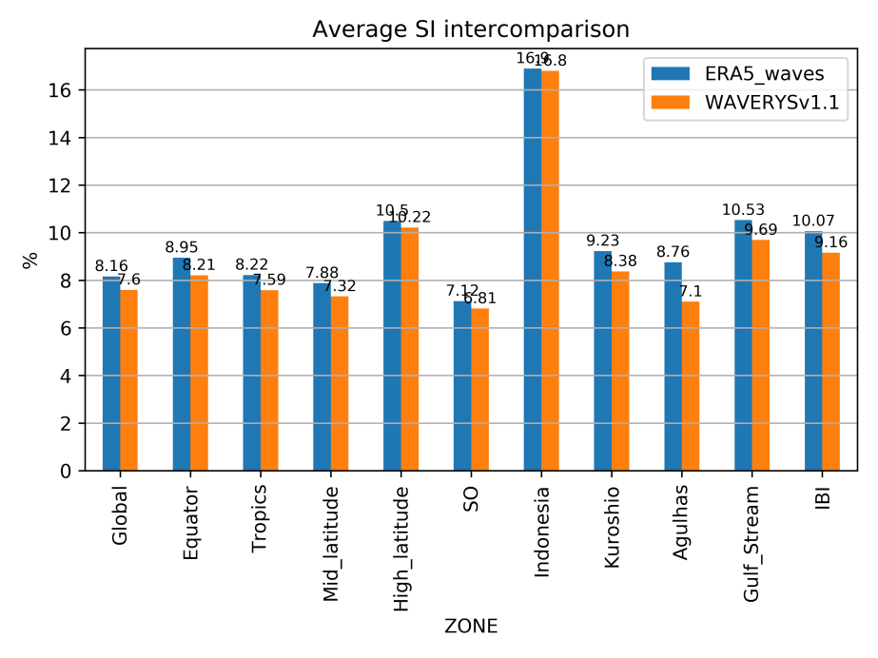
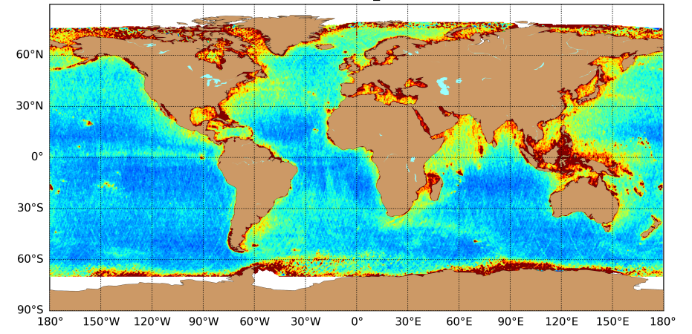
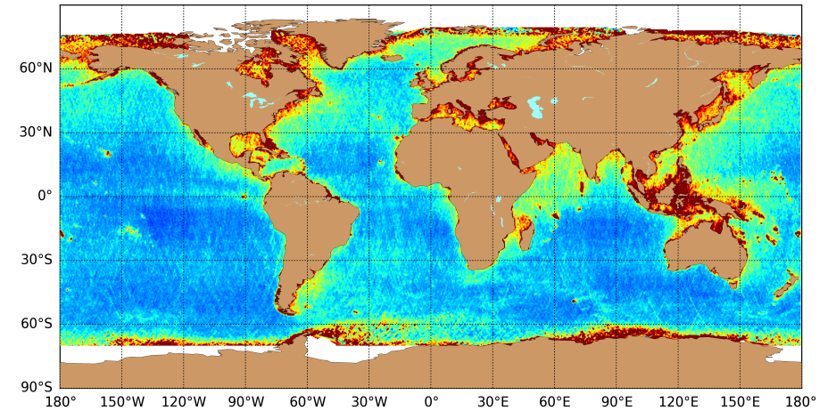
Validation with HY2A(2012-2018):SI
Hs SI (0.5° mapping)
ERA5
WAVERYS
WAVERYS is always better than ERA5 in terms of SI, no matter the region
Notably in region dominated by strong currents
Improvement in SI for Agulhas = 19% compared to ERA5

Slide 14
WAVERYS-ERA5 swell physics comparison (2010)
Difference in terms of Hs (m) [WAVERYS- ERA5] for primary swell
WAVERYS’ first swells are more dissipated compared to ERA5 in the tropical band (action of ST4 physics)
More energetic swells are generated in storm track zone for WAVERYS
This corresponds to improvements regarding known issues in wave modeling
m
Notes:
A l’oral : problème partitionnementn pour cette partie de houle.

Slide 15
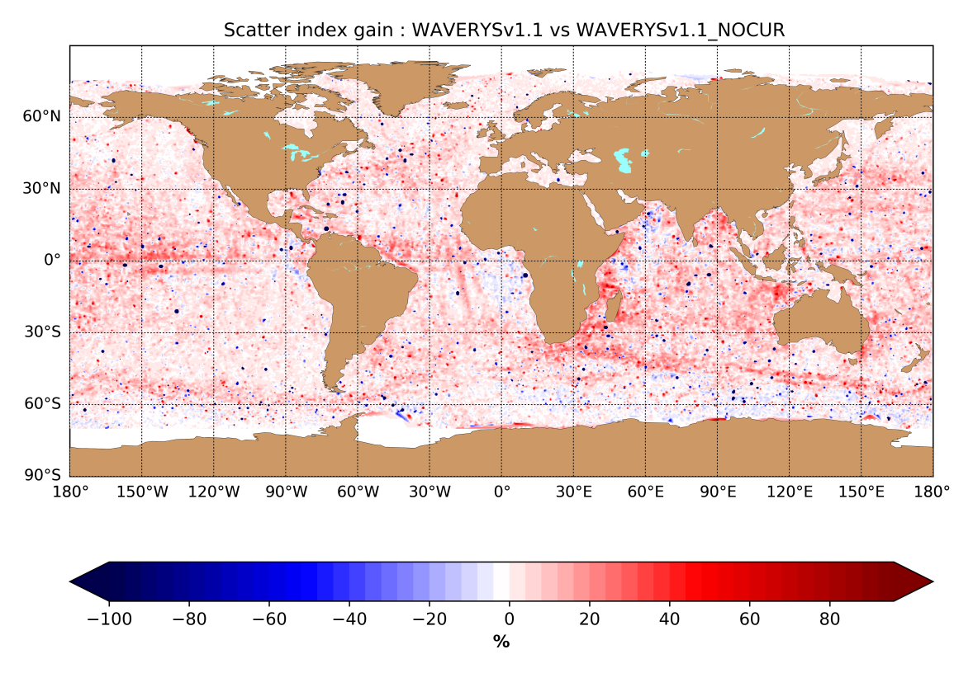
Importance of ocean currents
% of improvement WAVERYS (with currents) vs (no currents) for 2014
Taking into account ocean currents are relevant globally !
Improvements are noticeable in vicinity of ocean current systems
Region | Improvement
Global | 3.9 %
Equator | 6 %
Agulhas | 11,5 %

Slide 16
Conclusion
WAVERYS is a CMEMS global wave reanalysis at 20 km (1993-2018) which provides accurate sea states for regions dominated by ocean currents and long swells
Very good results : ~8 % SI on global average (8% better that ERA5 w.r.t HY2A altimeter) and small bias of SWH
WAVERYS is released since 3rd December 2019 on https://resources.marine.copernicus.eu/ product name : GLOBAL_REANALYSIS_WAV_001_032
2019 time series extension will be delivered in July 2020
A new 1/10° version, with new outputs and assimilated data is under development
Additional information in product’s quality information document (QUID)

Slide 17
MEAN PARAMETERS DELIVERED
Spectral significant wave height (Hm0)
Spectral moments (-1,0) wave period (Tm-10)
Spectral moments (0,2) wave period (Tm02)
Wave period at spectral peak / peak period (Tp)
Mean wave direction from (Mdir)
Wave principal direction at spectral peak
Stokes drift U
Stokes drift V
Spectral significant wind wave height
Spectral moments (0,1) wind wave period
Mean wind wave direction from
Spectral significant primary swell wave height
Spectral moments (0,1) primary swell wave period
Mean primary swell wave direction from
Spectral significant secondary swell wave height
Spectral moments (0,1) secondary swell wave period
Mean secondary swell wave direction from

