Slide 1
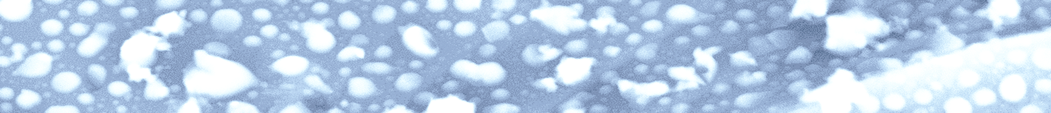






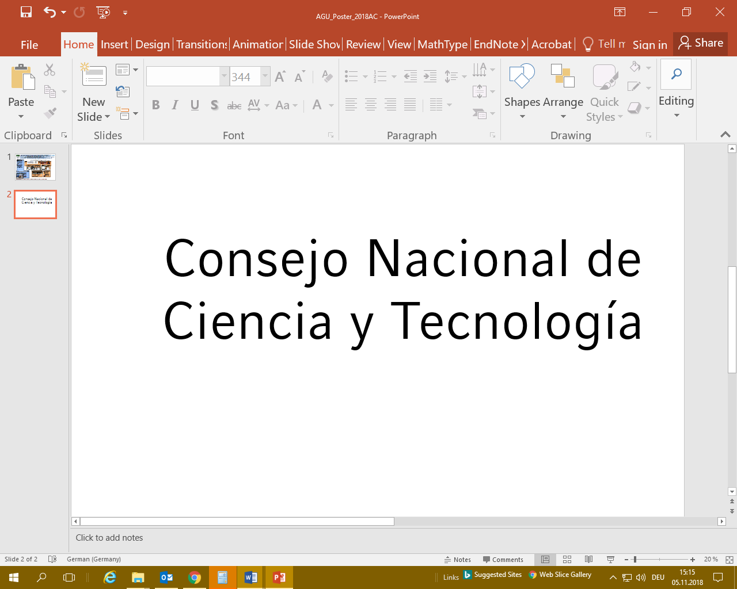


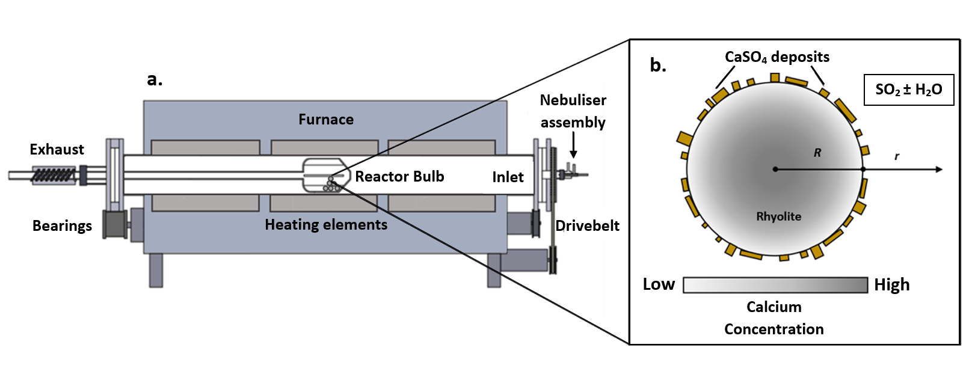


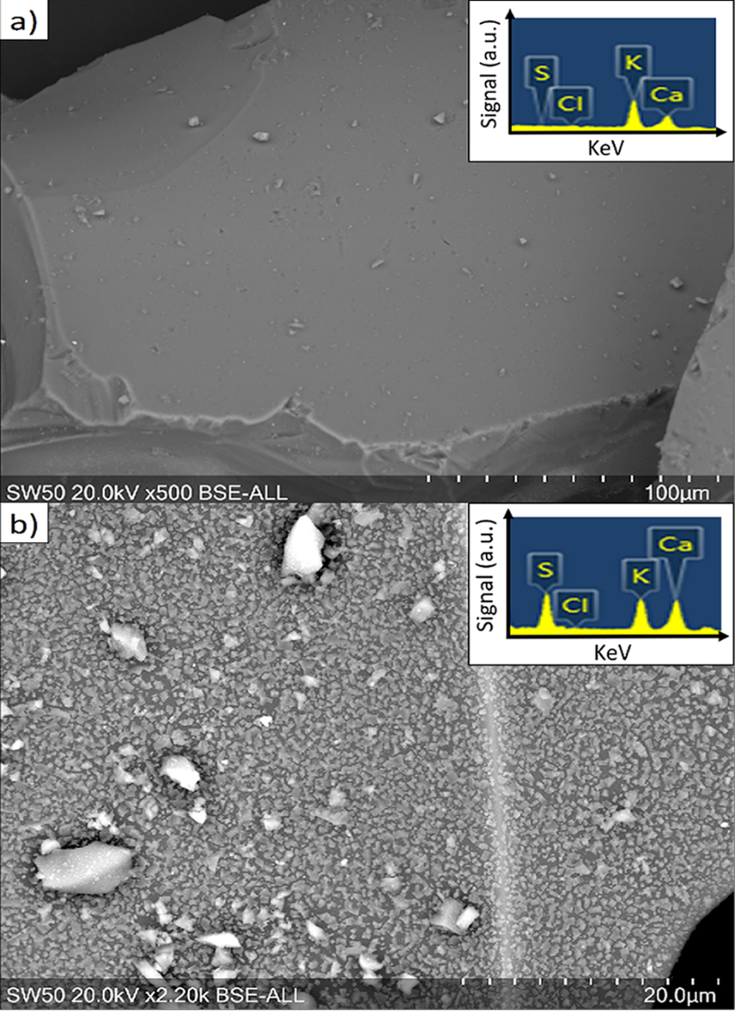
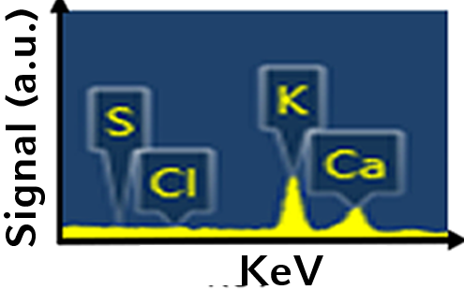

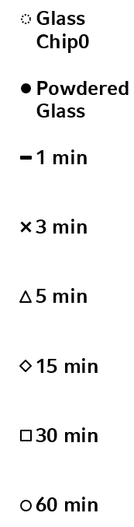
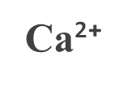
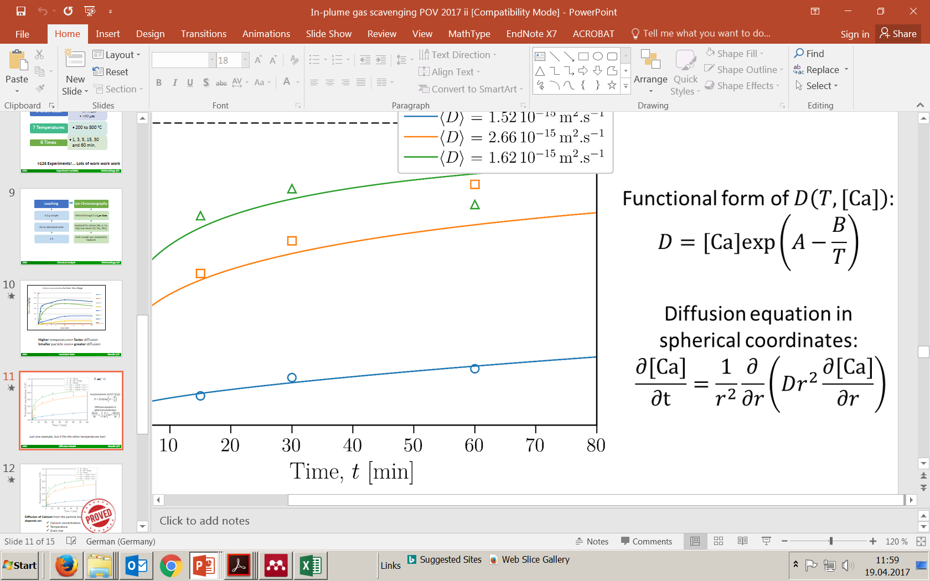



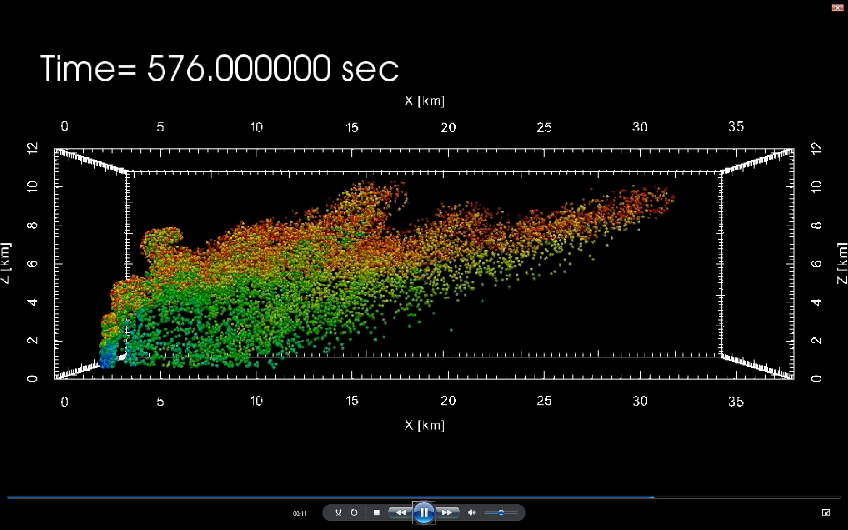
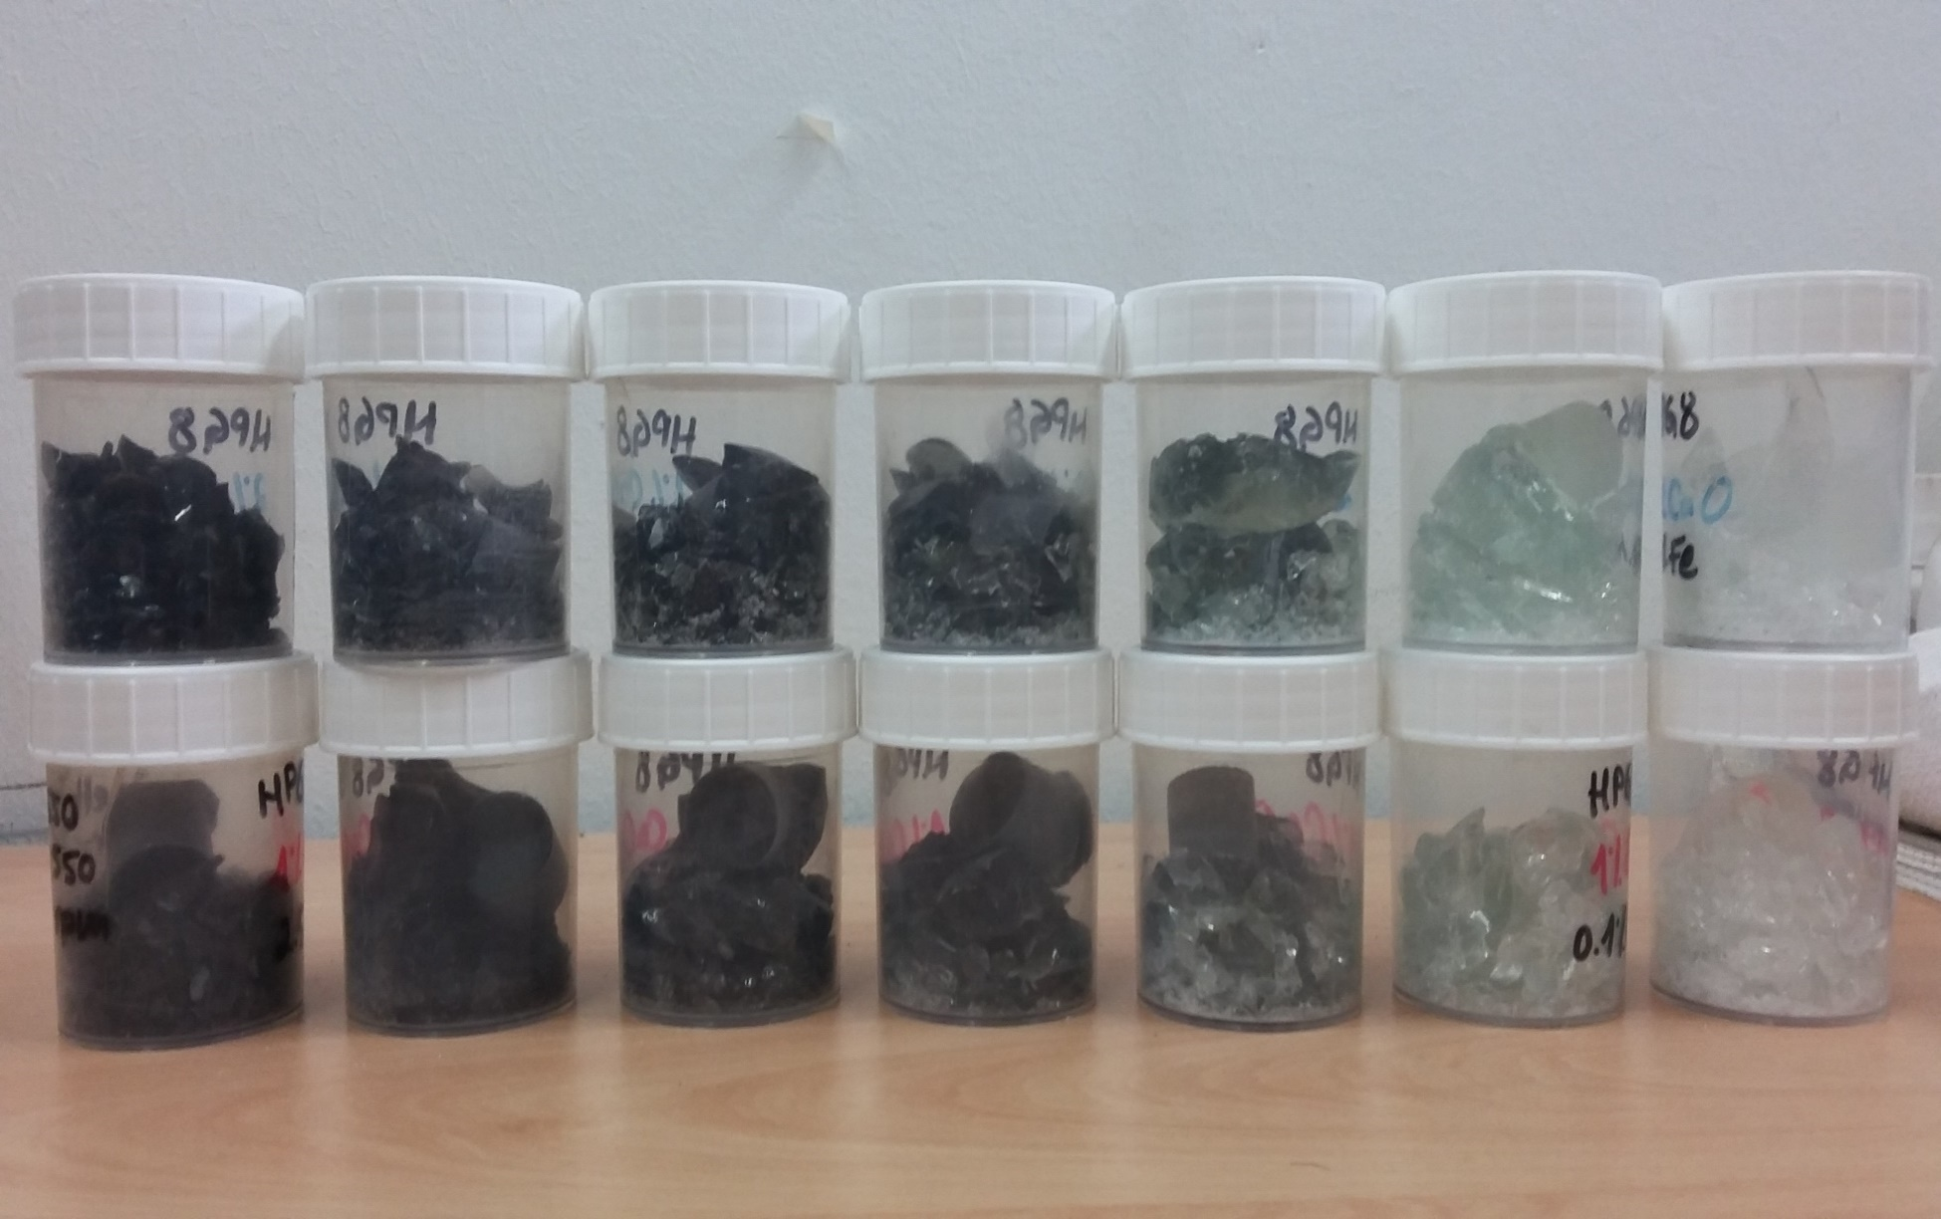

The role of calcium diffusion on high temperature SO₂ uptake by volcanic glasses
Ana S. Casas¹, Fabian B. Wadsworth², Paul M. Ayris¹, Pierre Delmelle³, Jeremie Vasseur¹, Corrado Cimarelli¹, and Donald B. Dingwell¹
ana.casas@lmu.de
¹Ludwig-Maximilians-Universität, Munich, Germany, ²Durham University, Durham, U.K., ³Catholic University of Louvain, Belgium.
1
Introduction
2
Methods: high temperature SO₂-glass interactions
2
Samples
Characterization
SO₂ high-temperature uptake by glass (from ash) has been studied and recognized to be an effective process to remove SO₂ from the atmosphere during large volcanic eruptions¹.
Variables
1) Calc alkaline rhyolite³ (natural)
2) HPG8¹ +1-2wt% CaO + 0-2.5wt%FeO
Temperature
Grain size distribution
Exposure time
200, 300, 400, 500, 600, 700 and 800°C
<63, 63-90 and >90 µm
1, 3, 5, 15, 30 and 60 min.
Leaching (1:250 ratio)
Microprobe analysis
Our work has also shed light into the mechanisms and parameters involved in volcanic gas uptake; chemisorption from SO₂, followed by CaSO₄ growth on the glass surfaces prompts the process, this drives a chemical potential induced-diffusion of Ca²⁺ which results in subsequent CaSO₄ growth.
IC analysis
Particle size distribution
Fe³⁺/Fe²⁺ ratio
determination
SEM, BET analysis
Potentiometric K₂Cr₂O₇ titration
Advanced Ash-Gas Reactor²
We noticed that T>500°C and grain sizes <90μm, are conditions that greatly favor SO₂ uptake by glass.
3
Results: SO₂ turns into CaSO₄ on sample surfaces
4
Ca²⁺ diffusion linked to Fe²⁺ oxidation?
Another interesting observation, was that the Fe³⁺/ΣFe ratio of the glass increases with increasing temperature and is almost directly proportional to the Ca²⁺ diffusion, leading to the hypothesis that both Ca²⁺ diffusion and Fe²⁺ oxidation are linked in as a cause/effect of SO₂ uptake.
IC Analysis
Showed Ca²⁺ as the main leached cation. Concentration increases with time and temp.
SEM
Confirmed Ca-bearing minerals on sample surfaces after experiments.
Fe²⁺ oxidizes
The Fe³⁺/ΣFe ratio increases with increasing temperatures.
Microprobe analysis of polished thick sections of the samples, showed consistent depletion beneath the particle surface.
Calcium depletion, i.e., outward diffusion, seems to be related to the increase of the bulk Fe³⁺⁄ ƩFe ratio.
Ca²⁺+2Fe²⁺=2h•+ 2Fe³⁺
1.0
R(µm)
>90
-15
90-63
-15
<63
-15
.
.
.
.
T [°C]
D(m² s⁻¹)
1.52
10
2.66
10
1.62
10
T(°C)
Pristine sample
0.8
CaSO₄
Signal (a.u.)
0.6
CaSO₄
CaSO₄
CaSO₄
CaSO₄
Normalized concentration, Ca/Cᵢ
CaSO₄
10
This relation was further tested by preparing haplogranitic glasses with different CaO and FeO wt%; 1-2% and 0-2.5% respectively and conducting high temperature glass-SO₂ experiments. Here we present the results and implications of the experiments.
Calcium concentration, Ca²⁺ [mg.kg⁻¹]
KeV
0.4
Ca²⁺
Signal (a.u.)
Ca²⁺
Ca²⁺
Ca²⁺
Depletion depth
0.2
Ca²⁺
Treated Sample
Depletion depth
0.0
KeV
0.0
20
40
50
60
70
5
6
Discussion
7
HPG8 vs Natural Rhyolite
7
Future work
H
Oxide wt% | HPG8 (Referred as „H“ in the Grafic) | Natural Rhyolite (Referred as „N“ in the Graph)
SiO2 | 78.28 | 75.95
Al2O3 | 11.76 | 11.91
Na2O | 4.58 | 3.74
K2O | 4.07 | 2.65
CaO | 1 ,2 | 1.7
FeOtotal | 0, 0.1, 0.5, 1, 1.5, 2 ,2.5 | 3.28
SO₂ uptake was tested for a syntetic glass (HPG8⁴) with various FeOt and CaO wt % contents and compared with the experiments¹ carried out with natural rhyolitic glass (calc-alkaline rhyolite from Krafla volcano, Iceland).
Leachate data confirmed that both the addition of CaO and FeOtotal, systematically increased the amount of leached Ca²⁺, thus the growth of CaSO₄, and thereby SO₂ uptake.
Our final goal is enable the modelling of high temperature SO₂ uptake by a given eruption. By knowing the mechanisms and variables controlling Calcium diffusion, we can modify the model of Suzuki et al. (2005)⁵ and predict the mass of SO₂ within an eruption.
Chaitén 2008 dome
N
SO₂ uptake has mostly been regarded as a low-temperature process, where SO₂ is condensed as H₂SO₄ on the ash. However, our work demostrates that high-temperature (>500°C) glass reacts with SO₂; initially chemisorbing it and further reacting to grow surficial CaSO₄.
Moreover, the effect of Fe in this process has never before been studied, and seems to exert a powerful control on Ca²⁺ diffusion (thus SO₂ uptake).
An important implication is that, there is a compositional dependence on Calcium diffusion, that should be taken in consideration when assessing high temperature SO₂ uptake.
This image is an example of a volcanic plume simulation, where the size particle distribution of ash is been tracked in 3 spatial coordinates, for an eruption of the magnitude of Pinatubo, 1991. Courtesy of Yujiro J. Suzuki.
H
H
N
N
HPG8 glasses with 2, and 1wt%CaO, upper and lower sets respectively,
And from left to right the FeO total is 0, 0.1, 0.5, 1, 1.5, 2, 2.5 wt%
References
1) Casas et al., 2019 Geochim. Cosmochim. Acta
2) Ayris et al., 2015 Bull Volcanol
3) Tuffen and Castro 2009 J Volcanol Geotherm Res
4) Holtz et al., 1992 Chem Geol
5) Suzuki et al., 2005 J Geoph Res

