Slide 1
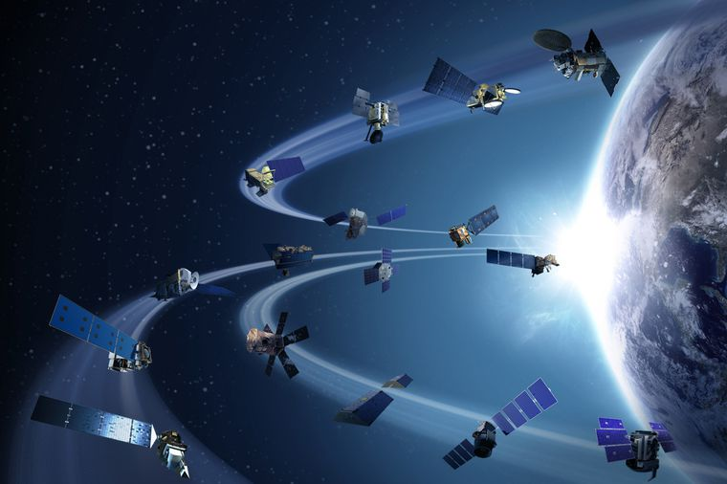
Satellite altimetry for hydraulic model calibration: potential of single and multi-mission series
Molari G.¹, Domeneghetti A.¹, Tourian M.J. ², Tarpanelli A.³, Moramarco T.³, Sneeuw N.²
¹ DICAM, University of Bologna, Bologna, Italy (giada.molari@unibo.it)
² Institute of Geodesy, University of Stuttgart, Germany
³ Research Institute for Geo-Hydrological Protection, National Research Council, Perugia, Italy

Slide 2

The limited temporal resolution (i.e. revisit time varying from 10 to 35 days) and decimeter accuracy of satellite altimetry strongly restrict their applications in hydraulic modelling.
Recently proposed multi-mission (MM) time series might represent a possible alternative to ensure higher spatial and temporal coverage.
The goal of this study is the assessment of remotely sensed water surface elevations usefulness for the calibration of a hydraulic model implemented for a 140-km stretch of the Po River (Italy). In particular this study presents:
a comparison of altimetry satellite data collected from different missions (ENVISAT (E), ENVISAT extended (EX), TOPEX/Poseidon (TP), SARAL/AltiKa (SA), Jason-2 (J2) and Jason-3 (J3);
insights to the effects of satellite series length on hydraulic model calibration;
the potential of multi-mission (MM) densified time series as possible alternative to overcome spatial and temporal limitations of single mission.

Slide 3
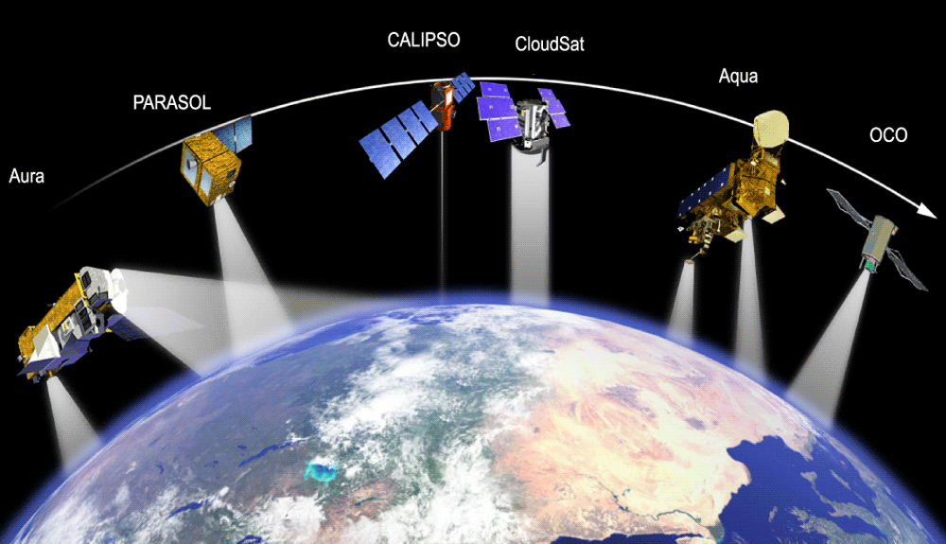
Click on one section for information
Multi-mission
Methodology
Satellite altimetry products
Results
Conclusions
Case study

Slide 4
Survey area: Po River (Italy)
The survey area is about 132-km stretch of the lower portion of the Po river, the longest Italian one. Since its economic importance, the Po river is constantly monitored from Basin Authority. River discharge and water elevations daily recorded at gauged stations are exploited for this research work.
In this river portion the river width spans among 200 and 500 meters.
Po river stretch considered in the study with the identification of gauded stations and the virtual stations (VSs) relative to the overall set of satellite mission

Slide 5
Satellite altimetry products
Temporal distribution of satellite altimetry missions used in this work
What is the satellite serie temporal resolution?

Slide 6
Satellite altimetry products
~ 10 days
~ 10 days
35 days
35 days
~ 10 days
~ 10 days

Slide 7
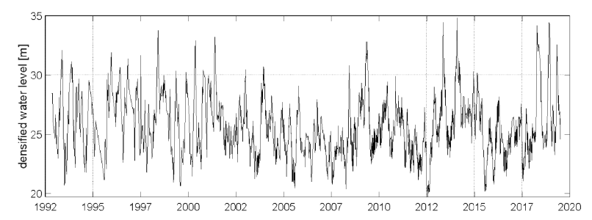
Multi-missions series
Water level time series from individual altimetry missions over the river are merged using an approach developed by Tourian et al. (2016). Adopting this solution, all VSs of different satellite altimeters along the Po River are connected to each other hydraulically and statistically.
Densified water level time series at VS J2-85
Using this methodology, we obtain a time series with 3 days effective temporal resolution from altimetry missions originally with 35- and 10-day temporal resolution.

Slide 8
Methodology
Model set up
The numerical simulations of the river stretch of interest is carried out by means of a quasi-two dimensional (quasi-2D) model implemented with the HEC-RAS code
Period of simulation
1992 - 2019
Upstream conditions
Mean daily discharge values at Borgoforte
Downstream conditions
Normal flow condtion at the beginning of the delta
Calibration technique
The calibration procedure focuses on the identification of the Manning coefficient, n (s·m^{-1/3}), of the main channel that maximizes the Nash-Sutcliffe efficiency (NS) coefficient on the observed water levels (mean daily water level), by varying it within the range 0.01-0.06 s·m^{-1/3}.

Slide 9
Methodology
Evaluation series of different lenghts
To investigate the impact of altimetry dataset length (i.e., the number of satellite overpasses available at a given VS from a specific altimeter, m) for different satellite products we repeat the calibration exercise by considering several altimetry subsets randomly sampled from the original altimetry series (i.e., E, TP, J2, etc.) with a length m that varies from 3 to 𝐿𝑡𝑜𝑡, where 𝐿𝑡𝑜𝑡 indicates the total amount of altimetric observations available for a given mission at a specific VS.
(1)
To overcome the uncertainty of the sampling procedure the calibration process is embedded in a Monte Carlo framework that generates 1000 random, samples for each m value (ℎ𝑠𝑎𝑡 series).
Finally, with the aim to infer the error introduced by the altimetry data, we repeat the same procedure by calibrating the numerical model with reference to different subsets randomly extracted from the water level values observed in situ at the VS (ℎ𝑠𝑖𝑡𝑢 series). Eq. (1) indicates the in situ series randomly extracted from the overall set.

Slide 10
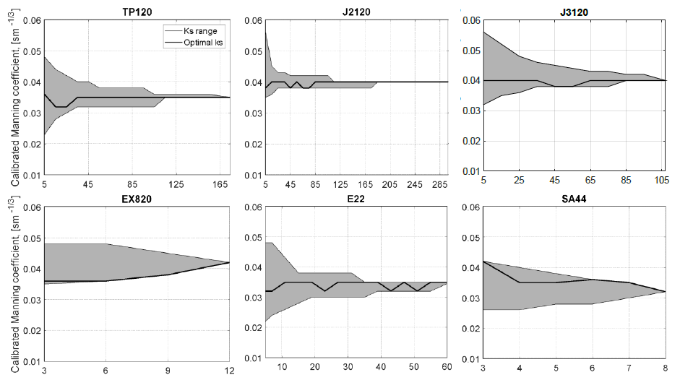
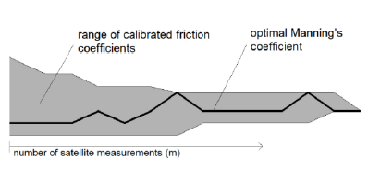
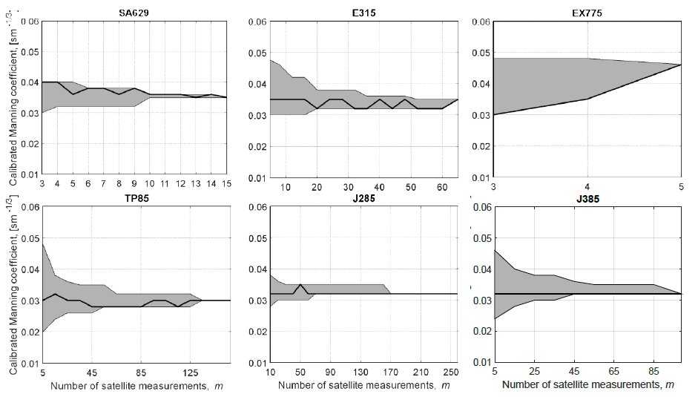
Results
Calibration results for single satellite missions
Calibration results for different altimetry series length: range of calibrated roughness coefficient (grey areas) and optimal Manning’s value (black line) as a function of the number of satellite measurements, m.

Slide 11
Results
Synoptic view of the MAE (mean absolute error) of each satellite mission in time (*ERS-2 is a recall from a previous investigation): the vertical height of each box is defined as the range of the MAE obtained from the calibration at different VSs considering 𝑚 = 𝐿𝑡𝑜𝑡.

Slide 12
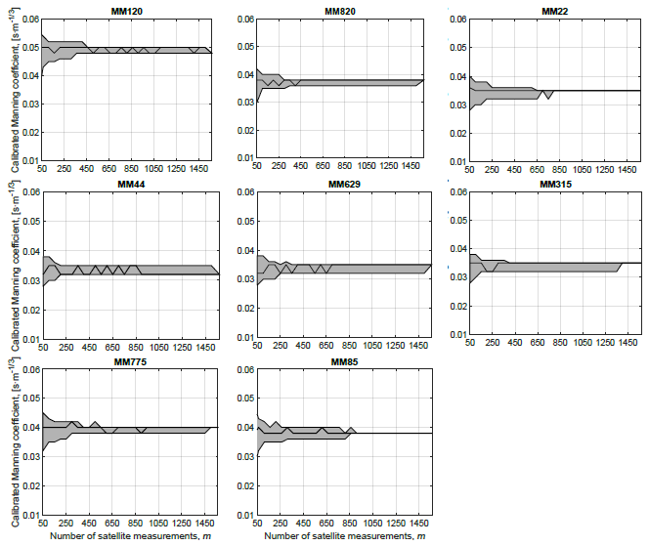
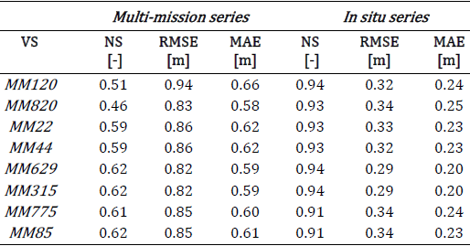
Results
Calibration results for multi missions
Table 1: Calibration results: NS, RMSE and MAE obtained from the calibration process performed adopting MM and in situ series (𝑚 = 𝐿𝑡𝑜𝑡).
Calibration results for different MM series length: range of calibrated roughness coefficient (grey areas) and optimal Manning’s value (black line) as a function of data length, m.

Slide 13
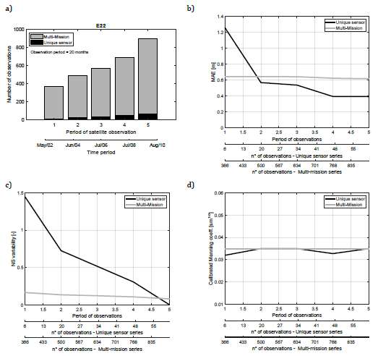
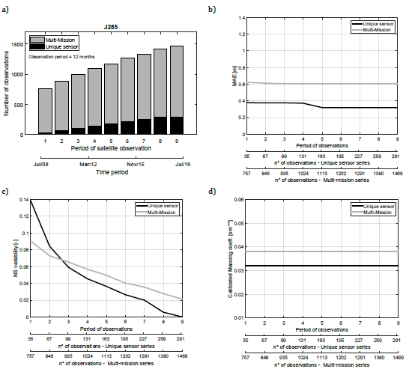
Results
Comparison of single and multi-mission series
E22
J285
MM and E22:/J285 a) number of observations depending on the observation period; b) MAE, c) NS and d) Manning’s coefficient as a function of the number of available observations for unique sensor (black line) and MM series (grey line).

Slide 14
Conclusions
This study investigates the potential of satellite altimetry sensors for hydraulic applications providing a comprehensive comparison of nowadays-available altimetry and multi-mission (MM) series (Tourian et al., 2016).
Results of the analysis highlight a general good estimation of the water levels with R² always larger than 0.6 in case of single mission. J2 series outperform all other series (mean error equal to 20 cm), followed by J3 and E. SA shows promising performances with high R² values (higher than 0.9), even though the limited extent of the available series prevents from retrieving general conclusions regarding its use. On the contrary, although the high number of observations, TP series do not ensure reliable estimation of water levels.
MM series ensure a uniform behavior along the study area (R² is nearly constant and equal to 0.80), however, their performances at a given location are always lower than those obtained considering the original altimetry series.

Slide 15
Conclusions
J2 series ensure trustworthiness and reliability on the calibration process with the lower temporal observation extent: lower than 1 year of data (̴ 30 observations), followed by J3 and E that reach the same reliability after 1.5, 1.6 and 3.5 years, respectively (i.e., 50, 60 and 35 observations, respectively).
The use of MM series for model calibration has provided errors higher than those obtained using original satellite series in case of considering their overall length: additional errors are equal to 0.5 m and 0.36 m in terms of Δ-RMSE and Δ-MAE, respectively.
MM series are able to ensure calibrations more reliable than those obtained in case of altimetry series provided by low frequency satellites (i.e., E, SA) that cover very short period (e.g. 1÷2 observation period; 20-40 months). In these conditions, MM series offer calibration performances (i.e., reliable estimation of the friction coefficient and lower uncertainty) higher than those ensured by original series. However, if satellite sensors with higher temporal observation frequency are available (i.e., J2 and J3), the use of original series, even though limited in terms of observations, appears the best option.

