Slide 1



Unrest episodes at Alcedo and Cerro Azul (Galápagos) revealed by InSAR data
and geodetic modelling
Federico Galetto
Co-authors:
Dr. Marco Bagnardi (NASA, MD, USA)
Prof. A. Hooper (Univ. Leeds, UK)

Slide 2
  Aim of the work: understanding unrest at Galápagos calderas
Western Galápagos (Ecuador)
Alcedo
Cerro Azul
Studied calderas:
a) Alcedo: non-eruptive unrest (2007-2011)
b) Cerro Azul: eruptive unrest (2007-2011)

Slide 3
Alcedo results
Jan. 2007 –Jan. 2010
Jan. 2010 – Jun. 2010
Jun. 2010 – Mar. 2011
lateral migration
Non-eruptive unrest for the lack of magma replenishment
Replenishment of the magma reservoir (sill)

Slide 4
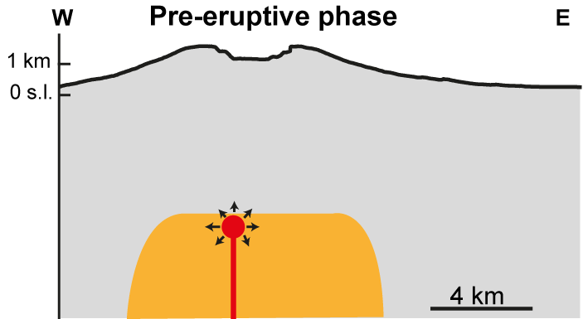
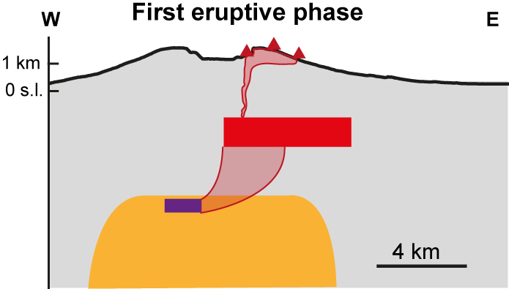
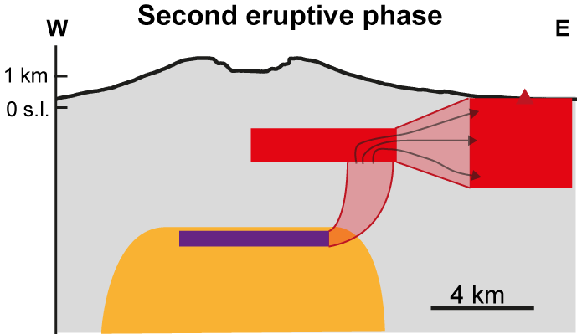
Cerro Azul results
(Oct 2007 – Apr 2008)
(29-31 May 2008)
Two eruptive phases related to the propagation of a radial dike
Dike propagation substained by an increase in magma feeding rates
(1-11 Jun 2008)

Slide 5
Conclusions
Alcedo
1) Non-eruptive unrest due to interrupted magma supply (aborted lateral intrusion)
2) Short term deformation expression of incremental growth of longer term resurgence
Cerro Azul
3) New method for geodetic inversion based on the wrapped phase difference among nearby coherent pixels
4) The two eruptive phases related to the propagation of a radial dike

Slide 6
Thank you for your attention
Galetto, F., Bagnardi, M., Acocella, V., & Hooper, A. (2019) Noneruptive Unrest at the Caldera of Alcedo Volcano (Galápagos Islands) Revealed by InSAR Data and Geodetic Modeling. Journal of Geophysical Research: Solid Earth, 124, 3365-3381. https://doi.org/10.1029/2018JB017103
Galetto, F., Hooper, A, Bagnardi, M., & Acocella, V. (2020)
The 2008 Eruptive Unrest at Cerro Azul Volcano (Galápagos) Revealed by InSAR Data and a Novel Method for Geodetic Modelling”. Journal of Geophysical Research: Solid Earth, 125, https://doi.org/10.1029/2019JB018521

Slide 7
Appendix

Slide 8
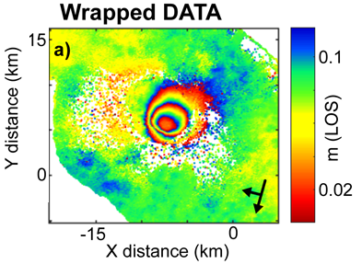
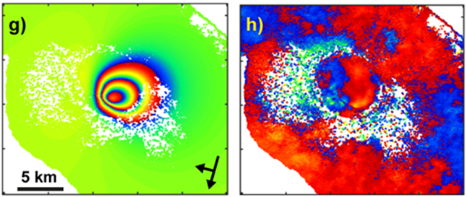
Methods
Ground deformation: a constant feature of Galápagos unrest
a) InSAR
Remote sensing technique providing ground displacement through the combination of radar images (468 interferograms generated)
b) Geodetic modelling
InSAR data inverted for possible magmatic sources responsible for the deformation (GBIS software; Bayesian approach)
InSAR Data
Model
Residuals

Slide 9
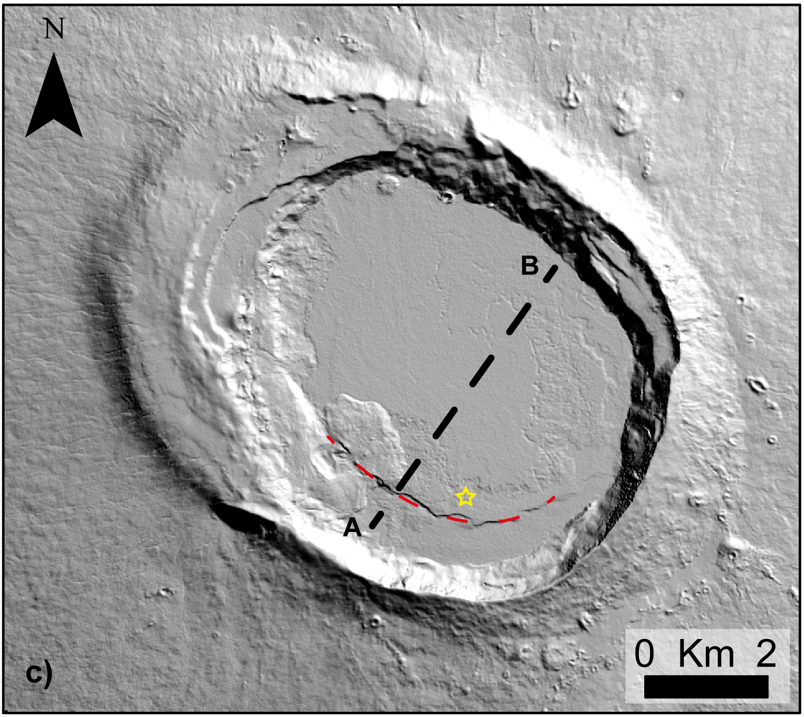
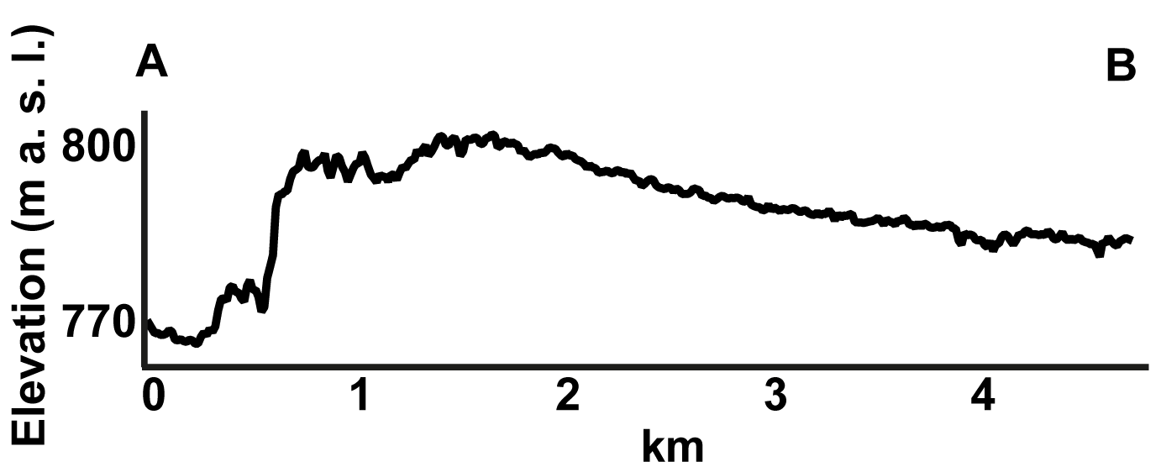
Alcedo
Inner ring fault and trapdoor uplift of the S caldera floor. Dying phase.
Unusual behaviour with repeated non-eruptive unrest.
Uplift >90 cm (1992-1997), subsidence <11 cm (1997-2001)
Minor resurgence

Slide 10
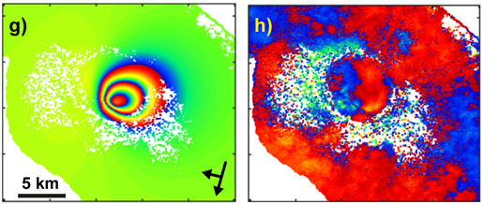
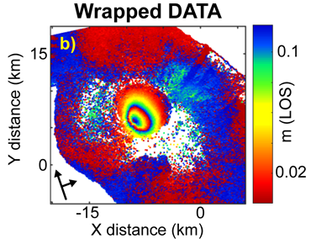
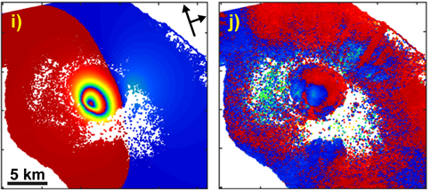
Alcedo
First event (January 2007 – January 2010): Outward dipping fault + sill
Sill
Fault

Slide 11
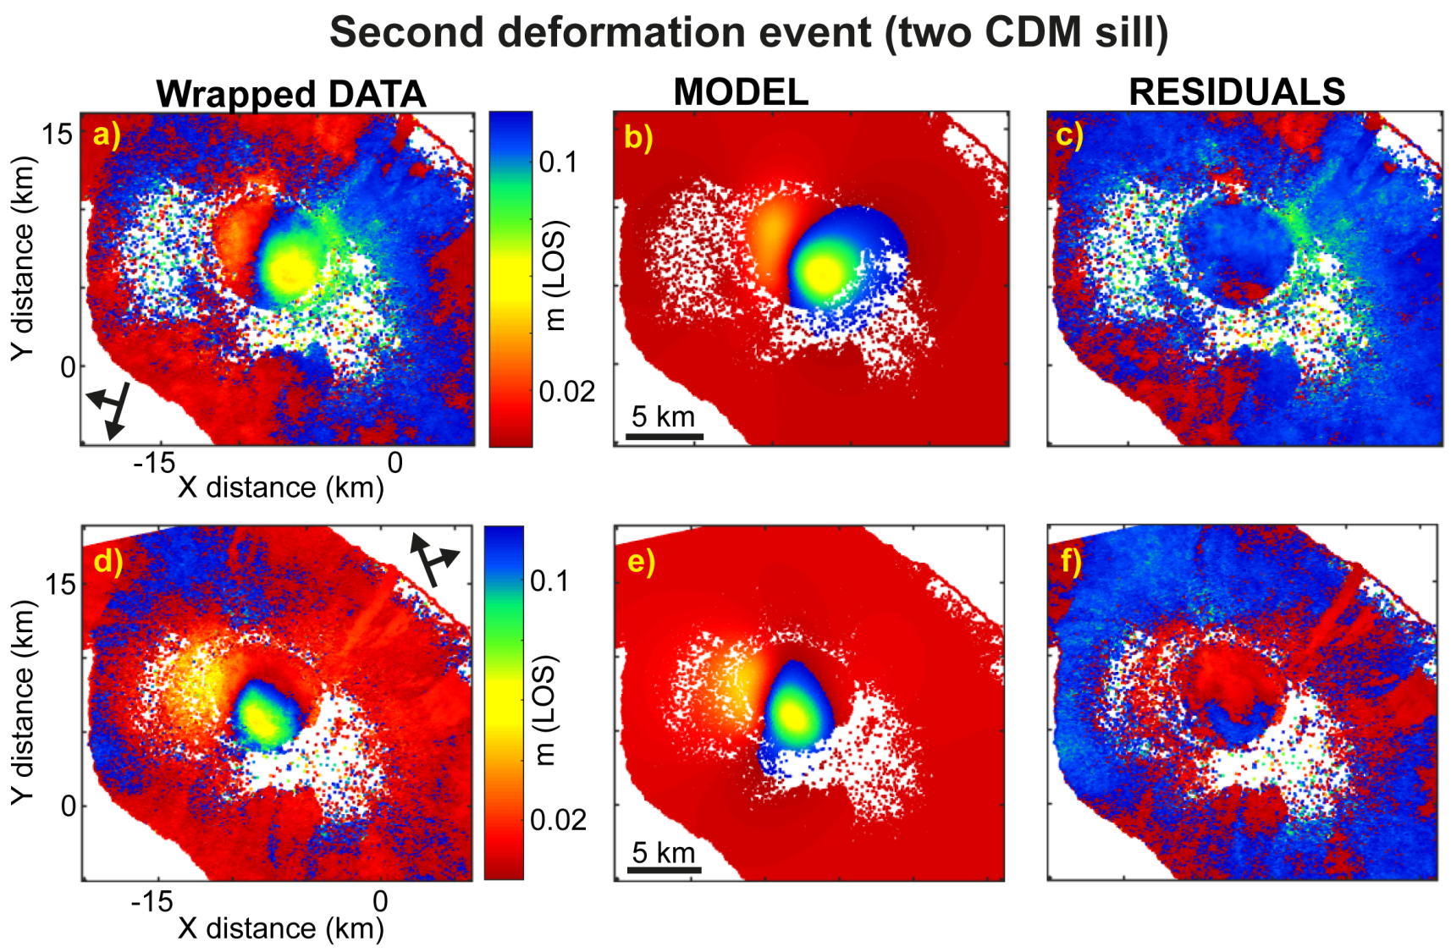
Alcedo
Second event (January 2010 – June 2010) Deflation of previously inflated sill and emplacement of new outer sill
Sill
Deflating sill
ΔV=-3.8±1.5 x10⁻³ km³
Rate=-7±3 x10⁻³ km³/yr
Inflating sill
ΔV=3.15±1.45x10⁻³ km³
Rate= 6±3x10⁻³ km³/yr

Slide 12
Alcedo
Third event (June 2010 – March 2011): New caldera inflation
Sill source
Rates=5.85±2.75x10⁻³ km³/yr

Slide 13
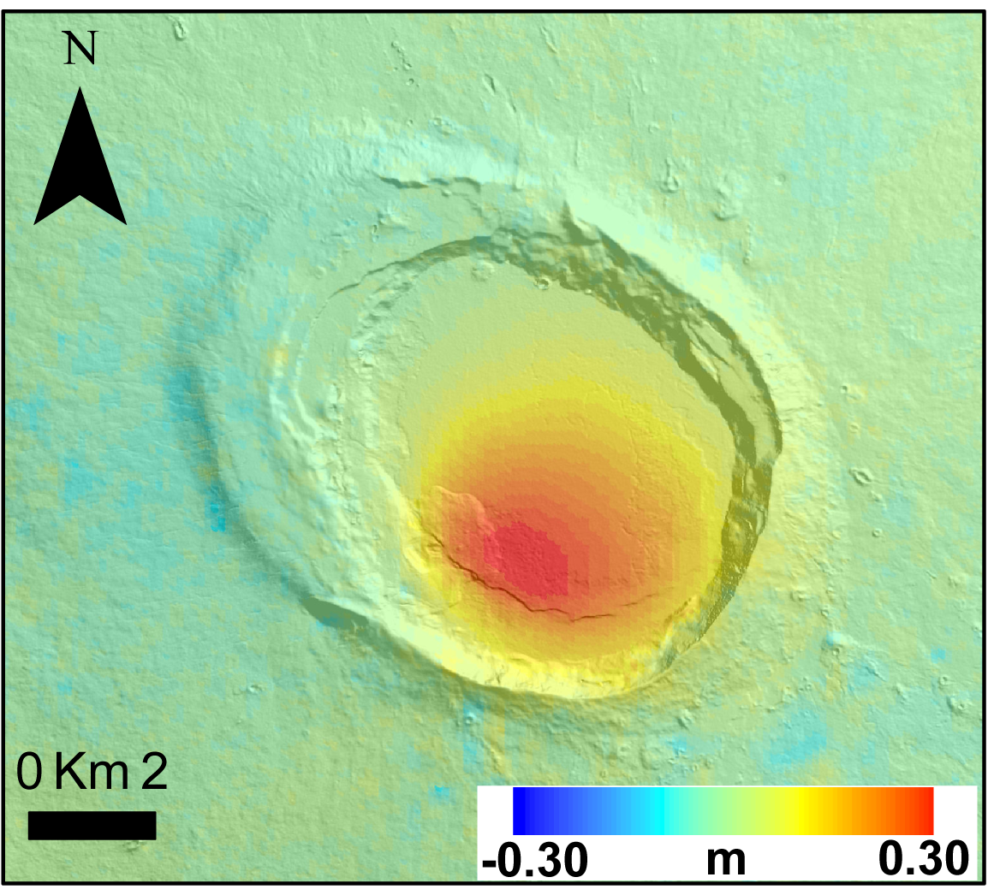
Alcedo discussion
1) Short-term deformations match in location with the longer-term (resurgence):
2) Resurgence is incremental and
not necessarily due to a continuous
uplift.
Vertical deformation
B
Topographic profile
A
Minor resurgence

Slide 14
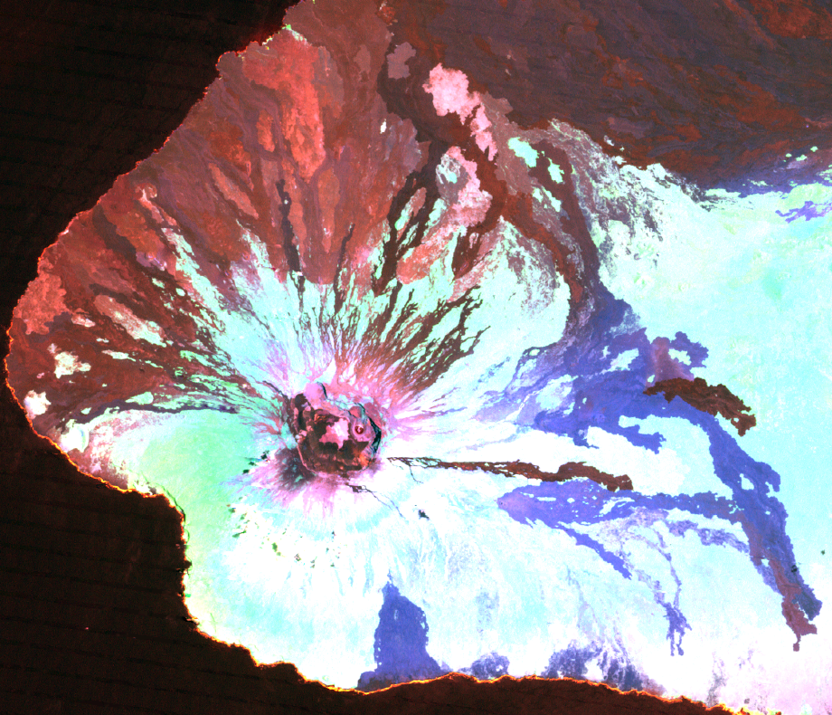
Cerro Azul
Eruption
May, 29th – June, 11th 2008
N
Landsat 7 (from USGS). False colours
R G B
Bands 2 4 5
Cerro Azul
6 km
Eruptive fissure

Slide 15
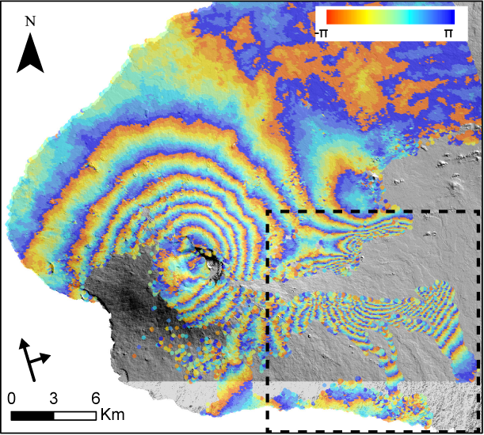
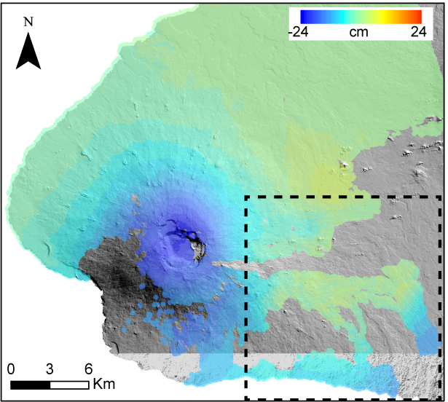
Unwrapping errors
Phase unwrapping allows passing from phase to displacement
Wrapped data
Unwrapped data
Many fringes (corresponding to ~60 cm LOS displacements)
No deformation (unwrapping errors)
Not possible to invert these data with GBIS

Slide 16
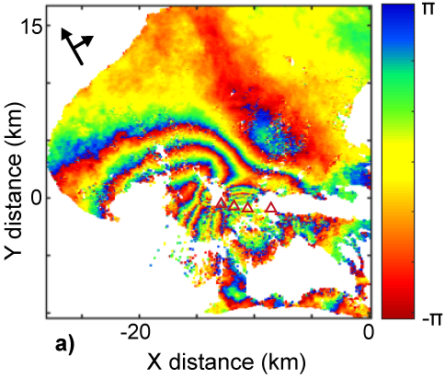
New method to face unwrapping errors
Method to invert the wrapped phase data directly, based on the wrapped phase differences among nearby coherent pixels
Method implemented in a new software written in Matlab (see Galetto et al., 2020 https://doi.org/10.1029/2019JB018521)
Software tested on synthetic data

Slide 17
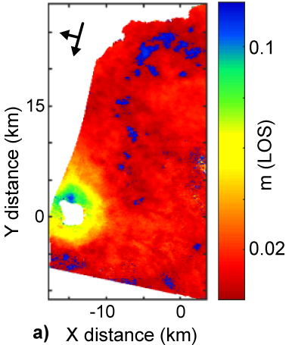
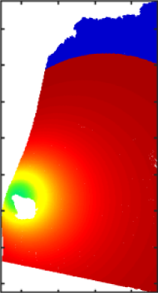
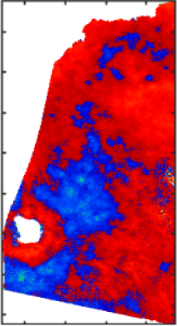
Cerro Azul: pre-eruptive inflation (Oct 2007 – Apr 2008)
Wrapped data
Model
Residuals
ΔV= 12.6±3.7 x10⁻³ km³
Rate=2.5±0.7 x10⁻² km³/yr.

Slide 18
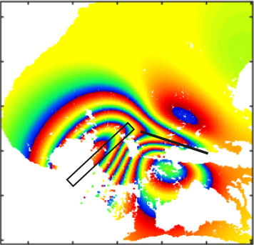
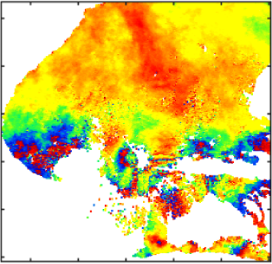
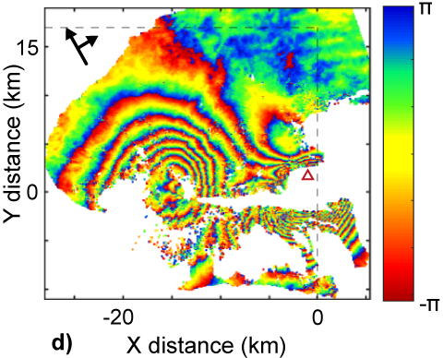
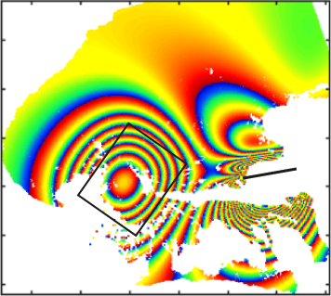
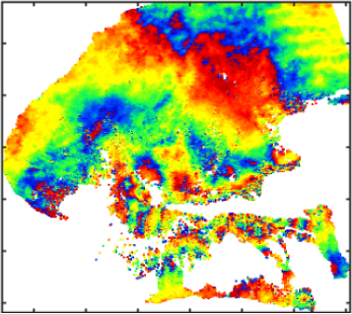
Cerro Azul: syn-eruption deformation
First eruptive phase (29-31 May 2008)
Wrapped data
Model
Residuals
ΔV(sill)= -11.2±0.6 x10⁻³ km³
ΔV(dike)= 9.9±0.5 x10⁻³ km³
Eruptive fissure
Second eruptive phase (1-11 June 2008)
ΔV(sill)=-25±2.2 x10⁻³ km³
ΔV(dike)=57.4±2.6 x10⁻³ km³

Slide 19
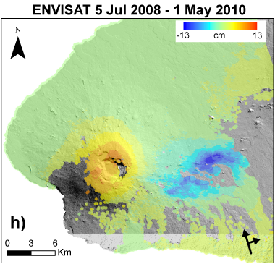
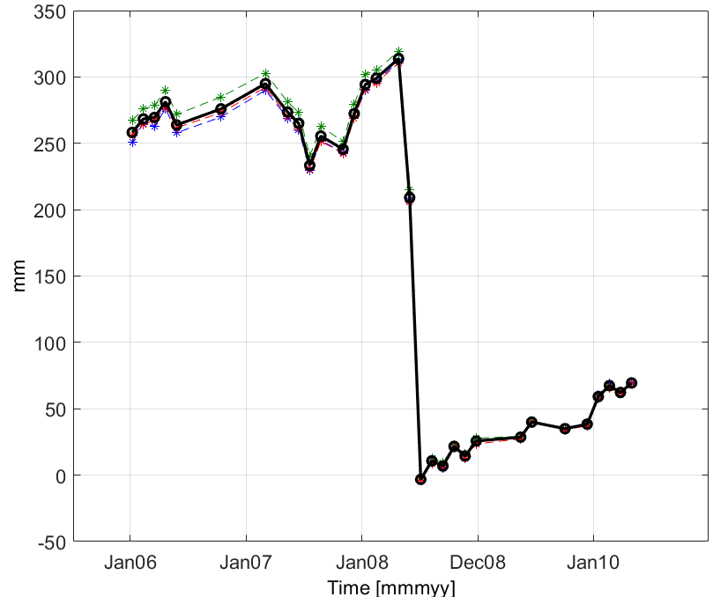
Post-eruption (July 2008 – 2010/2011)
ENVISAT (ascending)
Caldera uplift resumes

