Slide 1
Repurposing Britain’s Coal Measures
Louis Howell1*, Stuart Egan1, Bernard Besly1, Graham Leslie2, and Surika Sooriyathasan1
*l.p.Howell@keele.ac.uk
1 School of Geography Geography and the Environment, Keele University, Staffordshire, UK
2 British Geological Survey, Edinburgh, United Kingdom

Slide 2
What do we actually know about Carboniferous basins?
Where’s Scotland!?
Steer’s head
geometry
Leeder, 1982
‘Block and basin’
style rift architecture
Notes:
A schematic illustration of the Carboniferous basins of the UK (Leeder, 1982). As part of my PhD, I have been challenging some of the long-held misconceptions surrounding these basins…

Slide 3
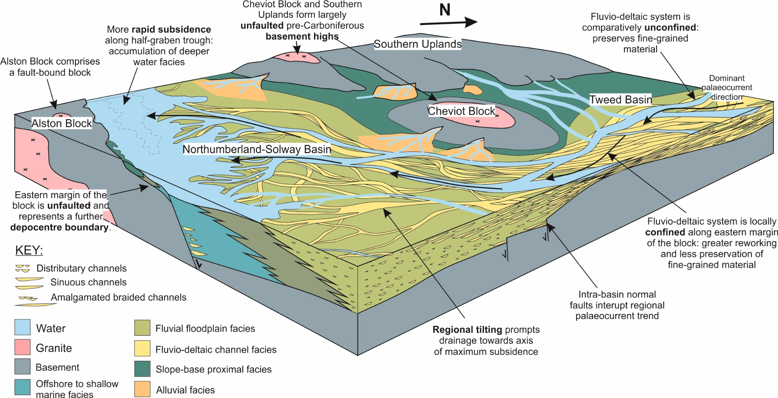
‘Block and basin’ style rift basin sedimentation
Fell Sandstone Fm., northern Pennine Basin
Notes:
Using a combined numerical modelling and seismic, borehole and field-based mapping approach, we have been investigating the influences of buoyant granite intrusions and flexural isostasy on the northern Pennine rift basin.
https://doi.org/10.1016/j.tecto.2019.02.008
10.31223/osf.io/yjxgn

Slide 4
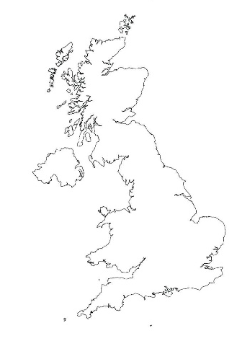
A
Post-rift thermal subsidence??
A McKenzian ‘thermal sag’ model for the late Carboniferous would anticipate exponentially decaying rates of subsidence.
B
In reality, subsidence rates increase.
A
B
Notes:
There is a widespread consensus that Carboniferous rift basins subsided due to thermal contraction during the late Carboniferous. We are beginning to challenge this misconception.
Burial history curves constructed throughout the Northwestern European Carboniferous Basin suggest subsidence trends more typical of foreland basin systems…

Slide 5
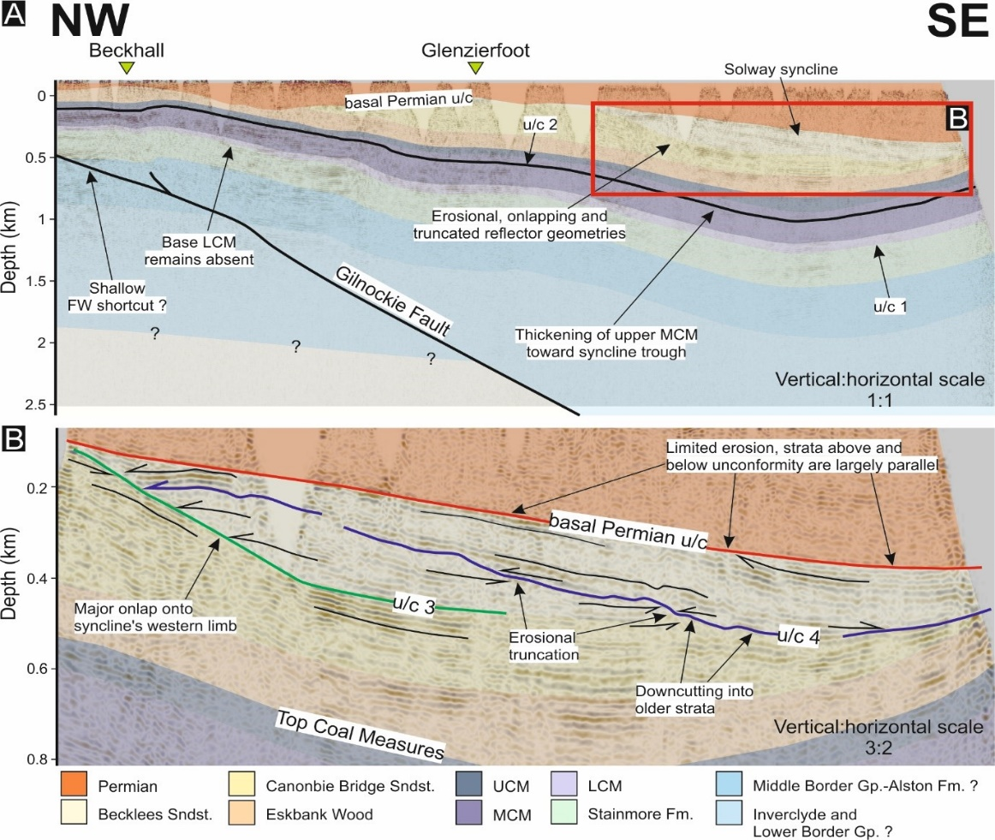
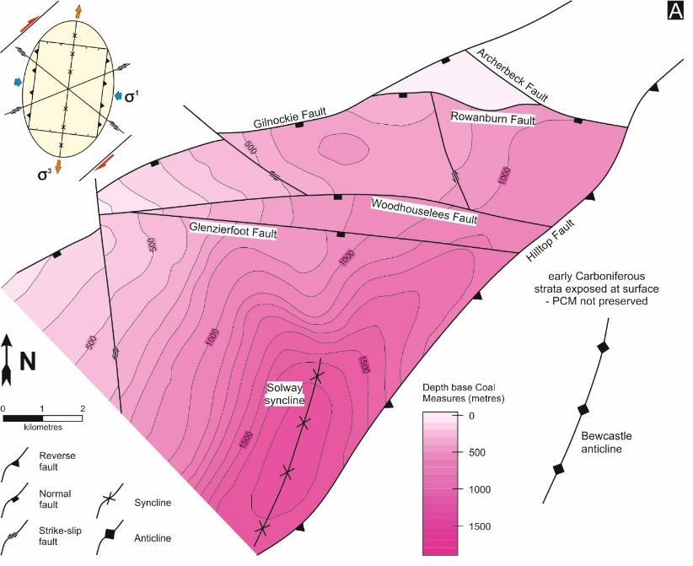
The Canonbie Coalfield
Here
NW
SE
Notes:
…local seismic and borehole-based mapping of the Canonbie Coalfield, SW Scotland, suggests that fault reactivation had begun to dictate the nature of local depocentres as early as the Westphalian B.

Slide 6
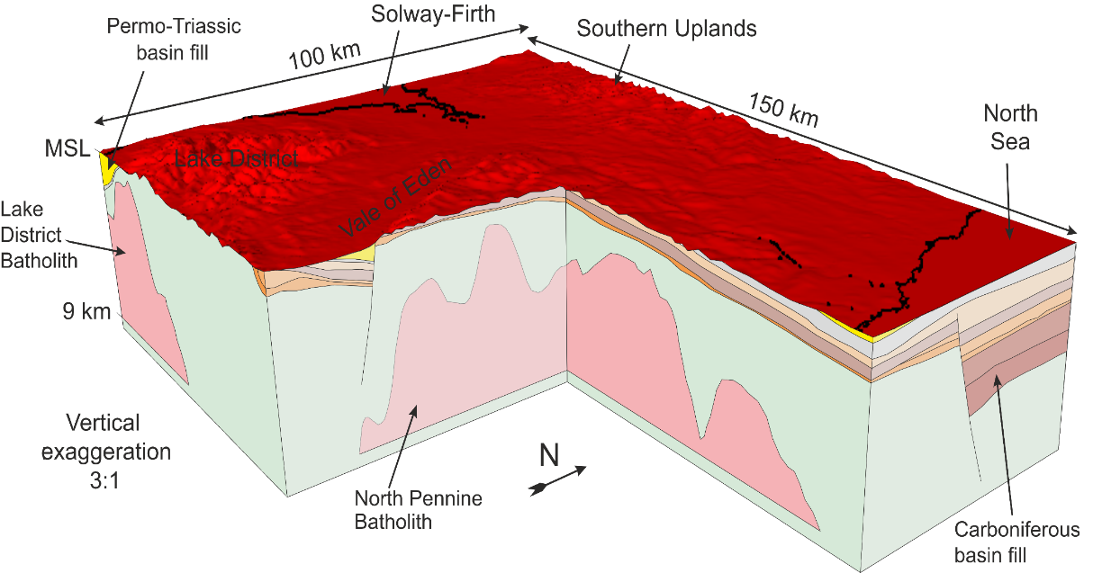
Understanding the subsurface
Notes:
In an attempt to place some of our findings within the contexts of 21st century problems, we have been developing a predictive finite difference 3D deep geothermal modelling methodology and applying it to the northern Pennine Basin of northern England.

Slide 7
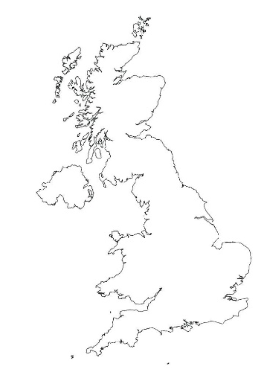
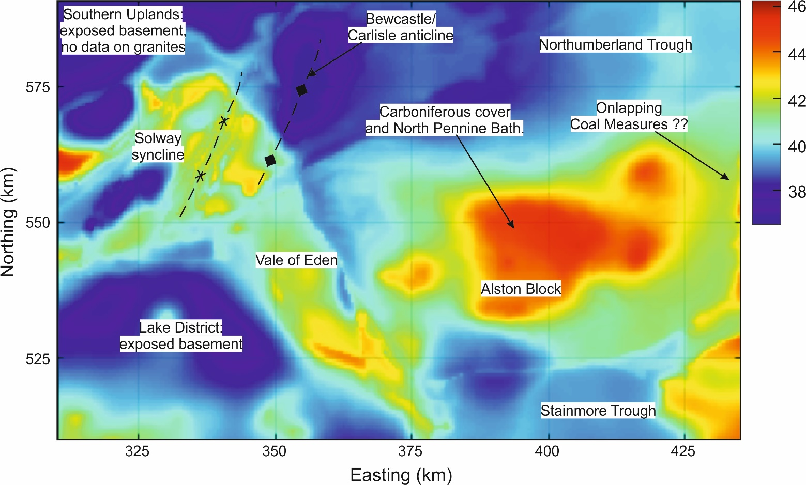
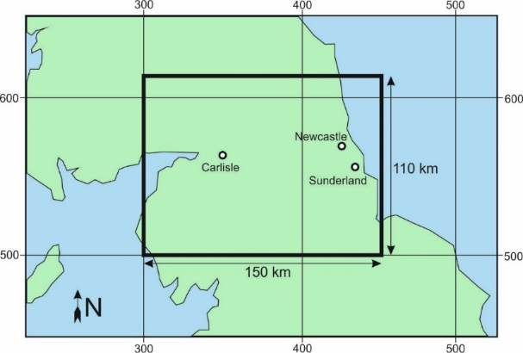
Deep geothermal potential in Carboniferous basins
Modelled temperature at 1 km depth
Notes:
Results generated from predictive 3D temperature model. Predicted subsurface temperature maps are of more resolute and accurate relative to typical resource maps for UK geothermal that are constructed by contouring around sparsely distributed and often unreliable data points.

