Slide 1




Hysteresis of tropical forests in the 21st century
Arie Staal, Ingo Fetzer, Lan Wang-Erlandsson, Joyce H.C. Bosmans, Stefan C. Dekker,
Egbert H. van Nes, Johan Rockström & Obbe A. Tuinenburg
Methods
Results
Local forest-cover hysteresis
Tropical forest stability
Introduction
Quantifying forest evapotranspiration
Climate change scenario
Conclusions
Atmospheric moisture tracking
Forest hysteresis effects on rainfall
© Authors. All rights reserved.
Click on the red buttons to move directly to specific sections. Click on the top banner to return to the start.
Click on the red arrows on the following slides to move to the next or previous slide. Click on the bottom banner for affiliations and contact information.
era
Earth Resilience
in the Anthropocene

Slide 2
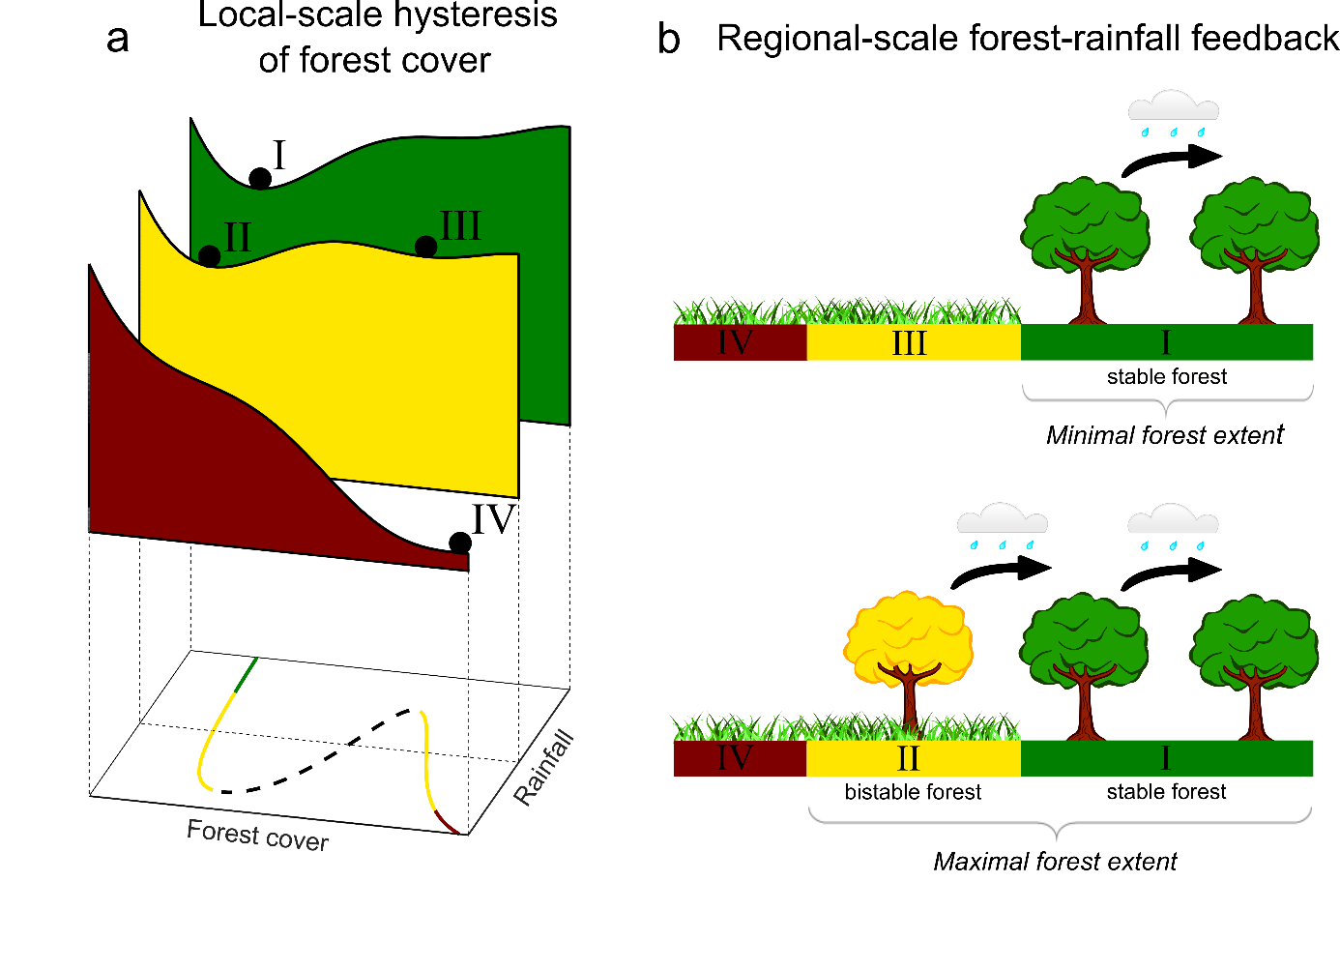
Hysteresis of tropical forests in the 21st century
Arie Staal, Ingo Fetzer, Lan Wang-Erlandsson, Joyce H.C. Bosmans, Stefan C. Dekker,
Egbert H. van Nes, Johan Rockström & Obbe A. Tuinenburg
Introduction
Tropical forests modify the conditions they depend on through feedbacks on different spatial scales. These feedbacks shape the hysteresis (history-dependence) of tropical forests, thus controlling their resilience to deforestation and response to climate change. Here we determine the emergent hysteresis from local-scale tipping points and regional-scale forest-rainfall feedbacks across the tropics under the recent climate and a severe climate-change scenario.
Local-scale hysteresis of forest cover and its interaction with the regional forest-rainfall feedback. a) A stability landscape of forest cover against rainfall levels. At high rainfall levels, high forest cover is uni-stable or “stable” (I; green). At intermediate rainfall levels, high forest cover (II) and low forest cover (III; nonforest) are bistable states (yellow). At low rainfall levels, only the nonforested state can exist (IV; red). b) The regional forest-rainfall feedback amplifies hysteresis.
era
Earth Resilience
in the Anthropocene

Slide 3
Hysteresis of tropical forests in the 21st century
Arie Staal, Ingo Fetzer, Lan Wang-Erlandsson, Joyce H.C. Bosmans, Stefan C. Dekker,
Egbert H. van Nes, Johan Rockström & Obbe A. Tuinenburg
Introduction
On a local scale (~1 km), the distribution of forest cover is distinctly bimodal. This bimodality is understood as a result of locally acting feedback processes that can generate alternative stable states. In case of such bistability, disturbances can make the system tip. Crucially, part of the distribution of tropical forest on the planet cannot simply be determined based on the present climate. Instead, past forest extent affects current extent; in other words, the system exhibits hysteresis.
Local-scale hysteresis of forest cover and its interaction with the regional forest-rainfall feedback. a) A stability landscape of forest cover against rainfall levels. At high rainfall levels, high forest cover is uni-stable or “stable” (I; green). At intermediate rainfall levels, high forest cover (II) and low forest cover (III; nonforest) are bistable states (yellow). At low rainfall levels, only the nonforested state can exist (IV; red). b) The regional forest-rainfall feedback amplifies hysteresis.
era
Earth Resilience
in the Anthropocene

Slide 4
Hysteresis of tropical forests in the 21st century
Arie Staal, Ingo Fetzer, Lan Wang-Erlandsson, Joyce H.C. Bosmans, Stefan C. Dekker,
Egbert H. van Nes, Johan Rockström & Obbe A. Tuinenburg
Introduction
On a regional scale (100−1000 km), tropical forests enhance rainfall. When trees photosynthesize, they extract soil moisture or groundwater and release it to the atmosphere. In this way, trees can maintain photosynthesis. This resulting increase in evapotranspiration can enhance rainfall over large areas, especially since water can re-evaporate and rain down multiple times. This forest-rainfall feedback is a self-stabilizing mechanism that elevates regional rainfall levels and reinforces the hysteresis of tropical forests.
Local-scale hysteresis of forest cover and its interaction with the regional forest-rainfall feedback. a) A stability landscape of forest cover against rainfall levels. At high rainfall levels, high forest cover is uni-stable or “stable” (I; green). At intermediate rainfall levels, high forest cover (II) and low forest cover (III; nonforest) are bistable states (yellow). At low rainfall levels, only the nonforested state can exist (IV; red). b) The regional forest-rainfall feedback amplifies hysteresis.
era
Earth Resilience
in the Anthropocene

Slide 5
Hysteresis of tropical forests in the 21st century
Arie Staal, Ingo Fetzer, Lan Wang-Erlandsson, Joyce H.C. Bosmans, Stefan C. Dekker,
Egbert H. van Nes, Johan Rockström & Obbe A. Tuinenburg
Introduction
Here we report the range of possible stable configurations of tropical forest under recent (2003−2014) and projected end-of-century (2071−2100) climatic conditions, based on 1) remote-sensing-based estimates of local hysteresis as delimited by local-scale tipping points, 2) high-resolution hydrological and atmospheric moisture tracking simulations, and 3) rainfall projections from the SSP5-8.5 scenario in CMIP6 model runs. We thus map the range of possible forest distributions now and under severe climate change.
Local-scale hysteresis of forest cover and its interaction with the regional forest-rainfall feedback. a) A stability landscape of forest cover against rainfall levels. At high rainfall levels, high forest cover is uni-stable or “stable” (I; green). At intermediate rainfall levels, high forest cover (II) and low forest cover (III; nonforest) are bistable states (yellow). At low rainfall levels, only the nonforested state can exist (IV; red). b) The regional forest-rainfall feedback amplifies hysteresis.
era
Earth Resilience
in the Anthropocene

Slide 6
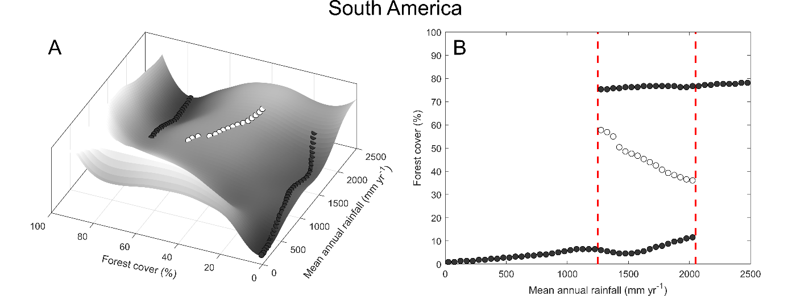
Hysteresis of tropical forests in the 21st century
Arie Staal, Ingo Fetzer, Lan Wang-Erlandsson, Joyce H.C. Bosmans, Stefan C. Dekker,
Egbert H. van Nes, Johan Rockström & Obbe A. Tuinenburg
Local-scale forest hysteresis
Local-scale tipping points for forest cover were determined using tree cover data following Hirota et al. (2011). An empirical stability landscape is constructed based on spatial distributions of tree cover against mean annual rainfall for each continent separately: South America, Africa, and Australasia. We used Landsat tree cover data for 2000 on 30 m resolution and masked out human-used areas, water bodies and bare ground.
Empirically derived bifurcation pattern for forest cover against mean annual rainfall in South America. A) Three-dimensional stability landscape, in which the depth qualitatively represents the potential energy of the state as inferred from forest cover data on 30 m resolution across the continent. Solid dots correspond to significant valleys and represent stable states, and open dots correspond to significant peaks and represent unstable states. B) Two-dimensional bifurcation plot, in which the red lines demarcate the bistability range between 1250−2050 mm yr⁻¹ at which forest and nonforest, a savanna-like state of low forest cover, are considered alternative stable states.
era
Earth Resilience
in the Anthropocene

Slide 7
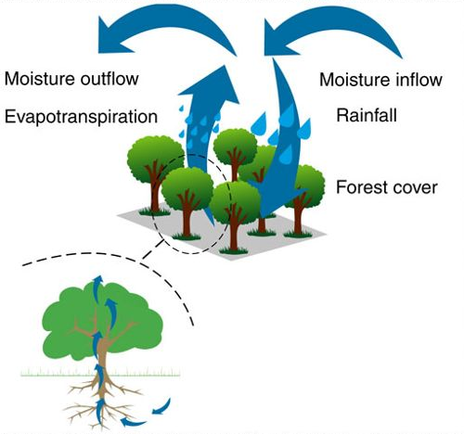
Hysteresis of tropical forests in the 21st century
Arie Staal, Ingo Fetzer, Lan Wang-Erlandsson, Joyce H.C. Bosmans, Stefan C. Dekker,
Egbert H. van Nes, Johan Rockström & Obbe A. Tuinenburg
Quantifying forest evapotranspiration
We performed spatially and temporally explicit calculations of the contribution of forest cover to evapotranspiration by means of transpiration and interception evaporation. We applied the PCRaster Global Water Balance hydrological model (PCR-GLOBWB) at 0.5° resolution. PCR-GLOBWB is a hydrological and water resources model that computes the vertical water balance in two soil layers and a groundwater layer. Our study period is 2003‒2014. See Staal et al. 2018 for details.
Trees access groundwater in deep soil layers and release it to the atmosphere by transpiration. This moisture can precipitate and evaporate repeatedly over forests, promoting forest growth in a cascading way. Figure taken from Zemp et al. (2017).
era
Earth Resilience
in the Anthropocene

Slide 8
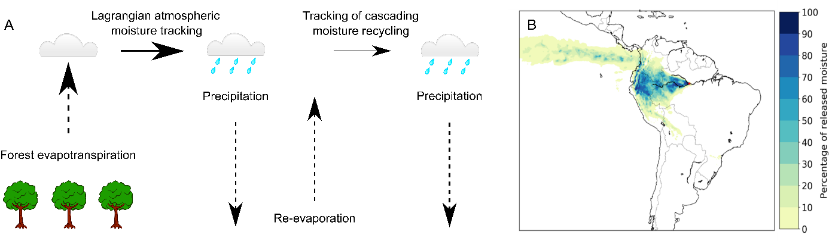
Hysteresis of tropical forests in the 21st century
Arie Staal, Ingo Fetzer, Lan Wang-Erlandsson, Joyce H.C. Bosmans, Stefan C. Dekker,
Egbert H. van Nes, Johan Rockström & Obbe A. Tuinenburg
Atmospheric moisture tracking
We determined where the moisture from enhanced evapotranspiration precipitates again by using atmospheric moisture tracking. We used a Lagrangian method of moisture tracking that track parcels of evaporated moisture through the atmosphere to their subsequent precipitation location. The trajectories were forced with the three-dimensional ERA5 reanalysis estimates of wind speed and direction. For more information, see Tuinenburg & Staal (in press).
From forest evapotranspiration to precipitation. A) Forest evapotranspiration is estimated using the PCR-GLOBWB model and then tracked through the atmosphere, accounting for multiple precipitation-evaporation cycles (“cascading moisture recycling”). B) The distribution of precipitation from evaporation in Manaus for one arbitrary month, simulated with the Lagrangian moisture tracking model by Tuinenburg & Staal (in press), in cumulative percentile of precipitation.
era
Earth Resilience
in the Anthropocene

Slide 9
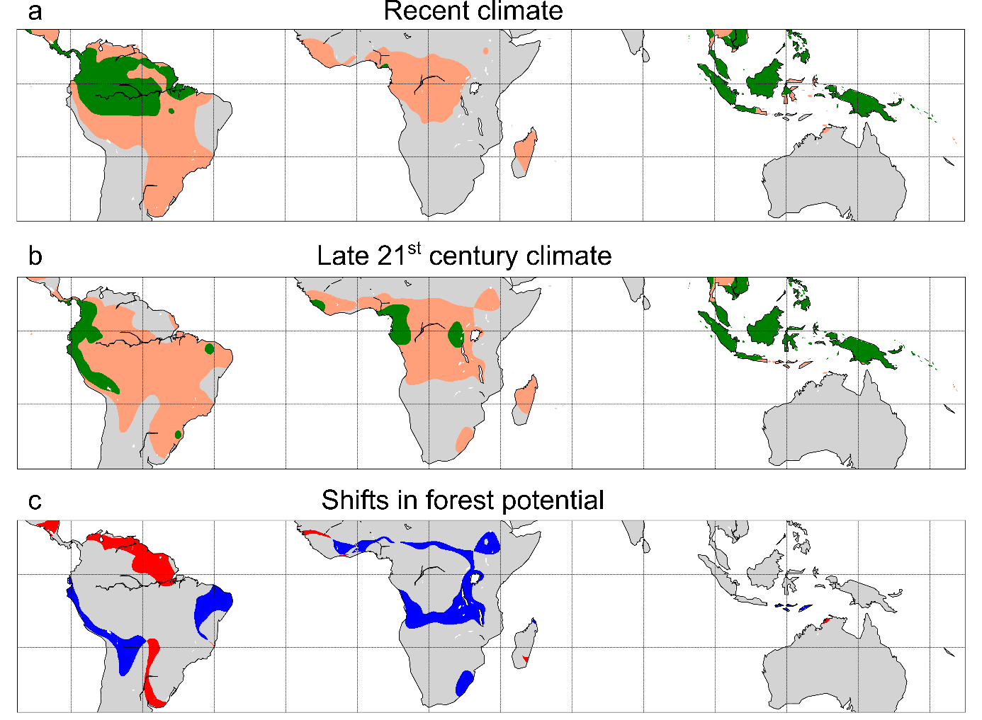
Hysteresis of tropical forests in the 21st century
Arie Staal, Ingo Fetzer, Lan Wang-Erlandsson, Joyce H.C. Bosmans, Stefan C. Dekker,
Egbert H. van Nes, Johan Rockström & Obbe A. Tuinenburg
Tropical forest stability
First, we simulated rainfall with forest cover removed and determine the minimal extent of forest cover under these conditions. We iterated this procedure where rainfall levels and forest distributions were updated depending on the forest-rainfall interactions. A minimum of 4.83 million km² of Amazon forest (60% of present extent) eventually recovered after complete deforestation. In Africa, only 22,000 km² of forest recovered (1% of present extent). In Australasia, 3.87 million km² forest area recovered (157% of present extent).
Changing hysteresis of forest cover in the tropics during the 21st century. A) Minimal (green) and maximal (beige) forest distributions under recent climate (2003−2014). B) Minimal (green) and maximal (beige) forest distributions under the late 21st century climate (2071−2100). C) Shifts in forest potential between the recent and late 21st century climates. Red areas are stable forest under the recent climate, but cross the tipping point into the nonforested rainfall range under the late 21st century climate; blue areas are too dry for forest under the recent climate, but cross the tipping point to the stable-forest rainfall range under the late 21st century climate.
era
Earth Resilience
in the Anthropocene

Slide 10
Hysteresis of tropical forests in the 21st century
Arie Staal, Ingo Fetzer, Lan Wang-Erlandsson, Joyce H.C. Bosmans, Stefan C. Dekker,
Egbert H. van Nes, Johan Rockström & Obbe A. Tuinenburg
Tropical forest stability
Next, we simulated rainfall in case of full forest cover and determine the maximal extent of forest cover. In this experiment, forest-induced moisture recycling caused rainfall levels to be higher than they are in reality. We thus estimate that up to 12.26 million km² of forest can exist in tropical South America (156% of present extent). In Africa, forest area stabilized at 5.35 million km² (140% of present extent). In Australasia, forest area stabilized at 4.57 million km² (185% of present extent).
Changing hysteresis of forest cover in the tropics during the 21st century. A) Minimal (green) and maximal (beige) forest distributions under recent climate (2003−2014). B) Minimal (green) and maximal (beige) forest distributions under the late 21st century climate (2071−2100). C) Shifts in forest potential between the recent and late 21st century climates. Red areas are stable forest under the recent climate, but cross the tipping point into the nonforested rainfall range under the late 21st century climate; blue areas are too dry for forest under the recent climate, but cross the tipping point to the stable-forest rainfall range under the late 21st century climate.
era
Earth Resilience
in the Anthropocene

Slide 11
Hysteresis of tropical forests in the 21st century
Arie Staal, Ingo Fetzer, Lan Wang-Erlandsson, Joyce H.C. Bosmans, Stefan C. Dekker,
Egbert H. van Nes, Johan Rockström & Obbe A. Tuinenburg
Climate change scenario
We use rainfall projections under climate change to assess how the stability of tropical forests may change by the end of the century. We take the mean annual rainfall from the severe SSP5-8.5 scenario in seven CMIP6 model runs for the late 21st century (2071‒2100). We find that global climate change will affect the hysteresis of tropical forests by the end of the 21st century.
Changing hysteresis of forest cover in the tropics during the 21st century. A) Minimal (green) and maximal (beige) forest distributions under recent climate (2003−2014). B) Minimal (green) and maximal (beige) forest distributions under the late 21st century climate (2071−2100). C) Shifts in forest potential between the recent and late 21st century climates. Red areas are stable forest under the recent climate, but cross the tipping point into the nonforested rainfall range under the late 21st century climate; blue areas are too dry for forest under the recent climate, but cross the tipping point to the stable-forest rainfall range under the late 21st century climate.
era
Earth Resilience
in the Anthropocene

Slide 12
Hysteresis of tropical forests in the 21st century
Arie Staal, Ingo Fetzer, Lan Wang-Erlandsson, Joyce H.C. Bosmans, Stefan C. Dekker,
Egbert H. van Nes, Johan Rockström & Obbe A. Tuinenburg
Climate change scenario
We find a large reduction of 66% to 1.66 million km² in minimal forest area for South America. The maximal forest area decreases by much less, namely by 4% to 12.15 million km². For Africa, the minimal forest area increases by three orders of magnitude to 1.15 million km², and the maximal forest area by 54% to 8.26 million km². For Australasia, we find an increase of 9% in minimal forest to 4.24 million km², and an increase of 3% in maximal forest area to 4.72 million km².
Changing hysteresis of forest cover in the tropics during the 21st century. A) Minimal (green) and maximal (beige) forest distributions under recent climate (2003−2014). B) Minimal (green) and maximal (beige) forest distributions under the late 21st century climate (2071−2100). C) Shifts in forest potential between the recent and late 21st century climates. Red areas are stable forest under the recent climate, but cross the tipping point into the nonforested rainfall range under the late 21st century climate; blue areas are too dry for forest under the recent climate, but cross the tipping point to the stable-forest rainfall range under the late 21st century climate.
era
Earth Resilience
in the Anthropocene

Slide 13
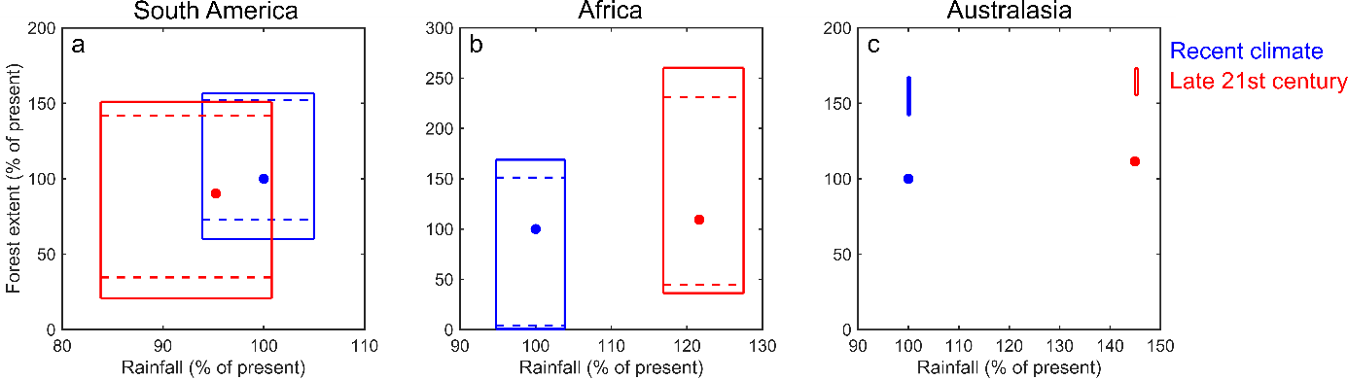
Hysteresis of tropical forests in the 21st century
Arie Staal, Ingo Fetzer, Lan Wang-Erlandsson, Joyce H.C. Bosmans, Stefan C. Dekker,
Egbert H. van Nes, Johan Rockström & Obbe A. Tuinenburg
Forest hysteresis effects on rainfall
Using our simulations starting from a fully forested forest versus a nonforested continent, we can estimate the potential influence of forest hysteresis on the hydrological cycles on the different continents. Current annual rainfall across tropical South America is on average 1,700 mm yr⁻¹. Upon starting simulations without any forest, it stabilized at 1,600 mm yr⁻¹. Upon starting from a fully forested continent, it stabilized at 1,790 mm yr⁻¹. For climate change we estimate a minimum of 1,390 mm yr⁻¹ and a maximum of 1,670 mm yr⁻¹.
The ranges of the intensity of the hydrological cycle (%) and total forest cover (%) under recent (blue; 2003−2014) and late 21st century climate (red; 2071−2100) for each continent. The ranges that are delineated by solid lines result from the interaction of local-scale hysteresis of forest cover with regional-scale forest-induced moisture recycling. The ranges that are delineated by dashed lines result from local-scale hysteresis only and do not account for regional-scale forest-induced moisture recycling (i.e. they assume ‘static rainfall’). Note that the static climates by definition imply no ranges along the x-axis, but these ranges are kept for display purposes. Blue dots indicate recent total annual rainfall and forest cover; red dots indicate late 21st-century total rainfall and forest cover with no other factors than climate change considered. A) South America; B) Africa; C) Australasia.
era
Earth Resilience
in the Anthropocene

Slide 14
Hysteresis of tropical forests in the 21st century
Arie Staal, Ingo Fetzer, Lan Wang-Erlandsson, Joyce H.C. Bosmans, Stefan C. Dekker,
Egbert H. van Nes, Johan Rockström & Obbe A. Tuinenburg
Forest hysteresis effects on rainfall
Current average annual rainfall in tropical Africa is 990 mm yr⁻¹. At minimal forest extent rainfall stabilized at 940 mm yr⁻¹ and at maximal extent at 1,020 mm yr⁻¹. Climate change is projected to increase average rainfall levels in Africa to 1,170 mm yr⁻¹. At minimal forest extent we estimate a level of 1,130 mm yr⁻¹ and at maximal forest extent 1,220 mm yr⁻¹.
The ranges of the intensity of the hydrological cycle (%) and total forest cover (%) under recent (blue; 2003−2014) and late 21st century climate (red; 2071−2100) for each continent. The ranges that are delineated by solid lines result from the interaction of local-scale hysteresis of forest cover with regional-scale forest-induced moisture recycling. The ranges that are delineated by dashed lines result from local-scale hysteresis only and do not account for regional-scale forest-induced moisture recycling (i.e. they assume ‘static rainfall’). Note that the static climates by definition imply no ranges along the x-axis, but these ranges are kept for display purposes. Blue dots indicate recent total annual rainfall and forest cover; red dots indicate late 21st-century total rainfall and forest cover with no other factors than climate change considered. A) South America; B) Africa; C) Australasia.
era
Earth Resilience
in the Anthropocene

Slide 15
Hysteresis of tropical forests in the 21st century
Arie Staal, Ingo Fetzer, Lan Wang-Erlandsson, Joyce H.C. Bosmans, Stefan C. Dekker,
Egbert H. van Nes, Johan Rockström & Obbe A. Tuinenburg
Forest hysteresis effects on rainfall
In Australasia, forest hysteresis has a negligible effect on average rainfall levels, ranging between 1,170 mm yr⁻¹ at minimal forest extent and 1,180 mm yr⁻¹ at maximal forest extent. Climate change increases average rainfall to 1,500 mm yr⁻¹ at minimal and maximal forest extent. The small effect of forest in our Australasian study area can be explained by the discontinuous land area of Indonesia reducing the potential for terrestrial moisture recycling.
The ranges of the intensity of the hydrological cycle (%) and total forest cover (%) under recent (blue; 2003−2014) and late 21st century climate (red; 2071−2100) for each continent. The ranges that are delineated by solid lines result from the interaction of local-scale hysteresis of forest cover with regional-scale forest-induced moisture recycling. The ranges that are delineated by dashed lines result from local-scale hysteresis only and do not account for regional-scale forest-induced moisture recycling (i.e. they assume ‘static rainfall’). Note that the static climates by definition imply no ranges along the x-axis, but these ranges are kept for display purposes. Blue dots indicate recent total annual rainfall and forest cover; red dots indicate late 21st-century total rainfall and forest cover with no other factors than climate change considered. A) South America; B) Africa; C) Australasia.
era
Earth Resilience
in the Anthropocene

Slide 16
Hysteresis of tropical forests in the 21st century
Arie Staal, Ingo Fetzer, Lan Wang-Erlandsson, Joyce H.C. Bosmans, Stefan C. Dekker,
Egbert H. van Nes, Johan Rockström & Obbe A. Tuinenburg
Conclusions
The existence of hysteresis due to local-scale feedbacks already implies that a multitude of tropical forest distributions are possible. As expected from theory, the regional-scale forest-rainfall feedback expands the range of possible distributions of forests, albeit to different extents on the different continents. Although under the current climate a majority of the Amazon forest still appears resilient to disturbance, we show that this resilience may deteriorate as a result of redistributions of rainfall due to global climate change. We further argue that the Congo rainforest should also be considered a tipping element. Because our results indicate that forest cover in the Congo is bistable, but that global climate change may enhance forest resilience, we suggest that deforestation has a potentially larger effect on its possible tipping than global climate change. Our results, however, do not indicate that the southeast Asian rainforests are tipping elements in the Earth system.
Our results highlight a fundamental property of Earth’s tropical forests: that forest extent is only partially determined by the environment. The hysteresis of tropical forests emerging from cross-scale feedbacks illustrates how the interplay between local and global changes can have lasting effects on the Earth system.
era
Earth Resilience
in the Anthropocene

Slide 17

Hysteresis of tropical forests in the 21st century
Arie Staal^{1,2}, Ingo Fetzer¹, Lan Wang-Erlandsson¹, Joyce H.C. Bosmans³, Stefan C. Dekker²,
Egbert H. van Nes⁴, Johan Rockström⁵ & Obbe A. Tuinenburg²
¹ Stockholm Resilience Centre, Stockholm University, Sweden
² Utrecht University, the Netherlands
³ Radboud University Nijmegen, the Netherlands
⁴ Wageningen University and Research Centre, the Netherlands
⁵ Potsdam Institute for Climate Impact Research, Germany
Contact:
ariestaal@gmail.com
@ArieStaal
© Authors. All rights reserved.
era
Earth Resilience
in the Anthropocene

