Slide 1
Implementation and assessment of a flux-limiter based wetting & drying scheme in NEMO
Enda O’Dea, Mike Bell (Met Office)
Andrew Coward, Jason Holt (NOC)
EGU, April 2020

Slide 2
Content
Motivation & introduction to methodology
Some details of the formulation
Results for idealised test cases
Results for operational configurations
Summary, questions (references)

Slide 3
One of the main motivations
Storm surge forecasting in the North Sea is very important
Propagation of surge and tide is very sensitive to bathymetric depth
The tidal amplitude on NW European shelf is very large
In models which cannot wet and dry the water is too deep or absent in regions where the water depth is comparable to the tidal range

Slide 4
Overview of W&D schemes
At points that might become wet a thin film of water D_{crit} cm deep (typically D_{crit} = 5 or 20) is retained; points where the water depth is less than D_{crit} are considered to be dry
Many implicit schemes have been tested for the shallow water equations (Balzano 1998 Coastal Eng, Candy AS 2017 Adv Water Resources)
POM (Oey 2005 Ocean Mod) and ROMS (Warner et al 2013, Comp. Geo. Sci) have implemented split-explicit schemes for 3D models
We have implemented a scheme based on that of ROMS in NEMO

Slide 5
Basic methodology
z
T
x
u
On a steep slope with a thin film of water, the water will start to race down the slope
ROMS solution: work out the direction of the depth mean flow at each velocity point; if the upstream tracer point has water depth ≤ r₁, set the velocity to zero
Flather & Heaps (1975) proposed a somewhat similar scheme

Slide 6
Conservation of heat
Time t
In water with uniformly constant T and S, noise in T and S develops unless …
The heat fluxes across the cell faces match the change in heat content due to the change in volume
Made sure the flux limiter did not interfere with this
T
u
z
Time t + Δt
x

Slide 7
Formulation of NEMO
Relevant aspects of the formulation of the NEMO model:
hydrostatic primitive equations
a quadrilateral C-grid
a free surface with layer thicknesses that depend on its height
a split-explicit time-step for the external mode
an upwind flux form for the advection of tracers and momentum
the Boussinesq approximation
The integrations presented use a terrain-following co-ordinate at points that may become dry
The scheme has recently been extended to mixed $z−σ$ coordinates with envelope bathymetry

Slide 8
Some details of wetting & drying formulation
The volume flux in the baroclinic step exactly matches the (appropriate weighted) sum of the fluxes on the external mode sub-steps
The transition to no flux in “dry” cells can be abrupt or ramped
The baroclinic velocities can evolve freely or can be multiplied by the flux limiter for the barotropic flow
Real world cases: some river inflows deepened; surface heat fluxes tapered to zero as D_{crit} is approached

Slide 9
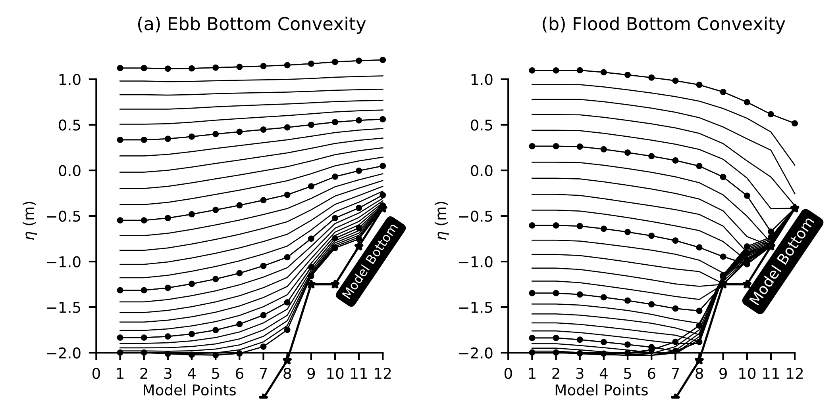
1D test cases: with Linear & Convex Slopes
Ebb
Flood
Simple 1D channel test cases following Balzano (1998)
Dotted lines are SSH at every 5th time-step
Linear slope
model
bottom
Convex slope
The model continues to ebb
over the sill (point 9)
sill
www.metoffice.gov.uk © Crown Copyright 2017, Met Office
Notes:
These tests come from Balzano. In other tests cases get non smooth solutions near the bed. In plot the wobbles in the plots shownare artefacts of the plotting. A point appears to have a wobble next to the bathy. What actually happens
Is that the next point is actually dry but must be plotted at the slope. These arenet really wobbles per say just a plotting artefact which we keep in Balzano’s format for ease of comparison. Another interesting test case is a drain out problem ..

Slide 10
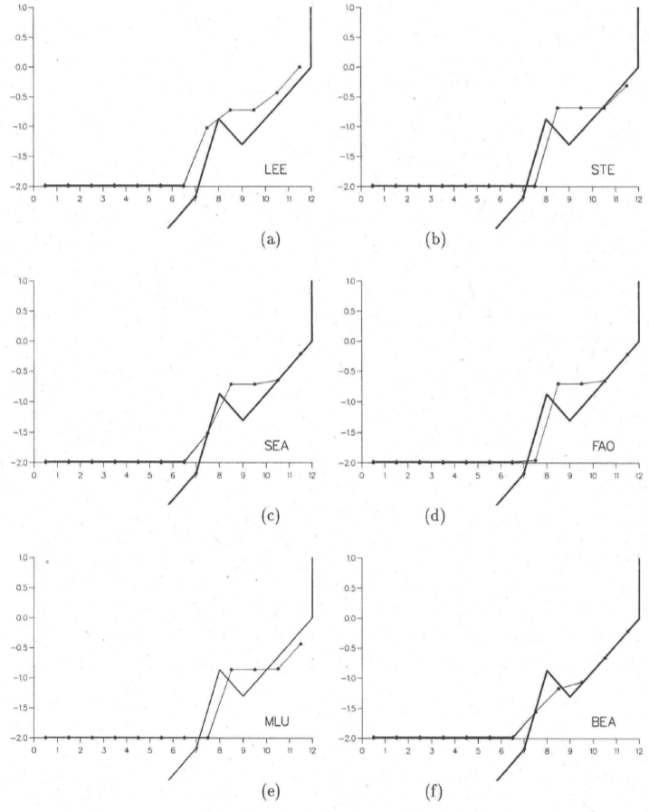
Reservoir Drain Experiment
Channel drained out to left of domain. Water in “notch” at point 9 should be level with “dam”at point 8
Comparison with several schemes
tested in Balzano (1998)
Models with bathymetry at T points averaged from that at u-points produce poor results
www.metoffice.gov.uk © Crown Copyright 2017, Met Office
Notes:
Point is the model should drain out and the bit caught at point 9 should be level with bathy at point 8

Slide 11
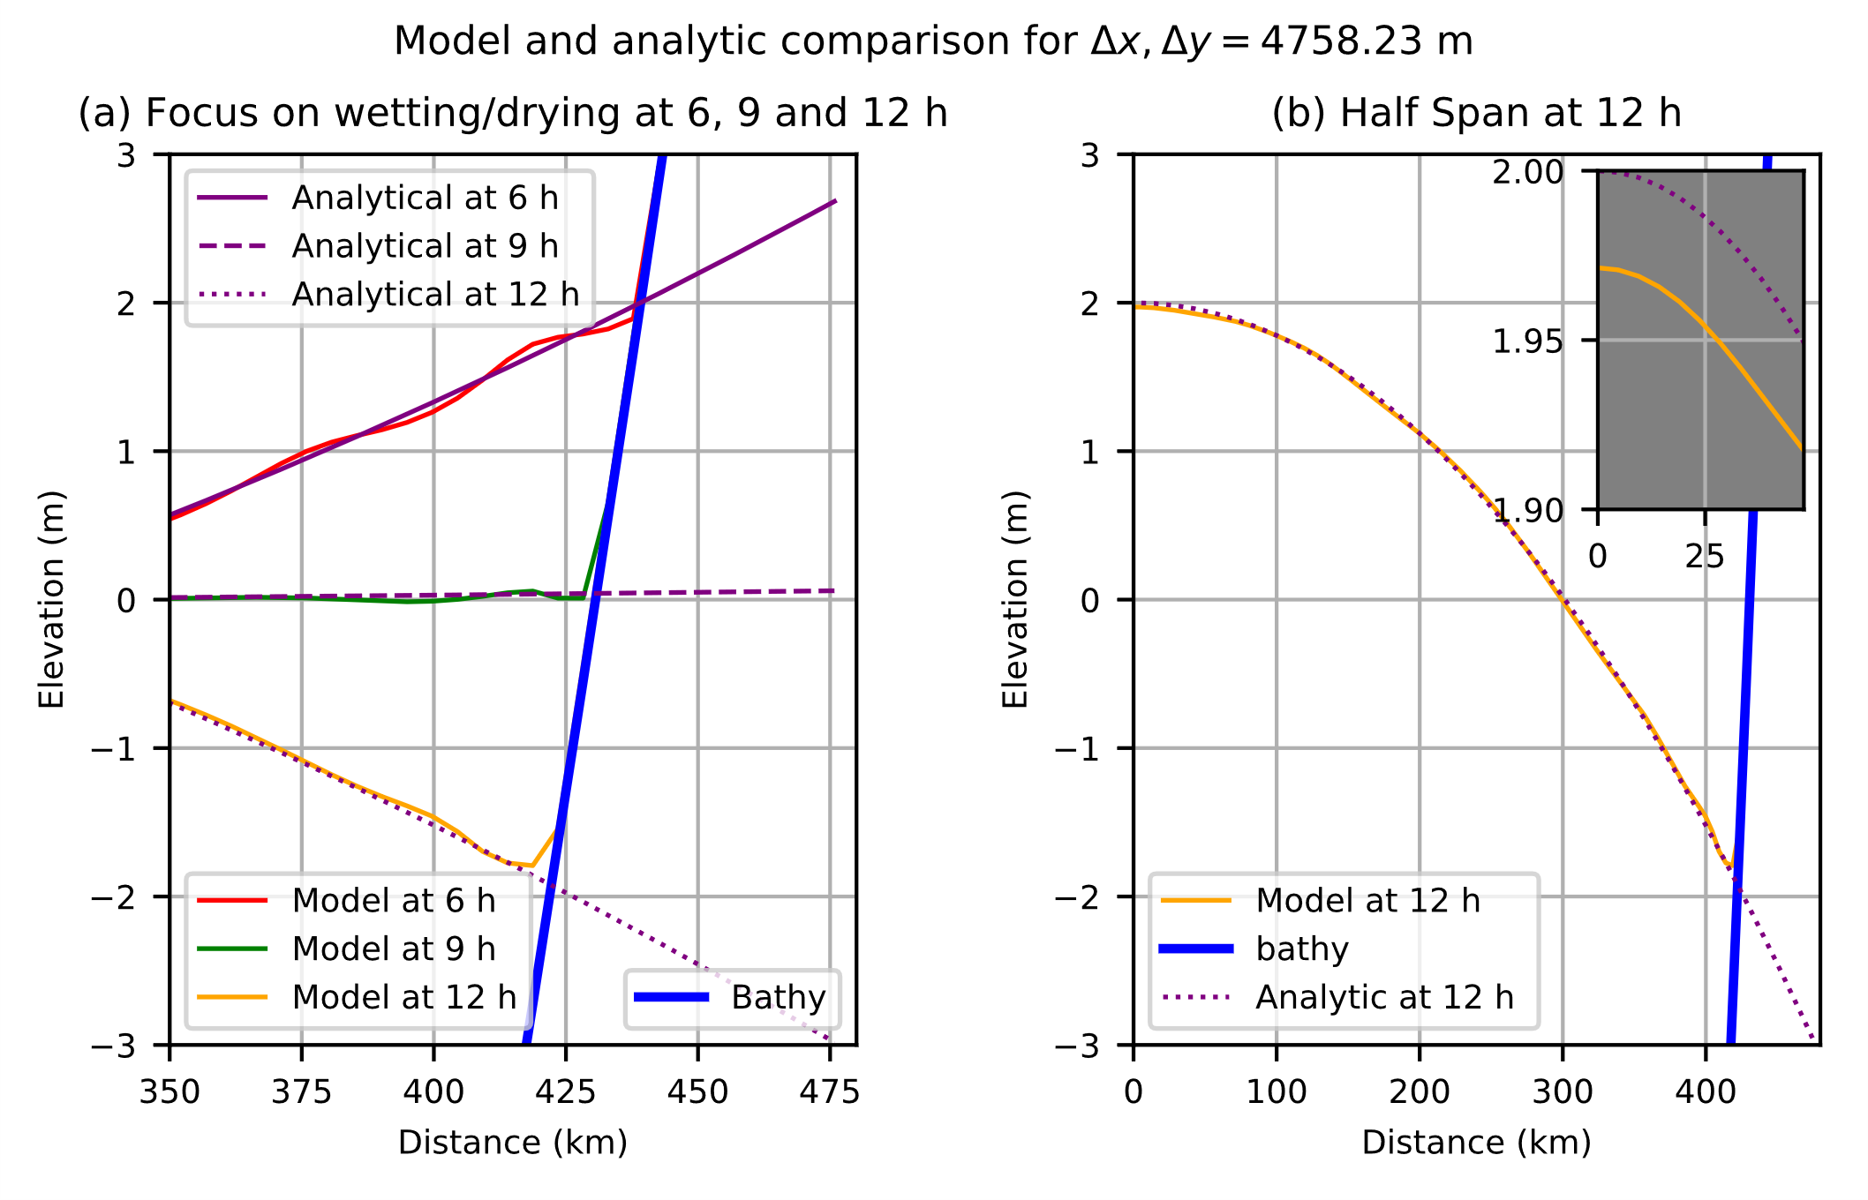
Parabolic Test case with Analytic solution (1)
1. Domain Set up
2D Parabolic bathy (Blue)
Initial SSH (purple)
2. Comparison with analytic solution
At max/min & mid-oscillation
Does well compared to existing schemes in literature.
Slight loss of amplitude
www.metoffice.gov.uk © Crown Copyright 2017, Met Office
Notes:
Parabolic tests case.
We have reduced error in terms of dissipation of the SSH amplitude. And the perturbations at the WAD interfacse are relatively small.

Slide 12
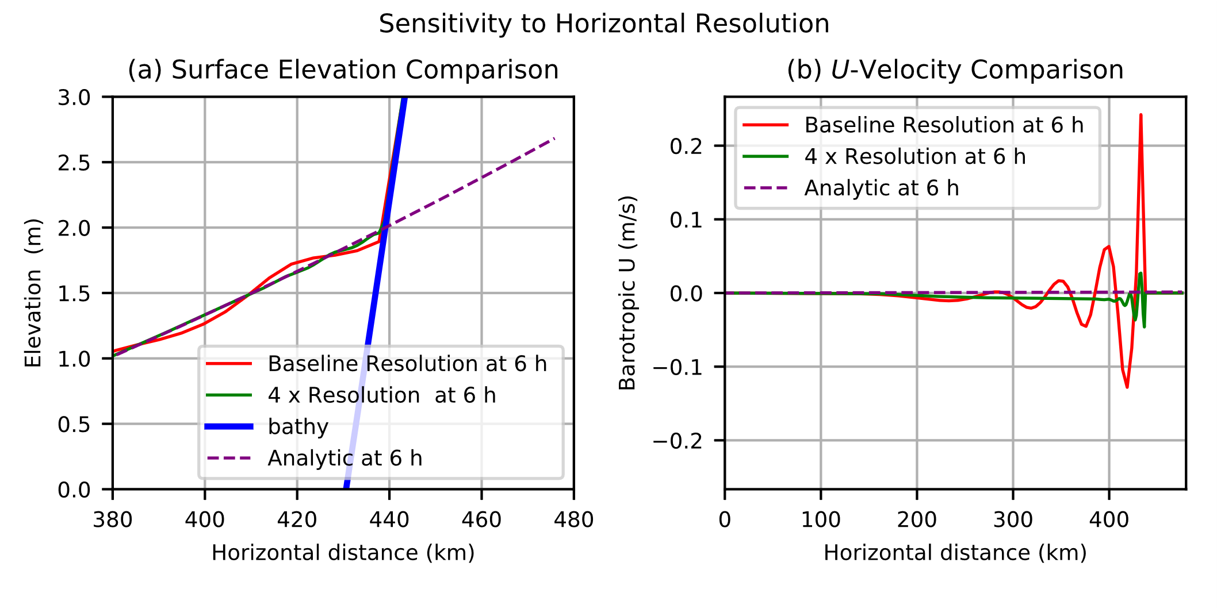
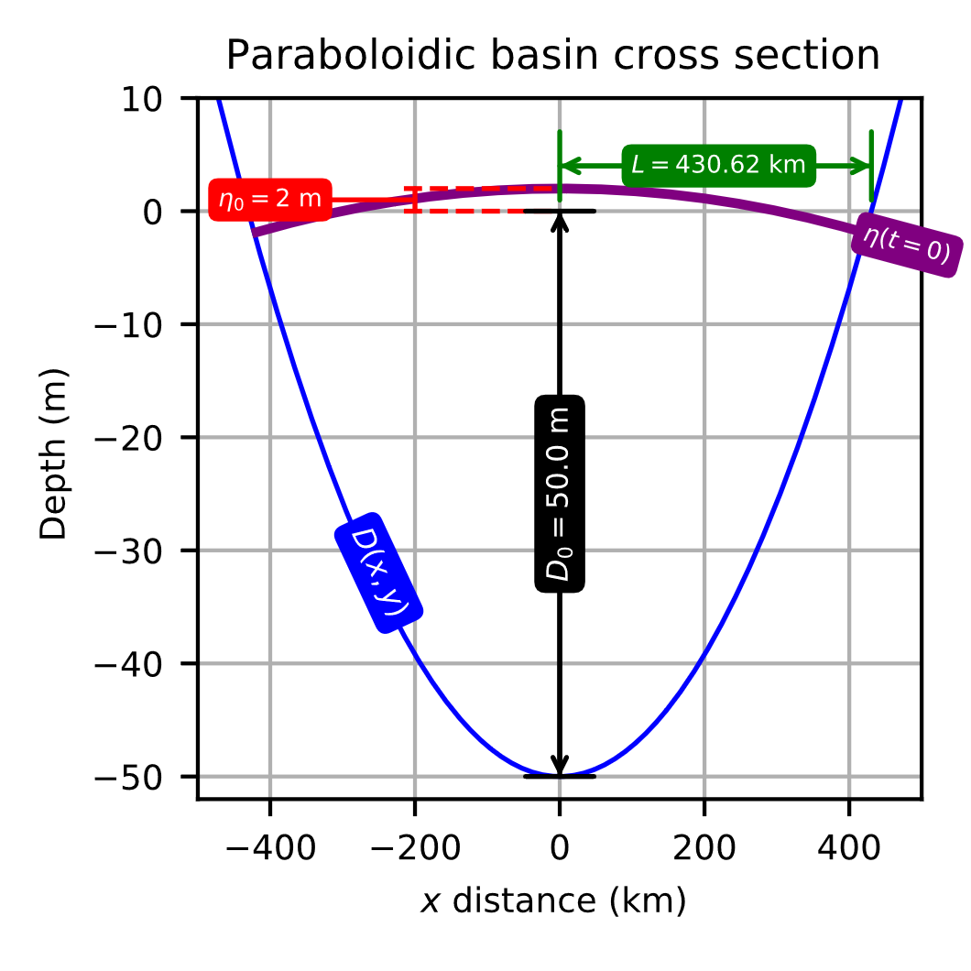
Parabolic Test case with Analytic solution (2)
1. Domain Set up
2D Parabolic bathy (Blue)
Initial SSH (purple)
3. Sensitivity to the model grid resolution
Increased resolution reduces oscillations
at W&D interface
www.metoffice.gov.uk © Crown Copyright 2017, Met Office
Notes:
Parabolic tests case.
We have reduced error in terms of dissipation of the SSH amplitude. And the perturbations at the WAD interfacse are relatively small.

Slide 13
1D Dam Break experiments with analytic solutions (1) Dam Break into water of shallow depth (Stoker solution)
$h_{r}$ is initial depth of water
to right of dam = 10⁻³ m
D_{crit} is the minimum depth
at “dry” cells = 10⁻⁶ m
A bore forms when the
dam breaks
(Delestre et al 2013)
A bore forms when the dam breaks
When D_{crit} is small enough the bore is quite well represented
www.metoffice.gov.uk © Crown Copyright 2017, Met Office
Notes:
Point is we need a wet depth for the model to work. This means we are never truly solving Ritters solution, though we can approach it by making the initial depth very small.
In the Stoker solution you get a bore like solution, which we also get which is encouraging. It shows that the model is doing what is asked of it.

Slide 14
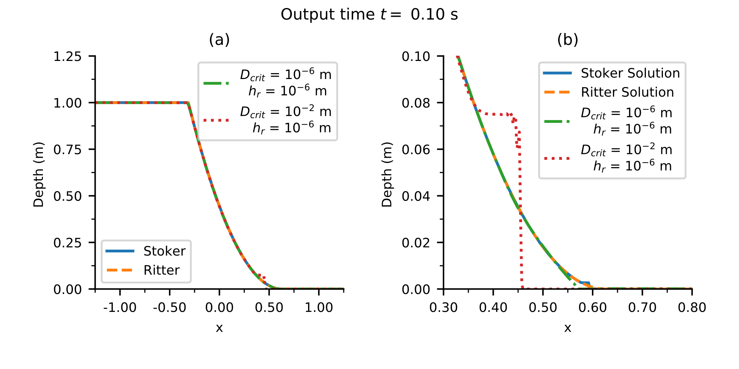
1D Dam Break experiments with analytic solutions (2) Dam Break into no water (Ritter Solution)
D_{crit} = 10⁻² m
D_{crit} = 10⁻⁶ m
Conclusion: Need to set D_{crit} to be smaller than one might expect
www.metoffice.gov.uk © Crown Copyright 2017, Met Office
Notes:
Point is we need a wet depth for the model to work. This means we are never truly solving Ritters solution, though we can approach it by making the initial depth very small.
In the Stoker solution you get a bore like solution, which we also get which is encouraging. It shows that the model is doing what is asked of it.

Slide 15
2D dam break tests
Experimental set up. Reservoir of water is between X=0 and X=1.
Dam is located at gap along X=0 and breaks to allow water to flow into initially dry domain to the LHS.
Sites mark point observations in Fracarollo and Ferarrai’s (1995) tank experiment
are indicated in black circles
www.metoffice.gov.uk © Crown Copyright 2017, Met Office
Notes:
The result of such bores in Stoker like solutions also applies in 2D dam case for which we can compare to experimental tank data instead of analytic solutions. The effect of the initial depth on the transient
Is displayed in the plot at site 13A

Slide 16
2D Side by side comparison of dam breaks with different initial dry depth depths ${\text{Dry}}_{\text{ini}}$
LHS: Dry_{ini} = 5. 10⁻³ m
RHS: Dry_{ini} = 10⁻⁴ m
Both sides:
D_{crit} = 10⁻⁴ m
www.metoffice.gov.uk © Crown Copyright 2017, Met Office
Notes:
This gives some context to what is happening across the domain. The Transient here can be seen as a wave of water travelling at the haed of the interface between wet and dry zones, spreading out fomr the dam break site.

Slide 17
Comparison of model and physical experiment of Fraccarollo & Ferrari J. Hydraulic Res, 1995
www.metoffice.gov.uk © Crown Copyright 2017, Met Office
Notes:
Here we can see ignoring transients te model does pretty well This is similar to the SWE solution in Ferrari JFM paper

Slide 18
Investigation of impact of ramping the flux limiter as D_{crit} is approached
Channel ends are closed
Next slide shows time-series at x=12 km
www.metoffice.gov.uk © Crown Copyright 2017, Met Office
Notes:
Here we have an initial solution that sloshes to the left and then bac to the right over the shelf.
Aa water trickles back down to the slope off the shelf there an be instances where the velocity time series is very noisy.
Application of a ramp on the flux limiter as the critical dept is approached helps reduced the noise and increases model stability

Slide 19
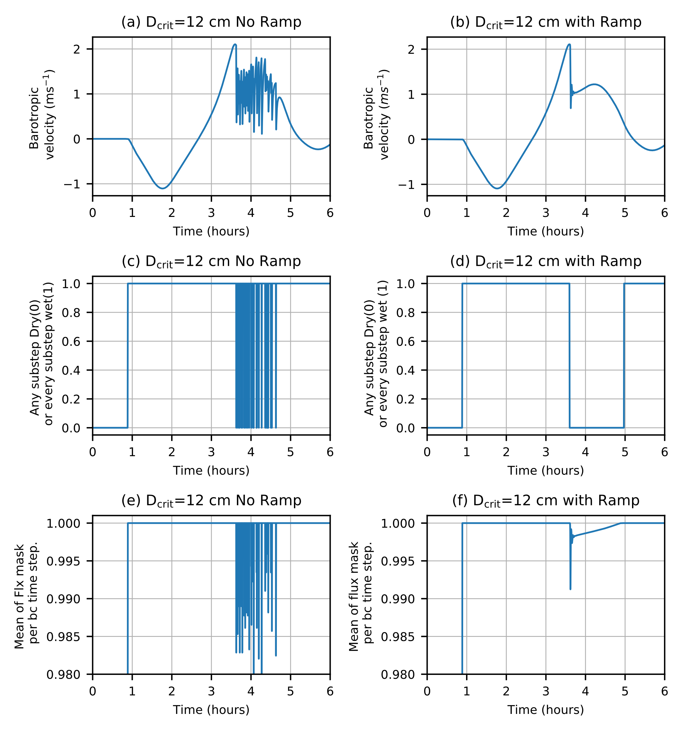
Investigation of impact of ramping the flux limiter
Barotropic velocity (ms⁻¹)
wet/dry state on every barotropic sub-step: 0 if any sub-step dry
1 if every sub-step wet
Time-mean of the flux mask on each baroclinic time-step
No ramp
With ramp
www.metoffice.gov.uk © Crown Copyright 2017, Met Office
Notes:
Here we have an initial solution that sloshes to the left and then bac to the right over the shelf.
Aa water trickles back down to the slope off the shelf there an be instances where the velocity time series is very noisy.
Application of a ramp on the flux limiter as the critical dept is approached helps reduced the noise and increases model stability

Slide 20
Test using real world “operational” configuration
Fully forced (surface and lateral boundaries)
AMM15 (1.5 km; 50 vertical levels)
Realistic initial 3D conditions
4-year simulation with 2 year comparison
Bathymetry is pre-smoothed to prevent
envelope intruding in WAD zones
Focus of the assessment is in the
Wadden Sea (red box).
www.metoffice.gov.uk © Crown Copyright 2017, Met Office
Notes:
Mixed results for the domain as a whole with standard Tide gauges. There are lots of data available for The Wadden sea at high resolution that allows detailed investigation of a zone that has lots of W&D.

Slide 21
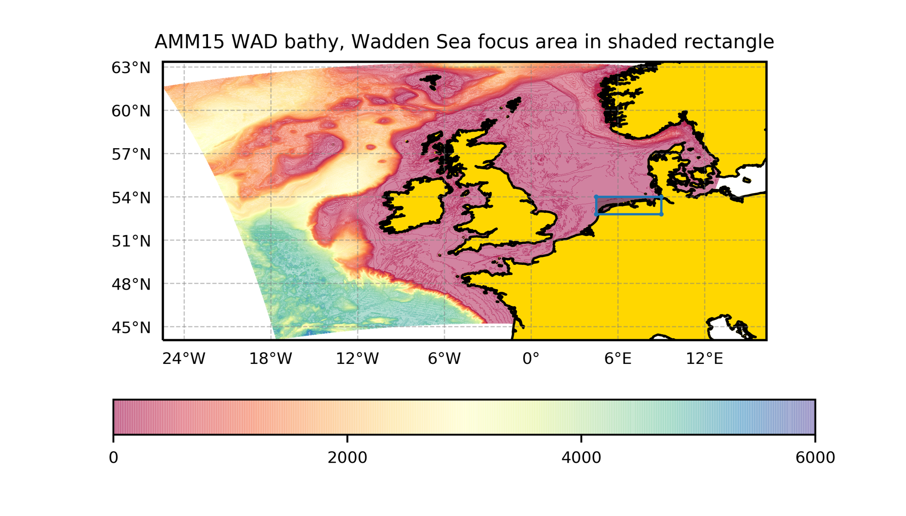
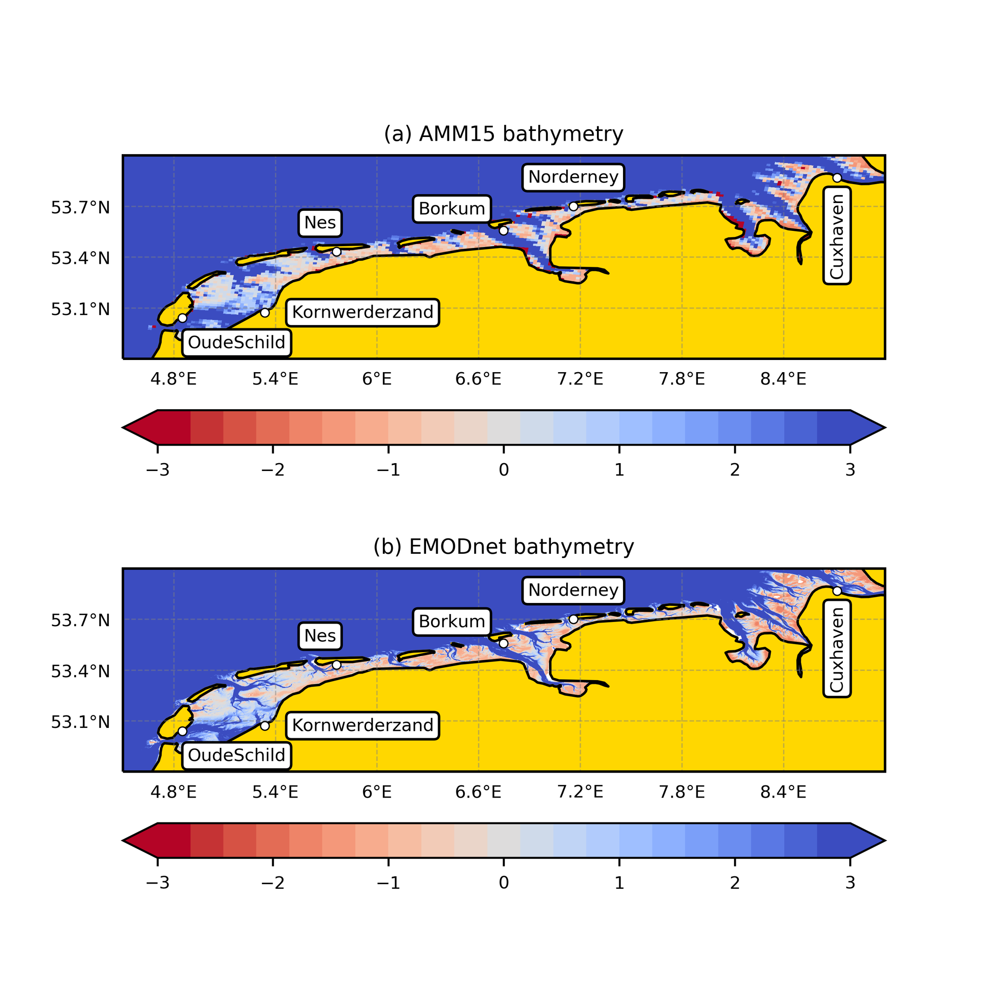
Locations of tide gauges used in assessment
AMM15
bathymetry
EMODnet
bathymetry
Note the AMM15 bathymetry does not capture some channels well
www.metoffice.gov.uk © Crown Copyright 2017, Met Office
Notes:
Mixed results for the domain as a whole with standard Tide gauges. There are lots of data available for The Wadden sea at high resolution that allows detailed investigation of a zone that has lots of W&D.

Slide 22
Important to consider limitations of model resolution. At Nes site, AMM15 (1.5 km) resolution is not sufficient to resolve fine scale channels. Its mean grid depth value is shallower than the channel and the model ends up drying at that grid point (blue solid) where the observation (green dash) shows it does not. This can strongly bias a tidal assessment The Model without WAD(orange dash) uses a minimum depth of 10 m
Tide gauge comparison (1)
SSH at OudeSchild
SSH at Nes
Notes:
The Edmonet Bathy shows that we are missing lots of detail at the 1.5km scale in AMM15 . The sites of the tide gauges may be in narrow unresolved channels in the AMM15 batyh. That means
AMM15 will dry out where in reality the actual site does not as it is in a deeper channel than the mean bathy over1.5km would suggest.

Slide 23
Harmonic analyses of gauges and model Shows relative importance of model errors in specific harmonics both amplitude and phase. For consistency omits model values at the times when observations are missing We show a comparison at 1 such site for several harmonics: Blue is difference between obs. and model with WAD. Orange dashed is difference between obs. and a model with a minimum depth of 10 m.
Tide Gauge
Comparison (2)
OudeSchild

Slide 24
Reason for poor results at Nes tide gauge The flow in and out of the channel leading to the Nes tide gauge is unresolved: There is no flow between cells C and D.
Cell D
Cell C

Slide 25
A model run with a minimum depth of 10 m (grey bars) is compared with the standard W&D model run at the sites in the Wadden Sea. The metric is the absolute maximum deviation between observations and model over a constituent’s period Bars are coloured green where the WAD error is less than the 10 m minimum depth run and red where WAD error is larger. The Nes site is the one where the W&D model dries out where it should not.
Tide gauge comparison (3)
| maximum error | (m)
OudeSchild
Nes
Notes:
Generally pretty good improvement for most sites for most constituents. . M4 etc are also notable.

Slide 26
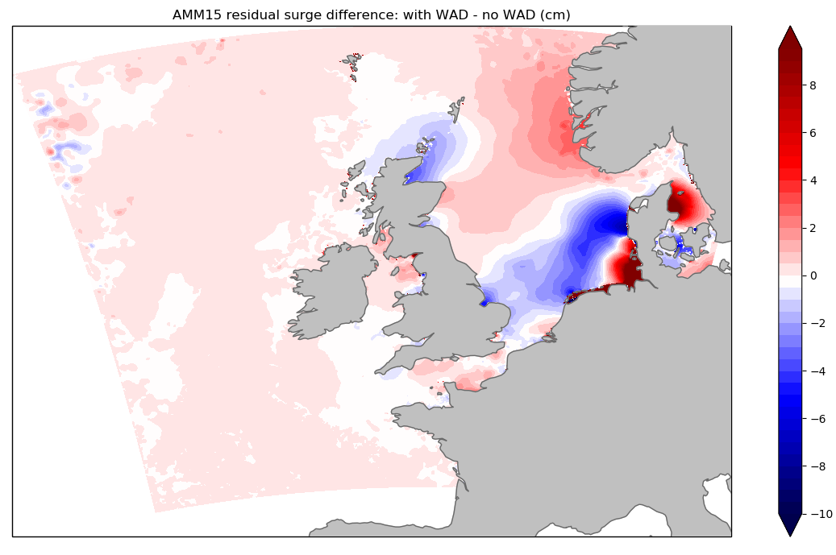
Differences WAD – no WAD
Sea Surface Height
Residual surge
8
cm
-10
Impact on fields is appreciable but no improvement
in statistical fit to tide gauges on UK coast – why ?

Slide 27
Summary and questions
A W&D scheme based on that of ROMS has been implemented in NEMO
Its performance in idealised test cases is robust / satisfactory
But which test cases and non-dimensional parameters (e.g. H/L) are most relevant to “real world” configurations?
Which aspects of results are most important (e.g. time-step restrictions)
“Real-world” configurations run stably
But statistical fit to tide gauges only improved in some shallow regions; so not benefitting from freedom to specify bathymetry more accurately
How should one resolve/represent drainage channels?

Slide 28
References
Balzano, A., 1998. Evaluation of methods for numerical simulation of wetting and drying in shallow water flow models. Coastal Engineering 34, 1-2, 83-107. doi.org/10.1016/S0378-3839(98)00015-5.
Delestre, O., Lucas, C., Ksinant, P.A., Darboux, F., Laguerre, C., Vo, T.N.T., James, F., Cordier, S., 2013. SWASHES: a compilation of shallow water analytic solutions for hydraulic and environmental studies. International Journal for Numerical Methods in Fluids 72, 269-300. URL: https:821 //www.idpoisson.fr/swashes/, doi:10.1002/fld.3741.
Flather, R.A., Heaps, N.S., 1975. Tidal computations for morecambe bay. Geophys. J. Roy. Astron. Soc. 42, 489-517.
Fraccarollo, L., Toro, E.F., 1995. Experimental and numerical assessment of the shallow water model for two-dimensional dam-break type problems. J. Hydraulic Res. 33, 843-864.
Oey, L.Y., 2005. An OGCM with movable land-sea boundaries. Ocean Modelling 13, 2, 176-195. doi:doi:https://doi.org/10.1016/j.ocemod.2006.01.001.
Warner, J., Defne, Z., Haas, K., Arango, H.G., 2013. A wetting and drying scheme for ROMS. Computers and Geosciences 58, 54-61. doi.org/10.1016/j.cageo.2013.05.004.

