Slide 1
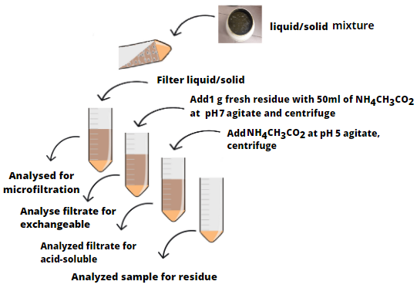
Nazia Zaffar (1), Erik Ferchau (2), Hermann Heilmeier (1), and Oliver Wiche (1) (1) Technical University of Bergakademie, Freiberg, Institute for Biosciences, Biology/Ecology Group, Germany (naziazaffarqau@gmail.com), (2) Technical University of Bergakademie, Institute for Thermal Engineering and Thermodynamics
Chemical fractionation of germanium (Ge) and rare earth elements (REEs) in biogas residue by a two-step sequential extraction procedure
Motivation
Ge and REEs are of increasing interest in phytoremediation and phytomining research. These elements are present in almost all soils and soil-grown plants contain considerable concentrations of these elements in their biomass. The process chain of phytomining involves following steps:
Accumulation of target elements in harvestable plant biomass (phytoextraction).
Production of bioenergy by burning or biogas production.
Recovery of the elements from bioenergy residues.
Although literature on bulk concentrations of elements in fermentation residues is extensive until today there is only a little information on how the elements are bound/distributed in the solid/liquid phases of the fermentation residues, particularly for target elements in phytoremediation research such as Ge and REEs.
Material and Methods
Laboratory experiments were conducted in which residues from anaerobic fermentation were separated into liquid/solid by microfiltration. Subsequently the solids were extracted by a two-step sequential extraction procedure as shown in Fig. 1. This procedure involved the extraction of solids with ammonium acetate (pH 7) and ammonium acetate (pH 5) to determine exchangeable as well as acid-soluble elements.
Fig.1 Steps of sequential extraction
Results
The percentage distribution of target element in the 4 fractions is presented graphically in Fig 2. As a result, we found that total concentrations in the residues were 0.5 µg/g for (Ge) and 8.7 µg/g for (REEs i.e sum of all lanthanides). In the liquid phase concentrations of Ge and REEs were very low ranging from 0.0001 µg/g Ge and 0.003 µg/g REEs, respectively. Concentrations of elements in the liquid phase represented 0.01% Ge and 0.04% REEs of the total element concentrations of the material, indicating that most of the elements were bound to solids. Results from the sequential extraction revealed that percentage distribution of elements were 1.2% (exchangeable Ge) 0.5% (exchangeable REEs) and 0.8% (acid-soluble Ge) 3.8% (acid-soluble REEs) from the total elements of the material.
Fig. 2 Percentage distribution of target elements in 4 fractions
Conclusion
We can conclude that most of the Ge and REEs in digestates are most probably bound into organic structures, which were not attracted by extraction solutions. This has major implications for the development of methods for the recovery of the target elements. Application of strong acids/or oxidation of organics prior to application of separation could make the method of recovery more efficient.

