Slide 1




CL4.5, Sea level rise: past, present and future
Abstract ID: EGU2020-7302
Estimating global mean sea-level rise and its uncertainties by 2100 and 2300 from expert assessment
Benjamin Horton
Nicole Khan, Niamh Cahill, Janice Lee, Timothy Shaw, Andra Garner, Andrew Kemp, Simon Engelhart, and Stefan Rahmstorf
Monday, 04 May 2020, 08:30-10:15

Slide 2
Variability of global mean sea-level (GMSL) projections among studies, even when using the same emissions scenarios, has led to confusion among decision making communities and the public (e.g. Fig. 1).
As an alternative to models, GMSL rise may be projected by surveying (e.g. Bamber et al., 2019). We previously surveyed experts (Horton et al., 2014 QSR; hereafter H14) to provide a probabilistic assessment of sea-level rise by 2100 and 2300 under two temperature scenarios. Now is an appropriate time to repeat the survey of H14 because during the past 5 years, progress has been made in better understanding several processes expected to influence GMSL rise (e.g., MICI) and in advancing the methodologies for projecting GMSL rise.
The results of this survey (hereafter H20) are compared with the H14 survey results and published literature to assess how and why the sea-level community’s projections evolved during the past 5 years and if there is movement toward a consensus of GMSL rise for 2100 and 2300 under different emission scenarios.
Fig 1: Comparison of upper estimates for high emissions scenarios from individual studies to IPCC projected ranges of sea level rise (SLR). Shown are the upper estimates of sea level rise for high emissions scenarios from 1983-2018 (purple), and the IPCC projected SLR ranges (blue) (Garner et al., 2018).
Estimating global mean sea-level rise and its uncertainties by 2100 and 2300 from expert assessment

Slide 3
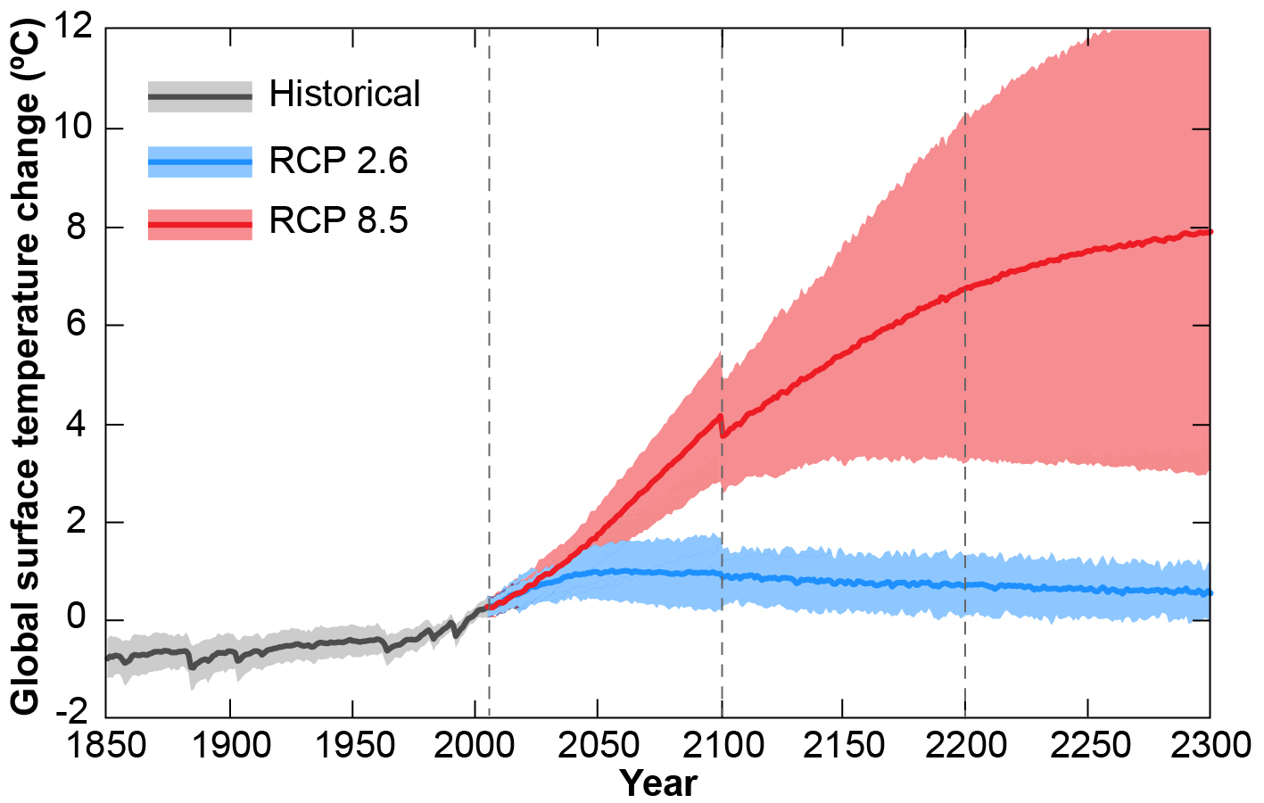
We obtained a sample of 878 experts who published at least six papers on “sea level” since 2014. We found e-mail addresses for 817 of these experts and invited them to participate in the survey. A total of 106 (13%) sea-level experts provided their probabilistic assessment of GMSL rise.
We retain the same aim as the original H14 study: to survey experts in the scientific community about how much GMSL change they anticipate for two time periods (2000–2100 and 2000–2300) under two temperature scenarios (derived from the upper and lower extremes of the RCP 2.6 and RCP 8.5 scenarios; Fig. 2).
Fig. 2: Time series of global annual mean surface air temperature anomalies (relative to 1986-2005) from CMIP5 concentration-driven experiments, modified from IPCC AR5. These temperature projections correspond to the lower (RCP 2.6; blue) and upper (RCP 8.5; red) greenhouse gas scenarios.
Estimating global mean sea-level rise and its uncertainties by 2100 and 2300 from expert assessment

Slide 4
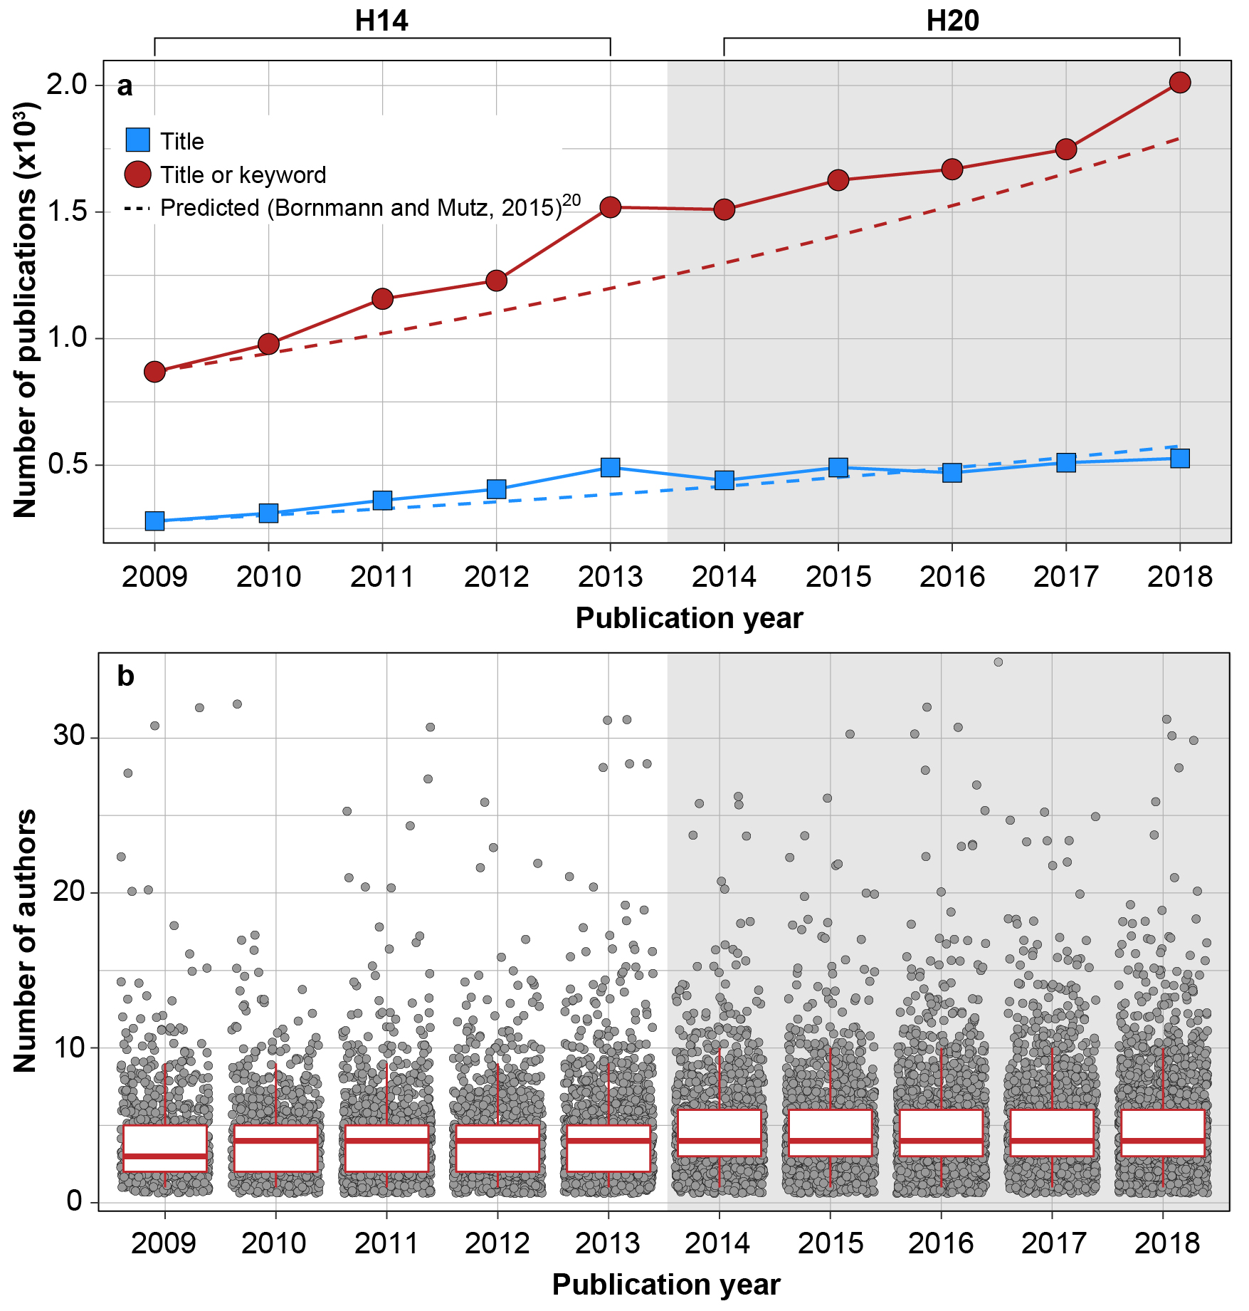
The number of papers published annually on the topic of “sea level” (term appearing in the title or listed as a keyword) more than doubled between 2009 and 2018 from 869 to 2012 (Fig. 3a).
Spike in the number of papers published in 2013 that we attribute to authors completing publications in time for them to be incorporated in IPCC AR5.
The number of authors on sea-level papers is highly variable among publications, but shows a modest increase through time (Fig. 3b). Between 2009 and 2013, the mean number of authors by year was 4.1 to 4.5, compared to 4.7 to 5.2 between 2014 and 2018.
Fig. 3: (A) Total number of papers published where “sea level” appears in title (blue squares). (B) Number of (co)authors on sea-level publications (grey circles) between 2009 and 2018.
Estimating global mean sea-level rise and its uncertainties by 2100 and 2300 from expert assessment

Slide 5
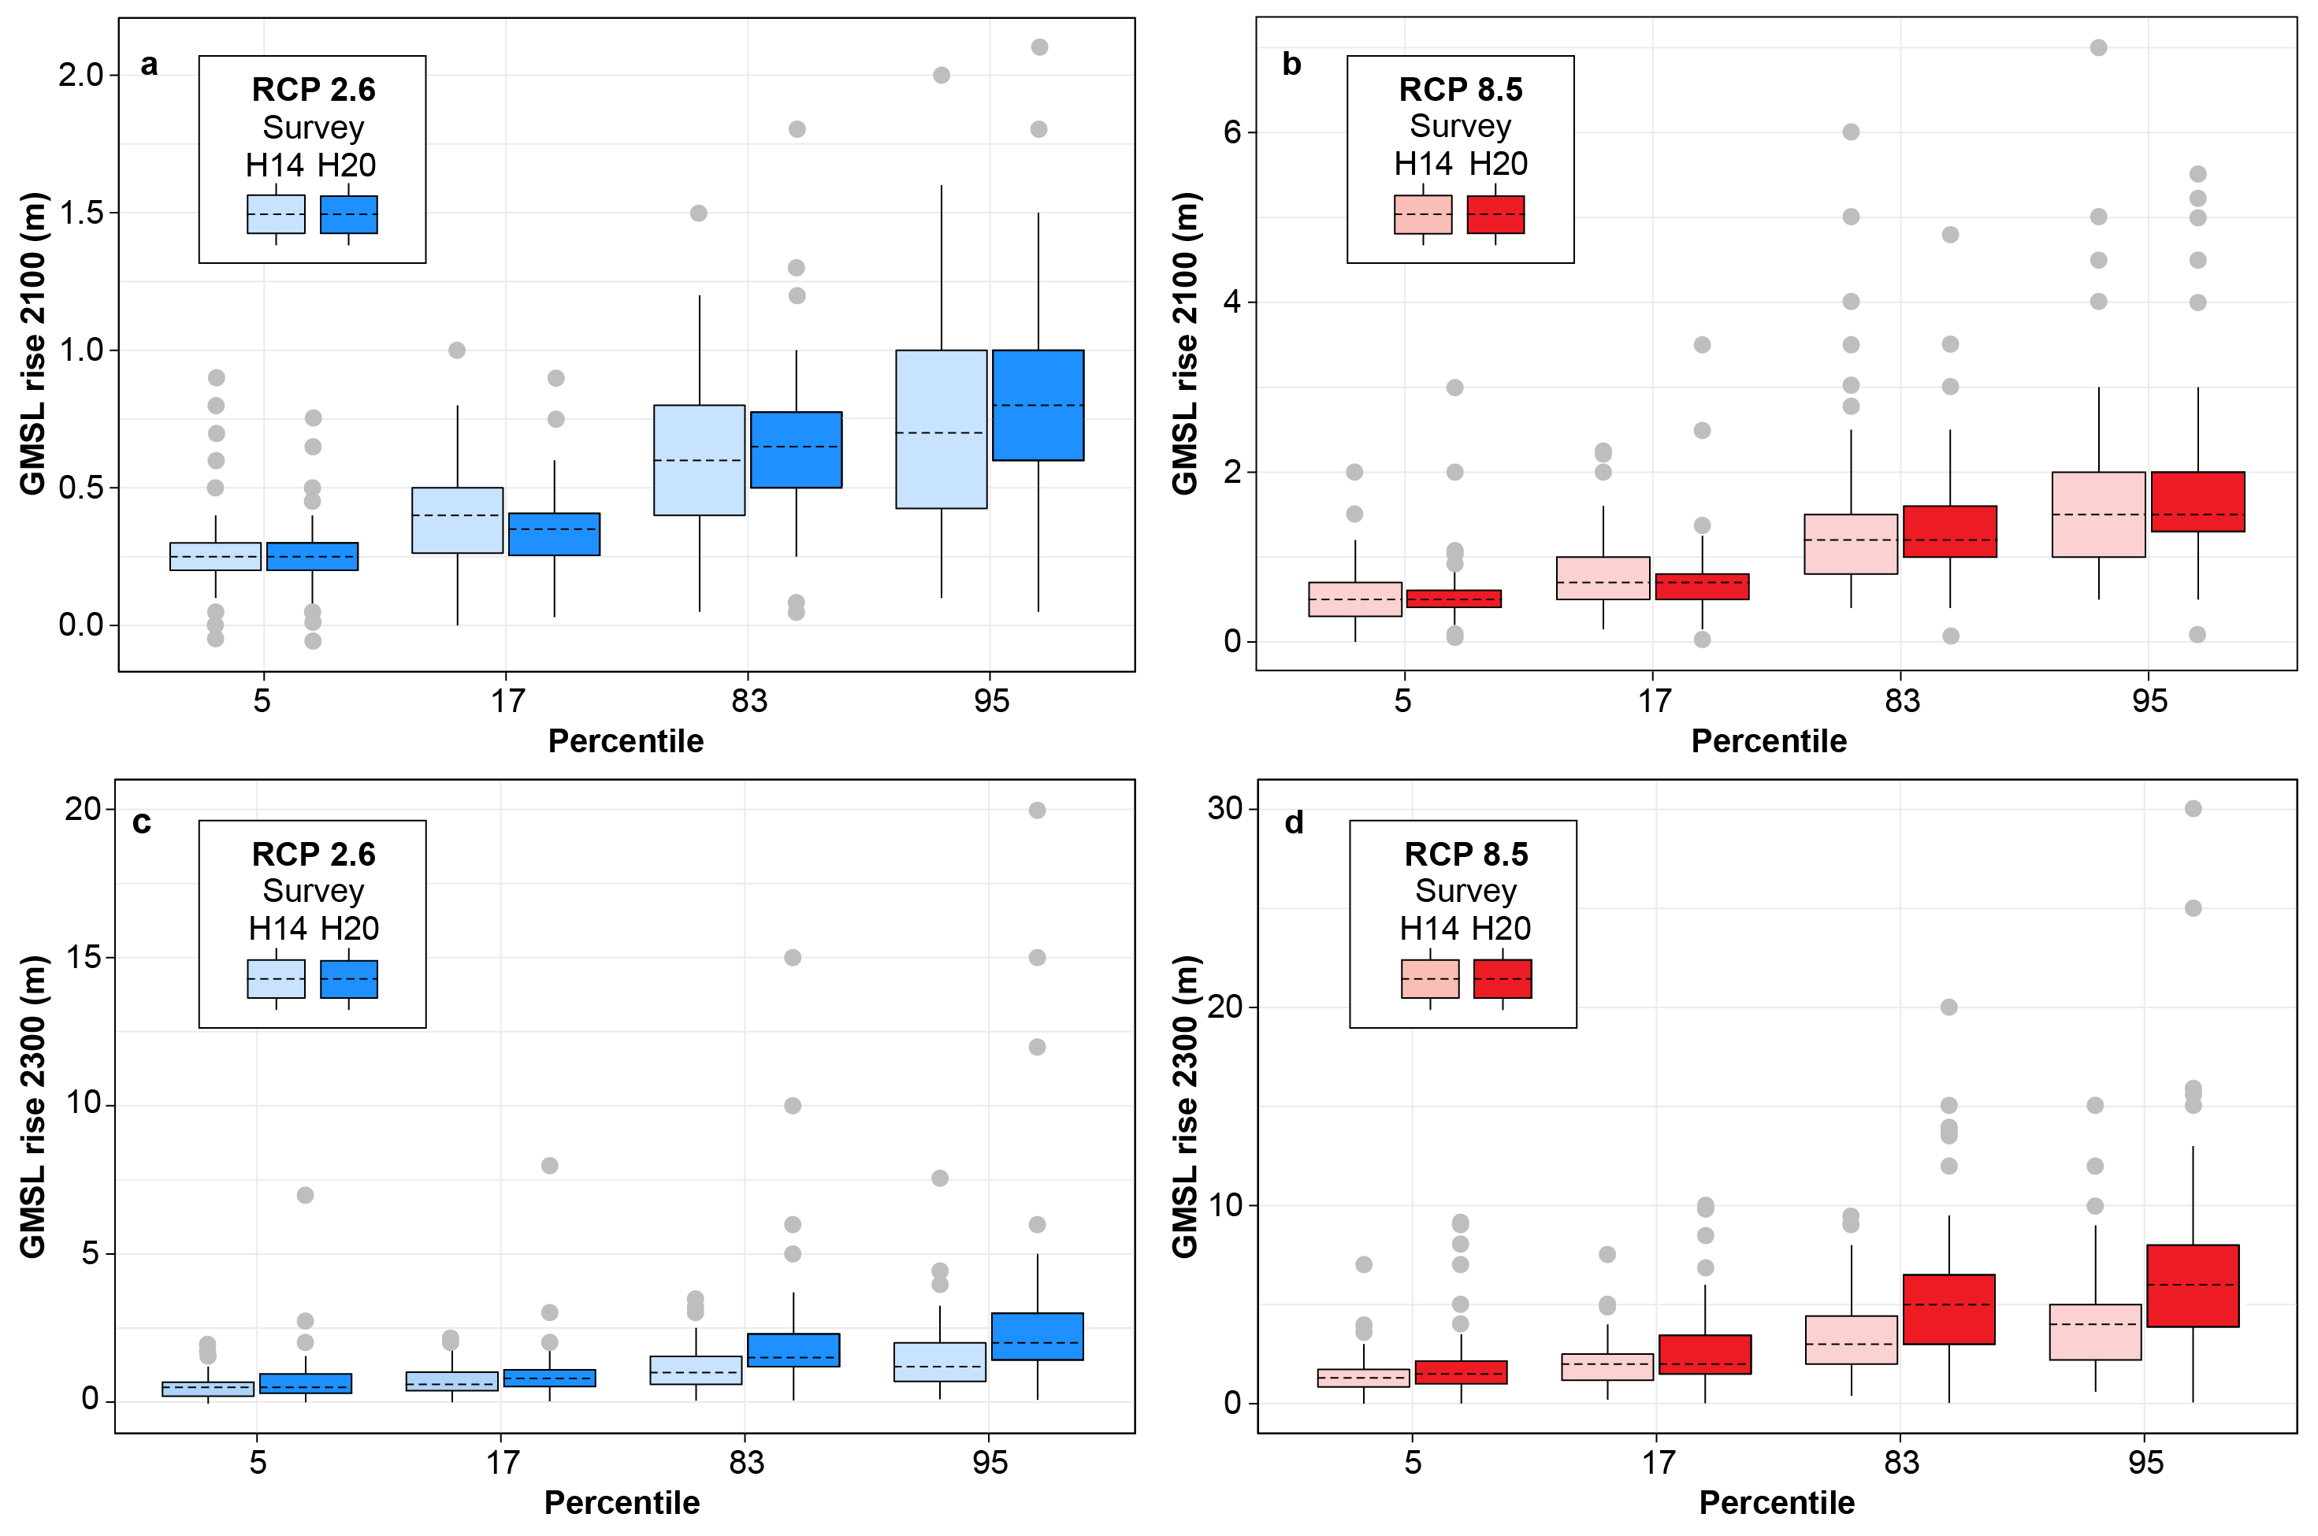
For GMSL projections, the experts provided two uncertainty ranges and a median estimate for RCP 2.6 and RCP 8.5. The inner GMSL projection uncertainty range (17 to 83 percentiles) defines the central 66% probability range of GMSL, which corresponds to the “likely” ranges of GMSL rise provided in IPCC AR5. The outer range (5th to 95th percentiles) defines the central 90% probability range of GMSL, which corresponds to the “very likely” ranges of GMSL rise provided in IPCC AR5.
Box plots of the survey results for the 5th, 17th, 83rd, and 95th percentiles across all respondents (n = 106) to provide an overview of the variability in the quantitative information provided by the survey (Fig. 4).
Fig. 4: Box plots of H14 and H20 surveys asked to estimate likely (17th to 83rd percentiles) and very likely (5th-95th percentiles) sea-level rise under RCP 2.6 and RCP 8.5 temperature scenarios and at two time points (2100 and 2300).
Estimating global mean sea-level rise and its uncertainties by 2100 and 2300 from expert assessment

Slide 6
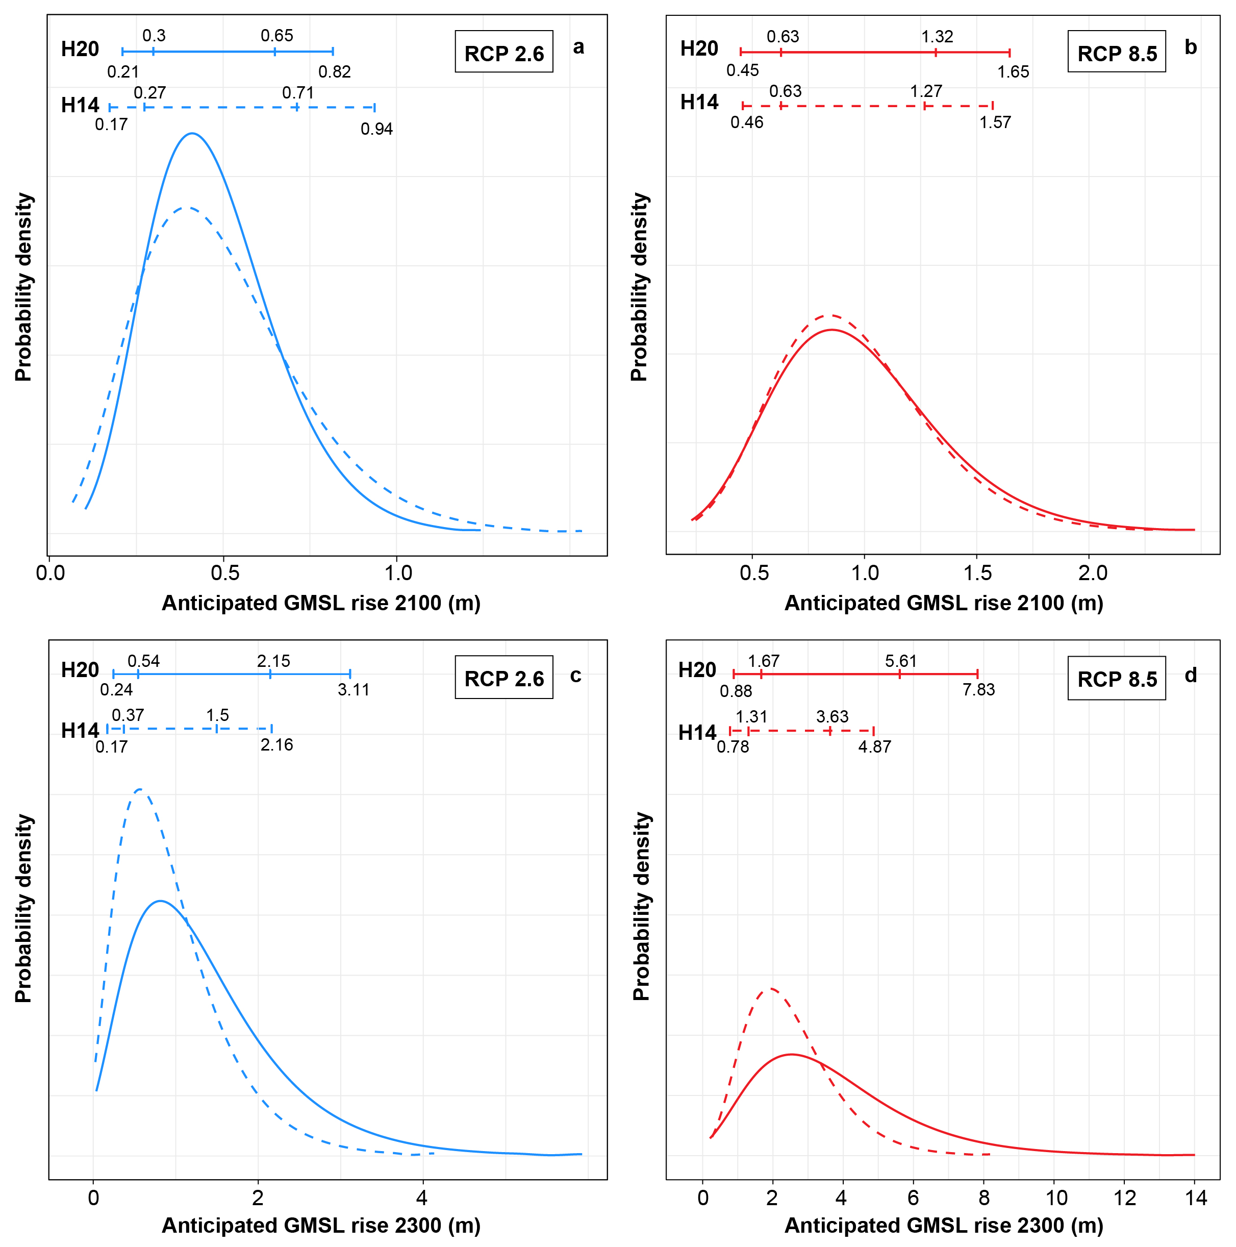
Expert projections also informed probability density functions (PDFs) providing the relative likelihood of GMSL under RCP 2.6 and RCP 8.5 by 2100 and 2300 (Fig. 5).
Under RCP 2.6, the PDFs suggest a likely range of GMSL rise of 0.30–0.65 m, a very likely range of 0.21–0.82 m, and a median of 0.45 m by 2100. By 2300, the PDFs suggest a likely range of GMSL rise of 0.54–2.15 m, a very likely range of 0.24–3.11 m, and a median of 1.18 m.
Under RCP 8.5, the likely range of GMSL rise is 0.63–1.32 m, the very likely range is 0.45–1.65 m, and the median is 0.93 m by 2100. By 2300, the likely range is 1.67–5.61 m, the very likely range is 0.88–7.83 m, and the median is 3.29 m.
Fig. 5: PDFs of H14 (dashed) and H20 (solid) surveys for RCP 2.6 (blue) and RCP 8.5 (red). The horizontal bars show the fifth, 17th, 83rd, and 95th percentile values.
Estimating global mean sea-level rise and its uncertainties by 2100 and 2300 from expert assessment

Slide 7
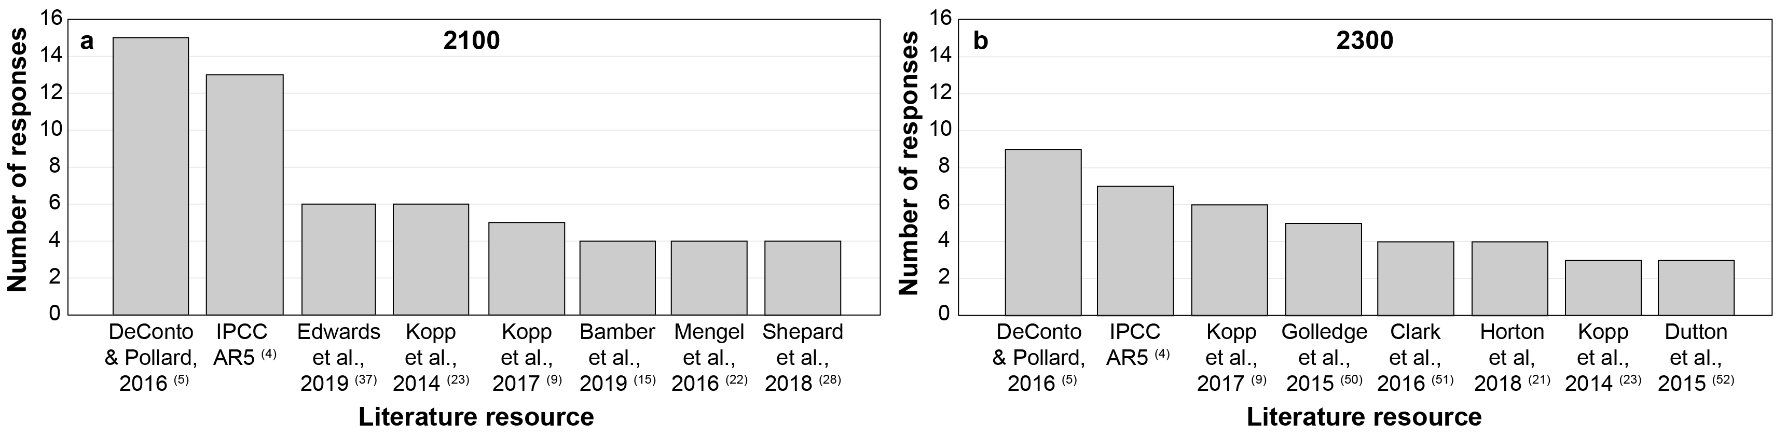
We also invited the experts to answer open-ended questions including what specific resource(s) (e.g., academic literature, government reports, etc.) were most influential to their responses for 2100 and 2300 under both RCP 2.6 and RCP 8.5 scenarios (Fig. 6).
In total, respondents listed 79 references that influenced their estimates, of which 67 were reported for the 2100 scenario.
While the role of the IPCC is prominent in societal and policy debates, we have no clear understanding of its impact on the field of climate science itself, or on other scientific fields. Here, the AR5 was the second most cited source, with 12% for 2100 and 10% in 2300.
Fig. 6: Bar chart of specific resources that were most influential to the expert projections of future global mean sea-level rise and its uncertainties for 2100 and 2300.
Estimating global mean sea-level rise and its uncertainties by 2100 and 2300 from expert assessment

Slide 8
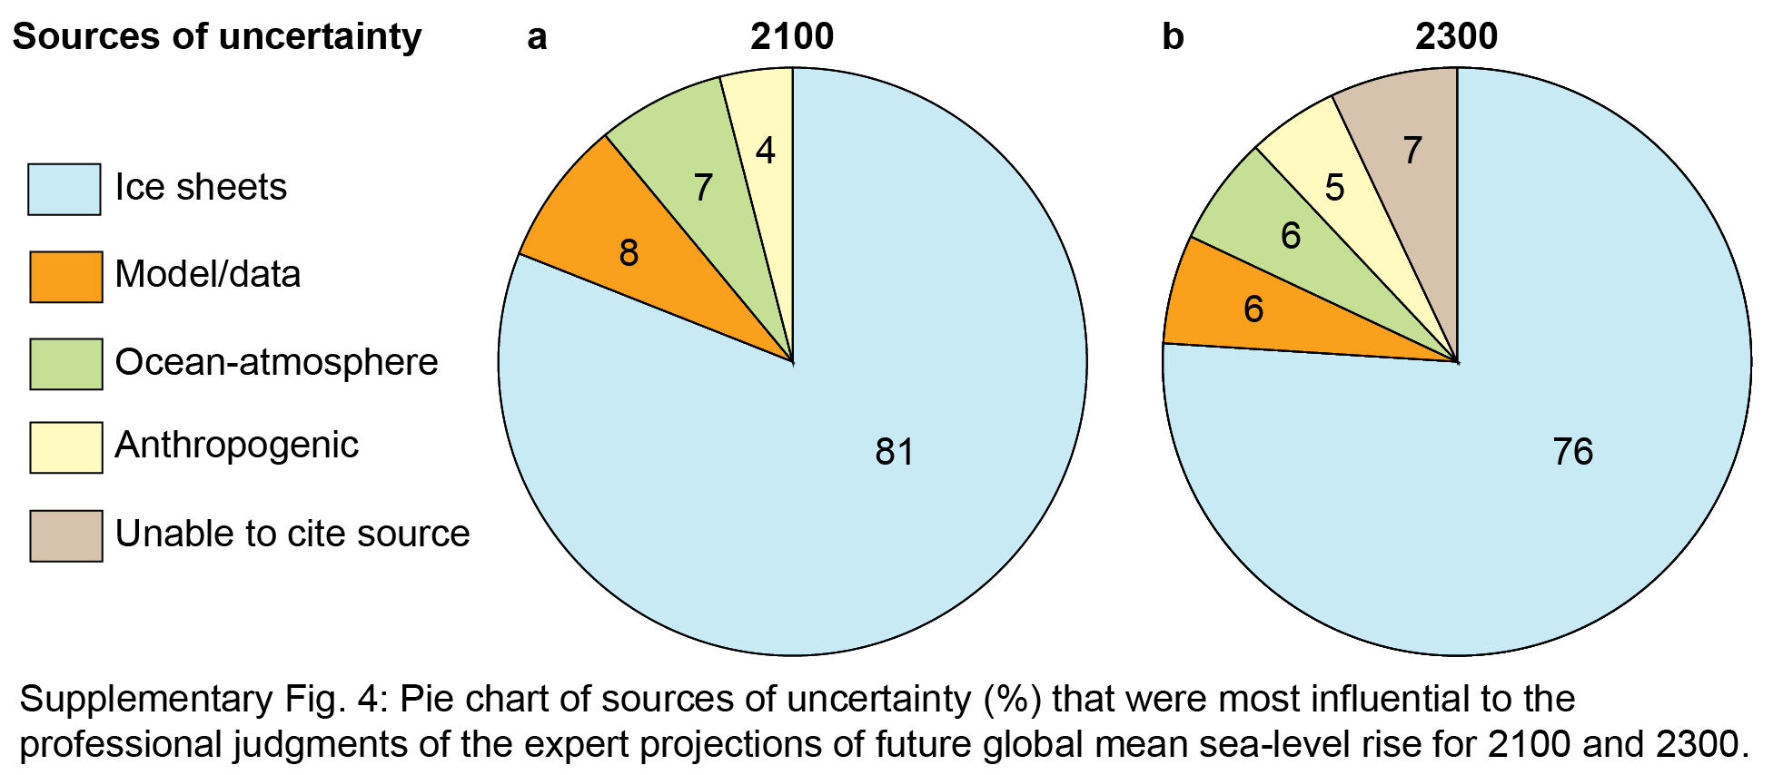
We also asked what they considered to be the greatest source of uncertainty for their estimates for 2100 and 2300 (Fig. 7).
We placed the responses for sources of uncertainty into four main categories: (1) ice-sheet uncertainty, (2) anthropogenic uncertainty, (3) model/data limitations, and (4) ocean-atmosphere uncertainty. In many cases, experts provided more than one source of uncertainty for their sea-level rise estimates. Some respondents were unable to cite a specific source.
Fig. 7: Pie chart of sources of uncertainty (%) that were most influential for 2100 and 2300.
Estimating global mean sea-level rise and its uncertainties by 2100 and 2300 from expert assessment

Slide 9
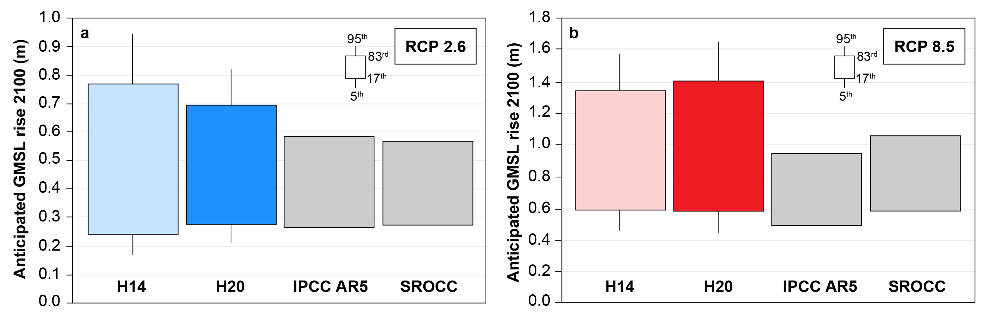
The expert projections for 2100 and 2300 generally illustrate that substantial uncertainty still remains in projecting GMSL rise, with a considerable proportion of experts projecting a greater rise by 2100 than the IPCC AR5 (Fig. 8). Our survey suggests that the high upper-end estimates and uncertainties arise from the expected response of the Antarctic Ice Sheet to warming. The multimeter GMSL rise projected by some experts under RCP 8.5 would expose up to hundreds of millions of people to coastal flooding and devastate coastal ecosystems.
Fig. 8: Box plots of likely (17th to 83rd percentiles) and very likely (5th-95th percentiles) sea-level rise for RCP 2.6 (blue) and RCP 8.5 (red) scenarios for 2100 from projections studies: H14 and H20 surveys; IPCC AR5 and SROCC.
Estimating global mean sea-level rise and its uncertainties by 2100 and 2300 from expert assessment

Slide 10
We are very grateful to everyone who took the time to take part in the survey
Thank you
Accepted in NPJ Climate and Atmospheric Science. Out soon…
Estimating global mean sea-level rise and its uncertainties by 2100 and 2300 from expert assessment

