Slide 1







Assessing future hurricane risk in the Caribbean based on large-scale predictor fields
Peter Pfleiderer^{1,2,3} and Carl-Friedrich Schleußner^{1,2,3}
peter.pfleiderer@climateanalytics.org
¹Humboldt-Universität zu Berlin, IRI THESys, Geographie, Berlin, Germany ²Climate Analytics, Berlin, Germany
³Potsdam Institute for Climate Impact Research, Potsdam, Germany
https://www.4freephotos.com/Horizon-line-over-ocean-7092.html

Slide 2
Outline
Introduction:
  Research question
  Motivation
Methods:
  Self organizing maps
  Data & preprocessing
  Construction of the self organizing map
Preliminary results:
  25 types of tropical Atlantic weather
  Observed tropical cyclone risk for the different weather types
  tropical cyclone risk for the different weather types in 2 high-res CMIP6 models
Summary
Next Steps
Questions for discussion

Slide 3
Research Question
What is the impact of global warming on the tropical cyclone risk for the Caribbean?
Challenges:
Observational time series are too short to answer the question
The representation of tropical cyclones (TCs) is weak in most global circulation models (GCMs)
An analysis based on only very few GCMs that produce reasonable TCs wouldn’t capture the whole range of large scale responses to global warming (simulated by the ensemble of all GCMs)

Slide 4
Motivation
The motivation of this study is to bypass the difficulties of most GCMs to simulate reasonable TCs by only analyzing how changes in large scale weather patterns (under global warming) might affect TC risk in the Caribbean
Approach:
Classify weather types using Self Organizing Maps (SOM) in reanalysis
Map the potential for TC risk to the weather types using observations
Check whether the observed relationship between TC risk and weather types is also found in high resolution GCMs
Assess future TC risk by applying the relationship between weather types and TC risk to the full GCM ensemble

Slide 5
Method: Self Organizing Maps (SOM)
Dimensionality reduction:
map high-dimensional data (lat-lon grid of several climate variables) onto a 2-dimensional map
Advantages over (other) clustering algorithm:
Similar number of members in each cluster
Clusters are arranged in a meaningful manner (neighboring nodes are similar to each other)
See Jaye et al. (2019) for a SOM application to cyclogenesis
One step in the training algorithm:
Best matching node
Adjustment of best matching unit
(and the units close to it)
training sample
Potential input space
https://en.wikipedia.org/wiki/Self-organizing_map

Slide 6
Data & Preprocessing
ERA5 on a 2.5x2.5 grid 10N-30N and 90W-10W
“Remove” TC’s from reanalysis:
  At each time step where a TC was observed:
  replace the 9 grid-cells around the center of the TC with the mean of the surrounding grid-cells
Weekly averages
Standardized Anomalies to 1981-2010
  X = (X – X.mean(1981:2010)) / X.std(1981-2010)
=> assure that the self organizing maps aren’t directly influenced by TCs and that a risk model based on these SOMs is applicable to GCMs that don’t produce TCs

Slide 7
Training the Self Organizing Map (SOM)
Training period:
ERA5 1981-2010
Input variables:
Vertical Wind Shear (VWS): eastward wind 850mbar – 200mbar
Mean Sea Level Pressure (MSLP)
Relative Humidity at 600mbar (RH)
SOM algorithm: https://github.com/JustGlowing/minisom
Input array
 | VWS_{lon1,lat1} | VWS_{lon1,lat2} | VWS_{lon1,lat3} | … | MSP_{lon1,lat1} | MSP_{lon1,lat2} | …
T1
T2
T3
…

Slide 8
25 weather flavors: Mean Sea Level Pressure
This is one node of the SOM. The pattern shows the MSLP-“weight” of the node. New samples can be classified by evaluating the (Euclidean) difference between the sample and the weights of all nodes
High pressure anomaly in the west
← Low pressure
High pressure anomaly in the east
Locations with a tropical storm the week after
Locations with a tropical storm the week after that are close (<2deg) to as island

Slide 9
25 weather flavors: Vertical Wind Shear (vws)
Low VWS in the Main development region
Low VWS in the Caribbean
Strong VWS
Locations with a tropical storm the week after
Locations with a tropical storm the week after that are close (<2deg) to as island

Slide 10
25 weather flavors: relative Humidity (600mbar)
Humid in the eastern tropical Atlantic
Humid in the Caribbean
Dry in the main development region
Locations with a tropical storm the week after
Locations with a tropical storm the week after that are close (<2deg) to as island

Slide 11
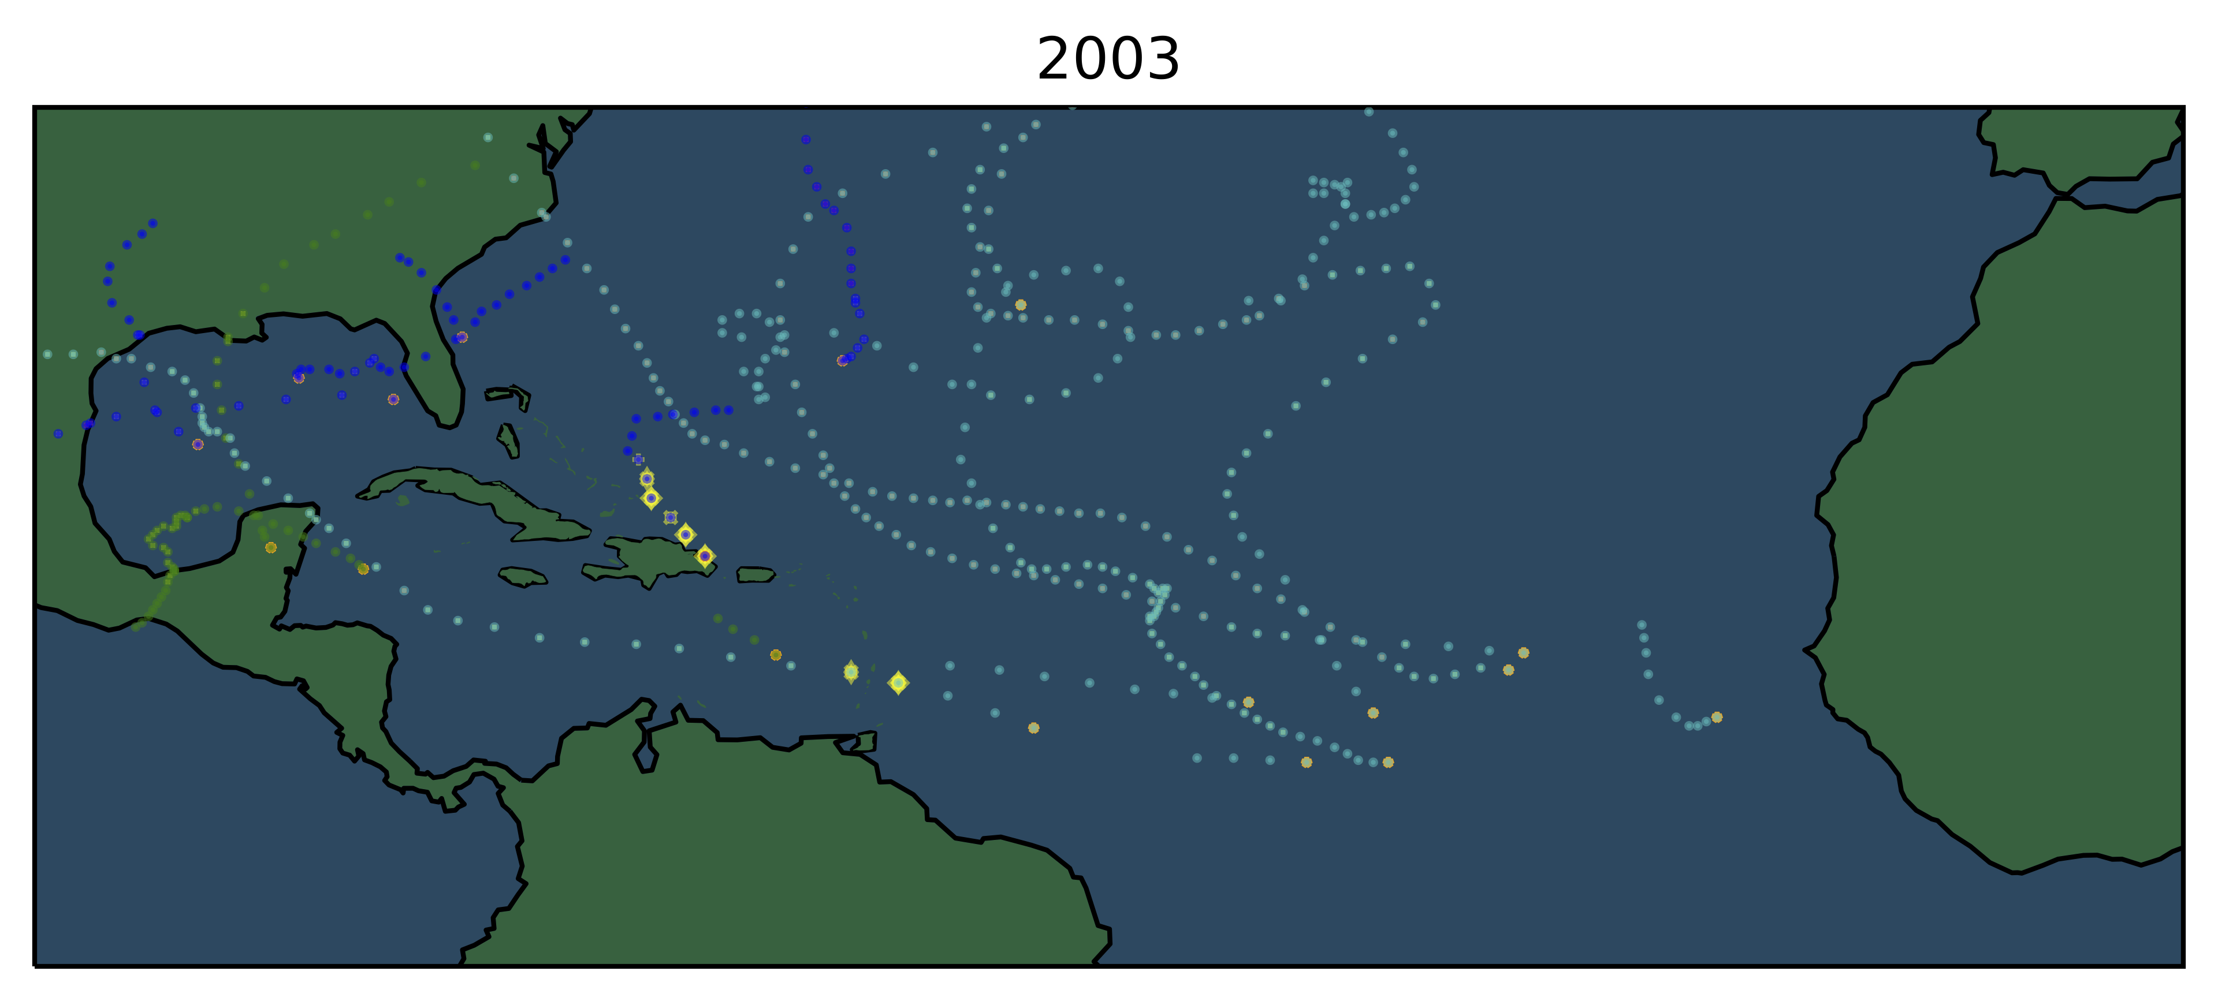
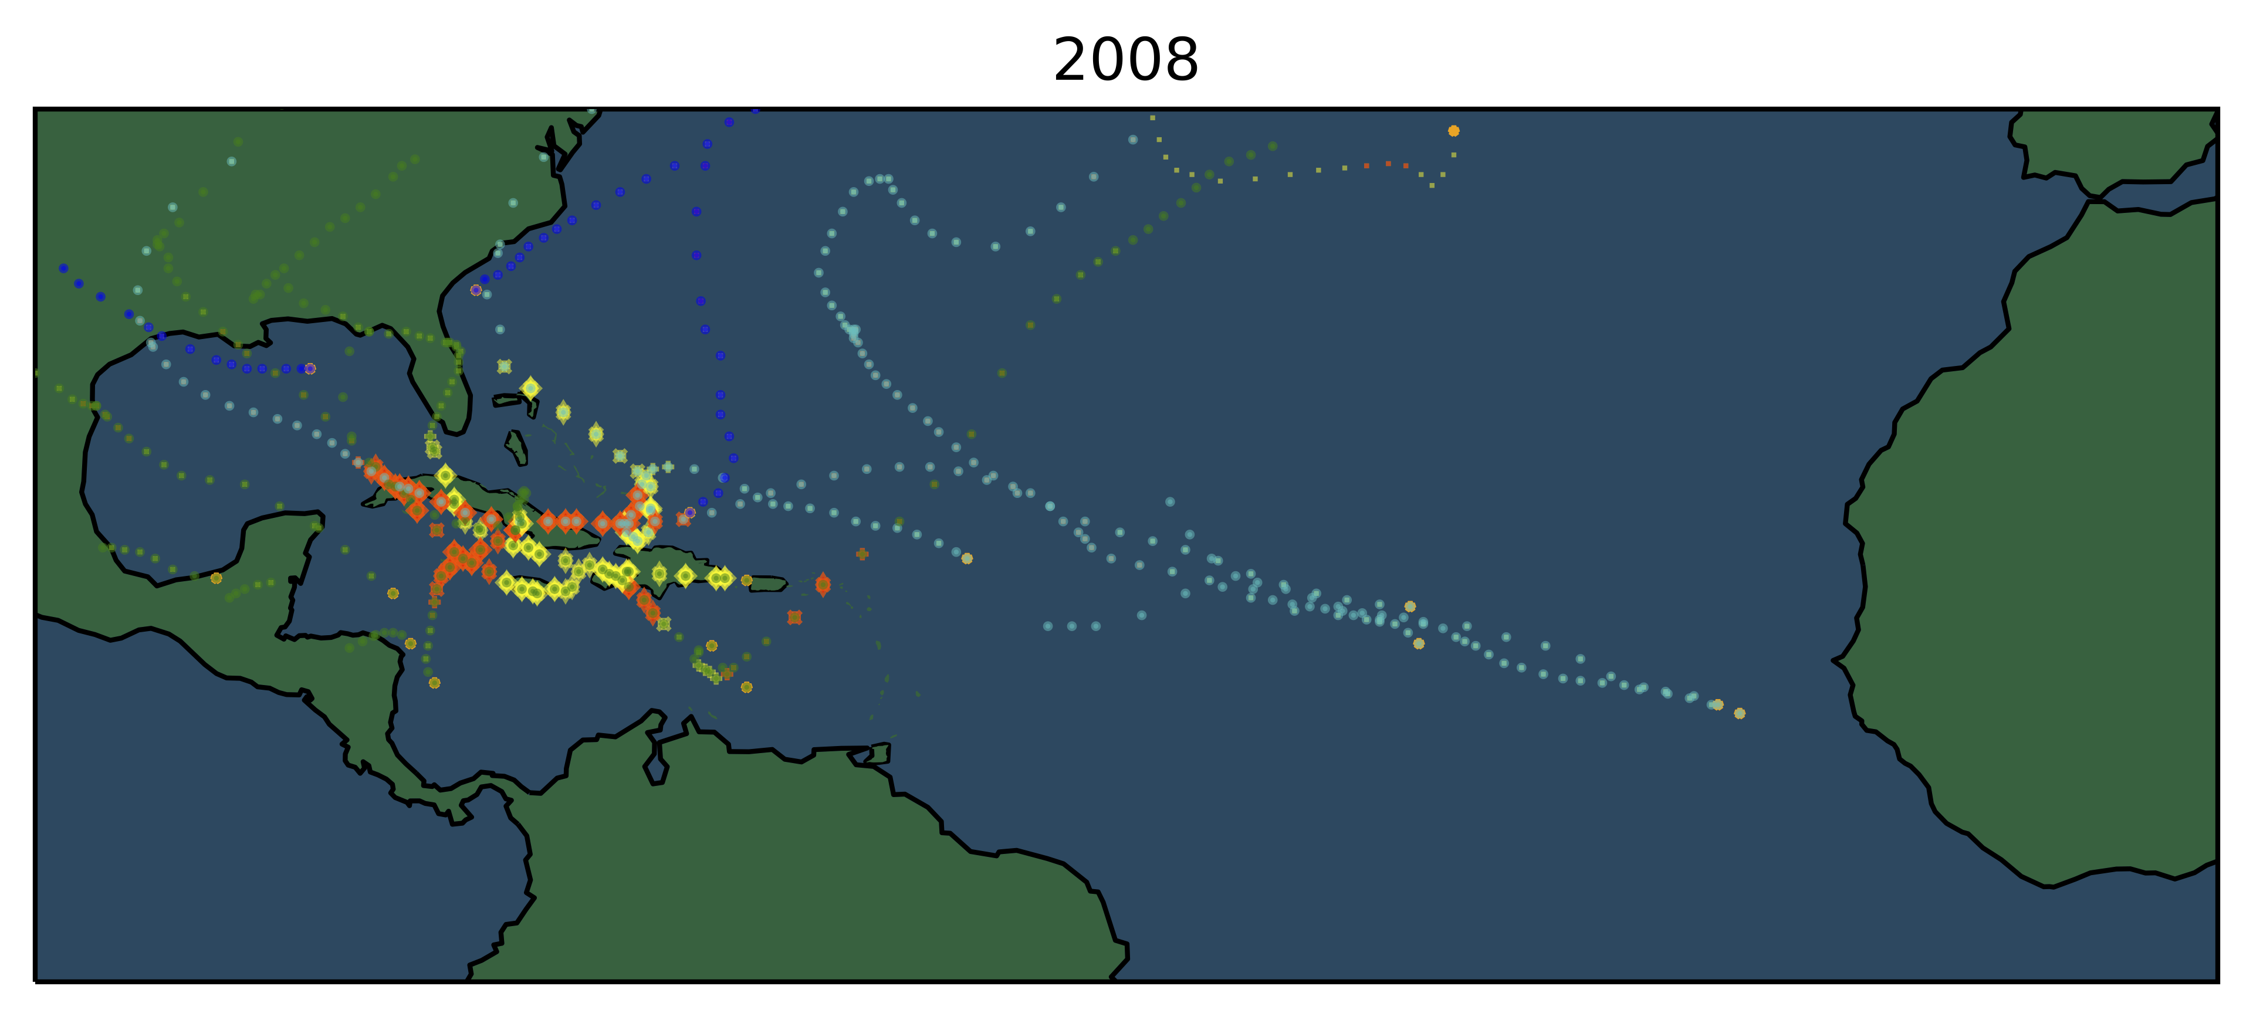
Step 2: Tropical cyclone risk for the Caribbean
The number of TCs or the Accumulated Cyclone Energy (ACE) in the basin is only a first order indicator for TC risk in the Caribbean
Additional information on the proximity of TC tracks to islands (indicated by orange and yellow markers) helps to better estimate risks

Slide 12
Potential for TC risk in the next week
-> only events closer than 2° from an island
Average ACE
Average max. wind speed [knots]
Average number of days with tropical storms
Average number of days with tropical cyclones (TCS)
The risk for TCs close to an island is higher for the nodes on the left side
As expected the weather of these nodes is characterized by low VWS, and high relative humidity

Slide 13
Summary of step 1&2:
We classified weekly weather in 25 weather flavors using self organizing maps
The risk of having TCs close to Caribbean islands in the following week is heterogeneously distributed amongst the weather types:
  After weeks with strong VWS, the risk of TCs is reduced
  After weeks with low relative humidity as well
  The risk is also lower after weeks with high pressure anomalies over the tropical Atlantic
-> Are these relationships represented in global circulation models (GCMs) and do they hold outside of the training data?

Slide 14
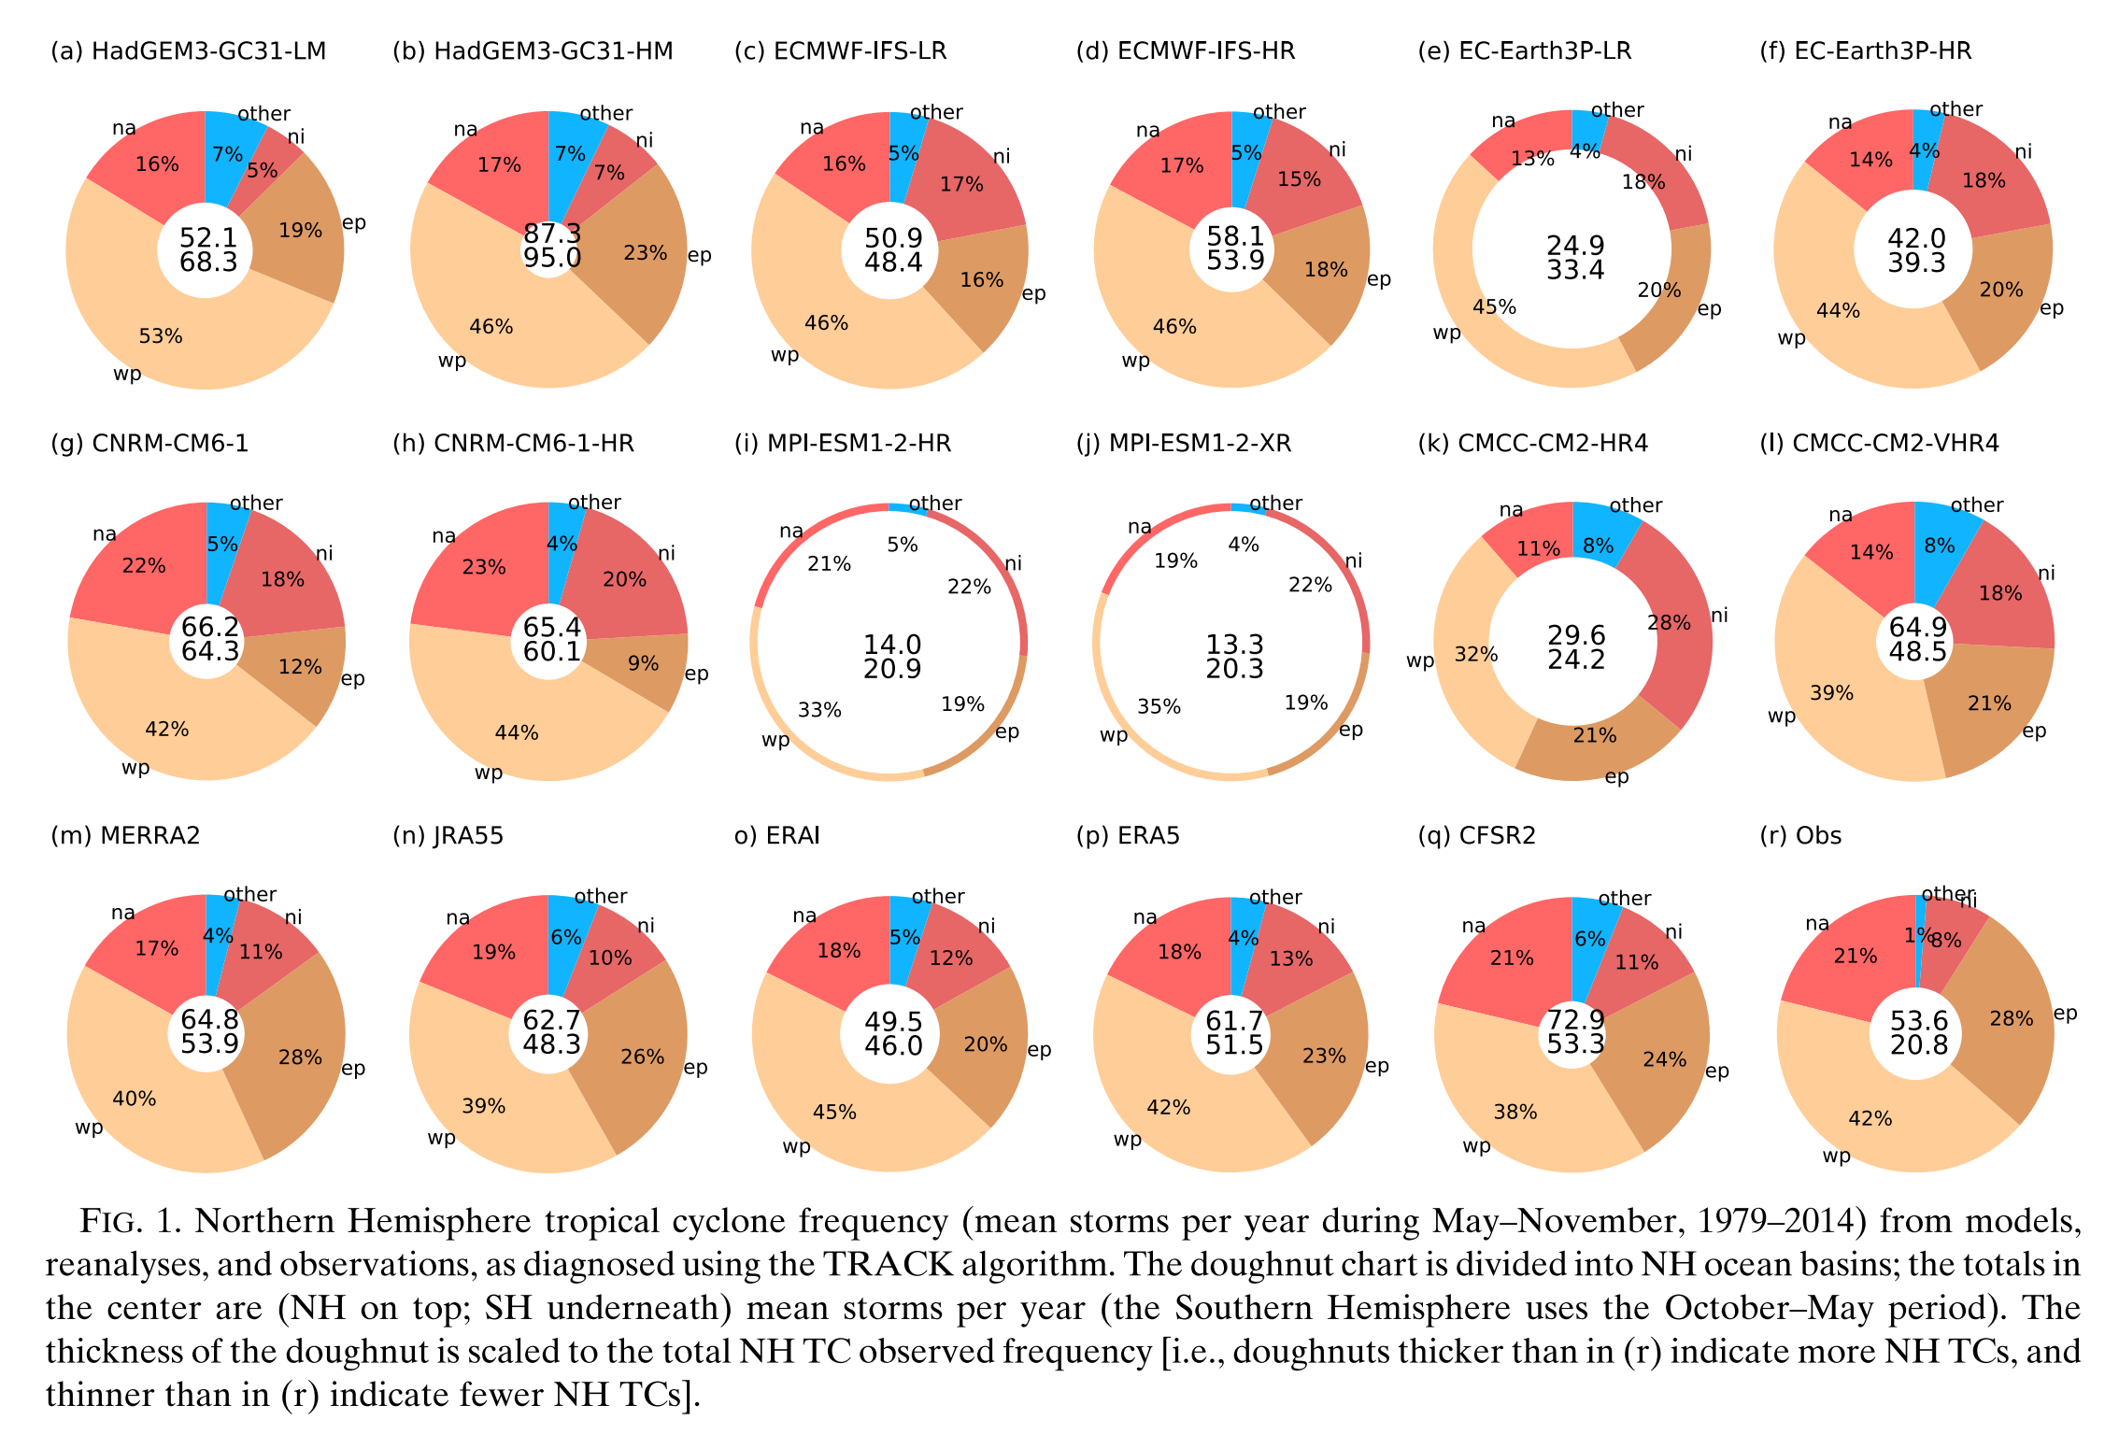
The model world: TCs in CMIP6 - PRIMAVERA
To test whether the relationships between the identified weather types and TC risk hold under different climate states we analyze TC occurrences in high resolution GCMs from the HighresMIP ensemble
Here we use TC tracks published under the PRIMAVERA project
Roberts et al. (2020) find that most of the high resolution GCMs simulate TC frequencies that are close to the observations (bottom right)
M. Roberts et al. 2020

Slide 15
Application for CMIP6
Data preprocessing as for ERA5
  At each time step where a TC was tracked:
  replace the 9 grid-cells around the center of the TC with the mean of the surrounding grid-cells
  Same grid as ERA5 (2.5x2.5 grid 10N-30N and 90W-10W)
  Weekly standardized anomalies to 1981-2010
Simulated weeks are classified using the self organizing map trained on ERA5 1981-2010

Slide 16
Preliminary results: ACE
These bars show the average ACE generated by TCs close to islands on weeks following samples that have been associated to this node
The overall tendency of higher ACE (one week after) weather types associated to nodes on the left and on the top is reproduced by the two tested GCMs
These weather types are characterized by low VWS, low pressure anomalies (especially in the MDR) and rather humid conditions
Within the nodes with higher ACE potential (top left corner), differences between ERA5 and the models are considerable
Higher Risk

Slide 17
Preliminary results: number of TCs
For the number of TCs, the same remarks are valid as for ACE (previous slide)
Here the differences between different data products for the high risk nodes (top right) are even larger
Higher Risk

Slide 18
Summary
We classified tropical Atlantic weekly weather patterns into 25 weather types
For each weather type we assessed the observed risk of TCs close to Caribbean islands one week later
As expected this risk is higher when vertical wind shear is low and the air is humid
Preliminary results suggest, that the observed relationship between weather types and TC risk are generally represented by (the 2 tested) high resolution global circulation models

Slide 19
Next steps
Evaluate whether the identified relationship between weather patterns and TC risks is robust under global warming
  Perform the same analysis for more high resolution GCMs
Build a risk model based on the classified weather types
Assess the impact of global warming on hurricane risk in the Caribbean by applying this risk model to climate projections of the entire CMIP6 (and CMIP5) ensemble

Slide 20
Questions for discussion
Do you think it is reasonable to apply self organizing maps on a combination of vertical wind shear, mean sea level pressure and relative humidity?
Do you think “weekly” is the right time scale for such an analysis?
Do you think it would be interesting to construct SOMs with training data from ERA5 and high resolution CMIP6 present runs to have more training data?

Slide 21
Thank you for your interest!
It would be nice if we could discuss these preliminary results and your thoughts on it in a poster session.
But I think it’s also nice, that you read the presentation until here. As a reward I would invite you for a drink the next time we can meet in person on a conference!

Slide 22
References
Jaye, A. B., Bruyère, C. L. & Done, J. M. y. Weather Clim. Extrem. 26, (2019).
Roberts, M. J. et al. Impact of model resolution on tropical cyclone simulation using the HighResMIP-PRIMAVERA multimodel ensemble. J. Clim. 33, 2557–2583 (2020).

Slide 23
Preliminary results: frequency of weather types
All weather types are (nearly) equally frequent in reanalysis and CNRM-CM6-1-HR and HadGEM3-GC31-HM

Slide 24
Preliminary results: number of TSs
Higher Risk

