Slide 1
Evaluation of the presence of a weak layer in numerical simulation of
lithospheric subduction
Agustina Pesce^{1, 2} Victor Sacek³
¹ CONICET, Argentina
² Instituto Geofísico Sismológico Volponi, UNSJ, Argentina
³ Instituto de Astronomia, Geofísica e Ciências Atmosféricas, Universidade de São Paulo, São Paulo, Brazil

Slide 2
Preservation of the
Decoupling in a
subduction scenario
Weak layer
Represent a lubrication
between both plates
GOAL
HOW
Continuous entrainement of a weak layer
PROBLEMS
Lubrication layer
Variations on the thickness and rheological structure of this weak layer affect the geodynamic evolution of the subducting plate

Slide 3
2D Numerical Code
Inputs:
Initial temperature distribution
Layer model
Rheology model
Velocity field
Boundary conditions
Solves the Stokes flow for a fluid using the Boussinesq approximation in a Cartesian coordinate system
MANDYOC
A finite element code to simulate the thermochemical convection

Slide 4
Inputs
Initial temperature
distribution
T varies linearly
with depth
Adiabatic heat
distribution
Layer model

Slide 5
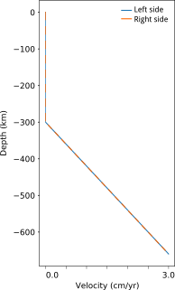
Inputs
Rheology model
Visco-plastic approach η = min(η_{visc} , η_{plast})
Byerlee's friction law
Frank-Kamenetskii rheology
Considers the speed of the lower mantle with respect to the continent
Velocity field

Slide 6
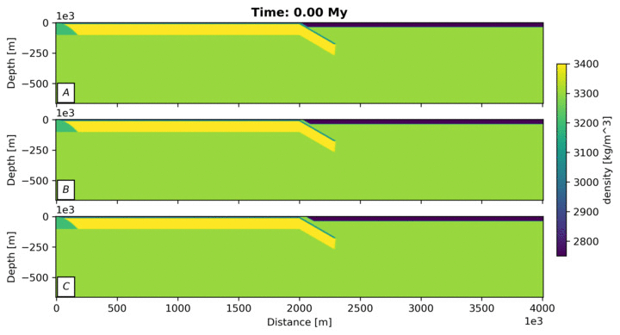
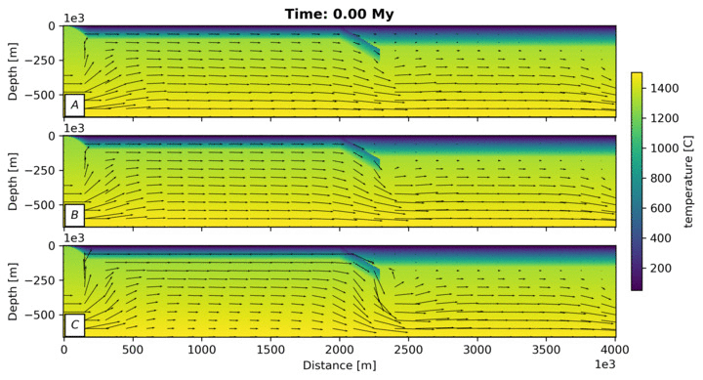
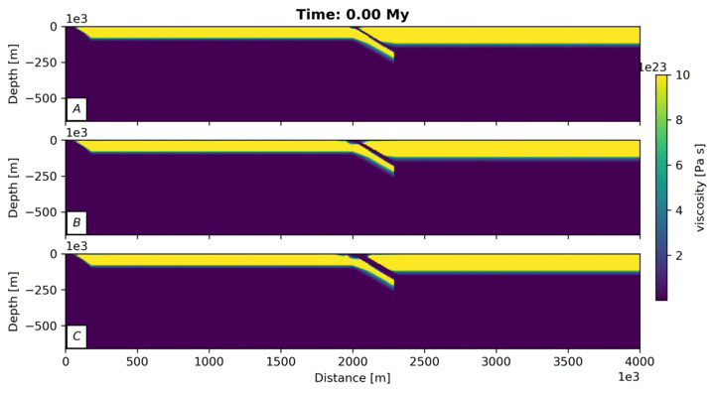
Using only a lubrication layer
A weak zone is imposed in the region between the two plates. This zone presents low viscosity and density relative to the surrounding lithosphere.
Thickness: 10 km (A); 30 km (B); 60 km (C)

Slide 7
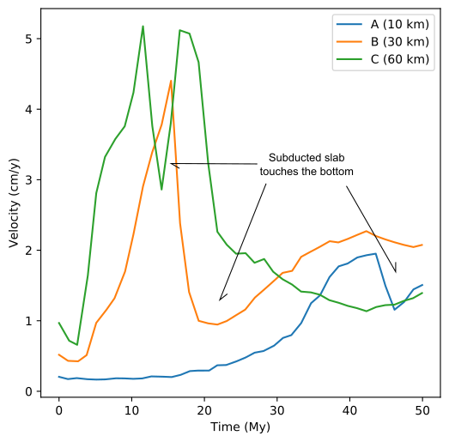
The backward movement of the slab in C is induced by the high speed of the plate in subduction relative to the horizontal velocity of the asthenosphere imposed on the lateral boundaries.
The decoupling depends on layer thickness.
The thickness affect the subduction velocity.
The lubrication layer is deformed and dragged with the subducted slab.
The coupling of the lithospheric plate generates the thickening of the continental lithosphere below the trench region.

Slide 8
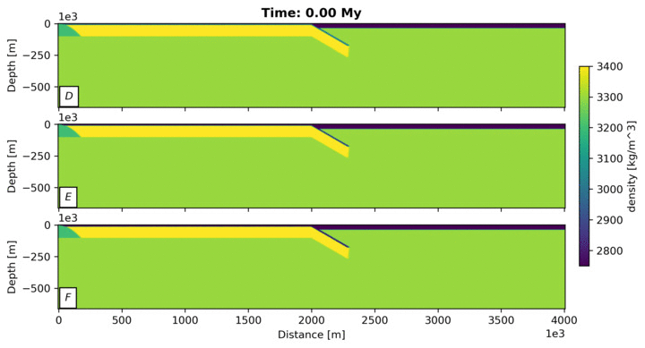
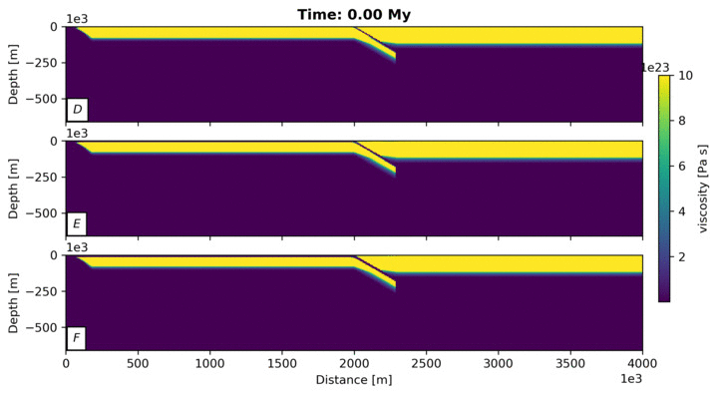
Using only continuous weak layer
A continuous weak zone is imposed on top of the oceanic plate is added with low density and viscosity.
Thickness: 2 km (D); 5 km (E); 10 km (F)

Slide 9
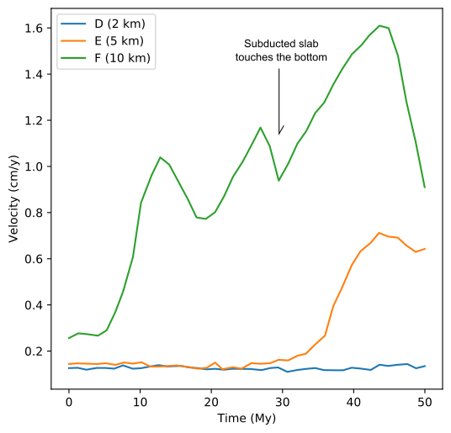
The layer thickness affect the velocity subduction.
A thick layer is required to generate decoupling of the plates, more than 10 km.

Slide 10
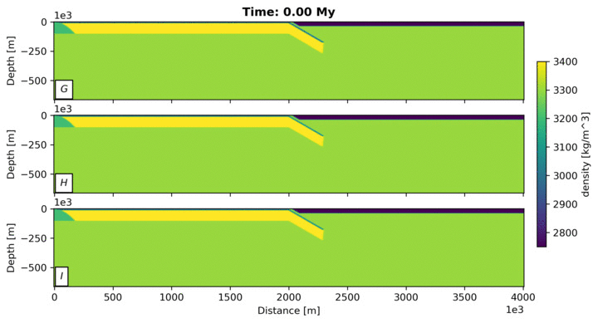
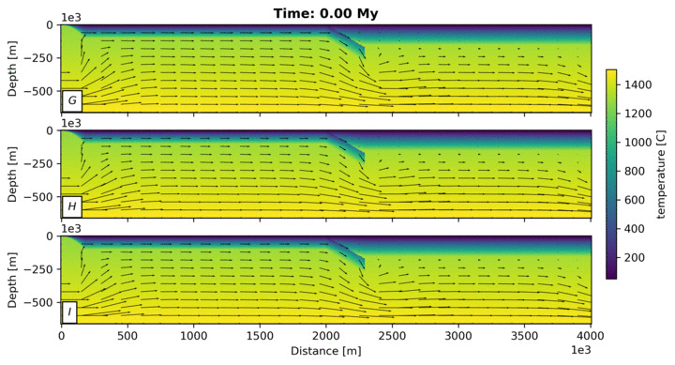
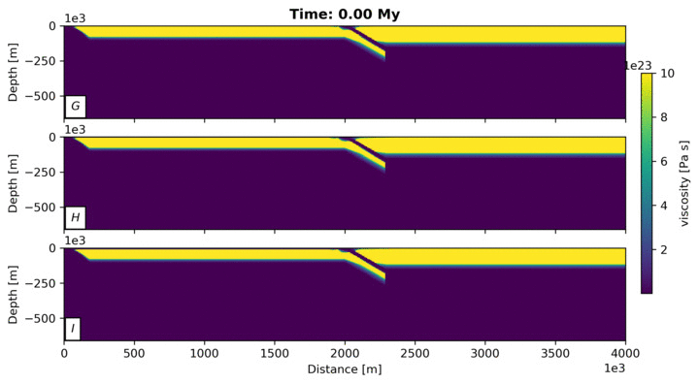
Combining a lubrication layer and a continuous weak layer
Lubrication thickness is 30 km.
Continuous weak layer: 2 km and ρ = 2.5 g/cm³ (G); 2 km and ρ = 3 g/cm³ (H); 5 km and ρ = 3 g/cm³ (I);

Slide 11
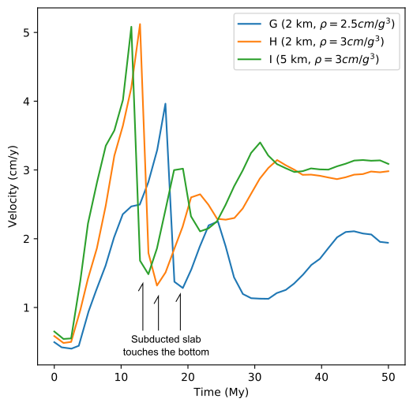
The lubrication zone is still dragged by the subducting plate, but the additional weak layer keeps between the plates, preventing the coupling of the two lithospheric plates.

Slide 12
Future work
Use these numerical scenario to analyse the subduction pattern of the Nazca plate observed in the southeastern portion of South America.

Slide 13
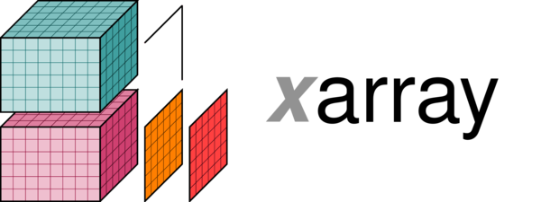
Acknowledgements
MANDYOC
MANtle DYnamics simulatOr Code
Geophysics Department IAG/USP
https://bitbucket.org/victorsacek/mandyoc/
All content under
Creative Commons Attribution 4.0

Slide 14
Slides are available for download:
https://doi.org/10.6084/m9.figshare.12235367

