Slide 1
NEMO The NEar real-time MOnitoring system for bright fireballs
Theresa Ott¹, Esther Drolshagen¹, Detlef Koschny², Gerhard Drolshagen¹, Christoph Pilger³, Pierrick Mialle⁴, Jeremie Vaubaillon⁵, and Björn Poppe¹
¹University of Oldenburg
²ESA, SSA-NEO Segment
³BGR, Hannover, Germany
⁴CTBTO PTS/IDC, Vienna International Center ⁵Observatoire de Paris

Slide 2
Shooting Stars
Bright fireballs cause a lot of public attention. They can scare, frighten, astound, surprise, or amaze people.
Foto-webcam.eu

Slide 3
Meteor Research
UpCosmos.com

Slide 4
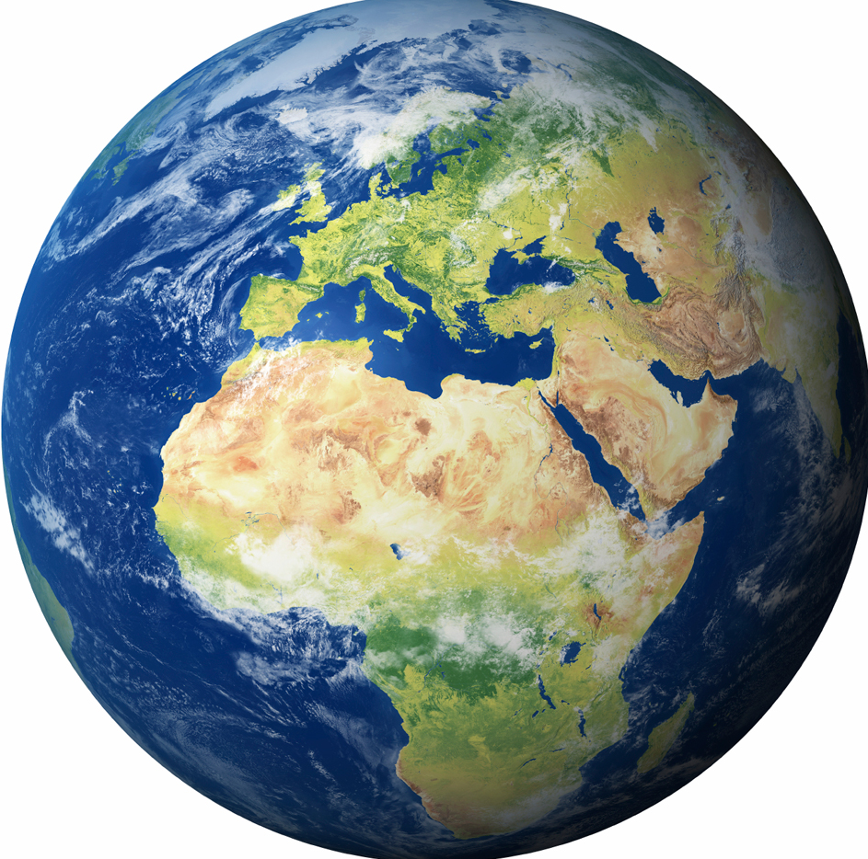
Meteoroid Impacts Daily Impact Mass
54 t material
Drolshagen et al. (2015)

Slide 5
Meteoroid Impacts Daily Impact Mass
= 72 milk cows
54 t
But mostly from small particles
Drolshagen et al. (2015)

Slide 6
Impact Risk Interval and Effect Estimation
Drolshagen et al. (2017)

Slide 7
Impact Risk Chelyabinsk $$≈$$ 20 m Asteroid

Slide 8
Impact Risk Chelyabinsk $$≈$$ 20 m Asteroid
Fortunately, no deaths
Over a thousand injured

Slide 9
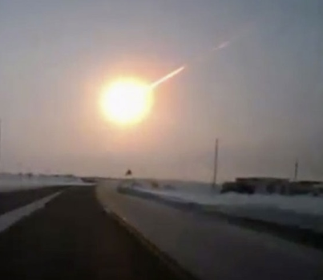
NEMO Near real-time MOnitoring system
Interested in objects that
regularly impact the Earth atmosphere
are too small to be detected by NEO surveys
cause bright fireballs
Validate models of meteoroid fluxes and the near-Earth asteroid population
Close the gap between large meteoroids and small asteroids
Youtube / Nasha gazeta
Chelyabinsk fireball 15. Feb. 2013

Slide 10
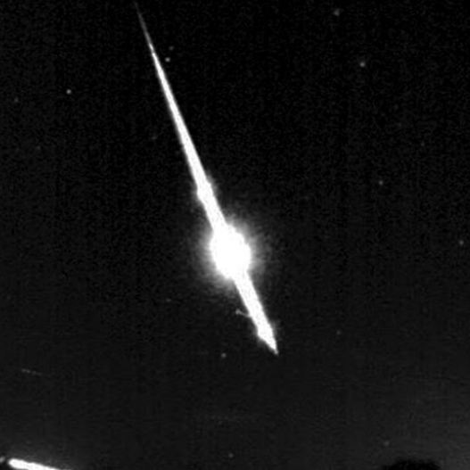
Coordination with FIS
Events brighter $$−10$$mag
Fireball Information System from Space Situational Awareness – near-Earth object (NEO)
SMART
Who is interested in the data?
Planetary Defence Office (ESA)
Planetary Defense Coordination Office (NASA)
IAWN (International Asteroid Warning Network)
BGR (Federal Institute for Geosciences and Natural Resources)
The public e.g. IMO (International Meteor Organisation)

Slide 11
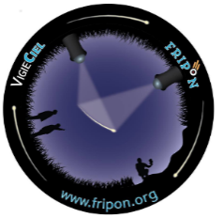
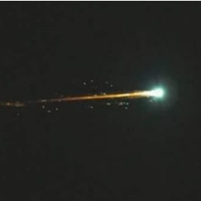
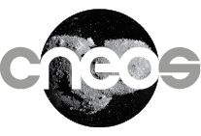
Main Objective
Fireball Sighting
Current Situation
NEMO
+ additional fireball systems
Twitter
P. Pszeniecka
Brighter $$−10$$mag
Brighter -10 mag

Slide 12
Data sources
Data from infrasound stations of the CTBTO –Comprehensive Nuclear-Test-Ban Treaty Organisation using vDEC
Publicly available data from US Government sensors
Re-entry predictions of satellites and space debris
Internet and social media
Meteor networks
+ additional fireball systems

Slide 13
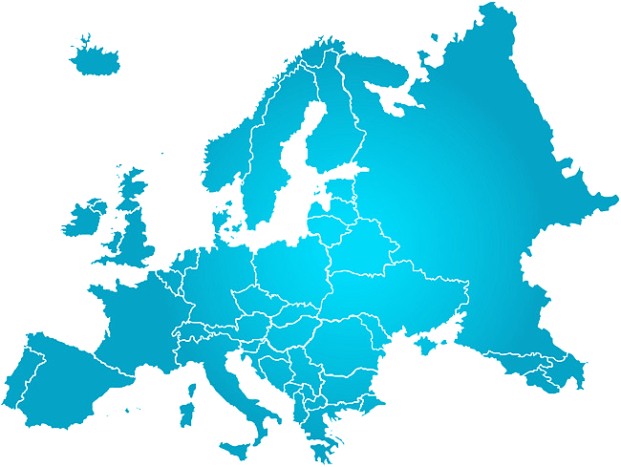
Some specific goals
Europe: Objects > 10 cm
Achieved by e.g.:

Slide 14
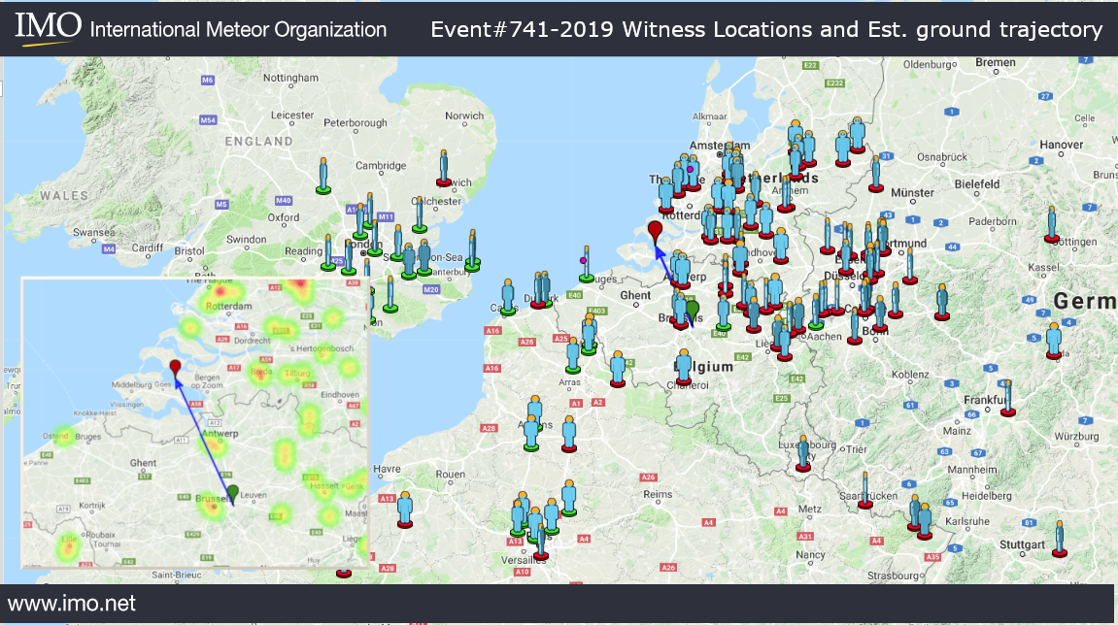
Local Meteor Detections
Public outreach
Local networks
Eye-witness reports
15 February 2019 – the Netherlands
ctbto.org
Fisheye cameras
FRIPON.org

Slide 15
Some specific goals
Global: Objects > ca 1 m
Achieved by e.g.:

Slide 16
NASA US Govt. Satellite Data
Chelyabinsk Asteroid
From CNEOS (Center for NEO Studies) at JPL (Jet Propulsion Laboratory)

Slide 17
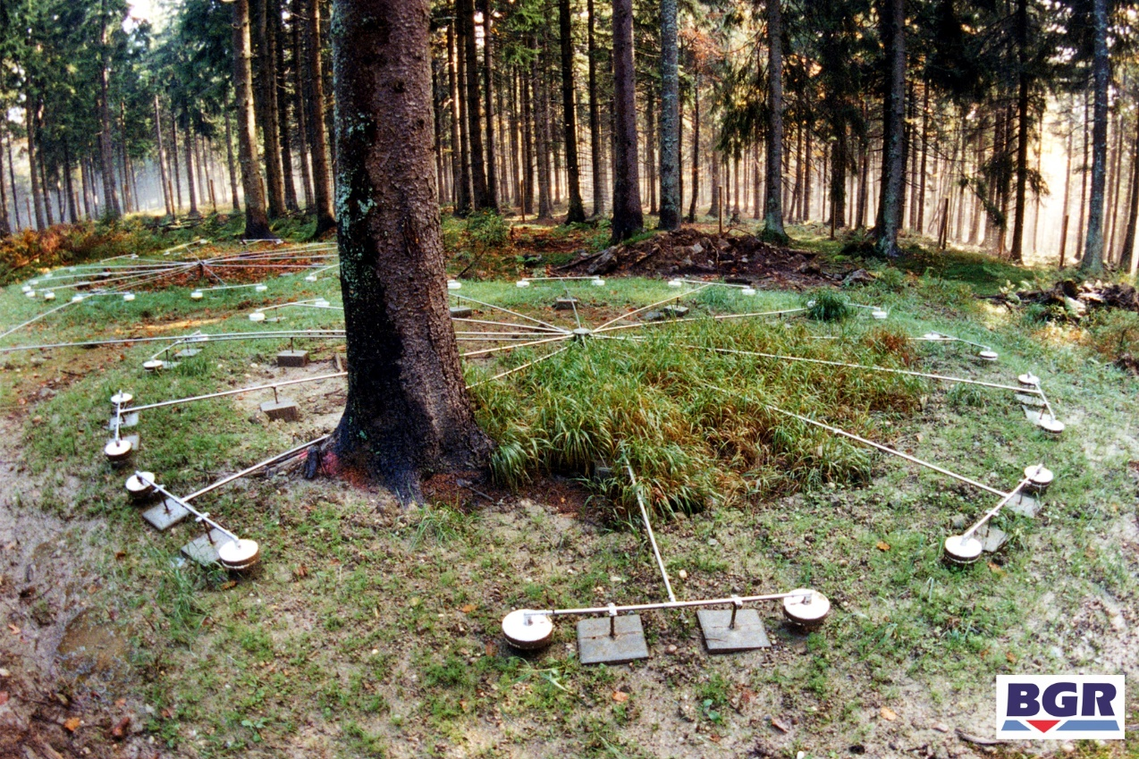
CTBTO IMS (International Monitoring System) - Infrasound
Bright fireball reported
Infrasound data is requested from BGR
BGR:
Federal Institute for Geosciences and Natural Resources
German National Data Center for the verification of the CTBT
For further collaboration details see Pilger et al. - EGU2020-3290
ctbto.org

Slide 18
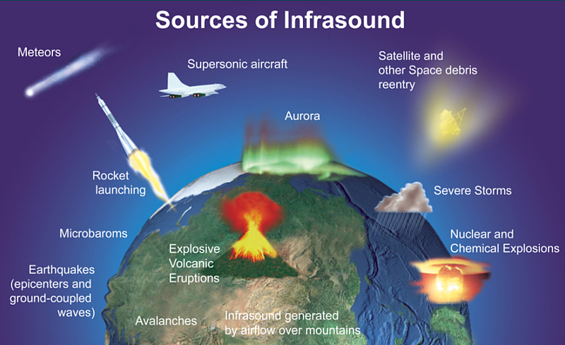
CTBTO IMS (International Monitoring System) - Infrasound
ctbto.org
ctbto.org

Slide 19
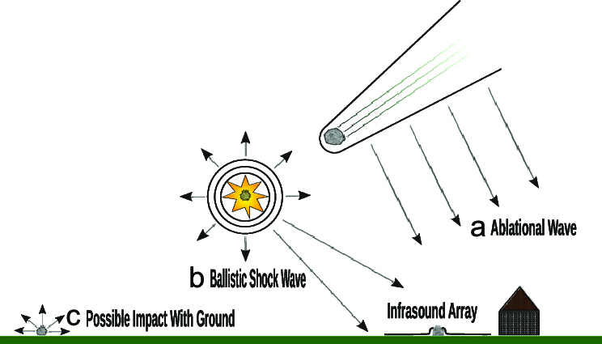
CTBTO IMS (International Monitoring System) - Infrasound
Asteroid impacts into the atmosphere can be detected by infrasound arrays similar to explosions in the atmosphere.
Fragmentation shows very well in the data.
ctbto.org
Image credit: E. Silber

Slide 20
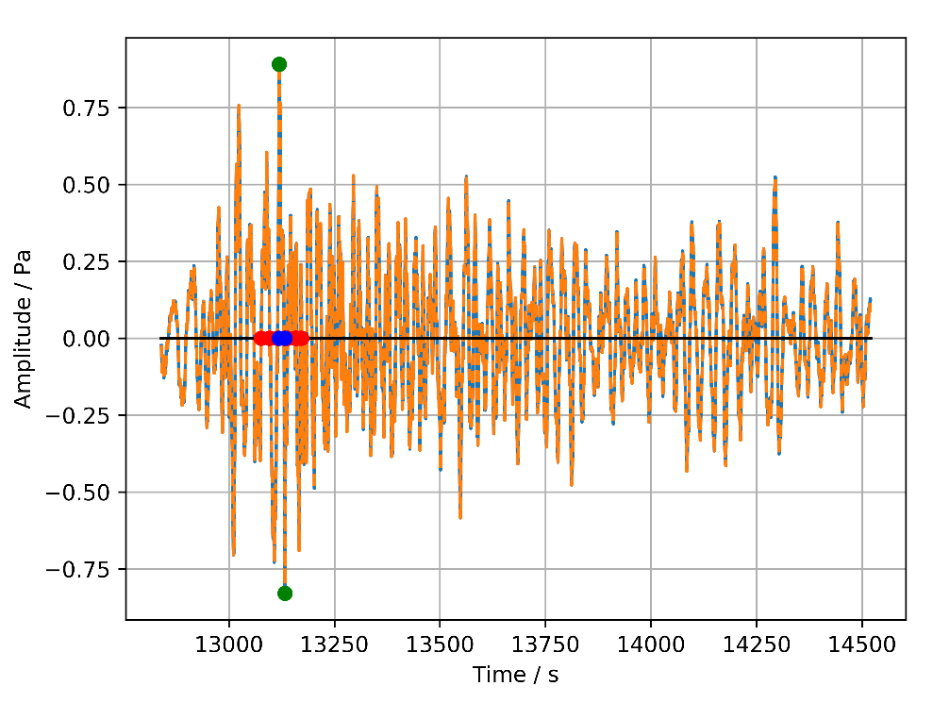
CTBTO IMS (International Monitoring System) - Infrasound
Meteor signal in waveform
Energy determination using period at maximum amplitude
ReVelle (1997): period-energy-relation based on nuclear explosions
ctbto.org

Slide 21
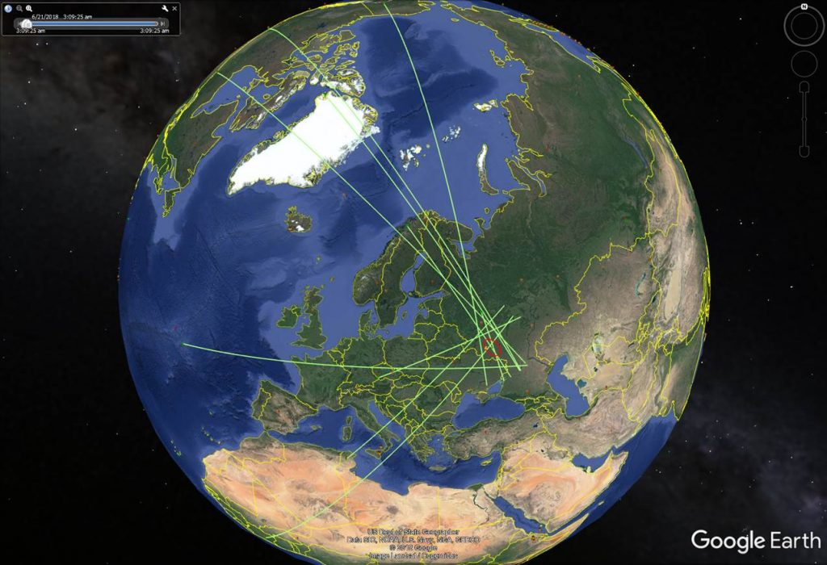
CTBTO Asteroid Detection Example
Russia 21 June 2018 01:15 UT
Asteroid entry detected by 10 IMS stations
CTBTO
W. Randy Bell
Pierrick Mialle
IDC, CTBTO

Slide 22
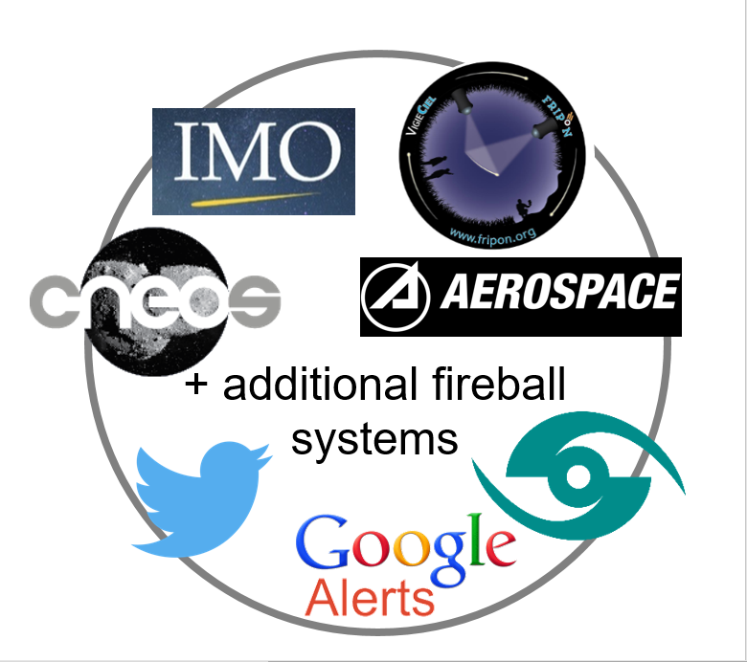
NEMO Event A bright fireball
First information for NEMO usually from Twitter -> starting point
ctbto.org
NEMO

Slide 23
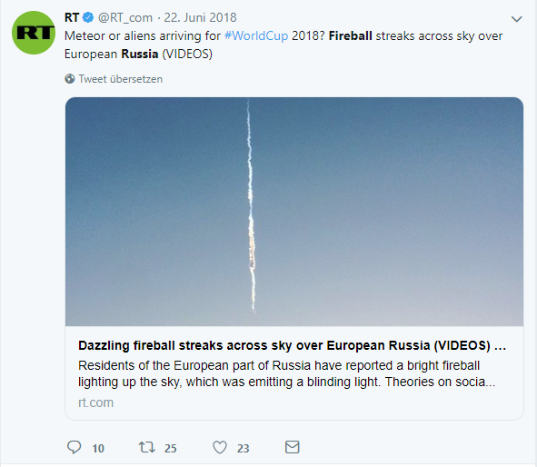
NEMO Event A bright fireball
Residents of the European part of Russia have reported a bright fireball lighting up the sky, which was emitting a blinding light. Theories on social media varied from a simple meteor to aliens arriving for World Cup 2018.
A first Tweet triggers the alert system
ctbto.org

Slide 24
NEMO Event A bright fireball
Sometimes a video is available
Apostol875/Youtube

Slide 25
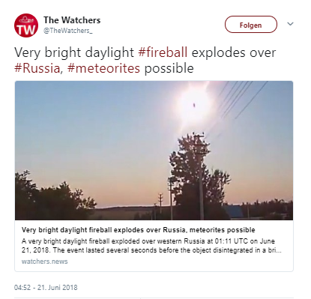
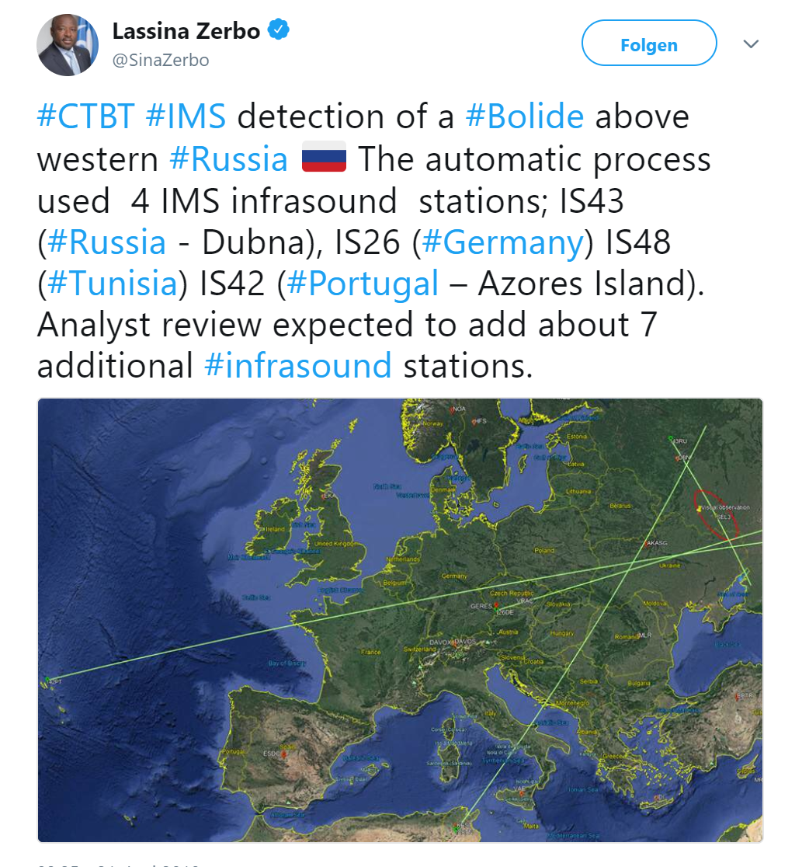
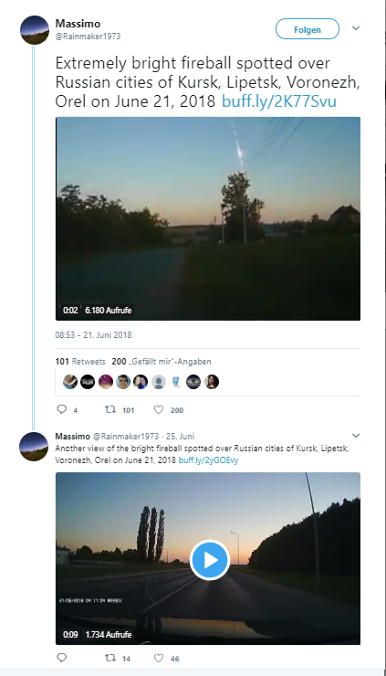
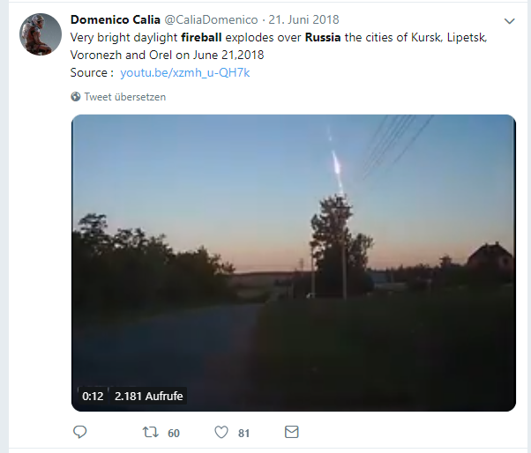
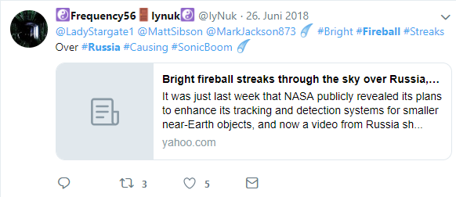
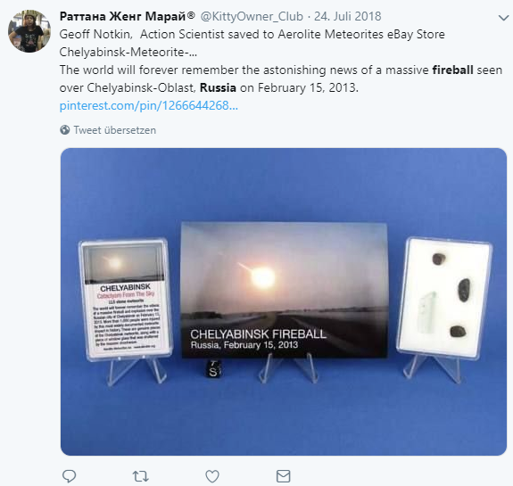
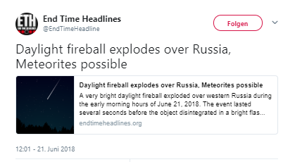
Daytime fireball over Russia 21 June 2018 - 01:15 UT (04:15 LT)
Followed by many more Tweets
ctbto.org
Twitter

Slide 26
Daytime fireball over Russia 21 June 2018 - 01:15 UT (04:15 LT)
Was the fireball detected by infrasound stations?
NEMO

Slide 27
Daytime fireball over Russia 21 June 2018 - 01:15 UT (04:15 LT)
Infrasound
Automatic detection: 4 IMS infrasound stations
Refined investigation: 10 infrasound stations
Mean period at maximum amplitude: 6.28 s
Source energy of: 2.4 kt TNT.
ctbto.org
P. Mialle

Slide 28
Daytime fireball over Russia 21 June 2018 - 01:15 UT (04:15 LT)
Infrasound
Analysis of the IMS infrasound data
ctbto.org
Ott et al. (2019)

Slide 29
Daytime fireball over Russia 21 June 2018 - 01:15 UT (04:15 LT)
Infrasound
10 Infrasound stations
a source energy of 2.4 kt TNT.
a size of about 4 m
CNEOS/JPL found
a source energy of 2.8 kt TNT.
Infrasound signal received with station I56US processed with PMCC.
ctbto.org

Slide 30
Daytime fireball over Russia 21 June 2018 - 01:15 UT (04:15 LT)
Collect and add further information
NEMO

Slide 31
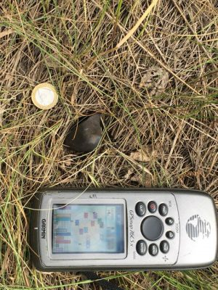
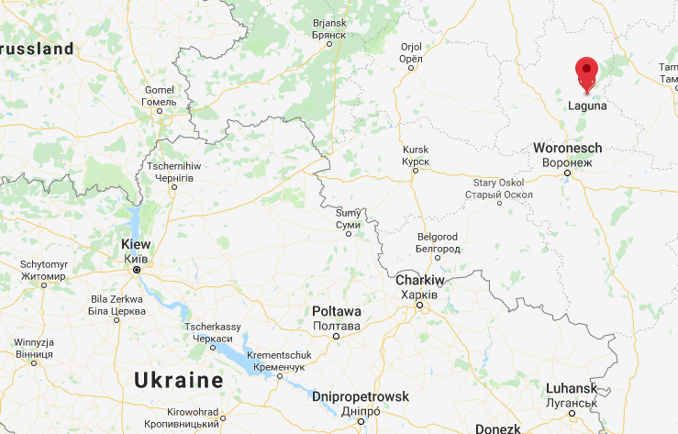
Daytime fireball over Russia 21 June 2018 - 01:15 UT (04:15 LT)
Scientists from the Ural Federal University
Found over 5 kg of meteorites
Largest: 0.55 kg
ctbto.org
$$→$$Density constraint for mass computations
UrFU University

Slide 32
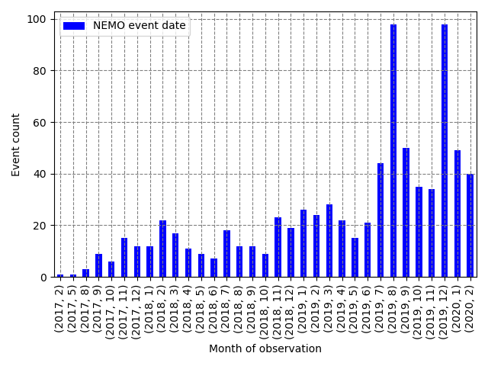
NEMO Events
First NEMO Event in August 2017
About 29 months of test-operation
Since Jan 2020 in operation at ESA
Over 800 events
ctbto.org
Increased activity due to meteor showers with a large quantity of fireballs

Slide 33
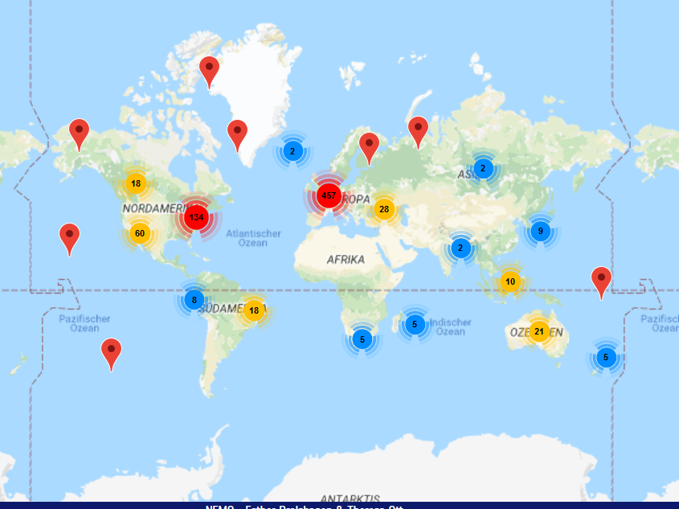
NEMO Events
ctbto.org

Slide 34
Outlook
Since the beginning of this year (2020) NEMO is in operation at the European Space Agency as part of its Space Safety Programme
Next Steps
Adding social media services to reduce biases based on location
More data from existing fireball networks and other sources
Access, analyze, and combine

Slide 35
References
https://www.fripon.org/?lang=en
https://cneos.jpl.nasa.gov/fireballs/
https://ghrc.nsstc.nasa.gov/lightning/overview_glm.html
https://www.ctbto.org/verification-regime/monitoring-technologies-how-they-work/infrasound-monitoring/
https://atlas.fallingstar.com/home.php
https://panstarrs.stsci.edu/
https://ares.jsc.nasa.gov/meteorite-falls/
http://www.ifa.hawaii.edu/info/press-releases/ATLAS_2019MO/
https://minorplanetcenter.net/mpec/K19/K19M72.html
https://remanzacco.blogspot.com/2019/06/small-asteroid-neocp-a10eom1-impacted.html
https://www.imo.net/new-year-italian-meteorite-recovered/
Ott, T., Drolshagen, E., Koschny, D., Mialle, P., Pilger, C., Vaubaillon, J., Drolshagen, G., Poppe, B. (2019), Combination of infrasound signals and complementary data for the analysis of bright fireballs, Planetary and Space Science, Volume 179, https://doi.org/10.1016/j.pss.2019.104715
https://www.imo.net/bright-fireball-over-alberta/
https://www.imo.net/fireball-over-the-caribbean-detected-before-it-entered/

Slide 36
Thank you for your interest

