Slide 1
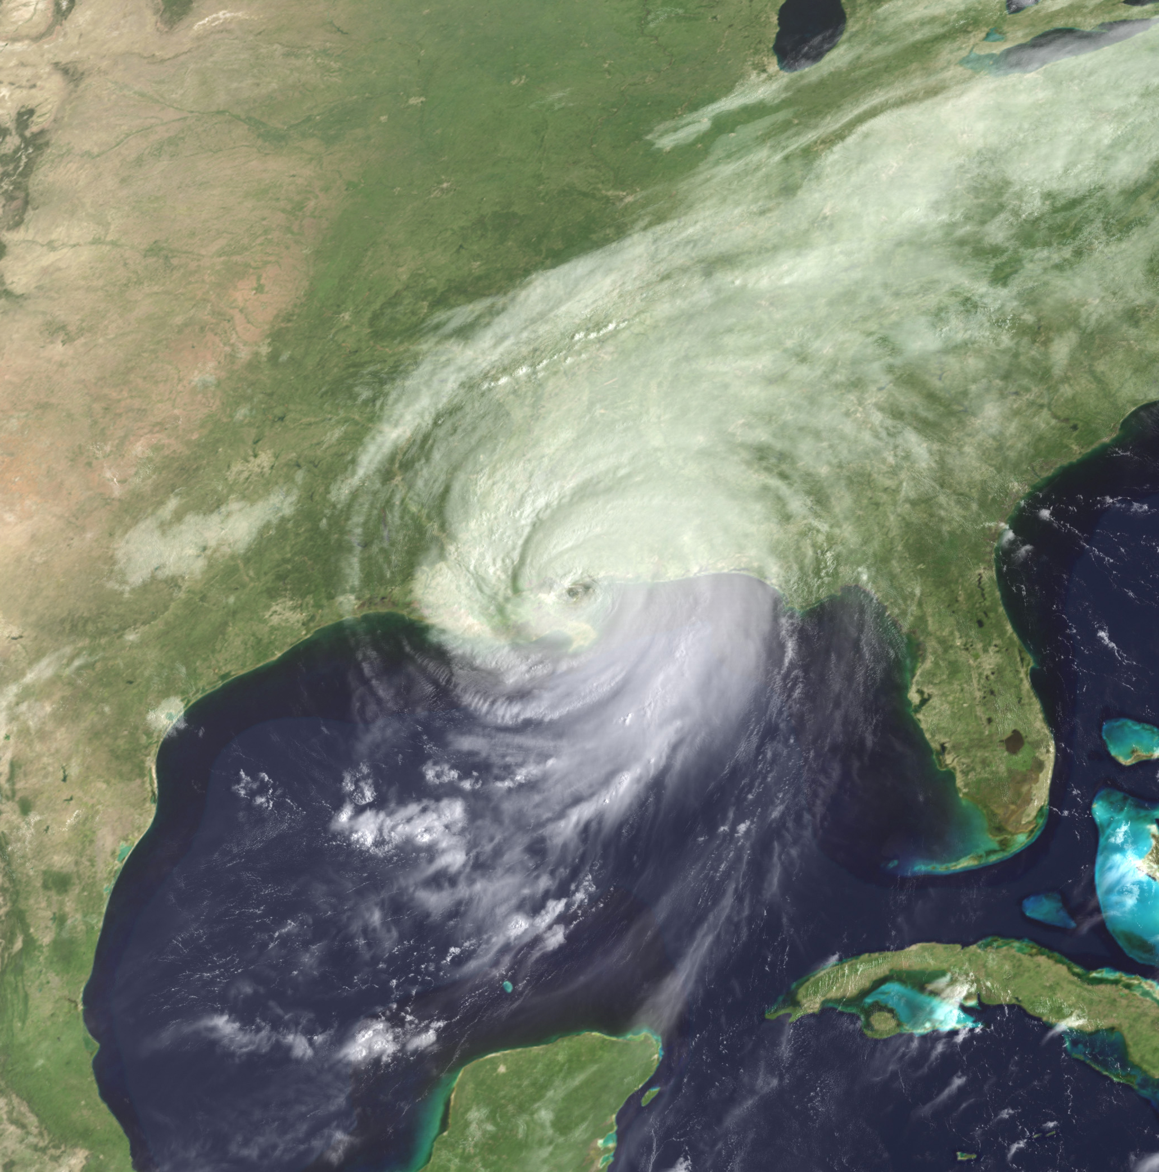



Unsolved problems in hydrology: societal responses to
unprecedented extreme events
Maria Rusca
Gabriele Messori
Giuliano Di Baldassarre

Slide 2
Hurricane Katrina approaches New Orleans, August 29 2005
Most destructive tropical cyclone recorded at the time
Claimed over 1,800 lives
Costliest disaster in U.S. history at the time
Uneven vulnerability and recovery trajectory

Slide 3
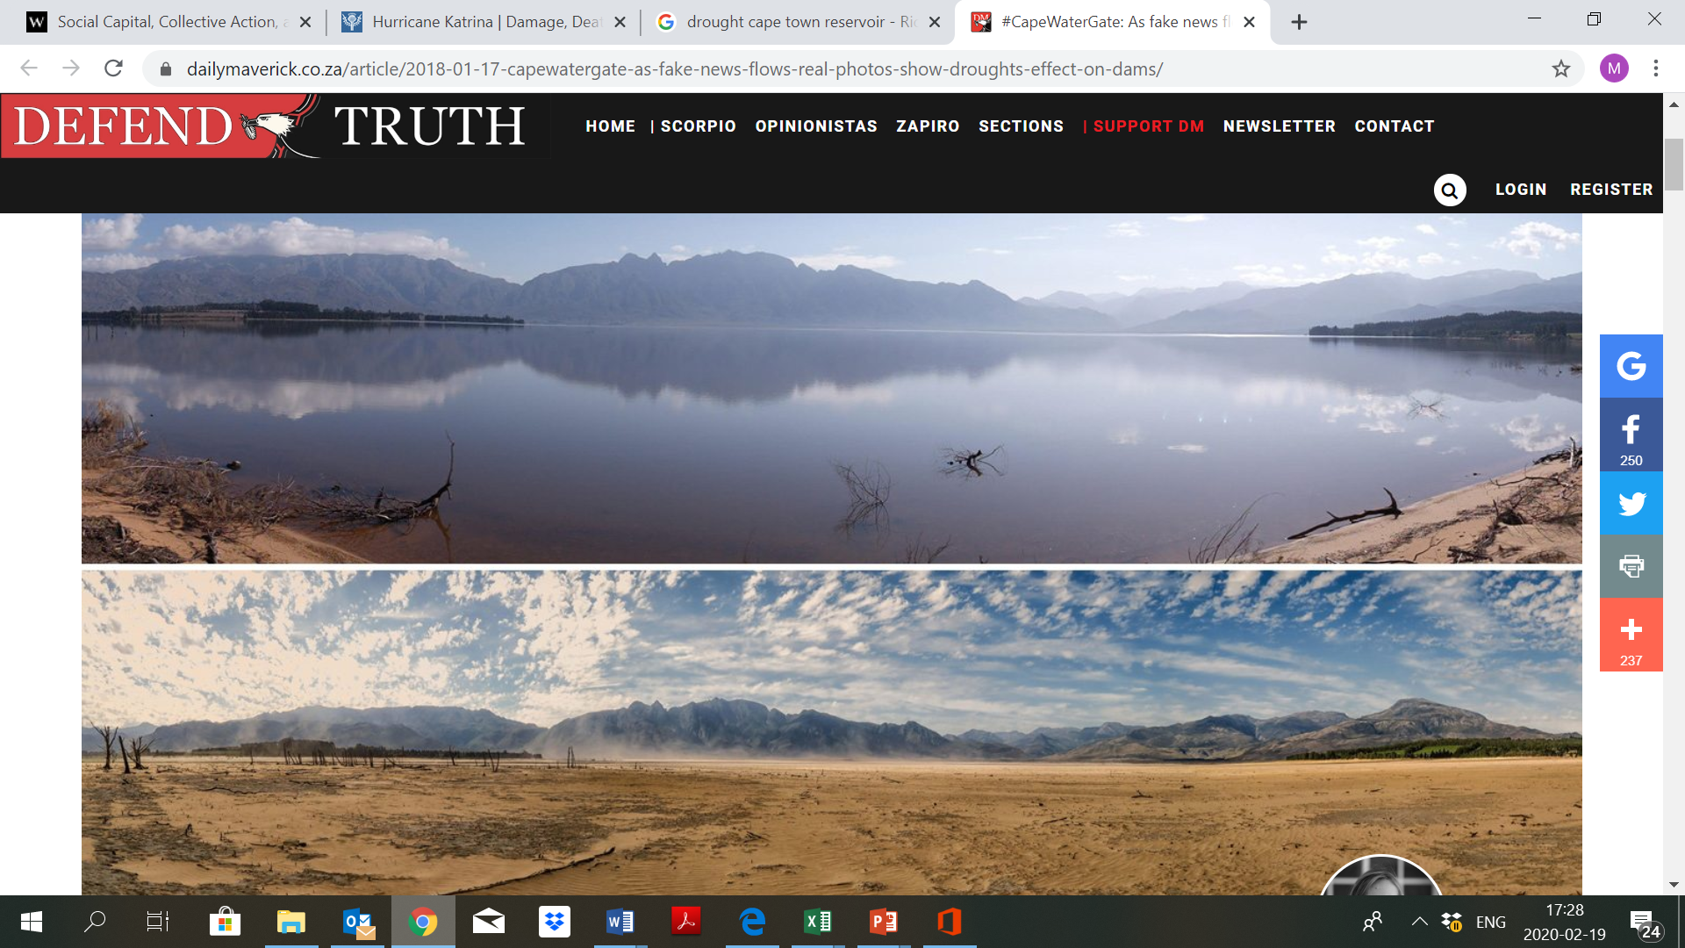
Theewaterskloof Dam, July 2014
Cape Town, 2015-2018
Theewaterskloof Dam, January 2018
Reservoirs water level: 22.8%
Usable water: 12.3%
Wolski P., 2018

Slide 4

Day Zero
Cape Town, 2015-2018
Drop in rainfall (Conradie 2018; Wolski 2018; Winter 2018; Botai et al. 2017).
From 780 to 325 mm/year (2015), 221 mm/year (2016), 157 mm/year (2017)
From increasing water consumption to ‘water-wise City’ (COCT 2018)
Uneven vulnerability and recovery trajectories
Source: Savelli et al., forthcoming

Slide 5
Floods and droughts have impacted humanity throughout history
Increasing global trends in floods and drought related disasters
Floods and drought related disasters exacerbated by climate change
New
Normal
Unprecedented hydroclimatic events

Slide 6
New
Normal
Unprecedented hydroclimatic events
How will these unprecedented extremes unfold?
What possible societal responses will these extreme occurrences engender?
  Immediate response
  Recovery trajectory

Slide 7

Cicero, De Oratore, II, 36
New
Normal
Unprecedented hydroclimatic events
History is a "teacher of life".
The study of the past should serve as a lesson for the future

Slide 8
Cicero, De Oratore, II, 36
New
Normal
Unprecedented hydroclimatic events
History to develop plausible scenarios of societal responses to unprecedented events
Social science theories on vulnerability to and recovery from disasters
Case study analyses

Slide 9
Societal responses to
Preliminary findings
Household responses
unprecedented hydroclimatic events

Slide 10
Drought onset
Income, vulnerability and recovery trajectory, Savelli et al. (under review)
Uneven development trajectory
Disaster Onset
Uneven Recovery trajectory

Slide 11
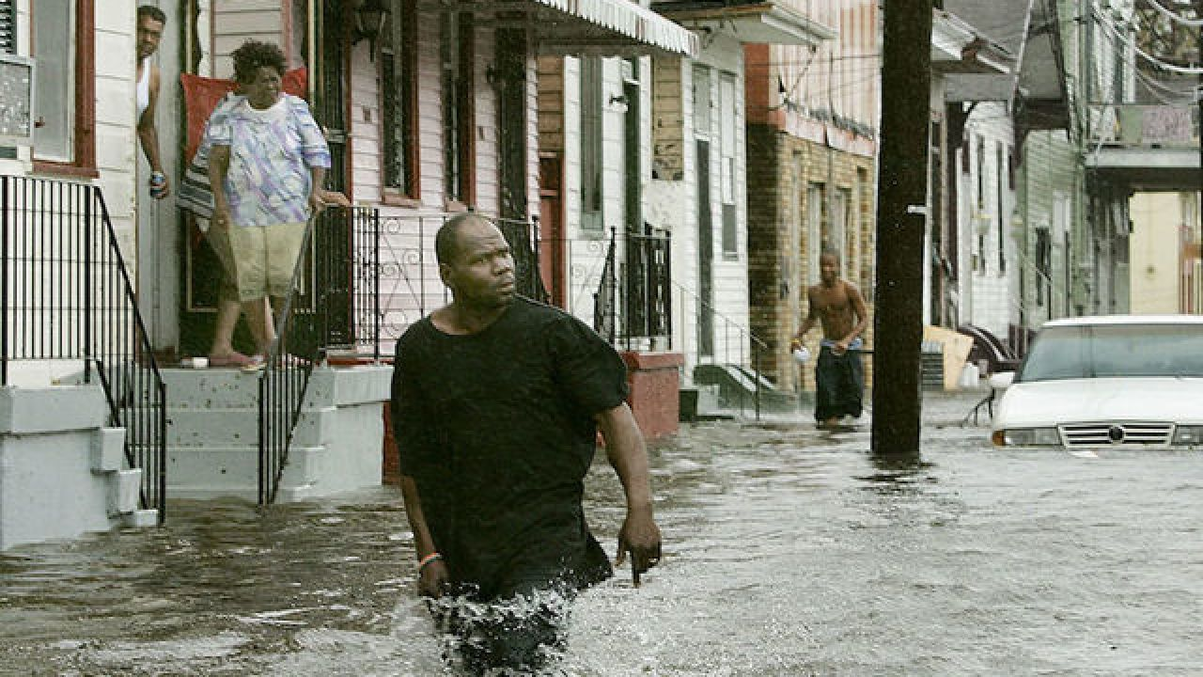
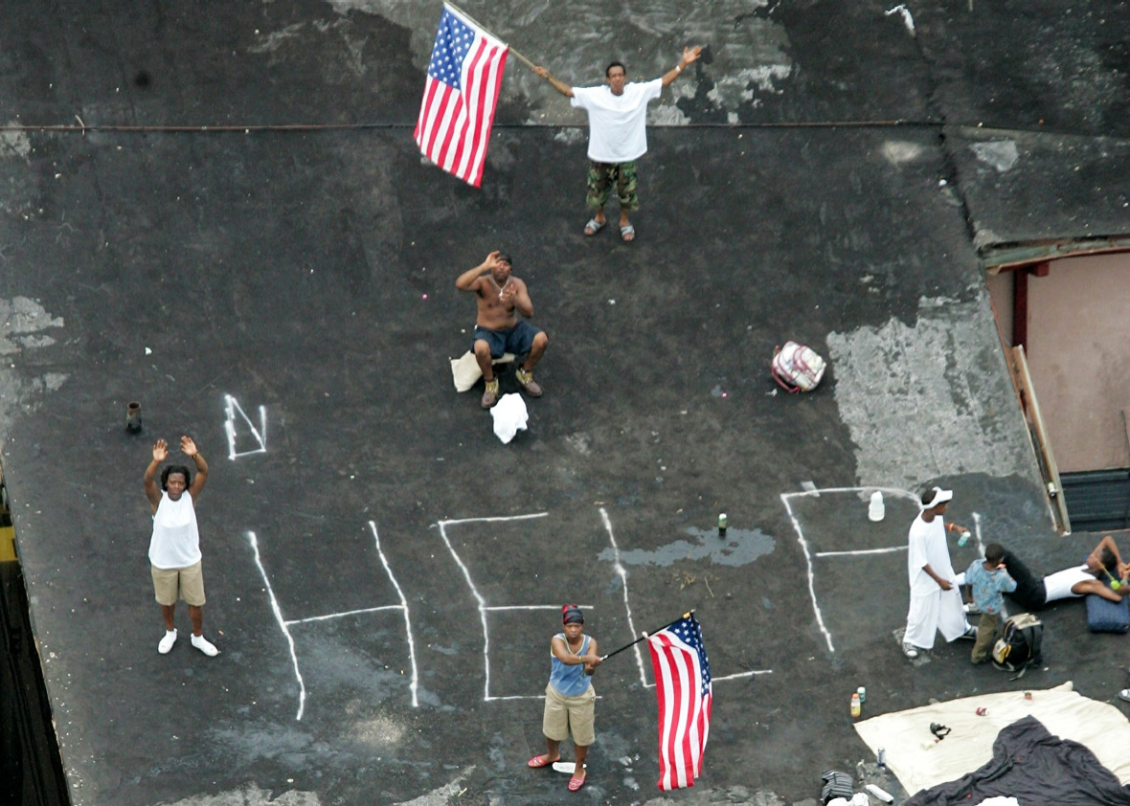
Precedents and forecast (Travis, 2005; Fischettti, 2001)
- Hurricane Betsy (1965)
- NOAA
- Hurricane Andrew (1992)
- Universities
- Hurricane George (1998)
- Environmental agency
Costliest storm
- 200000 homes devastated
- 100 USD million damages
- Over 1800 people died
Uneven exposure and vulnerability
- Gender, race, class and physical vulnerability intersect
- Lower 9th ward and Lake Pontchartrain
- Type of housing
- Lack of transport for mandatory evacuation
Substantial vulnerabilities can lead to catastrophic results
Uneven development trajectory
Disaster Onset
Uneven recovery trajectory

Slide 12
Differentiated vulnerability and displacement period (Cutter and Emrich, 2006)
Entrenchment: “Katrina ghettos” (Sovacool et al., 2019)
Inequalities are not reduced (Chuang et al., 2019)
Less vulnerable groups return and recover
quicker (Weil et al., 2018)
Encroachment: waiving of policies (Sovacool et al., 2019)
Re-employment: white almost 4 time more likely to
return to their jobs (Elliott and Pais, 2006)
Subjugation of black labor (Keegan, 2020)
Gentrification (Van Holm et al, 2019)
Long-term PTSS (Raker et al., 2019; Galea et al., 2008)
Inequalities are reproduced in recovery trajectories
Uneven development trajectory
Disaster Onset
Uneven Recovery trajectory

Slide 13
Alternative (uneven) recovery trajectory (Di Baldassarre et al., Earth’s Future, 2017)
Uneven development trajectory
Disaster Onset
Uneven Recovery trajectory

Slide 14
Societal responses to
Political response:
Transformative potential of disasters?
unprecedented hydroclimatic events

Slide 15
Tipping point
Top down repression
Reactionary and progressive transformations
Nature and severity of the impacts
Type of regimes in place before the disaster
Discursive capture of the event
Socio-economic inequalities
Social capital
(Gawronski and Olson, 2013; Pellign and Dill, 2010; Drury and Olson, 1998; Albala-Bertrand, 1993; Williamson, 2018; Ullberg, 2013; Steinberg, 2000)

Slide 16
Societal responses to
unprecedented extreme events
Maria Rusca
Gabriele Messori
Giuliano Di Baldassarre

