Slide 1
Global Methane Emissions Through An Isotopic Lens
(3D Modelling of Atmospheric Methane Isotopologues)
Alice Drinkwater^{1,2} Tim Arnold^{1,2}, Paul Palmer¹
¹University of Edinburgh School of GeoSciences
²National Physical Laboratory
alice.drinkwater@ed.ac.uk

Slide 2
Stable isotopic replacements (¹³C and D) represented as ‘delta values’. Shown are mean values from Sherwood et al. (2017)*
Ratio of emitted singly-substituted isotopologues can be used as source signatures
World regions have signatures depending on which emissions sources are dominant.
*Owen A Sherwood, Stefan Schwietzke, Victoria A Arling, and Giuseppe Etiope. Global inventory of gas geochemistry data from fossil fuel, microbial and burning sources, version 2017. Earth System Science Data, 9(2):639–656, 2017

Slide 3
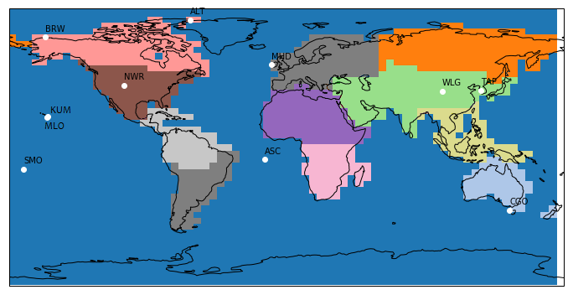
Global inversion to solve for regional source signatures 2004-17
11 NOAA sites
Separate 12 global regions
GEOS-Chem Model
Maximum A-Posteriori Solution

Slide 4
Process
Repeated inversions for 2004 to create initial conditions
Forward run of GEOS-Chem 2005-2017
MAP inversion
Repeat inversion
Check improved estimates
Forward run with posterior regional signatures

Slide 5
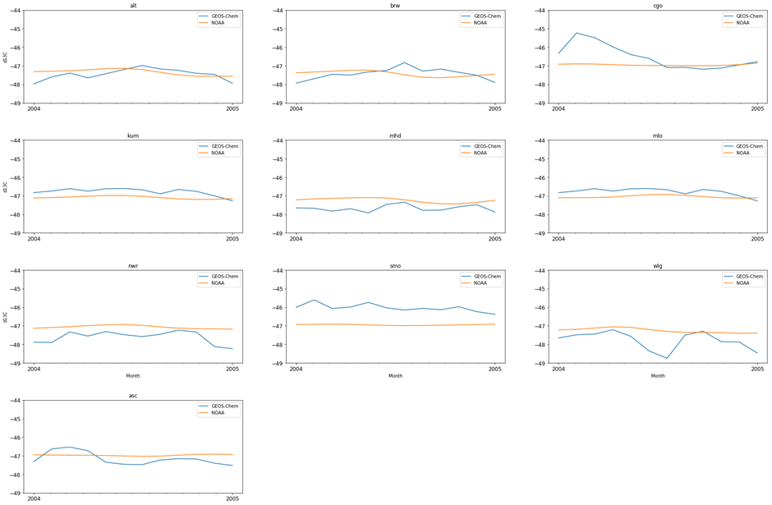
Prior is based upon forward runs of GEOS-Chem, with emissions datasets scaled depending on source typical d13C value.
Shown is the work-in-progress prior for 2004.

Slide 6
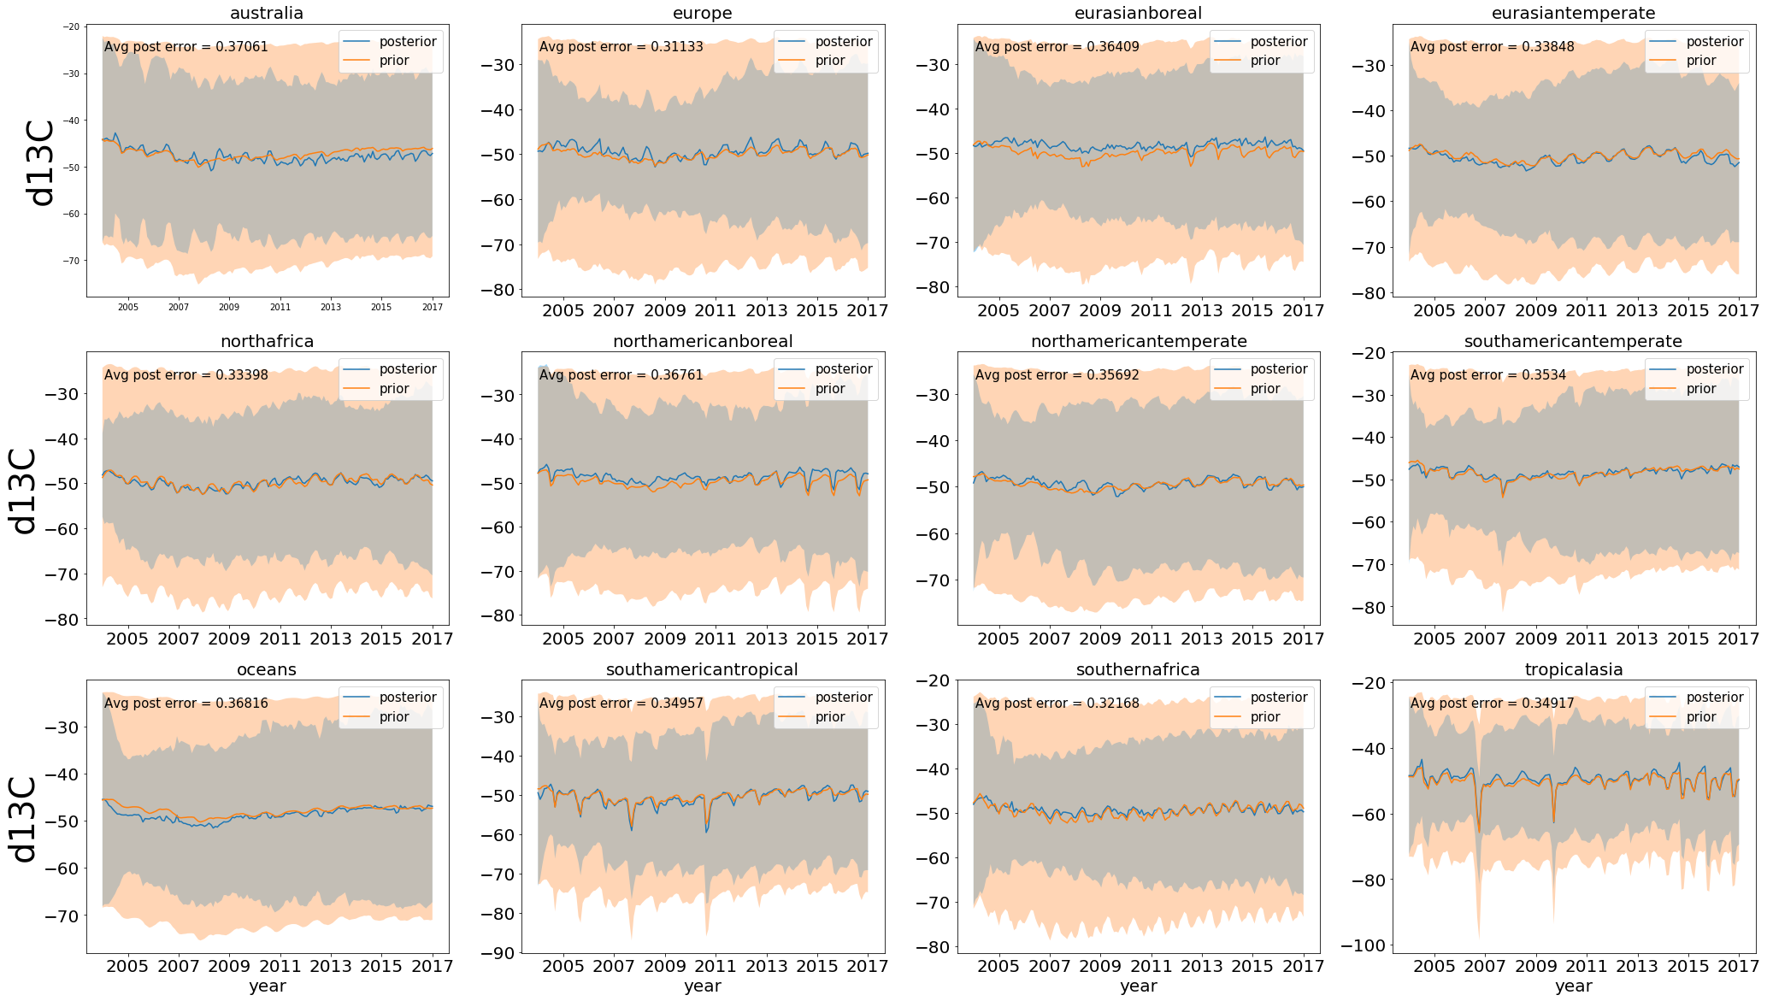
Result will be improved estimates of regional δ¹³C signatures, from which emissions types can be determined.
Preliminary result shown (separated by region, orange is prior and blue posterior δ¹³C estimate).

Slide 7
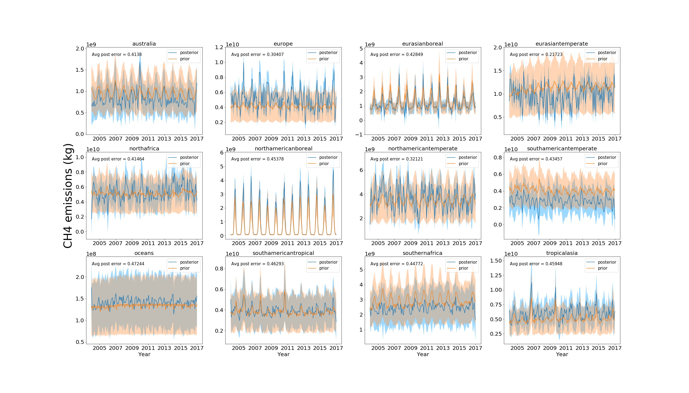
Results can be fed into an inversion for total CH₄ emissions.
This was previously completed without isotope data, solving for regional emissions.
Next steps:
-refine δ¹³C inversion
-incorporate δD into global modelling

