Slide 1
Classification of seismic events in Kamchatka (Russia) with different machine learning techniques
Natalia Galina, Nikolai Shapiro, Dmitriy Droznin, Leonard Seydoux

Slide 2
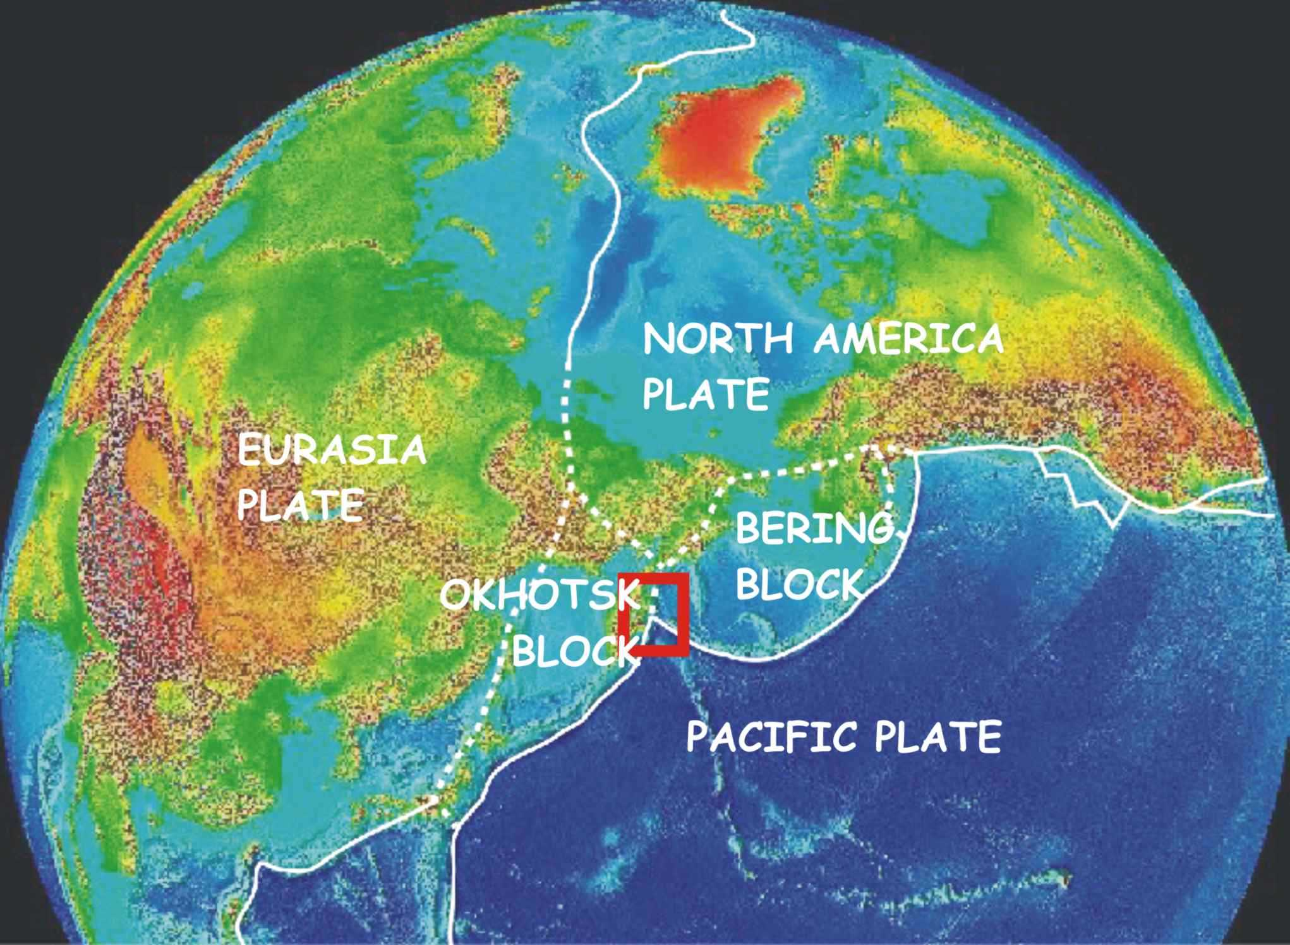
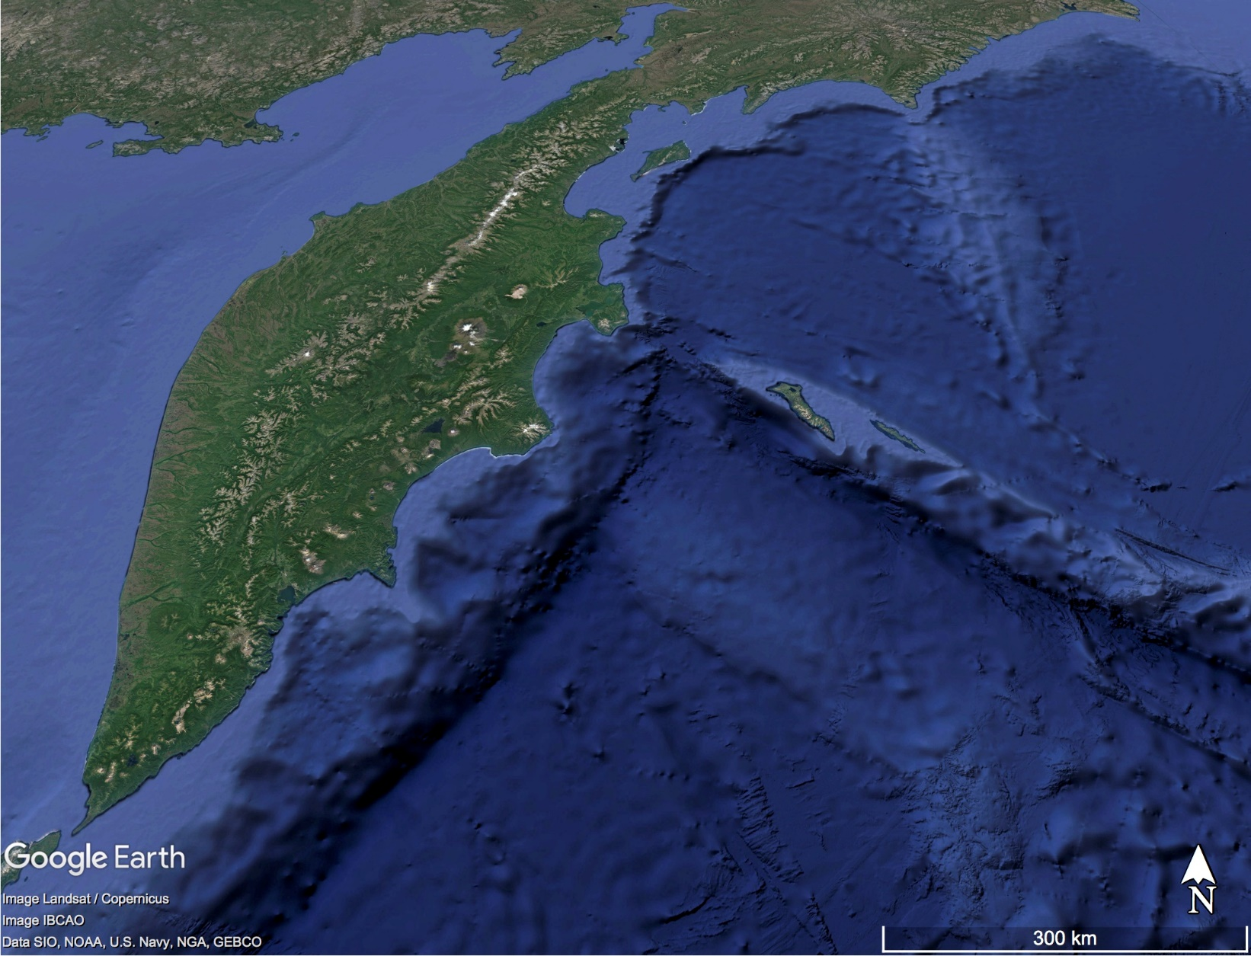
Kamchatka: present day tectonics
Klyuchevskoy
volcano group
Aleutian trench
Kamchatka has a unique tectonic setting,
it is an active subduction zone that exhibits intense seismic and volcanic activities.
Kuril-Kamchatka trench
Emperor seamounts

Slide 3
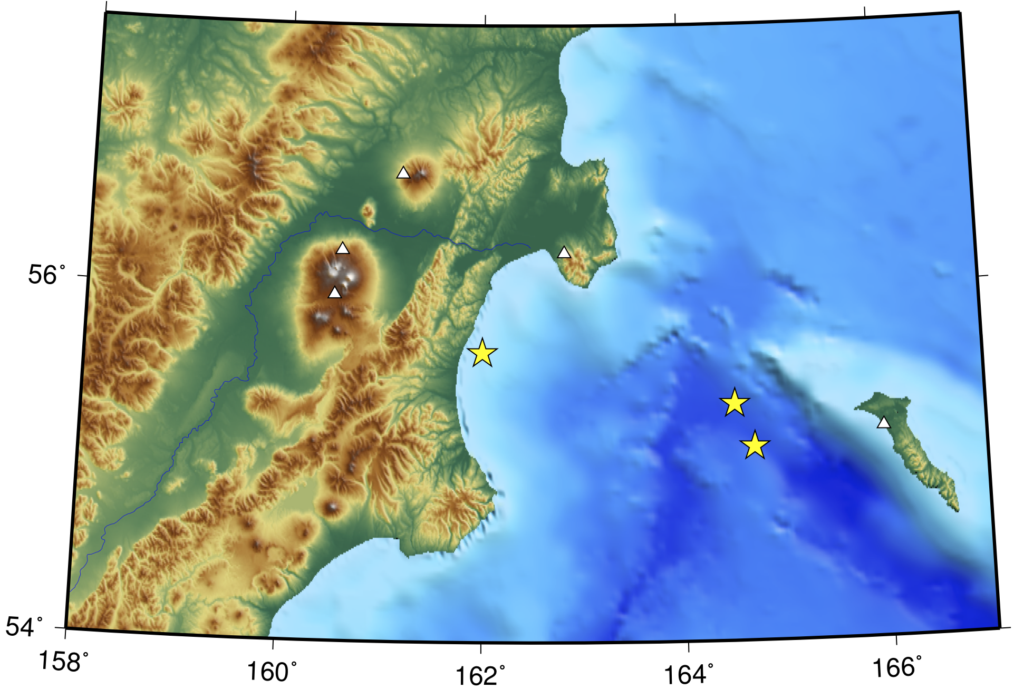
SRK
Shiveluch volcano
Tectonic and volcanic earthquakes are often nearly simultaneously recorded at the same station
KRS
KBT
KVG
BZW
M = 6.1
M = 6.1
BKI
M = 7.3
Here, we consider seismograms recorded between December 2018 and April 2019. During this time period when a M=7.3 earthquake followed by an aftershock sequence occurred nearly simultaneously with a strong eruption of Shiveluch volcano.

Slide 4
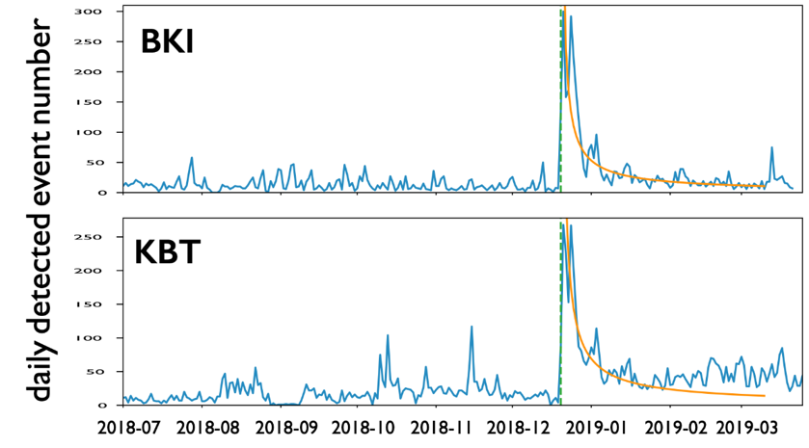
Detected earthquakes July 2018 – April 2019
SRK
Omori law fit
$$N\left(t\right)=\frac{k}{{(c+t)}^{p}}$$
KRS
KBT
BZW
What is the origin of this increment?
M = 6.1
M = 6.1
BKI
M = 7.3
M=7.3 Earthquake : 2018-12-20 17:01:55 (UTC)
Shiveluch eruption : started on 2018-12-22 ???
Plots by Droznin D.

Slide 5
So, in this work we will study data from KBT station that recorded both tectonic and volcanic events and try to find a reason of increment in earthquakes number, i.e. was it connected to volcanic unrests or other tectonic activity
In the problem of dividing activity into two types we used both unsupervised and supervised methods of machine learning and several representations of seismic signals:
regular features (signal duration, amplitude, peak frequency, etc.)
smoothed and unsmoothed spectra of signal
scattering coefficients (result of wavelet transform of a signal)

Slide 6
Clustering
is automatic grouping of similar objects into sets and is the class of unsupervised machine learning methods
One can see that it is an ambiguous problem, and the result varies with the chosen method
from scikit-learn.org
Here we chose simple methods: K-means and Agglomerative clustering

Slide 7
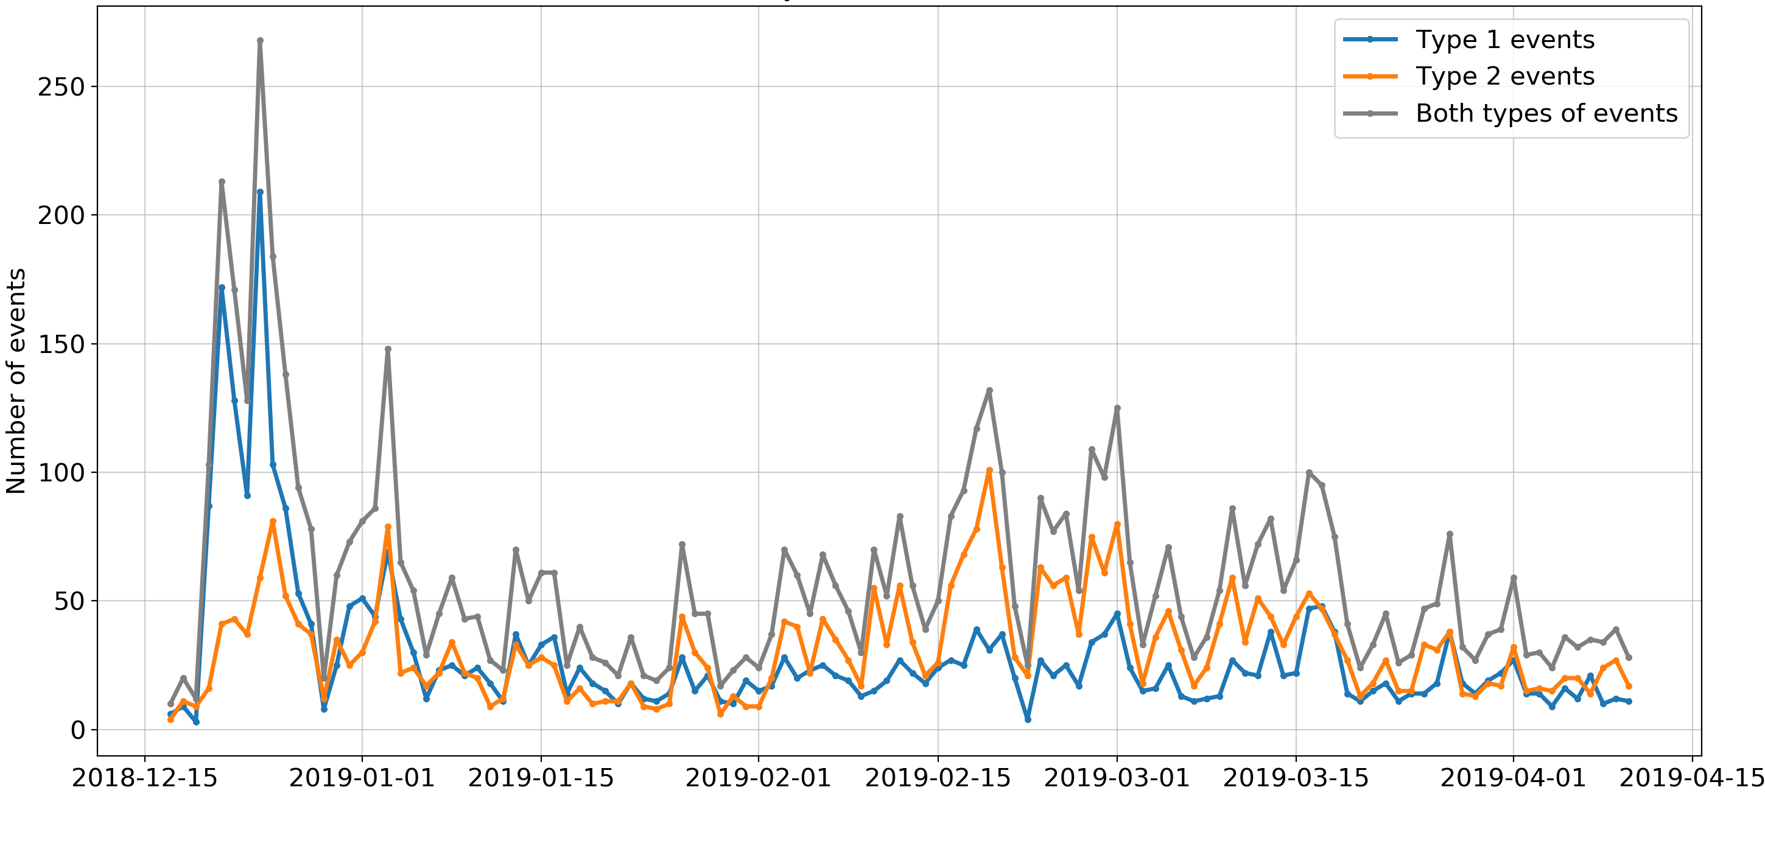
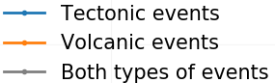
Clustering using smoothed spectra
K-means clustering
M=6.1
M=7.3
M=5.0 and Shiveluch eruption
Shiveluch activation
December
Data on the volcanic activity from emsd.ru

Slide 8
Classification
is identifying to which category an object belongs to and is the class of supervised machine learning methods.
In this work we used next algorithms: SVM and Random Forest
Labeled data: 902 tectonic and 273 volcanic events
Training set
Test set
Classificator
Labels
Entire dataset

Slide 9
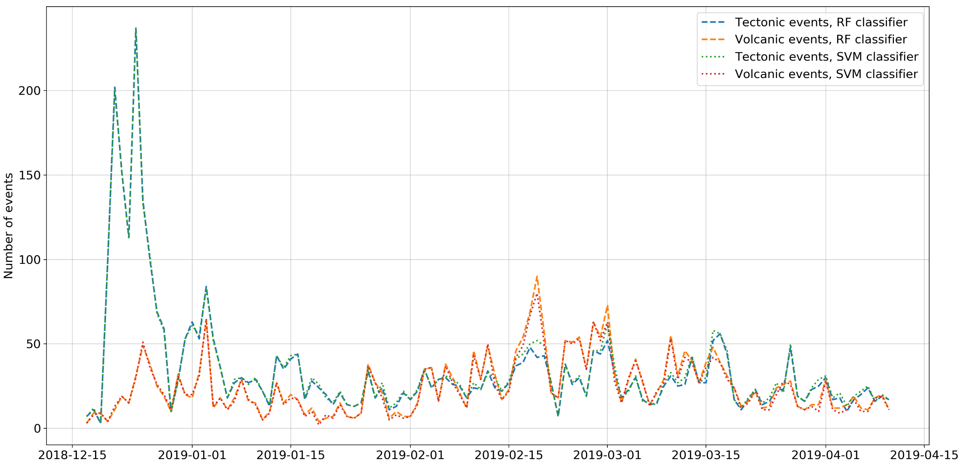
Classification: RF vs. SVM

Slide 10
Conclusions
The results of manual processing showed that, regardless of the signal representations used, supervised algorithms provide better results: tectonic earthquakes are less often classified as volcanic.
Results are quite stable relatively different classifiers and their main parameters
Deviation of the aftershocks distribution from the Omori law cannot be explained only by volcanic activity

Slide 11
Thank you for your attention!

Slide 12
Appendix:
Detailed explanations

Slide 13
Kamchatka: present day tectonics
Kamchatka has a unique tectonic setting

Slide 14
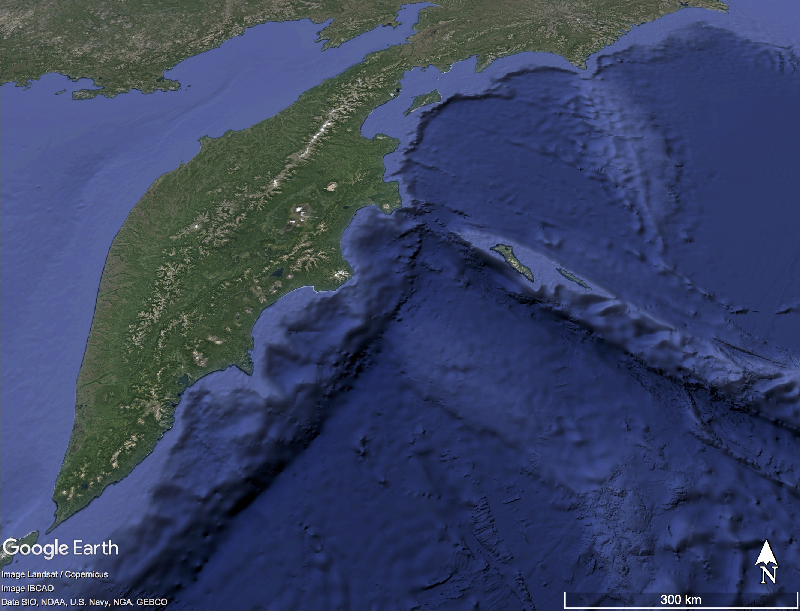
Klyuchevskoy
volcanic group
Kamchatka is an active subduction zone that exhibits intense seismic and volcanic activities.
Two trenches of volcanos
Aleutian trench
Kuril-Kamchatka trench
Emperor seamounts

Slide 15
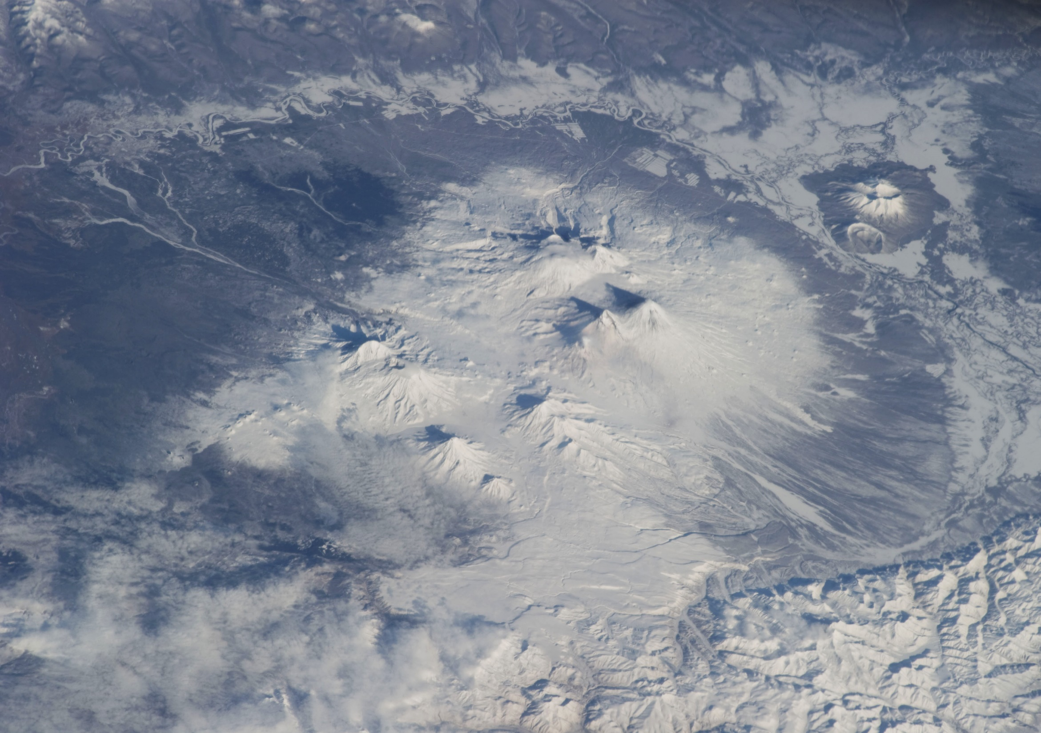
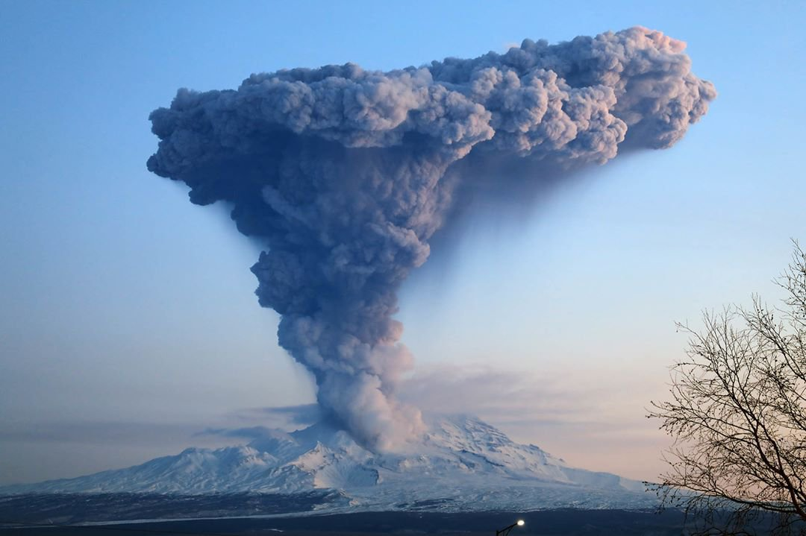
Klyuchevskoy volcanic group (KVG)
Shiveluch
Klyuchevskoy
Bezymyanny
Tolbachik
Largest cluster of subduction volcanoes in the world
13 strato-volcanoes with different compositions and eruption styles
3 volcanoes active at present
Magma production rate ~1m³/sec (comparable to Hawaii)
Possible connection with Hawaii-Emperor seamounts
In current work we investigate earthquakes from this volcano that located to the North from KVG

Slide 16
Kamchatka seismicity and catalogs
01.01.2018 – 01.04.2019 (~450 days)
9603 catalogued regional earthquakes (locations + magnitudes)
14574 catalogued volcanic earthquakes (locations + magnitudes)
24768 volcanic earthquakes on Shiveluch
9890 volcanic earthquakes on Klyuchevskoy
5683 volcanic earthquakes on Tolbachik
603 volcanic earthquakes on Bezymianny

Slide 17
Kamchatka seismicity and catalogs
On average: 20 regional and 90 volcanic (30 located) earthquakes per day
This activity strongly increases during eruptions and aftershock sequences (100-ds events per day)
Amount of data is too big for manual processing
The situation with volcanic events is complicated due to their low-amplitudes of wave arrivals (so it is impossible to locate them)
These reasons led us to investigating of the automatic seismograms processing algorithm with detection of events and their further classification (seismic or volcanic class at first stage)

Slide 18
SRK
Shiveluch volcano
Tectonic and volcanic earthquakes are often nearly simultaneously recorded at the same station
KRS
KBT
KVG
BZW
M = 6.1
M = 6.1
BKI
M = 7.3
Here, we consider seismograms recorded between December 2018 and April 2019. During this time period when a M=7.3 earthquake followed by an aftershock sequence occurred nearly simultaneously with a strong eruption of Shiveluch volcano.

Slide 19
Let us consider the cumulative number of events detected on different stations
Information on stations location:
BKI is far from the coast but close to main tectonic events in the observed period of time
SRK is located on the slope of Shiveluch
KBT is just on the coastline and equal distanced from location of tectonic events and Shiveluch
KRS and BZW are stations in the KVG

Slide 20
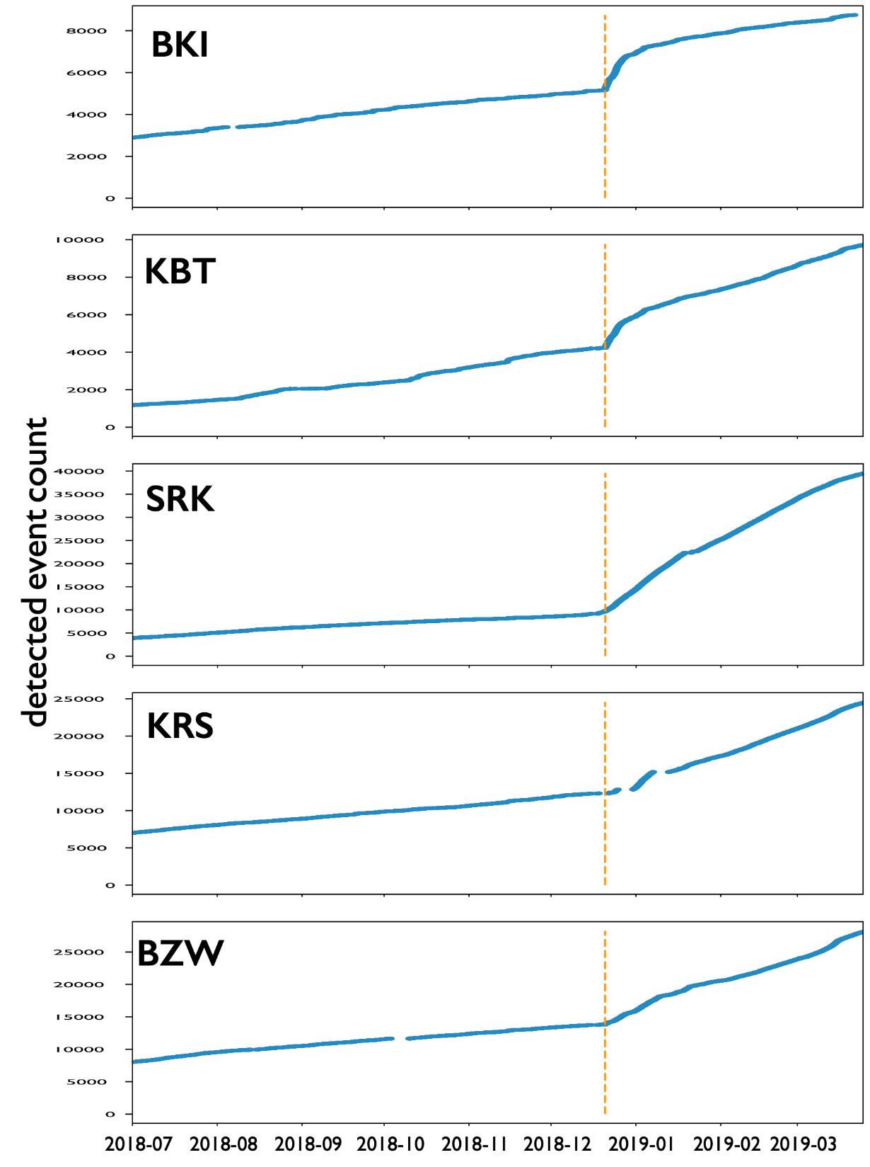
Detected earthquakes July 2018 – April 2019
SRK
KRS
KBT
BZW
M = 6.1
M = 6.1
BKI
M = 7.3
M=7.3 Earthquake : 2018-12-20 17:01:55 (UTC)
Shiveluch eruption : started on 2018-12-22 ???
Plots by Droznin D.

Slide 21
Well, cumulative plots look pretty similar with a leap at the same time.
But is the reason of this leap same at all stations?
Let us have a look at noncumulative plots…

Slide 22
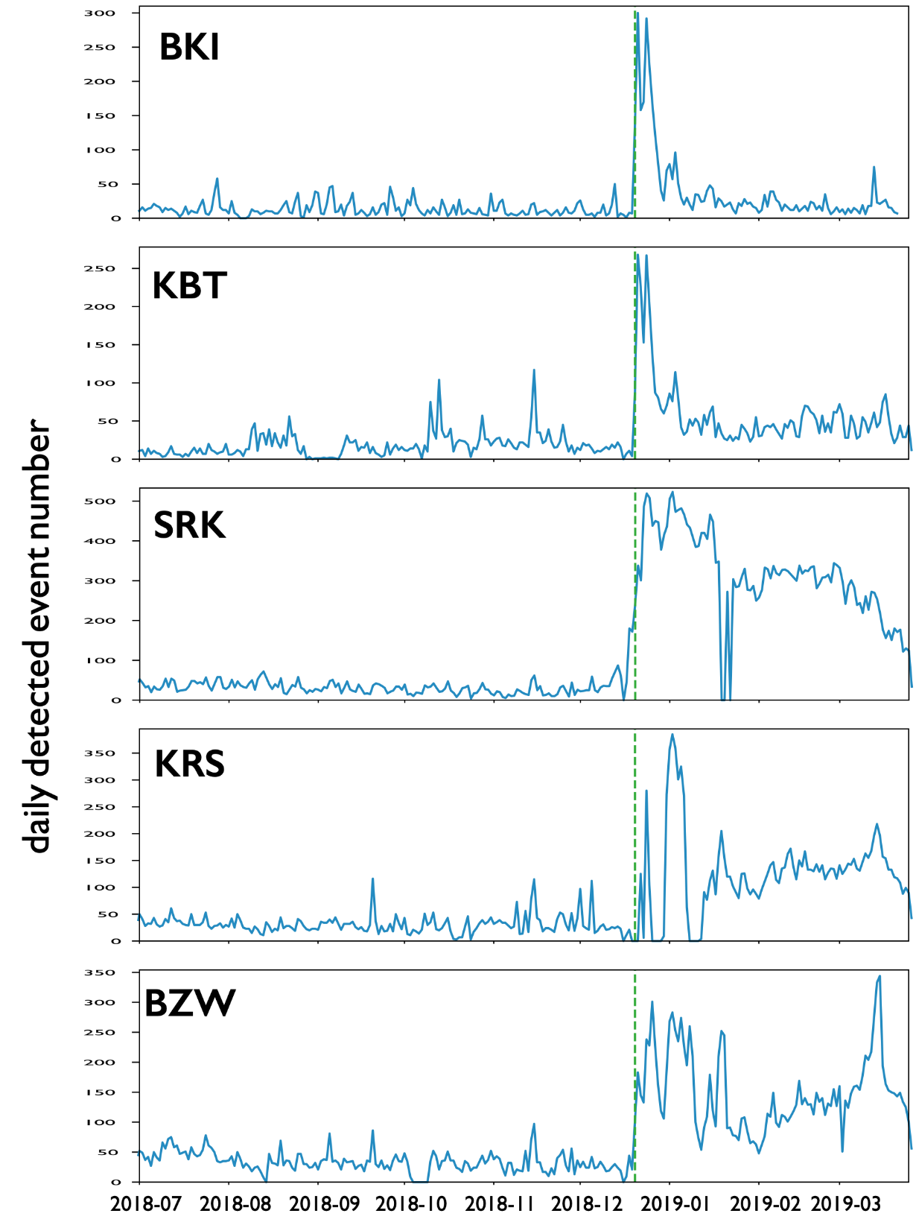
Detected earthquakes July 2018 – April 2019
M = 7.3
M = 6.1
SRK
KRS
KBT
BZW
M = 6.1
M = 6.1
BKI
M = 7.3
M=7.3 Earthquake : 2018-12-20 17:01:55 (UTC)
Shiveluch eruption : started on 2018-12-22 ???
Plots by Droznin D.

Slide 23
Detected earthquakes July 2018 – April 2019
North Kuril
swarm
M = 6.1
SRK
KRS
KBT
BZW
M = 6.1
M = 6.1
BKI
M = 7.3
M=7.3 Earthquake : 2018-12-20 17:01:55 (UTC)
Shiveluch eruption : started on 2018-12-22 ???
Plots by Droznin D.

Slide 24
Detected earthquakes July 2018 – April 2019
SRK
KRS
KBT
Shiveluch eruption
(ongoing)
BZW
M = 6.1
M = 6.1
BKI
M = 7.3
M=7.3 Earthquake : 2018-12-20 17:01:55 (UTC)
Shiveluch eruption : started on 2018-12-22 ???
Plots by Droznin D.

Slide 25
Detected earthquakes July 2018 – April 2019
SRK
KRS
KBT
BZW
M = 6.1
M = 6.1
BKI
M = 7.3
Bezymianny
eruptions
KVG re-activation
M=7.3 Earthquake : 2018-12-20 17:01:55 (UTC)
Shiveluch eruption : started on 2018-12-22 ???
KVG re-activation
Plots by Droznin D.

Slide 26
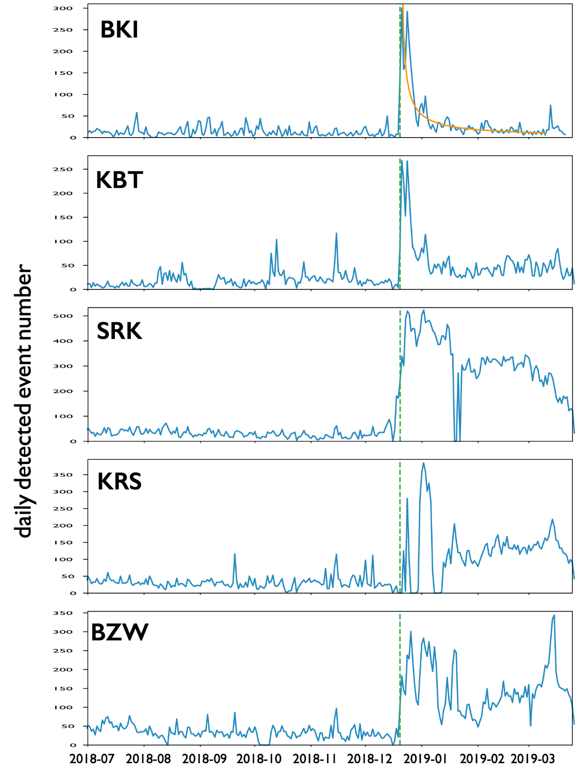
Detected earthquakes July 2018 – April 2019
Omori law fit
$$N\left(t\right)=\frac{k}{{(c+t)}^{p}}$$
SRK
KRS
KBT
BZW
M = 6.1
M = 6.1
BKI
M = 7.3
M=7.3 Earthquake : 2018-12-20 17:01:55 (UTC)
Shiveluch eruption : started on 2018-12-22 ???
Plots by Droznin D.

Slide 27
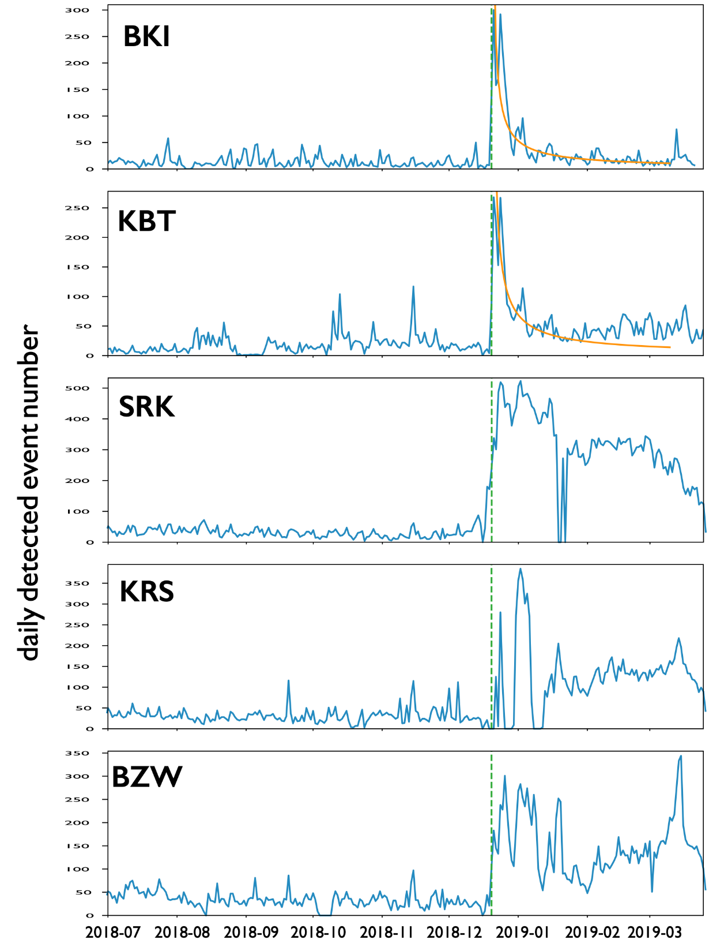
Detected earthquakes July 2018 – April 2019
Omori law fit
$$N\left(t\right)=\frac{k}{{(c+t)}^{p}}$$
SRK
KRS
KBT
BZW
M = 6.1
M = 6.1
BKI
M = 7.3
M=7.3 Earthquake : 2018-12-20 17:01:55 (UTC)
Shiveluch eruption : started on 2018-12-22 ???
Plots by Droznin D.

Slide 28
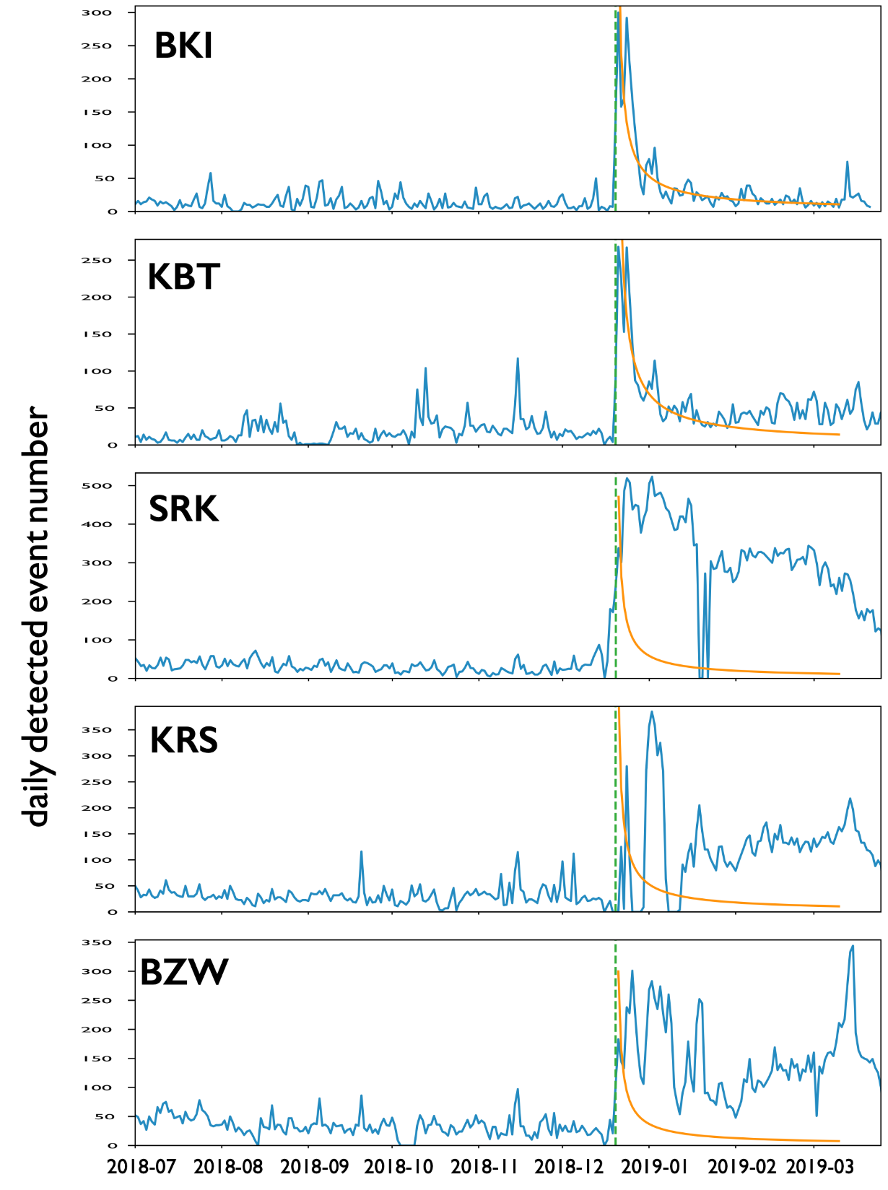
Detected earthquakes July 2018 – April 2019
Omori law fit
$$N\left(t\right)=\frac{k}{{(c+t)}^{p}}$$
What is the origin of this increment?
SRK
KRS
KBT
BZW
M = 6.1
M = 6.1
BKI
M = 7.3
M=7.3 Earthquake : 2018-12-20 17:01:55 (UTC)
Shiveluch eruption : started on 2018-12-22 ???
Plots by Droznin D.

Slide 29
So, in this work we will study data from KBT station that recorded both tectonic and volcanic events and try to find a reason of increment in earthquakes number, i.e. was it connected to volcanic unrests or other tectonic activity

Slide 30
Outline
Seismogram processing and earthquake detection
Feature extraction
Creating labeled set for supervised learning
Spectra smoothing
Results of clustering and classification
Conclusions and further directions

Slide 31
Seismogram processing
Bandpass filtering (0.5 – 10 Hz) and decimating (Fs from 200 to 20 Hz)
Seismogram smoothing with time window of 30 s

Slide 32
Earthquake detection
Signal-to-noise ratio: $SNR= {v_{max}}/{v_{min}}$
where $v_{min}=max(v_{min}^{1},v_{min}^{2})$
$$v_{max}$$
$$v_{min}^{1}$$
$$v_{min}^{2}$$

Slide 33
Earthquake detection
All detections with $SNR≥1.35$ have been selected

Slide 34
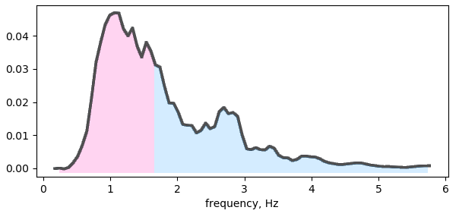
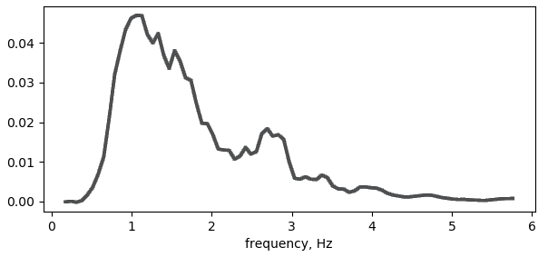
Feature extraction
$$f_{max}$$
$$f_{mean}$$
$$f_{median}$$
For each detection next parameters were estimated
Peak frequency $f_{max}$
Mean frequency is defined as
$$f_{mean}=\frac{\sum_{i}{P(f_{i})f_{i}}}{\sum_{i}{P(f_{i})}}$$
Median frequency can be found from the condition
$$\sum_{j=1}^{j_{MDF}}{P(f_{j})}=\sum_{j=j_{MDF}}^{M}{P(f_{j})}=\frac{1}{2}\sum_{j=1}^{M}{P(f_{j})}$$

Slide 35
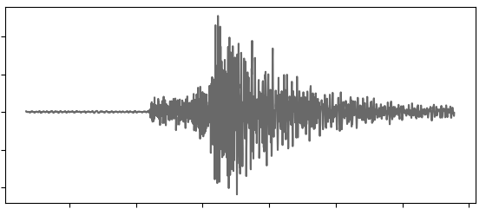
Feature extraction
$$f_{mean}$$
$$A={A_{max}}/5$$
$$2σ$$
duration
bandwidth
Bandwidth is defined as difference between first and last frequencies where$P(f)≥0.01P_{max}$
The standard deviation from the mean frequency
Signal amplitude
Signal duration
SNR of the detection

Slide 36
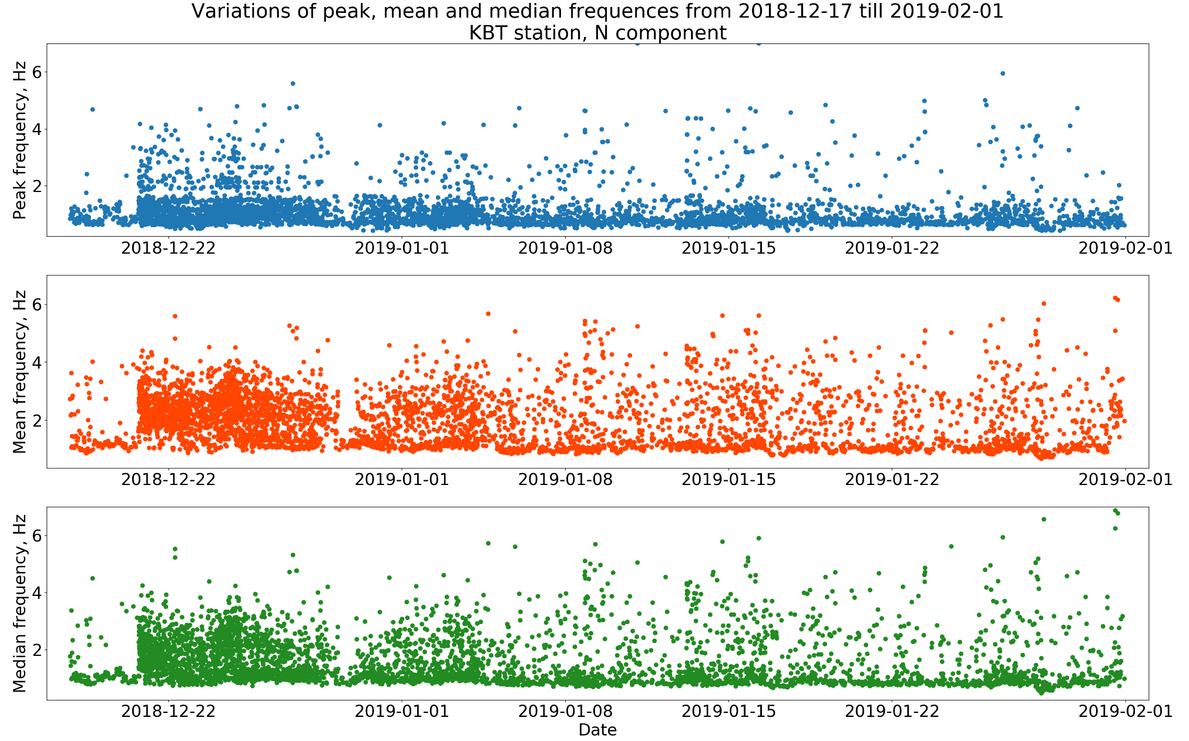

Slide 37
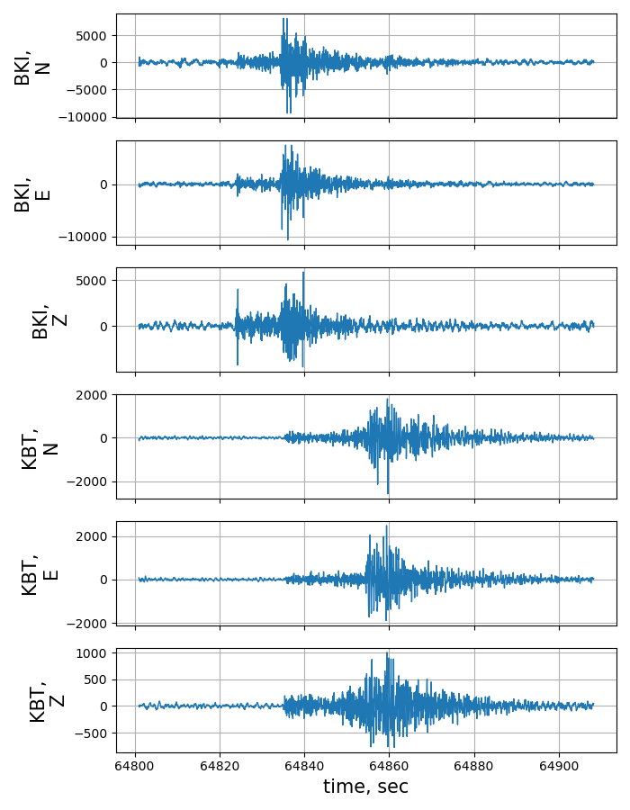
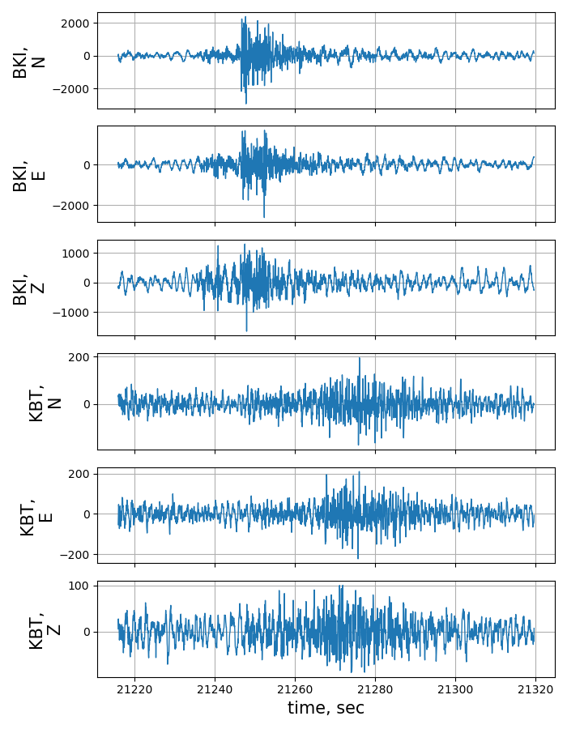
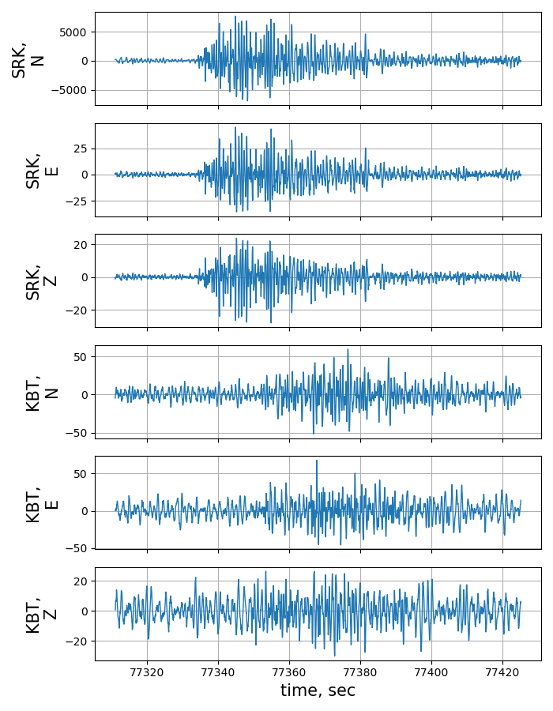
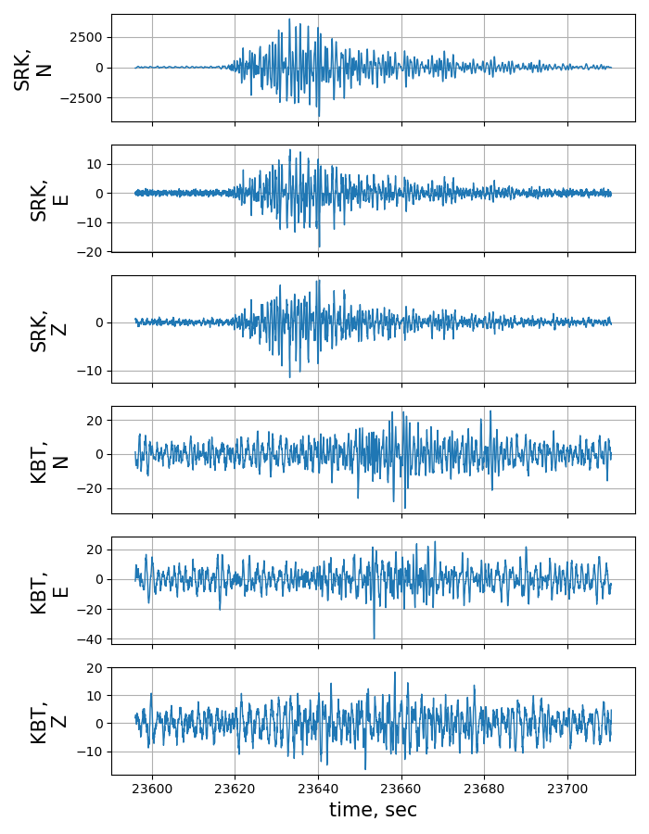
Creating labeled set
To create the labeled set, i.e. set of events which class is known (tectonic or volcanic), we took two reference stations to be more confident about detections on KBT station
BKI ⟶ “pure” tectonic events SRK ⟶ “pure” volcanic events
KBT BKI
KBT BKI
KBT SRK
KBT SRK

Slide 38
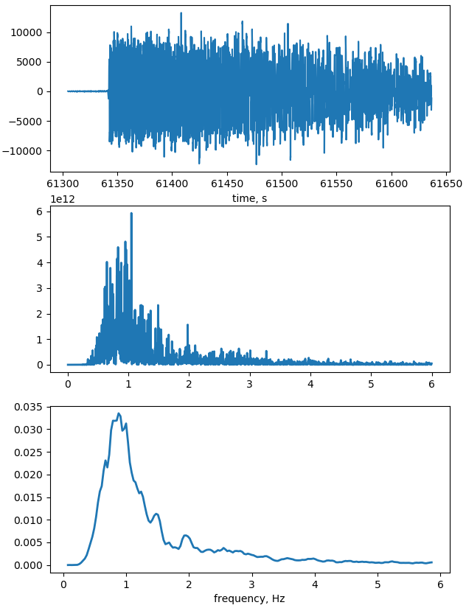
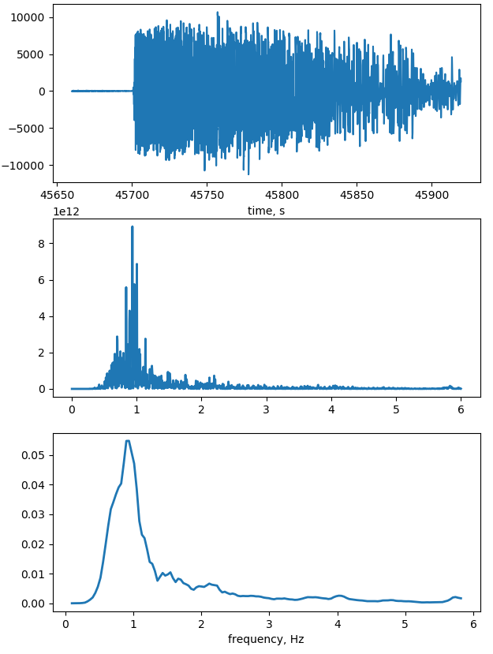
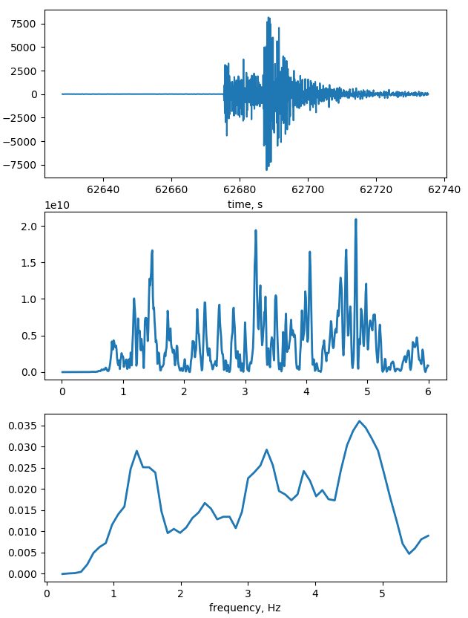
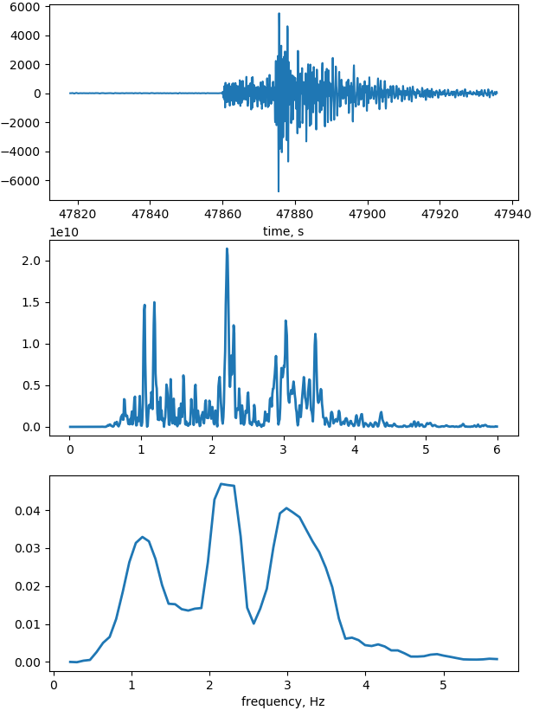
We had to remove strong tectonic events from the labeled set, because later it was found that they are accompanied with saturation effect on the stations that lead to frequency content similar to volcanic events
M=7.3 M=6.1 moderate events

Slide 39
Clustering
is automatic grouping of similar objects into sets and is the class of unsupervised machine learning methods
One can see that it is an ambiguous problem, and the result varies with the chosen method
from scikit-learn.org

Slide 40
Clustering
We chose a couple of quite simple methods
K-means
set of N samples X ⟶ K disjoint clusters C
each cluster is described by the mean of $μ_{j}$ of the samples in the cluster – centroids
algorithm aims to choose centroids that minimize the inertia, or within-cluster sum-of-squares criterion
$$\sum_{i=1}^{N}{\min_{μ_{j}∈C}\left({\left\|x_{i}−μ_{j}\right\|}^{2}\right)}$$
Agglomerative clustering
is a hierarchical clustering using a bottom up approach: each observation starts in its own cluster, and clusters are successively merged together
linkage criteria determines the metric used for the merge strategy

Slide 41
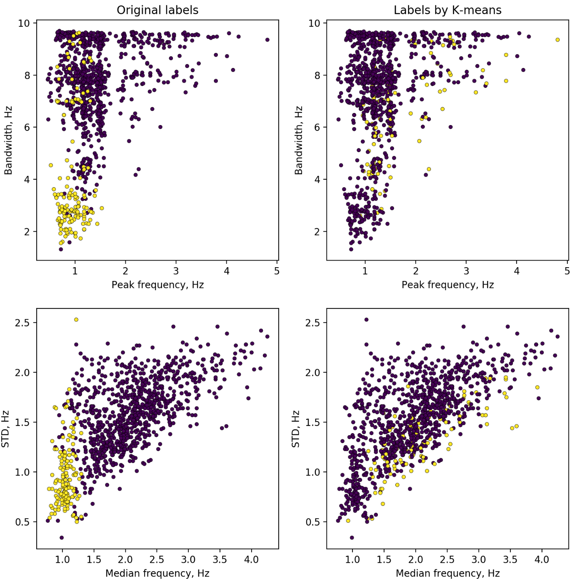
K-means clustering using features
Performance of clustering algorithms on labeled set is poor and the result is inadequate

Slide 42
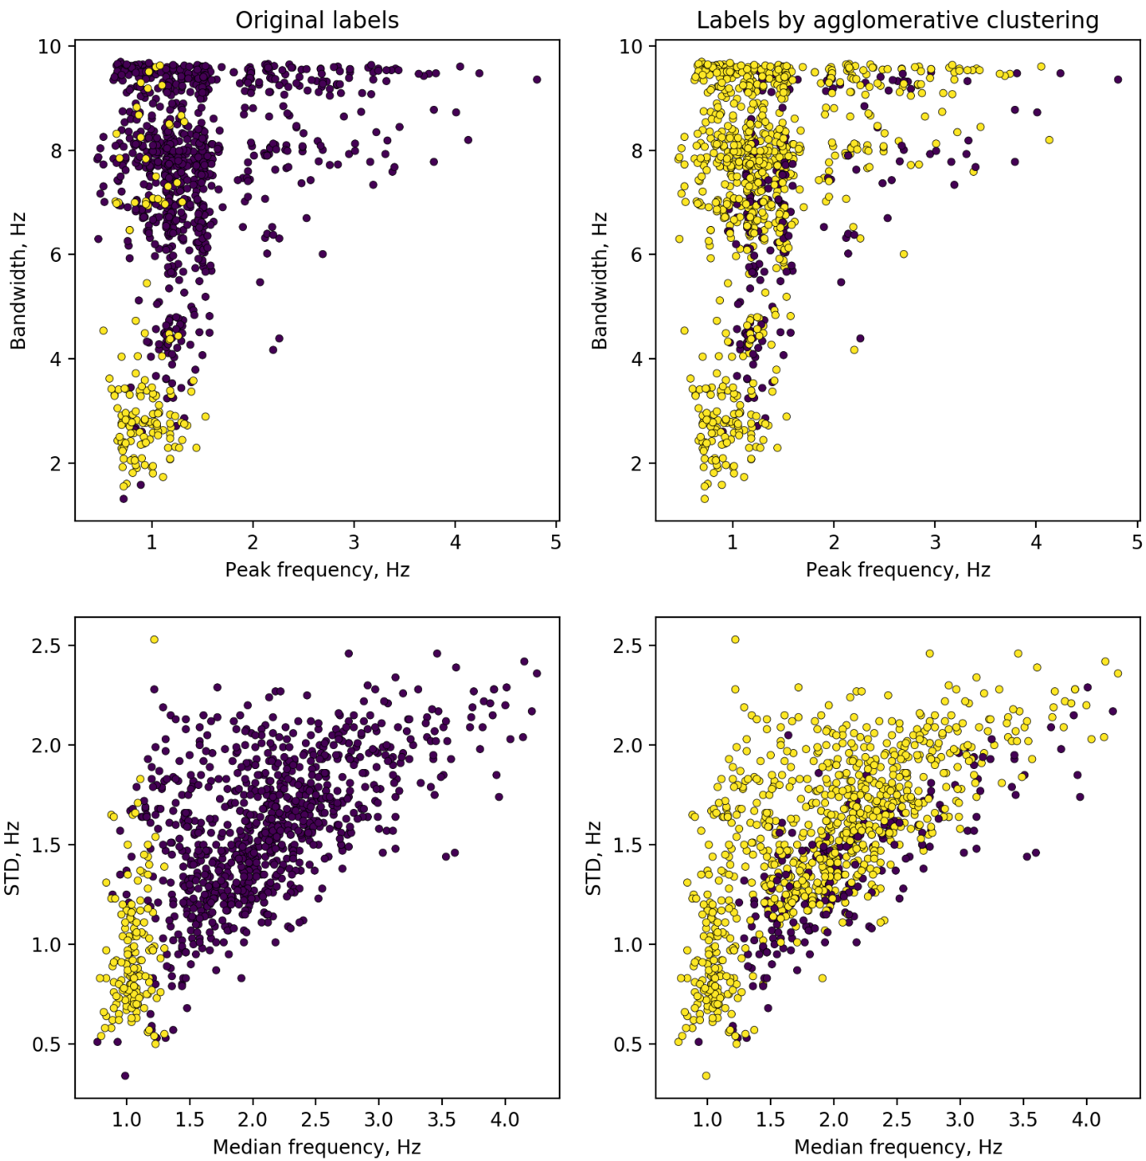
Agglomerative clustering using features
Performance of clustering algorithms on labeled set is poor and the result is inadequate
So we decided to use spectral representations of signals instead of features

Slide 43
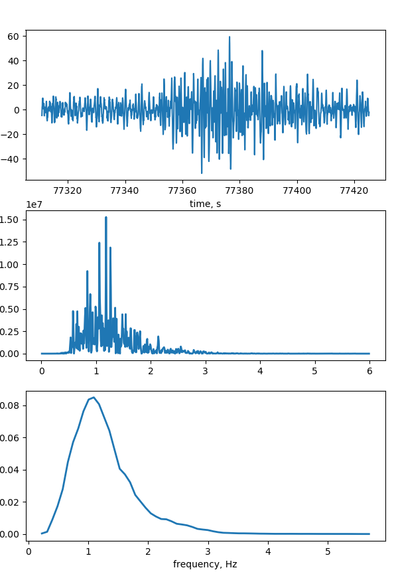
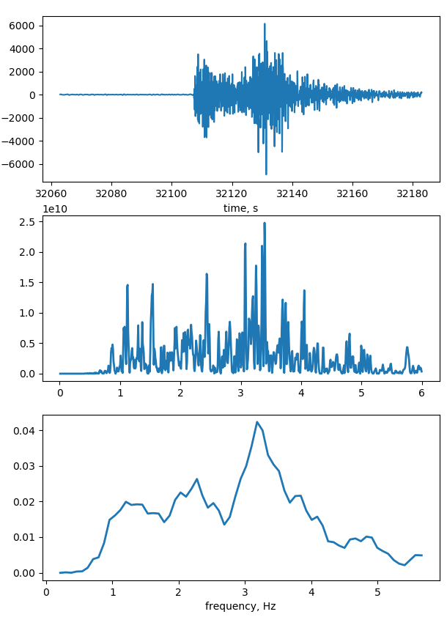
Clustering using smoothed spectra
Sliding window of 50 points, high-frequencies are cut off
8 features ⟶ set of 85 frequencies
Volcanic event
Tectonic event

Slide 44
K-means clustering using smoothed spectra
It can be seen that even one of the simplest clustering algorithms have not so bad performance on the labeled set
What if we present the entire data set to the algorithm?

Slide 45
Clustering using smoothed spectra
K-means clustering
M=6.1
M=7.3
M=5.0 and Shiveluch eruption
Shiveluch activation
December
Data on the volcanic activity from emsd.ru

Slide 46
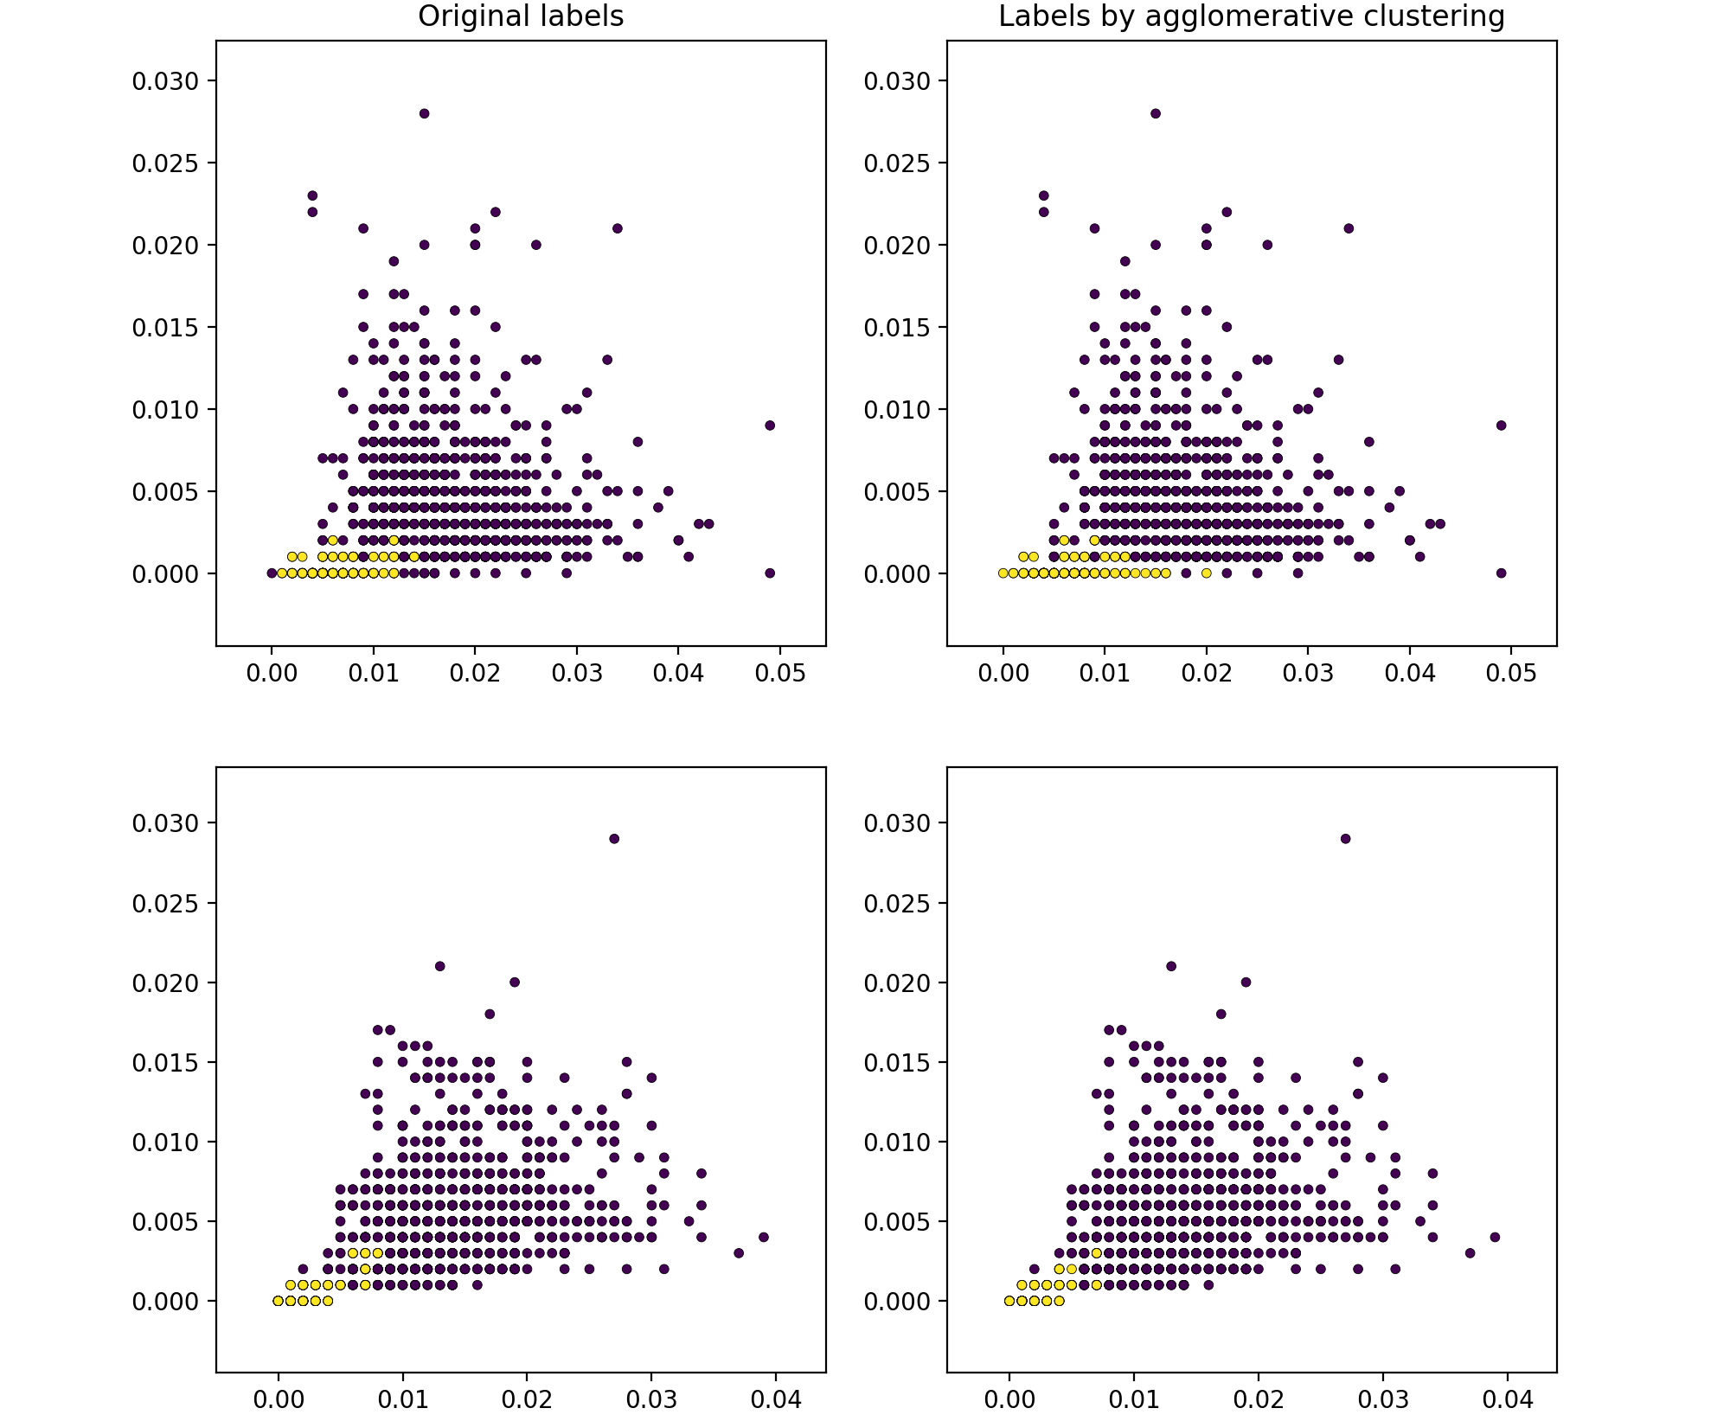
Agglomerative clustering using smoothed spectra

Slide 47
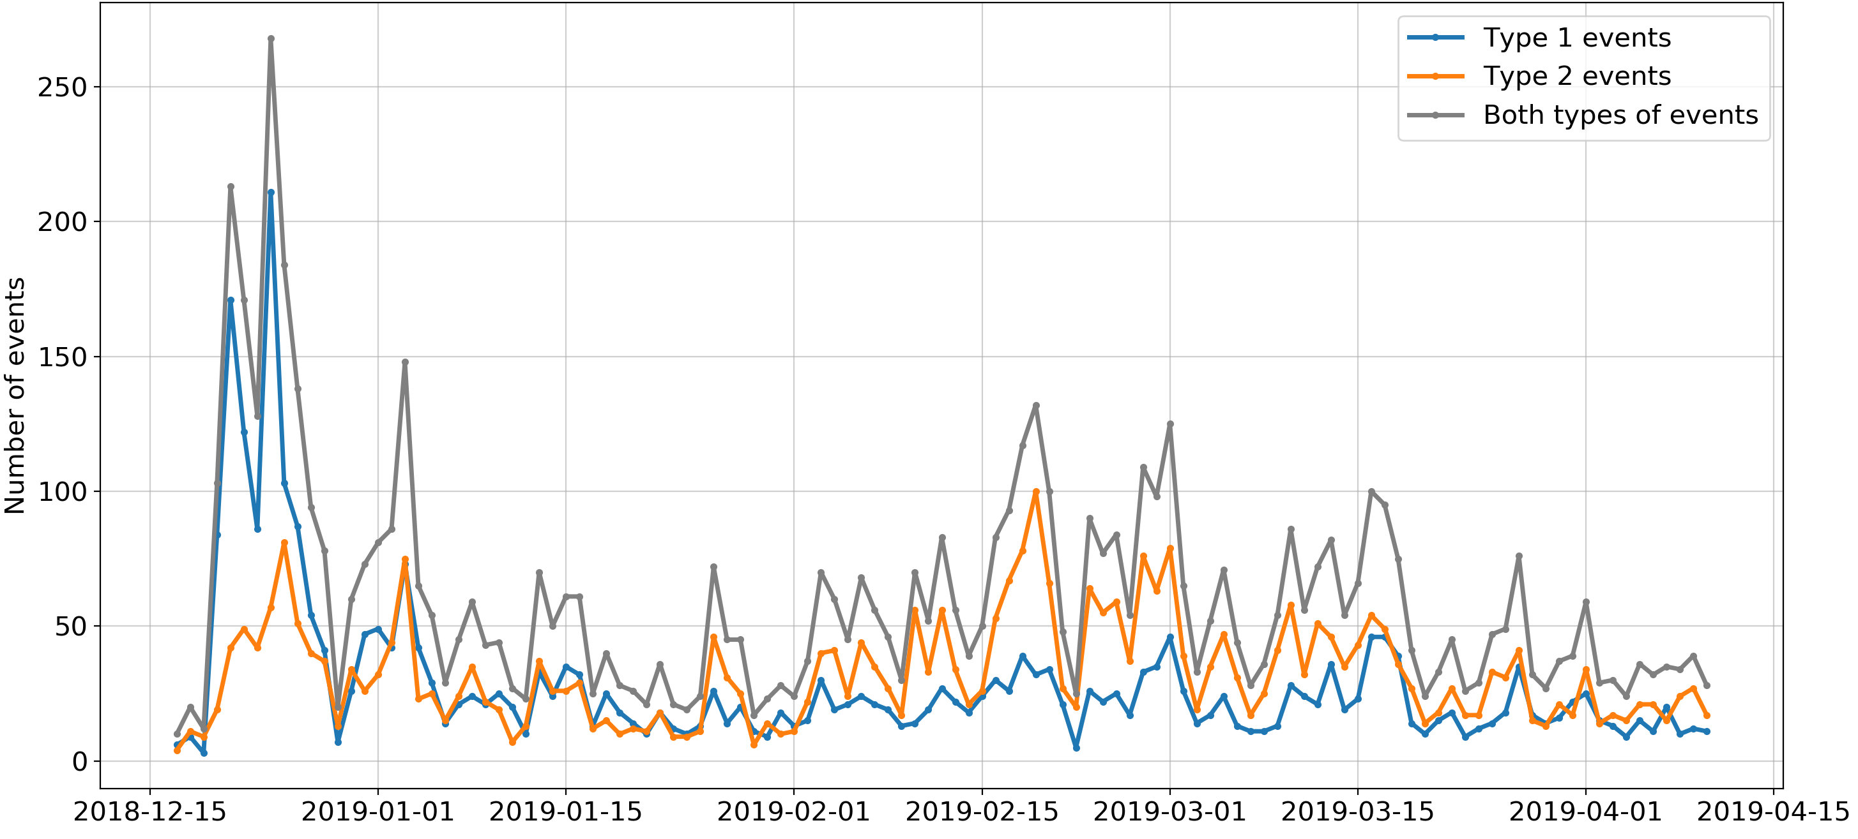
Clustering using smoothed spectra
Agglomerative clustering

Slide 48
Classification
is identifying to which category an object belongs to and is the class of supervised machine learning methods
Labeled data: 902 tectonic and 273 volcanic events
Training set
Test set
Classificator
Labels
Entire dataset

Slide 49
Classification
Support vector machine (SVM)
constructs a hyper-plane or set of hyper-planes in a high or infinite dimensional space
good separation is achieved by the hyperplane that has the largest distance to the nearest training-data point of any class (so-called margin)
different Kernel functions can be specified for the decision function
modified from scikit-learn.org

Slide 50
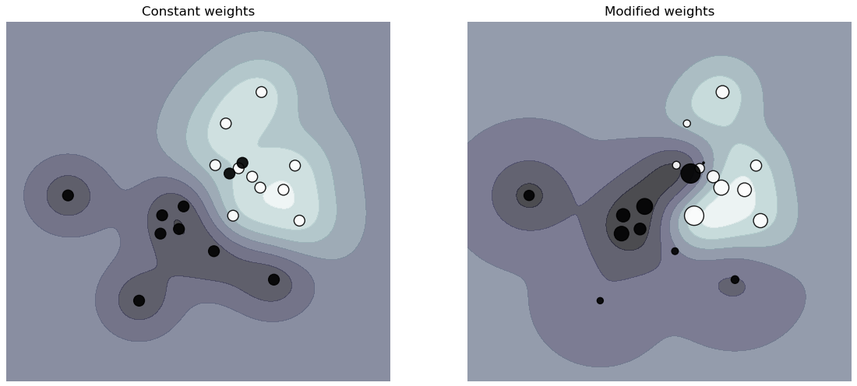
Classification: SVM
Accuracy of labeling on the test set with different kernels using different signal representations
 | features |  |  | spectra
 | linear | polynomial | rbf | linear | polynomial | rbf
weighted* | 0.974 | 0.974 | 0.982 | 0.971 | 0.977 | 0.971
unweighted | 0.982 | 0.987 | 0.982 | 0.977 | 0.971 | 0.977
* The weighting makes classifier puts more emphasis on getting these points right. So we tried to put weight to volcanic class
from scikit-learn.org

Slide 51
It can be seen that the performance of the SVM on the test set is stable to the parameters choice
Next slides will show the comparison of the results on the entire dataset

Slide 52
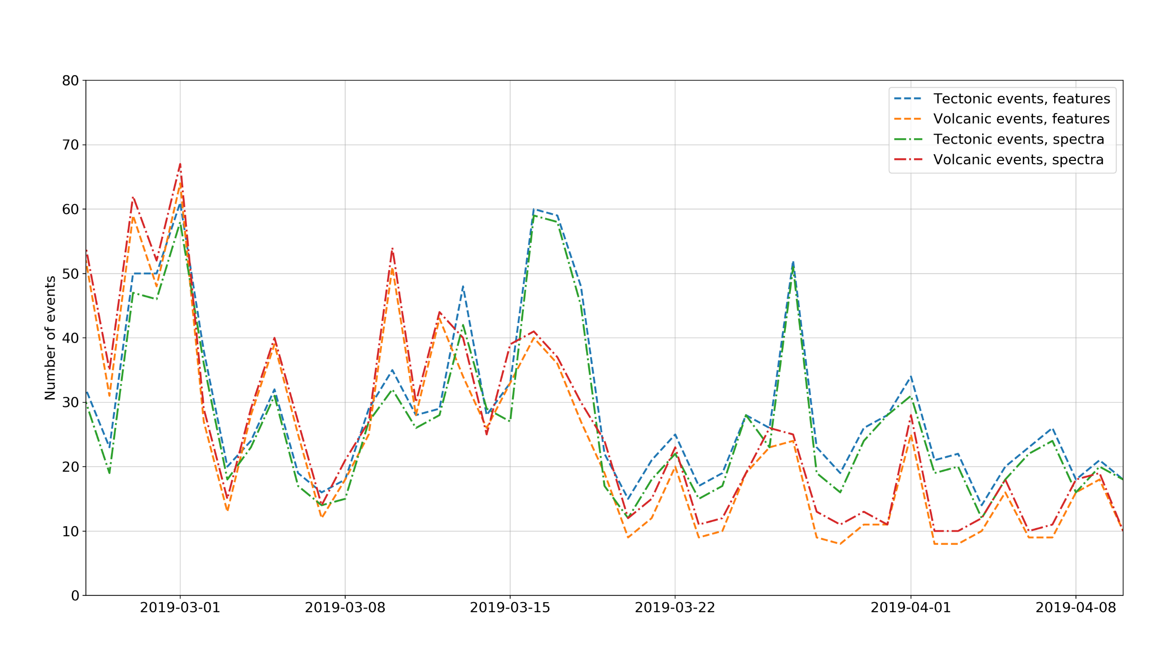
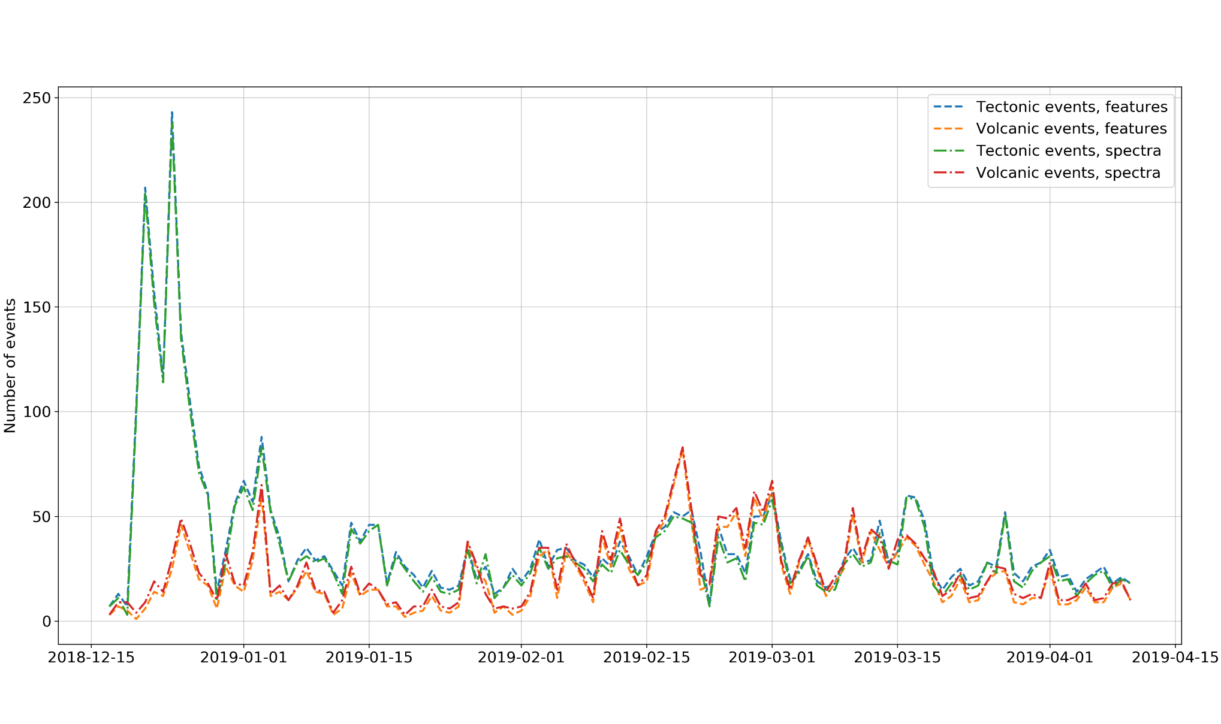
Classification: features vs. spectra

Slide 53
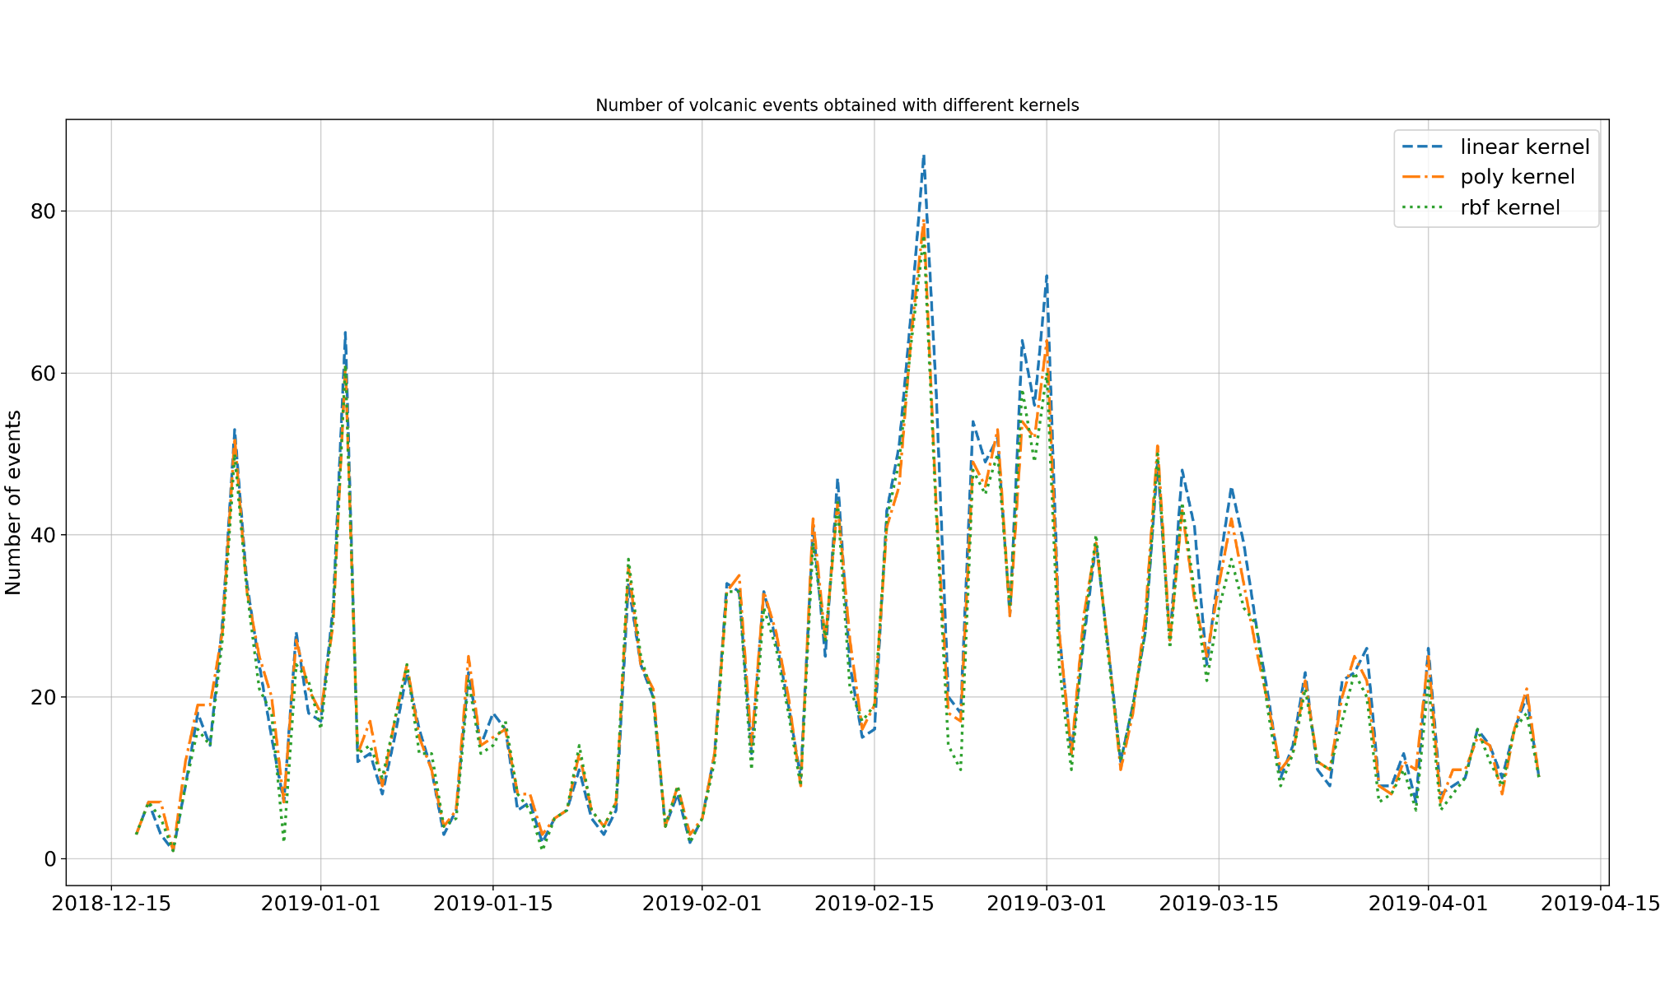
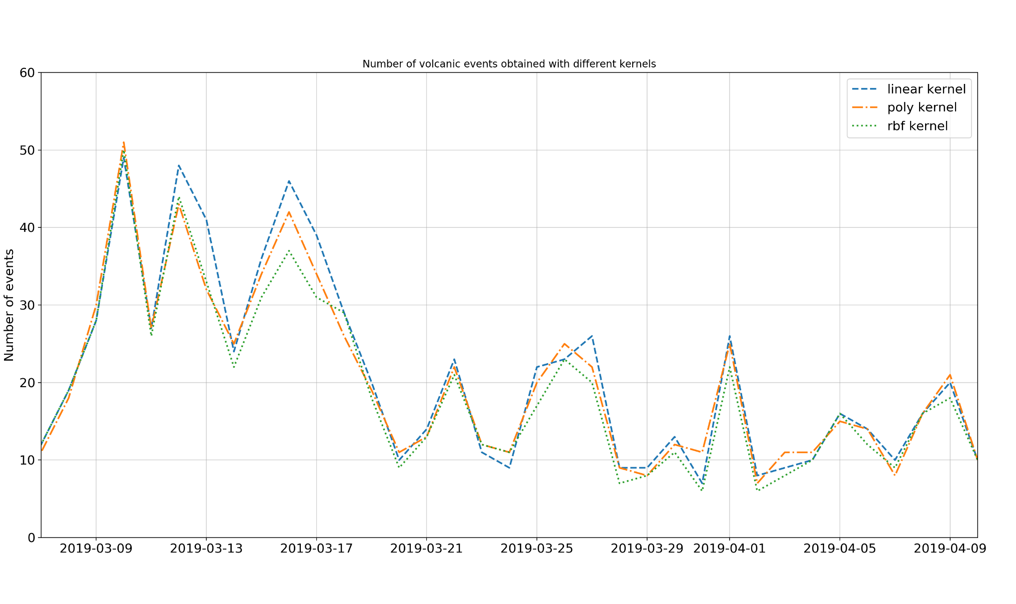
Classification: kernel choice

Slide 54
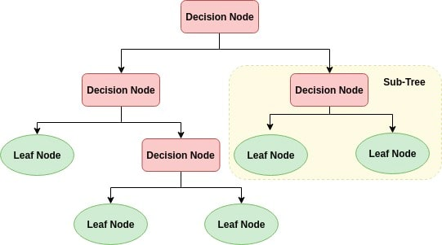
Classification
Random forest
is an ensemble learning method that constructs a multitude of decision trees at training time and outputs the class that is the mode of the classes of the individual trees
a decision tree is a flowchart-like structure:
an internal node is a "test" on an attribute
a branch is the outcome of the test
a leaf node is a label
the paths from root to leaf are classification rules

Slide 55
Classification: RF vs. SVM

Slide 56
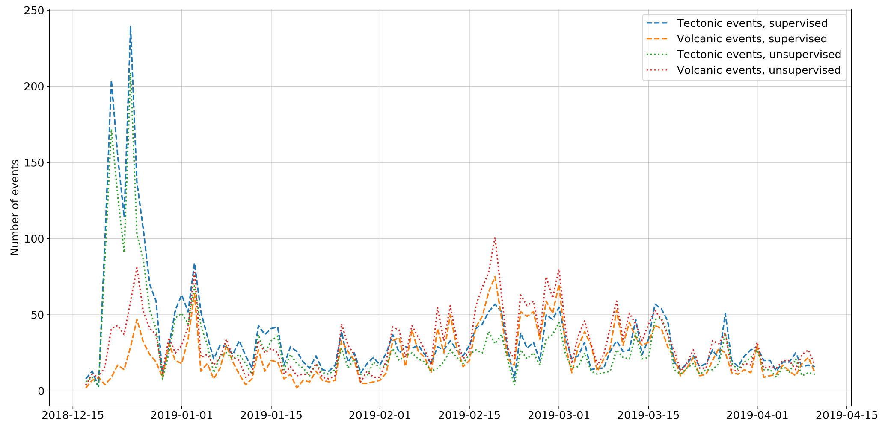
Comparison of unsupervised and supervised learning

Slide 57
Scattering coefficients
Well, we have seen that regular Fourier Transform (FT) worked well with seismic signals and algorithms performance was quite good.
But it is known that the FT is applicable when frequency content is stationary , and most of the signals in nature are non-stationary
So, FT has high resolution in frequency domain, but zero resolution in time domain

Slide 58
Scattering coefficients
A better approach for analyzing signals with a dynamical frequency spectrum is the Wavelet Transform (WT).
The WT has a high resolution in both the frequency- and the time-domain.
How does the Wavelet Transform work?
The FT uses a series of sine-waves with different frequencies to analyze a signal. In fact, a signal is represented through a linear combination of sine-waves.
The WT uses a series of functions called wavelets, each with a different scale.
from ataspinar.com

Slide 59
Scattering coefficients
Original (mother) wavelet moves along the signal from its beginning to the end and at each point the convolution of the wavelet with the signal is calculated. After that the wavelet is scaled that it becomes larger and the procedure repeats.
So, the scalogram is the time-scale representation of a signal and the output of the WT

Slide 60
Scattering coefficients
Pooling is a subsampling procedure and it can be performed in different ways (averaging, taking the maximum value, etc.)
modified from Seydoux et al.
Now one event is described by 3458 coefficients (vs. 8 features and 85 values of a smoothed spectrum)

Slide 61
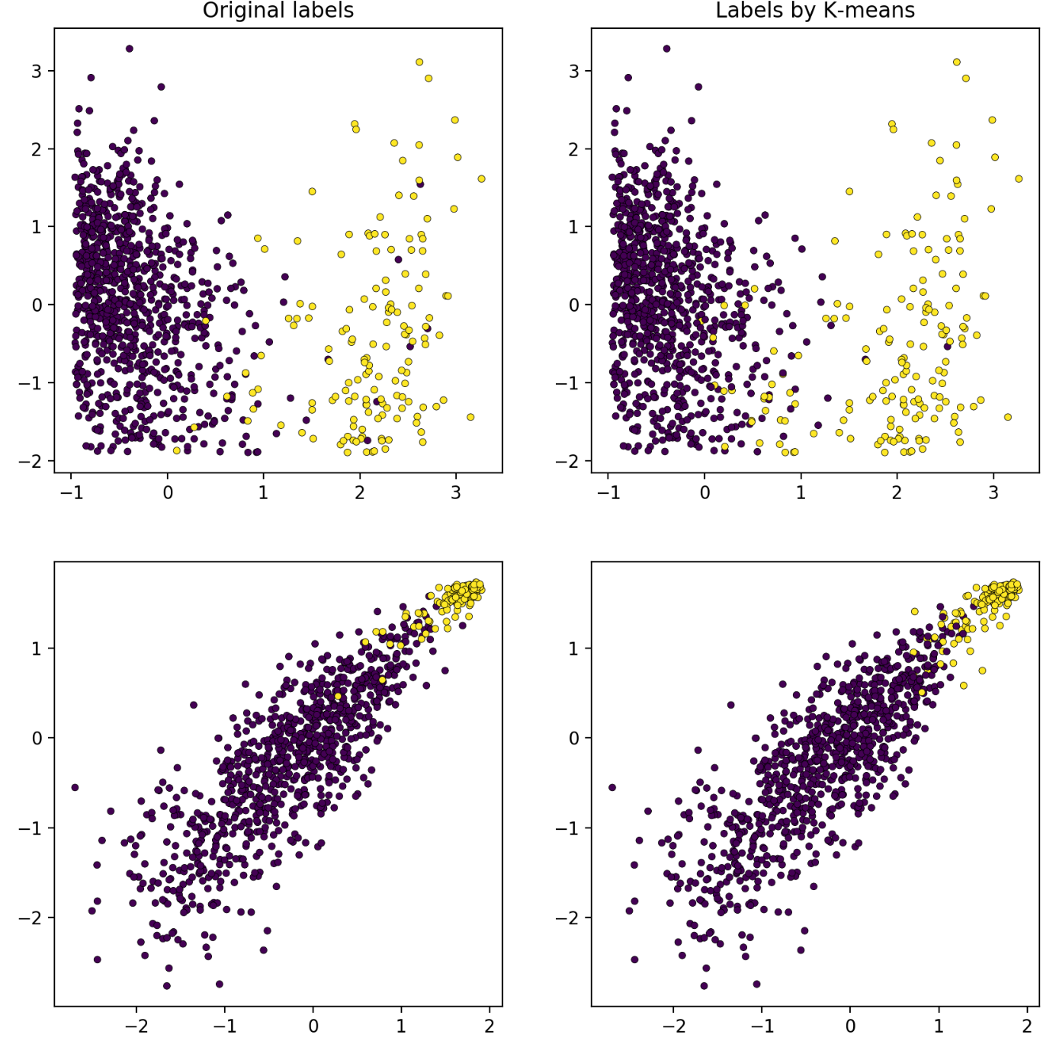
Clustering using scattering coefficients
Performance of clustering algorithms on the labeled set is very good:
1000/1041 correct predictions both for K-means and agglomerative clustering algorithm

Slide 62
If we present the entire dataset for clustering algorithms the main difference from the previous results is the higher volcanic activity according to the algorithm

Slide 63
In fact, all activity plots have similar form and features that slightly depend on parameters chosen for this or that algorithm (kernel type for SVM, number of trees in Random Forest, etc.)
So, we will not show this plots further and consider main types of algorithms to assess their perfomance better

Slide 64
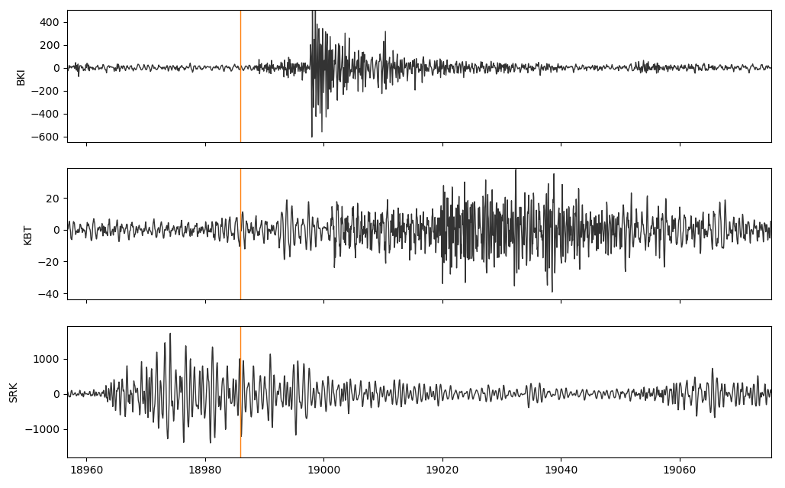
Manual seismograms processing
The horizontal (N) components of BKI, KBT and SRK stations were used.
tectonic event
Classification algorithms returned two classes of events: 0 for tectonic and 1 for volcanic.
During manual processing, the following types of events were introduced: 2 for noise/calibration signal, 3 for overlap, i.e. the case when both a tectonic earthquake and volcanic one occurred at the same time and at KBT station they formed a complex signal
volcanic event

Slide 65
Manual seismograms processing
Due to high activity levels the following days were considered: December 22-25, 30, 2018, January 3 and February 19, 2019 with total number of checked detections of 1091
41 of them were defined as calibration signals/noise and 67 of them are labeled as overlaps of tectonic and volcanic events

Slide 66
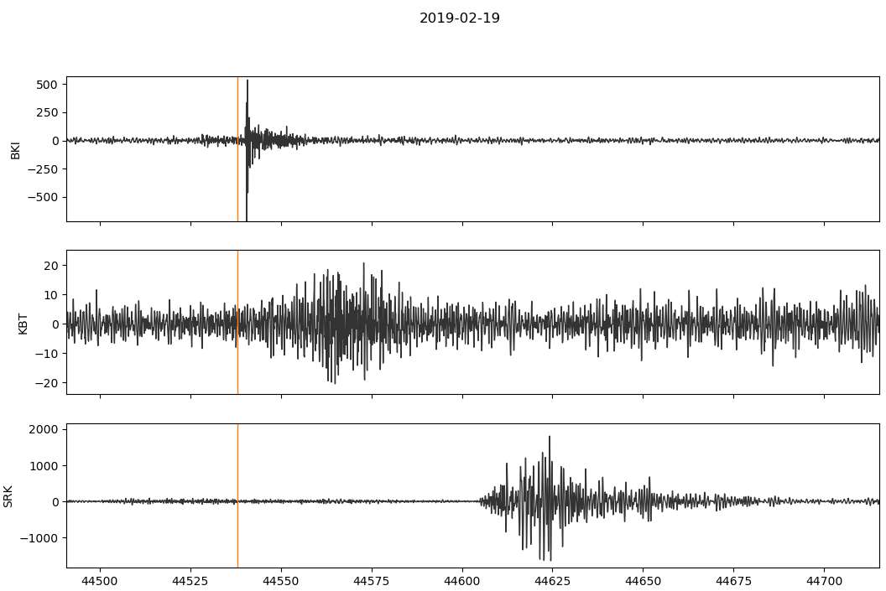
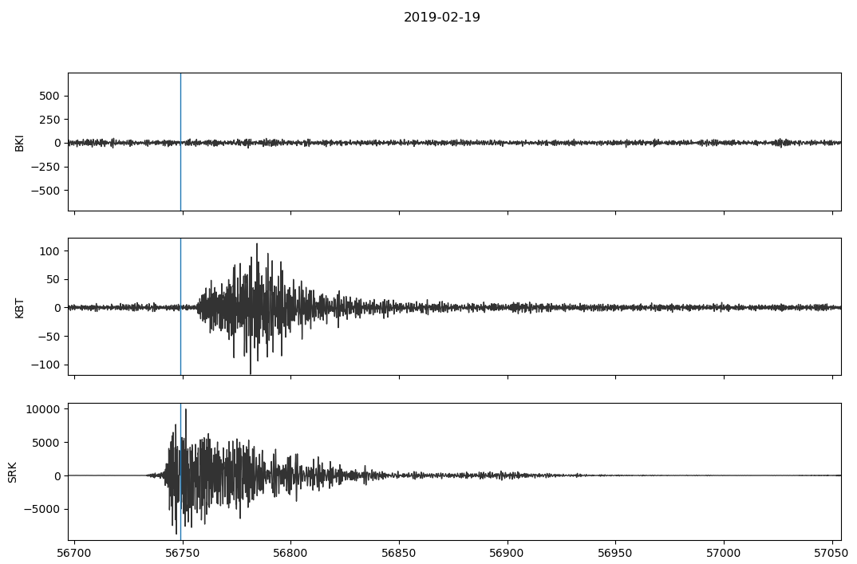
Manual seismograms processing
The main type of mistakes is the false classification of a weak tectonic event as a volcanic one
false volcanic event
Very rarely very strong volcanic earthquakes were classified as tectonic ones
false tectonic event
The least number (60) of the first type errors are made by the Random Forest algorithm when using smoothed spectra, but at the same time it makes relatively many errors of the second type (9)

Slide 67
Conclusions
The results of manual processing showed that, regardless of the signal representations used, supervised algorithms provide better results: tectonic earthquakes are less often classified as volcanic.
Results are quite stable relatively different classifiers and their main parameters
Deviation of the aftershocks distribution from the Omori law cannot be explained only by volcanic activity

