Slide 1
Assessing the operational value of short-term forecast information under climate change
Henrique Moreno Dumont Goulart^{1,4}, Matteo Giuliani¹, Jonathan Herman², Scott Steinschneider³, Andrea Castelletti¹
1 Politecnico di Milano, IT
2 University of California Davis, US
3 Cornell University, US
4 Deltares, NL

Slide 2
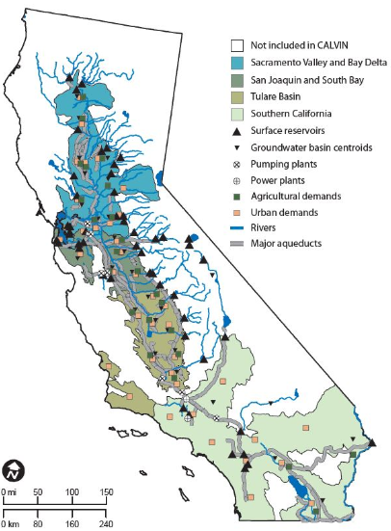
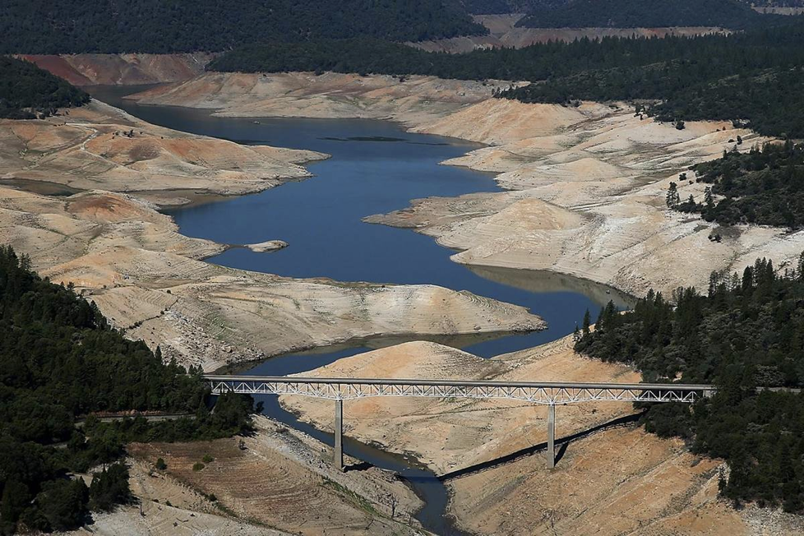
Water resources management in California
Lake Oroville, 2014
Lake Oroville, 2017
Motivation:
value of inflow forecasts only assessed over historical hydroclimatic conditions
climate projections suggest increasing variability with more frequent and intense extreme events
How much will be the value of forecast information under future more variable conditions?

Slide 3
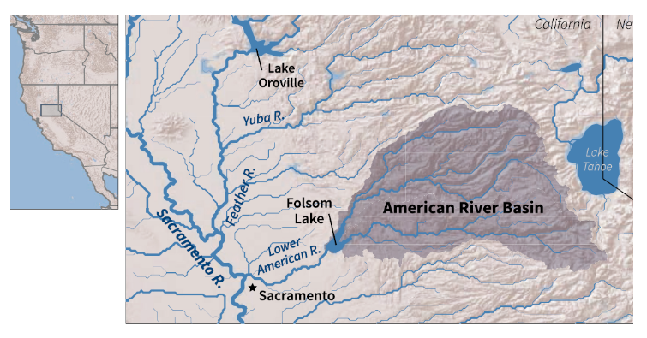
Case study: Folsom Reservoir
97 scenarios of future inflows from a U.S. Bureau of Reclamation study in which downscaled climate data from the CMIP5 ensemble are fed into the variable infiltration capacity (VIC) model
Operating objectives:
Water supply
Flood protection for the city of Sacramento

Slide 4
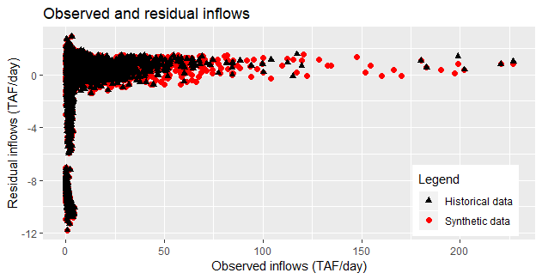
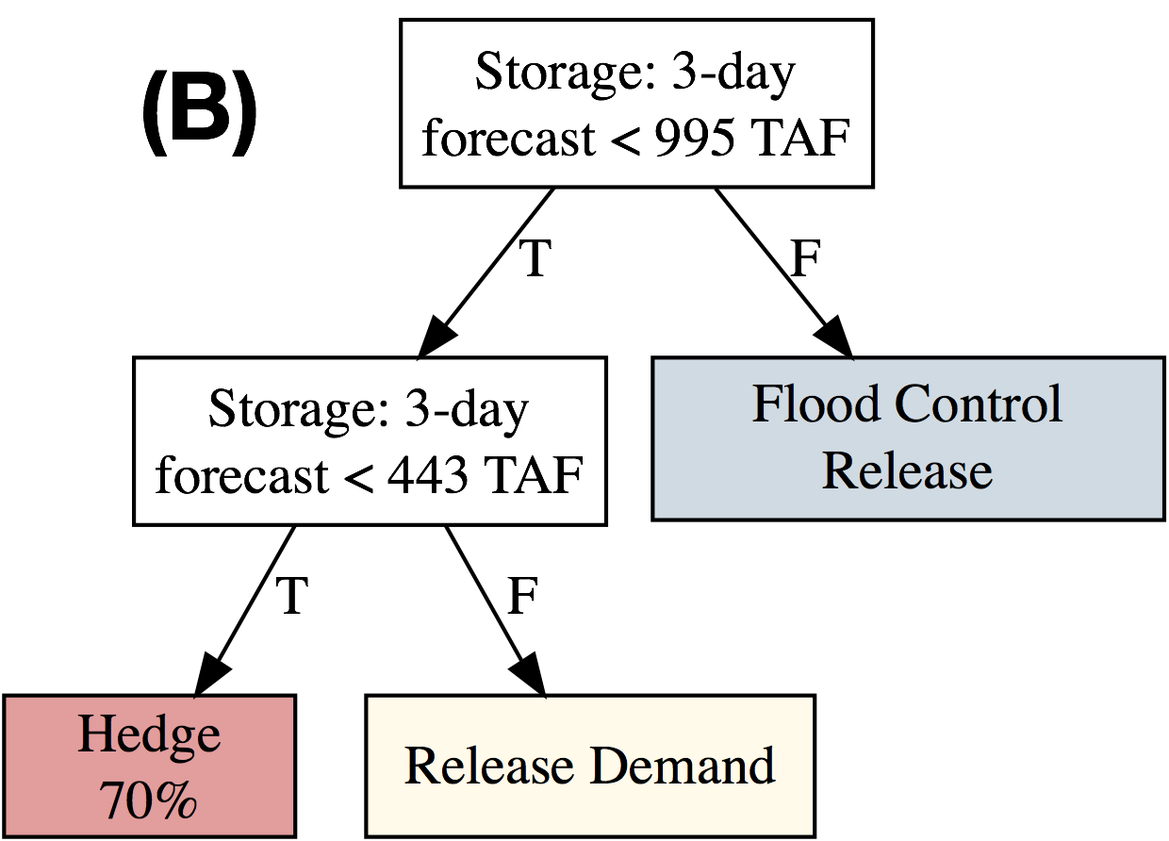
Methodology
1. Expected Value of Perfect Information | EVPI = maximum potential improvement between a perfect operating policy (assuming full knowledge of the future) and a baseline operating policy (with no forecast information)
2. Synthetic Forecast Generation | Synthetic inflow forecasts capture error structure of existing forecast system, i.e. NCEP daily S2S reforecasts with 3-day lead time used as input for SAC-SMA hydrologic model with degree-day snow routine
3. Forecast value | Forecast value = gain in performance obtained by a policy informed with the inflow forecast designed via policy tree with respect to the baseline solution
perfect policy
baseline policy
EVPI
cost

Slide 5
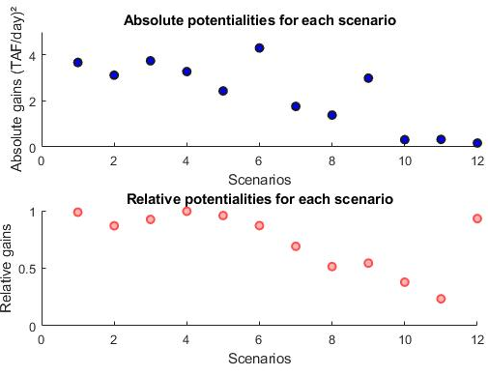
Results: Expected Value of Perfect Information
Absolute value
Absolute value: $POP −BOP$
(end-user benefit)
Relative value: $\frac{POP −BOP}{BOP}$
(operator benefit)
Relative value
Some discrepancies between absolute and relative values generate inconsitent perceptions of forecast value between end-users and operators, hindering forecast uptake

Slide 6
Results: Future forecast value
Absolute forecast value increases in the future
Relative forecast value depend on the projected climate

Slide 7
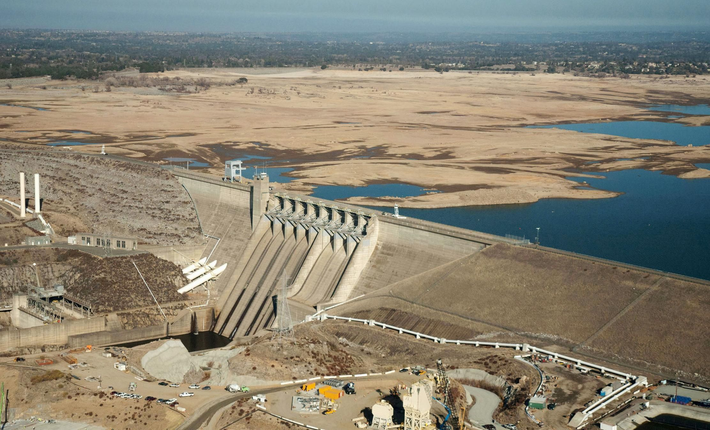
Henrique Moreno Dumont Goulart, Matteo Giuliani, Jonathan Herman, Scott Steinschneider, Andrea Castelletti

