Slide 1
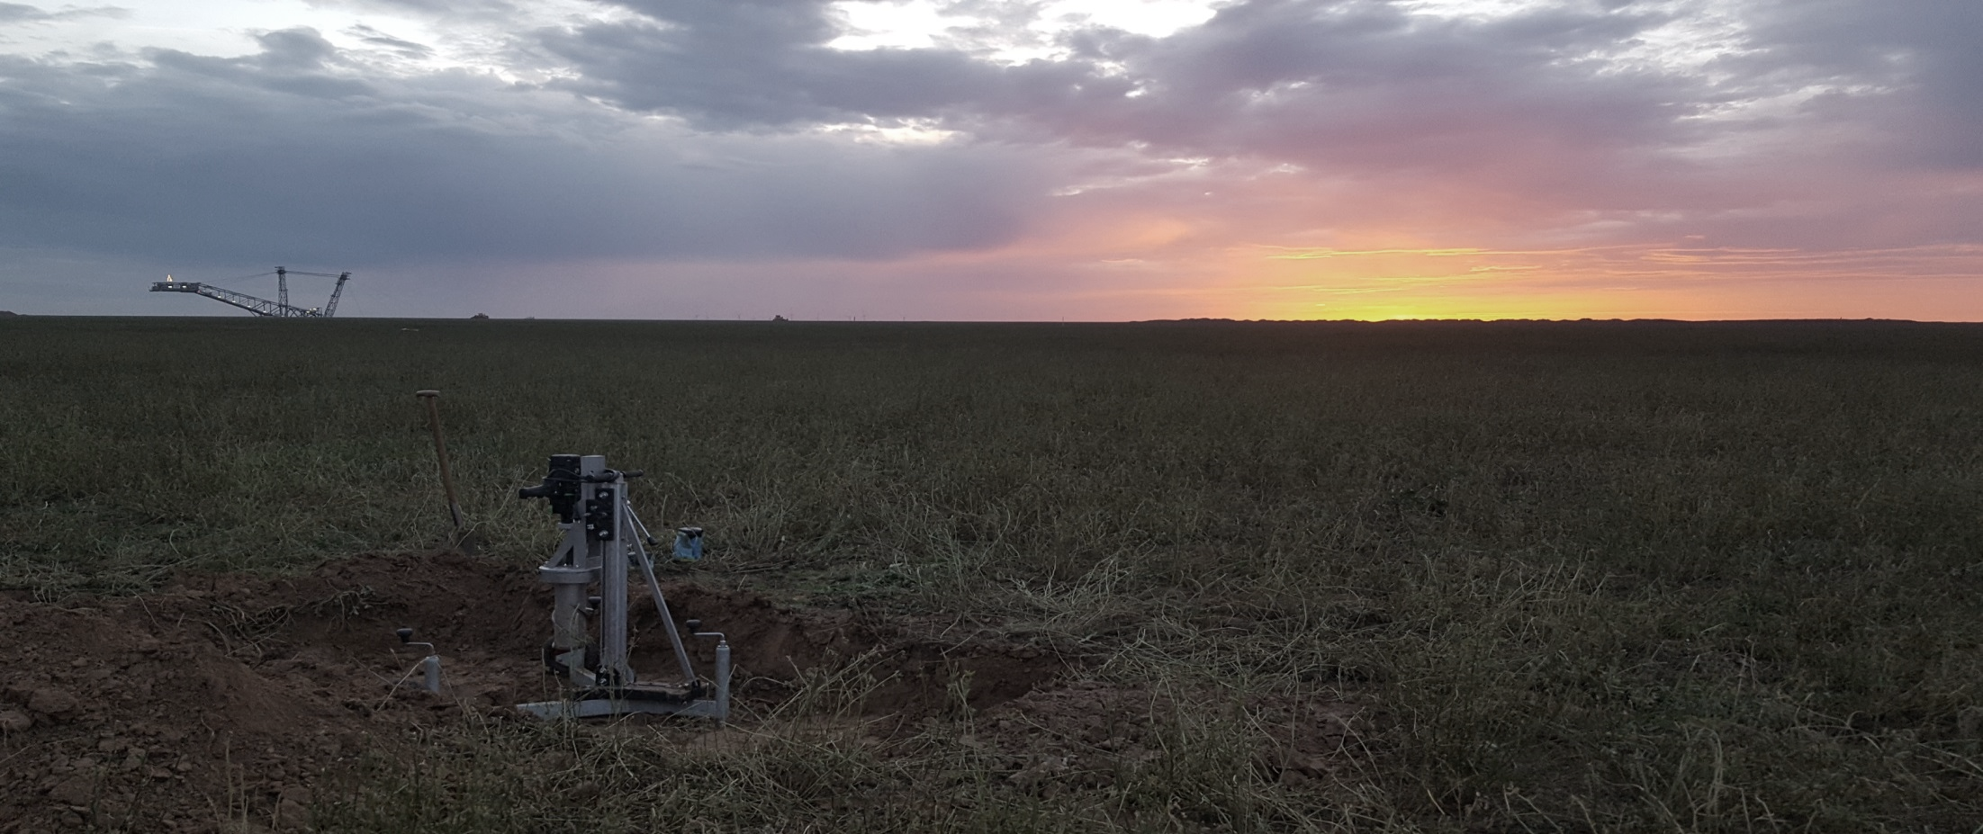
Connectivity across scales and resolution
EGU 2020 DFG Prj-Nr.: AOBJ: 628683
Maik Lucas , S. Schlüter, H.-J. Vogel, D. Vetterlein

Slide 2
Outline
Introduction
Methods
Results
Conclusion
This presentation is based on: Lucas, M, Vetterlein, D, Vogel, H‐J, Schlüter, S. Revealing pore connectivity across scales and resolutions with X‐ray CT. Eur J Soil Sci. 2020; 1– 15. https://doi.org/10.1111/ejss.12961
- click on image to navigate -

Slide 4
Introduction objective and research question
µCT analysis of undisturbed field samples from a reclamation site showed no changes in pore size distribution over time, although there was a steady increase in biopore volume
How does this increase effect soil hydraulic properties?
Pore connectivity is one of the most important parameters to quantify soil structure and link it to soil functions. Thus, the Euler number, χ and the connection probability of two random points within the pore system, i.e. the Γ‐indicator, were determined as a function of minimum pore diameter.

Slide 5
Introduction objective and research question
Can we use the connectivity metrics to investigate the changes in pore connectivity with X-ray CT across scales?
Can we disentangle different pore types by characteristic traces in certain connectivity metrics?

Slide 6
Methods the data set
µCT dataset of ~ 600 samples from a reclamation site including three different sample sizes were analyzed (10 cm Ø , 3 cm Ø , 0.7 cm Ø )
Details about research site: Pihlap et al. 2019
µCT analysis and soil structural changes over time described in: Lucas et al. 2019
The development of biopores over time could be described within 3 cm Ø samples and pore size distribution could be described by a scale fusion of all sample sizes

Slide 7
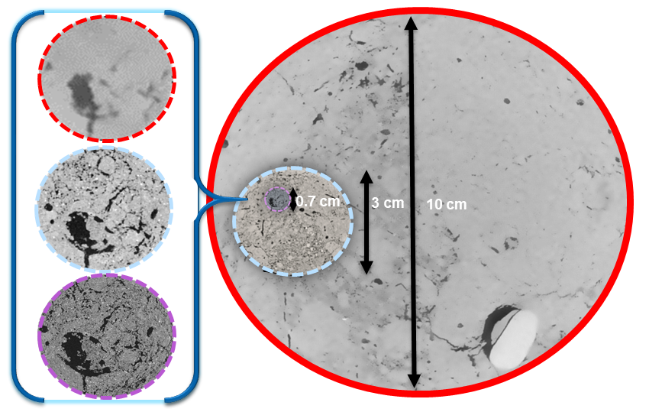
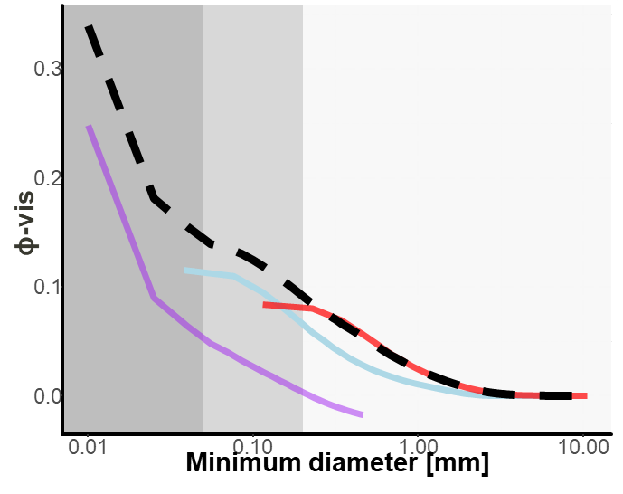
Methods scale fusion
Joined pore size distribution
Reducing the trade off between sample size and resolution by joining the information of different sample diameters to describe porosity (ϕ-vis) down to 5 µm pore diameter.
[Lucas et al., 2019]
[Lucas et al., 2020]

Slide 8
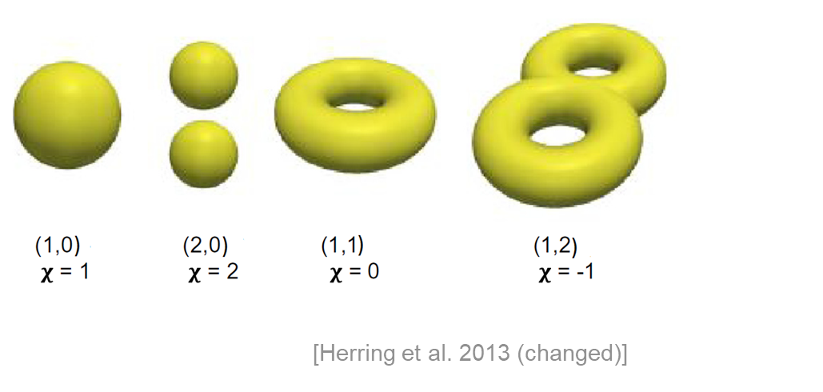
Methods connectivity metrics
Γ reflects the probability to find a continuous path through the pore system and χ reflects the number of internal connections without considering their lengths
$$χ=N−C +H$$
Χ
N: unconnected clusters
C: total number of redundant loops
H: number of closed cavities
(negligible in soil pore systems)
Neues Bild einfügen: Bild löschen / auf das Symbol klicken / neues Bild auswählen: Bild wird im vorgegebenen Format eingefügt
$$Γp=\frac{1}{N_{p}^{2}}\sum_{k=1}^{N_{i}}{n_{k}^{2}}$$
Г
N_{p}: is the number of all pore voxels p
N_{i}: the number of all clusters
n_{k}: number of pore voxel in cluster k
Value between 0 (no connection) and 1 (one connected system)

Slide 9
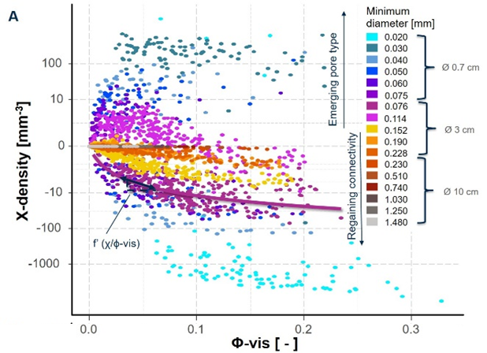
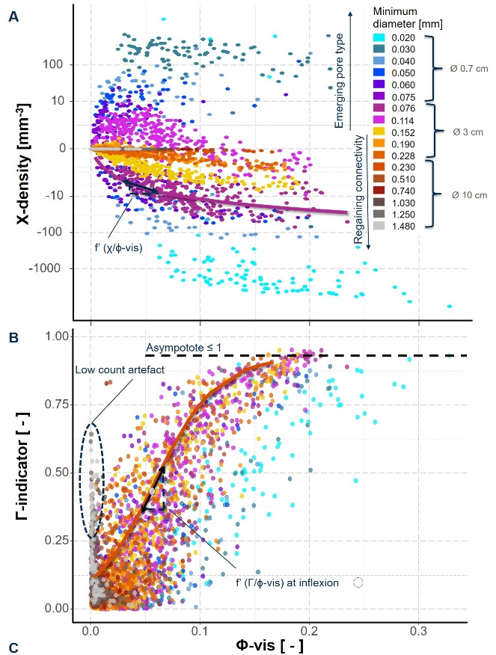
Results
$$χ$$
χ-density always decreased linearly with increasing ϕ-vis at any minimum pore diameter
addition of the minimum pore diameters (0.11, 0.05, 0.03 mm) caused a vast increase towards positive χ-densities
a new pore type must have emerged at this pore size that is still isolated at this diameter
$$Γ$$
Logistic relationship between Γ and ϕ-vis except for the largest pore size classes (<1 mm)
Same Level of clustering (Γ-value) was reached at very different ϕ-vis for different minimum pore diameters
[Lucas et al., 2020]

Slide 10
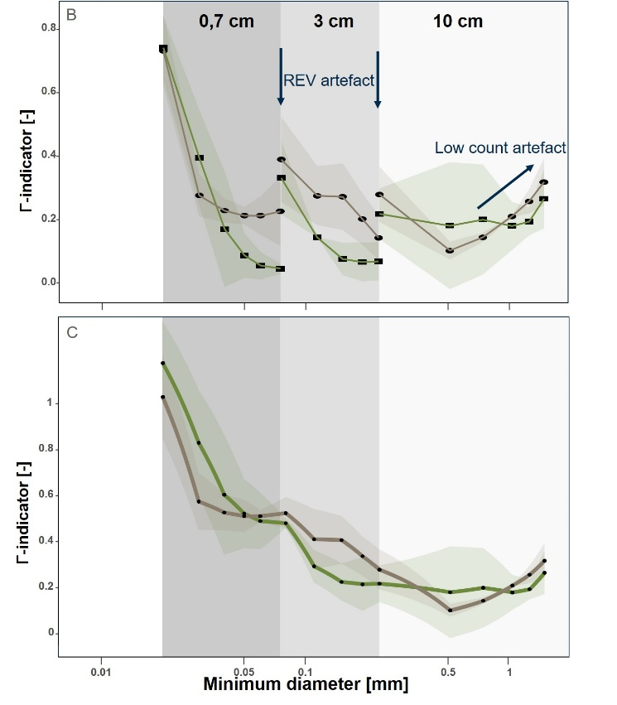
Results scale artefact for $Γ$
Mean values of Γ jumped towards lower Γ-indicators at the transition from one sample size to the next smaller sample size.
Large pore clusters were disrupted in the smaller sample size due to the “REV artefact”
We developed a new method for a joint-Γ-curve that merges information from three samples sizes.
joint-Γ-curve
[Lucas et al., 2020]

Slide 11
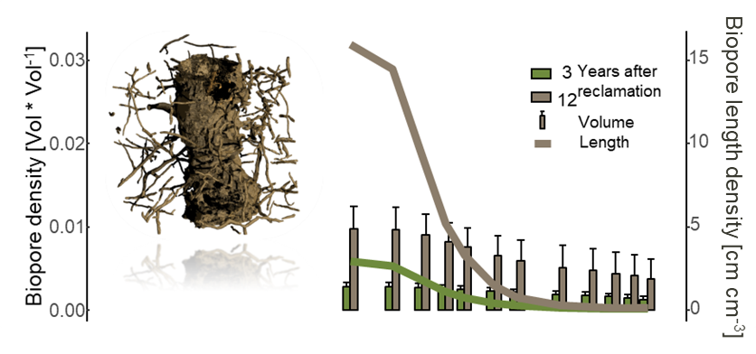
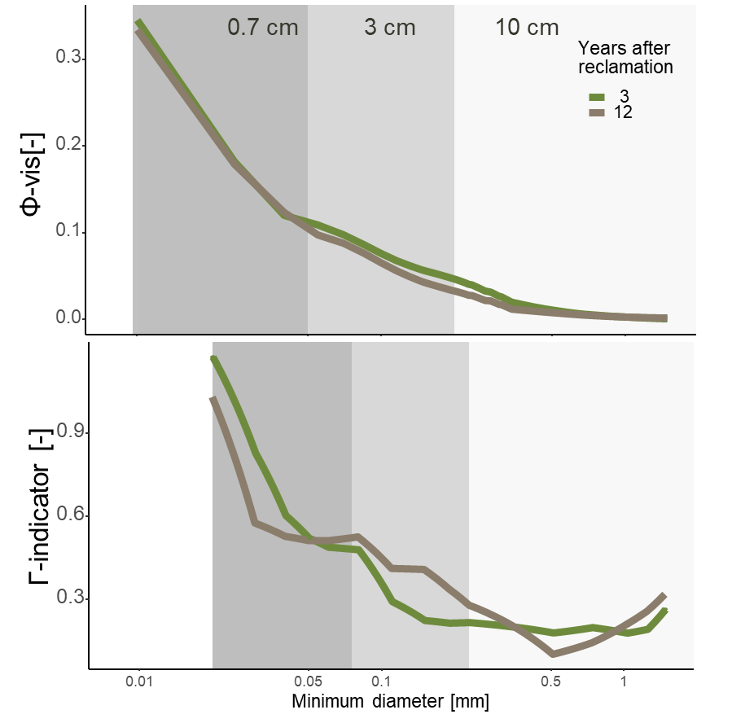
Results Biopores
Almost the same pores size distribution, but differences in connection probability Г
only approx. 1 Vol-% of the elongated shaped biopores lead to good long-range connectivity through rather oriented pores that connect the otherwise randomly distributed pore space. Most significant contribution to long-range connectivity from biopore diameters around 0.2 mm
[Lucas et al., 2020]

Slide 12
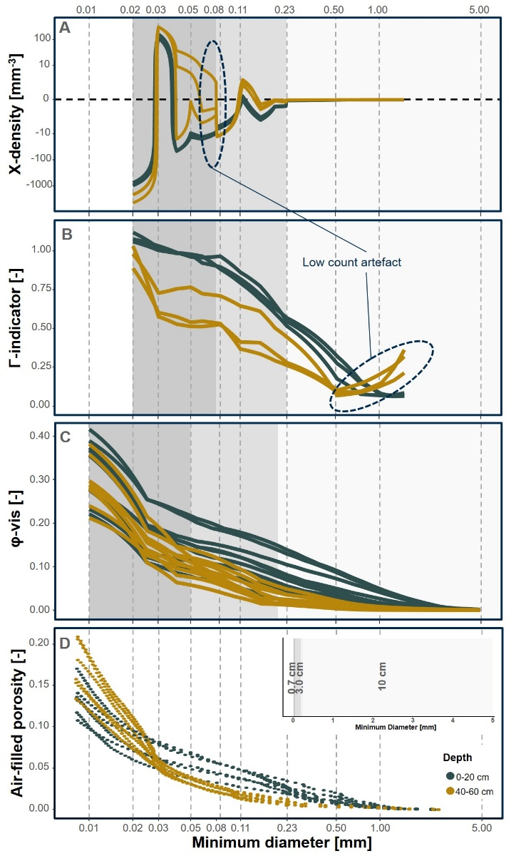
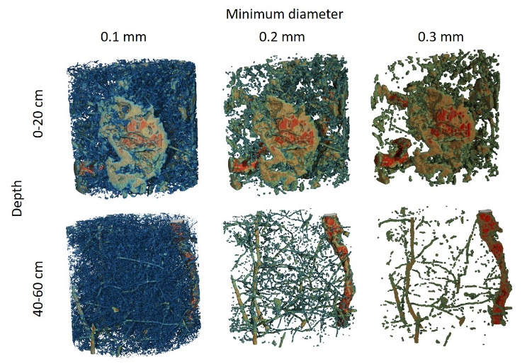
Secondary pores: Tillage induced
Corrected Γ-indicator of the tilled fields: Steady increase beginning at a pore diameter of 1 mm. Subsoils: Steady increase starting at 0.5 mm as larger pores are almost absent without plowing. The increase was especially high between pore diameters of 0.03 mm and 0.02 mm
The macropore volume was higher within the topsoil in both kind of measurement techniques (evaporation method (D) and X-ray µCT (C)) due to the increase of ϕ-vis for macropores >0.2
The curves from the measurements of topsoil and subsoil slowly converge below a minimum pore diameter of 0.2 mm. The pore size distribution, measured by the evaporation method is shifted towards smaller pores as it in fact does measure size distribution of pore bottle-necks.
At pores >0.03 mm (dark blue) more isolated pores than new connections emerged, (χ-densities positive). These pores are dispersly distributed secondary pores. At the smallest pore diameter of 0.02 mm the χ-density decreases again massively towards the minimum as even smaller pore necks emerge (light blue in Figure). Through them the entire pore network becomes connected and Γ reaches values of around 1. As a result, at the corresponding tension also the water of the unconnected pores >0.3 mm is drained and causes the shift between PSD and bottle-neck distribution.
[Lucas et al., 2020]

Slide 13
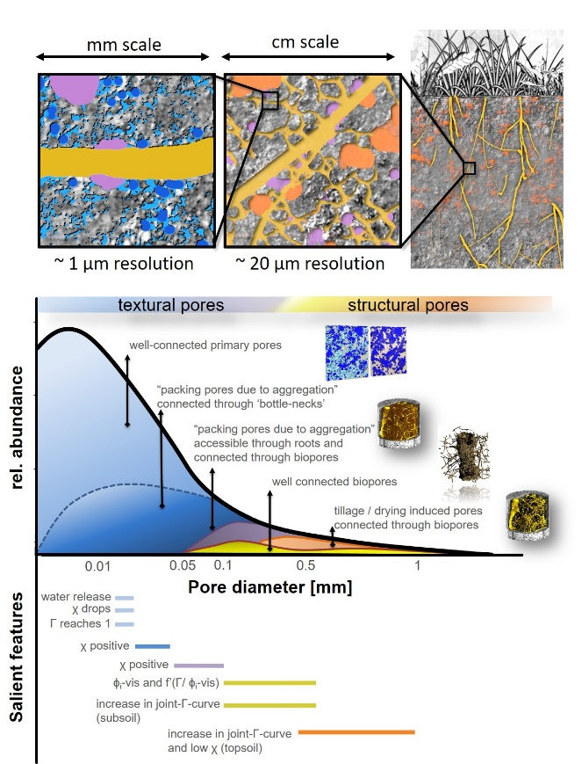
Conclusions
(1) Different scale artifacts overlap with actual pore features, which must be carefully considered during the interpretation of connectivity across scales
(2) Γ is highly sensitive to the “REV-artefact”, which occures when subsampling of an intact soil core cuts off long-distance connections. A joint-Γ-curve integrating information obtained from various samples can be used. The Euler number (χ) as a local metric does not need this scale fusion.
(3) By combining the information of χ and Γ the contribution of different pore types to the overall pore connectivity can be described and disentangled across scales..
(4) Biopores connect the pore system of diameters between 0.5 and 0.1 mm. For the specific soil investigated in this study this was not necessarily coupled with an increase in pore volume. In contrast, tillage could be seen as a shift of pores of diameter >0.05 mm towards pores larger than 0.2 mm which went along with an increase in pore volume and thus also in connectivity.
[Lucas et al., 2020]

Slide 14
Thank you for your attention!
We thank the “Deutsche Forschungsgemeinschaft” for founding the project
DFG Prj-Nr.: AOBJ: 628683

Slide 15
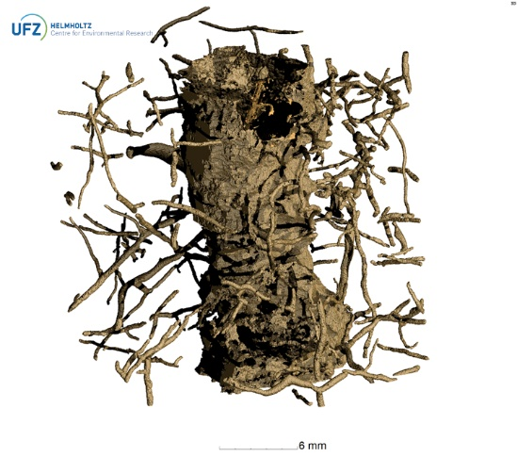
Biopores ≙ all tube-like pores > 38 µm
Depth:
[Lucas et al., 2019]

Slide 16
References
- All references are included by hyperlinks -

