Slide 1
COnstraining Orographic Drag Effects (COORDE): A model comparison of resolved and parametrized orographic drag
Annelize van Niekerk
Irina Sandu (ECMWF), Ayrton Zadra (Environment Canada), Eric Bazile (Meteo France), Takafumi Kanehama (JMA), Martin Kohler (DWD), Myung-Seo Koo (KIAPS), Yukihiro Kuroki (JMA), Michael Toy (CIRES), Simon B. Vosper (Met Office) and Valery Yudin (NOAA)

Slide 2
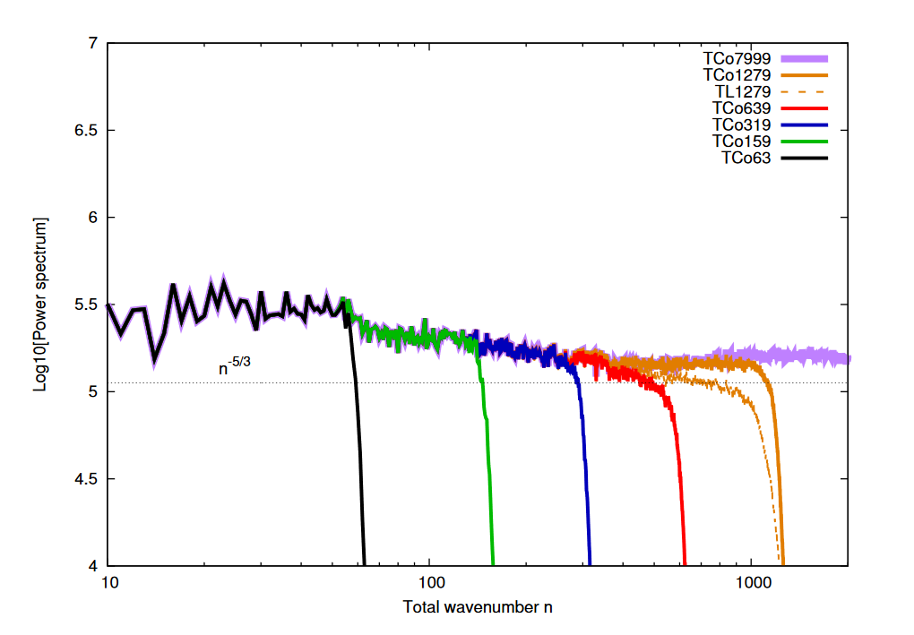
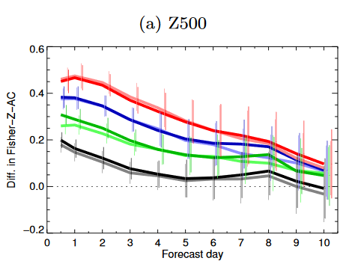
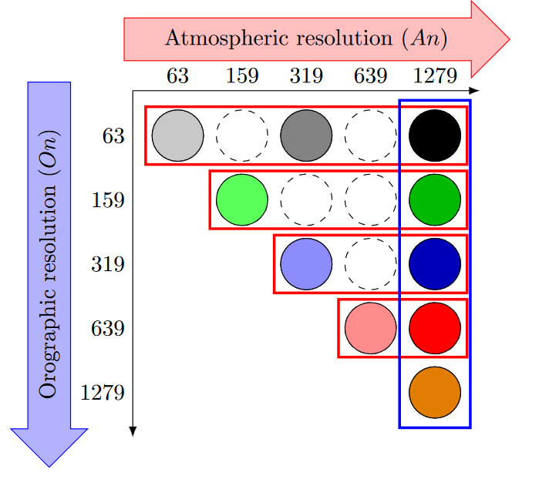
Resolved orography plays a significant role in model circulation accuracy
80 km
Anomaly correlation of large-scale circulation 500hPa Geopotential height:
36 km
18 km
Increasing atmospheric resolution
Kanehama et al (2019), JAMES
Increasing orographic resolution
Notes:
The forecast accuracy is significantly improved by better resolving the orography, even the smallest scales give a large contribution.

Slide 3
Vertically propagating orographic gravity wave drag
Trapped waves/
Low-level wave breaking
Orographic flow blocking drag
Turbulent orographic drag
Vegetative roughness drag
Notes:
Because we cannot resolved the small scale orography, we need to be parametrized their effects on the circulation. However, the orography has many scales and several processes co-occurring. Typically, models try to account for orographic processes shown in this slide. Additionally, there is also vegetative drag that is occurring over land, and can lead to overlap in how to model the total drag.

Slide 4
Orographic drag parametrizations
Zonally averaged vertically integrated momentum budget:
Orographic height spectrum:
80 km
Zonal momentum
$$\frac{d<ρu> }{dt}=$$
$$−p\left(z_{0}\right)\frac{∂z_{0} }{∂x} +<ρfv>−\frac{∂<ρuv>}{∂y}$$
36 km
18 km
Resolved Dynamics
Resolved orographic pressure drag
Coriolis
Horizontal momentum flux
Sub-grid scale orographic drag
Boundary layer diffusion
Turbulent orographic form drag
$$+ τ_{BLK} +{ τ }_{BL} {+ τ}_{TOFD}$$
$$+ τ_{GWD}$$
$$+ τ_{LLD}$$
$$<…> =\int_{z_{0}}^{z_{top}}{⋯ dz}$$
Notes:
These parametrizations are all added as a term within the momentum budget, which also includes a resolved component.
As the resolution of the model is varied the resolved orographic drag generally increases and the parametrizations should account for this.
Because of the overlap between the processes (and the greyzone between the resolved and parametrized orographic drag), particularly those occurring at low-levels, the way in which models partition drag is very uncertain.

Slide 5
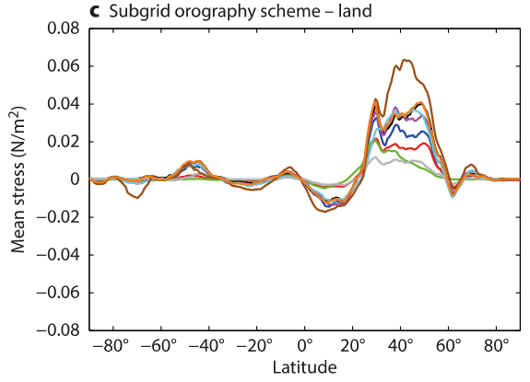
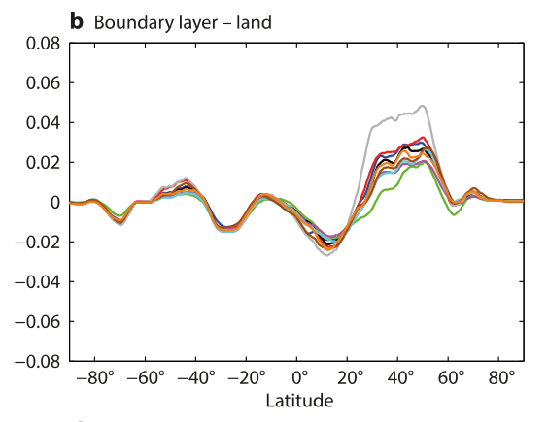
Orographic drag parametrizations are uncertain
Plots show zonal mean parametrized surface stress over land at 16 km resolutions:
UM MO
ECMWF IFS
UM MO
ECMWF IFS
Parametrization are not well constrained by observations – makes them ‘tunable’
WGNE Drag Project, Report No.1, A. Zadra (2013)
Notes:
This uncertainty is exemplified in the WGNE drag project, which showed that models partition their drag into boundary layer and orographic drag quite differently.

Slide 6
COnstraining ORographic Drag Effects (COORDE)
Aims to explore:
The variety of different orographic drag parametrizations employed in current operational models
Resolution sensitivity of resolved and parametrized drag
The ability of the parametrizations to reproduce explicitly resolved orographic drag from high resolution simulations
Notes:
Motivated by this, we set up the COORDE project in order to reduce these uncertainties.
The aims of the project are listed on the slide.
We take stock of the different processes accounted for in the models and try to understand the implications of this.
The ability for the parametrizations to adapt to resolution is important for understanding their formulation and for the ‘seamless’ way in which models are used these days
Since it is difficult to constrain drag directly using observations, we can use high resolution models, in which the drag is explicitly resolved, to determine what the parametrized drag should be

Slide 7
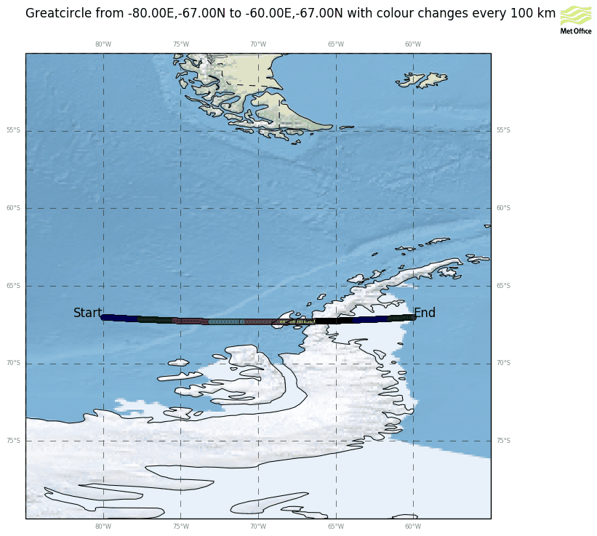
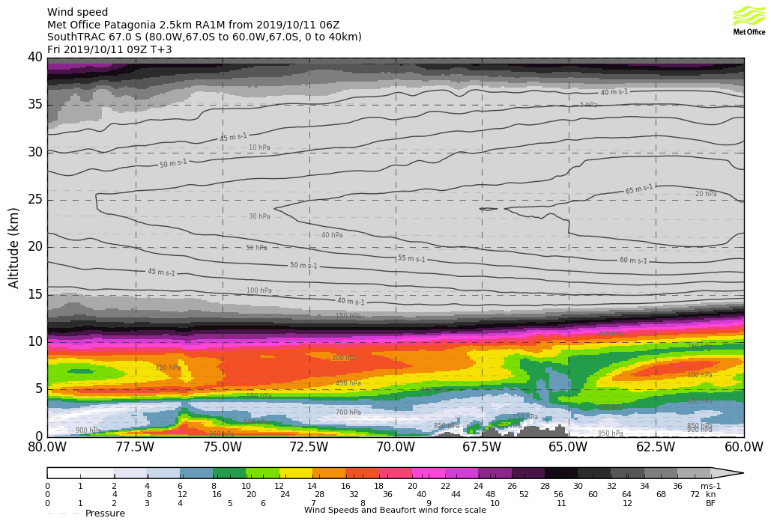
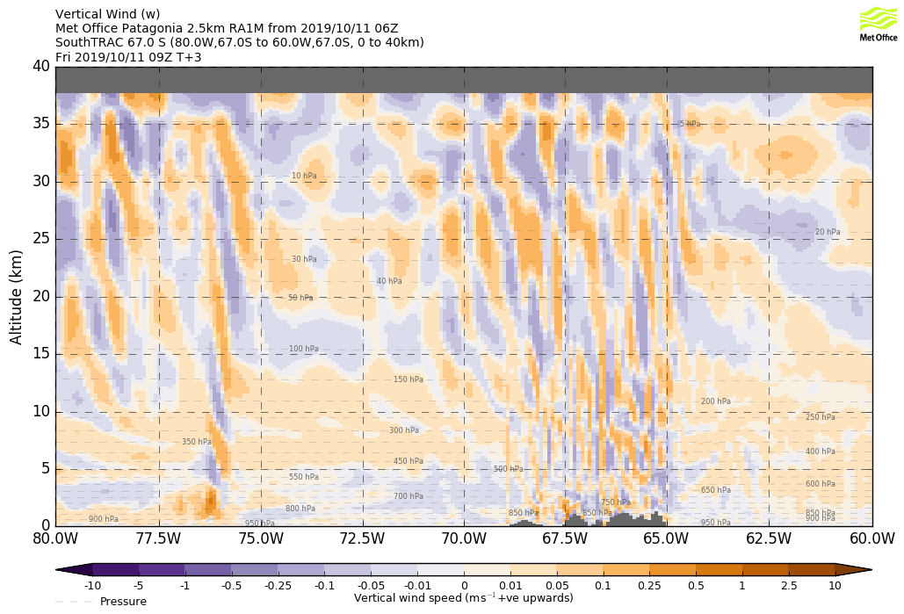
(Vertically) non-local impacts of orographic gravity wave drag
2.5 km model simulation over the Antarctic Peninsula with Met Office Unified Model
~100 km

Slide 8
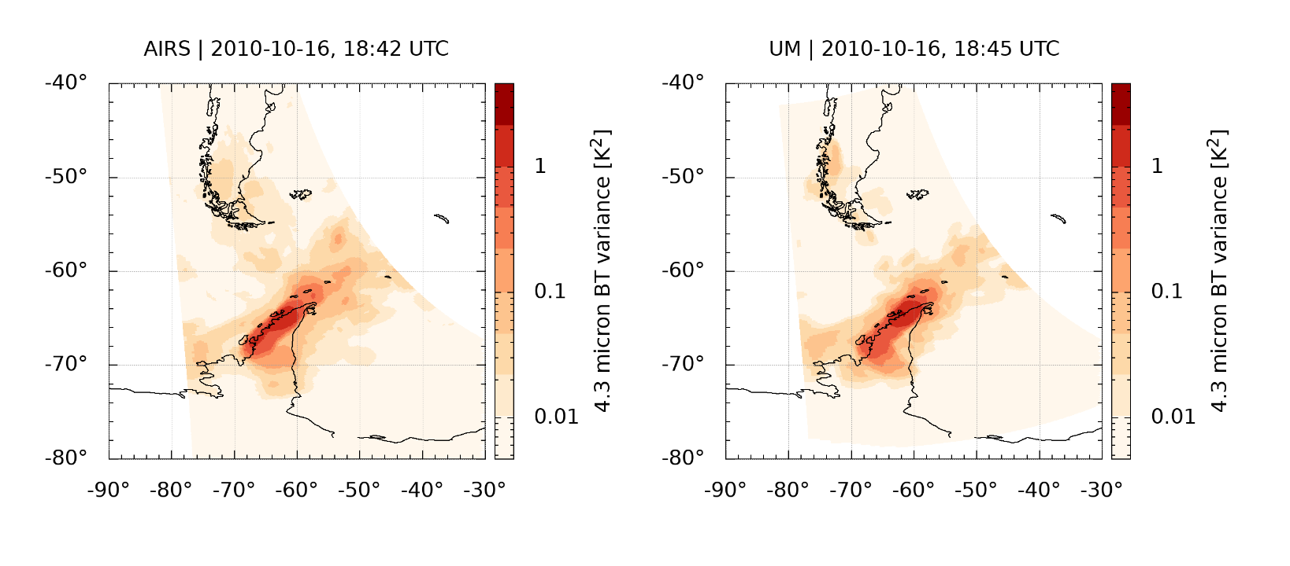
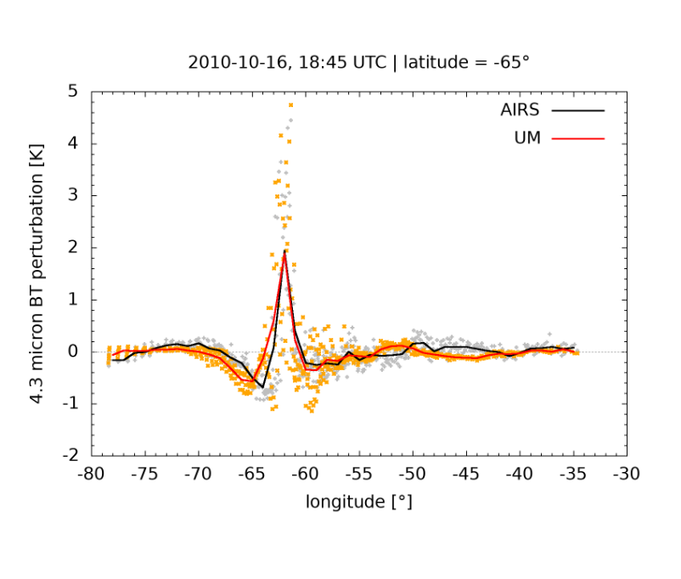
Satellite derived observations for validating high resolution simulations
Model and satellite wave amplitude and phase agree very well
AIRS satellite observation
2.5 km UM simulation
Plots show inferred temperature variances (linked to wave activity) at 30-40 km altitude
c/o Lars Hoffmann,
see: http://www.issibern.ch/teams/consonorogravity
Notes:
We know that high resolution models are relatively good at modelling waves over topography, so it is well motivated to use them as a proxy for the truth in order to constrain parametrizations

Slide 9
Orographic drag parametrizations
Zonally averaged vertically integrated momentum budget:
Orographic height spectrum:
80 km
Zonal momentum
$$\frac{d<ρu> }{dt}=$$
$$−p\left(z_{0}\right)\frac{∂z_{0} }{∂x}$$
36 km
18 km
Resolved Dynamics
Resolved orographic pressure drag
Sub-grid scale orographic drag
Boundary layer diffusion
Turbulent orographic form drag
$$+ τ_{BLK} +{ τ }_{BL} {+ τ}_{TOFD}$$
$$+ τ_{GWD}$$
$$+ τ_{LLD}$$
$$<…> =\int_{z_{0}}^{z_{top}}{⋯ dz}$$
Notes:
In this work, the parametrizations are evaluated in two ways: firstly, by comparing the relevant terms within the momentum budget in the high resolution simulations to their parametrized counterparts terms in the low resolution simulations
At the surface, this can be done through the vertically integrated zonal momentum budget by looking at the surface stresses.
BLK = stress from blocking
GWD = gravity wave stress
LLD = all other low level drag (e.g. low level wave breaking)

Slide 10
Orographic drag parametrizations
Zonally averaged vertically integrated momentum budget:
Orographic height spectrum:
80 km
Zonal momentum
$$\frac{d<ρu>(z) }{dt}=$$
$$− ρuw(z)$$
36 km
18 km
Resolved Dynamics
Gravity wave vertical momentum flux
X
X
X
Sub-grid scale orographic drag
Boundary layer diffusion
Turbulent orographic form drag
$$+ τ_{BLK} +{ τ }_{BL} {+ τ}_{TOFD}$$
$$+ τ_{GWD}(z)$$
$$<…> =\int_{z}^{z_{top}}{⋯ dz}$$
Notes:
In the free atmosphere, away from the BL, we can also diagnose the vertical momentum fluxes from the gravity waves and thus the resolved gravity wave drag

Slide 11
Orographic drag parametrizations
Horizontally averaged momentum budget in the free atmosphere:
Orographic height spectrum:
80 km
Zonal momentum
$$\frac{d u(z) }{dt}=$$
$$− \frac{1}{ρ}\frac{∂}{∂z}ρuw(z)$$
36 km
18 km
Resolved Dynamics
Gravity wave drag
X
X
X
Sub-grid scale orographic drag
Boundary layer diffusion
Turbulent orographic form drag
$$+ F_{BLK} +{ F }_{BL} {+ F}_{TOFD}$$
$$+ F_{GWD}(z)$$
Notes:
In the free atmosphere, away from the BL, we can also diagnose the vertical momentum fluxes from the gravity waves and thus the resolved gravity wave drag. This gives us constraints on the parametrization of gravity wave drag in the stratosphere.

Slide 12
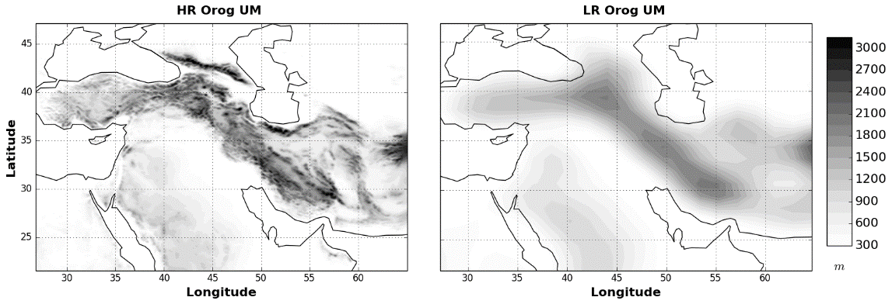
Model setup
High resolution (HR) : 9km – 6km global &
3km – 1.8 km regional
High resolution orography
Low resolution orography
High resolution simulation with high resolution orography
-
High resolution simulation with low resolution orography
Gives impact of resolved orography
Low resolution (LR) : 100 km
Low resolution simulation with parametrized orographic drag
-
Low resolution simulation without parametrized orographic drag
Gives impact of parametrized orographic drag
24-hour short-range forecasts initialised from analysis
1 to 14th January 2015
Middle resolution (MR) : 40km
To test resolution sensitivity
See van Niekerk et al (2018)
Notes:
However, it is much more difficult to deduce the drag throughout the troposphere from resolved orography, so we have a method of deducing this using specially designed experiments with high resolution simulations.
This method involves high resolution simulations with high resolution orography and low resolution orography prescribed at the surface. This will then give us the impact of resolved orography on circulation.
Then this is compared with experiments in which the parametrized orographic is turned off. If the parametrization were doing the right thing, we could see a similar response in the circulation
Finally, we also look at some middle resolution experiments to test the resolution sensitivity.

Slide 13
Models
11 models in total from:
Centre | Model | Resolutions
ECMWF | IFS | LR: 125 km MR: 40 km HR: 9 km
Met Office | UM | LR: 130 km MR: 40 km HR: 9 km & 1.8 km
KIAPS | KIM | LR: 130 km MR: 40 km HR: 6 km
JMA | GSM1705 GSM2003 | LR: 130 km MR: 40 km LR: 130 km MR: 40 km HR: 9 km
DWD | ICON | LR: 130 km MR: 40 km HR: 2.5 km
Meteo-France | ARPEGE AROME | LR: 130 km MR: 40 km HR: 2.5 km
NOAA/NCEP | FV3GFS WRF | LR: 100 km HR: 3 km
Environment-Canada | GDPS RDPS | LR: 100 km MR: 40 km 3 km
Notes:
Several institutes contributed to this, they are listed here

Slide 14
COnstraining ORographic Drag Effects (COORDE)
Aims to explore:
The variety of different orographic drag parametrizations employed in current operational models
Resolution sensitivity of resolved and parametrized drag
The ability of the parametrizations to reproduce explicitly resolved orographic drag from high resolution simulations

Slide 15
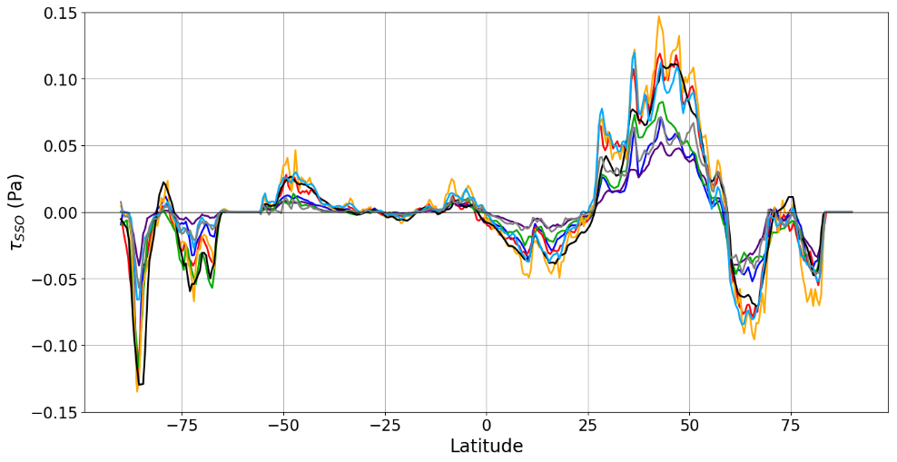
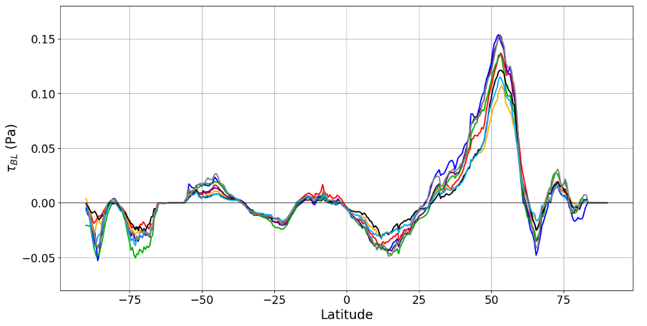
Parametrized surface stress
Notes:
We begin by looking at the surface stresses in the models.
The WGNE drag project showed that the model compensated one parametrization for another, this can also be seen in our model submissions. Representing the variety of different parametrizations employed
There is a particularly large spread in this region because the two schemes maximise at different latitudes

Slide 16
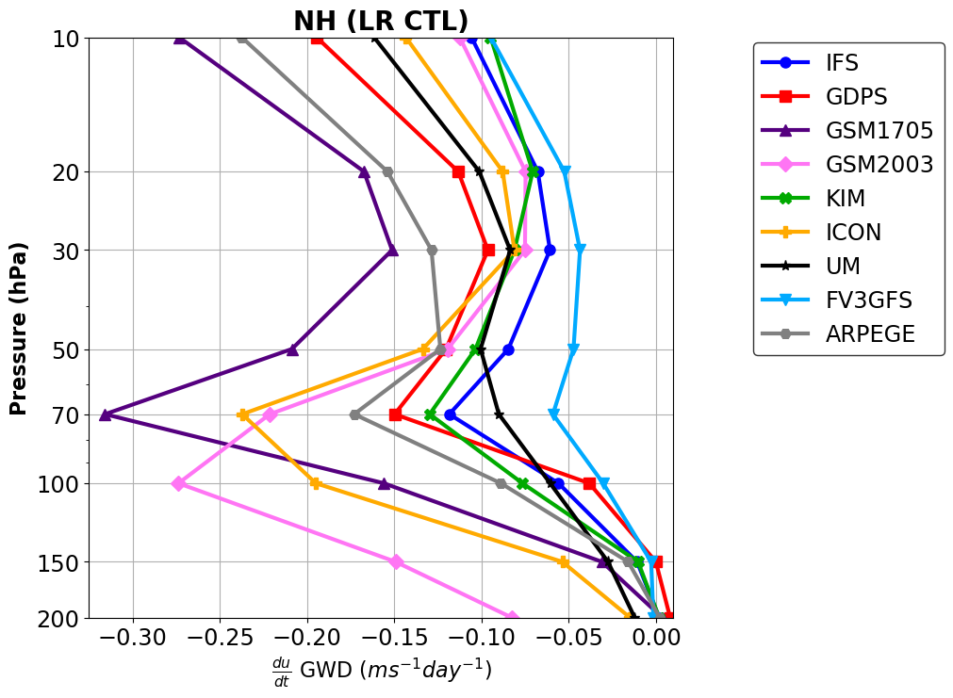
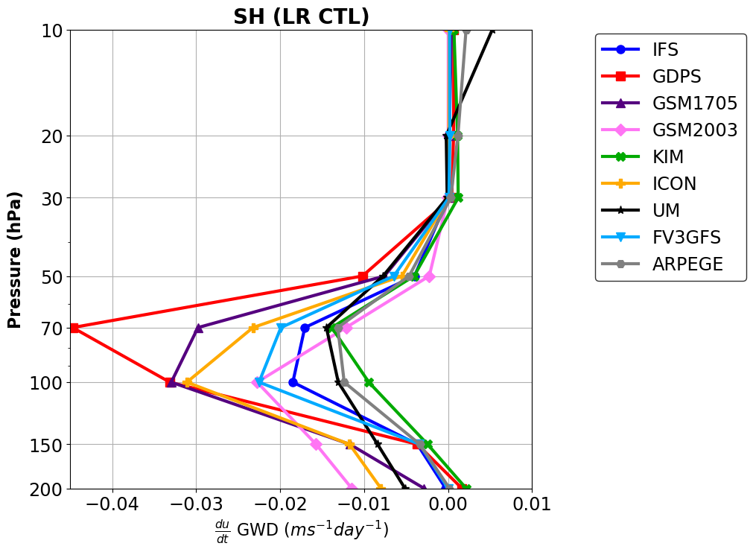
Orographic gravity wave drag parametrizations
Zonal momentum budget:
Parametrized gravity wave drag (NH)
Parametrized gravity wave drag (SH)
100 km
100 km
Plot shows parametrized GWD over NH & SH
Stratosphere at 100 km resolution
Notes:
Then we look at the parametrized gravity wave drag within the free atmosphere over the Northern Hemisphere (NH) and Southern Hemisphere (SH)
There is a large spread in the parametrized drag over these regions at a resolution of 100 km

Slide 17
COnstraining ORographic Drag Effects (COORDE)
Aims to explore:
The variety of different orographic drag parametrizations employed in current operational models
Resolution sensitivity of resolved and parametrized drag
The ability of the parametrizations to reproduce explicitly resolved orographic drag from high resolution simulations

Slide 18
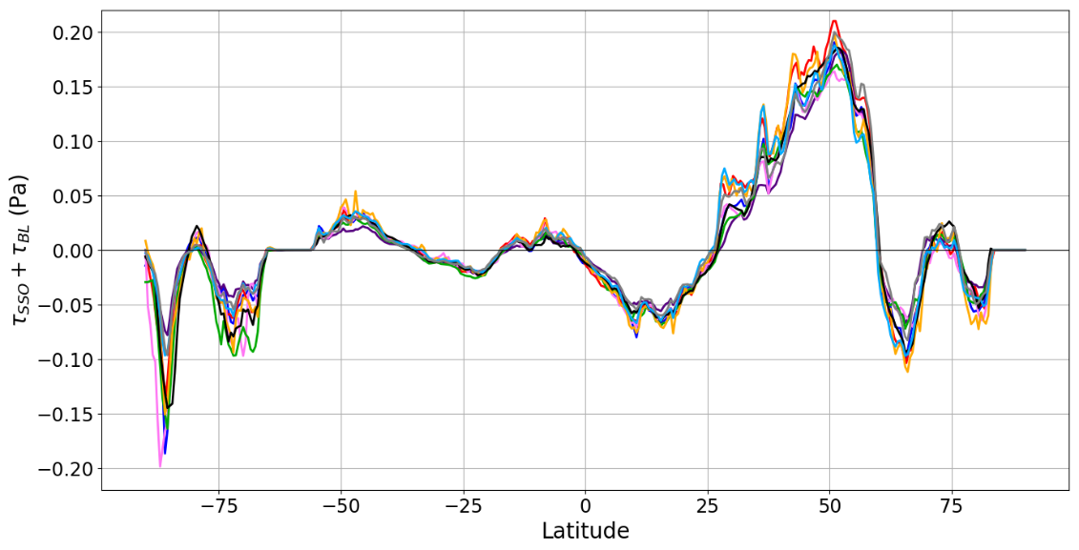
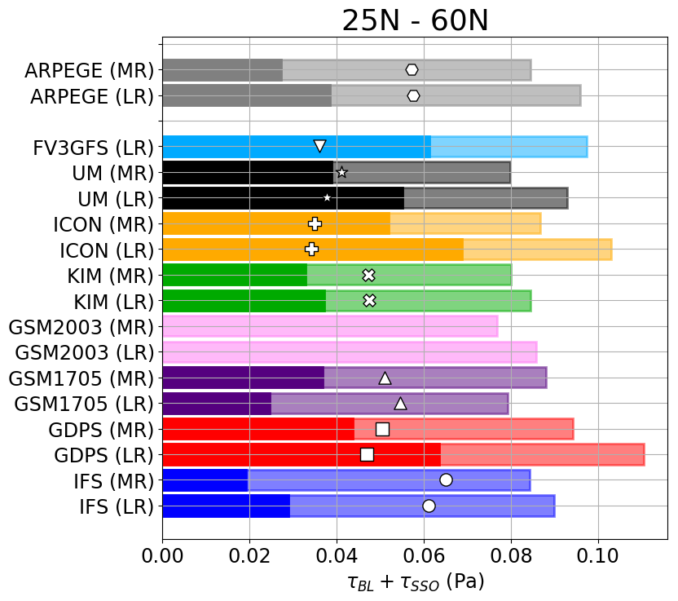
Parametrized surface stress
Zonal momentum budget:
$$+ τ_{SSO}$$
Sub-grid scale orographic drag
Zonal momentum
Resolved Dynamics
$$\frac{d<ρu> }{dt}= −p\left(z_{0}\right)\frac{∂z_{0} }{∂x}$$
$$+ τ_{BL}$$
Turbulent boundary layer drag
There is a large spread in the total drag at comparable resolution
Most models show a reduction in the parametrized drag at higher resolution, dominated by SSO
Models with larger SSO component have a stronger resolution sensitivity
Notes:
Focusing on one particular region, we can look at the contributions from the different drag components, and their resolution sensitivity. Plot on the right shows the contribution from SSO stress (dark bar) and the total BL + SSO stress (light bar). The white marker shows the BL stress. LR = 100 km resolution and MR = 40 km resolution.
We notice that there is a large spread in the total stress between the models, and their partitioning into BL and SSO is very different
Also note that most models show a reduction in the drag at higher resolution, but not all of them.
Also apparent that models with larger SSO component have a stronger resolution sensitivity.

Slide 19
Orographic gravity wave drag parametrizations
Parametrized gravity wave drag (NH)
Parametrized gravity wave drag (SH)
100 km
100 km
Plot shows parametrized GWD over NH & SH
Stratosphere at 100 km resolution

Slide 20
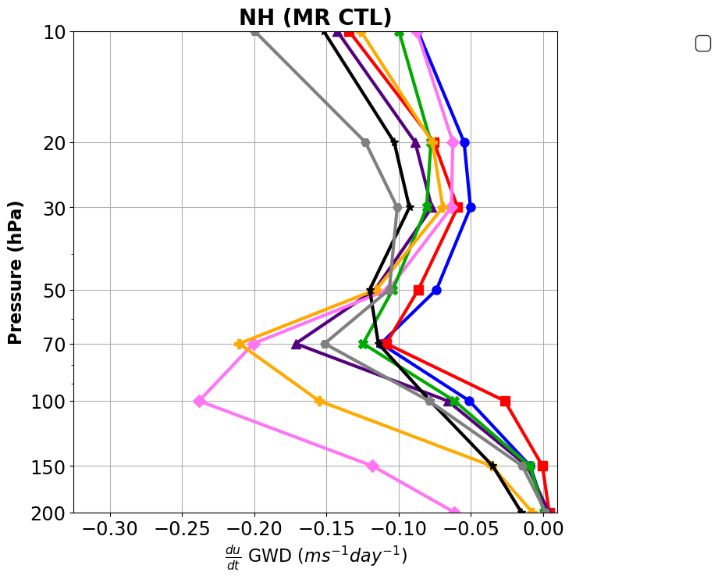
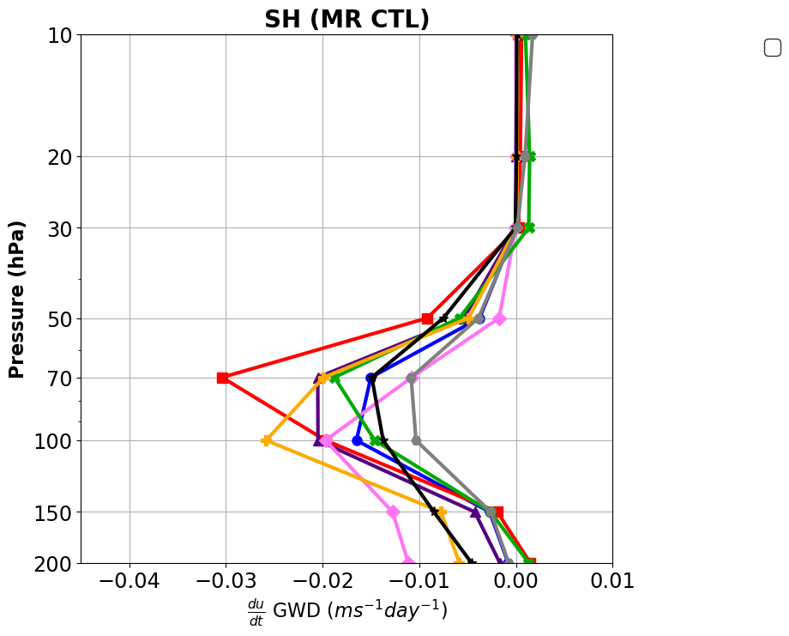
Orographic gravity wave drag parametrizations
Parametrized gravity wave drag (NH)
Parametrized gravity wave drag (SH)
40 km
40 km
Plot shows parametrized GWD over NH & SH
Stratosphere at 40 km resolution
Notes:
The parametrized GWD is actually relatively insensitive to resolution in many of the models.

Slide 21
COnstraining ORographic Drag Effects (COORDE)
Aims to explore:
The variety of different orographic drag parametrizations employed in current operational models
Resolution sensitivity of resolved and parametrized drag
The ability of the parametrizations to reproduce explicitly resolved orographic drag from high resolution simulations

Slide 22
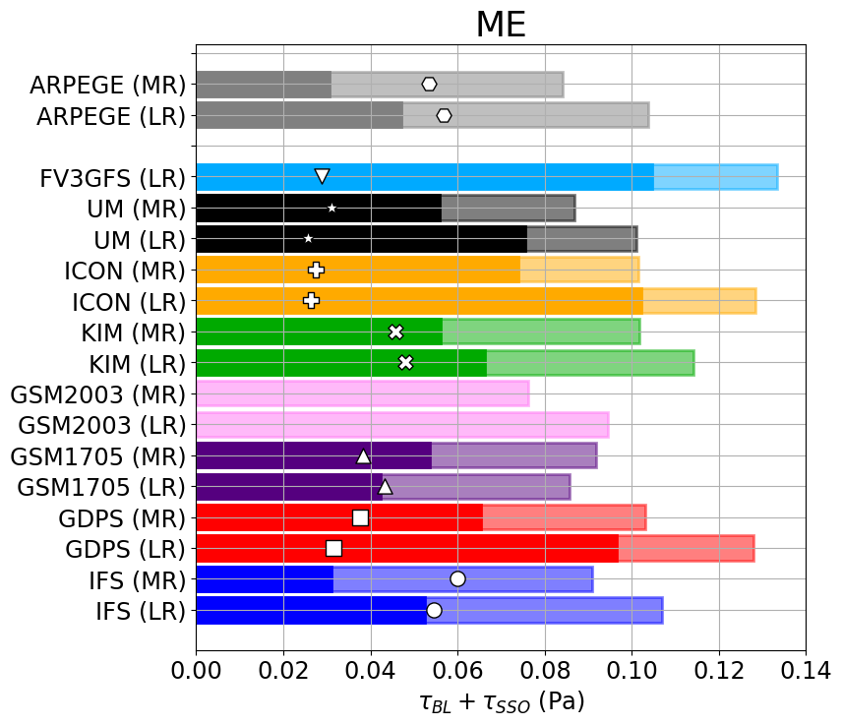
Constraining surface stress
Zonal momentum budget:
$$+ τ_{SSO}$$
Sub-grid scale orographic drag
Zonal momentum
Resolved Dynamics
$$\frac{d<ρu> }{dt}= −p\left(z_{0}\right)\frac{∂z_{0} }{∂x}$$
$$+ τ_{BL}$$
Turbulent boundary layer drag
Notes:
We can now begin to constrain the surface stress using our high resolution simulations over the Middle East.
Again, looking at the parametrized drag over this region, we see a large spread and different resolution sensitivities

Slide 23
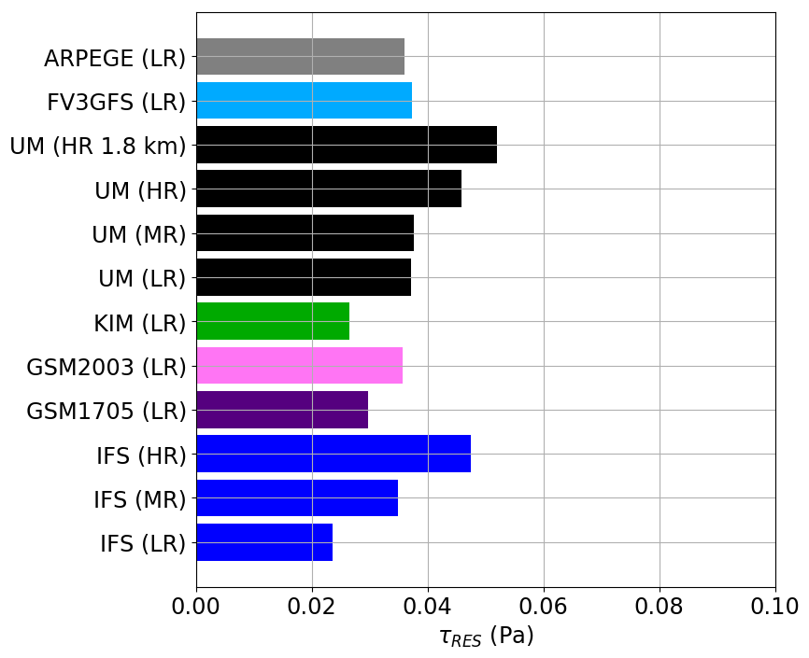
Constraining surface stress
Zonal momentum budget:
$$+ τ_{SSO}$$
Sub-grid scale orographic drag
Zonal momentum
Resolved Dynamics
$$\frac{d<ρu> }{dt}= −p\left(z_{0}\right)\frac{∂z_{0} }{∂x}$$
$$+ τ_{BL}$$
Turbulent boundary layer drag
Parametrized SSO stress should be at most ~ 0.03 Pa in LR and ~ 0.02 Pa in MR
SSO stress is 0.04 – 0.1 in LR
Notes:
The resolved surface stress indicates that the parametrized surface stress is significantly over estimated in most of the models.

Slide 24
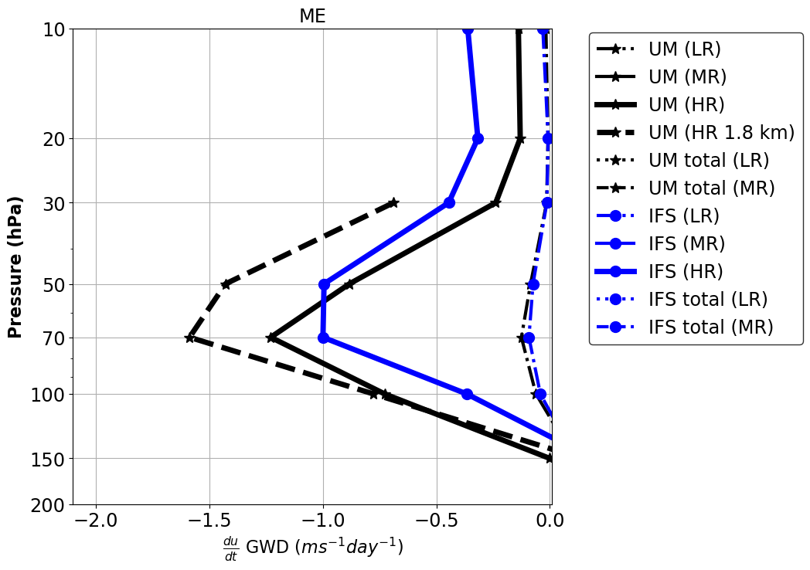
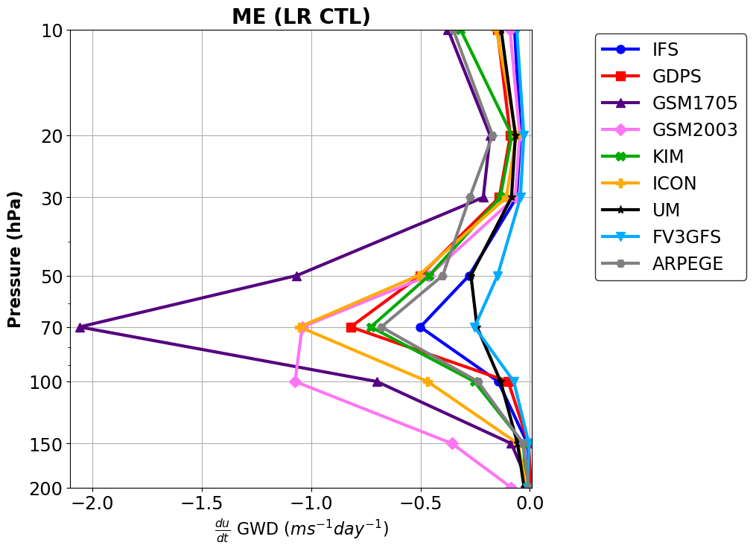
Orographic gravity wave drag parametrizations
Zonal momentum budget:
Zonal momentum
Resolved Dynamics
Sub-grid scale orographic drag
$$\frac{d u }{dt}= −\frac{1}{ρ} \frac{∂}{∂z}(ρuw)$$
$$+ F_{GWD}$$
Resolved and total gravity wave drag
Parametrized gravity wave drag
9 km
(resolved)
100 km
parametrized
1.8 km
(resolved)
100 km (resolved)
Plot shows GWD over the Middle East
stratosphere
Notes:
Now compare the resolved and parametrized gravity wave drag in the stratosphere

Slide 25
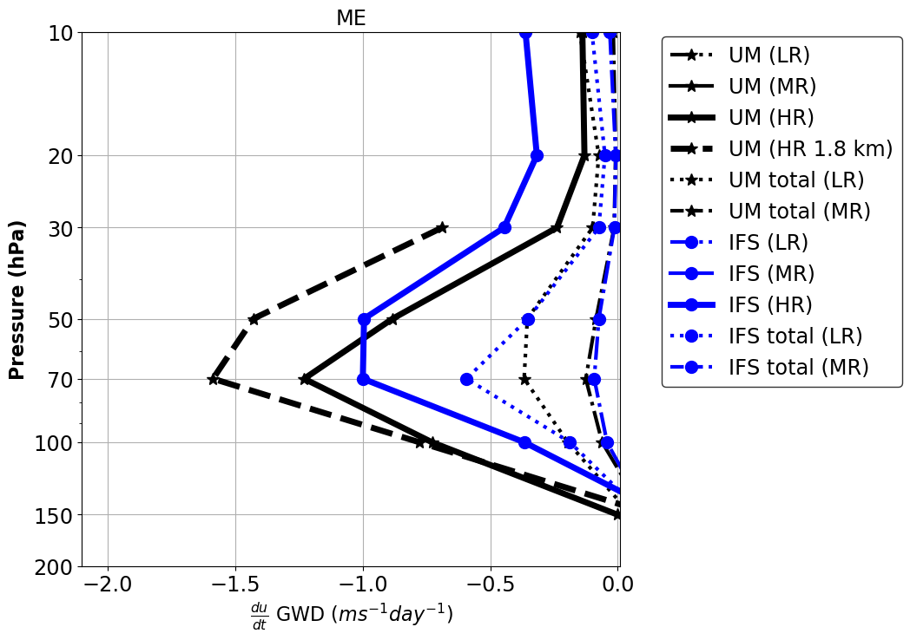
Orographic gravity wave drag parametrizations
Zonal momentum budget:
Zonal momentum
Resolved Dynamics
Sub-grid scale orographic drag
$$\frac{d u }{dt}= −\frac{1}{ρ} \frac{∂}{∂z}(ρuw)$$
$$+ F_{GWD}$$
Resolved and total gravity wave drag
Parametrized gravity wave drag
100 km (total)
100 km
parametrized
1.8 km
(resolved)
Plot shows GWD over the Middle East
stratosphere
Notes:
The total GWD at 100 km resolution is underestimated by approximately 2/3 compared with the total resolved GWD in a 1.8 km simulation. Only the GSM1705 model has a large amount of GWD at that resolution.

Slide 26
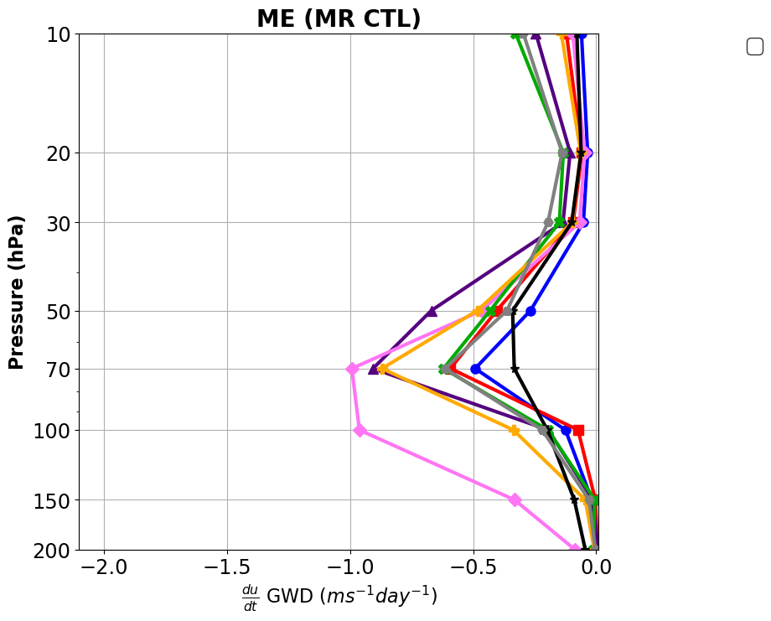
Orographic gravity wave drag parametrizations
Zonal momentum budget:
Zonal momentum
Resolved Dynamics
Sub-grid scale orographic drag
$$\frac{d u }{dt}= −\frac{1}{ρ} \frac{∂}{∂z}(ρuw)$$
$$+ F_{GWD}$$
Resolved and total gravity wave drag
Parametrized gravity wave drag
100 km (total)
100 km
1.8 km
(resolved)
40 km
parametrized
Plot shows GWD over the Middle East
stratosphere

Slide 27
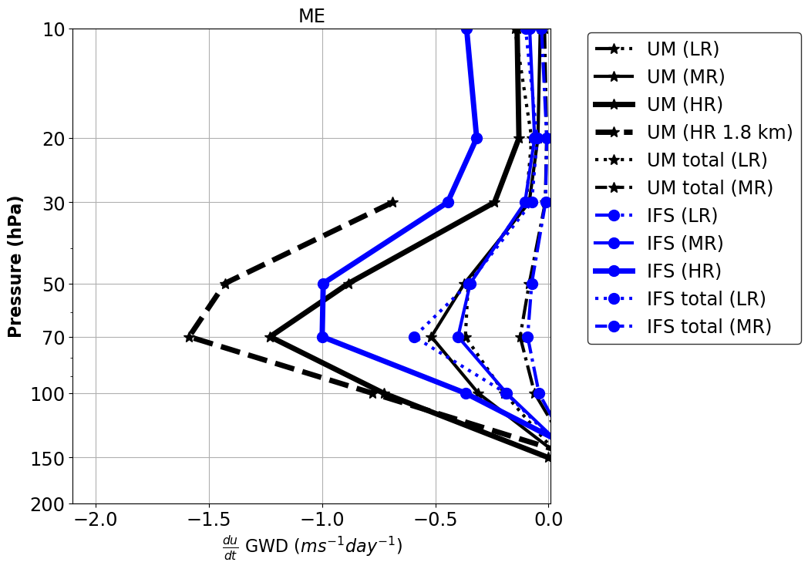
Orographic gravity wave drag parametrizations
Zonal momentum budget:
Zonal momentum
Resolved Dynamics
Sub-grid scale orographic drag
$$\frac{d u }{dt}= −\frac{1}{ρ} \frac{∂}{∂z}(ρuw)$$
$$+ F_{GWD}$$
Resolved and total gravity wave drag
Parametrized gravity wave drag
Parametrized gravity wave drag
40 km (resolved)
100 km
40 km
parametrized
1.8 km
(resolved)
40 km
Plot shows GWD over the Middle East
stratosphere

Slide 28
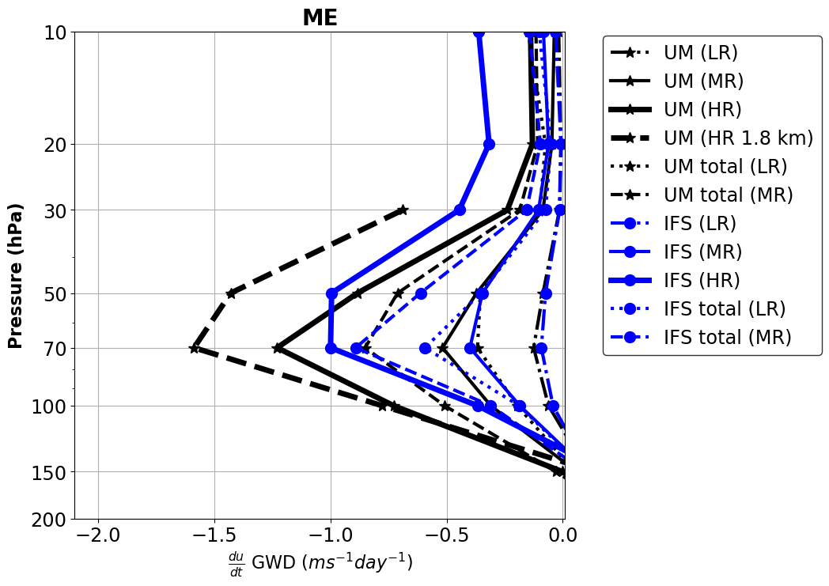
Orographic gravity wave drag parametrizations
Zonal momentum budget:
Zonal momentum
Resolved Dynamics
Sub-grid scale orographic drag
$$\frac{d u }{dt}= −\frac{1}{ρ} \frac{∂}{∂z}(ρuw)$$
$$+ F_{GWD}$$
Resolved and total gravity wave drag
Parametrized gravity wave drag
40 km (total)
40 km
parametrized
1.8 km
(resolved)
40 km
Plot shows GWD over the Middle East
stratosphere
Notes:
The total GWD at 40 km resolution is underestimated by about 50%.

Slide 29
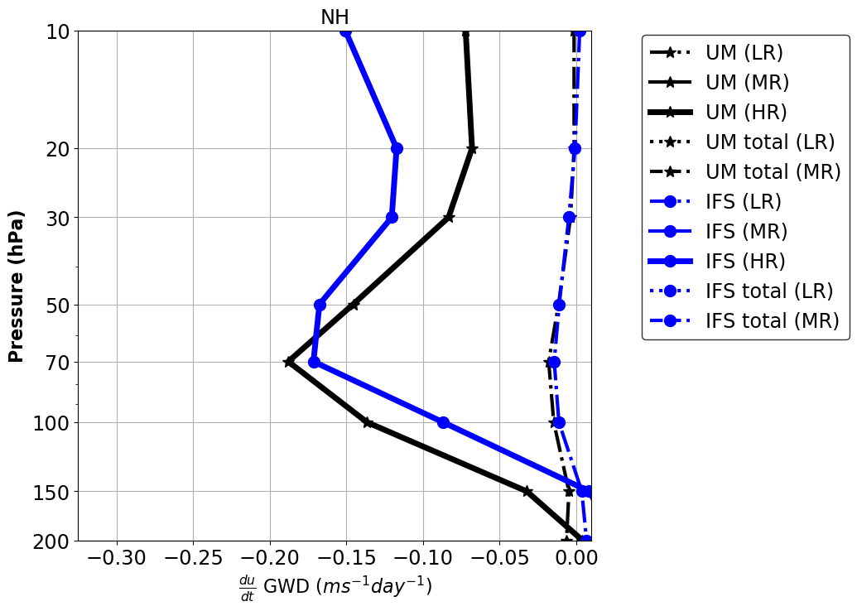
Orographic gravity wave drag parametrizations
Zonal momentum budget:
Zonal momentum
Resolved Dynamics
Sub-grid scale orographic drag
$$\frac{d u }{dt}= −\frac{1}{ρ} \frac{∂}{∂z}(ρuw)$$
$$+ F_{GWD}$$
Resolved and total gravity wave drag
Parametrized gravity wave drag
9 km
(resolved)
100 km
100 km (resolved)
Plot shows GWD over NH
stratosphere

Slide 30
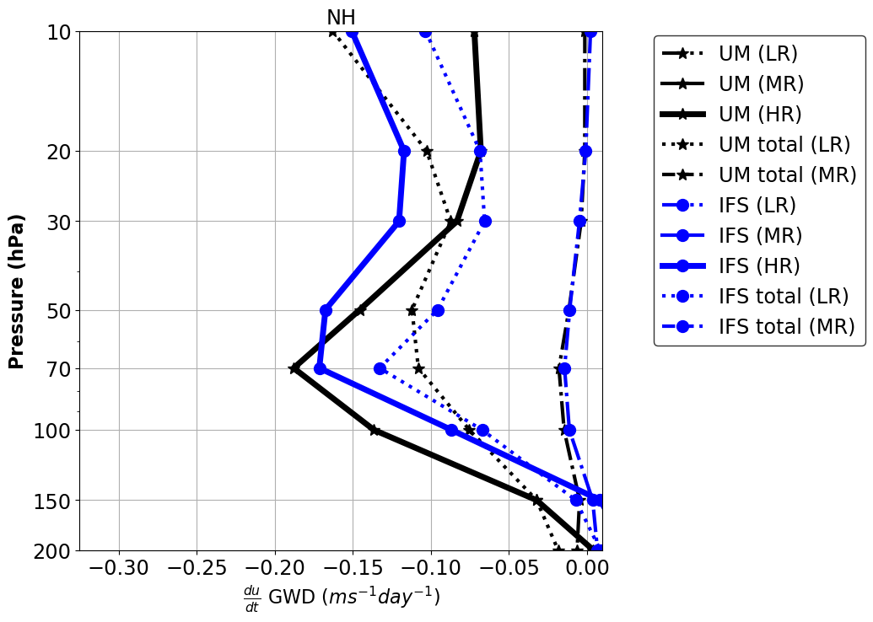
Orographic gravity wave drag parametrizations
Zonal momentum budget:
Zonal momentum
Resolved Dynamics
Sub-grid scale orographic drag
$$\frac{d u }{dt}= −\frac{1}{ρ} \frac{∂}{∂z}(ρuw)$$
$$+ F_{GWD}$$
Resolved and total gravity wave drag
Parametrized gravity wave drag
9 km
(resolved)
100 km
100 km (total)
Plot shows GWD over NH
stratosphere

Slide 31
Orographic gravity wave drag parametrizations
Zonal momentum budget:
Zonal momentum
Resolved Dynamics
Sub-grid scale orographic drag
$$\frac{d u }{dt}= −\frac{1}{ρ} \frac{∂}{∂z}(ρuw)$$
$$+ F_{GWD}$$
Resolved and total gravity wave drag
Parametrized gravity wave drag
9 km
(resolved)
40 km
100 km (total)
Plot shows GWD over NH
stratosphere
Notes:
Similarly, the total GWD is underestimated over the NH at 100km resolution

Slide 32
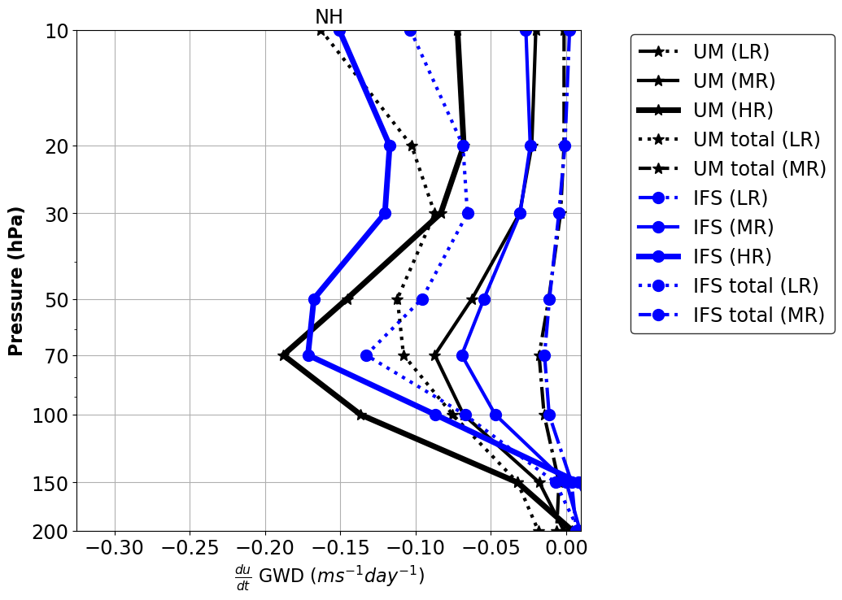
Orographic gravity wave drag parametrizations
Zonal momentum budget:
Zonal momentum
Resolved Dynamics
Sub-grid scale orographic drag
$$\frac{d u }{dt}= −\frac{1}{ρ} \frac{∂}{∂z}(ρuw)$$
$$+ F_{GWD}$$
Resolved and total gravity wave drag
Parametrized gravity wave drag
9 km
(resolved)
40 km
40 km (resolved)
Plot shows GWD over NH
stratosphere

Slide 33
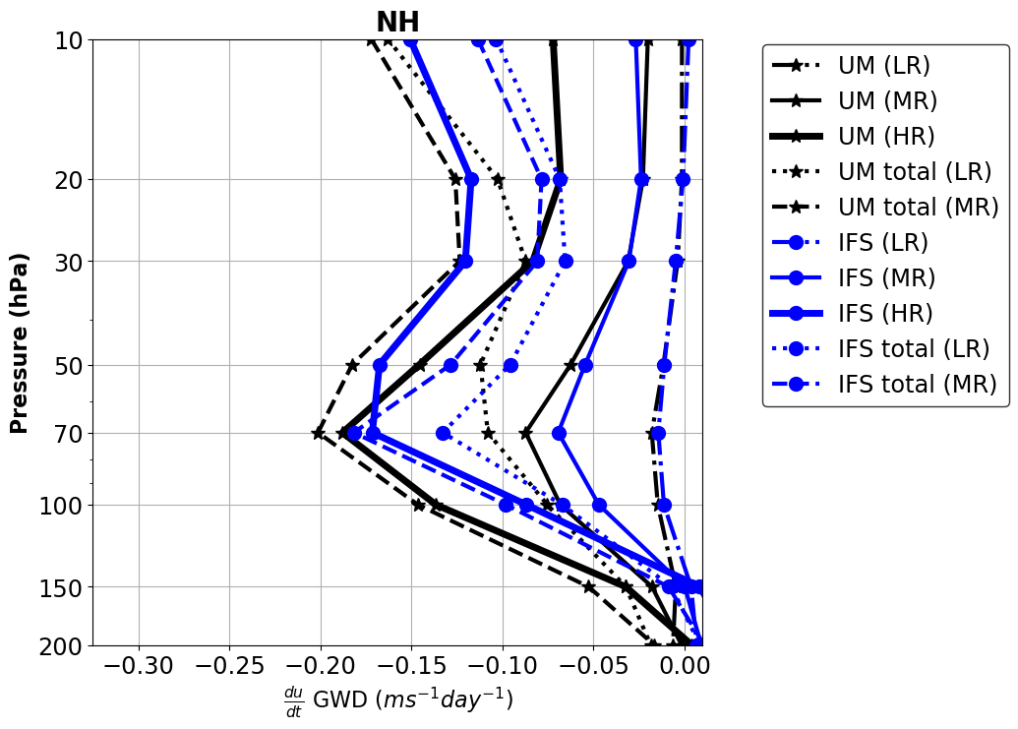
Orographic gravity wave drag parametrizations
Zonal momentum budget:
Zonal momentum
Resolved Dynamics
Sub-grid scale orographic drag
$$\frac{d u }{dt}= −\frac{1}{ρ} \frac{∂}{∂z}(ρuw)$$
$$+ F_{GWD}$$
Resolved and total gravity wave drag
Parametrized gravity wave drag
9 km
(resolved)
40 km
40 km (total)
Plot shows GWD over NH
stratosphere
Notes:
The total GWD is not as significantly underestimated over the NH at 40km resolution, but higher regional simulations shown before suggest that the 9km global simulations are not fully capturing the drag

Slide 34
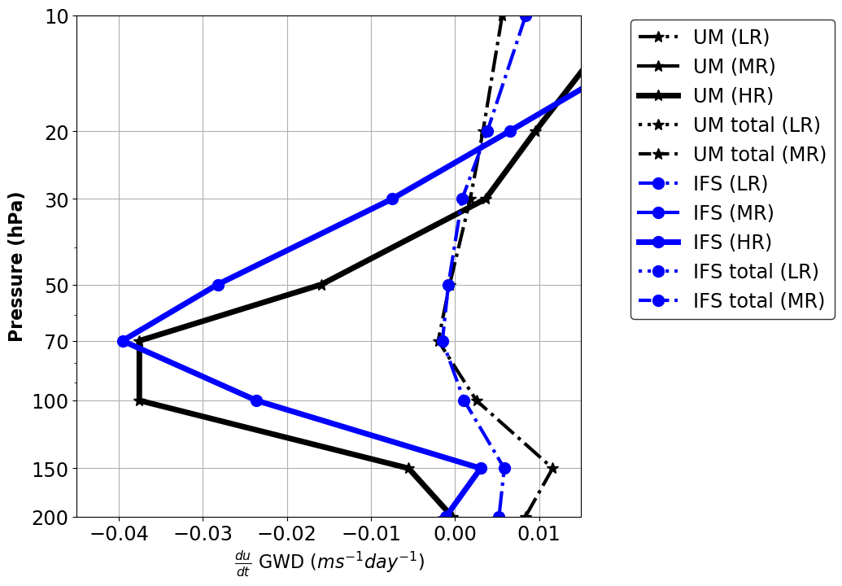
Orographic gravity wave drag parametrizations
Zonal momentum budget:
Zonal momentum
Resolved Dynamics
Sub-grid scale orographic drag
$$\frac{d u }{dt}= −\frac{1}{ρ} \frac{∂}{∂z}(ρuw)$$
$$+ F_{GWD}$$
Resolved and total gravity wave drag
Parametrized gravity wave drag
9 km
(resolved)
100 km
100 km (resolved)
Plot shows GWD over SH
stratosphere

Slide 35
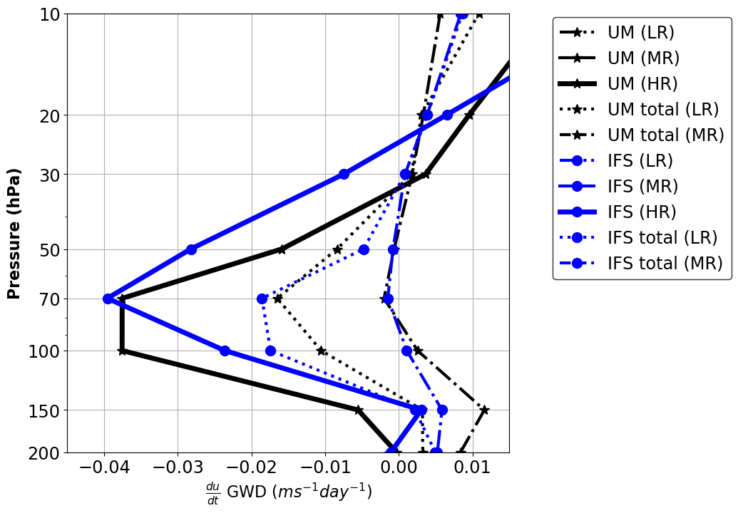
Orographic gravity wave drag parametrizations
Zonal momentum budget:
Zonal momentum
Resolved Dynamics
Sub-grid scale orographic drag
$$\frac{d u }{dt}= −\frac{1}{ρ} \frac{∂}{∂z}(ρuw)$$
$$+ F_{GWD}$$
Resolved and total gravity wave drag
Parametrized gravity wave drag
9 km
(resolved)
100 km
100 km (total)
Plot shows GWD over SH
stratosphere
Notes:
And again, the total is very much underestimated at 100 km resolution over the SH

Slide 36
Orographic gravity wave drag parametrizations
Zonal momentum budget:
Zonal momentum
Resolved Dynamics
Sub-grid scale orographic drag
$$\frac{d u }{dt}= −\frac{1}{ρ} \frac{∂}{∂z}(ρuw)$$
$$+ F_{GWD}$$
Resolved and total gravity wave drag
Parametrized gravity wave drag
9 km
(resolved)
40 km
100 km (total)
Plot shows GWD over SH
stratosphere

Slide 37
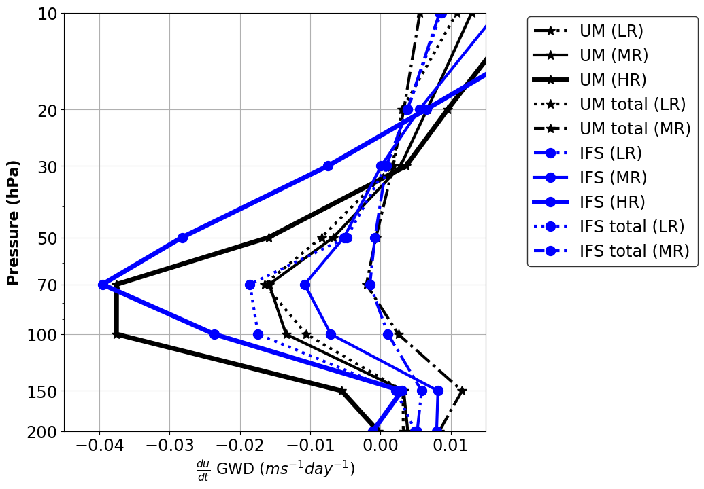
Orographic gravity wave drag parametrizations
Zonal momentum budget:
Zonal momentum
Resolved Dynamics
Sub-grid scale orographic drag
$$\frac{d u }{dt}= −\frac{1}{ρ} \frac{∂}{∂z}(ρuw)$$
$$+ F_{GWD}$$
Resolved and total gravity wave drag
Parametrized gravity wave drag
9 km
(resolved)
100 km
40 km
40 km (resolved)
Plot shows GWD over SH
stratosphere

Slide 38
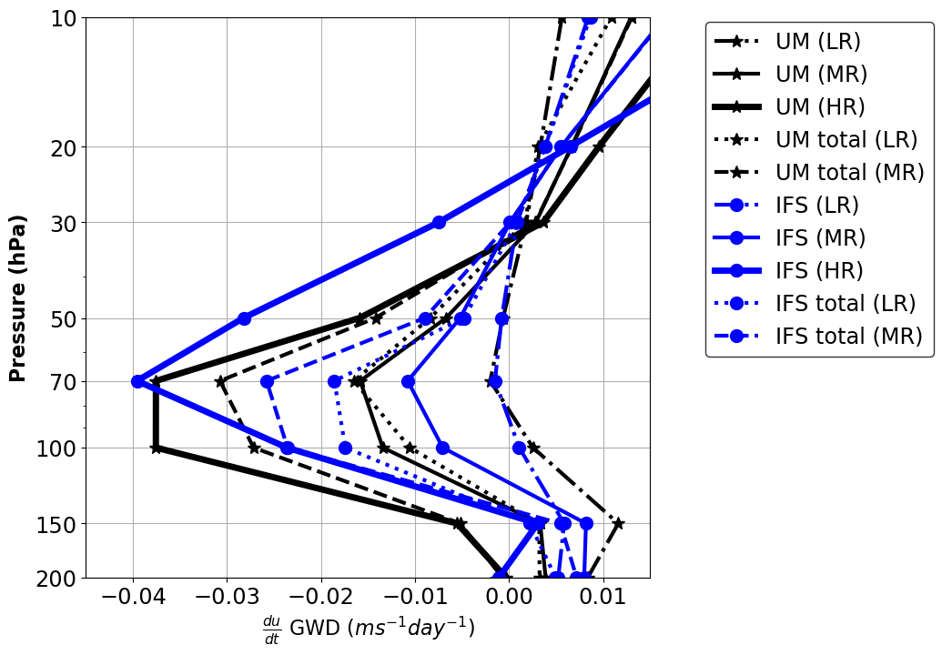
Orographic gravity wave drag parametrizations
Zonal momentum budget:
Zonal momentum
Resolved Dynamics
Sub-grid scale orographic drag
$$\frac{d u }{dt}= −\frac{1}{ρ} \frac{∂}{∂z}(ρuw)$$
$$+ F_{GWD}$$
Resolved and total gravity wave drag
Parametrized gravity wave drag
9 km
(resolved)
40 km
40 km (total)
Plot shows GWD over SH
stratosphere
Notes:
And again, the total is very much underestimated at 40 km resolution over the SH – this is more significant over the SH than over the NH

Slide 39
Model setup
High resolution (HR) : 9km – 6km global &
3km – 1.8 km regional
High resolution orography
Low resolution orography
High resolution simulation with high resolution orography
-
High resolution simulation with low resolution orography
Gives impact of resolved orography
Low resolution (LR) : 100 km
Low resolution simulation with parametrized orographic drag
-
Low resolution simulation without parametrized orographic drag
Gives impact of parametrized orographic drag
24-hour short-range forecasts initialised from analysis
1 to 14th January 2015
Notes:
We can now look at the impact of the resolved and parametrized orography in order to constrain the drag throughout the troposphere

Slide 40
Orographic
drag throughout the atmosphere
Parametrized orographic drag
Notes:
Plots show the impact on the zonal wind from parametrized orographic drag at 100 km resolution longitudinally averaged over the Middle East.
There are large differences here, reflecting the different parametrization schemes

Slide 41
Orographic
drag throughout the atmosphere
Resolved orographic drag
Notes:
Plots show the impact on the zonal wind from resolved orography at various resolutions, quoted in plots, longitudinally averaged over the Middle East.

Slide 42
Orographic
drag throughout the atmosphere
Resolved orographic drag
Notes:
The resolved orography leads to deceleration at tropopause due to gravity waves

Slide 43
Orographic
drag throughout the atmosphere
Parametrized orographic drag
Notes:
The parametrizations do not have enough of this deceleration, consistent with momentum budgets

Slide 44
Orographic
drag throughout the atmosphere
Parametrized orographic drag
Notes:
The parametrizations have a large deceleration near the surface, although it varies between models.

Slide 45
Orographic
drag throughout the atmosphere
Resolved orographic drag
Resolved orographic drag
Notes:
The resolved orography does not see such a large deceleration near the surface, suggesting models are overestimating the low-level drag but underestimating the gravity wave drag

Slide 46
Conclusions
Models at seasonal and climate resolutions close their momentum budget differently, using different orographic drag parametrizations (consistent with WGNE drag project)
These drag parametrizations exhibit different resolution sensitivities – due to the different processes they represent
Most models overestimate the parametrized surface stress from flow blocking and low-level orographic drag processes
Most models underestimate the parameterized gravity wave drag at climate and seasonal resolutions, by more than 50 % - this is consistent with climate models having a cold-pole problem in the SH
It is possible that models have compensated for a lack of vertically propagating gravity wave drag by increasing their low-level drag components…

Slide 47
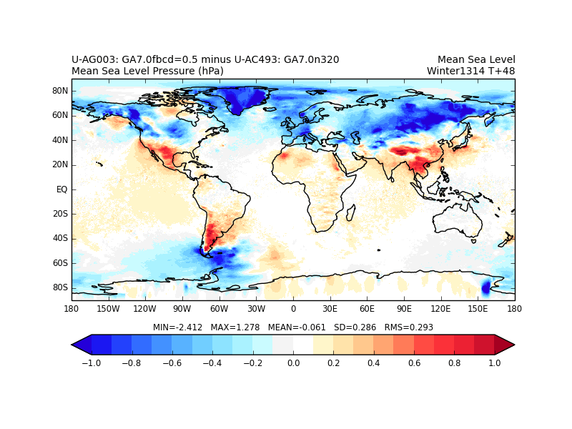
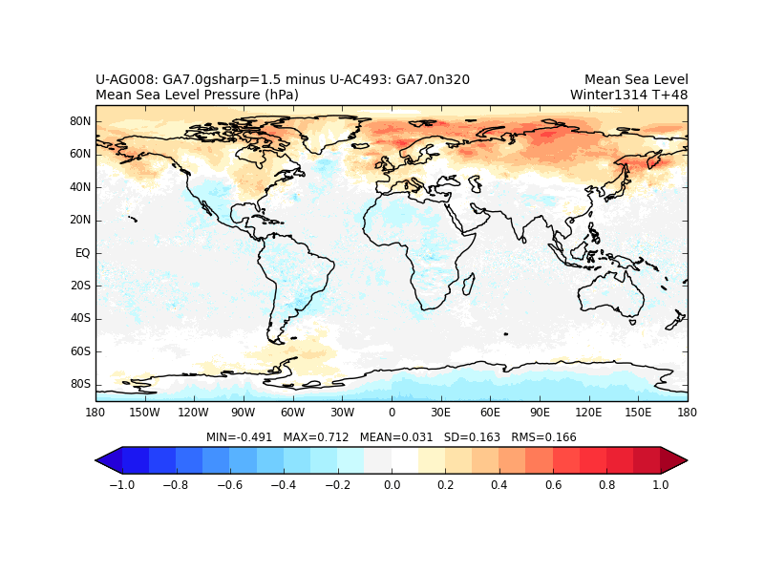
Conclusions
It is possible that models have compensated for a lack of vertically propagating gravity wave drag by increasing their low-level drag components…
Plots show mean sea level pressure response
Reducing low-level blocking 4x
Increasing GWD 3x

Slide 48
Orographic
drag throughout the atmosphere
Model error relative to analysis
Notes:
These plots show errors in zonal winds at 100 km resolution, with parametrizations on. These are consistent with idea that some models have too much low-level drag and not enough GWD.

