Slide 1



Seismic Surface Wave Tomography on dense 3D active data
EGU 2020
Ilaria Barone
Emanuel Kästle
Claudio Strobbia
Giorgio Cassiani
Università degli Studi di Padova
realtimeseismic

Slide 2
2D SURFACE WAVE tomograpHY USING ACTIVE SEISMIC DATA
The METHOD
Surface Wave Tomography (SWT) is a widespread technique to image crustal and upper mantle structures using surface waves produced by earthquakes or ambient noise sources.
The tomographical inversion is run frequency by frequency to retrieve 2D phase velocity maps.
  In this study we apply SWT to 3D active data at the exploration scale.
  Different tomographical algorithms are tested:
  Fast Marching Surface Tomography tool (FMST) (Rawlinson and Sambridge, 2005)
  Reversible Jump algorithm (RJMCMC) (Bodin and Sambridge, 2009)
  Eikonal Tomography (Lin et al., 2009)
Phase velocity
T = 200 s
T = 75 s
T = 35 s
T = 25 s
T = 18 s
T = 8 s
Kästle et al., 2018

Slide 3
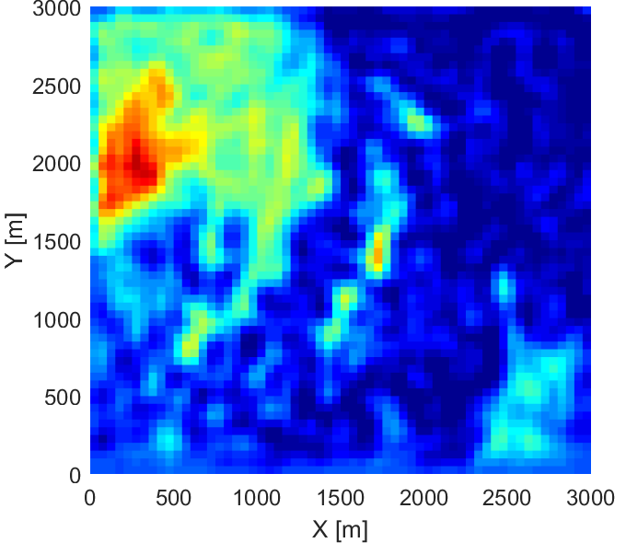
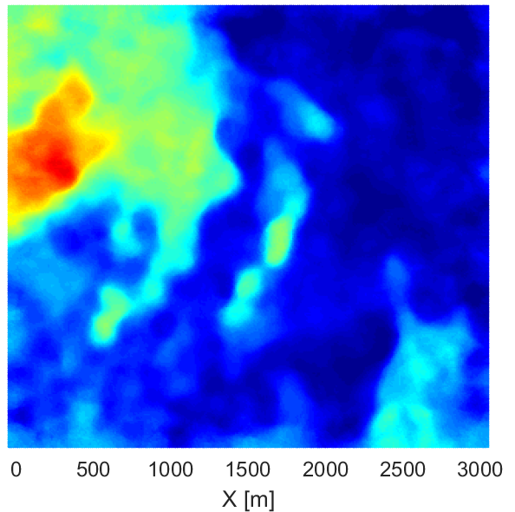
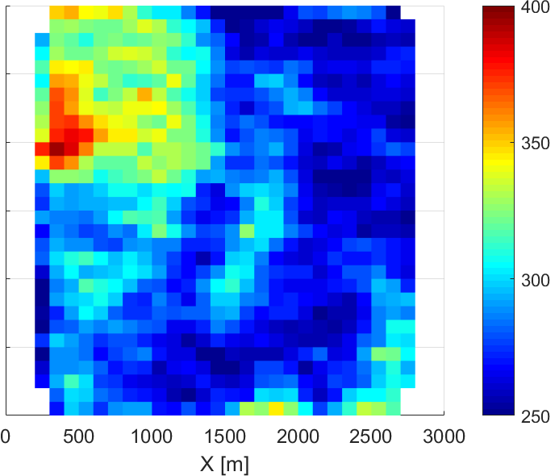
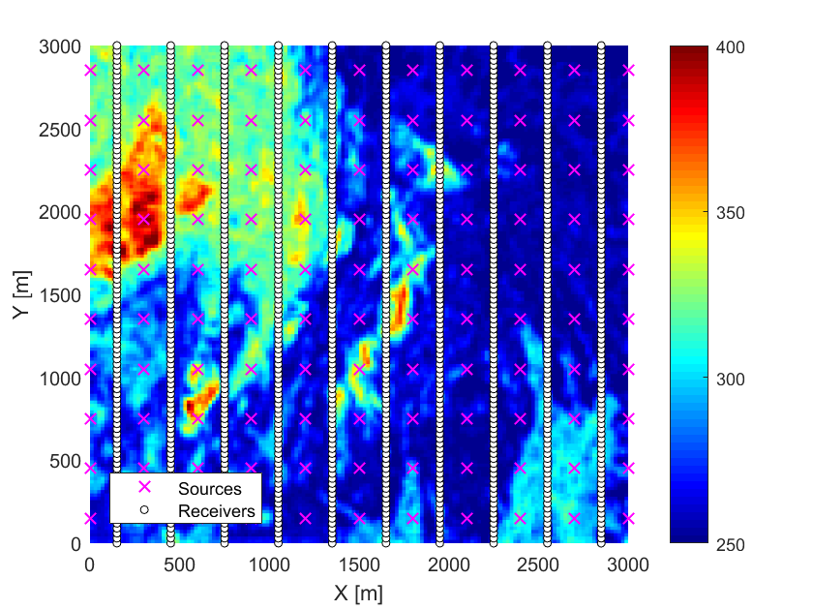
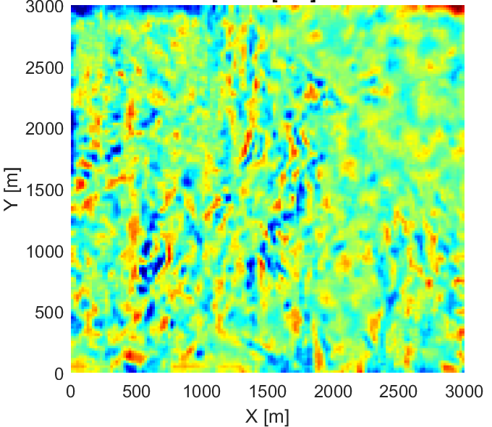
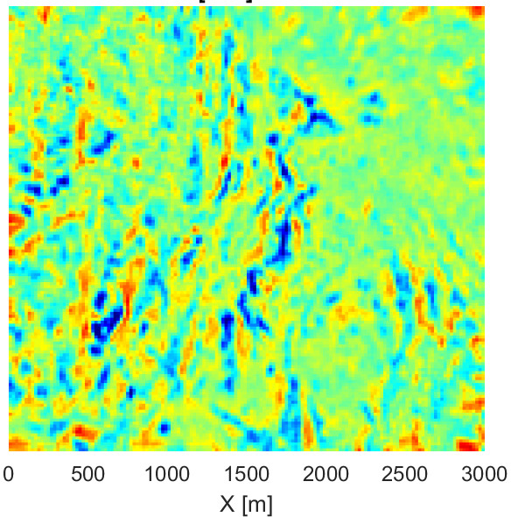
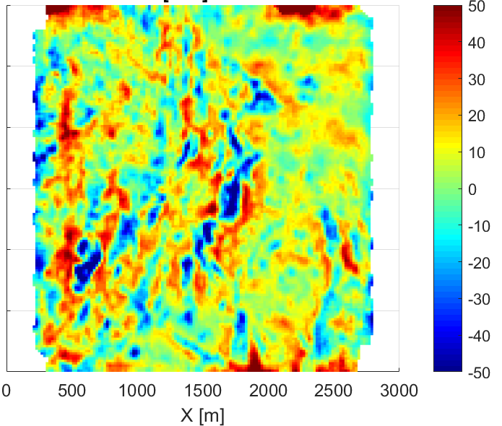
2D SURFACE WAVE tomograpHY USING ACTIVE SEISMIC DATA
TESTS ON Synthetic data
FMST
RJMCMC
EIKONAL TOMOGRAPHY
c [m/s]
c [m/s]
Output model (5% noise)
c [m/s]
Model error
RMS = 11.42 m/s
RMS = 10.56 m/s
RMS = 17.22 m/s

Slide 4
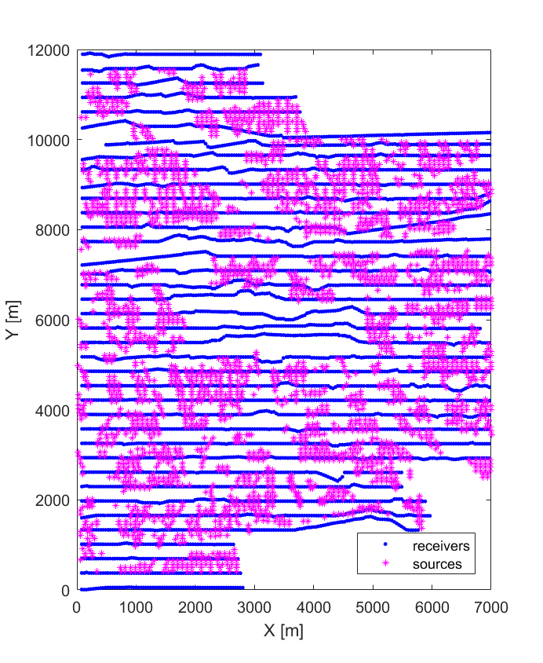
2D SURFACE WAVE tomograpHY USING ACTIVE SEISMIC DATA
TESTS ON REAL data
LMO-VELOCITY SCAN
We use a 3D active dataset from oil and gas industry in the Po plain, with 3777 source positions and 5551 receivers.
Source-receiver travel times for one frequency and one mode (fundamental mode) are derived from phase differences. We implemented a workflow that starts from 2 Hz, where only the fundamental mode is present: a shot-dependent LMO correction is used to support 2D phase unwrapping, then travel time tomography is applied and a phase velocity map is retrieved. The analysis progressively moves to higher frequencies, where a pseudo 2D f-k filter is designed based on the previous frequency phase velocity distribution.
frequency = 2 Hz
2D PHASE UNWRAPPING
TRAVEL TIME TOMOGRAPHY
Next frequency
PSEUDO 2D F-K FILTER
LMO-VELOCITY SCAN
Next frequency
2D PHASE UNWRAPPING
TRAVEL TIME TOMOGRAPHY
All frequencies analysed?
NO
YES
DEPTH INVERSION

Slide 5
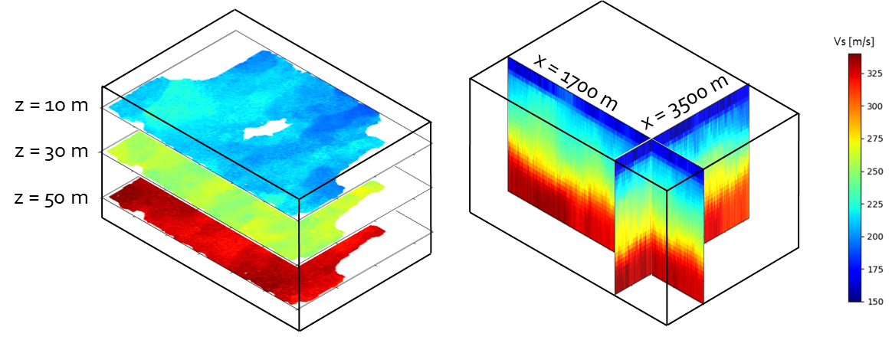
2D SURFACE WAVE tomograpHY USING ACTIVE SEISMIC DATA
TESTS ON REAL data
LMO-VELOCITY SCAN
All processing steps are repeated for all frequencies of analysis (2 - 7 Hz).
Phase velocity maps for all frequencies are produced. We reconstruct all local dispersion curves and invert them separately to retrieve a 3-D Vs model.
frequency = 2 Hz
2D PHASE UNWRAPPING
TRAVEL TIME TOMOGRAPHY
Next frequency
PSEUDO 2D F-K FILTER
LMO-VELOCITY SCAN
Next frequency
2D PHASE UNWRAPPING
TRAVEL TIME TOMOGRAPHY
All frequencies analysed?
NO
YES
DEPTH INVERSION

