Slide 1
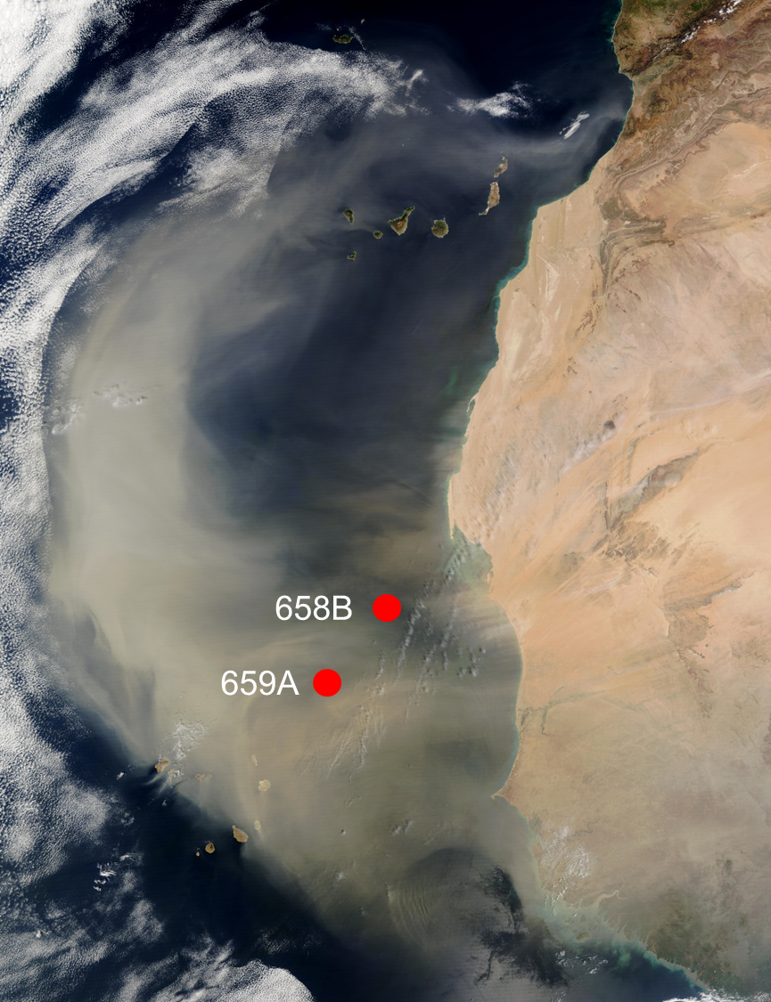
Direct dating of marine sediments using luminescence techniques: Insights from ODP cores 658B and 659A.
Simon Armitage^{1,2}, Diana Sahy³, Joanna Tindall^{1,2}, Robyn Pinder⁴
¹Department of Geography, Royal Holloway University of London, Egham, United Kingdom. ²SFF Centre for Early Sapiens Behaviour (SapienCE), University of Bergen, Norway. ³Geochronology and Tracers Facility, NERC Isotope Geosciences Laboratory, British Geological Survey, Nottingham, United Kingdom. ⁴Department of Geography, University College London, London, United Kingdom. ⁵Geography and Earth Sciences, Aberystwyth University, Aberystwyth, United Kingdom.
The problem
Deep-sea core chronologies are constructed by:
1) Matching to a global δ¹⁸O record (e.g. LR04)
2) ¹⁴C dating
3) Identification of event horizons (e.g. tephra, first/last appearance of species etc)
Often work well, but each has limitations, making some timeframes/regions hard to date
The solution
Direct dating of the minerogenic fraction using luminescence dating
Uses silt-sand sized quartz or feldspar yielding ages with a (1σ ) precision of 5-10%
Study sites
ODP cores 658B and 659A off the west coast of North Africa
High dust content due to their location under the Saharan dust plume
658B is a high productivity upwelling site (2300 m water depth)
659A is a low productivity non-upwelling site (3100 m water depth)
© Authors. All rights reserved.

Slide 2
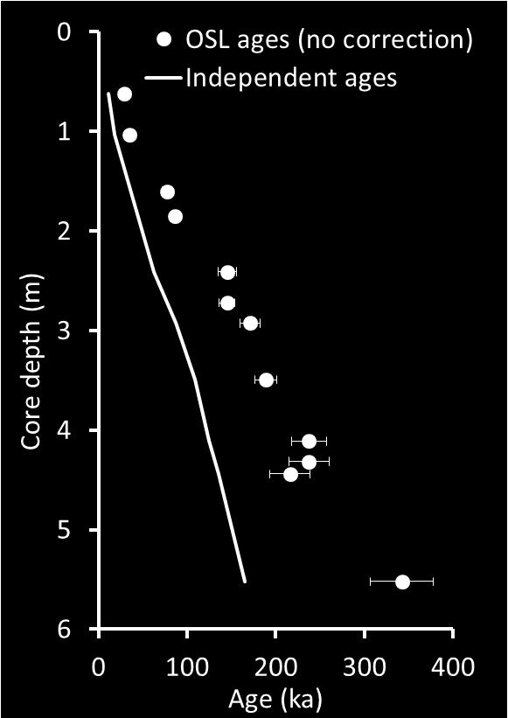
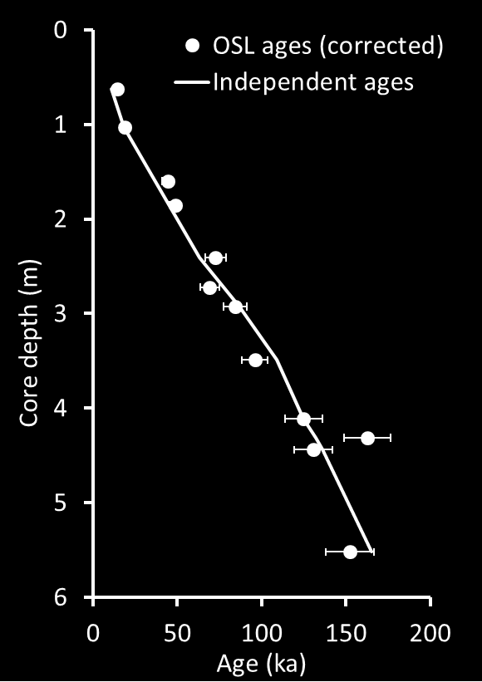
Luminescence dating Listen to the audio description of this slide →
Age (ka) = Absorbed dose (Gy) / Dose rate (Gy/ka)
²³⁸U – ²³⁴Th – ²³⁴Pa – ²³⁴U – ²³⁰Th – ²²⁶Ra - … - ²⁰⁶Pb
Time
Equilibrium
Excess ²³⁰Th
Authigenic U
²³⁸U
²³²Th
⁴⁰K
²³⁰Th
excess
²³⁸U
Auth.
Model for dose rates in luminescence dating. All samples contain U, Th and K, and in terrestrial sediments the U and Th decay series are in equilibrium. Production of insoluble ²³⁰Th in the water column leads to excess ²³⁰Th in marine sediment, while reduction of U to its insoluble state at the sediment/water interface incorporates authigenic U.
Age-depth models for core 659A. The solid line represents the independent age-depth model for this core. The left panel shows 12 luminescence ages calculated assuming U and Th in equilibrium. The right panel shows the same samples after measurement of and correction for excess ²³⁰Th and authigenic U.
© Authors. All rights reserved.

Slide 3
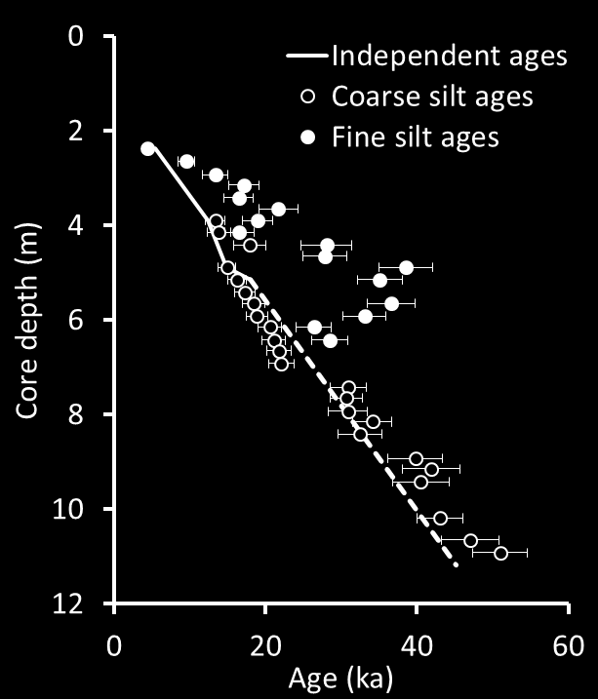
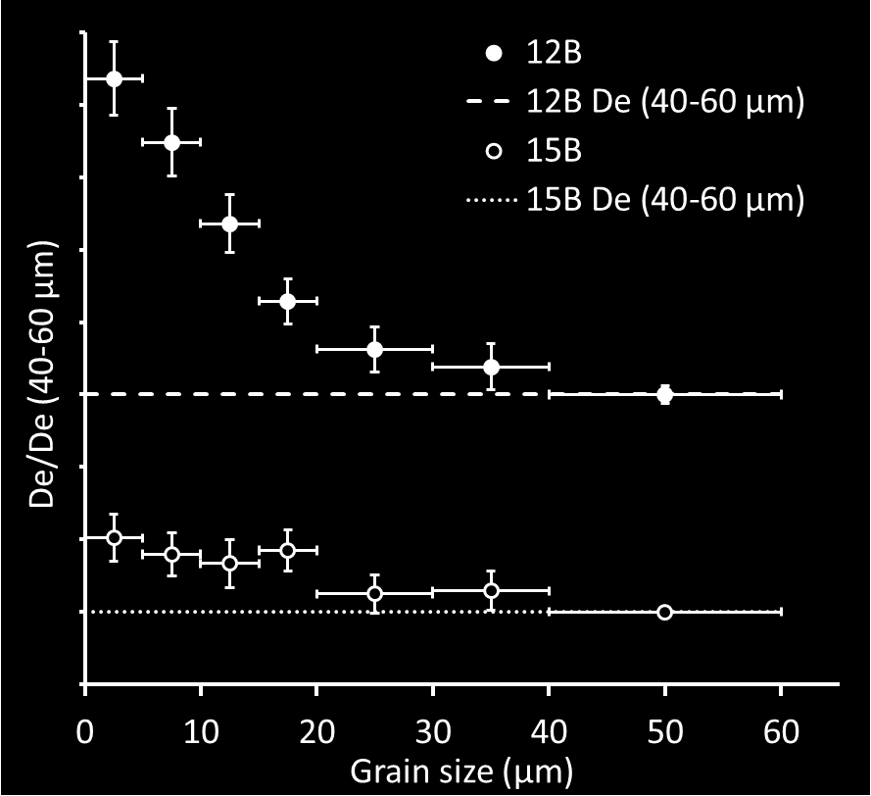
Age (ka) = Absorbed dose (Gy) / Dose rate (Gy/ka)
Conclusions
Luminescence is a viable method for dating deep-sea cores
U-series disequilibrium must be measured and the effects on dose rate modelled
Seafloor remobilisation of sediment may cause age overestimates, but can be diagnosed
Luminescence will be most useful where other chronometers are problematic, or to provide an initial chronology to guide other techniques e.g. tephrochronology
References
Armitage, S.J., (2015) Optically stimulated luminescence dating of Ocean Drilling Program Core 658B: Complications arising from authigenic uranium uptake and lateral sediment movement. Quaternary Geochronology 30, 270-274.
Armitage, S.J., Pinder, R.C. (2017) Testing the applicability of optically stimulated luminescence dating to Ocean Drilling Program Cores. Quaternary Geochronology 39, 124-130.
Left: Ages for core 658B measured on fine (4-11 µm) and coarse (40-63 µm) silt. Fine silt ages are too old and contain a large age inversion. Coarse silt ages are correct. We suggest that (old) fine silt is mobilised by seafloor currents, without exposure to sunlight, leading to age overestimates. This phenomenon is not ubiquitous (659A yields good fine silt ages) and is diagnosed by observing decreasing absorbed doses with increasing grain size. Figure after Armitage (2015). Right: Absorbed dose (De) variation with grain size for samples 658B-12B and 15B. All data are normalised to that for the 40-63 µm fraction. Both datasets suggest seafloor remobilisation of finer fractions. Figure after Armitage and Pinder (2017)
© Authors. All rights reserved.

