Slide 1



The impact of southward propagation of the upper-tropospheric Rossby wave activity on the Red Sea trough
Zakieh Alizadeh¹, Alireza Mohebalhojeh¹, Farhang Ahmadi-Givi¹, Mohammad Mirzaei¹, Sakineh Khansalari²
¹Department of Space Physics, Institute of Geophysics, University of Tehran, Iran
²Atmospheric Science and Meteorological Research Center, Tehran, Iran
6 / May / 2020

Slide 2
Catalog
Introduction
Purpose of the research
Data and methods
Results
Conclusion
2

Slide 3
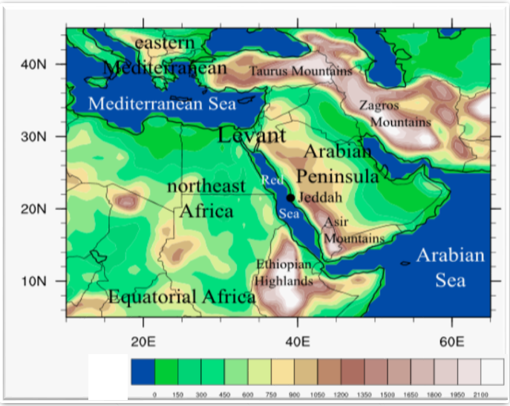


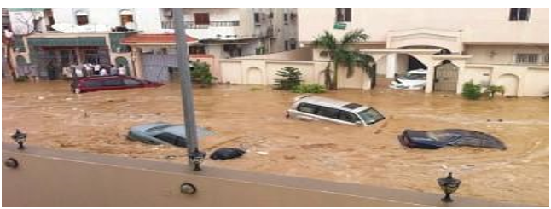
Introduction a) Introducing the system of interest (Sudan lows)
The northeast of Africa is affected by the low-pressure systems with characteristics of tropical regions and shaped by various surface factors
Sudan lows
Under specific sets of synoptic–dynamic conditions
linking the tropical and extratropical latitudes
&
linking the lower and upper tropospheric levels
Sudan
Result
Heavy rainfall events in the Eastern Mediterranean
(de Vrise et al. 2013)
3
(McGuire et al., 1988; Ziv, 2001; Knippertz, 2005; Rubin et al., 2007; Hart et al., 2010; Favors and Abatzoglou, 2013)

Slide 4
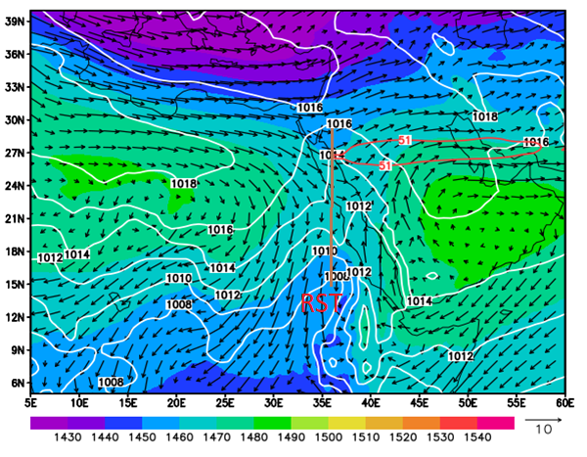
Introduction b) Climatology of the RST for winters of 1980 to 2017
A deep trough with the lowest central pressure of 1008 hPa exists over central Sudan which extends to the northeast of the Red Sea with a tilt in the southwest–northeast direction.
This low-pressure tongue, is called the Red Sea trough or RST.
(RST) Climatological state of the Red Sea trough
The RST is surrounded by high-pressure centers such as the Siberian high-pressure to the northeast, the Arabian anticyclone to the east and the high-pressure over Africa to the west.
Wind vectors at 850 hPa due to their clockwise rotation were weakened and shifted in central Sudan and northeast of the Red Sea to the southwest–northeast direction.
Using the average wind speed at the 250 hPa pressure level, the red contour denotes the central core of the subtropical with a velocity of 51 meter per second.
4

Slide 5
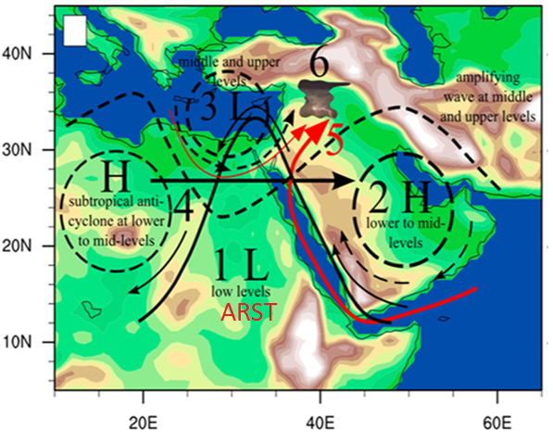
Introduction
c) The factors dynamic of the RST activation
(ARST) Active Red Sea trough
The northward extension of the RST. This type of RST is called the “Active Red Sea Trough” or ARST
The intensification of the Arbian anticyclone
The intrusion of a mid latitude upper level trough
The intensification of the subtropical jet
Enhanced moisture transport from the adjacent seas
Upward motions resulting from the synoptic-scale dynamical forcing and tropospheric instability
5
(de Vrise et al. 2013)

Slide 6
Purpose of the research
Investigating the coupling of the Rossby wave activity in the upper troposphere with the RST and surface cyclones in the northeast African and the Red Sea regions
6

Slide 7
Outline of the research
(3-1)
(1)
Distribution of wave activity flux
for the critical phases
Identifying the cyclones
Tracking the cyclones
1980-2017 (winter)
in the northeast Africa and the Red Sea
(3-2)
Distribution of surface cyclones
for the critical phases
(2)
(2-1)
(3)
Climatology of the Rossby wave activity flux
1980-2017 (winter)
from 100 °W to 100 °E
The budget of Rossby wave activity flux
a) Qualitative
b) Quantative
in the northeast Africa and the Red Sea
Determination of critical phases of the wave activity flux
in the central subdomain
(3-3)
States of the RST
for the critical phases
7

Slide 8
1) The first stage of the research
Identifying and tracking the cyclones
Method: CTS
The University of Melbourne Cyclone Tracking Software/Scheme (UMCTS)
Murray and Simmonds, 1991a,b; Simmonds et al., 1999; Lim and Simmonds, 2007; Simmonds and Keay, 2008
DATA
ECMWF ERA-Interim | Mean Sea level pressure | Surface geopotential height | Resolution: 80 km | Time step: 6 hr
period: winter (1980-2017)
Cyclones identification area: 25-45 E and 0-30 N
8

Slide 9
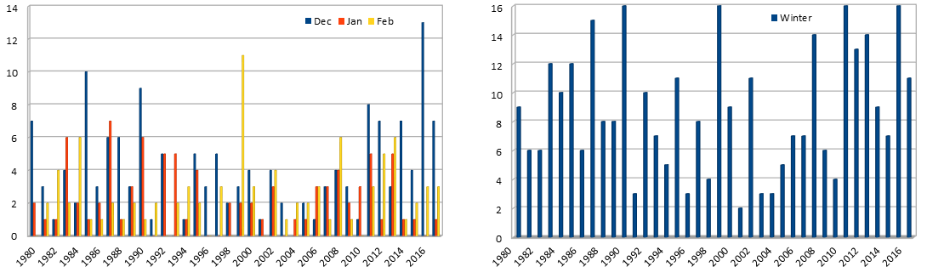
  1) The first stage of the research
  1-1) Climatology of the cyclone frequency of occurrence a) Identifying the cyclones of more than one day
1990
1999
2011
2016
In December with 46%
In February with 27%
In January with 26%
2001
332 cyclones were identified during the whole 38 winters
9

Slide 10
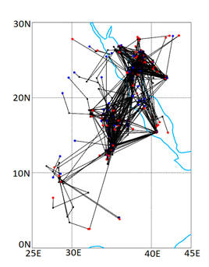
  1) The first stage of the research
  1-1) Climatology of cyclones b) Tracking the cyclones
The blue (red) circles are the locations of the formation (attenuation) of the cyclones
The black lines are the trajectories (from cyclogenesis to cyclolysis)
Black circles indicating movement of the cyclones every six hours
Result
Cyclones are extended from central Sudan to northeast of the Red Sea
in a southwest–northeast direction
In the range where wind vectors are weakened between two high pressures
(Slide No. 4)
The inverted trough of these cyclones is expanded in the same direction
(Slide No. 4)
10

Slide 11
2) The second stage of the research
Calculating the Rossby wave activity flux and its divergence
Method: Esler and Haynes (1999)
wave activity density
wave activity equation
nonconservative source/sink
wave activity flux
DATA
Esler and Haynes (1999)
ECMWF ERA-Interim | geopotential height | Resolution: 80 km | Time step: 6 hr | period: winter (1980-2017)
Calculating wave activity flux area: 100 W-100 E and 15-70 N
11
Andrews 1983; Plumb, 1986; Esler and Haynes, 1999

Slide 12
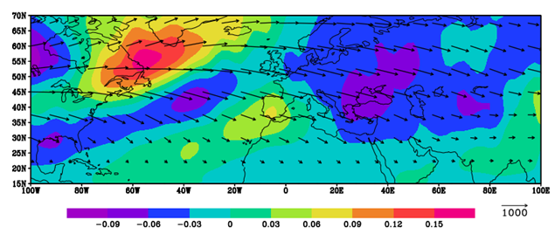
2) The second stage of the research
2-1) Climatology of the Rossby wave activity flux
a) Qualitative
from 100 °W to 100 °E_ 300 hPa level_ 1980-2017 winters
The wide track visible across the North Atlantic = Atlantic storm track
The smaller track along the Mediterranean = Mediterranean storm track
horizontal wave activity flux and its divergence
Vectors indicate the Rossby-wave propagation
Result
Receiving activity from the North Atlantic storm track, the flux divergence core of the Mediterranean storm track also takes part in sending activity to the eastern Mediterranean as well as to parts of Africa including the north of Sudan.
The activity in the eastern Mediterranean, is supplied from two sources: directly from the flux convergence core of the North Atlantic storm track and the flux divergence core of the Mediterranean storm track.
12
convergence
divergence

Slide 13
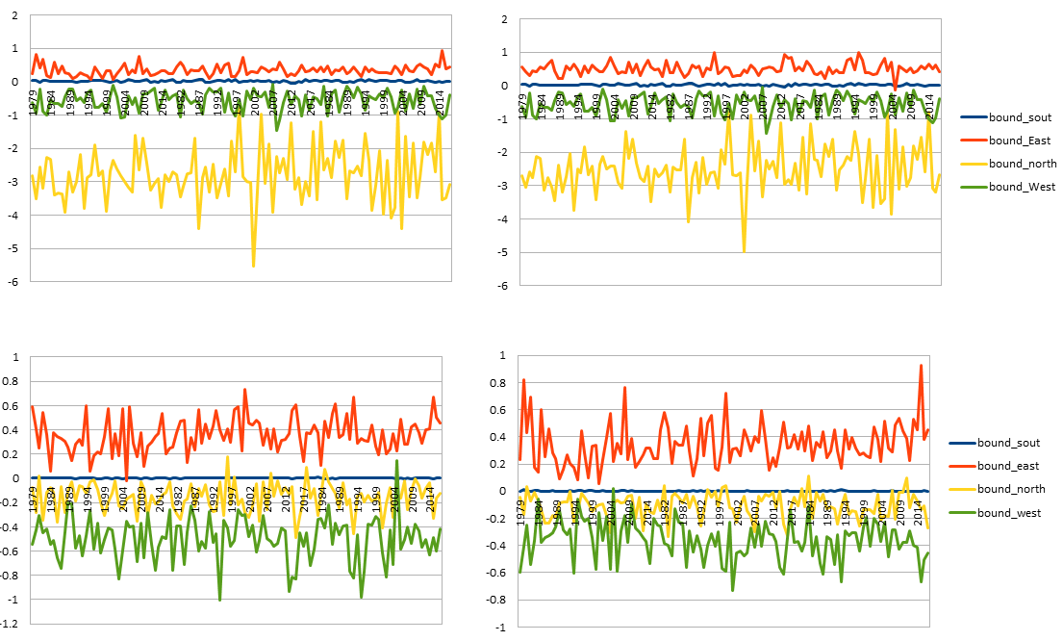
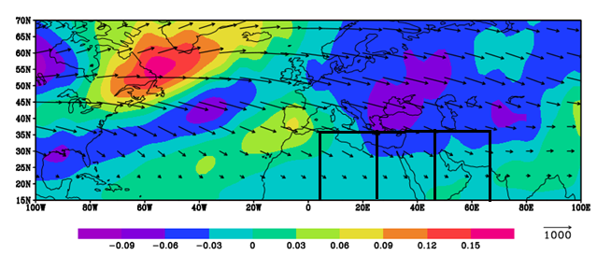
2) The second stage of the research
2-1) Climatology of the Rossby wave activity flux
b) Quantitative
in the northeast African and the Red Sea regions
Rectangular domain with three subdomains of equal
area at the 300 hPa level
Domain_Main
Subdomain_Western
Note:
Negative values = flux into
Positive values = flux out of
Result
In the main domain & western subdomain, the wave activity mostly enters from the northern boundary
The central and eastern subdomain, most of the wave
activity enters from the western boundary
Subdomain_Eastern
Subdomain_Central
13

Slide 14
The third stage of the research
Determination of positive and negative critical phases of the wave activity flux
in the central subdomain
The mean and standard deviation values of the wave activity influx for the central subdomain where the cyclones are formed.
The critical positive phase for the months with influx values greater than mean plus the standard deviation.
The critical negative phase for the months with influx values less than mean minus the standard deviation.
Dec
Jan
Feb
positive
84 | 86 | 98 | 03 | 05 | 08 | 10 | 13 | 81 | 94 | 13 | 15 | 17 | 92 | 93 | 95 | 96 | 01 | 02 | 04
Dec
Jan
Feb
14
negative
79 | 81 | 89 | 94 | 00 | 06 | 09 | 80 | 86 | 96 | 98 | 99 | 01 | 80 | 85 | 86 | 88 | 05 | 10

Slide 15
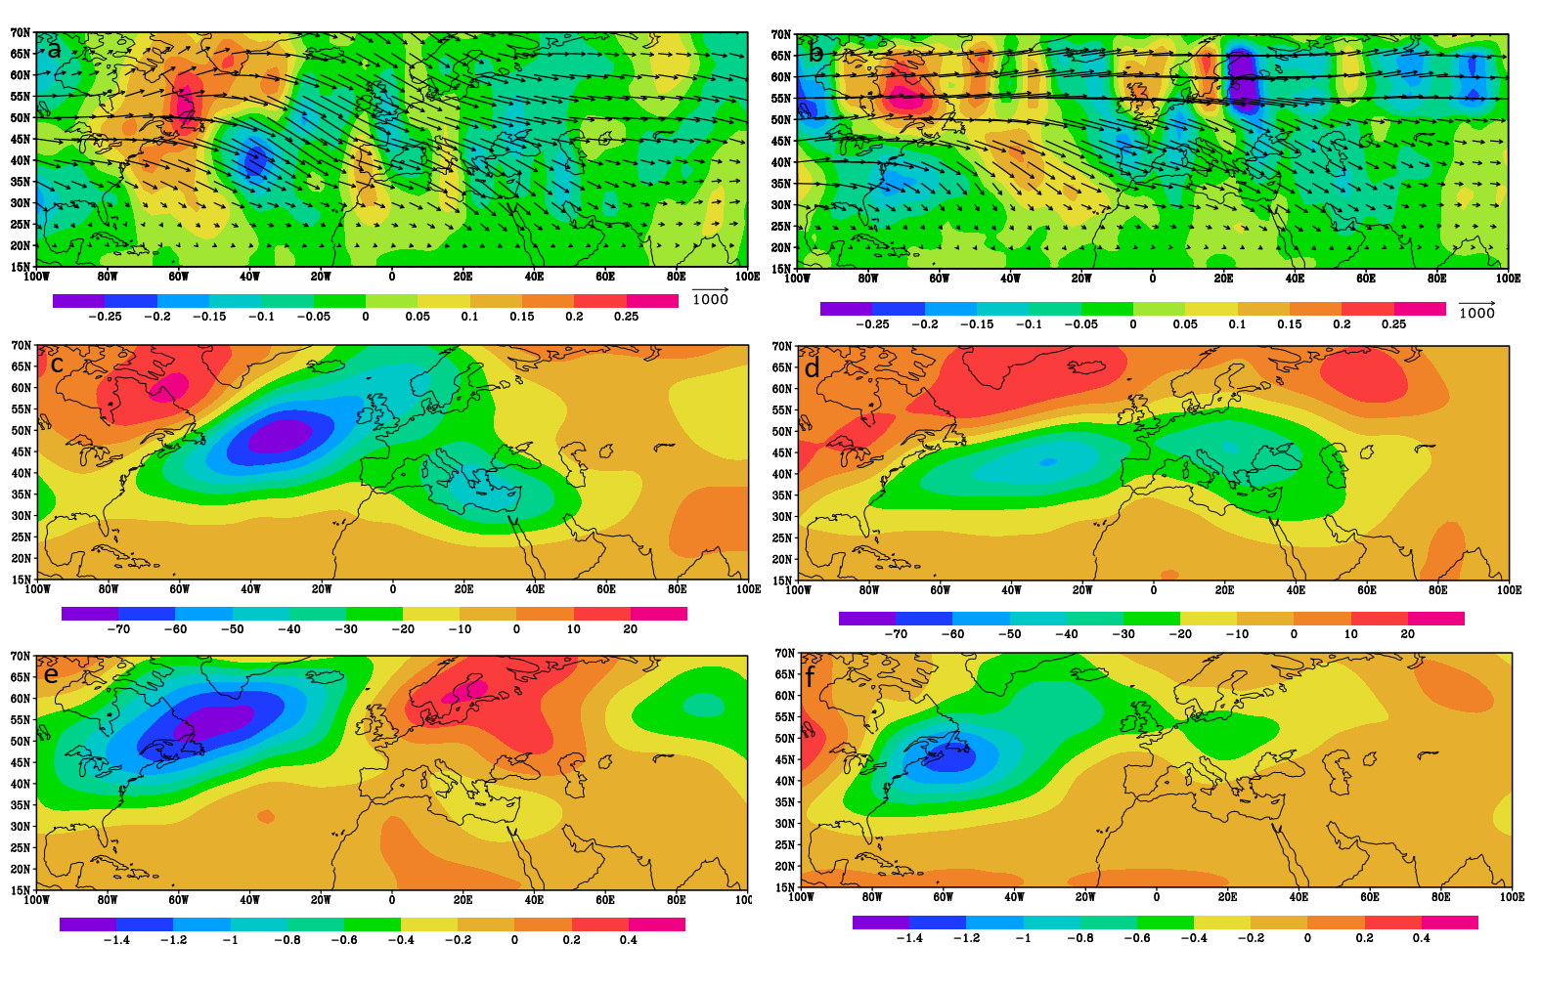
3) The third stage of the research
3-1) Distribution of wave activity flux
for critical phases
The horizontal flux of wave activity
& its divergence
For the positive & negative phases the convergence and divergence cores of the North Atlantic storm track are divided into two branches over the Atlantic Ocean.
For the positive (negative) phase, the stronger (weaker) branch extends to lower latitudes and merges with the Mediterranean storm track.
The meridional flux of wave activity
In the positive phase, the southwest–northeast orientation of the momentum convergence line and jet forcing is consistent with the dominance of anticyclonic Rossbt-wave breaking.
For the vertical flux of wave activity, which reflects meridional heat transfer, the values are lower in the positive phase compared to the negative phase in the subtropical regions, especially in the eastern Mediterranean.
The vertical flux of wave activity
15

Slide 16
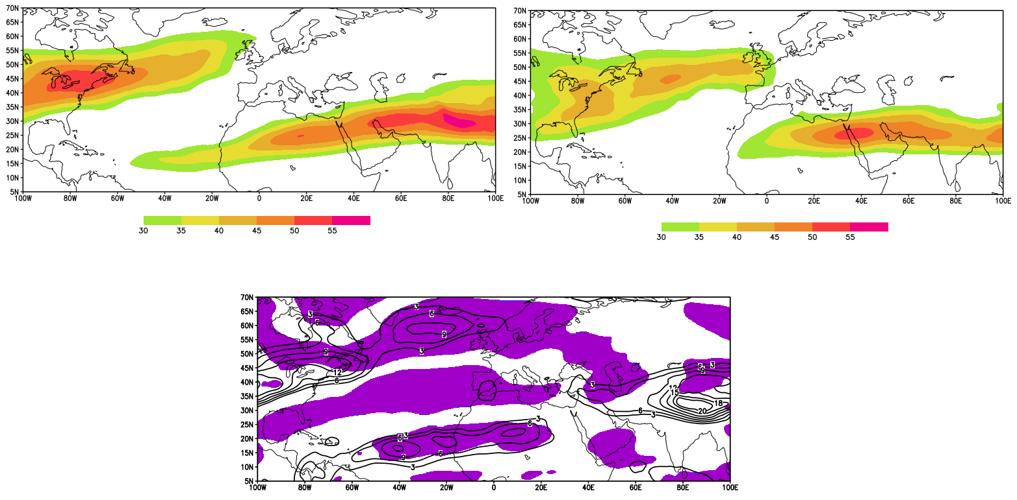
3) The third stage of the research
3-1-1) Mean wind speed at 250 hPa level
for critical phases
The jet core in the positive phase is stronger and wider than that in the negative phase.
Positive
Negative
Positive minus negative
16

Slide 17
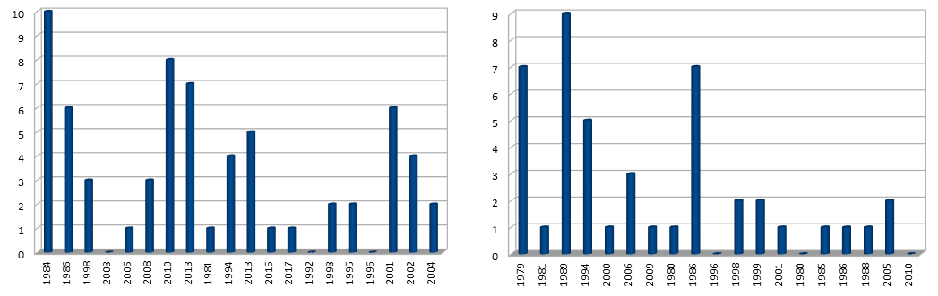
3) The third stage of the research
  3-2) Distribution of surface cyclones
  a) Identifying the cyclones (tracked for more than one day)
  for critical phases
The numbers of cyclones are 66 and 45 in the critical positive and negative phases, respectively.
Positive
Negative
17

Slide 18
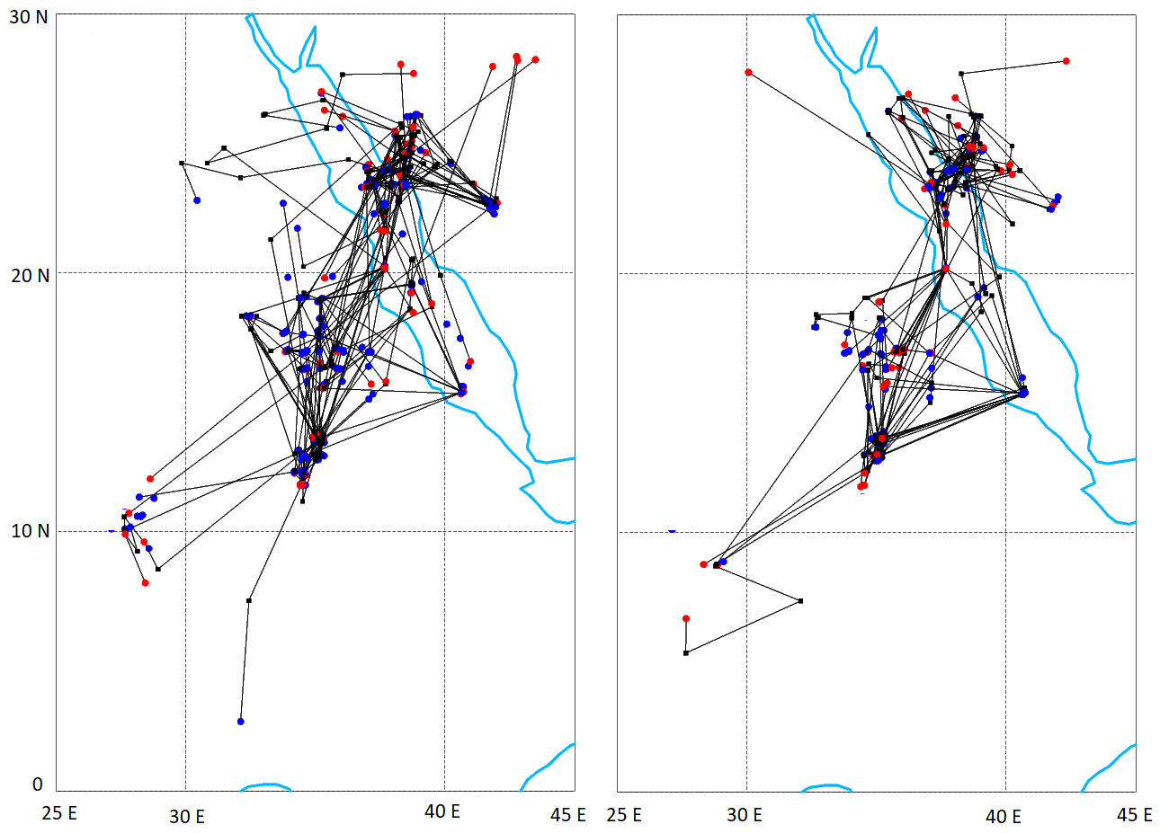
3) The third stage of the research
3-2) Distribution of surface cyclones
  b) Tracking the cyclones
  for critical phases
The tracks extend in a southwest–northeast direction
from central Sudan to northeast of the Red Sea.
Positive
Negative
The density of tracks seems higher in the positive phase
18

Slide 19
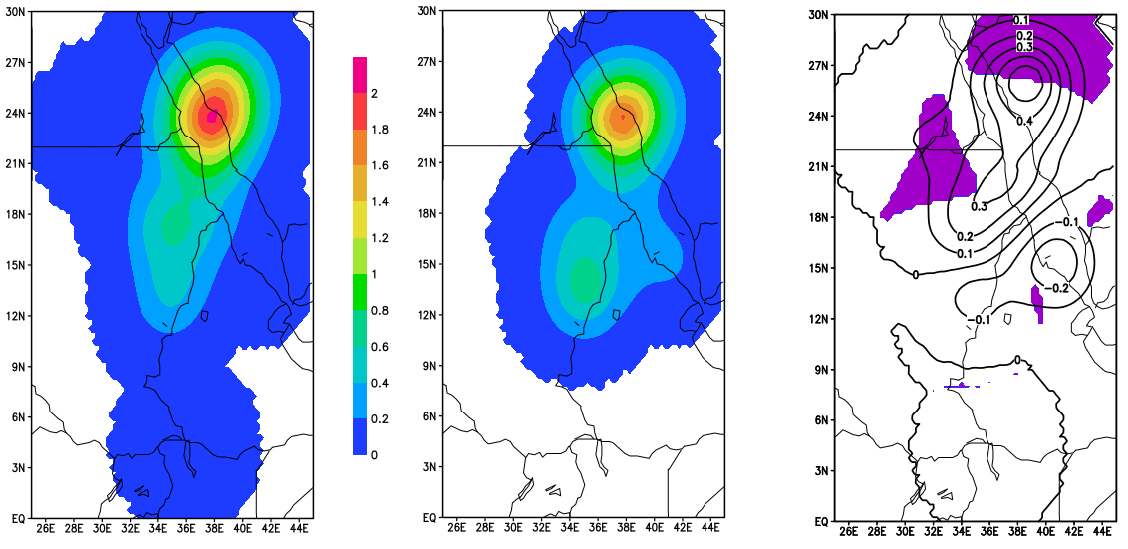
3) The third stage of the research
3-2) Distribution of surface cyclones
  c) Average cyclogenesis
  for critical phases
The maximum of cyclone formation over the Red Sea at 24 degrees North and 35 degrees East is stronger in the positive phase.
Result
Positive
Negative
Positive minus negative
The cyclone formation over the northeast Africa and the Red Sea is related to the amounts of wave activity entering the central subdomain from its northern and western boundaries.
There is a strong role for the upper-tropospheric flux convergence of the Mediterranean storm track in cyclone intensification in the northeast of the Red Sea.
19

Slide 20
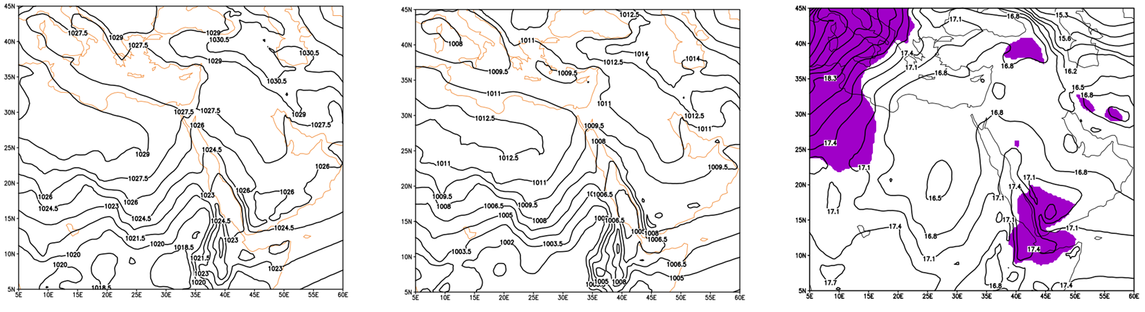
3) The third stage of the research
3-3) States of the RST
a) Mean Sea level pressure
  for critical phases
The RST is stronger in the critical positive phase with stronger extension to the north and east of the Mediterranean and weaker in the critical negative phase.
The difference of the two phases exceeds 17 hPa in the central RST region of the southern Red Sea.
Positive
Negative
Positive minus negative
20

Slide 21
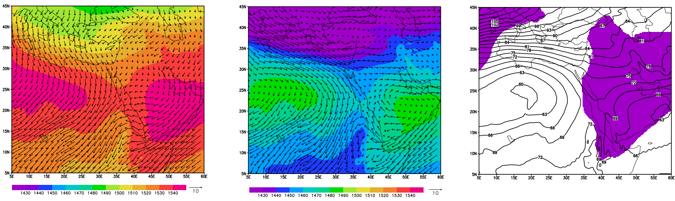
3) The third stage of the research
3-3) States of the RST
b) The geopotential height and wind vectors at 850 hPa
  for critical phases
The Siberian high, the Arabian anticyclone, and the African high are all stronger in the critical positive phase.
The transfer of moisture to the Red Sea
and Sudan, which contributes to strengthening the RST
Negative
Positive minus negative
Positive
Geopotential height difference between
the two phases reaches 63 gpm.
21

Slide 22
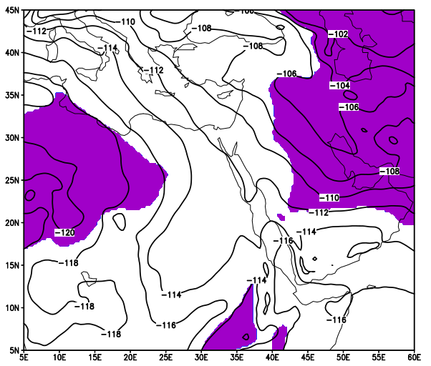
3) The third stage of the research
3-3) States of the RST
c) The 1000-850 hPa thickness difference
Positive minus negative
The lower-tropospheric column is colder during the positive phase.
22

Slide 23
Conclusion
In the critical positive phase, the RST stretches to the northeast of the Mediterranean Sea while strengthening,
and cyclogenesis increases in northeastern Africa, particularly the northeast of the Red Sea.
Receiving wave activity from the North Atlantic storm track
Receiving wave activity from the divergence core of the Mediterranean storm track (dominated by zonal flux)
Receiving wave activity from the convergence core of the Mediterranean storm track
Anticyclonic Rossby-wave breaking
The intensification of the subtropical jet
Lower tropospheric intrusion of cold air from upstream
Intensification of the Siberian high, the Arabian anticyclone and the African high
Because of
23

Slide 24

Thank you for paying attention

