Slide 1
On the effect of surface roughness on velocity profiles and runout lengths of dry granular flows
Lukas Reider
Roland Kaitna
University of Natural Resources and Life Sciences, Vienna (BOKU)

Slide 2
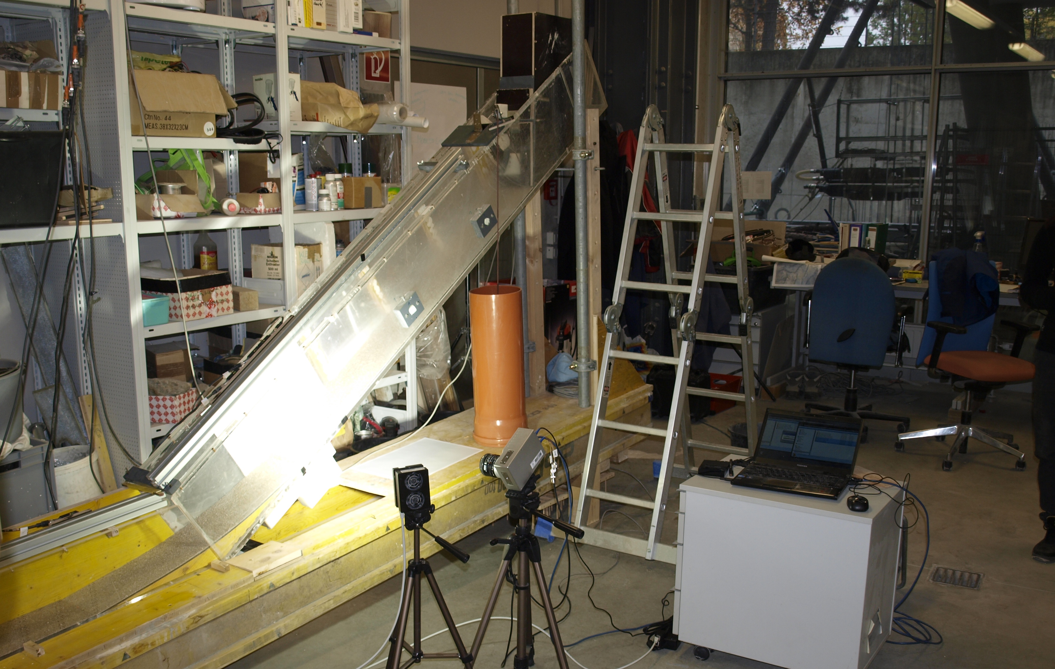
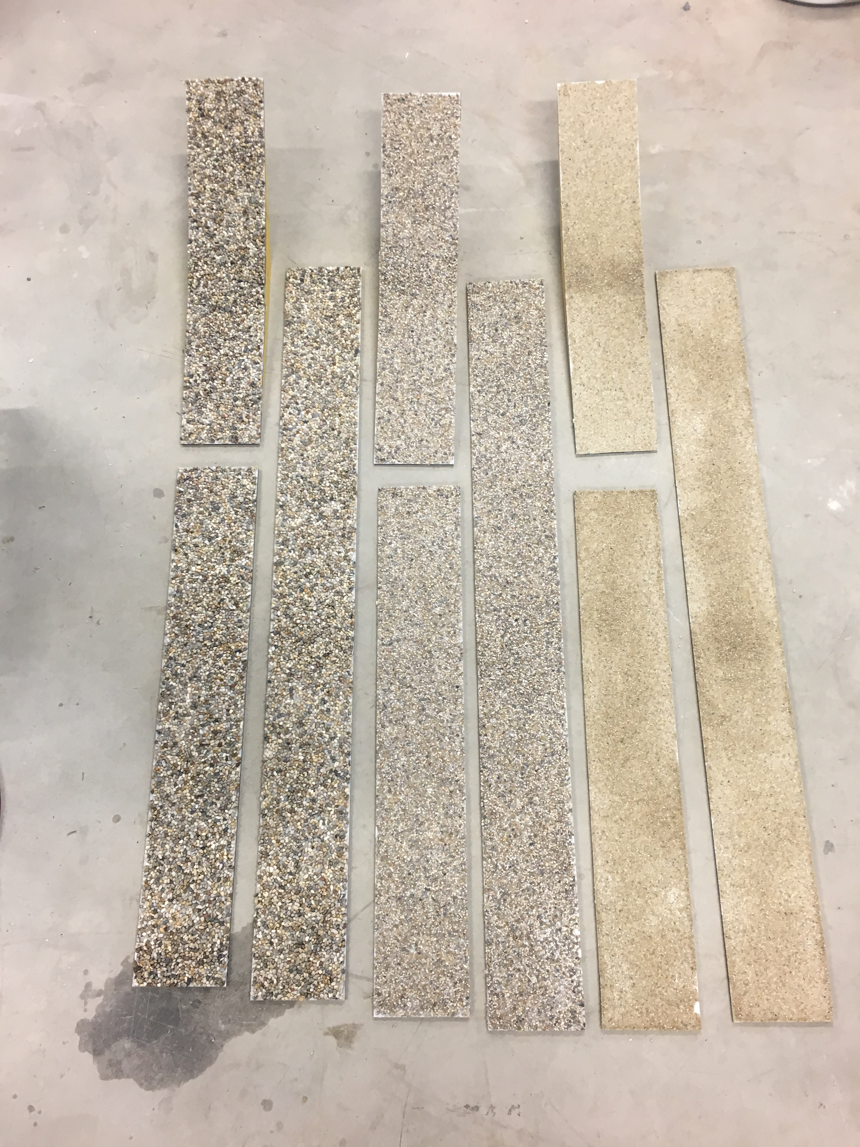
Experiments
High speed camera
Basal roughness:
R0 = 0 mm
R1 = 2 mm
R2 = 4 mm
R3 = 6 mm
Release volumes of 4 mm ceramic beads:
V1 = 3.5 kg
V2 = 7.0 kg
V3 = 10.5 kg

Slide 3
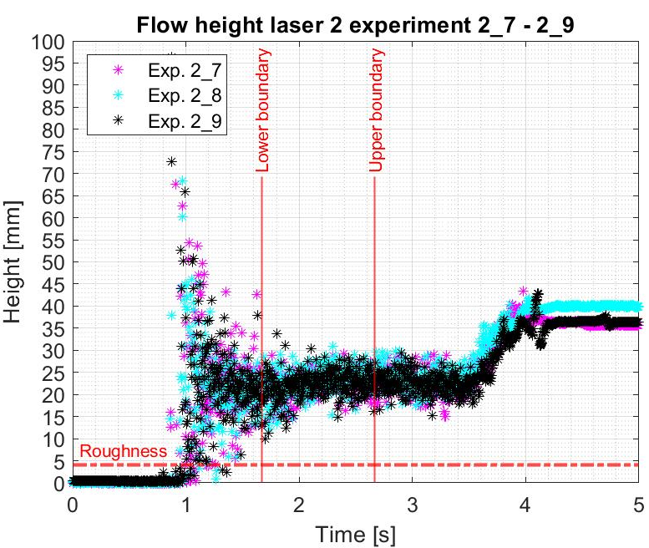
Analysis focuses on section of constant flow height

Slide 4
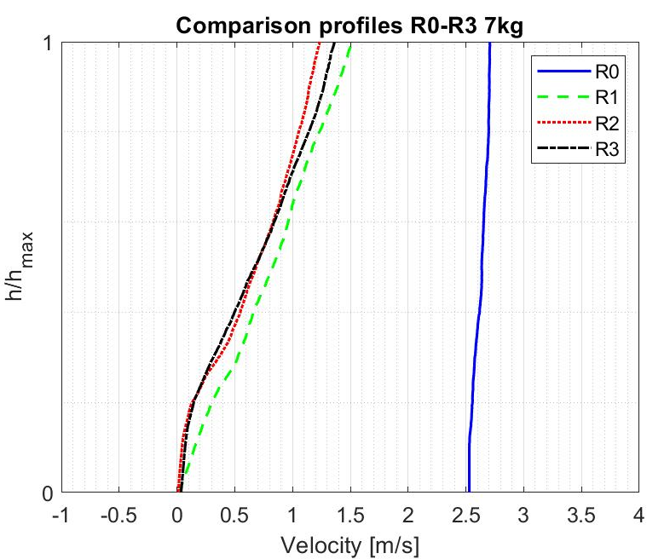
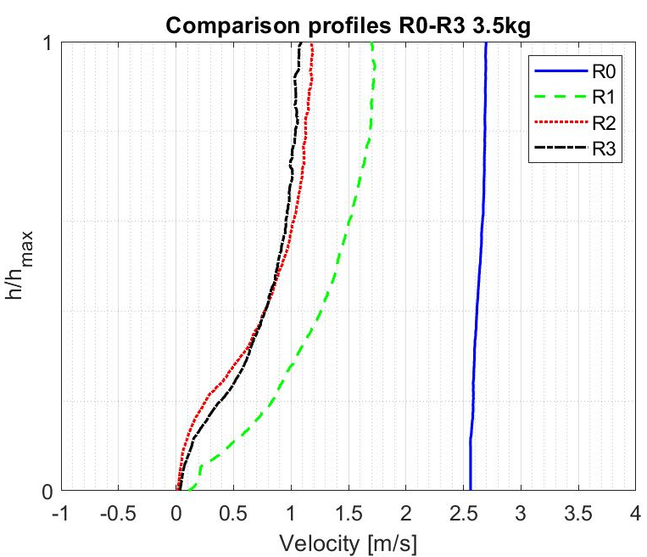
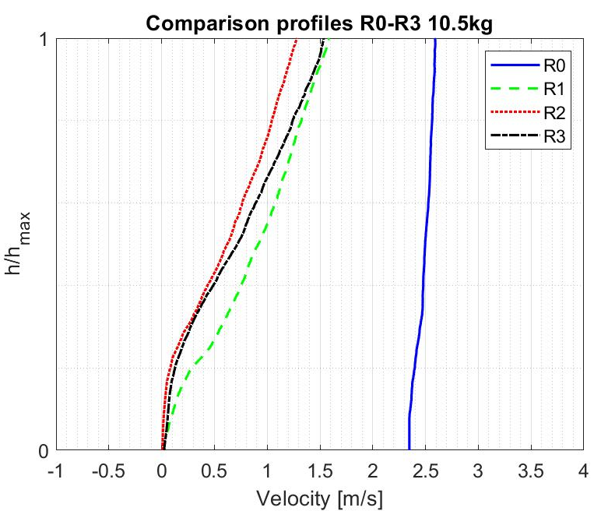
RESULTS – Velocity profiles
On R0 the mass was sliding as one block
Velocity profiles depending on starting volume and on the rough surfaces
R1=2mm R2=4mm R3=6mm
V1=7.0kg V2=3.5kg V3=10.5kg

Slide 5
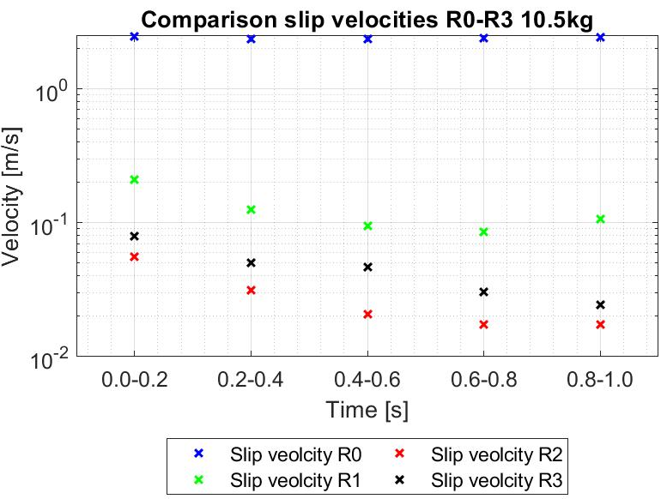
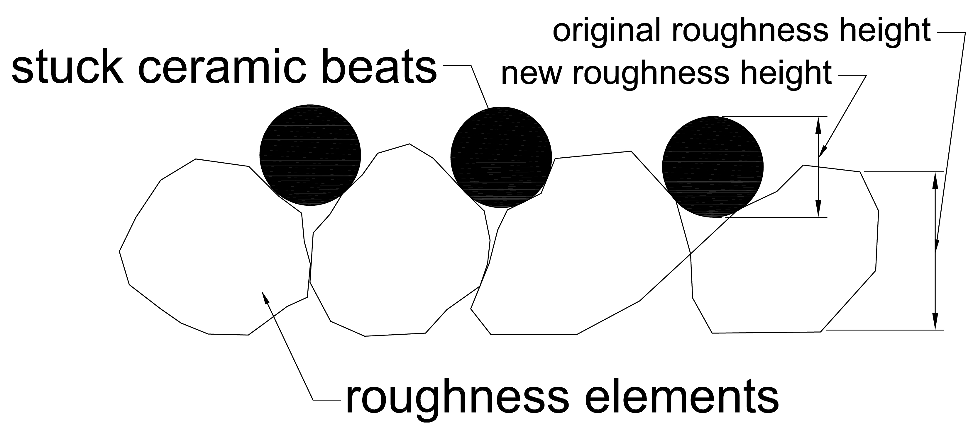
RESULTS – Slip velocities
Mostly sliding for smooth surface
Slip velocity first decreases with roughness and then increases again (flow material got stuck in roughness)
Slip velocities decrease with time¹
¹ cf. Schaefer, M. and Bugnion, L. (2013)
Sketch of decreased roughness due to stuck ceramic beats.
R1=2mm R2=4mm R3=6mm
V1=7.0kg V2=3.5kg V3=10.5kg

Slide 6
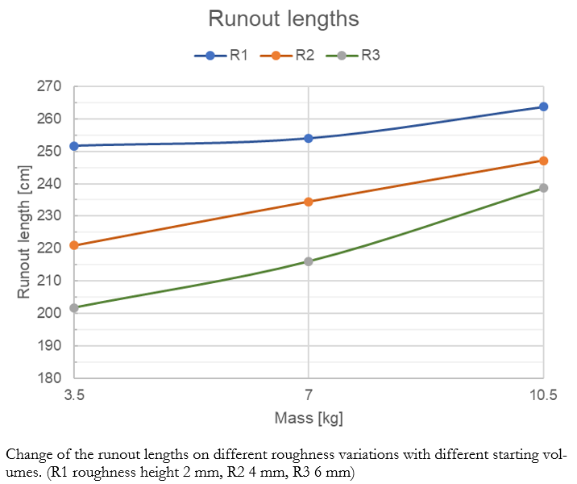
RESULTS – Runout lengths
Runout lengths…
increases with decreasing roughness
increases with increasing starting volume
R1=2mm R2=4mm R3=6mm
V1=7.0kg V2=3.5kg V3=10.5kg

Slide 7
Summary and Discussion
Runout distance decreases with a higher roughness
Increasing the roughness above a certain height makes no difference regarding friction coefficients
Bigger starting volumes lead to higher velocities, flow heights and runout distances on the rough surfaces
Scaling effects² as well as side wall friction³ must be considered
Further experiments with larger starting volumes are recommended
Analysed section of flow should be extended in further experiments⁴
² Iverson, R. (2015); Kesseler, M. et al. (2018)
³ Job, P. et al. (2005)
⁴ Schaefer, M. and Bugnion, L. (2013)

Slide 8
References
Iverson, Richard M. (2015): Scaling and design of landslide and debris-flow experiments. In: Geomorphology, Volume 244, 09.2015, p. 9–20, DOI: 10.1016/j.geomorph.2015.02.033.
Jop, Pierre, Forterre, Yoël and Pouliquen, Olivier (2005): Crucial role of sidewalls in granular surface flows: consequences for the rheology. In: Journal of Fluid Mechanics, Volume 541, Issue 1, 11.10.2005, p. 167, DOI: 10.1017/S0022112005005987.
Reider, Lukas (2020): On the effect of surface roughness on velocity profiles and runout lengths of dry granular flows. Master‘s thesis - Institute of Mountain Risk Engineering (IAN), University of Natural Resources and Life Sciences Vienna (BOKU), pp. 95.
Schaefer, Marius and Bugnion, Louis (2013): Velocity profile variations in granular flows with changing boundary conditions: insights from experiments. In: Physics of Fluids, Volume 25, Issue 6, 06.2013, p. 063303, DOI: 10.1063/1.4810973.

