Slide 1
Making the event set
Using AMIP (highresSST-present = 1950-2014, highresSST-future = 2015-2050) runs from PRIMAVERA models (part of CMIP6)
Total number of model years = 2100
Event set will be freely available
(5) (3) (3)
(2) (2)
(1) (1)
(1) (1)
(1) (1)
(km)
Numbers in brackets = number of ensemble members available for each run at time of making event set

Slide 2
Making the event set
Storms identified with TRACK (Hodges 1995) (thanks to Malcolm Roberts and Kevin Hodges)
Footprints defined as maximum gusts over 72 hour period for each storm
Gusts not available for most models so footprints are made from daily maximum winds then converted to gusts statistically
Problem with storm ‘contamination’ – more than one system in 72 hour period
Had to develop ‘decontamination’ method (different to previous methods which were based on 6 hourly maximum winds/gusts rather than daily)
Footprints all converted to uniform grid (approx. ~18km resolution at 50oN)

Slide 3
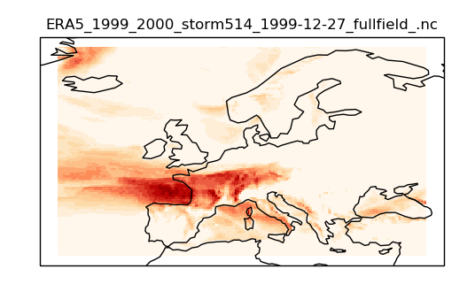
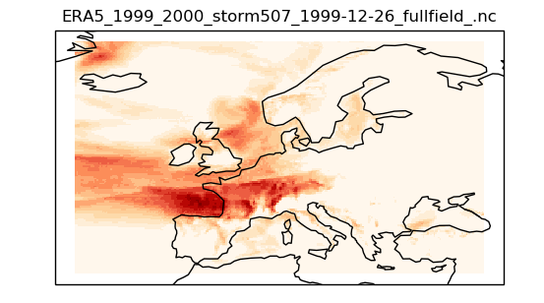
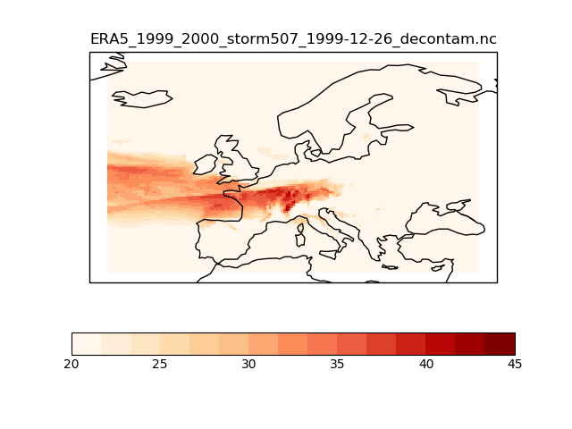
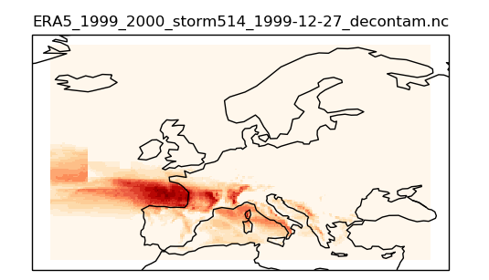
Decontamination method tested on real storms from ERA5¹
Method involves splitting up daily wind/gust field and assigning each grid point to closest storm track on that day
Example: Lothar (1999-12-26) and Martin (1999-12-27)
Lothar – before decontamination (max gusts 25,26,27th Dec 1999)
Martin – before decontamination (max gusts 26,27,28th Dec 1999)
Before decontamination, both footprints have similar pattern over France/Germany/Switzerland
Lothar – decontaminated
Martin – decontaminated
Different patterns revealed after decontamination
¹Copernicus Climate Change Service (C3S) (2017): ERA5: Fifth generation of ECMWF atmospheric reanalyses of the global climate . Copernicus Climate Change Service Climate Data Store (CDS), accessed 2019. https://cds.climate.copernicus.eu/cdsapp#!/home

Slide 4
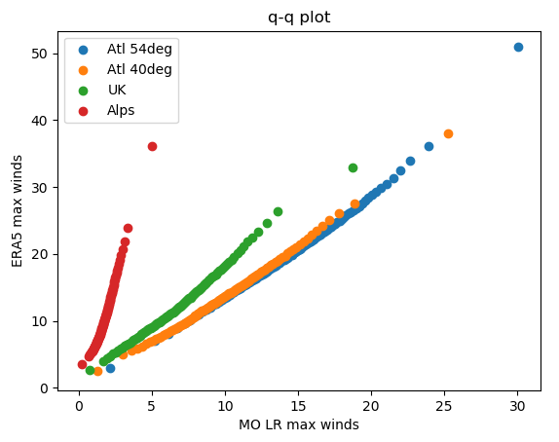
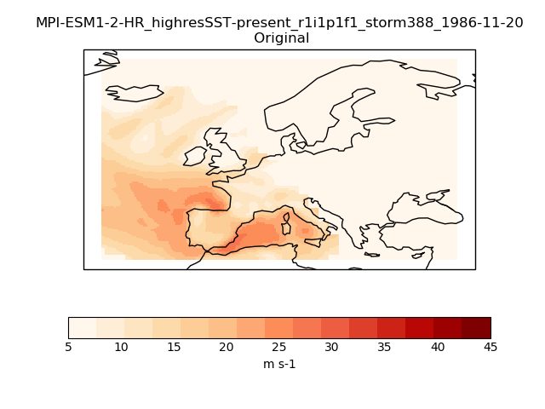
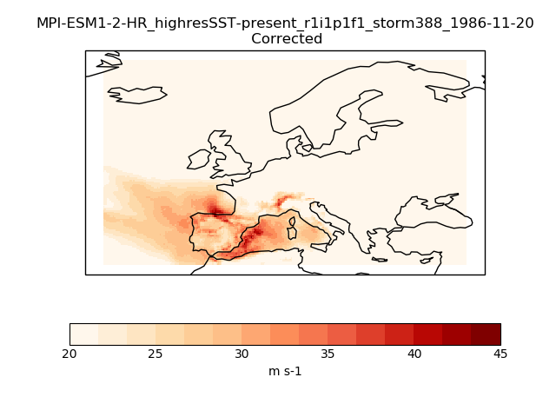
Conversion from winds to gusts/bias correction/downscaling
Some models show bias in daily maximum winds, especially over high altitude
Correct using quantile mapping from regridded model winds (onto ERA5 grid) to ERA5 gusts, at each grid point
Empirical for values < p98, using extreme value analysis for values >= p98
Large uncertainty in bias corrected maximum gusts

Slide 5
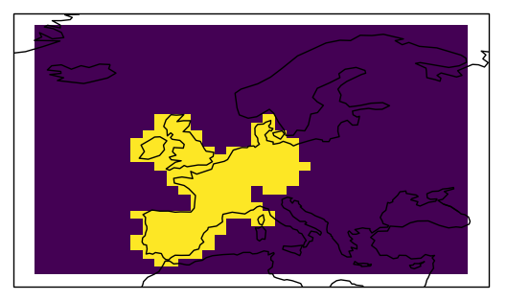
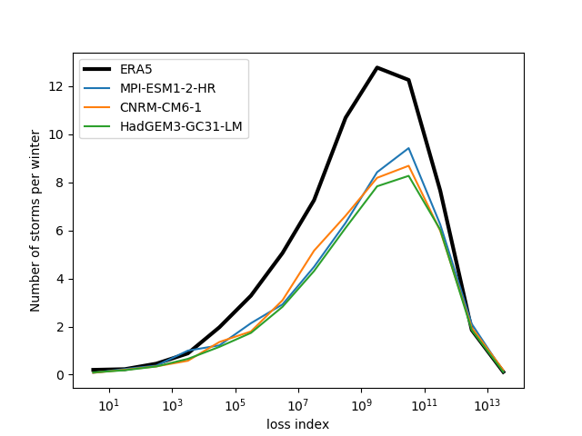
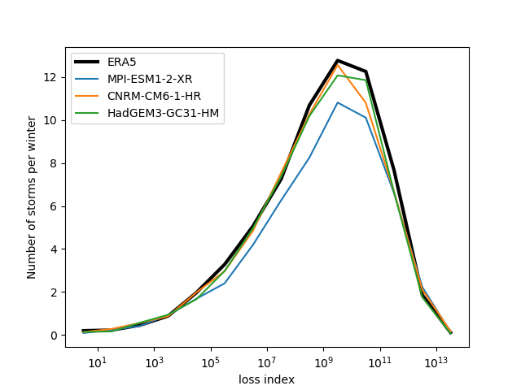
Results (from 975 model years of data so far)
Calculate loss index for each storm (proportional to insured loss): loss for each footprint $∝\sum_{i}{{area}_{i}×{popdens}_{i}×{\left(\frac{v_{max,i}}{v_{98,i}}−1\right)}^{3} }$ (Pinto et al 2007, NHESS, 7, 165)
Calculate loss index for each storm over same domain used by C3S-WISC
Higher resolution models show improved number of mid-strength storms
Low resolution
High resolution
Note log scale (few low intensity storms because the bin size is smaller in linear space)

Slide 6
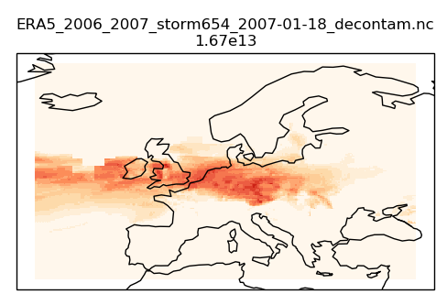
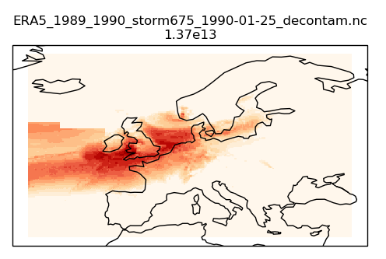
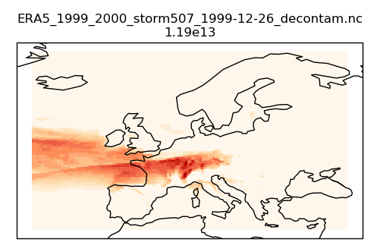
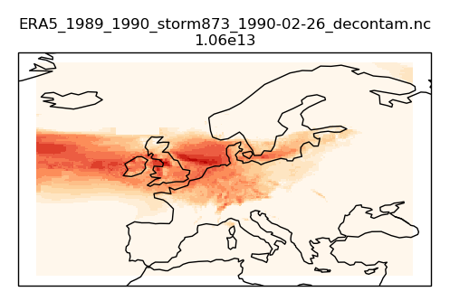
Severe storms
In ERA5, there were 4 storms in 35 winters with loss index > 1e13 (Daria 1990-01-25, Vivian 1990-02-26, Lothar 1999-12-26, Kyrill 2007-01-18) (p=0.114)
In models, there are 105 storms with loss index > 1e13 in 975 winters (p=0.108)
Model rate varies even between different ensemble members of same model at same resolution (eg HadGEM3-GC31-LM r1i1p1f1 p=0.08, HadGEM3-GC31-LM r1i2p1f1 p=0.17) – shows importance of longer datasets.
31 storms with loss index higher than has been observed -> can use event set to study worst case scenarios
ERA5
PRIMAVERA – example storm footprints

Slide 7
summary
Made a windstorm event set from PRIMAVERA AMIP models to use in catastrophe modelling
After bias correction, storm frequency and intensity compare well to ERA5 storms
Higher resolution models show an improvement in the number of mid-strength storms
May be useful dataset for assessing impact of storms stronger than have been observed
Still need to complete analysis comparing different resolutions, compare present day to future, get feedback from industry users
Event set will be freely available

