Slide 1
South Pacific Paleoclimate Sensitivity in Last Interglacial
PhD Project from Julia Hagemann
Alfred-Wegener-Institute
Supervisor: Ralf Tiedemann
& Frank Lamy

Slide 2
Last Interglacial (Eemian)
During MIS 5: 130 – 115 kyr PB
Higher global mean temperature of ~1.5° C¹
Higher temperature in the polar regions of 3 – 5° C^{2,3}
Higher sea level by ~7 m⁴
¹ Turney & Jones, 2010
² Overpeck et al., 2006 – Antarctica
³ z. B. Otto-Bliesner et al., 2006 – Greenland
⁴ z. B. Kopp et al., 2013
Notes:
Motivation, warum stadium 5
Bedeutung, insbesondere für den SOMotivation, warum stadium 5
Bedeutung, insbesondere für den SO
ICE Sheet
Eem / Holozän temperature unterschied im SO?
Climate sensitivity
ICE Sheet
Eem / Holozän temperature unterschied im SO?
Climate sensitivity

Slide 3
Information of the Project Core
Mirai Cruise Leg 2
Core name: MR16-09 PC03
Chilean margin: 46° 24.32’ S, 77° 19.45’ W
3082 m water depth, 17.47 m length
Sediment: mainly grey to live grey clay, with slightly mixed thin siltic layers at a depth of 8 m to the bottom
Notes:
Motivation, warum stadium 5
Bedeutung, insbesondere für den SOMotivation, warum stadium 5
Bedeutung, insbesondere für den SO
ICE Sheet
Eem / Holozän temperature unterschied im SO?
Climate sensitivity
ICE Sheet
Eem / Holozän temperature unterschied im SO?
Climate sensitivity

Slide 4
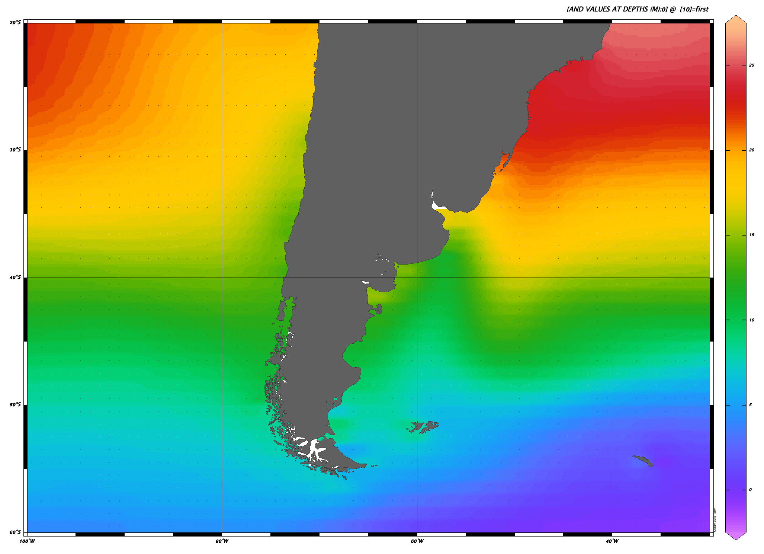
20° S
30° S
40° S
50° S
60° S
SST
25° C
20° C
15° C
10° C
5° C
0° C
Mirai Cruise MR16-09
5 PC01
6 PC02
7 PC03 – 150 ka
8 PC04
de Bar et al., 2018
2 ODP 1234 – 150 ka
Síani et al., 2013
5 MD07-3088 – 21 ka
Ho et al., 2012
1 GeoB3388-1 – 700 ka
4 GeoB3327-5 – 513 ka
10 PS75/034-2 – 692 ka
Caniupán et al., 2011
9 MD07-3218 – 60 ka
Kaiser et al., 2005
Lamy et al., 2004
3 ODP 1233 – 70 ka
1
ACC:
Antarctic Circumpolar Current
CHC:
Cape Horn Current
PCC:
Peru Chile Current
SPC:
South Pacific Current
PCC
2
3
SPC
4
5
7
6
8
9
10
CHC
ACC
100° W 80° W 60° W 40° W
Notes:
Für SPC siehe Strub et al., 2019
ACC siehe Orsi et al., 1994

Slide 5
Precursor Occurrence
Temperature [° C]
E. huxleyi
¹G. bulloides (δ¹⁸O):
0 – 100 m extended to 100 – 200 m
²Archaea (TEX₈₆):
150 – 550 m extended to ~50 – 150 m proxy represents photic zone (~50 – 200 m)
³Coccolithophorida E. huxleyi (U^{K}₃₇):
0 – 60 m extended to 60 – 120m
G. bulloides
Thaumarachaeota
Depth [m]
Salinity [PSU]
¹ Kretschmer et al., 2018
² Peason & Ingals, 2013
³ Saavedra-Pellitero et al., 2014

Slide 6
Some Information:
BIT
branched vs. isoprenoidal tetraether
Shows the ratio of the mostly land produced GDGTs (branched) vs. the mostly marine produced GDGTs (isoprenoidal)
Can also be treated as terrestrial proxy like alkanes
Should not be above > 0.3 to not influence the water temperature proxy
C37:4
Is influenced by temperature and salinity
Can act as a proxy for subartic/ subpolar water mass distribution, or for (terrestrial) freshwater input
Alkane
C27 – C33
Leaf remains of terrestrial plants

Slide 7
Holocene
Pleistocene
MIS 1
MIS 2
MIS 3
MIS 4
MIS 5
MIS 6
Stratigraphy of core MR16-09 PC03 is based on oxygen isotopes, paleomagnetics and tuning to the EDML ice-core
Over T-II the subsurface temperatures of SST^{H} reach surface temperatures
The water temperature rise over T-II is 9 – 10° C, over T-I just 6° C.
In the section from 41 – 15 kyr BP SST’ and SST^{H} are not synchronous
BIT, %C_{37:4} & Alkanes covary closely
Between 41 – 15 kyr BP, sedimentation-rates are highest coinciding with stronger fresh water input (%C_{37:4})
The lowest terrestrial input was during the interglacial periods
© Authors. All rights reserved

Slide 8
Age [kyr]
Stratigraphy of core MR16-09 PC03 is based on oxygen isotopes, paleomagnetics and tuning to the EDML ice-core
Over T-II the subsurface temperatures of SST^{H} reach surface temperatures
The water temperature rise over T-II is 9 – 10° C, over T-I just 6° C.
In the section from 41 – 15 kyr BP SST’ and SST^{H} are not synchronous
BIT, %C_{37:4} & Alkanes covary closely
Between 41 – 15 kyr BP, sedimentation-rates are highest coinciding with stronger fresh water input (%C_{37:4})
The lowest terrestrial input was during the interglacial periods
MD07-3088
e.g. © Authors. All rights reserved

