Slide 1
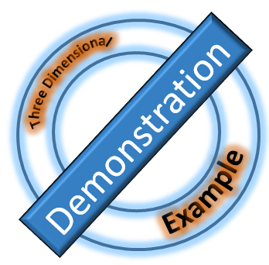
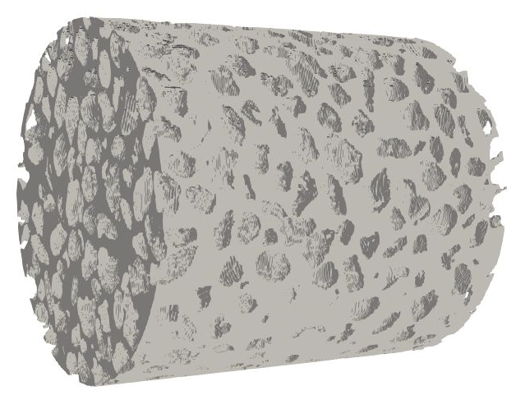
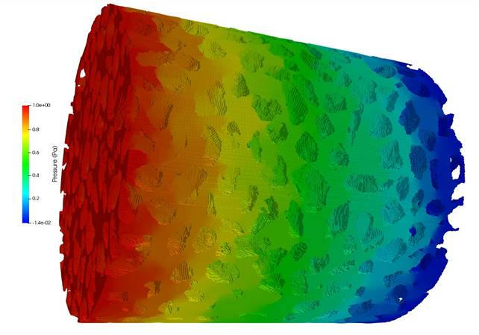
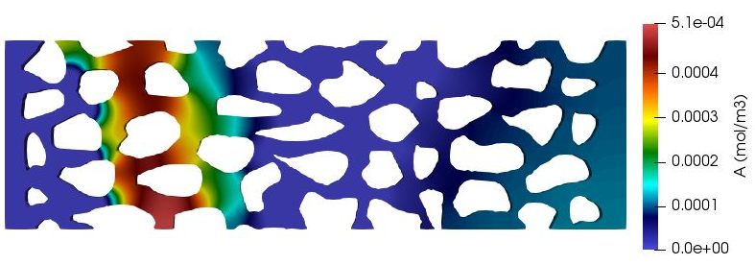
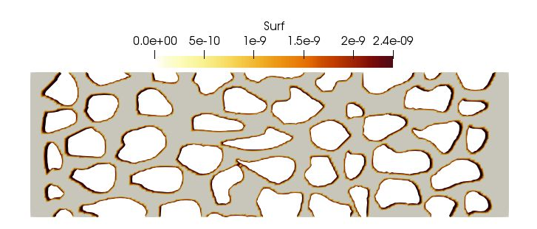
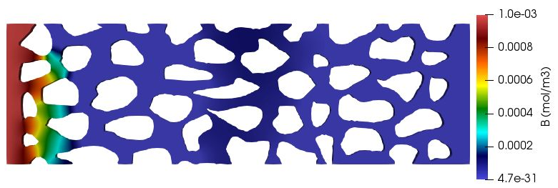
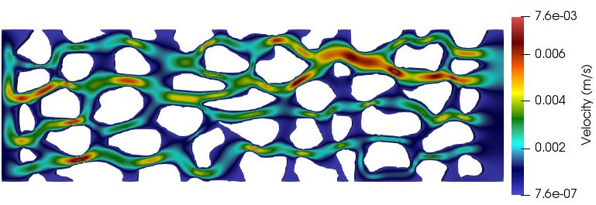
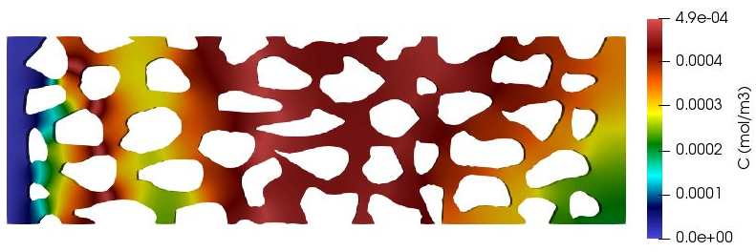
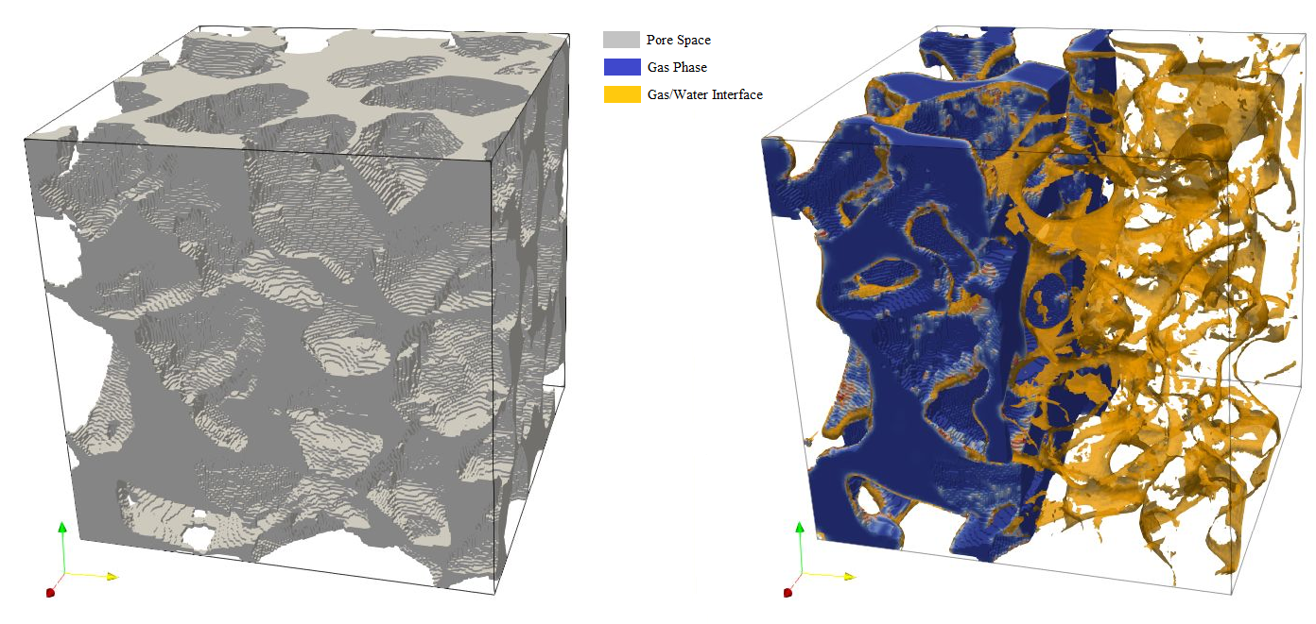
A Pore-Scale Reactive Transport Modelling Approach for Investigating the Effect of Soil Physical Properties on Biogeochemical Processes
Amir Golparvar¹, Matthias Kästner² and Martin Thullner¹
1 Department of Environmental Microbiology, Helmholtz Centre for Environmental Research - UFZ, Leipzig, Germany
2 Department of Environmental Biotechnology, Helmholtz Centre for Environmental Research - UFZ, Leipzig, Germany
Introduction
The vadose zone hosts a wide range of various microorganisms which provide different soil ecosystem services from nutrient cycling to biodegradation of harmful chemical substances. The efficiency of such in-situ biodegradation is influenced by different biotic and abiotic factors ranging from physical properties of the soil to the redox conditions controlled by the activity of the involved chemical compounds. Pore-scale phenomena have been shown to be considerably affecting the macro-scale processes, therefore a quantitative bottom-top approach of these mechanisms in situ is adamant. For this purpose, numerical methods would be desirable that combine the simulation of variable/controllable water saturation conditions and water/air dynamics in porous structures directly obtained from CT scanned samples with the simulation of advective and diffusive micro-scale transport of all components as well as their biogeochemical transformations in both, the air and the water phase.
Verification and Demonstration of Model performance
Cont’d…
1.a
Gaseous Phase (Air)
Figure 3.c - Repacked flow-cell with a coarse grained sand (mean diameter = 1mm; range =0.6 - 2.0 mm) imaged at a resolution of 7.5 µm/voxel and length of 1cm**.
Liquid Phase (Water)
1.b
1.c
Figure 1 - In order to validate the multicomponent diffusion transport part of the model, a simple scenario involving a gaseous and liquid phase at rest is designed (1.a). A volatile compound in water is allowed to enter air, depending on its Henry’s constant. Figure 1.b shows concentration of the volatile species in both water and air at 0.1 millisecond. Figure 1.c shows concentration profile of volatile compound at 10 milliseconds. There is a perfect match between output of numerical model and the analytical solution.
Water Phase
Water Phase
3.d
3.c
Gas Phase
Gas Phase
Figure 3.d - A single phase (fully water saturated) simulation is run to calculate the permeability of the flow-cell. The color map shows the pressure distribution at steady state.
AIM
The present study introduces a novel pore-scale numerical modeling approach for the pore scale simulation of water and air movement, advectve-diffusive transport in the aqueous and gaseous phase, and an arbitrary set of reactive processes.
The developed approach is designed to identify the drivers of biogeochemical processes in the subsurface in presence of other factors at the pore scale level.
2.a
2.c
Inlet
Outlet
Conclusions
This presented approach fills the current gap in modelling biogeochemical processes in unsaturated porous media.
The model has proven to be precise in mimicking all essential components of biogeochemical reactive transport in vadose zone.
More simulations comparing with high-resolution experimental data is yet to be performed to ensure its validity in 3 dimensional systems.
Model approach can be applied to assess the effect of soil physical properties on the transport and degradation of contaminants in soil
0.28 mm
2.d
0.92 mm
Figure 2 - Showcasing a two dimensional fully water saturated porous medium with total pore volume of 2.91e-12 cubic meters (Fig 2.a). A cyclic injection scenario with dissolved component “A” and “B” allowed to enter from “Inlet” boundary from left with time interval of 0.1s. “A” and “B” are evolved in space and time via advection, diffusion and reaction (A + B → C) mechanisms. The velocity and concentration profiles of each component (A, B and C) after 0.54s are shown in figures 2.b, 2.c, 2.d and 2.e respectively.
Method
Updating Velocity and Pressure fields via solving Navier-Stokes Equation
Defining Aqueous and Gaseous phase using Volume of Fluid Method
Enhancing numerical dispersion around fluid-fluid and fluid-solid interfaces by filtering capillary fluxes
Explicit representation of pore space via digitization of micro-CT images
Solving Advective-Diffusive-Reactive Equation for chemical species available in both aqueous and gaseous phases
Reaction Network is defined and solved via an established externally-coupled package: Biogeochemical Reactive Network Simulator (BRNS) [1]
Consider reactive processes include microbially mediated degradation along with turnover kinetics, microbial activity, dormancy as well as abiotic reactions in soil water and soil air, and at the solid matrix surface.
The entire coupled model is solved using finite volume approach in fully parallelized environment
2.e
2.b
3.75 mm
3.a
3.b
References
[1]: Centler et al., 2010. Computers & Geosci. 36: 397-405.
**: Unpublished work – prepared by Frederic Leuther.
Figure 3 - A 3D simulation of two phase flow. Figure 3.a shows a subsampled pore space (in gray) of a repacked flow-cell with a coarse grained sand (mean diameter = 1mm; range =0.6 - 2.0 mm) imaged at a resolution of 7.5 µm/voxel (500*500*500 computational cells). Initially the pore volume is filled with water and air is being injected from left and side. Figure 3.b depicts air distribution in the pore space at steady state (Courtesy of Soil System Science Department, UFZ**)
CONTACT INFORMATION

