Slide 1
Linking regional changes in the intensity distribution of daily tropical precipitation to changes in large-scale circulation and convective inhibition
Rob Chadwick, Angeline Pendergrass, Segolene Berthou, Lincoln Alves, and Aurel Moise
EGU2020 online – See captions under slides for brief descriptions
Notes:
In this presentation, we will examine how the intensity distribution of daily precipitation changes under warming. We will describe this in terms of two idealised modes, and link these modes to physical processes.

Slide 2
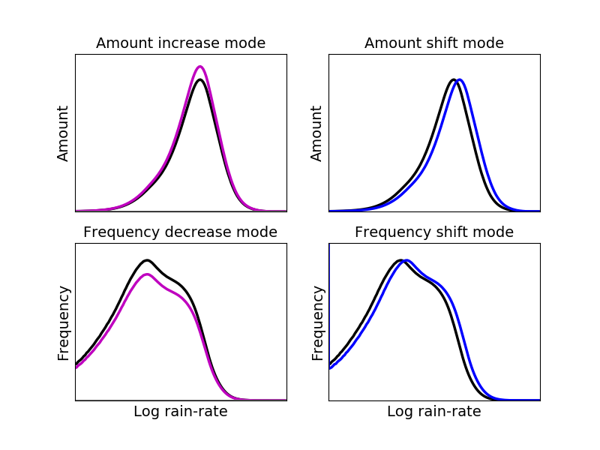
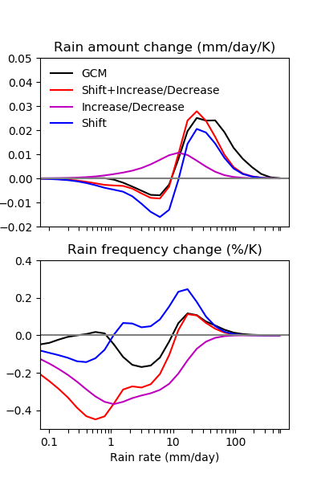
Daily precipitation intensity distribution change
Present day
Log rain-rate
Log rain-rate
Change under warming
Rain rate (mm/d)
Rain-rate (mm/day)
Pendergrass et al., 2014a,b, J. Climate
Notes:
The present-day and change under warming of the globally aggregated daily precipitation amount distribution in the CMIP5 ensemble mean is shown in the left-hand figure. The amount of precipitation that falls at high intensities increases, while less falls at medium intensities. This change can be represented by a combination of two idealised modes (in log rain-rate space), shown in the top-right plots: 1) an amount increase mode, whereby the amount of precipitation at all rain-rates scales up; and 2) an amount shift mode, whereby precipitation falls at higher intensities. The bottom-right plot shows these two modes fitted to the CMIP5 models, where they do a good job of capturing the precipitation distribution change at all but the highest rain-rates.

Slide 3
Changes in frequency
Present day
Change under warming
Rain-rate (mm/day)
Pendergrass et al., 2014a,b, J. Climate
Notes:
Two equivalent modes can also be described in terms of precipitation frequency change (as opposed to the total amount of precipitation at each rain-rate, shown in the previous slide). In this case, we obtain a frequency decrease mode and a frequency shift mode. This fit in frequency space does a good job at capturing the increased frequency of precipitation at high rain-rates, and a reasonable job at representing the reduced frequency at medium rain-rates. However, the modes do a poor job at low rain-rates – possibly because different processes are at work.

Slide 4
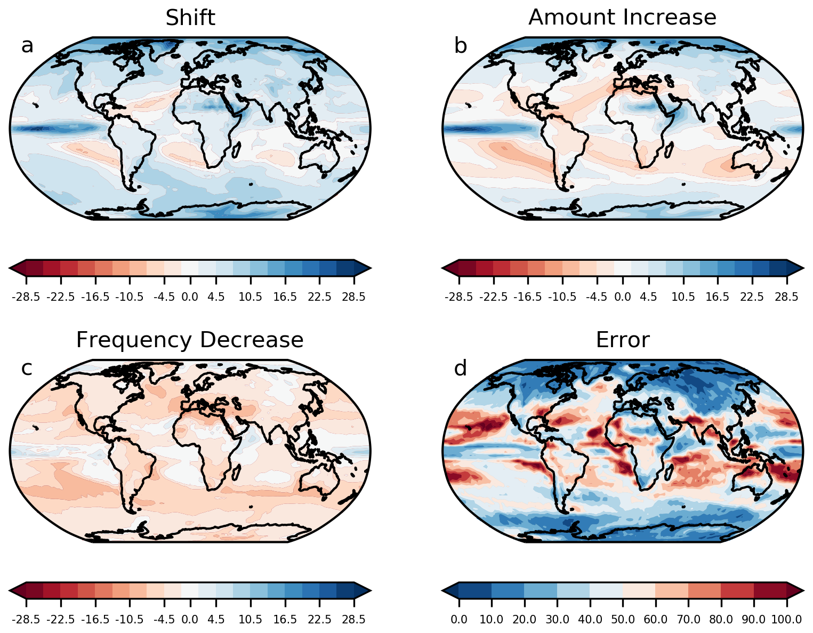
Regional modes of daily precipitation change
%
%
Notes:
We extend these modes to regional changes in daily precipitation change distributions. In general, there is a decrease in frequency and an increase in precipitation intensity in most regions of the globe, but there is also considerable regional variation, consistent with regional variations in mean precipitation change.

Slide 5
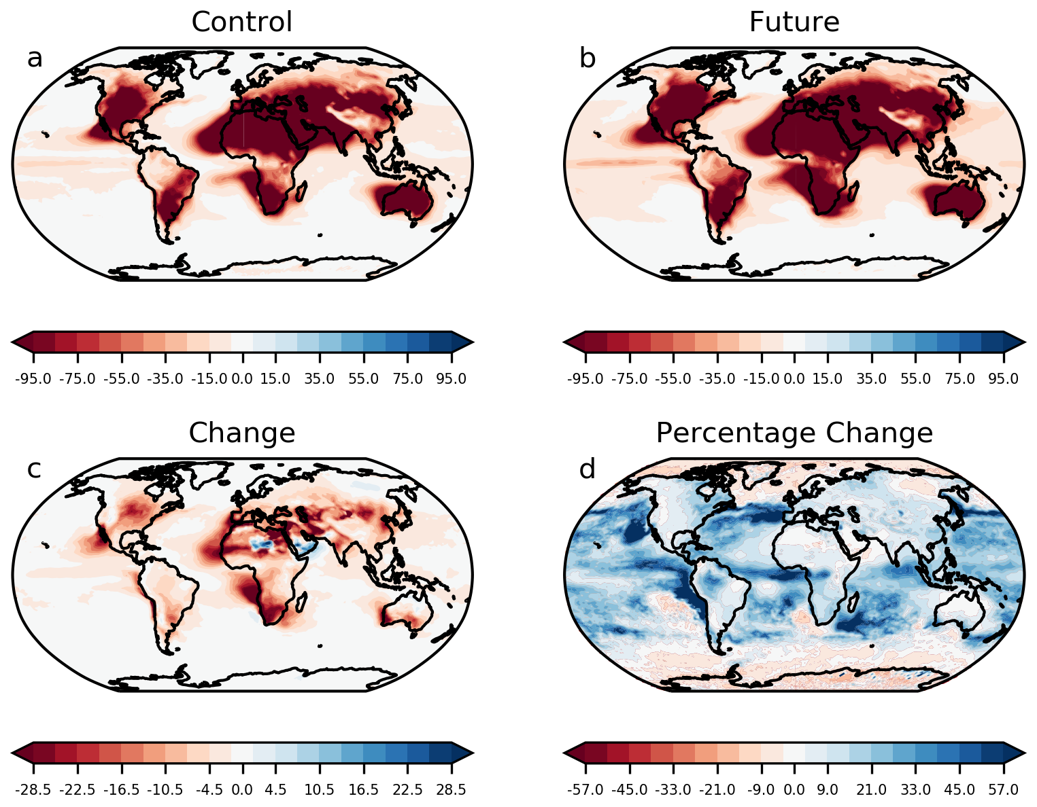
CIN and CAPE changes
Chen et al., 2019, J.Climate
CIN change in HadGEM3 (%)
Rasmussen et al., 2017, Clim. Dyn.
Notes:
The physical basis behind these idealised modes remains unclear. For deep convective precipitation, one recent hypothesis has been that an increase in convective inhibition (CIN) under warming, driven over land by reduced RH, leads to a decreased frequency of convection. This could allow convective instability to build up for longer between events, leading to more intense convective precipitation when it does occur. We try and link this hypothesis to the two idealised modes in the previous slides.

Slide 6
CIN and frequency decrease mode
Assume that the frequency of deep convection scales under warming as a decreasing function of time-mean CIN:
For increasing CIN, this gives a fractional decrease in frequency that is independent of rain-rate, i.e. a frequency decrease mode:
Primes denote future values under warming
Notes:
Under certain assumptions, an increase in CIN could lead to a frequency decrease mode.

Slide 7


Simple dry static energy budget model of deep convective precipitation
Cooling from large-scale forcing over time between (and during) events,
F = - <Qrad + DSE flux conv.>
Convective heating, LP
T profile at end of event
T profile at end of event
Previous Event
Current Event
time
Precipitation during event
Large-scale forcing (radiation and circulation)
Change in DSE storage (vertical integral of atmospheric warming)
Notes:
In order to examine the consequences of a reduced frequency of convection on the intensity distribution of convective precipitation, we use a simple model of the dry static energy (DSE) budget, based on a series of discrete convective events occurring in a GCM-scale grid-box. A schematic of this model is shown above.

Slide 8
Simple model predictions under warming
For all events in the rainfall pdf, change in intensity is:
Primes denote future values under warming
This produces a frequency shift mode:
Different idealised assumptions can be made about the relative importance of DSE flux convergence and local radiative cooling.
Under strict Weak Temperature Gradient assumptions, large-scale forcing F is dominated by DSE flux convergence during convective events (large-scale circulation).
Under local radiative convective equilibrium assumptions (not realistic but interesting to examine), large-scale forcing F is dominated by local radiative cooling.
Notes:
Under certain assumptions, this simple DSE model leads to a frequency shift mode. The magnitude of the shift in intensity is related to the change in convective frequency, combined with the change in time-mean large-scale forcing. Depending which assumptions are made about the relative balance between DSE flux convergence (by the large-scale circulation) and local radiative cooling, one or the other is more dominant. In the deep tropics, where the weak temperature gradient assumption is applicable, DSE flux convergence is likely to dominate.

Slide 9
Summary
Increased CIN under warming, associated with decreased RH over land, could lead to a decreased frequency of convective events.
Decreased frequency is associated with an increase in precipitation intensity.
Change in the large-scale forcing also affects precipitation intensity.
The large-scale forcing links long-term mean rainfall changes to the daily pdf change, on both global and regional scales.
Changes in the shape of the precipitation distribution will also affect extreme events. This could be more influenced by Clausius-Clapeyron moisture scaling than the distribution change as a whole.

Slide 10
Questions?

