Slide 1
Coupling historical maps and Lidar data to recognize man-made landforms in urban areas
Terrone M¹. Faccini F.^{1,2}, Paliaga G.², Piana P.³
¹ Department of Earth, Environmental and Life Sciences, University of Genoa, Genoa, Italy, ² National Research Council, Research Institute for the Geo-Hydrological Protection, Turin, Italy, ³ Department of Politics, University of Genoa, Genoa, Italy
Dr.Martino Terrone
DISTAV, University of Genoa

Slide 2
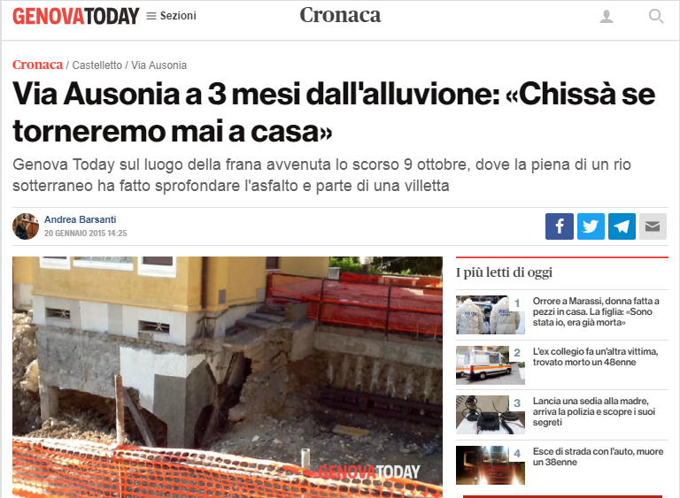
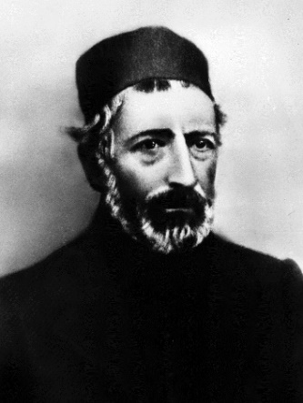
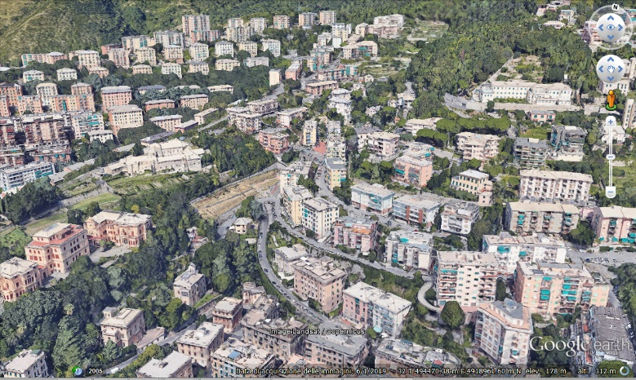
Old maps as a tool for geological studies
A house built in the 1930s collapsed during a heavy rainfall event in October 2014.
It was discovered that the house stood over a stream completely urbanized in the late nineteenth century
Let me take a look
at OLD MAPS
Photo by GENOVA TODAY
1

Slide 3
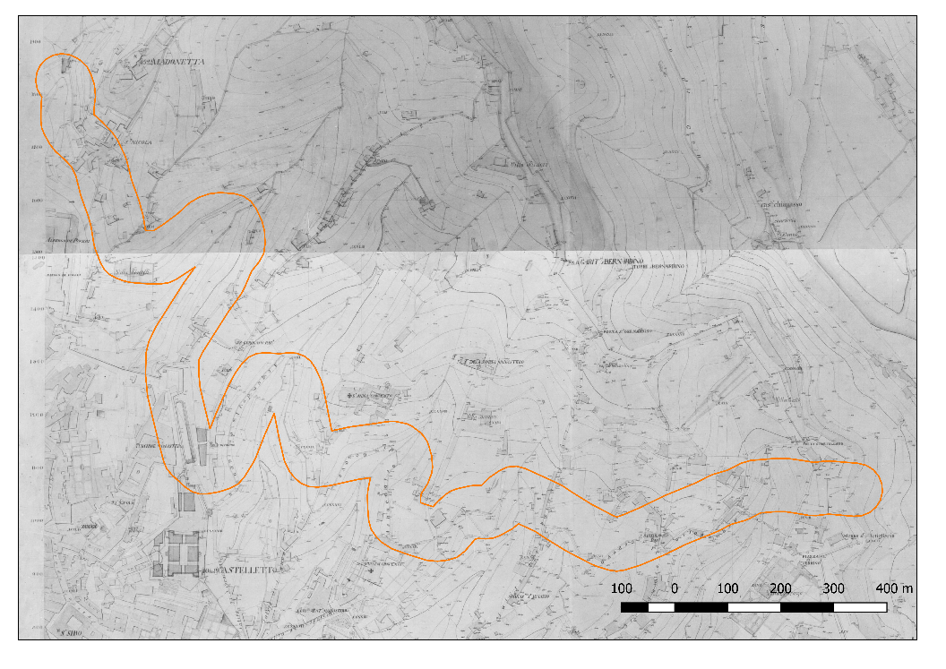
A topographer and inventor : Ignazio Porro (1801 – 1875)
Officer of the Kingdom of Sardinia Army, academic, topographer, scientist and inventor.
Between 1835-38 he produced his famous “Carta generale di difesa di Genova (1:2.000)” using innovative optical instruments and improving the method of Tacheometry which allowed rapid and precise surveying
The map consists of 52 different sheets covering the urban area of Genoa and its environs. It documents with topographical accuracy the morphology of the city before the massive modifications that took place from the mid–nineteenth century.
2
Notes:
Introduzione Ignazio Porro

Slide 4
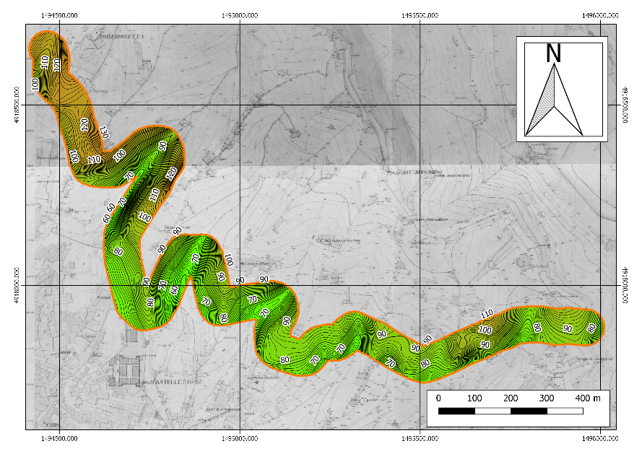
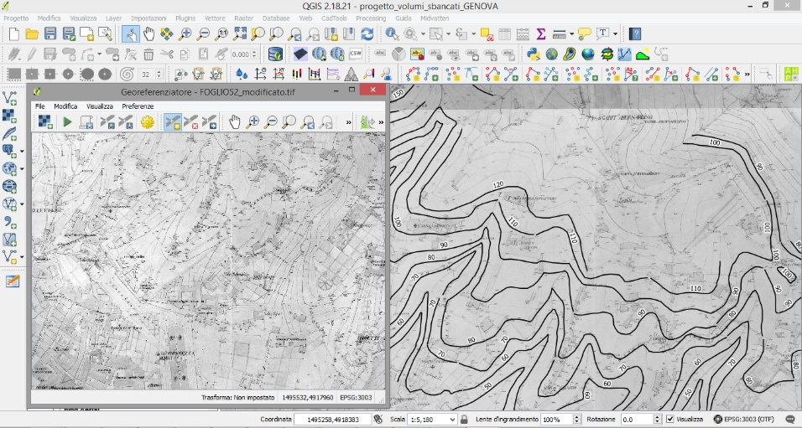
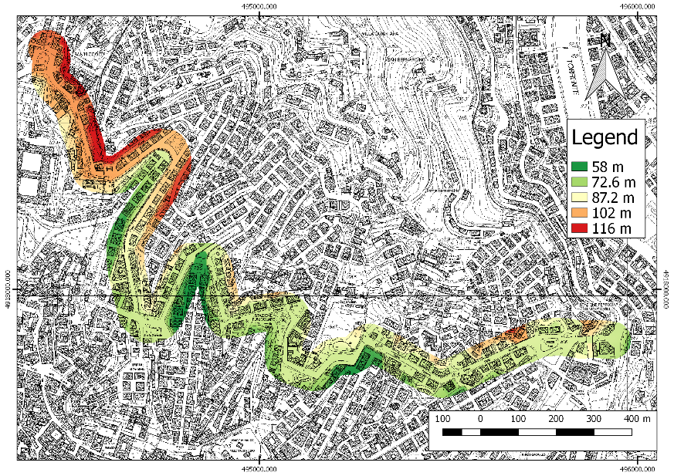
From old maps to
“antique” Digital Terrain Model
# 2nd step: Interpolating contour lines to obtain “antique” DTM
# 1st step: Georeferencing and
manually digitizing contour lines
# 3rd step: Comparing the “antique” DTM with new LIDAR
3
Notes:
Georiferimento con QGis

Slide 5
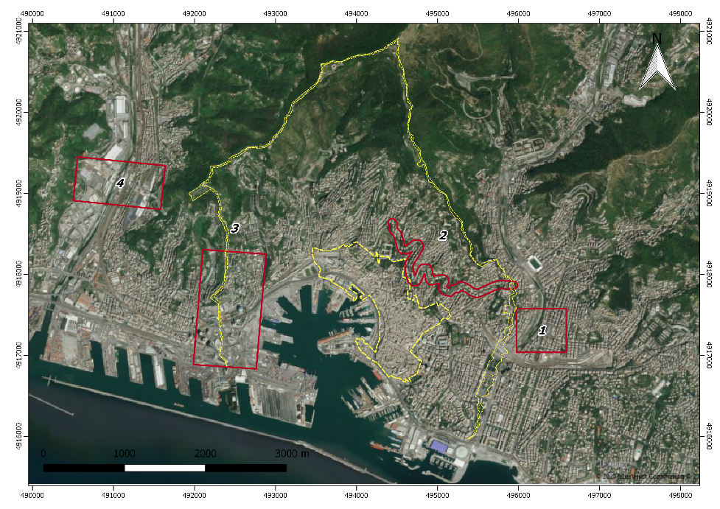
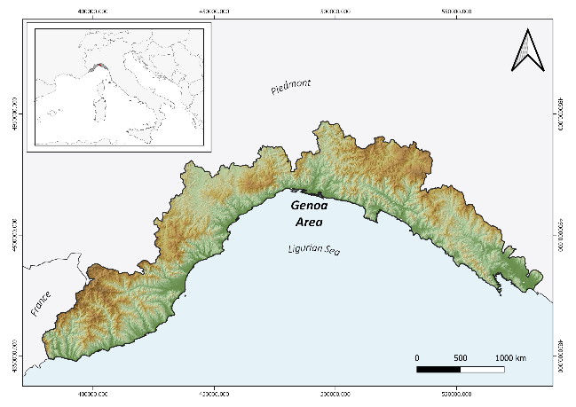
Study area: Centre of Genoa Municipality
Sant’Agata Old Bridge
Circonvallazione a Monte (Eng → ‘Hilly Beltway’)
San Benigno Promontory
Polcevera Valley (Ponte Morandi area)
4

Slide 6
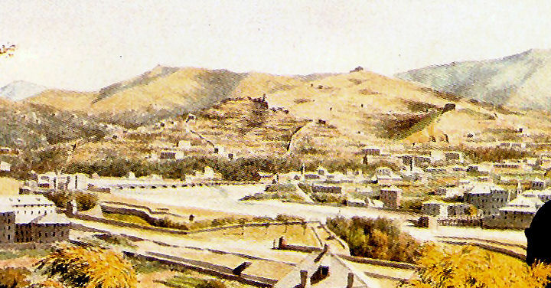
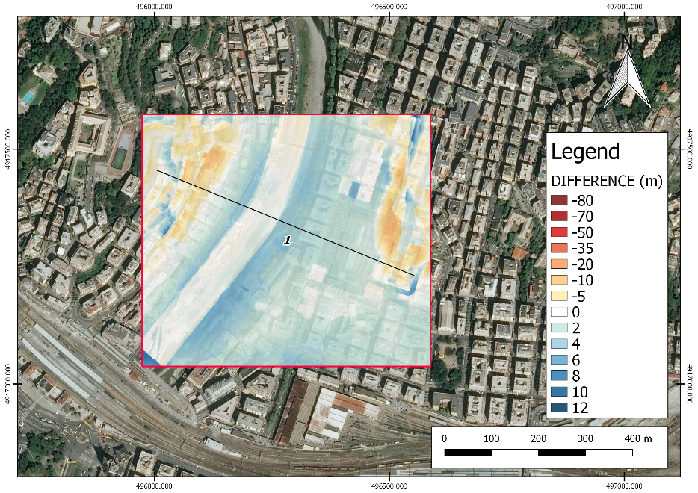
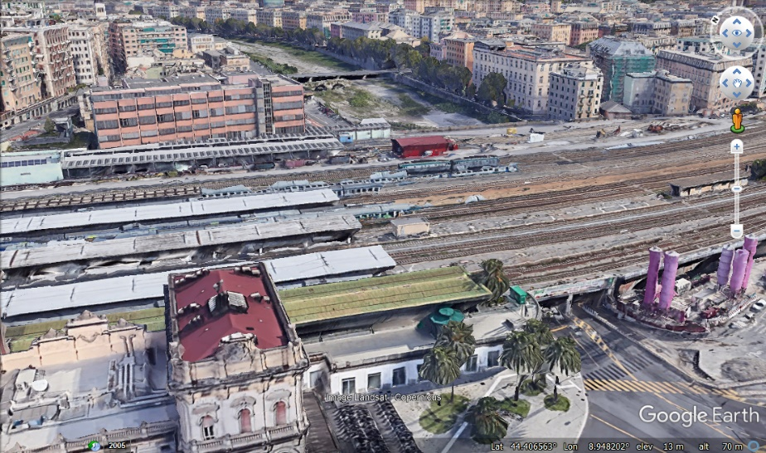
Sant’Agata Old Bridge
New surface
Old surface
5

Slide 7
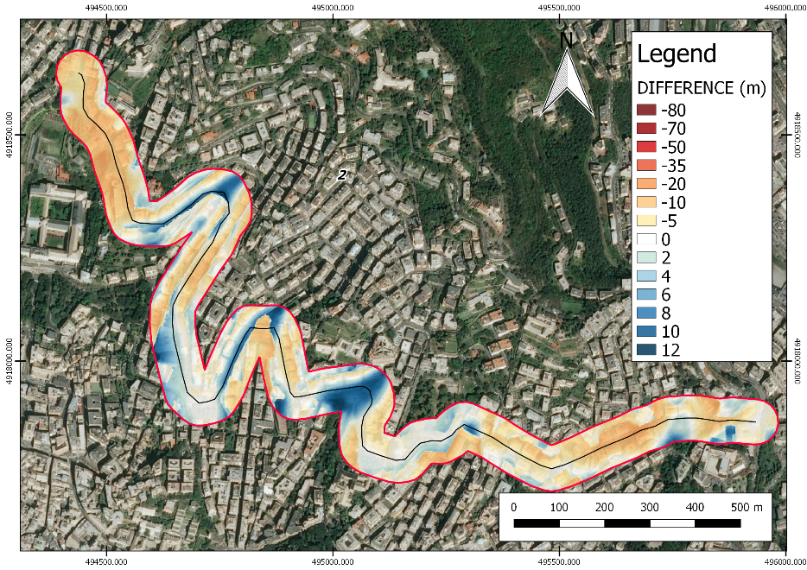
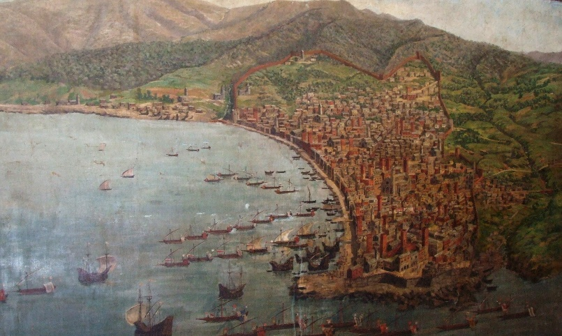
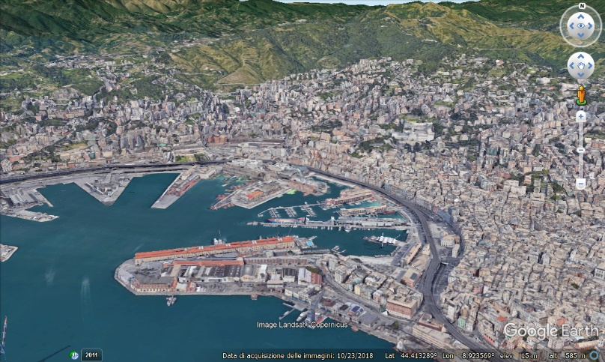
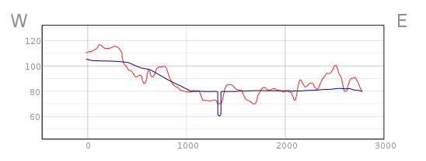
Circonvallazione a Monte
New surface
Old surface
6

Slide 8
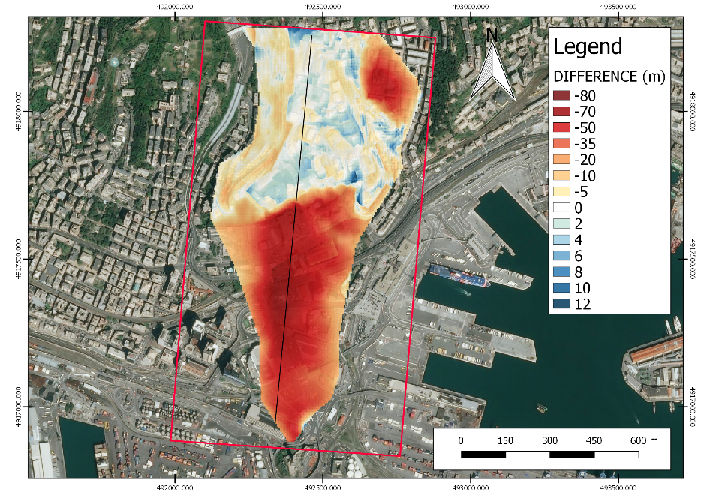
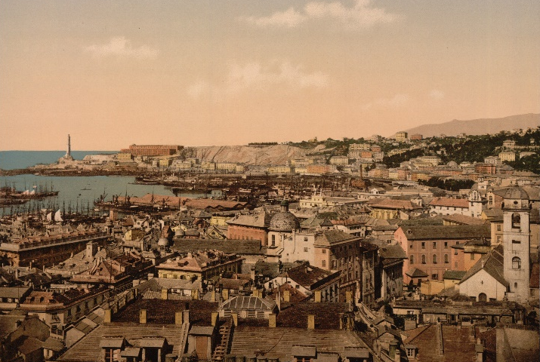
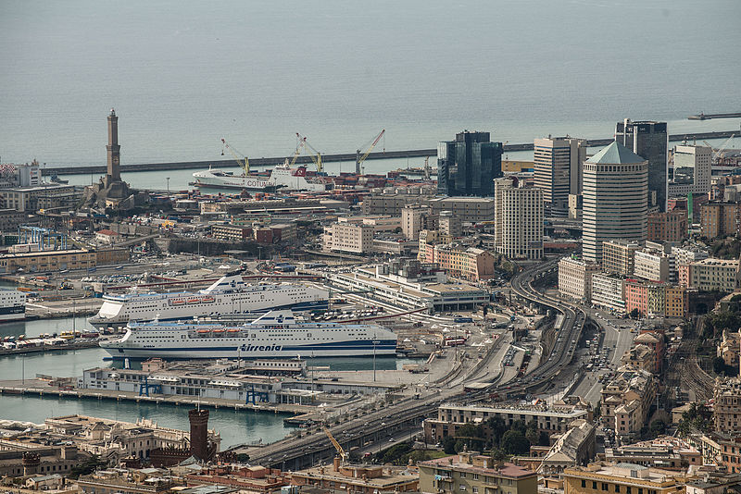
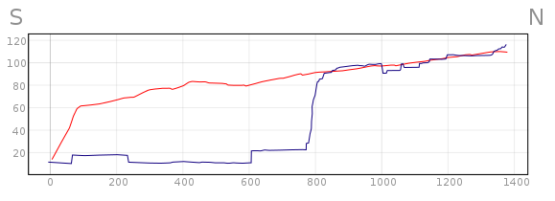
San Benigno Promontory
New surface
Old surface
>70 m
Di Alessandro.photographer - Opera propria, CC BY-SA 4.0,
https://commons.wikimedia.org/w/index.php?curid=43175960
7

Slide 9
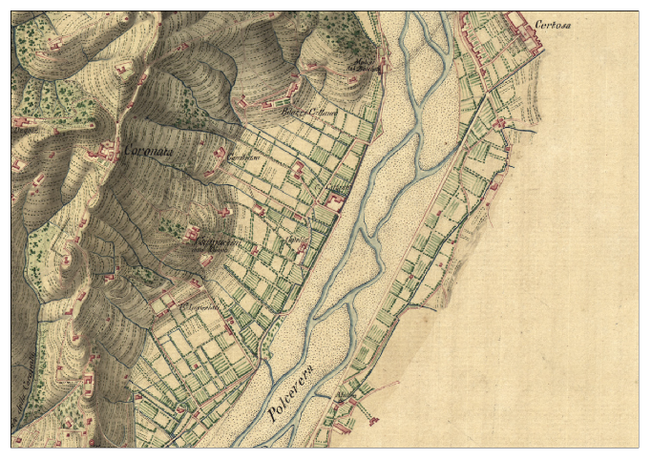
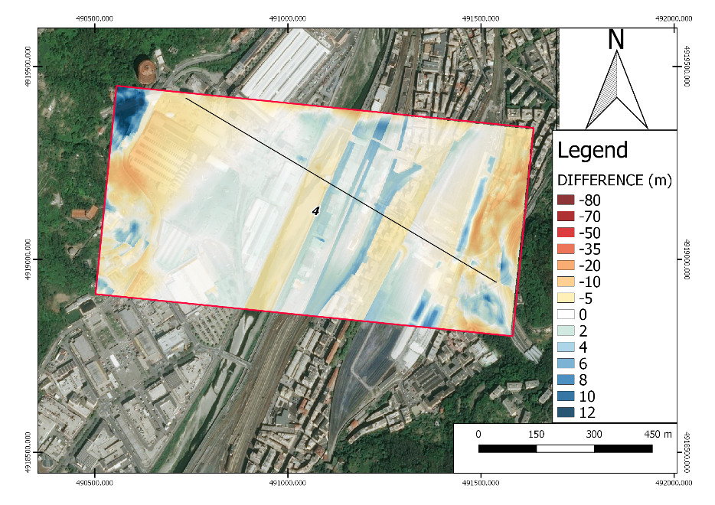
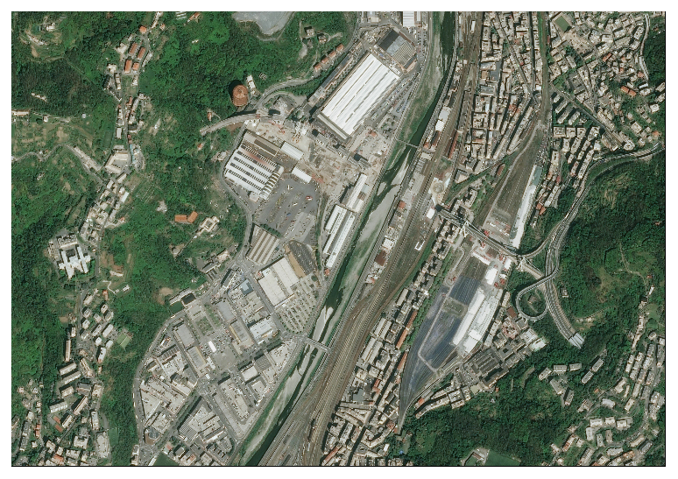
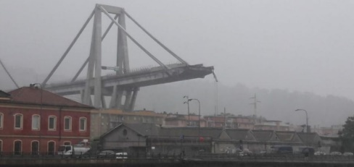
Polcevera Valley
New surface
Old surface
Morandi Bridge collapsed in 2018
8

Slide 10
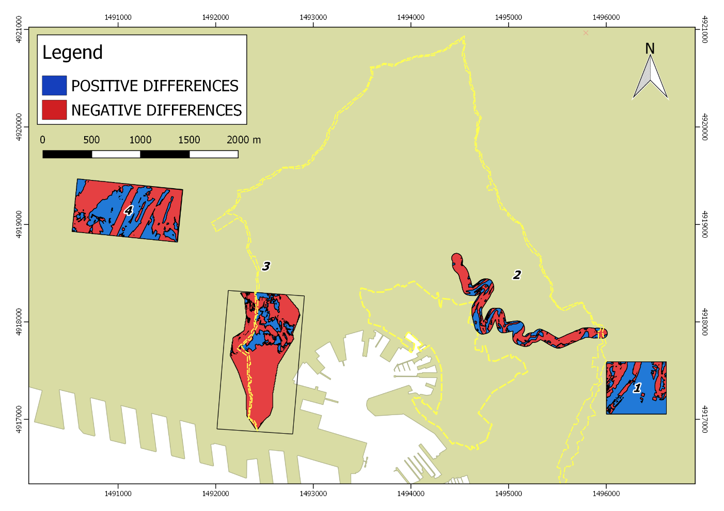
Final Overview
Good representation of changes occurred during two centuries of industrialization and urbanization
Good georeferencing (error = 5 – 15 m)
Old maps as useful tools for preliminary analysis in landscape and urban planning
9

Slide 11
THANK YOU FOR YOUR ATTENTION
martino.terrone@edu.unige.it
Faccini@unige.it
guido.paliaga@irpi.cnr.it
pietro.piana@edu.unige.it
10

