Slide 1
The topological origin of anomalous transport: Persistence of β in the face of varying correlation length. And the role of preferential flow
Yaniv Edery
IIT - Israel Institute of Technology
www.pmvlab.com
yanivedery@technion.ac.il

Slide 2
Lab tour
The group
Our labs focuses on visualizing flow, reaction and deformation in porous media. We create our own porous material and match the refractive index of it with various fluids, if it's a wetting or a non wetting phase. By doing so we manage to see through the transparent porous material and saturating fluid, thus allowing us to visualize fluorescent beads and fluorescent dye as they advanced and percolate within the porous material. We visualized our system using confocal microscopy and ultrahigh speed cameras thus allowing 3D reconstructions of the material and the flow. We urge all of you to visit our website and see the work that being done in our lab.
We also have a lot of numerical and theoretical work, as can be seen in this presentation. For any question do email me.

Slide 3
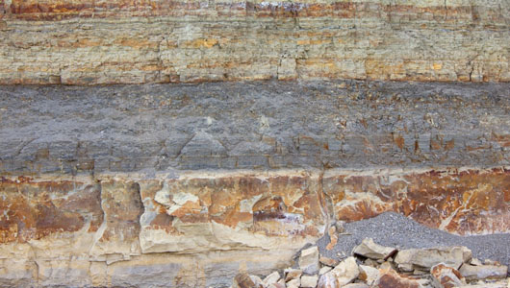
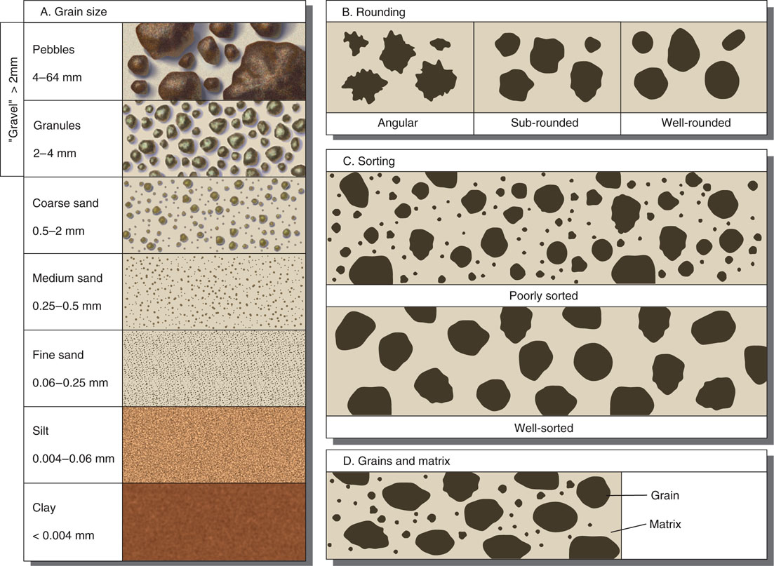
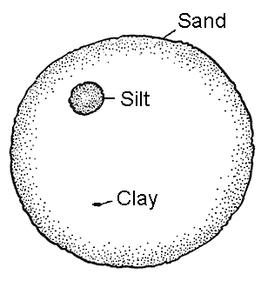
Pore size effect on porous media flows
Predicting the flow in a porous material is difficult mainly due to the large heterogeneity in conductivities throughout the porous material. This variation in conductivity leads to variation in local pressures and therefore variations in the velocity field. Thus creating a complicated flow pattern through the porous material which can affect various reaction patterns.

Slide 4
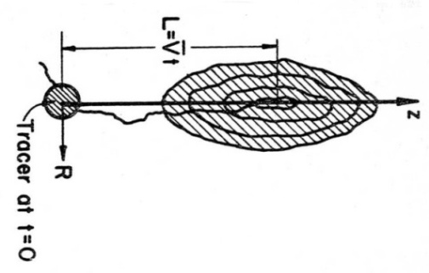
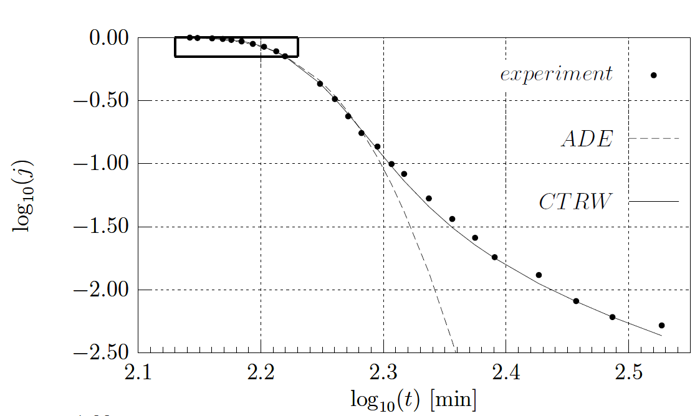
Anomalous transport in heterogeneous porous media
The variations in heterogeneities, as can be seen in the image to the left, leads to a complicated flow pattern marked by the blue dye. Often, we only have a breakthrough curve at the end of the experiment from which we have to deduce this flow pattern. This breakthrough curve is generally considered anomalous due to the heavy forward and backward tails of solutes as they leave the flow cell. This anomalous transport can be captured by a continuous time random walk where the mean flux, represented by the velocity and t1mark in green, is related to the main bulk of solute leaving the system. The heavy tail is characterized by the β exponent, marked in red circle around the probability density function and the forward tail in time. The t2 is the cut off time, leading the distribution function to be Fickian for long sampling times.
Levy and Berkowitz, J Cont Hydrol 2003
Notes:
The tails of the contaminenet are very important !

Slide 5
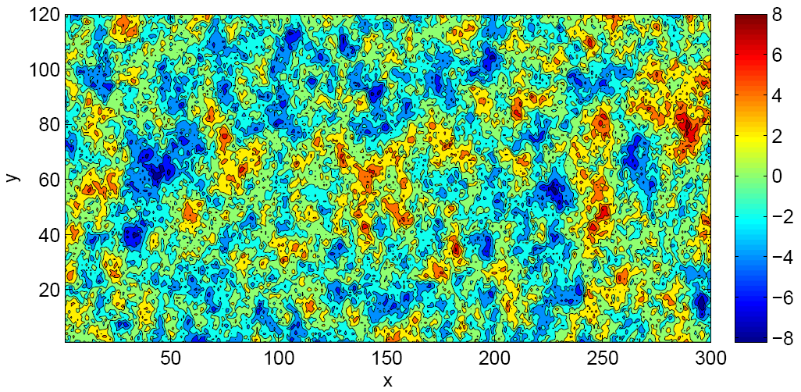
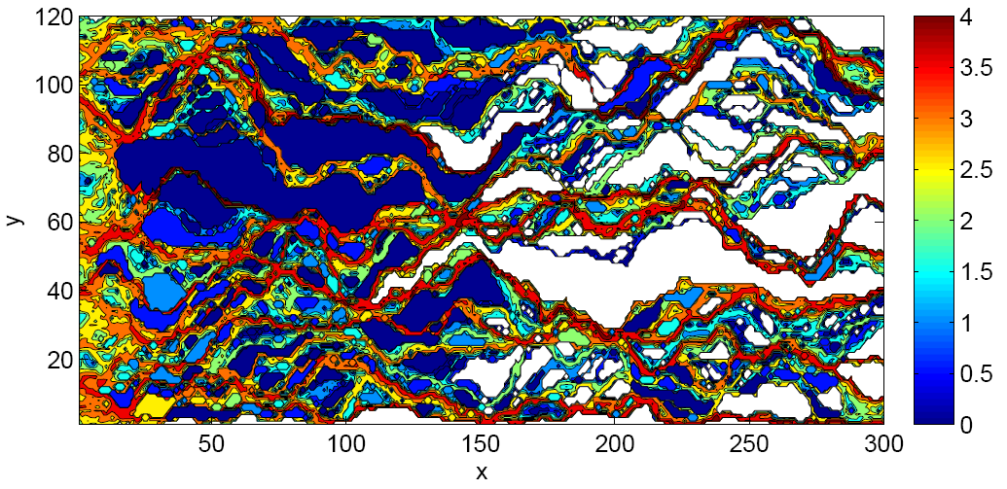
Natural Heterogeneity: Transport Patterns “Revisited”
Color bar in log number of particles visiting each cell
Spatial map of full K field; ln(K) variance σ²=5. Statistically homogeneous and isotropic, multivariate Gaussian field
Color bar in ln(K) scale
While we cannot repack this huge flow cell repeatedly and do the experiment, we can simulate a conductivity field repeatedly and run a simulation on it, as can be seen by the log of conductivity field to the left. Running a particle tracker code on that conductivity field will outline the preferential flow that can be seen in the next image which are very similar to what can be seen in the experiment. These preferential flow or unique transport patterns must be marked within the breakthrough curve as will be shown in the next slide.
Edery et al. [2014]

Slide 6
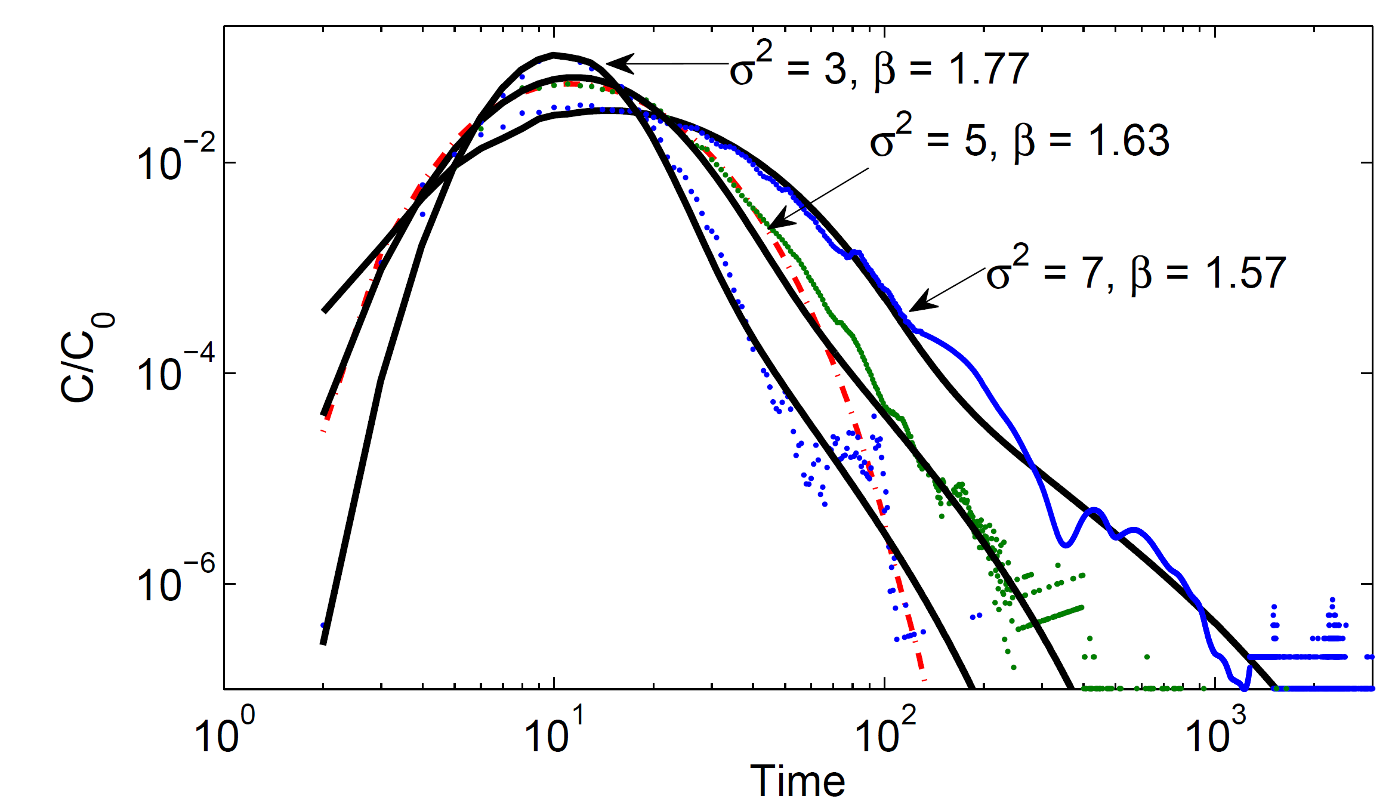
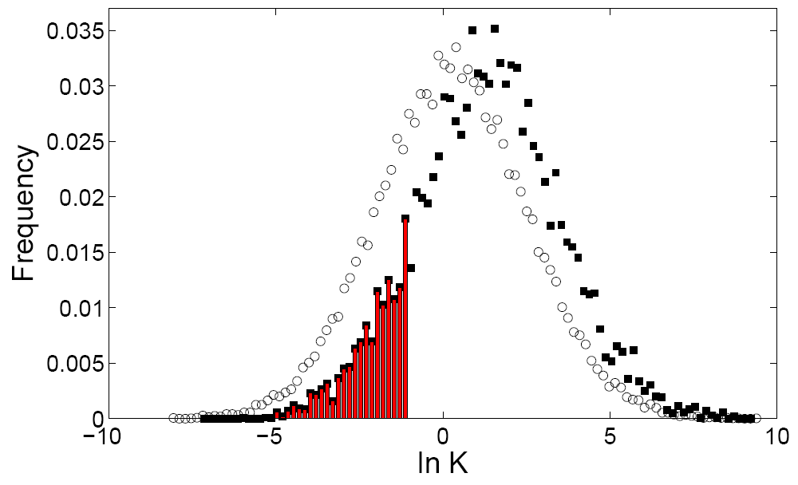
The Lagrangian vs. Eulerian
Break through curve
Conductivity Histograms
These unique flow patterns are manifested in the anomalous tail at the breakthrough curve to the left, and they are also correlated with the heterogeneity level marked by the variance. Weighing the conductivity values by the visitation of each particles shows that the particles are seeing a higher distribution of conductivities, as can be seen from the graph to the right. In the next slide using the weighted histogram of conductivities and transforming it to waiting time we get the exact temporal distribution function fitted in the breakthrough came.
Edery et al. [2014]
Ensemble (100 realizations) breakthrough curves (points) for three ln(K) variances and corresponding CTRW fits. Also shown, ADE for σ²=5 (v=3.4; average fluid velocity = 5.6).
Oscillations in tails caused by formation of limited set of preferential channels, leading to variations in the distribution of small numbers of particles arriving at outlet.
Open circles: normalized by the number of cells, for spatial map of full K field; σ²=5; mean ln(K)=0.26, skewness 0.03
Filled squares: preferential particle paths, weighted and normalized by number of particles visiting in each cell, {wK}; weighted mean ln(K)=1.43, skewness 3.89 Bars in red indicate frequency of LCTs.
Notes:
למה אנחנו מתעניינים בעקומי פריצה?
כי זה המדד הכמעט יחידי שיש לנו בשדה

Slide 7
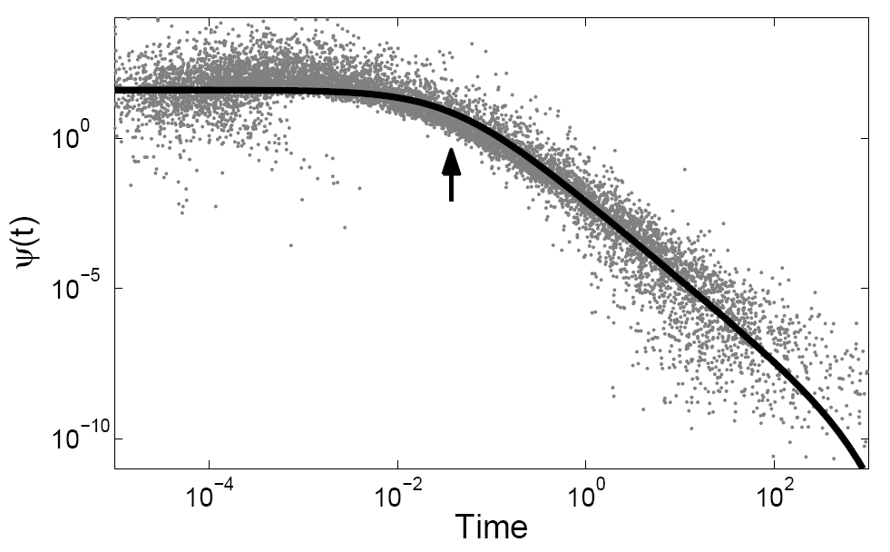
Natural Heterogeneity – CTRW Transport Description
Taking the histogram weighted by particle visitation from the previous slide and transforming it to waiting time we get the distribution function used to fit the breakthrough curve. Thus showing us that the breakthrough curve represents the ensemble of particles unique sampling the conductivity field.
This was done in our previous work from 2014 yet many questions remain open. Specifically, how does the correlation length that smooths the conductivity between adjacent affects this distribution function and preferential flows?
Edery et al. [2014]
Ensemble particle-weighted conductivity histogram (σ2=5, 100 realizations); based on conductivity histrogram, transforming to particle transition time distribution within cells, representing ψ(t) vs. t.
Solid curve shows the TPL with same values for breakthrough curve shown in inset.
Arrow marks t1, the onset of the power law region at t1 < t < t2, corresponding to ln(K) < -1.

Slide 8
Correlation length and preferential flows - Methods
To investigate the transition between Fickian to non-Fickian transport, as the correlation length changes, a set of numerical simulations is performed to produce a layout of 2D conductivity field distributed by a log-normal distribution with mean ln(k) ~ 0 and variance σ² =5. This conductivity field is made of 120×300 conductivity bins (each with a size of Δ= 0.2, therefore, the field size is 24×60).
Each field is produced by a statistical homogenous and isotropic Gaussian field in the ln(k), with a dimensionless correlation length l/L, produced by an exponential covariance, that ranges from 5×10⁻³, weakly correlated, to 5×10⁻², strongly correlated, where L is the field length
For each correlation length, 1000 realizations where produced, and a stability test was done to verify the mean conductivity. Each realization had a deterministic pressure drop (ΔP=100) imposed from the inlet (left) to the outlet (right). Thus, the streamline for each realization is retrieved and from it, the local velocities, given that the porosity θ=0.3.
Each streamline realization is used to model solute transport by a standard Lagrangian, particle tracking model from which a break-through curve (BTC) is produced. For each realization, 10⁵ particles are flux-weighted at the inlet according to the inlet permeability distribution.
The BTCs are produced for each simulation by registering the rate of particles at the outlet (after 300 unit length) in time for each realization of the heterogeneous domain. These BTCs represent a cross-sectional temporal distribution for particles arriving from various preferential flows. As such, a BTC from a single realization seems abrupt and not continues since particles are funneled towards a preferential flow, and from each preferential flow, the funneled particles exit at different times [Edery et al., 2014]. To reach a continuous BTC flux of particles, the BTCs from the 1000 realizations are average. The averaged BTC is then normalized by the total number of particles, producing a normalized BTC. This process is reproduced for each correlation length in the study to allow comparable datasets.

Slide 9
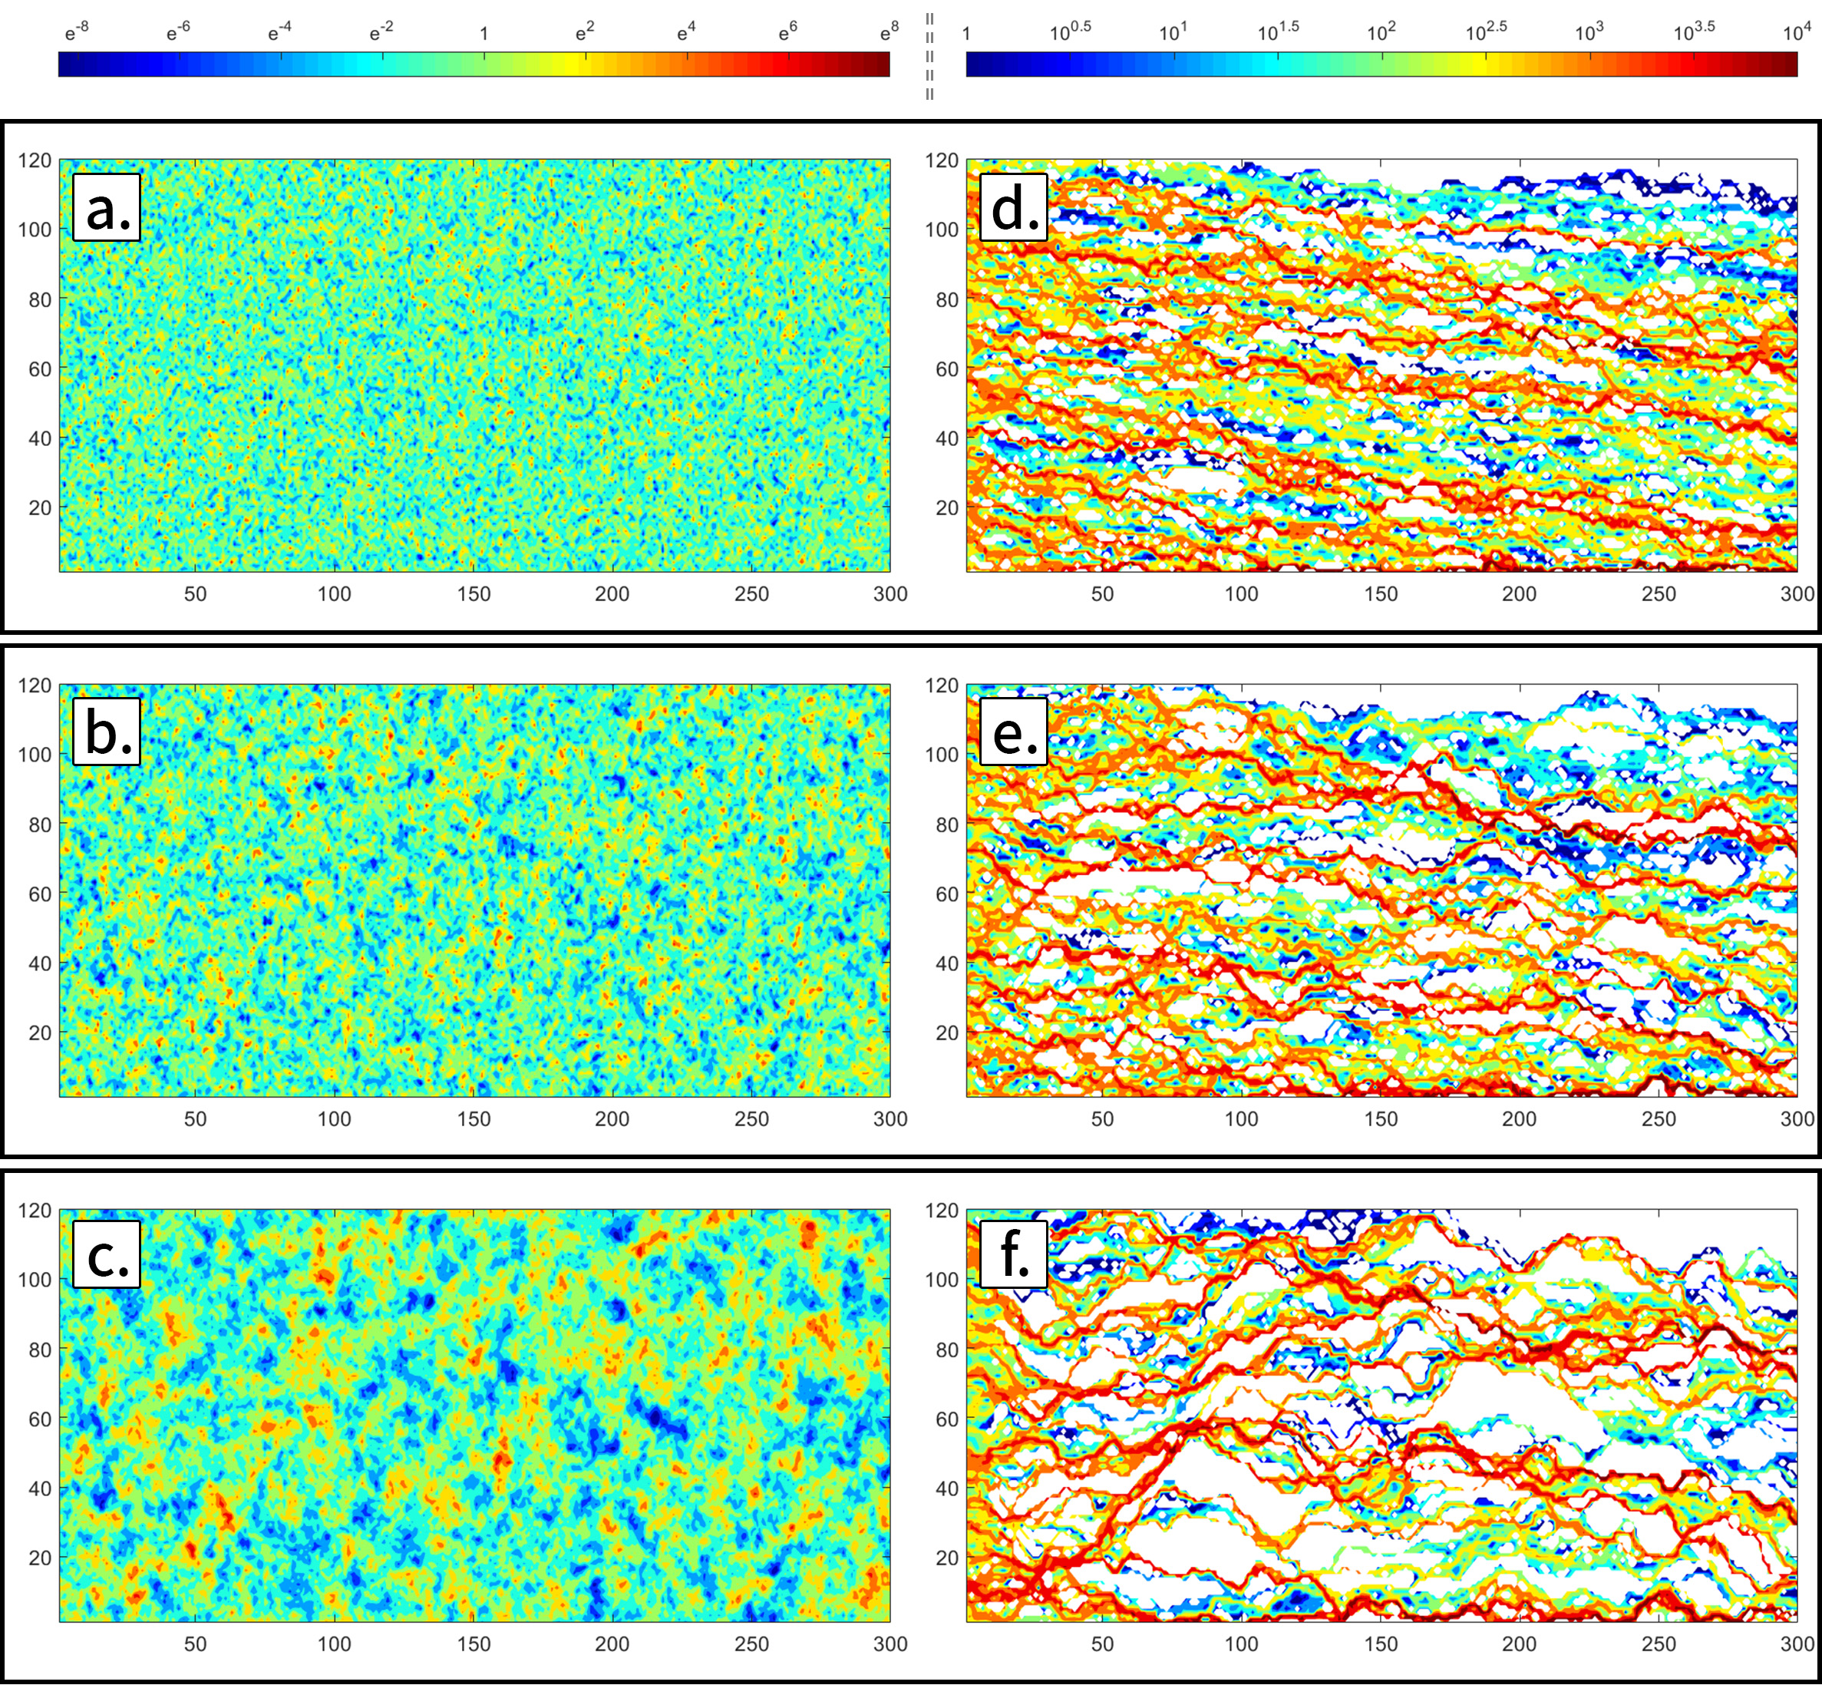
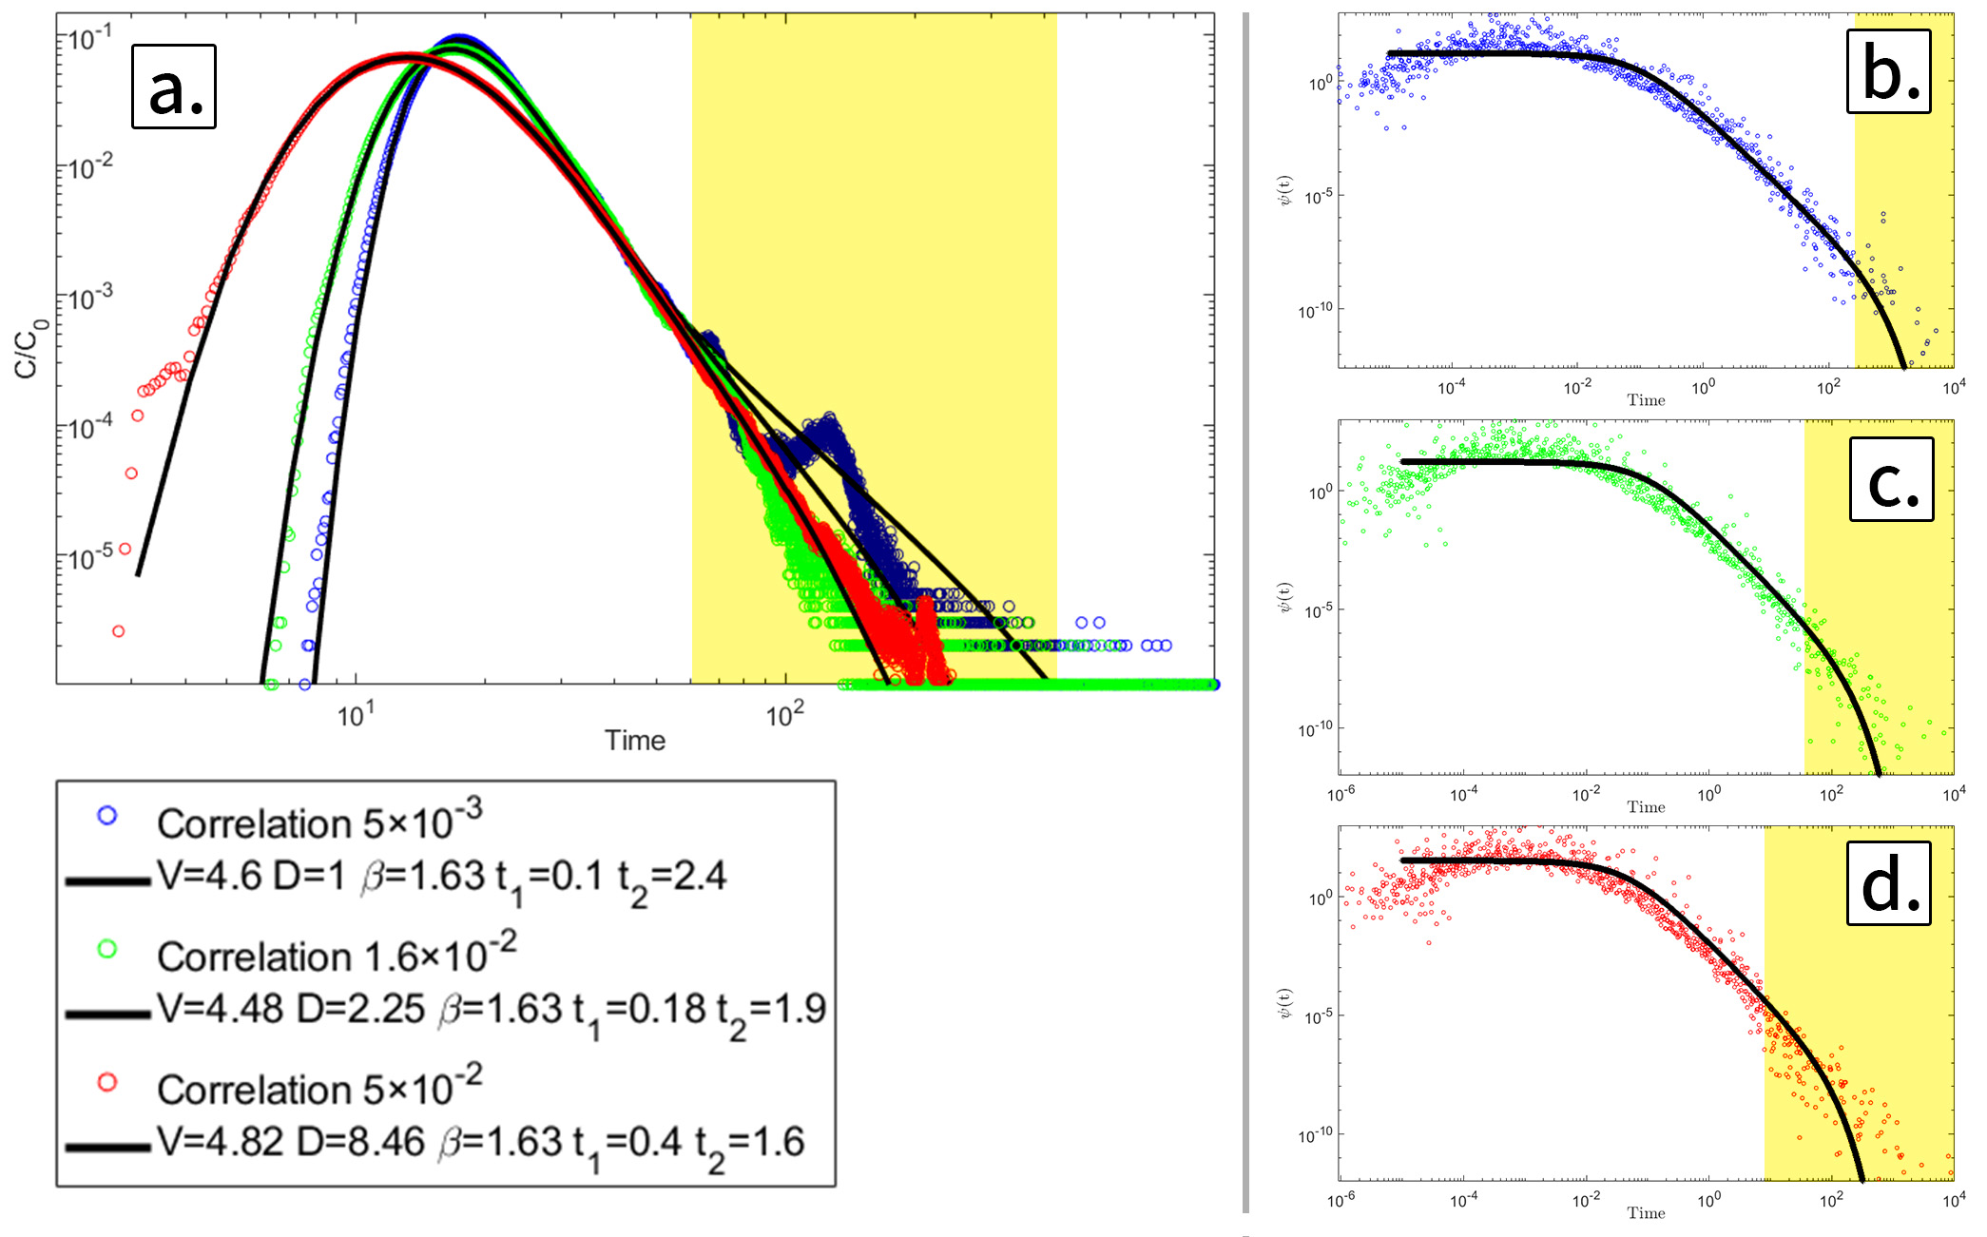
Correlation length and preferential flows
As can be seen from the right graph, increasing the correlation length generates large inclusions with similar conductivities. This effects the patterning of preferential flow as can be seen from the particle per bin graph to the far right. Increasing the correlation length leads to a more meandering and torturous preferential flow. While this correlation length increase effects considerably the preferential flow, the breakthrough curves changes manifests mainly in the tail and width. Looking at the probability density function, extracted as before from the conductivity histogram weighted particles, we can see that it is the t2 which decreases as the correlation length increases.

Slide 10
The topological origin of preferential flows
A careful look at the preferential flows and how they change shows something interesting; as the correlation length increases, the number of preferential flows decreases, yet there are preferential flows that are persistent in their location regardless of the correlation length. These persistent preferential flows (PPFs) that are shared for all correlation lengths are revealed by marking the cells visited by particles for the same realization field yet with varying correlation lengths simulation. These PPFs in the next slide, showed that these preferential flows are 40% of the entire domain, and between 50% to 80% of these PPF’s are commune between the various correlation lengths. This means that the PPF is dominant for various correlation lengths and are persistent in their location.
Probing the permeabilities within these PPFs weighted by the visiting particles shows that the PPFs low conductivities overlay on the total field weighted permeability, yet the PPFs high permeabilities overlay on the permeabilities of the total field un-weighted permeability distribution for all correlations.
The mean and variance of the weighted permeabilities on the PPFs coincide with this finding, the variance is smaller while the mean is between the weighted and unweighted mean, and both are associated with the correlation length increase. Therefore, these preferential flow locations are common for all correlation length, not due to the absolute permeability value at their path, but rather by the permeability location and relative value, or in other words, by the topological arrangement of these permeabilities.
This finding is verified for 100 realizations and proved to be the case for all of them. The shared preferential flows for the same realization seed with varying correlation length is 35%-45% from the whole domain available for flow and between 50% to 80% of the total preferential flows in total, while the absolute value of permeabilities changes between correlation lengths.

Slide 11
The topological origin of preferential flows
Edery (submitted) [2019]

Slide 12
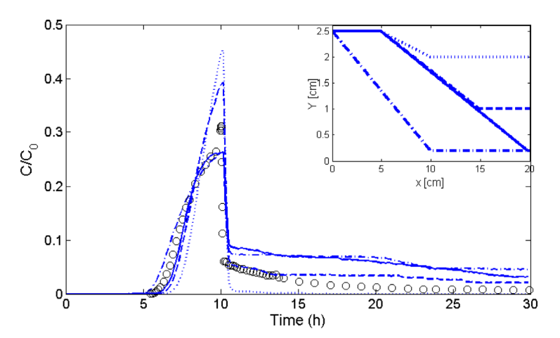
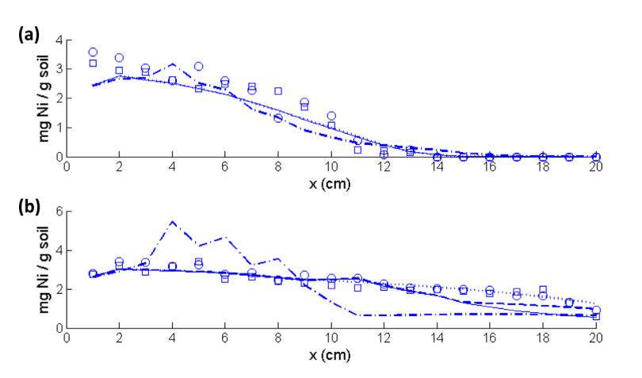
Reactive transport and preferential flows
While this finding is interesting by itself, proving the significant of conductivity topology and correlation with adjacent bins, it is extremely important when understanding the effect of preferential flows on reactive transport.
The main effect of preferential flow and permeability topology is on the breakthrough curve tail for tracer experiments, it will have an affect on the location and the overall amount of reaction for the reactive case.
In the left figures we see how only incorporating the funneling effect of preferential flow, allowed us to reproduce both the breakthrough curve and reaction distribution for a column experiment during chemical sorption.
Raveh-Rubin & Edery et al. 2015
Rubin et al. [2015]
Notes:
The nickle profile in time

Slide 13
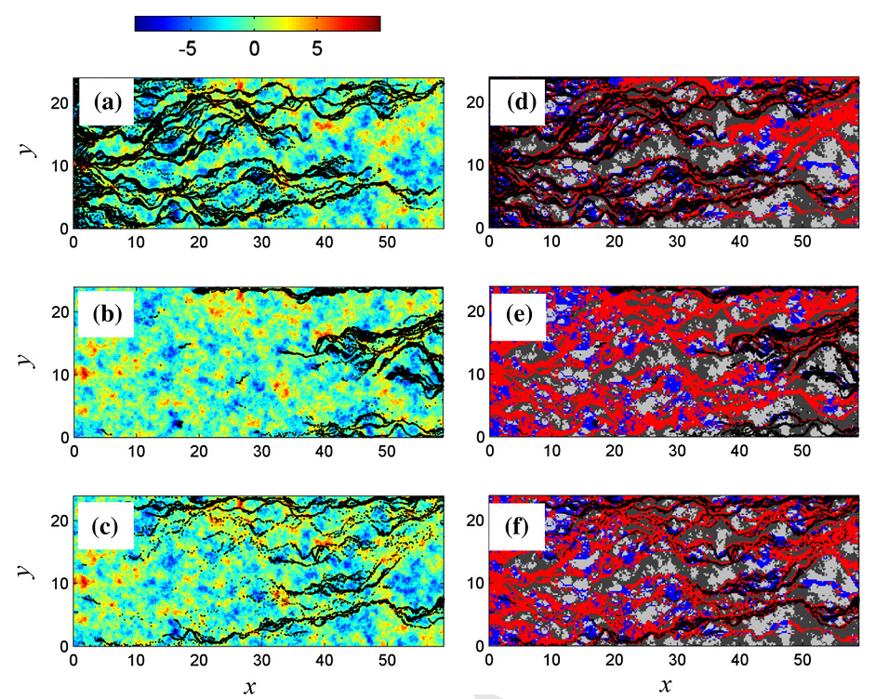
Reactive transport preferential flow
Introducing bimolecular reaction during particle flow within the conductivity bin layout, proved that reaction occurs in specific conductivities within the preferential flows and therefore these reactions are mainly localized in hot spots where the meeting between species is more probable.
In this study we managed to characterize these specific locations and their distribution proving again the importance of these preferential flow for reactive transport.
Edery et al. [2016]
Notes:
hese preferential pathways are formed mainly by high conductivity cells and generally contain an important component of (sometimes isolated and a relatively small number of) lower conductivity values. A key finding of our analysis is that while the former dominate the behavior, the latter are shown to provide a non-negligible contribution to the global number of reactions taking place in the domain for strongly heterogeneous media, i.e., for the largest investigated values of σY2. Reactions are detected across the complete simulation time window (of about 5.5 pore volumes) for the strongly advective case. When diffusion plays an important role, the reactive process essentially stops after the injection of a limited amount (∼2.5) of pore volumes.

Slide 14
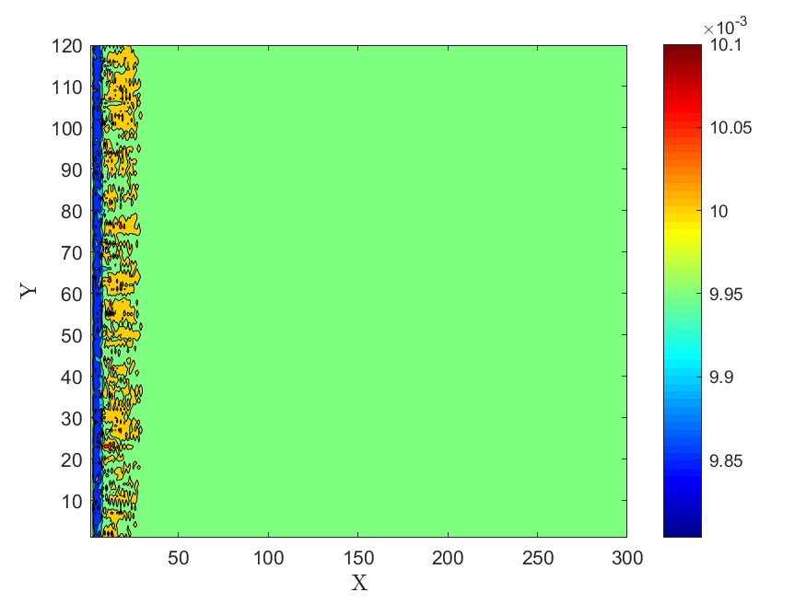
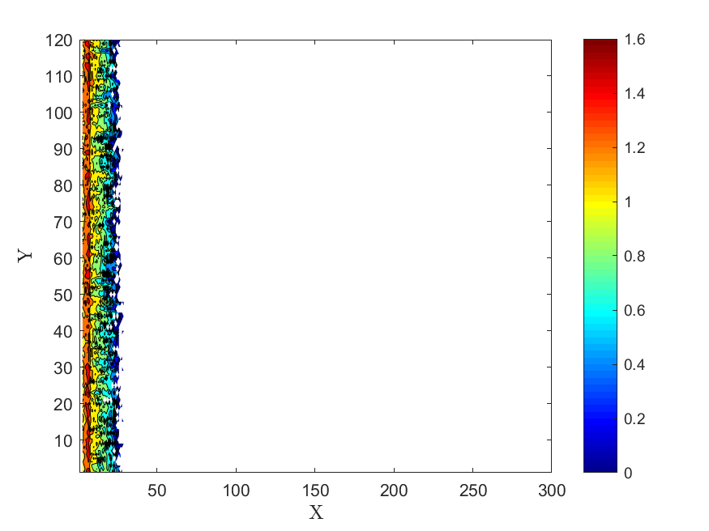
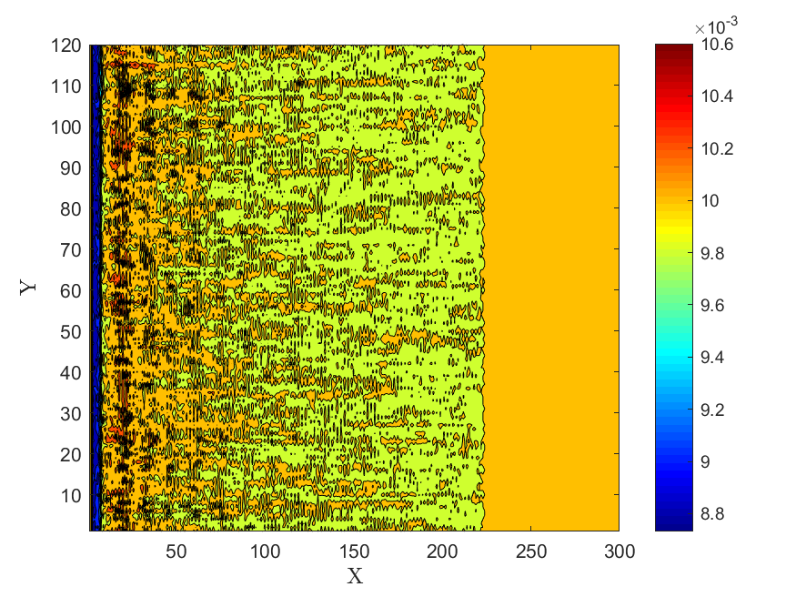
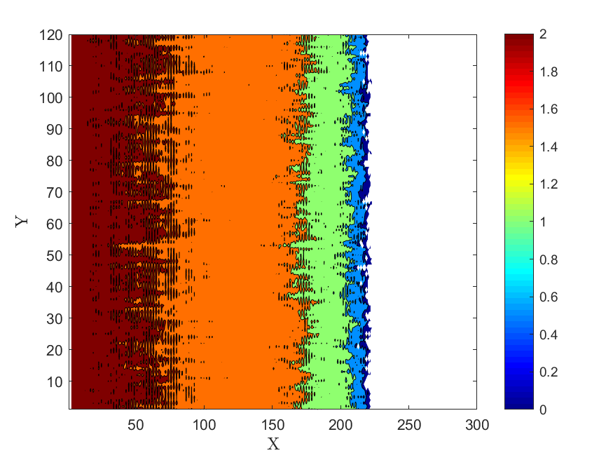
Dissolution\precipitation & preferential flows – var 0
Conductivity field – first time step
Particle distribution – first time step
Incorporating dissolution\ precipitation reaction within the same conductivity bin model, proved difficult as we needed to update the pressure distribution for each simulation. However doing so showed that even within a completely homogeneous, single valued conductivity layout, preferential flow emerge due to the nucleation and instability of the precipitation\dissolution mechanism.
Conductivity field – 10 time step
Particle distribution – 10 time step
Edery, Porta, and Guadagnini.
[In preparation]

Slide 15
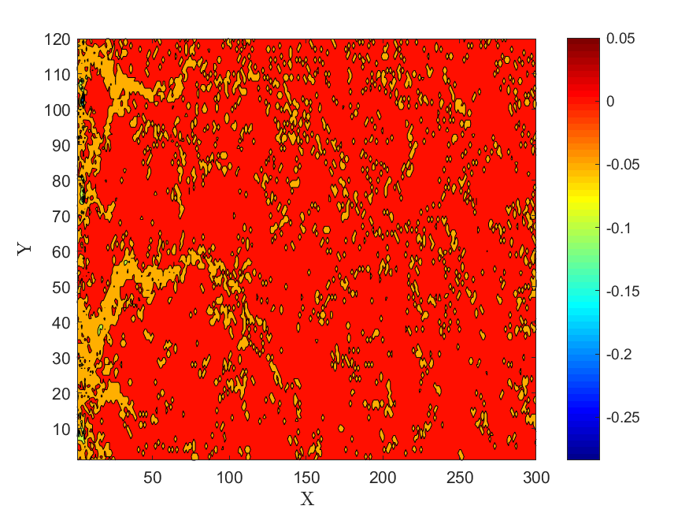
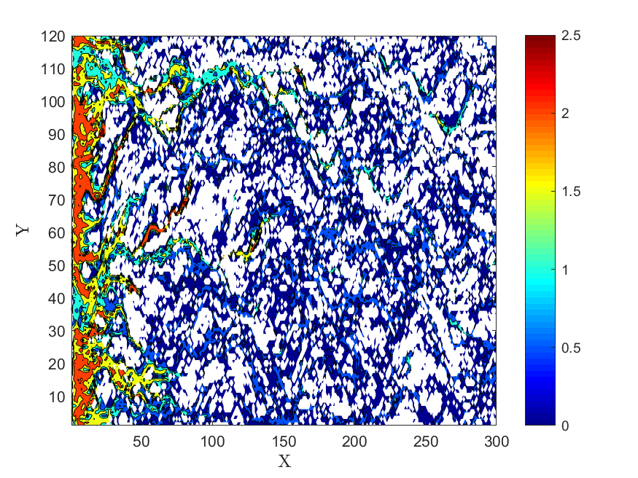
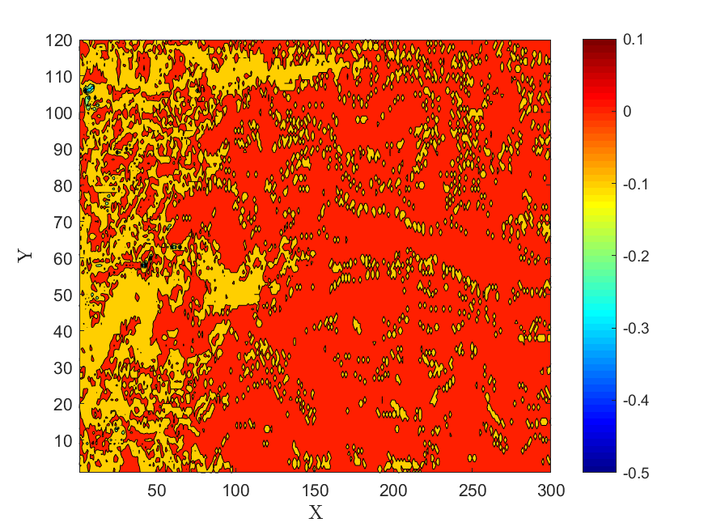
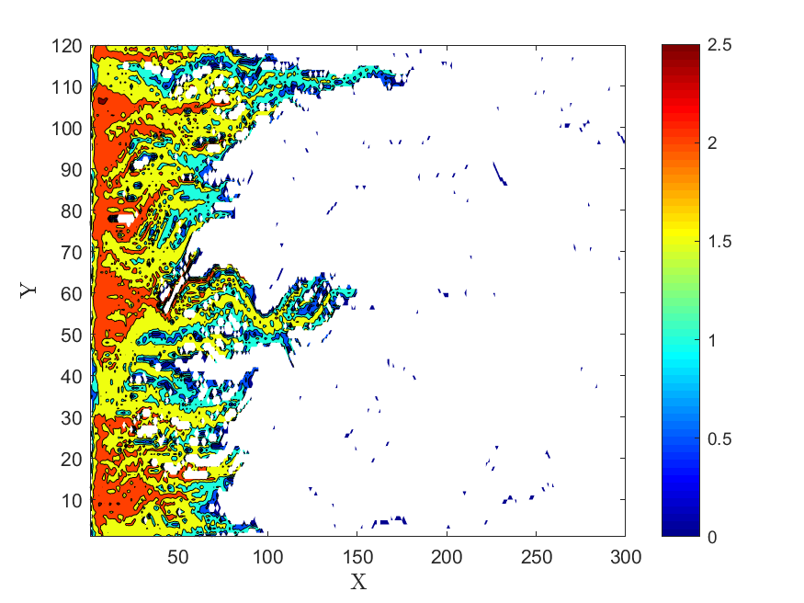
Dissolution\precipitation & preferential flows – var 1 & 5
Conductivity field change
Var 5
Increasing the variance of conductivities leads to the emergent preferential flows showed before. However it also effected the pattern of precipitation\ dissolution as the particles are funneled towards the preferential flow and mainly dissolves them making them more permeable to flow. Again this effect is acerbated with the increase in variance, as can be seen from the figures in the left.
Particle distribution
Var 5
Particle distribution
Var 1
Conductivity field change
Var 1
Edery, Porta, and Guadagnini.
[In preparation]

Slide 16
Summary
Preferential flows are inherent to porous media flow.
We can relate the effect of the sub-sampling of preferential flow to the BTC characteristics.
There is a relation between the topological nature of conductivity layout to the preferential flow route.
Preferential flows are influential to various reactive transport scenario.
Preferential flows effect the location and magnitude of bimolecular reaction.
They can explain sorption pattern layouts and mechanism.
And, preferential flows are both affecting and affected by precipitation\dissolution reaction.
1. Y. Edery, A. Guadagnini, H. Scher and B. Berkowitz, Water Resources Research 50 (2), 1490-1505 (2014).
2. S. Raveh‐Rubin, Y. Edery, I. Dror and B. Berkowitz, Water Resources Research 51 (9), 7702-7722 (2015).
3. Y. Edery, G. M. Porta, A. Guadagnini, H. Scher and B. Berkowitz, Transport in Porous Media 115 (2), 291-310 (2016).
4. Y. Edery, arXiv preprint arXiv:1906.07061 (2019).

