Slide 1
Disclaimer: The views expressed on this presentation are those of the authors and do not necessarily reflect the view of the CTBTO
Comparison study for different approaches in applying High-Resolution Atmospheric Transport Modelling based on validation with Xe-133 observations in Europe
Anne Philipp, Michael Schoeppner, Jolanta Kusmierczyk-Michulec, Pierre Bourgouin, and Martin Kalinowski
CTBTO, Vienna, Austria
Contact author: anne.philipp@ctbto.org
EGU2020: Sharing Geoscience Online 4-8 May, 2020

Slide 2
Background
Currently: The Comprehensive Nuclear-Test-Ban Treaty Organization (CTBTO) uses the FLEXPART model (a Lagrangian particle dispersion model; LPDM) with meteorological input from the European Centre for Medium-Range Weather Forecasts (ECMWF) and the National Centers for Environmental Prediction (NCEP) with 0.5° input and output resolution for their Atmospheric Transport Modelling (ATM).

Slide 3
Objectives
The Comprehensive Nuclear-Test-Ban Treaty Organization (CTBTO) investigates the best method to add the utilization of High-Resolution Atmospheric Transport Modelling (HRATM) in their operational and automatized pipeline
Supporting the decision process, the CTBTO accomplishes a comparison study with different approaches for applying HRATM.

Slide 4
Approaches
Using the Weather Research and Forecasting model (WRF) as “a step in between” to increase the meteorological input resolution from 0.5° to 0.1°, followed by the specified version FLEXPART-WRF.
Using the ECMWF meteorological input at 0.1° resolution with the operational ATM and produce output at 0.1° resolution.

Slide 5
Demonstration of WRF enhencement
Typical met data in 0.5 deg
Refined WRF output in 12 km
higher resolution, but computationally expensive

Slide 6
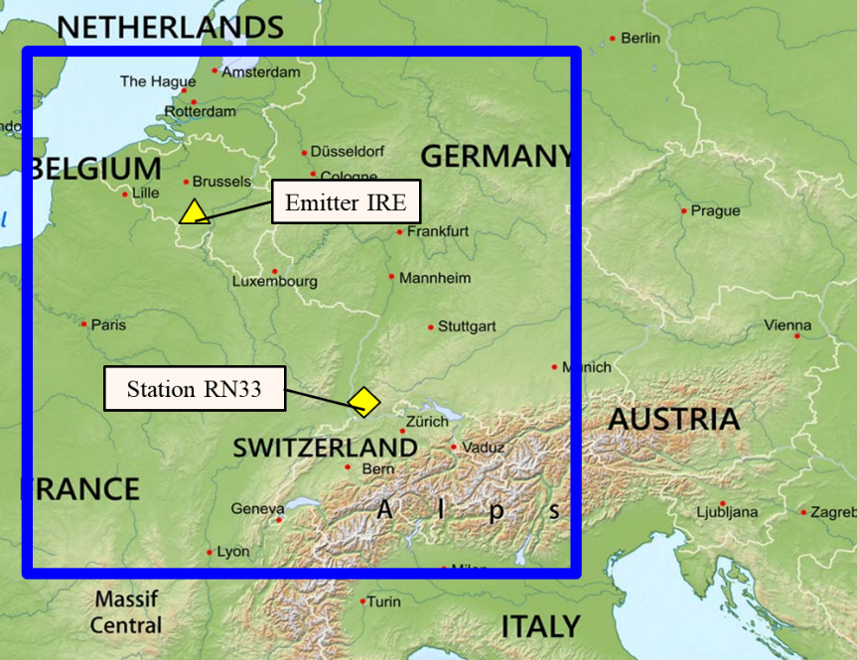
Initial study design
Selected episodes with Xe-133
Selected time periods with elevated concentrations of XE-133 at RN33.
Sampling periods start at 06 UTC and were 24 hours long. (Dates indicate the collection stop time.)
# | Period start date | Length | Highest concentration
1 | 2013 11 27 | 7 days | 26.8 mBq/m³
2 | 2014 01 19 | 11 days | 7.6 mBq/m³
3 | 2014 03 13 | 7 days | 16.1 mBq/m³
4 | 2014 04 04 | 6 days | 16.0 mBq/m³
5 | 2014 07 07 | 10 days | 6.1 mBq/m³
6 | 2014 07 26 | 7 days | 6.3 mBq/m³
7 | 2014 08 28 | 8 days | 7.3 mBq/m³
WRF domain parameters
Blue box:
Parent domain in 9 km resolution
Nesting:
2-level nests with 3 km and 1 km resolution around emitter and receptor
(Yellow markers are not related to the sub-domain size)
Simplest selection in physical parameterizations in WRF

Slide 7
Validation of initial configuration
Comparison of HRATM output resolution (50 km) to operational and established Flexpart ATM model with 0.5 degree resolution.
Input data were NCEP with 0.5° resolution
 | ATM 0.5° | HRATM 50 km
Correlation (1) | 0.85 | 0.51
Fractional bias (0) | 0.13 | 0.10
F5 (1) | 0.79 | 0.88
KS (0) | 0.27 | 0.19
Rank | 3.31 | 3.14
HRATM yields a rank comparable to standard Flexpart ATM, BUT:
→ higher resolutions led to lower ranks (not shown here)
 | ATM 0.5 deg | HRATM 50 km
Correlation (1) | 0.85 | 0.51
Fractional bias (0) | 0.13 | 0.10
F5 (1) | 0.79 | 0.88
KS (0) | 0.27 | 0.19
Rank | 3.31 | 3.14
 | ATM 0.5 deg | HRATM 50 km
Correlation (1) | 0.85 | 0.51
Fractional bias (0) | 0.13 | 0.10
F5 (1) | 0.79 | 0.88
KS (0) | 0.27 | 0.19
Rank | 3.31 | 3.14
HRATM yields a rank comparable to standard Flexpart ATM

Slide 8
Conclusions on first results
→ still simplest physical parameterizations selected
→ WRF domain not well enough defined
→ WRF crashes for random dates
→ no nudging and therefore WRF period was splitted

Slide 9
Next steps
Finding optimum settings for HRATM with another case study by applying HRATM to the DPRK test site:
with different meteorological input data (ECMWF/NCEP)
with different setup of domains (1, 2 or 3 domains)
with different physical parameterizations
with and without WRF in between

Slide 10
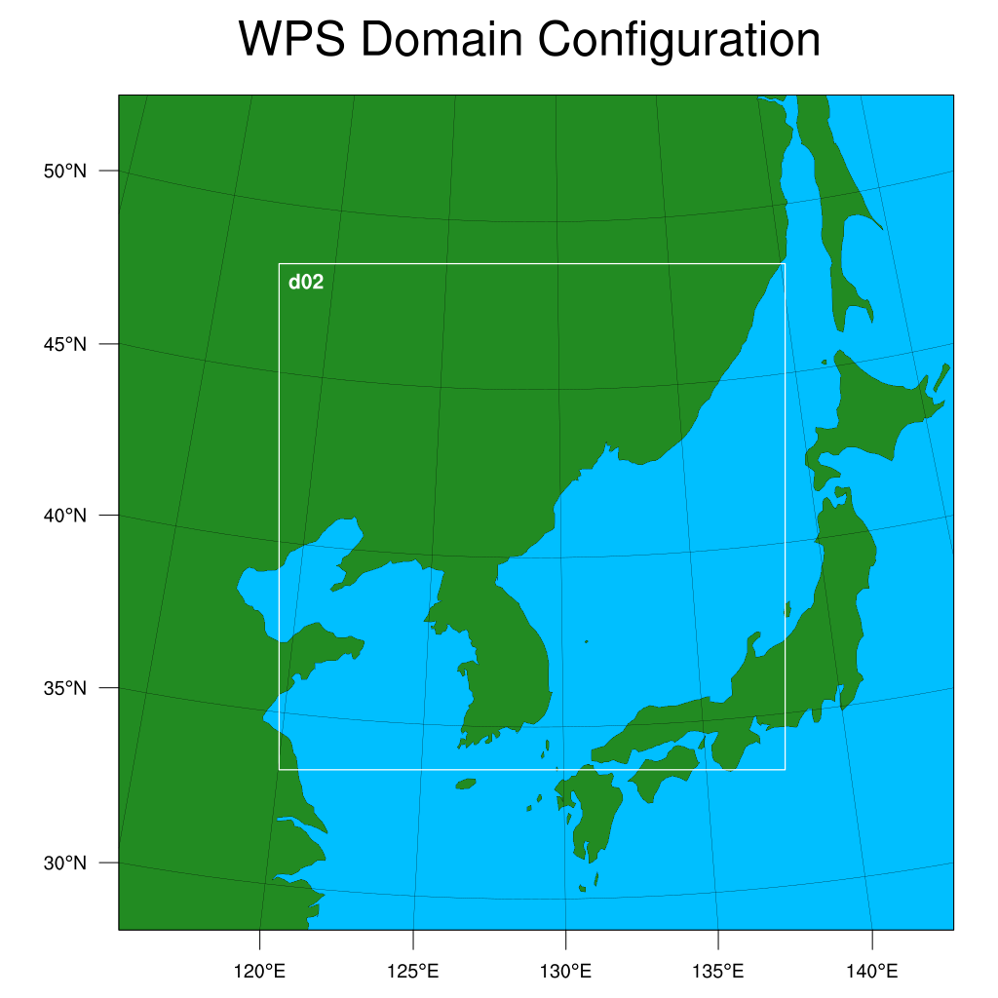
DPRK test site with HRATM
2 domains
3 domains
domain | d01 | d02
resolution | 27km | 9km
#grid points | 100 | 181
domain | d01 | d02 | d03
resolution | 27km | 9km | 3km
#grid points | 100 | 181 | 304

Slide 11
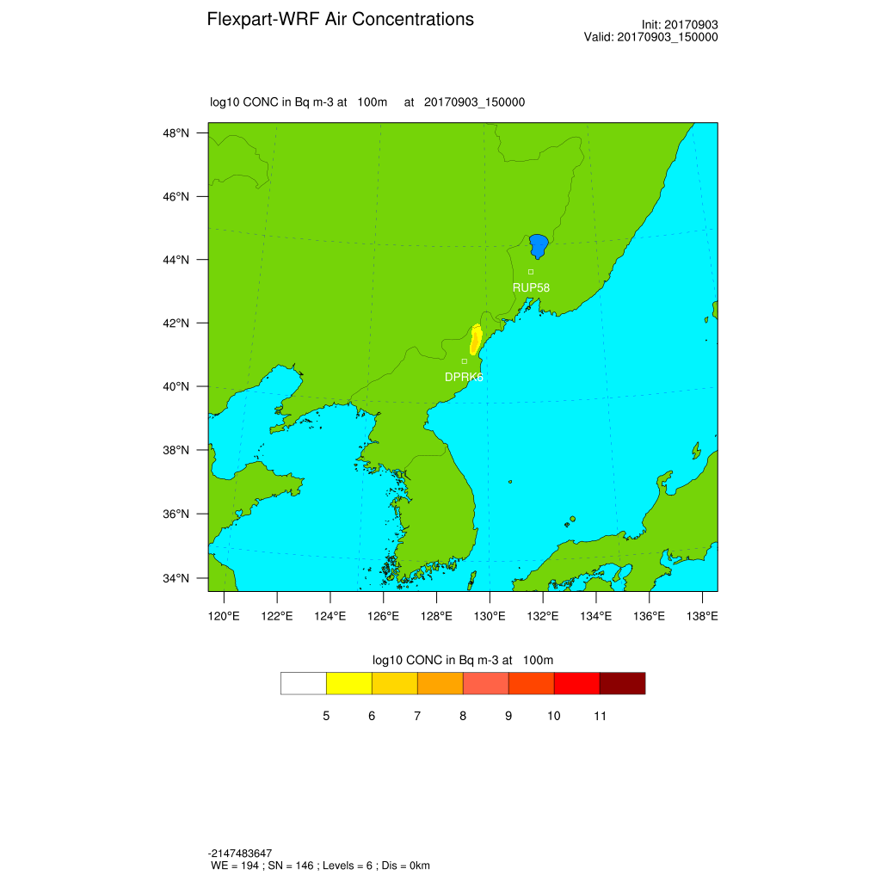
Difference between domains for NCEP 0.5°
2 domains
3 domains

Slide 12
Difference between input data
2 domains/NCEP0.5°
2 domains/ECMWF0.5°

Slide 13
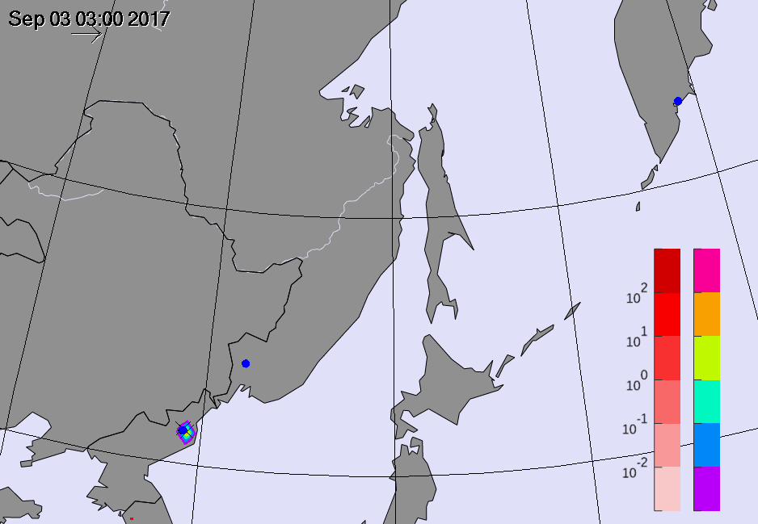
Difference in input data resolution
kd
Comparison of operational ATM results (without WRF) for ECMWF 0.5° (raindow colors) vs ECMWF 0.1° (red colors) input data :
Animated GIF; for viewing please change to presentation mode
lower blue dot: DPRK test site
upper blue dot: station RUP58 of the International Monitoring System (IMS) nobel gas system

Slide 14
Outlook
Evaluation of results by, e.g.:
investigating the dependency on input data resolution
comparing WRF results against measurements
comparing FLEXPART and FLEXPART-WRF results to measurements from IMS stations
The original study will be conducted as a validation case after the DPRK case is evaluated and the HRATM configuration is approved.

Slide 15
Thank you!

