Slide 1
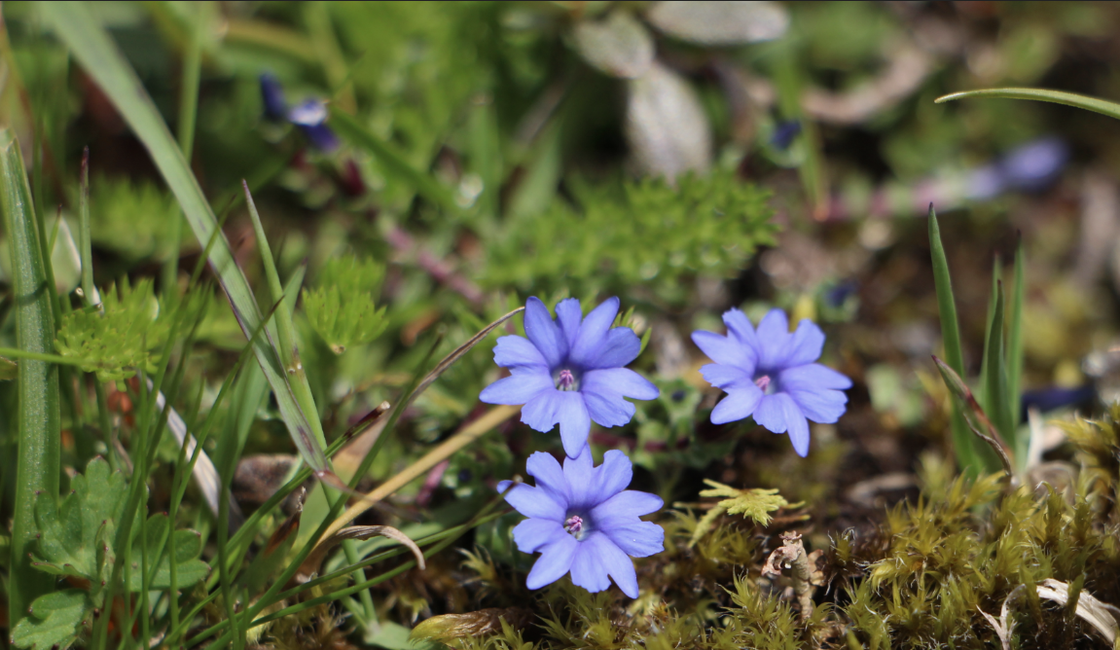
Prepared for Ecology Letters
Global controls of photosynthetic capacity: climate versus nutrients
Y. Peng, K.J. Bloomfield, L.A. Cernusak, T.F. Domingues and I.C. Prentice
yp3518@ic.ac.uk

Slide 2
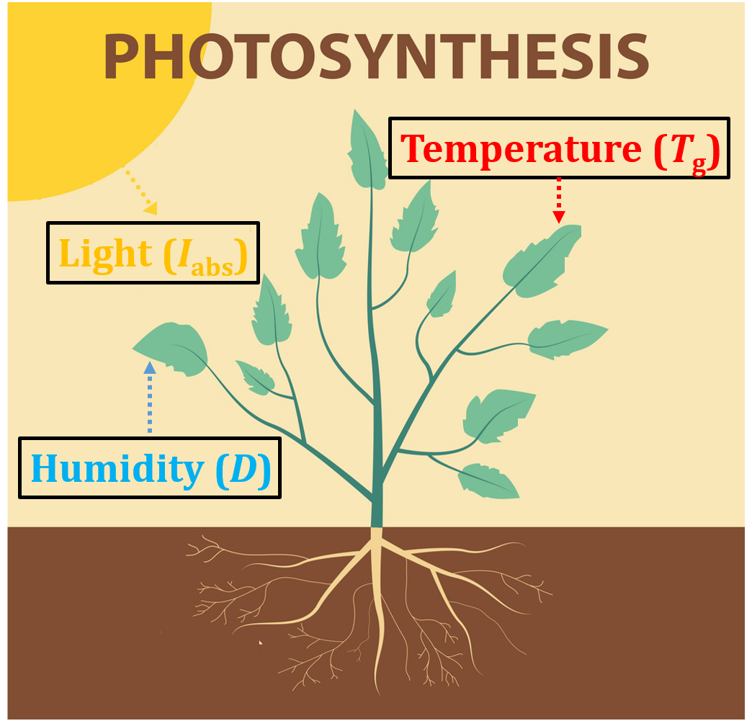
Introduction & Aims
Introduction
The control of photosynthetic capacity is a key process in the terrestrial carbon cycle.
Long-term controls of photosynthesis were critical and treated in different ways (climate vs. nutrients).
Aims
We aimed at predicting global responses of V_{cmax25} and J_{max25} to environmental constraints based on the coordination and least-cost hypotheses, and testing the sensitivity of predictions to nutrient supply.
Nutrients (N, P)
Notes:
For climates: (1) χ (Intercellular to ambient CO₂ concentrations) was positive to temperature but negative to humidity and elevations (Wang et al. 2017). (2)V_{cmax} and J_{max} (Maximum rate of carboxylation and electron transport) was determined by light, but also negative to T_{g} (Togashi et al. 2018).
For nutrients - V_{cmax} was constrained by specific minimum values of N_{area} and P_{area} (Domingues et al. 2010; Walker et al. 2014).

Slide 3
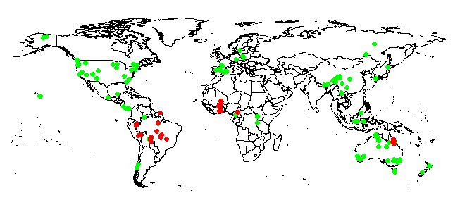
Methods
Least-cost hypothesis and coordination theory
χ = Γ*c_{a} + (1 – Γ*/c_{a}) ξ/(ξ + √D)
V_{cmax,o} = φ₀ I_{abs} [(c_{i} + K)/(c_{i} + 2Γ*)] √[1 – (c*/m)^{2/3}]
J_{max,o} = 4 φ₀ I_{abs} / √{1/[1 – (c*/m)^{2/3}] – 1]
276 sites, 5198 individuals: V_{cmax}, (J_{max}), N_{area}, P_{area}, LMA.
106 sites: Soil C:N, P, pH
Model bias comparisons
B = 100 (V_{cmax25}[pred] – V_{cmax25}[obs])/ V_{cmax25}[obs].
Prentice et al. 2014; Wang et al. 2017
Notes:
During photosynthesis, the intercellular CO2 concentration (Ci) is decreased comparing with ambient CO2 concentration (Ca), so that their ratio X is constrained within a limited range (0.5-0.9), and determined by growth environments (Temperature + vpd). Based on least-cost hypothesis, X is set by the interaction of photosynthesis and stomatal conductance, which minimize the sum of costs of maintaining required capacities for carboxylation and transpiration.
Then, following coordination hypothesis, carboxylation (Vcmax) and electron transport (Jmax) will co-limit photosynthesis. Vcmax is adjusted to growth conditions so that neither carboxylation and electron transport will be in excess, because a higher rate would produce additional maintenance costs, while a lower rate would under-utilize the available light. Therefore, it is expected that photosynthesis is determined by PPFD, Tg and vpd.
We also calculated model bias, which is then related to environmental variables.

Slide 4
Results
V_{cmax25} was proportional to light availability, and increased towards colder and drier environments – as expected due to higher investment in photosynthetic enzymes, or when stomata are more closed.
Predictor for V_{cmax25} | Theoretical value | All species coefficient R² = 0.11 | Site-mean coefficient R² = 0.28
ln (light) | 1 | 0.95 ± 0.20 –0.04 ± 0.01 NA | 0.91 ± 0.20
Temperature | –0.05 |  | –0.04 ± 0.01
ln (Vapor-pressure-deficient) | 0.02 |  | 0.24 ± 0.12
Predictor for J_{max25}/ V­_{cmax25} | Theoretical value | All species coefficient R² = 0.14 | Site-mean coefficient R² = 0.20
Temperature | –0.02 | –0.016 ± 0.003 | –0.019 ± 0.003
Notes:
Vcmax25 is direct proportional to PPFD, as expected due to additional electrons supported for photosynthesis.
Vcmax25 is negative to Tg, because in colder environments, there will be higher investment in photosynthetic enzymes (due to temperature dependency of rubisco). This is also supported by decline of light-use-efficiency (stocker et al. 2018) and increase of photosynthetic nitrogen use efficiency (Kattage et al. 2007) towards warmer environments, and increased Vcmax25 in higher elevations (Peng et al. 2020).
Vcmax25 is positive to vpd – in drier environment, leaf stomata was relatively more closed, which prevents excessive transpiration and accelerating photosynthesis. This can be observed when plants are allowed to acclimate to moderate drought (Manzoni et al. 2011; Medlyn et al. 2011; Crous et al. 2013; Zhou et al. 2016; Smith and Dukes, 2017).
Overall, we see a nearly no difference for coefficient between theoretical values and observational values. Except for a steep observational slope of vpd…we think it might be because (1) the theory may not best capture low moisture condition, which often goes higher vpd and further decreasing leaf stomal conductance (2) the lower vpd sites may sometimes be corresponded with wet tropical regions (related to deeper soil and strong water holding capacity), and this will have lower leaf P due to acid and/or low P soils (more detailed in next page) – therefore the actual Vcmax25 here (in such low vpd sites) may be constrained by low P status. Considering those two possible “outliers” in low and high vpd, the observed vpd slope will be steeper than expected.
We also see that site-mean shows much better fitted performance than all-species data, suggest that the climate variables could explain more variability of photosynthesis between communities rather than within communities.

Slide 5
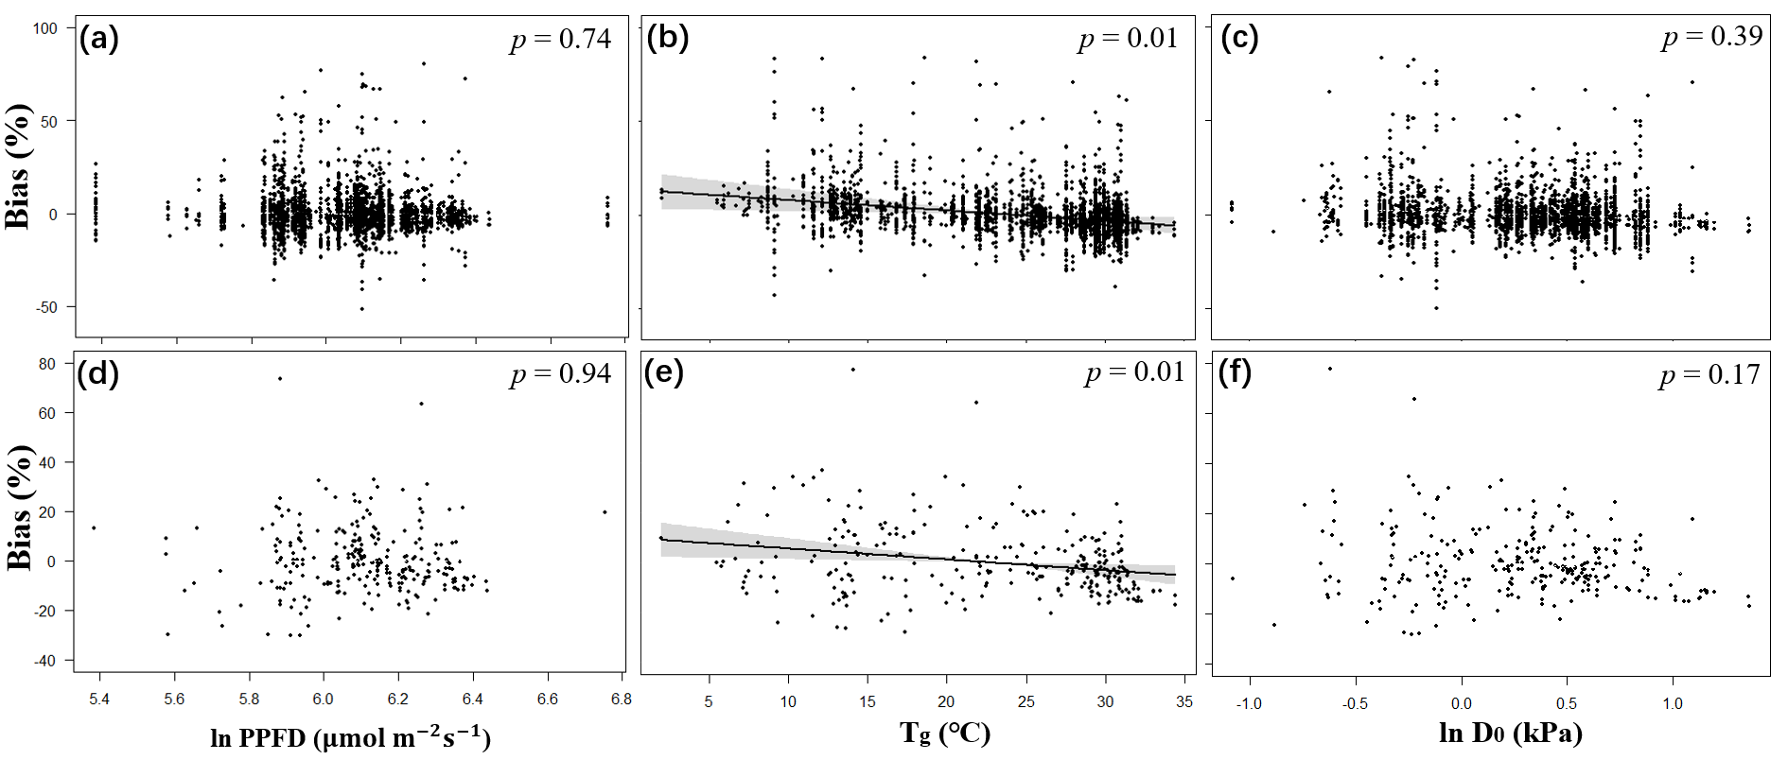
Results
The bias of V_{cmax25} was only negative to temperature, reflecting the theoretical slope of temperature steeper than observation slope - due to the difference between (predicted) air temperature and (actual) leaf temperature.
Notes:
It is not surprised that in higher temperatures, photosynthesis will be slightly be underestimated. Because our theory has considered as growth temperature, when air temperature is used as a proxy for leaf temperature – therefore, causing an underestimation of slope.

Slide 6
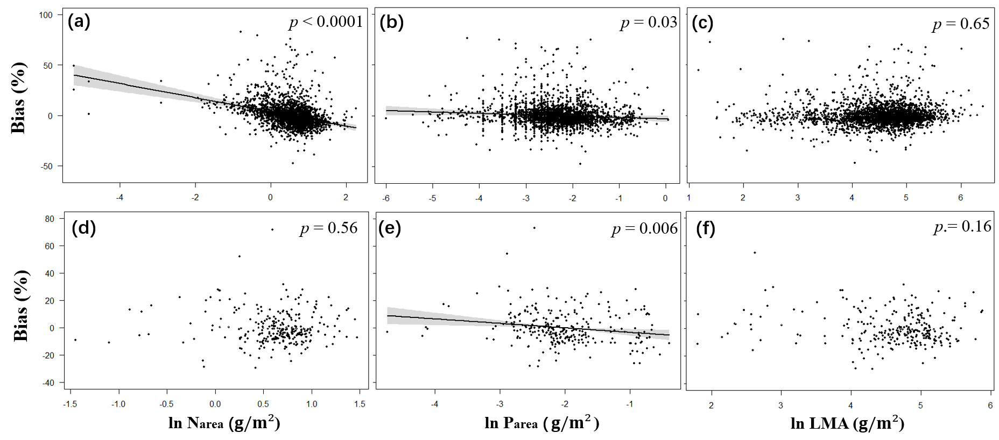
Results
Statistical models for photosynthesis overestimated V_{cmax25} in low-P leaves. P_{area} is further positive to soil P and pH.
A relationship of model bias to leaf N only appears in the all-species analysis, and no relationship shown between leaf N and soil C:N ratio.
Notes:
We proved that model bias is strongly negative to Parea, and then, Parea is further positive to Soil P and pH. This suggests a great dependency of Vcmax25 on P availability as shown in tropical forest….
However, the relationship between Vcmax25 and Narea is robust, and stable…because large amounts of N invested in Rubisco and other photosynthesis enzymes…we did not see a bias related to N in site-mean, and no relationship found between leaf N and soil C:N, suggesting that N may not be a necessary predictor in the theory of photosynthesis prediction. However, a bias found at site-species…this can be accepted, because there has been a light gradient of change in N and Vcmax25 from top to understory, in previous studies. It is possible that, for example, in top of canopy, the plants with extremely high N (under competitions), will make plants to over-invest Rubisco to support higher rate of Vcmax25…therefore, such a tendency will cause an overestimation of Vcmax25 in high N leaves within communities.

Slide 7
Conclusion
Climates (T_{g}, D) and light availability (PPFD) are still the dominated drivers on photosynthetic capacity, supporting acclimation/adaptation of leaf photosynthetic traits.
There is a previously noted dependency of V_{cmax25} on P availability; but not the control of V_{cmax} by N availability that has been assumed in many models.

Slide 8
References
Domingues, T.F., Meir, P., Feldpausch, T.R., Saiz, G., Veenendaal, E.M., Schrodt, F. et al. (2010) Co-limitation of photosynthetic capacity by nitrogen and phosphorus in West Africa woodlands. Plant Cell Environ., 33, 959-980.
Peng, Y., Bloomfield, K. J., Prentice, I. C. (2020). A theory of plant function helps to explain leaf‐trait and productivity responses to elevation. New Phytol. doi: 10.1111/nph.16447
Prentice, I. C., Dong, N., Gleason, S. M., Maire, V. & Wright, I. J. (2014). Balancing the costs of carbon gain and water transport: testing a new theoretical framework for plant Ecol. Lett., 17, 82-91.
Smith, N. G., Keenan, T. F., Colin Prentice, I., Wang, H., Wright, I. J., Niinemets, Ü. et al. (2019). Global photosynthetic capacity is optimized to the environment. Ecol. Lett., 22, 506-517.
Stocker, B.D., Zscheischler, J., Keenan, T.F., Prentice, I.C., Peñuelas, J. & Seneviratne, S.I. (2018). Quantifying soil moisture impacts on light use efficiency across biomes. New Phytol., 218, 1430-1449.
Togashi, H.F., Prentice, I.C., Atkin, O.K., Macfarlane, C., Prober, S.M., Bloomfield, K.J. & Evans, B.J. (2018) Thermal acclimation of leaf photosynthetic traits in an evergreen woodland, consistent with the coordination hypothesis. Biogeosciences, 15, 3461-3474.
Walker, A. P., Beckerman, A. P., Gu, L., Kattge, J., Cernusak, L. A., Domingues, T. F. et al. (2014). The relationship of leaf photosynthetic traits–Vcmax and Jmax–to leaf nitrogen, leaf phosphorus, and specific leaf area: a meta‐analysis and modeling study. Ecol. Evol., 4, 3218-3235.
Wang, H., Prentice, I. C., Davis, T. W., Keenan, T. F., Wright, I. J., Peng, C. (2017a). Photosynthetic responses to altitude: an explanation based on optimality principles. New Phytol., 213, 976-982.
Wang, H., Prentice, I. C., Keenan, T. F., Davis, T. W., Wright, I. J., Cornwell, W. K. et al. (2017b). Towards a universal model for carbon dioxide uptake by plants. Nat. Plants, 3, 734-741.

