Slide 1


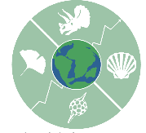



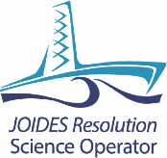

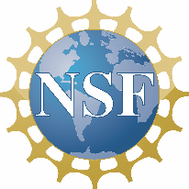

Extending Ocean Drilling Pursuits (eODP):
Making Scientific Ocean Drilling Data Accessible Through Searchable Databases
Andrew J. Fraass^{1,2}, Leah J. LeVay³, Jocelyn A. Sessa², Shanan E. Peters⁴
¹School of Earth Sciences, University of Bristol, UK
²Academy of Natural Sciences of Drexel University, USA
³International Ocean Discovery Program, Texas A&M University, USA
⁴Department of Geoscience, University of Wisconsin, USA
Draft logo
The eODP project will migrate shipboard ocean drilling data into searchable, relational databases. Lithology, micropaleontology, and age models are the initial focus with future plans to add more datasets.

Slide 2
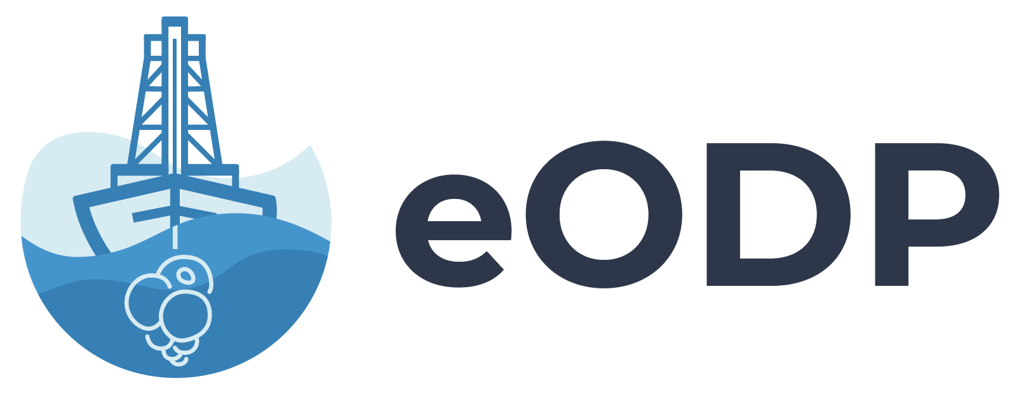
Scientific ocean drilling through the International Ocean Discovery Program (IODP) and its predecessors has a far-reaching legacy. They have produced vast quantities of marine data, the results of which have revolutionized many geoscience subdisciplines. Meta-analytical studies from these efforts exist for micropaleontology, paleoclimate, and marine sedimentation,and several outstanding resources have curated and made available elements of offshore drilling data; however, much of the data remain heterogeneous and dispersed. Each study, therefore, requires reassembling a synthesis of data from numerous sources - a slow, difficult process that limits reproducibility and slows the progress of hypothesis testing and generation. A programmatically-accessible repository of scientific ocean drilling data that spans the globe will allow for large-scale marine sedimentary geology and micropaleontologic studies and may help stimulate major advances in these fields.The eODP project, funded through the NSF’s EarthCube program, seeks to facilitate access to and visualization of these large microfossil and stratigraphic datasets. To achieve these goals, eODP will be enhancing two existing database structures: the Paleobiology Database (PBDB) and Macrostrat, and ingesting and/or exchange data from several sources: the IODP LIMS and Janus databases, Open Core Data (OCD), and Neptune Sandbox.

Slide 3

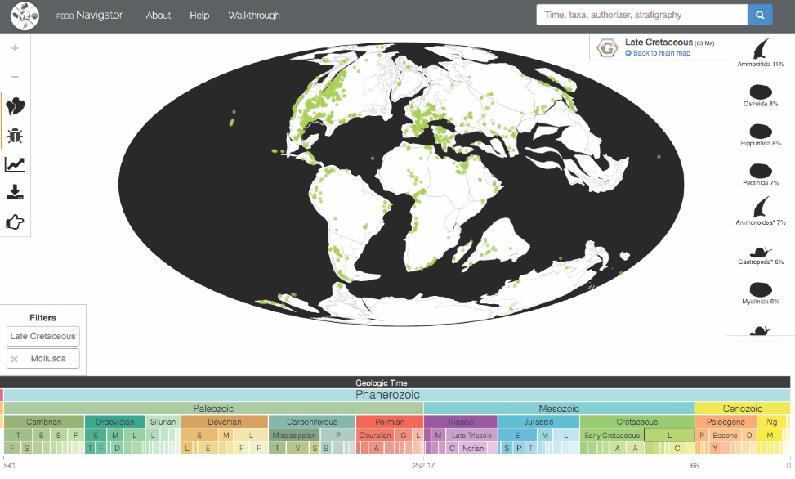
Paleobiology Database
Created in 1998, the PBDB (paleobiodb.org) is an open resource of paleontological data on all fossil organisms through all time periods. Bibliographic references, taxonomic names, synonymies and classifications, primary collection data, taxonomic occurrences, re-identifications of occurrences, and geologic time scales are stored in a relational database. The PBDB contains over 67,000 references, 380,000 taxa and 1,395,000 occurrences in 199,000 collections. The PBDB has active partnerships with other international open data cyberinfrastructure projects, like the Global Biodiversity Information Facility and with iDigBio through the ePANDDA project (epandda.org). Additionally, anyone can access the entire database via an API.
Ocean drilling microfossil occurrences and taxonomy will be housed in the PBDB, which can support quantitative and qualitative abundance data and multiple taxonomic concepts. The PBDB provides visualization tools that can be used for biogeographic reconstructions, global occurrences, or diversity. Data can be searched for by taxa name, taxa type, age, and region. Through building a robust, distributed set of microfossil occurrences, eODP will allow micropaleontologists to answer questions about regional or global diversity, group evolution, ecological responses to global-scale events, and long-term interactions between trophic levels. A new user interface will allow micropaleontologists to easily enter their own datasets.

Slide 4

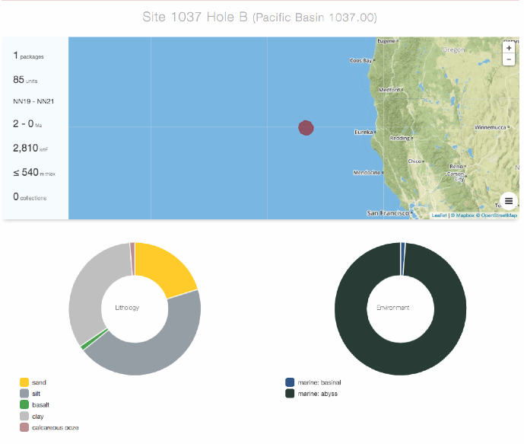
Macrostrat
Macrostrat, started in 2005, has assembled chronostratigraphic rock units and basic properties in order to enable quantitative analyses of large-scale sedimentation patterns around the globe. The database currently contains 1,474 regional rock columns, 33,903 rock units from North America, the Caribbean, New Zealand, and the marine realm and is integrated with more than 1.89 million geologic map polygons from over 100 separate geological maps sources spanning the globe at multiple different spatial resolutions.
Macrostrat will house ocean drilling lithologic data along with site age models. These data will be searchable by lithology type, age, and region allowing scientists to study marine sedimentation trends through time. The program will host alternate depth scales to accommodate spliced sequences. Macrostrat will allow for multiple age models to be stored for each site so that researchers can choose the age model they prefer or input their own. Through the Macrostrat API, age models will be linked to the ocean drilling taxonomic data in the PBDB.

Slide 5
Open Core Data
Flyover Country
Open Core Data (OCD) merges IODP, ODP, and Continental Scientific Drilling project data that can be referenced in various collections such as datasets with DOIs, sample collections with IGSN or any of number collection and identifier methods. Each dataset can be downloaded as a csv file. OCD utilizes the standards developed by the AGU-lead Enabling FAIR Data Project and collaborated with EarthCube Project 418 for publishing schema.org type Dataset resources aligned with FAIR principles.
The mobile app for geoscience, Flyover Country, will make eODP data discoverable through its interface. In partnership with OCD and the PBDB, Flyover Country displays ocean drilling sites and fossil occurrences. Flyover Country will be able to show microfossil occurrences and will host curated pop-up content for general audiences.

Slide 6
Outcomes
Get Involved
eODP will accomplish the following goals:
Enable construction of sediment-grounded and flexible age models in an environment that encompasses the deep-sea and continental records.
Expand existing lithology and age model construction approaches in this integrated offshore-onshore stratigraphically-focused environment.
Adapt key microfossil data into the PBDB data model from OCD and other sources.
Develop new API-driven web user interfaces for easily discovering and acquiring data.
Establish user working groups for community input and feedback.
This project is targeting shipboard drilling-derived data, but the infrastructure will be put in place to allow the addition of other shore-based information. eODP is just beginning and we need input from you! The success of eODP hinges upon the interaction, feedback, and contribution of the scientific ocean drilling community, and we invite anyone interested in participating in this project to join us.
Over the next three years, eODP will host a series of workshops that will seek community input on microfossils/taxonomy and stratigraphy.
If you are interested in being involved in a workshop or to receive project updates, send an email to Andy Fraass or Leah LeVay and we will add you to the email list.

Slide 7


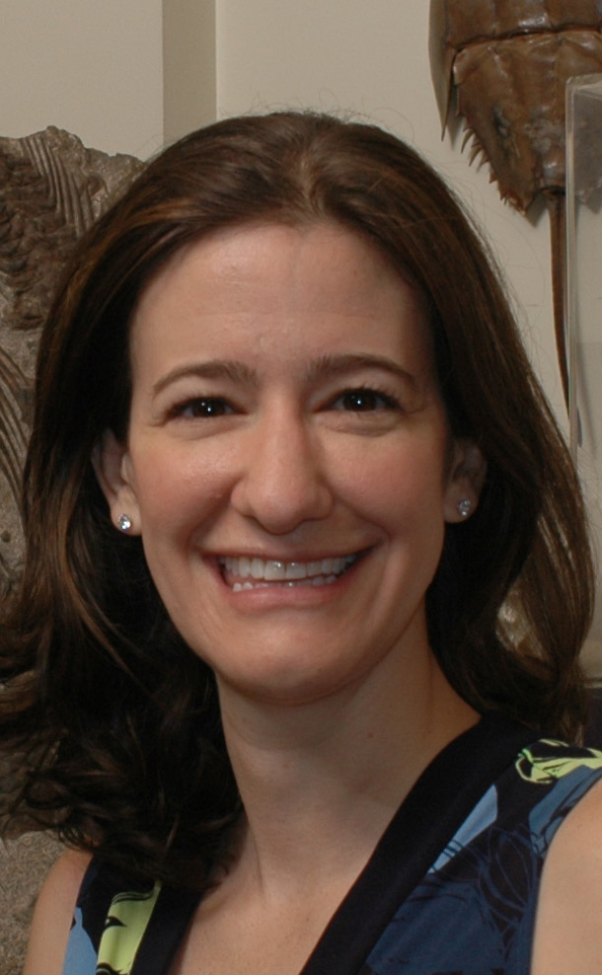
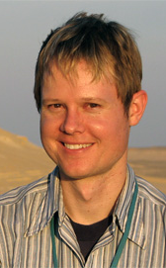
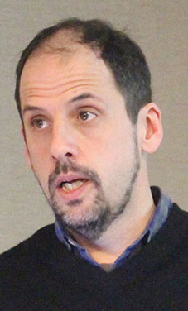

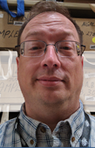



PIs
Andy Fraass
Leah LeVay
Jocelyn Sessa
Shanan Peters
Dev Team
Acknowledgements
eODP is funded by NSF grant ICER-1928362; PBDB by NSF EAR-0949416, NSF ICER-1540929, NSF ICER-1540997, and NSF DUE-1504718; Macrostrat by NSF EAR-1150082, NSF ICER-1440312, and U. Wisconsin, Madison Dept. of Geoscience; OCD by NSF EAR-1550787; Flyover Country by NSF EAR 1541800, NSF EAR-1550913, and NSF ICER-1643329. L.J.L. salary is supported by NSF OCE-1326927. A.F.J. is supported by the Vice Chancellor’s Fellowship of the University of Bristol. Logo design was provided by SGCI (Science Gateways Community Institute).
Seth Kaufman
Daven Quinn
Doug Fils
Reed McEwan
Michael McClennen
Shane Loeffler

