Slide 1
Wind waves modeling in the polar low weather conditions
Alexandra Kuznetsova
E.Poplavsky, N.Rusakov, Yu.Troitskaya
Institute of Applied Physics of the Russian Academy of Sciences

Slide 2
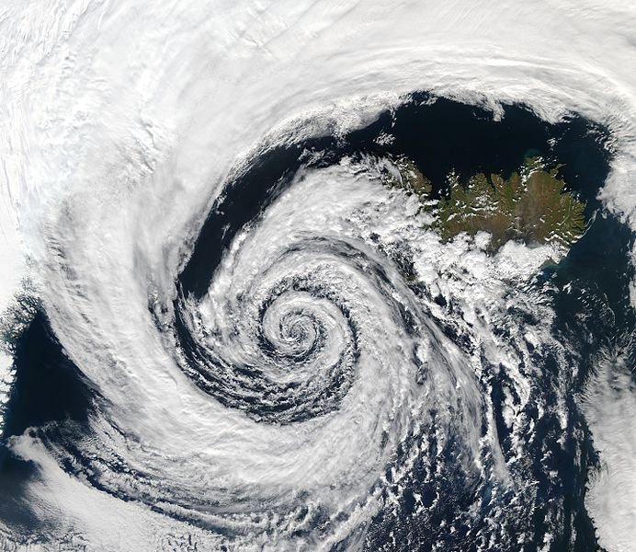
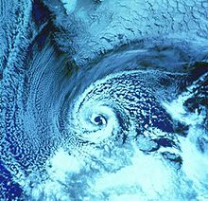
Arctic storms and polar lows pose a great danger to developing commercial and passenger shipping, coastal infrastructure, and also for oil production from offshore platforms. This is primarily due to high waves and extreme winds.
Notes:
Almost three-quarters of the earth’s surface is covered by water, and a large proportion of the world’s population lives in close proximity to a shoreline. Tropical cyclones, or hurricane phenomena directly affect the lives of people in coastal regions and can cause destruction. Nowadays the average storm
intensity is increasing due to climate change. Also, Hurricanes are followed by strong winds that create large waves that can flood coastal areas and cause shoreline erosion.

Slide 3
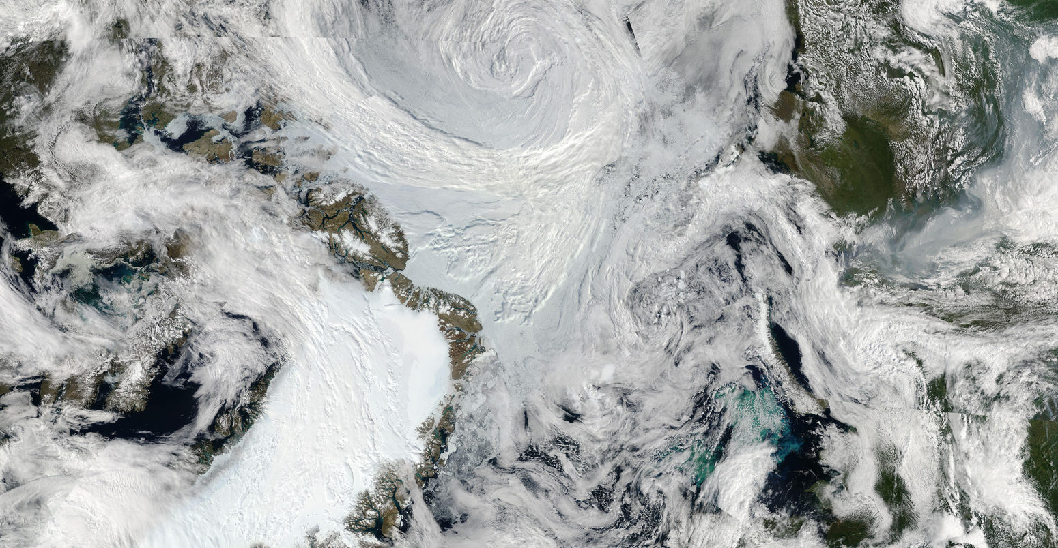
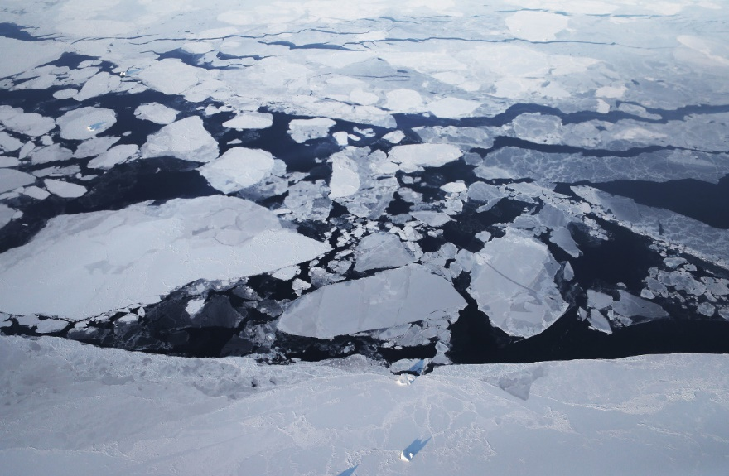
Such episodes of adverse weather conditions due to their rapid development are poorly predicted by modern models. For this purpose, the representation of the event of polar low is studied in the wave model WAVEWATCH III.

Slide 4
Instrument for the prediction of waves –
WAVEWATCH III
Hasselman equation:
N – wave action density
Source terms parameterizations S_{tot}
wind input S_{in}
nonlinear 4 waves interaction S_{nl}
dissipation S_{ds}
bottom friction S_{bot}
depth-induced breaking S_{db}
3 waves interaction S_{tr}
scattering S_{sc}
interaction with ice S_{ice}
refraction S_{ref}
The influence of ice in the WW3 model is taken into account using the parameterizations:
IC1, IS1 (E. Rogers and S. Zieger; S. Zieger),
IC2, IS2 (E. Rogers, S. Zieger; F. Ardhuin, C. Sevigny, G. Boutin ),
IC3 (E. Rogers, X. Zhao, S. Cheng, S. Zieger,),
IC4 (C. Collins and E. Rogers).
Notes:
The wave modeling may be implemented in the framework of modern third generation wave model WAVEWATCH III. It has various packages of physical processes parameterizations. The resulting values of mean wave and wind parameters allowed the evaluating of the air-sea exchange processes parameters at hurricane wind. In this case, we compare big scale and of the hurricane-induced waves with ‘short but extended fetch’ and notice the specific importance of the input source term in the short-fetch conditions.

Slide 5
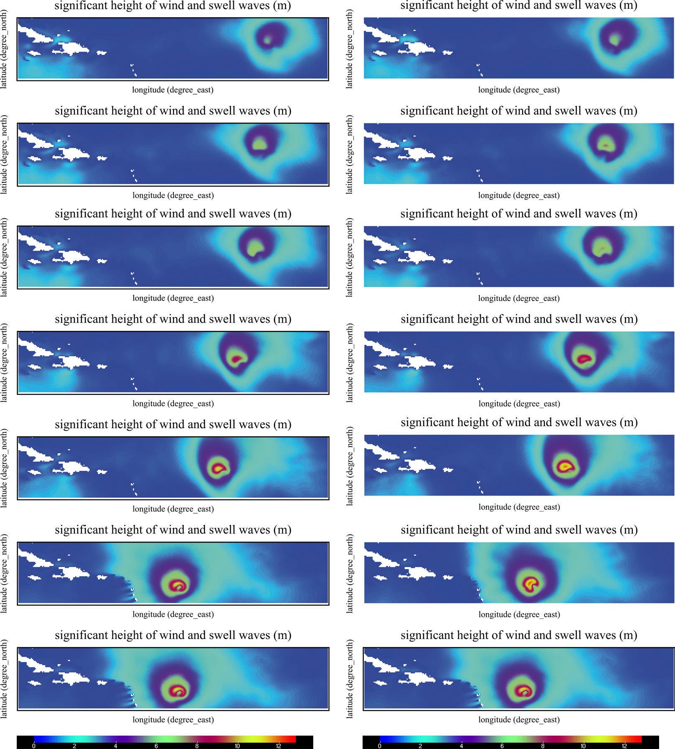
The test case with extreme waves in the hurricane conditions was considered in WW3 (no interaction with ice)
Evolution of the hurricane Irma
(ST4 parameterization in the left column, ST6 – in the right column)
The model reproduces the rotating and motion of the hurricane. The typical phases of a hurricane development and the increase of its intensification are shown.
The asymmetry of distribution of the surface wave field is obtained.
The resulting significant wave height distribution

Slide 6
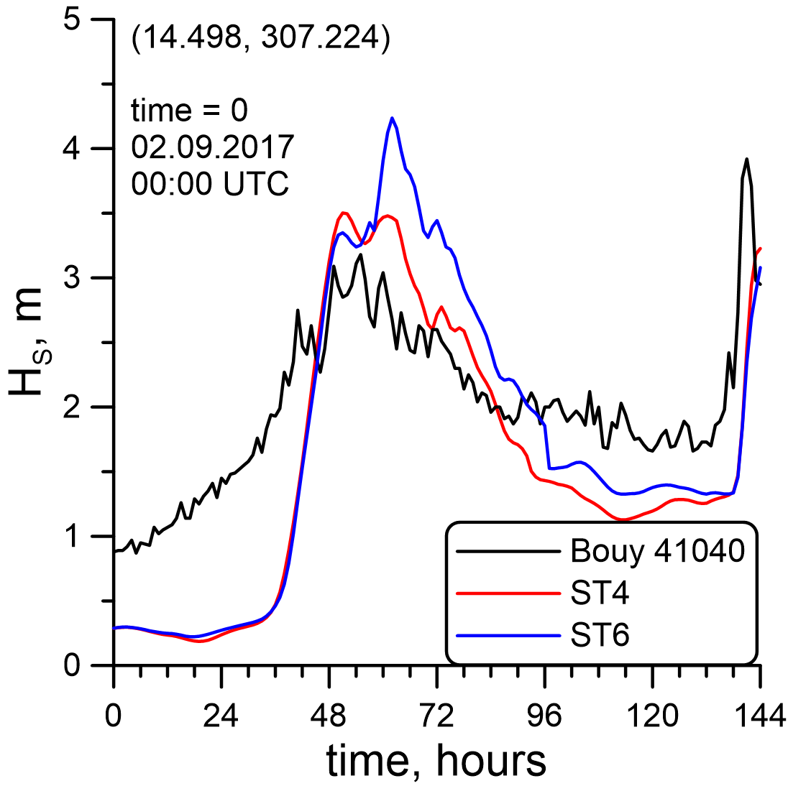
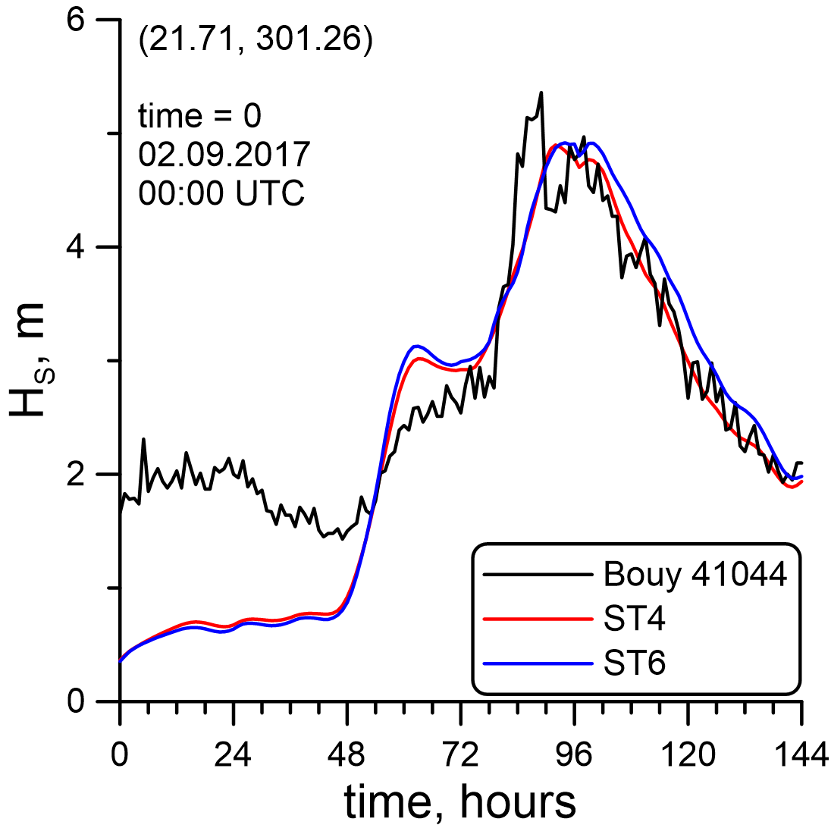
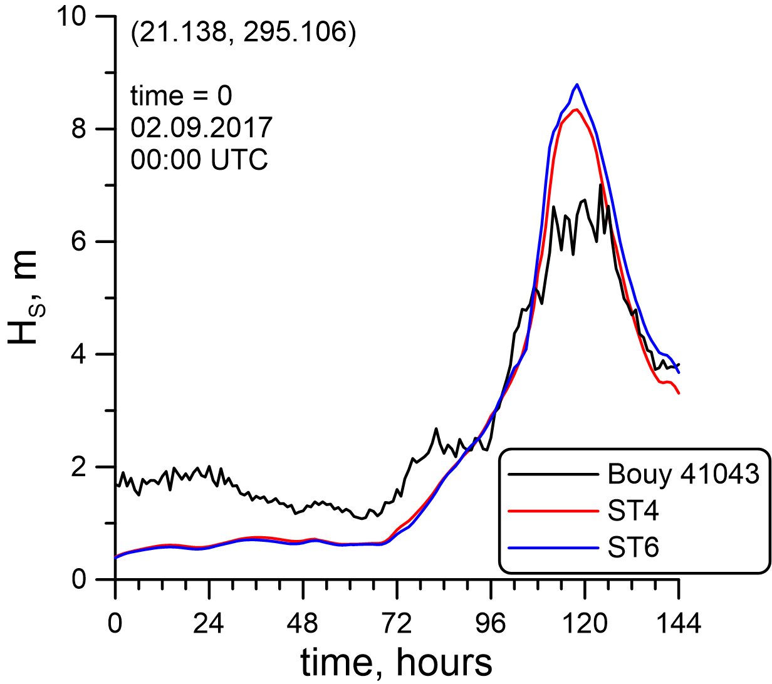
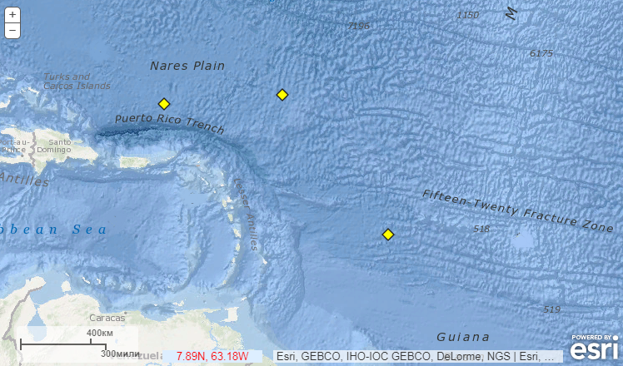
Comparison of the modeled WW3 data and buoy measured data
Significant wave height at three buoys location simulated in WW3 with ST4 (red), ST6 (blue), and buoy data (black) for the period from 02/09/2017 to 04/09/2017. (a) – buoy 41040, (b) – buoy 41044, (c) – buoy 41043.
The generally good correlation is found between the observational H_{s} values and WW3 wave model results under tropical cyclone conditions both for ST4 and ST6 parameterizations.
41043
41044
41040
Notes:
We examine significant wave height (H_{s}) at three NDBC buoys.

Slide 7
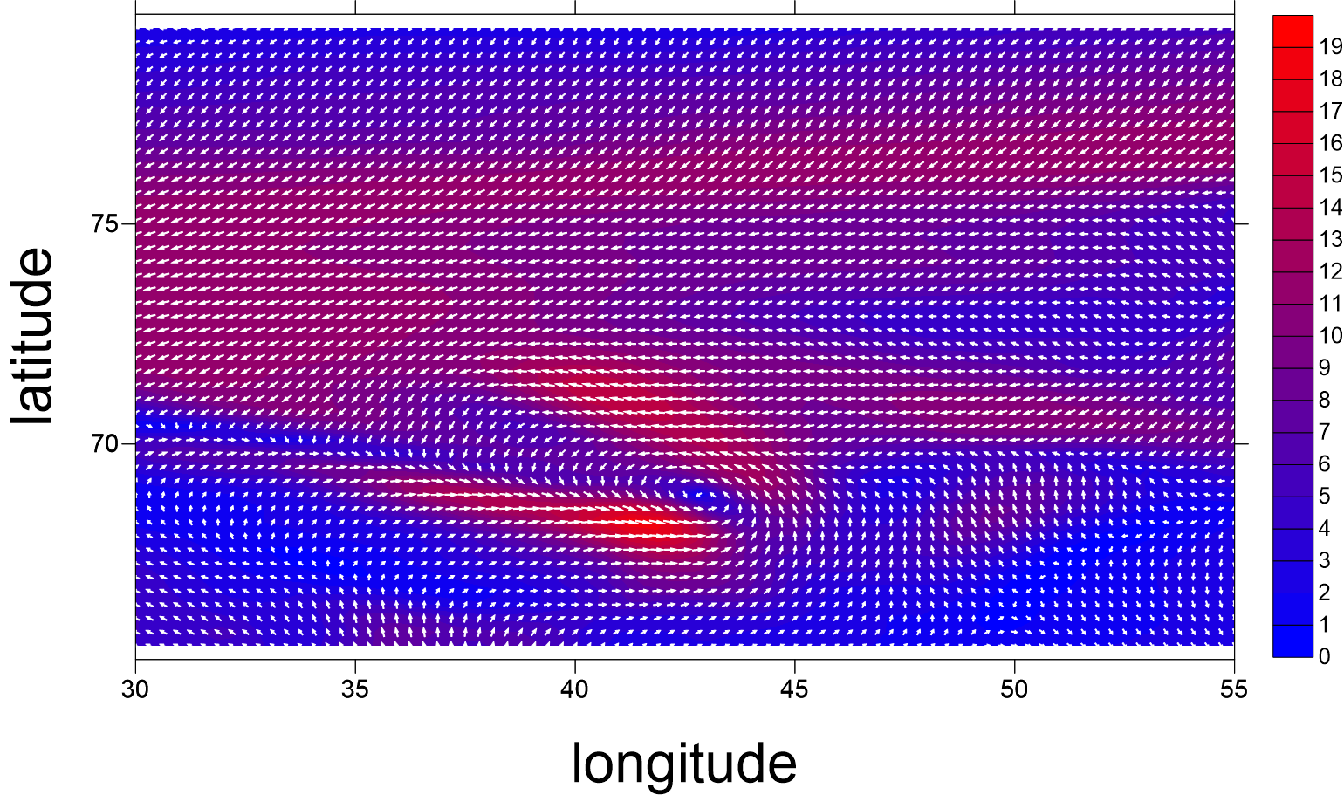
Polar low test case
To simulate wind waves under conditions of polar depression, the Barents Sea was selected, where, according to the data of [1, 2], a large number of polar hurricanes are observed.
Among the identified polar lows, for example, in [3], a hurricane that took place on 05.02.2009, observed at coordinates 69 N 40 E is chosen.
1. Smirnova, J. E et al. Geophysical Research Letters, 2015.
2. Smirnova, J., & Golubkin, P. Monthly Weather Review, 2017.
3. Noer, G., & Lien, T. Norwegian Meteorological Institute Rep. 2010.

Slide 8
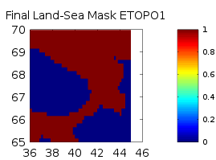
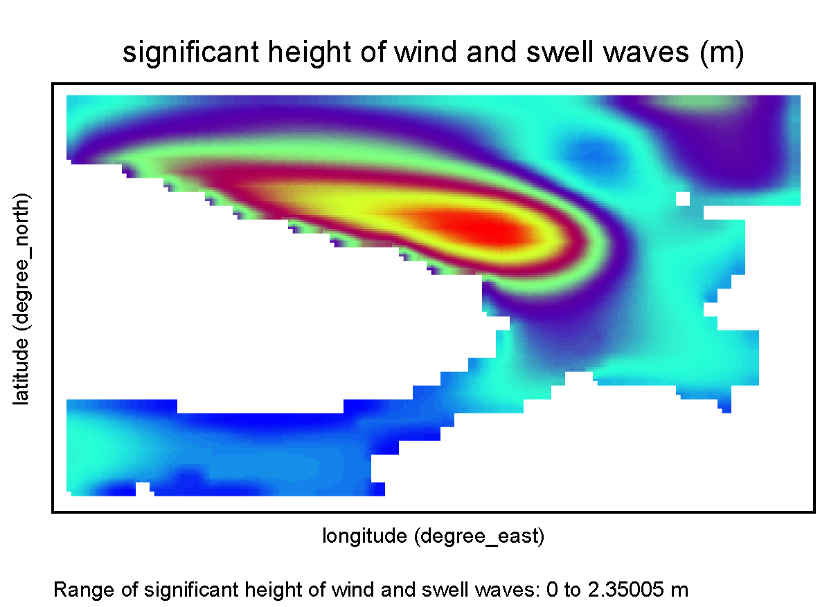
Configuration & preliminary results
ETOPO1 topographical and bathymetry data with 0,166º increment is used
Longitudes are varying from 36 up to 45 degrees and latitudes varying from 65 up to 70 degrees is considered
32 frequencies in the interval from 0,0373 Hz, 24 angular directions
Wind forcing: CFSR reanalysis
The simulations are carried out at the IAP RAS cluster using pure MPI option of the model code.
Another option of wind forcing should be considered – WRF Polar model
Notes:
The numerical simulations of waves under hurricane Irma conditions are performed within WAVEWATCH III v.5.16 model (WW3). The area with longitudes varying from 14 up to 24 degrees and latitudes varying from 280 up to 330 degrees is considered. The ETOPO1 data is used to create bathymetry and mask files. The development of the waves is forced by the wind field from the CFSv2 reanalysis with 0,205 resolution. The simulations are carried out at the IAP RAS cluster using pure MPI option of the model code.

Slide 9
Options of wind and ice forcing
Regular wind reanalysis (CFSR, ERA-Interim, etc.)
ASR (Arctic System Reanalysis)
WRF Polar model (with smaller grid size)
WRF (with different PBL options, including LES option)
Of particular interest is the application of the model to open sea conditions, since the Polar WRF modifications relate mainly to the processing of fractional sea ice and its frequency within the grid; therefore, this model can surpass the standard WRF in the sea ice zone (Tastula and Vihma 2011).

Slide 10
WRF configurations
Option | WRF ARW | WRF Polar
Number of domains | 3 | 3
geographical data | MODIS LAKES (30s) | MODIS LAKES (30s)
initial and boundary conditions | NCEP Climate Forecast System Version 2 (CFSR) 6-hourly Products | NCEP Climate Forecast System Version 2 (CFSR) 6-hourly Products
micro physics | Goddard Scheme | Goddard Scheme
land surface | 5–layer Thermal Diffusion Scheme | 5–layer Thermal Diffusion Scheme
PBL | Yonsei University Scheme + LES (3d domain) | MYNN Scheme Level 2.5
cumulus parameterization | Kain–Fritsch Scheme | Kain–Fritsch Scheme
shortwave and longwave radiation | New Goddard Shortwave and Longwave Schemes | New Goddard Shortwave and Longwave Schemes
surface layer | Revised MM5 Scheme | MYNN Scheme

Slide 11
3 considered domains are shown at the picture
For the WRF Polar run, additional fields in the WP S met_em files were implemented from ASR data: sea ice thickness, sea ice albedo, sea depth on sea ice
Run performed for 4.02.2009 – 8.02.2009

Slide 12
WRF Polar
2nd domain
WRF ARW
2nd domain

Slide 13
WRF Polar
3^{d} domain
WRF ARW (LES)
3^{d} domain

Slide 14
Conclusions
It is shown that WW3 model reproduces the rotating and motion of the test case of the tropical cyclone Irma. The asymmetry of distribution of the surface wave field is obtained. The next step was the inclusion of sea ice effects for the conditions of polar low.
For the identified polar low, wind waves under conditions of polar depression in the Barents Sea are simulated.
Four possible options of the wind forcing are considered: Regular wind reanalysis (CFSR, ERA-Interim, etc.), ASR (Arctic System Reanalysis), WRF Polar model (with smaller grid size), WRF (PBL: Younsei University Scheme + LES option). WRF LES and WRF Polar are compared.
Further comparison of WRF Polar and WRF ARW is planned. WW3 runs with chosen WRF/WRF Polar forcing will be performed. Comparison of the obtained data with the altimeter data will be made.

Slide 15
Thanks!
Acknowledgement. This work is supported by RFBR grant # 18-05-60299.
Notes:
15

