Slide 1

A systems approach to modelling phosphorus pollution risk in Scottish rivers using Bayesian Belief Networks
Miriam Glendell, Andy Vinten, Samia Richards, Zisis Gagkas, Allan Lilly, Nikki Baggaley, Malcolm Coull, Nick Schurch, Alessandro Gimona, Ina Pohle, Mads Troldborg and Marc Stutter

Slide 2

The challenge
Water pollution is responsible for failure of 17% of Scottish waterbodies to reach good ecological status
Phosphorus is among multiple stressors affecting ecological status¹
Need for decision support tools to disentangle the complex interactions and inform cost-effective mitigation measures
¹Glendell et al. 2019 Modelling the Ecological Impact of Phosphorus in Catchments with Multiple Environmental Stressors. Journal of Environmental Quality 48(5) https://doi.org/10.2134/jeq2019.05.0195

Slide 3
Bayesian Belief Networks
Graphical probabilistic models
Integrate inter-subjective probabilities (stakeholder and expert knowledge) with data in a transparent way
Explicit uncertainty estimation
Easily updated / integrated with new data & knowledge
Trans-disciplinary – help to integrate biophysical and social aspects

Slide 4
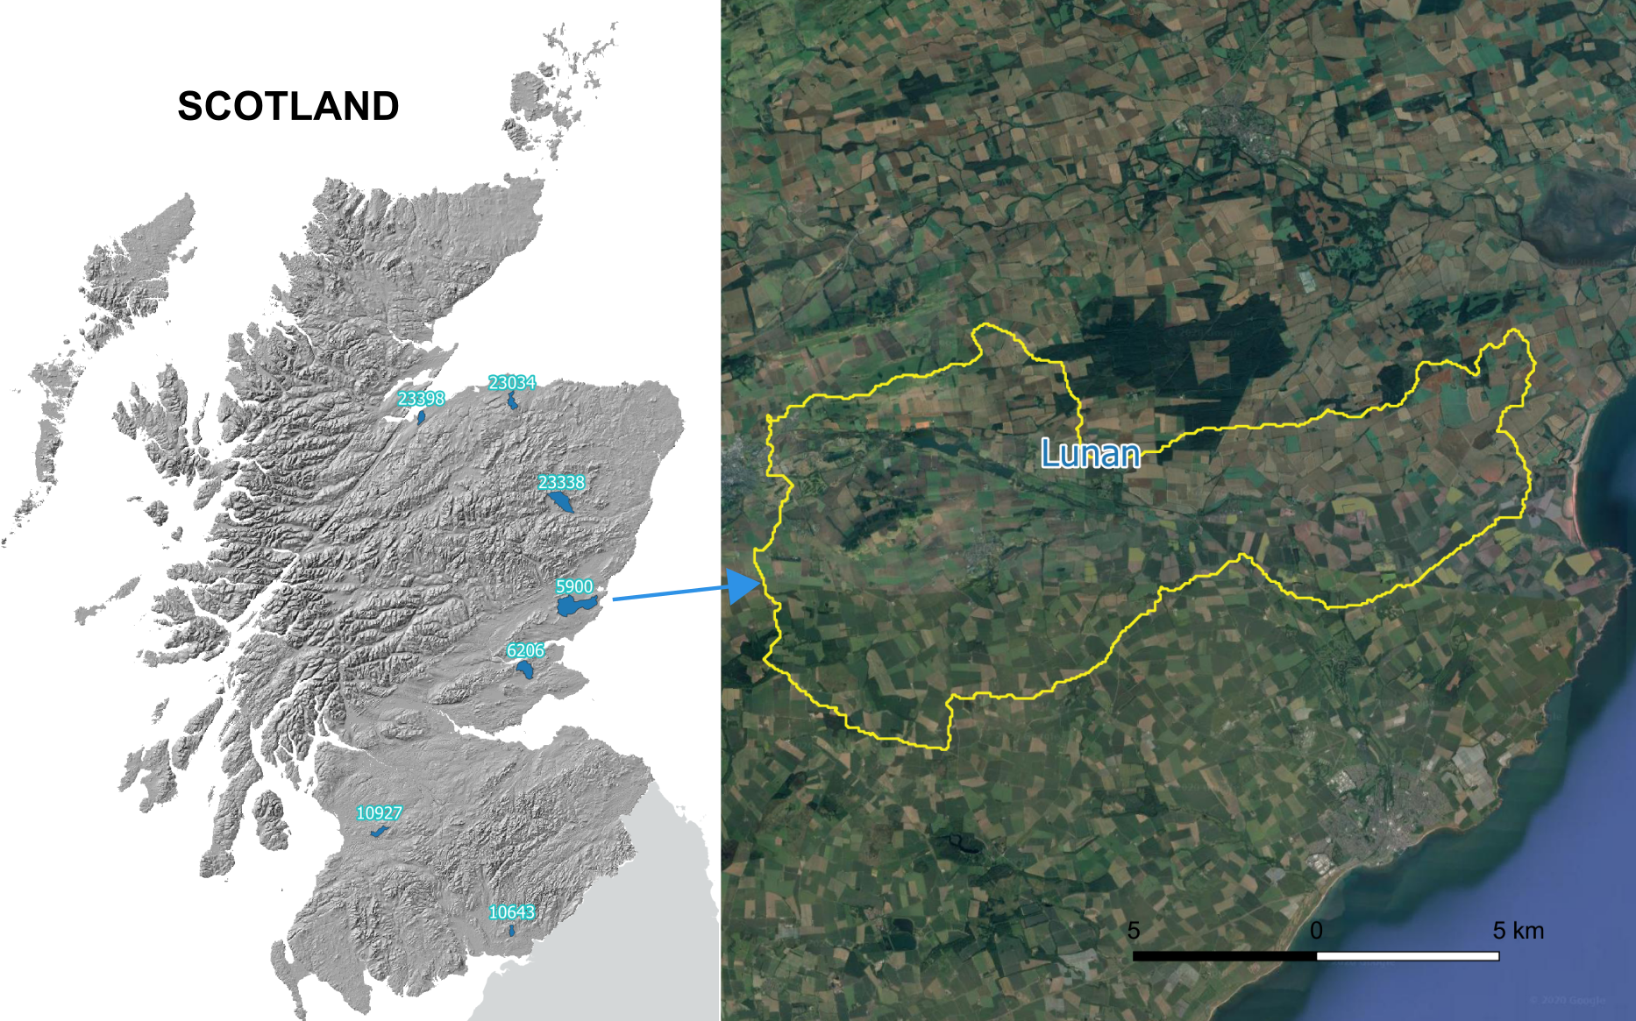
Objectives
Develop a phosphorus water pollution decision support tool
Risk maps of P losses along Source → Mobilisation → Transport → Delivery continuum
Model probability of phosphorus concentrations falling into WFD Ecological Status classes
Demonstrating example of Lunan catchment (124km², arable land use, Poor Ecological Status)
Upscaling to further 6 study catchments is underway

Slide 5
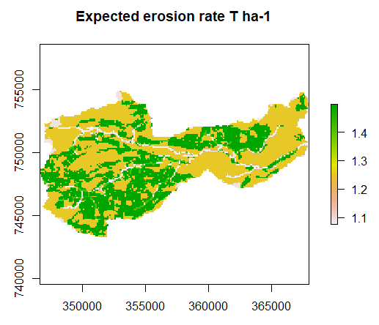
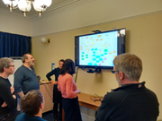
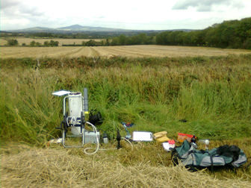
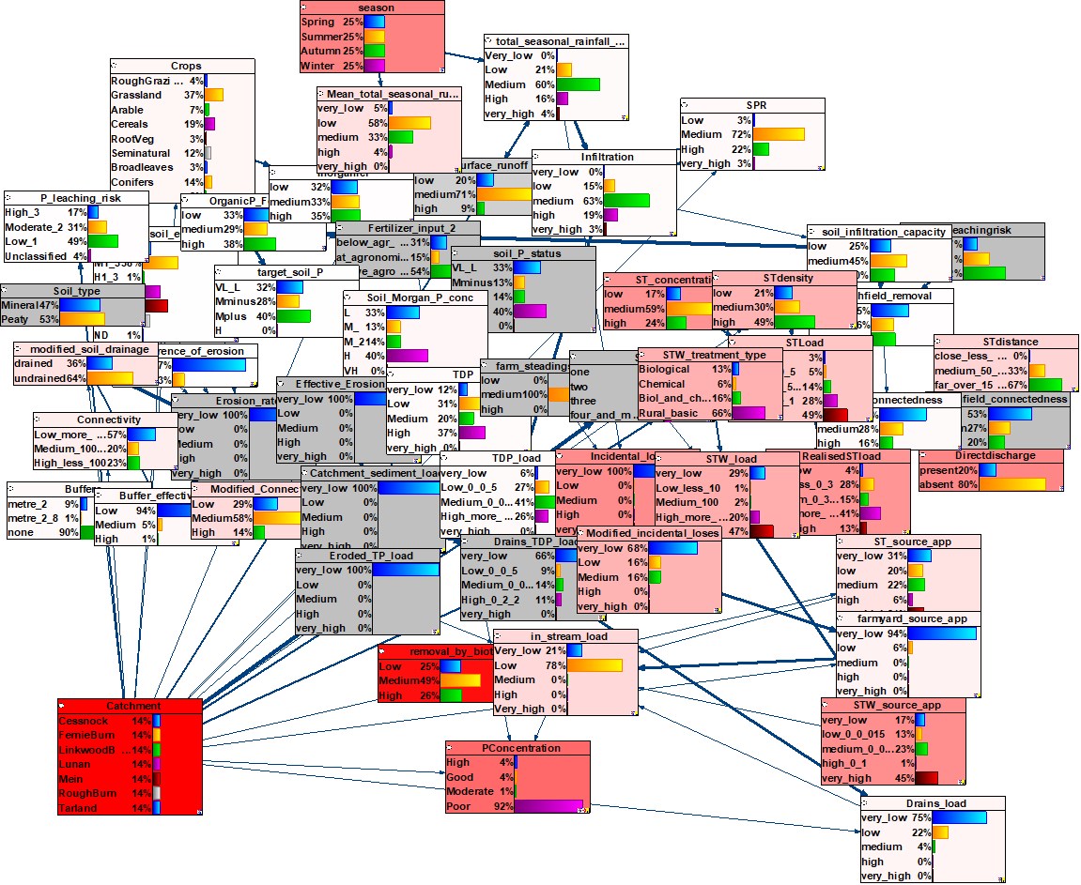
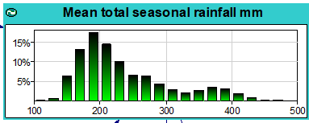
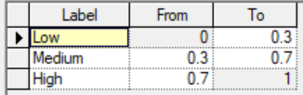
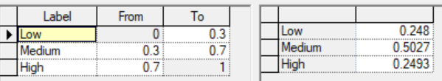
Model co-construction
Define objectives
Develop conceptual model of the system with experts and stakeholders
Parameterise model
Discretize model states & derive probabilities
Evaluate model sensitivity
Spatial application - modelled scenarios

Slide 6
Model structure
Example input data:
Runoff and SRP concentration time series
Raster maps 100x100m - mean total seasonal rainfall, land use, soil drainage, soil erosion risk class, topographic connectivity, location of STWs, STs and farm steadings
Literature & expert opinion – ST and STW concentration & discharge, buffer effectiveness

Slide 7
Hydrology and soil erosion sub-model examples
Hybrid network includes both continuous stochastic variables and discrete probability tables - used for prediction at catchment outlet
For spatially distributed prediction in GIS a discrete network is derived by converting stochastic variables to probability tables

Slide 8
Sensitivity analysis
Which are the most important variables?
Deeper red denotes more influential variables
Thicker arrows show stronger relative strength (Value of Information) between parameters
Most influential variables:
in-stream removal
sewage treatment (STW) type
septic tank (ST) density, concentration, distance to stream, presence of direct ST discharge to stream
season
Notes:
Show just a sub-set

Slide 9
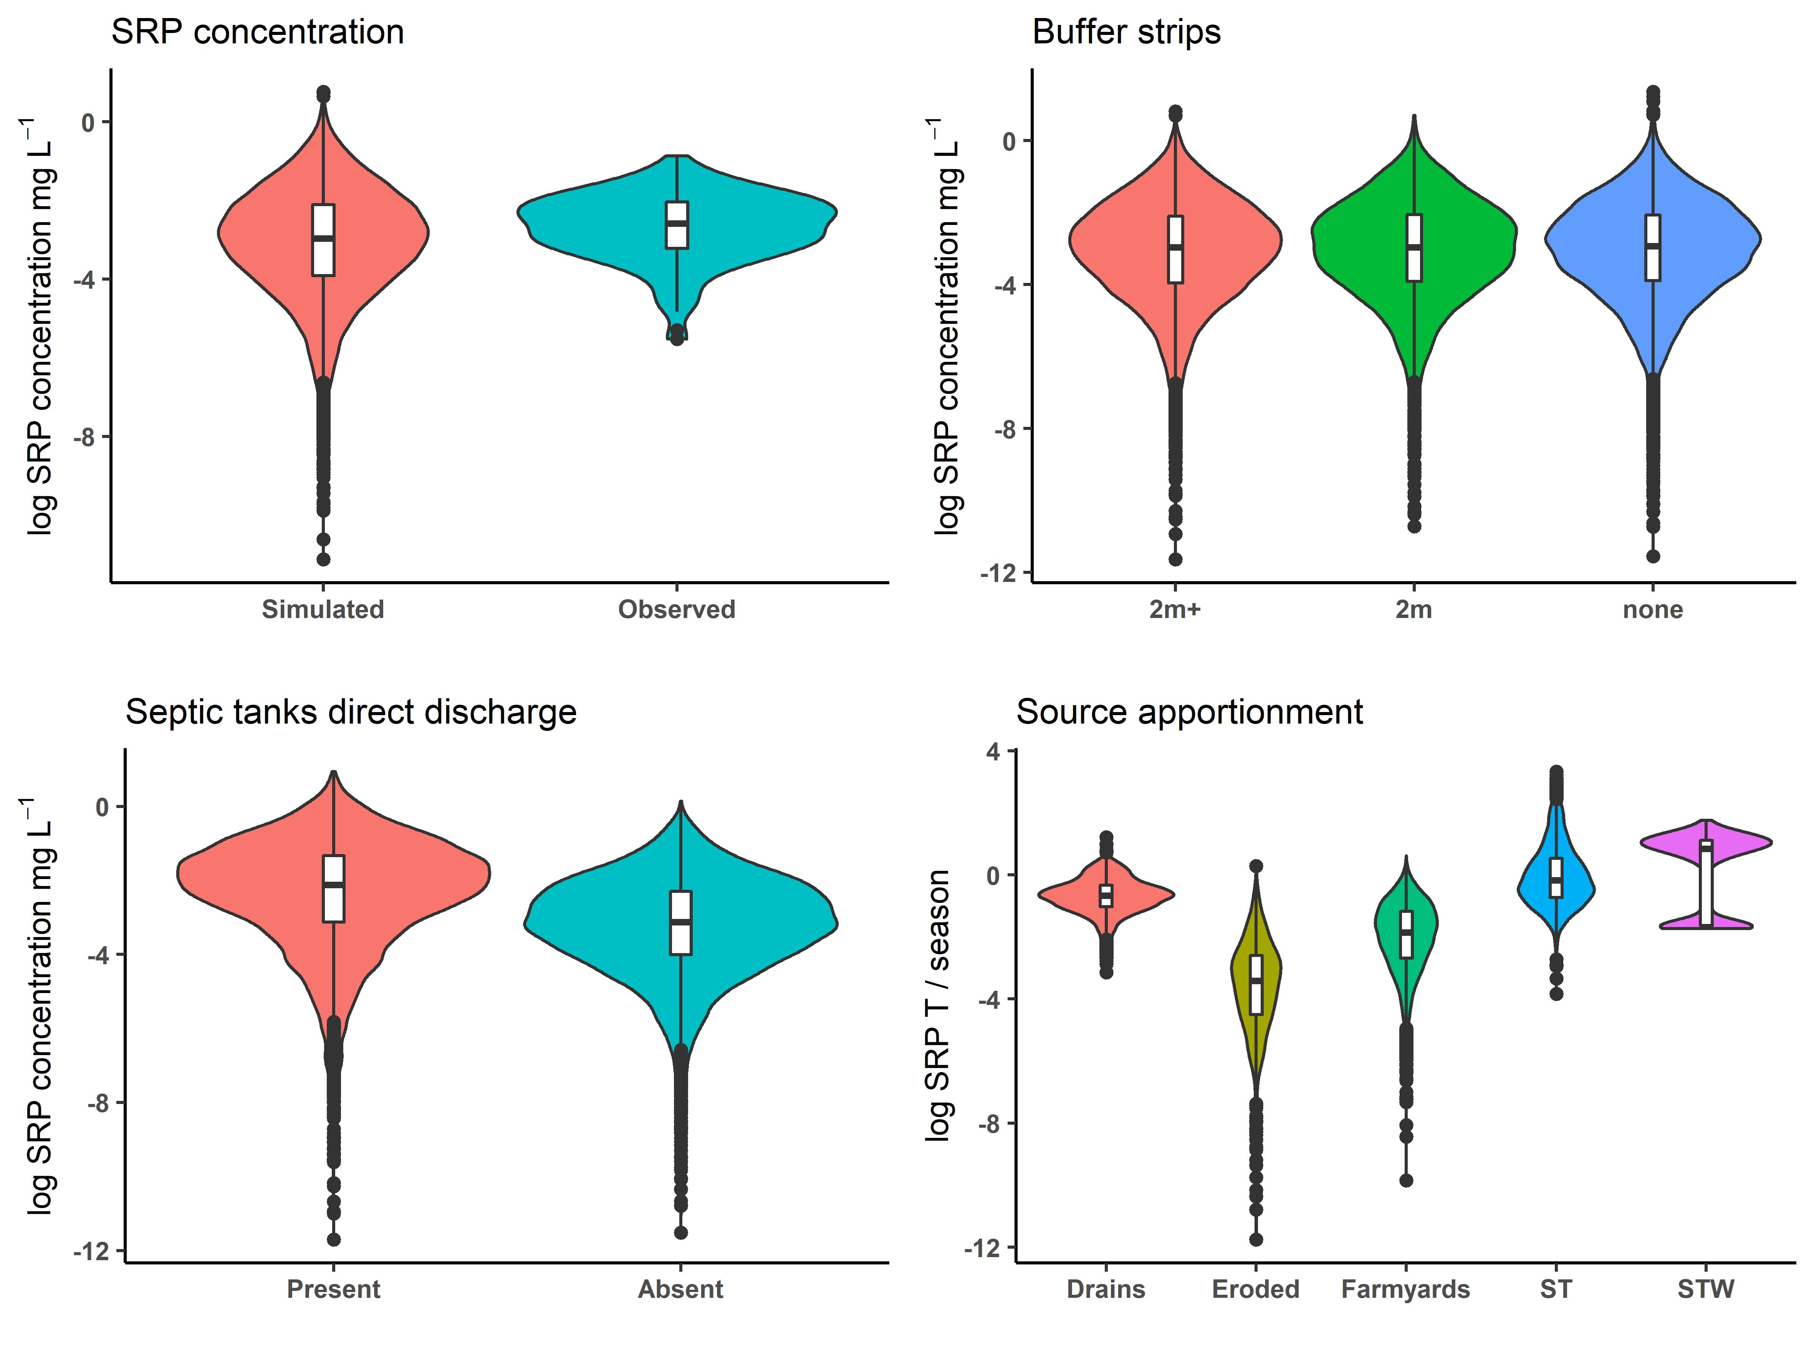
Example results

Slide 10
Influence of seasonal dilution on water quality is greater than soil P
Summer
Soil Morgan P levels
Winter
L
M
H

Slide 11
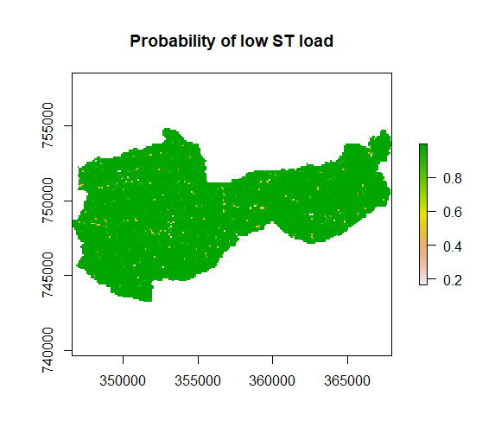
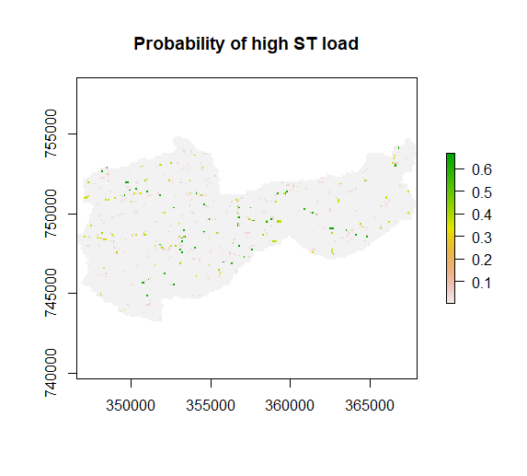
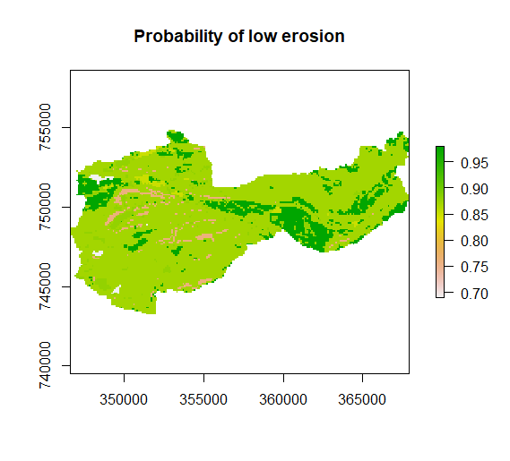
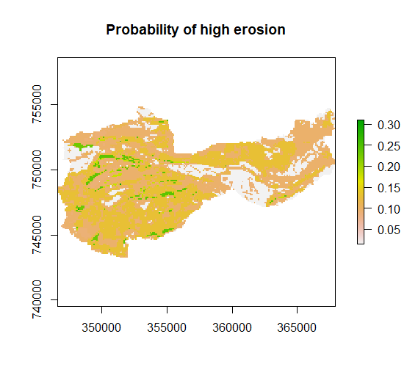
Spatial risk maps
Identify specific risk areas

Slide 12
Conclusions & challenges
BBN helps to synthesise the current system understanding with stakeholders using diverse data
Sensitivity analysis helps to identify key variables and inform future data collection
Allows ‘what-if’ scenario analysis to inform management within a risk framework
Hybrid network performs well when compared with observations
Currently discretisation is necessary for spatial application adding predictive uncertainty – further software development is needed

Slide 13
This research is funded by the Rural & Environmental Science and Analytical Services Division of the Scottish Government miriam.glendell@hutton.ac.uk

