Slide 1
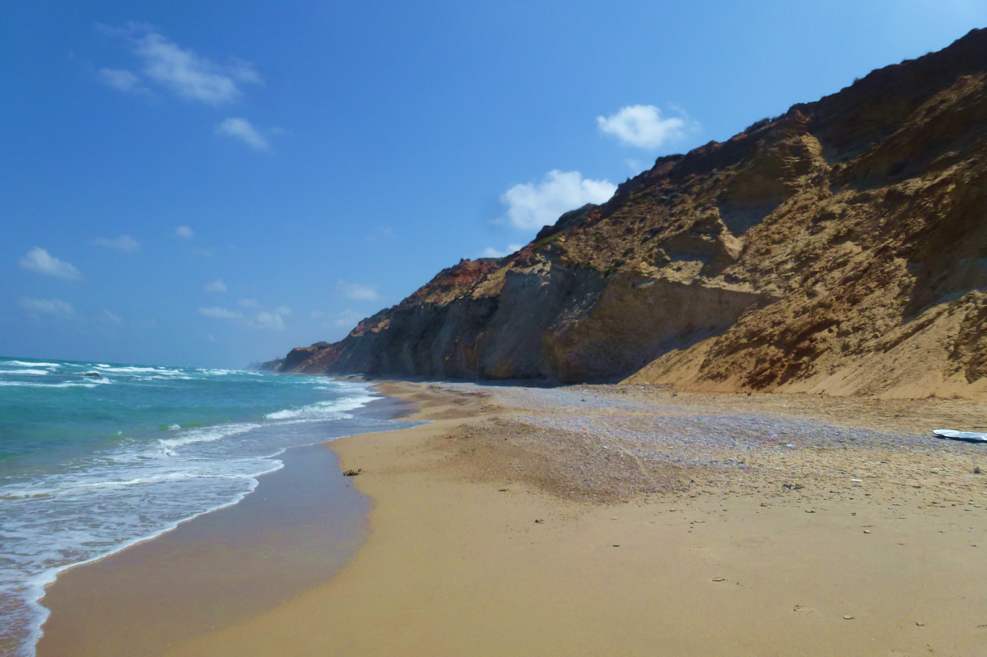

Spatial and temporal changes of sediment grain size along Israel’s Mediterranean cliff-dominated beaches
Onn Crouvi, Ran Shemesh, Oded Katz, Amit Mushkin, Navot Morag, and Nadav Lensky
Geological Survey of Israel, Jerusalem, Israel

Slide 2

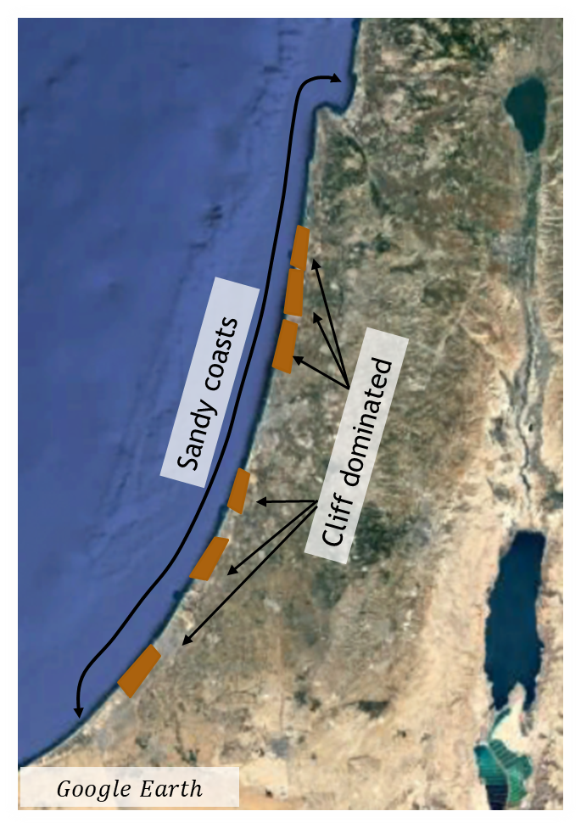
Motivation
Changes in sediment grain size, shape or density can lead to morphological changes of beach systems.
Spatial variation of grain size along beach profiles has been well studied, temporal variation in beach grain size has received less attention.
The fate of cliff-eroded sediments along sandy coasts was rarely studied as most studies focused on shingle beaches.
Goals
Quantify the temporal dynamics of beach sediments in cliff-dominated beaches along Israel’s Mediterranean coast.
Explore their relationship to cliff erosion as well as sand abrasion/attrition.

Slide 3
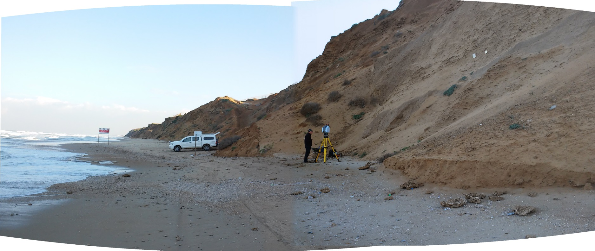
Approach and methods
Repetitive sampling of surficial sediments (0-2 cm) along two cross shore transects over 3 years. Sampling interval varied from 10 days to 3 months.
Sampling at four locations along the profile: Talus, backshore and 2 at foreshore.
Particle size distribution (PSD) was evaluated using two complementary approaches:
1) Sieving over the range 0.5 - 12.5 mm using 12 sieves,
2) Laser diffraction over the range of 0.02 μm to 2 mm.
Talus
Foreshore
Backshore

Slide 4
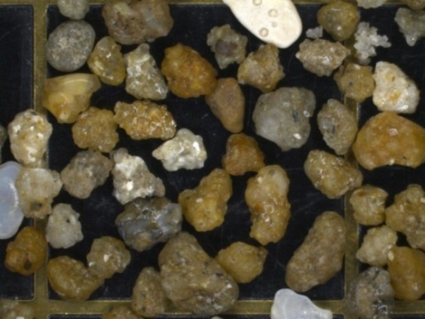
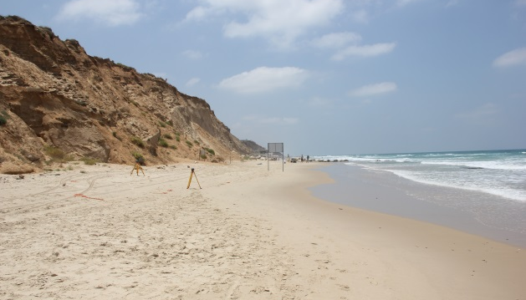
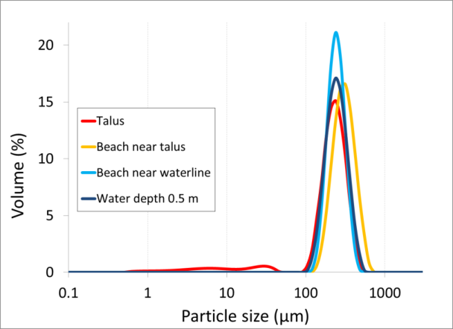
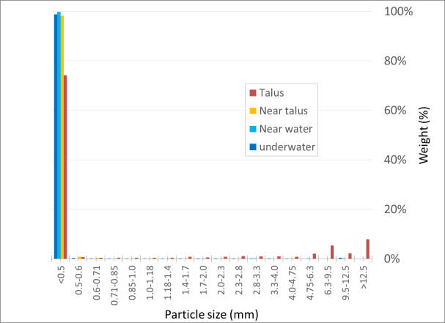
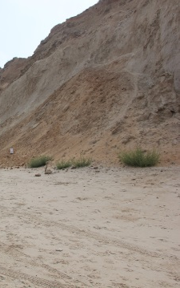
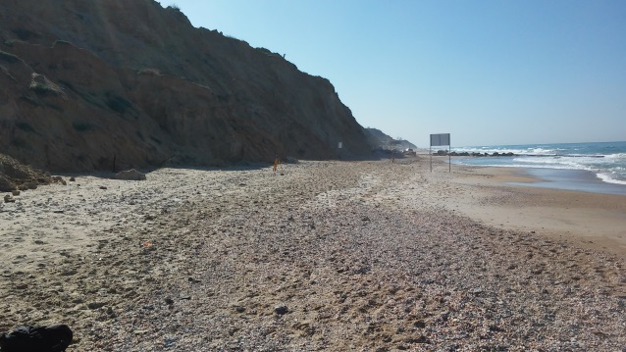
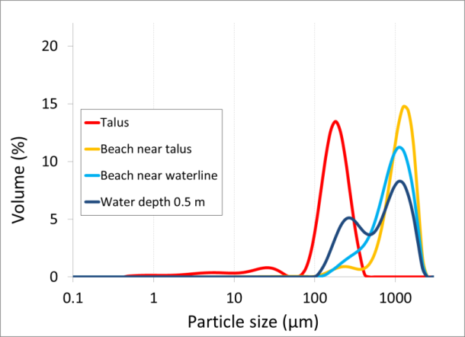
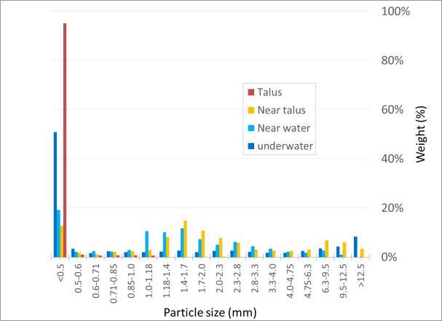
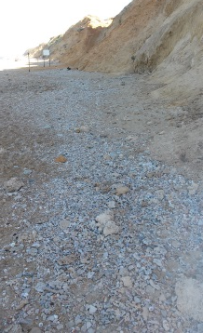
Results
Samples exhibit unimodal PSD, with a mode either at the f. sand fraction (180-220 µm, quartz), or at the coarse sand to v. coarse sand fraction (900-1,200 µm, eolianite rock).
The coarse fraction dominants the PSD mostly during winter, whereas at summer it is usually absent.
5 mm
Summer - backshore
Quartz
Winter - backshore
Eolianite
Quartz

Slide 5
Interpretation of PSD seasonal cycle
S W S W S W S
Talus
The addition of coarse fraction during winter is related to high-energy wave storms that mobilize and transport cliff-derived materials (taluses) along the beach.
The disappearance of the coarse fraction towards summer is related to sand abrasion by wave and/or by wind action, i.e. breakage of the ~1 mm eolianite rocks into ~200 µm quartz grains.
Backshore
Foreshore
Foreshore

Slide 6
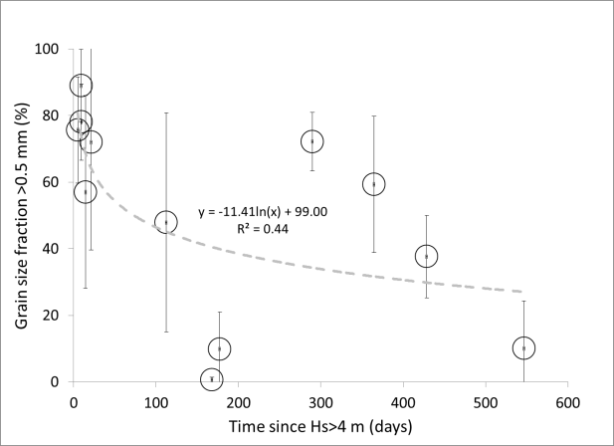
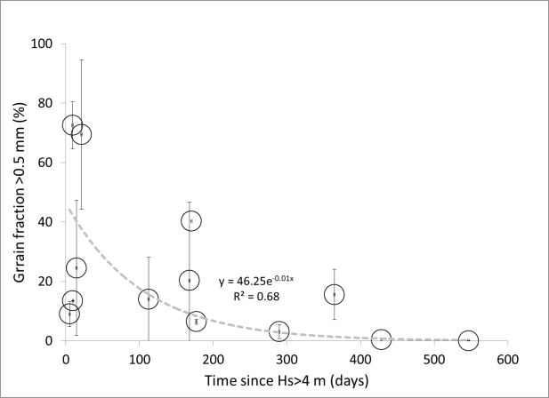
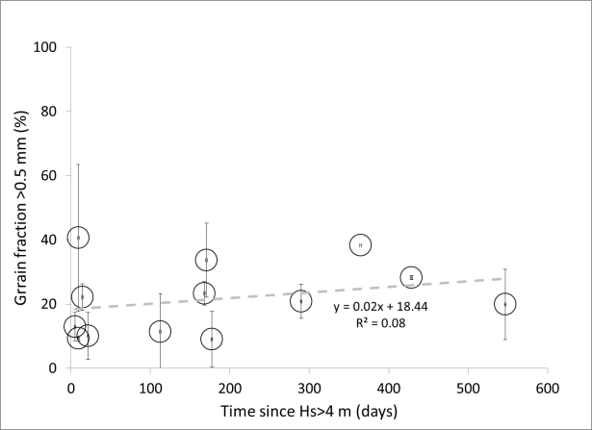
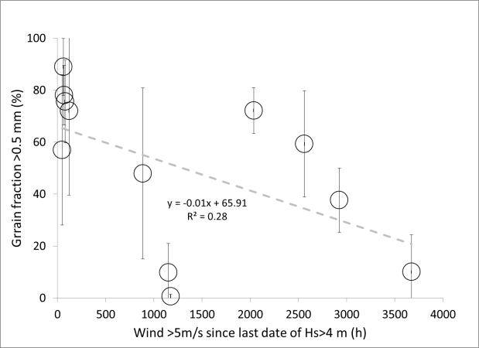
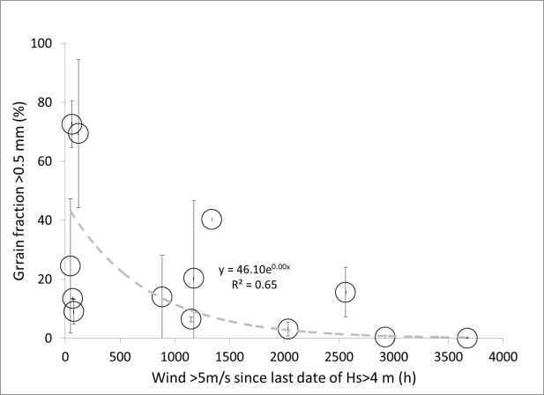
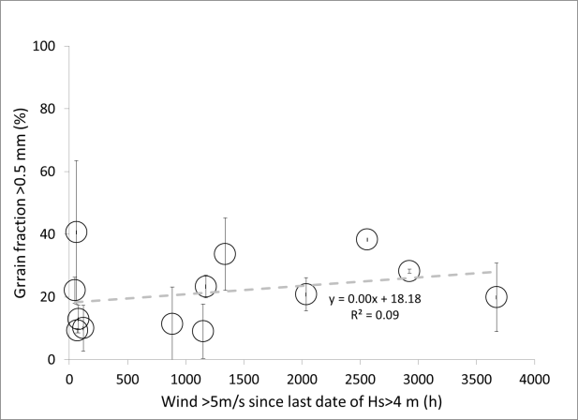
Talus
Foreshore
Backshore
Coarse fraction decreases with time that passed since waves reached cliff base during sea storms
Coarse fraction decreases with time of high speed winds since waves reached cliff base during sea storms
Our findings emphasize the importance of cliff erosion and sand abrasion in controlling the temporal variation in PSD along cliff-dominated beaches

