Slide 1


Spent coffee grains biochar activation and its effects on the characteristics of the final products to be used as sorbents or catalysts support
Nikolaos Mourgkogiannis, Ioannis Nikolopoulos, Eleana Kordouli, Christos Kordulis, Alexis Lycourghiotis,
Hrissi K. Karapanagioti *
Department of Chemistry, University of Patras, 26504, Patras, Greece
* Corresponding author: E-mail: karapanagioti@upatras.gr, Tel +30 2610996728
The problem
Climate change effects are visible in various sectors of human life such as agriculture, industry and health. Therefore, it is necessary to search and implement green and sustainable technologies in order to reduce or eliminate the effects of this change. Over the last years, in the context of aforementioned goal, the idea of a circular economy has been adopted. Based on this, waste biomass materials have been used for production of biochars obtained with environmentally friendly processes such as pyrolysis. The present study aims to characterize the physicochemical properties of biochars obtained from spent coffee grounds for the determination of their characteristics related with catalytic and sorptive functionalities.
1/5
Objectives
Biochar
Pyrolysis

Slide 2
Spent coffee grains biochar activation and its effects on the characteristics of the final products to be used as sorbents or catalysts support
Nikolaos Mourgkogiannis, Ioannis Nikolopoulos, Eleana Kordouli, Christos Kordulis, Alexis Lycourghiotis,
Hrissi K. Karapanagioti *
Department of Chemistry, University of Patras, 26504, Patras, Greece
* Corresponding author: E-mail: karapanagioti@upatras.gr, Tel +30 2610996728
Samples and Methods
Coffee is considered the most widely spread beverage and annually, approximately, 11 million tons produced all around the world. Spent coffee grounds are considered a valuable, rich source of bioactive compounds and a useful resource material for a variety of other applications. Raw spent coffee residue (Raw-SCG), biochar from spent coffee residue (SCG) and the activated SCG biochar with distilled H₂O (W-SCG), H₂SO₄ (SCG-S), H₃PO₄ (SCG-P), and NaOH (SCG-ALK) were fully characterized for their surface area, ash, surface topography, surface elemental analysis, surface functional groups and suspension pH.
2/5
FTIR analysis
SCG
SCG-P
Surface area and porocity
Ash Content
SCG-ALK
W-SCG
SCG-S
Suspension pH
SEM/EDS

Slide 3
Spent coffee grains biochar activation and its effects on the characteristics of the final products to be used as sorbents or catalysts support
Nikolaos Mourgkogiannis, Ioannis Nikolopoulos, Eleana Kordouli, Christos Kordulis, Alexis Lycourghiotis,
Hrissi K. Karapanagioti *
Department of Chemistry, University of Patras, 26504, Patras, Greece
*Corresponding author: E-mail: karapanagioti@upatras.gr, Tel +30 2610996728
Results
SCGs produced at 850ºC have high specific surface and micropore area and at the same time, low external surface area. The t-plot for the SCG disclose that the activation with H₃PO₄ leads to high specific surface (921 m²/g) and micropore (626 m²/g) area compared to other SCG samples. Simultaneously, the activation of SCG increases the pore size of biochar and the highest pore size was observed for the SCG–ALK (37 Å) compared to activated SCG-S (34 Å) and SCG-P (34 Å). The Raw-SCG has slightly acidic nature (pH 5.5) than the biochar SCG (pH 10.6) which has the highest alkaline nature. For the activated SCG biochars, SCG-S (pH 4.6) is more acidic than SCG-P (pH 5.2). Furthermore, W-SCG biochar (pH 9.1) is more alkaline than SCG-ALK (pH 8.8).
3/5
Suspension pH
Surface area and porosity
Ash Content
Pore size distribution

Slide 4
Spent coffee grains biochar activation and its effects on the characteristics of the final products to be used as sorbents or catalysts support
Nikolaos Mourgkogiannis, Ioannis Nikolopoulos, Eleana Kordouli, Christos Kordulis, Alexis Lycourghiotis,
Hrissi K. Karapanagioti *
Department of Chemistry, University of Patras, 26504, Patras, Greece
*Corresponding author: E-mail: karapanagioti@upatras.gr, Tel +30 2610996728
Results
The samples present a peak at 1050 cm⁻¹ that corresponds to (C-O) bond and a weak peak at 3450 cm⁻¹ that reveals O-H groups. For the Raw-SCG a carboxyl stretching mode (C=O) demonstrate a weak peak at 1740 cm⁻¹; the sharp peaks at 2830 and 2950 cm⁻¹ are related to aliphatic C-H₂ bending. The presence of a shallow peak at 2450 cm⁻¹ corresponds to CO₂ bond for the SCG and W-SCG.It is very important to mention that the peaks of W-SCG and SCG-ALK are similar.
4/5
FTIR
SEM
Elemental Analysis

Slide 5
Spent coffee grains biochar activation and its effects on the characteristics of the final products to be used as sorbents or catalysts support
Nikolaos Mourgkogiannis, Ioannis Nikolopoulos, Eleana Kordouli, Christos Kordulis, Alexis Lycourghiotis,
Hrissi K. Karapanagioti *
Department of Chemistry, University of Patras, 26504, Patras, Greece
*Corresponding author: E-mail: karapanagioti@upatras.gr, Tel +30 2610996728
Conclusions
Biochar activation with distilled water (W-SCG), and NaOH solution (SCG-ALK) led to a significant increase of specific surface area by ~ 100 m² /g due to the increase of micropore area. Further increase in the specific surface area occurred for the activated biochar SCG-P and SCG-S with H₂SO₄ and H₃PO₄ solution, respectively. For the five biochar samples, the characterization results indicated that the W-SCG and SCG-P are more favourable to be tested for their sorption capacity and catalytic activity in future studies due to their environmental and cost-effective activation.
Conclusions
5/5
Acknowlegment

Slide 6
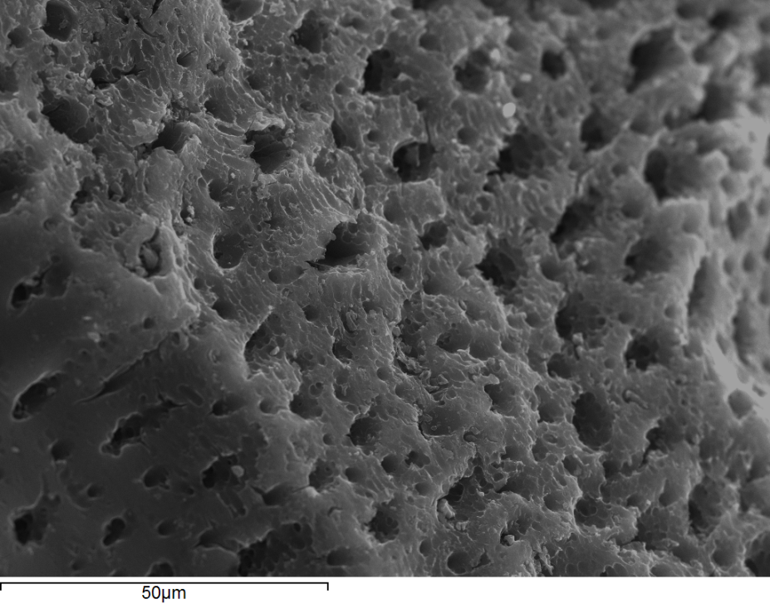
Objectives
The present study aims to:
Investigate biochars development and properties at high pyrolysis temperature.
Develop new effective sorbents with desired physicochemical characteristics for their potential use in wastewater treatment.
Characterize raw and produced materials:
  the surface area and the porosity of SCG.
  the suspension pH and ash content of SCG.
  the functional groups observed on the surface of SCG.
  the SEM micrographs of raw SCG, biochar and activated SCG.
X

Slide 7
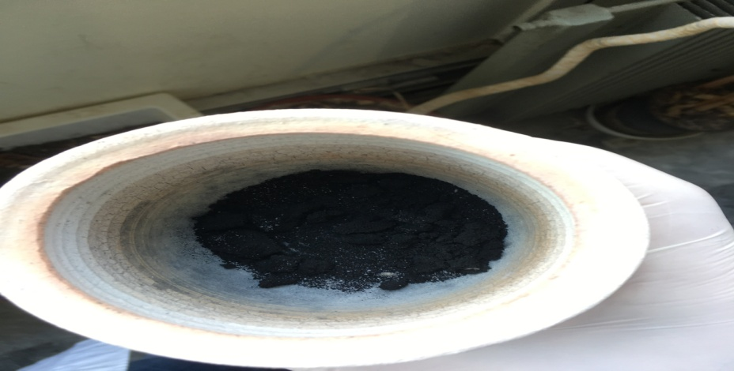
Biochar
Biochar is a rich in carbon by-product produced from agro-industrial wastes when biomass is heated under various pyrolytic conditions.
Raw spent coffee grains obtained from coffee shop located in the University of Patras Campus were used for the production of biochar SCG.
Biochar SCG activated with distilled H₂O (W-SCG), H₂SO₄ (SCG-S), H₃PO₄ (SCG-P), and NaOH (SCG-ALK).
X

Slide 8
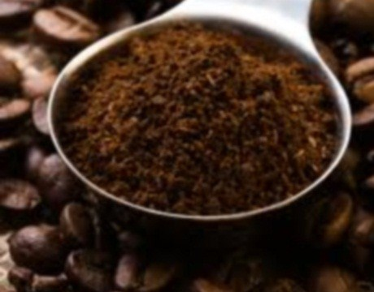
SCG
SCG
  Biosorbents – untreated
  Biochars – pyrolyzed
Wet raw SCG
~62.84 ± 0.63% moisture
X

Slide 9
W-SCG
Flushing with distilled water (3D)
at 70ºC
Into Vacuum Flask
pH neutral
Washed biochar heated over night at 110ºC
X

Slide 10
Surface area and Porosity
Samples | Surface Area (m²/g) | Micropore Area (m²/g) | External Area (m²/g) | Pore Volume (cm³/g) | Micropore Volume (cm³/g) | Pore Size (Å)
Raw SCG | 0.40 | - | 0.54 | 0.00067 | 0.000089 | -
SCG | 751 | 514 | 238 | 0.39 | 0.24 | 31
W- SCG | 858 | 603 | 255 | 0.44 | 0.28 | 32
SCG-P | 921 | 626 | 295 | 0.49 | 0.30 | 34
SCG-S | 914 | 601 | 313 | 0.49 | 0.29 | 34
SCG-ALK | 876 | 603 | 273 | 0.28 | 0.28 | 37
X

Slide 11
SCG-ALK
Standard solution (NaOH)
Concentration 2 M
Into Round Bottom Flask Double Neck
m biochar / V solution: 1 g / 20 mL
at 80ºC
4 h
Activated biochar heated over night at 110ºC
X

Slide 12
FTIR
0.5 mg of dried sample
turned into a pellet.
50 mg of dried KBr.
Wavenumber measurement range was 4000-400 cm⁻¹
Performed with a PerkinElmer FTIR spectrometer.
Analysed by IRSearchMaster 6.0 software.
X

Slide 13
Suspension pH
Electrolyte solution (NaNO₃)
pH 7
Concentration 0.1 M
Into vials
m sample / V solution: 0.32 g / 20 mL
24 h
Analysed by a portable multi-parameter analyser with pH electrode
X

Slide 14
Ash Content
Materials were placed in a Memmet oven at 50 ± 5ºC for several hours to remove the moisture.
1 g of drying raw SCG was heated at 750ºC for the determination of the ash content.
1 g of biochar SCG was heated at 750ºC for the determination of the ash content.
X

Slide 15
Surface area and porosity
Raw SCG was degassed at 60ºC under mild nitrogen flow for 1 h.
Biochar SCG was degassed at 300ºC under mild nitrogen flow for 1 h.
Performed by gas (N₂) adsorption−desorption with the Micromeritics TriStar 3000 Analyzer system using the Brunauer, Emmett, and Teller (BET) equation.
Analysed by Micromeritics TriStar 3000 software.
X

Slide 16
Pore size distribution
SCG
W-SCG
SCG-P
SCG-S
SCG-ALK
X

Slide 17
Ash Content
Raw SCG
1.7%
SCG
12%
X

Slide 18
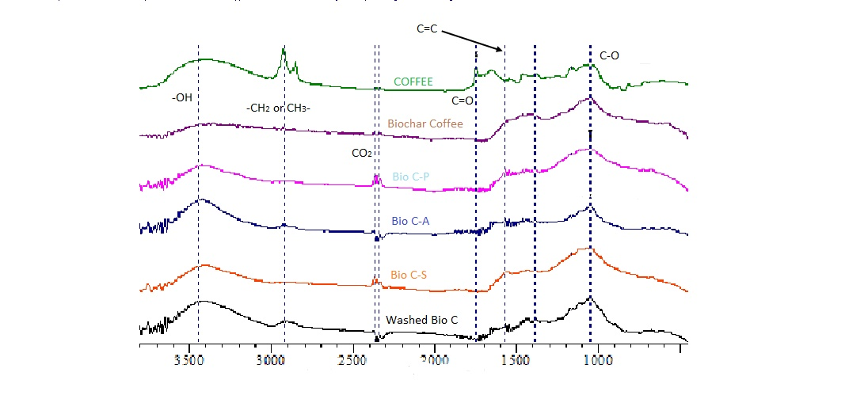
FTIR
Raw SCG
SCG
SCG-P
SCG-ALK
SCG-S
W-SCG
X

Slide 19
SCG-P
Model solution (H₃PO₄)
Concentration 2 M
Into Round Bottom Flask Double Neck
m biochar / V solution: 1 g / 20 mL
at 80ºC
4 h
Activated biochar heated over night at 110ºC
X

Slide 20
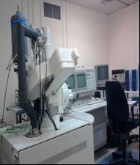
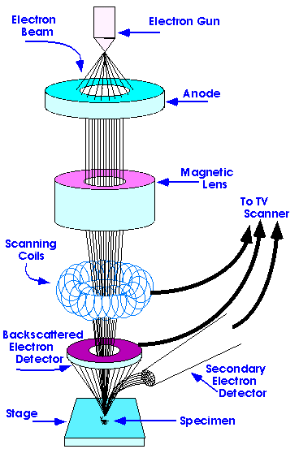
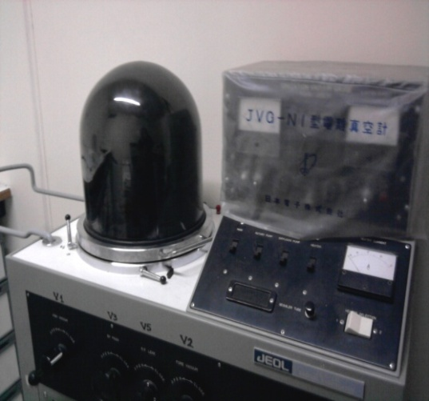
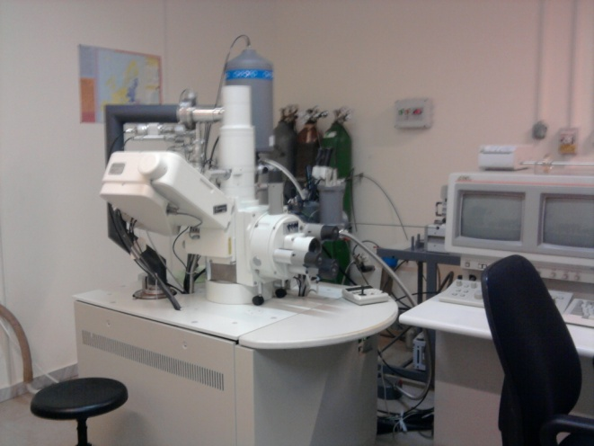
SEM
Gold sputtering JEOL, JFC-1100.
SEM, JEOL 6300
SEM parts
X

Slide 21
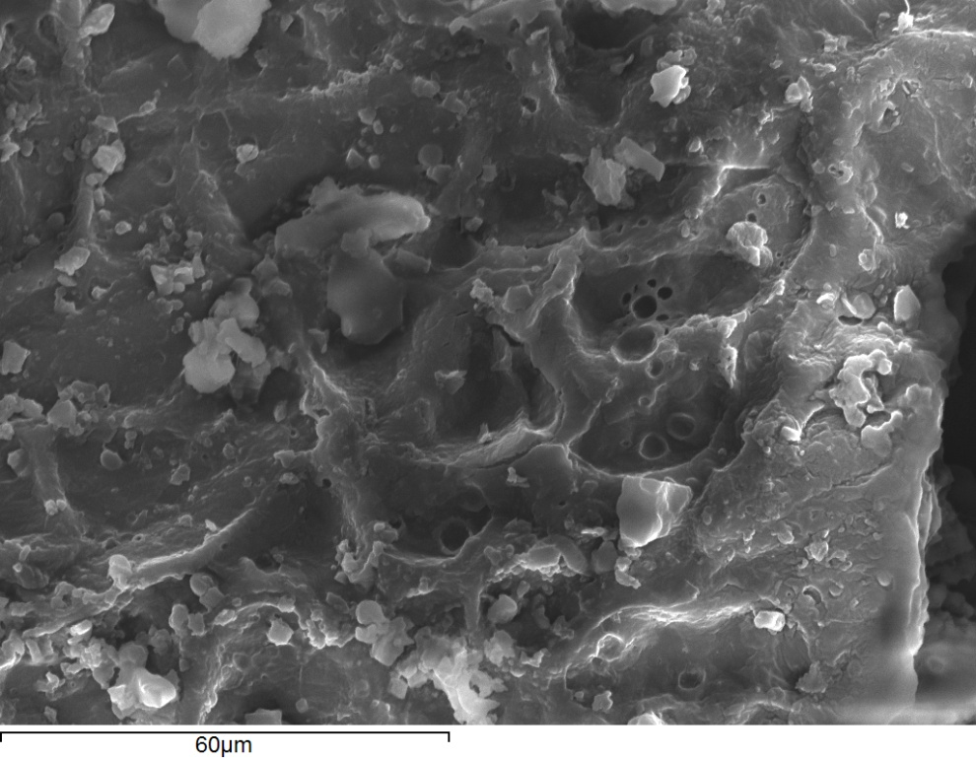
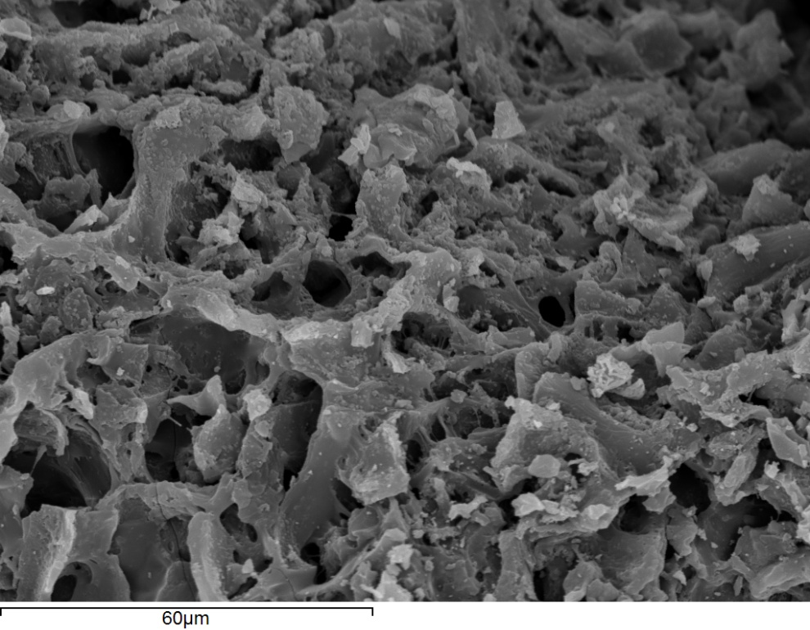
SEM
1/3
Raw SCG
Biochar SCG obtained at 850ºC

Slide 22
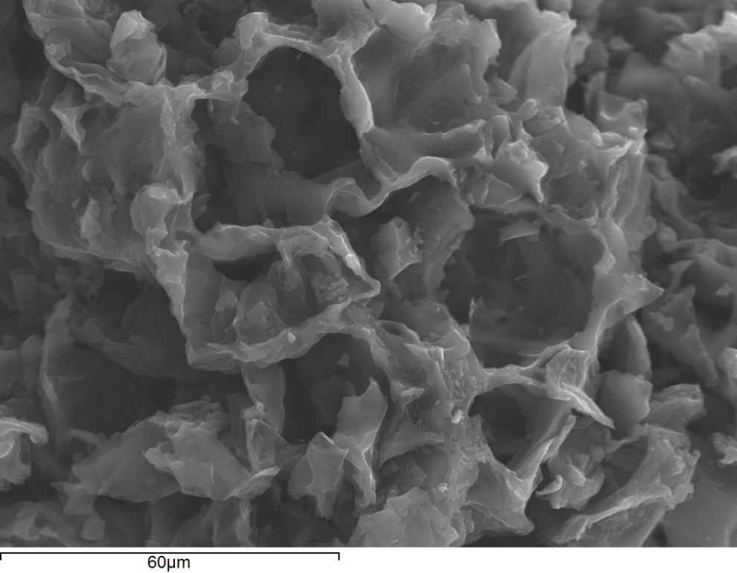
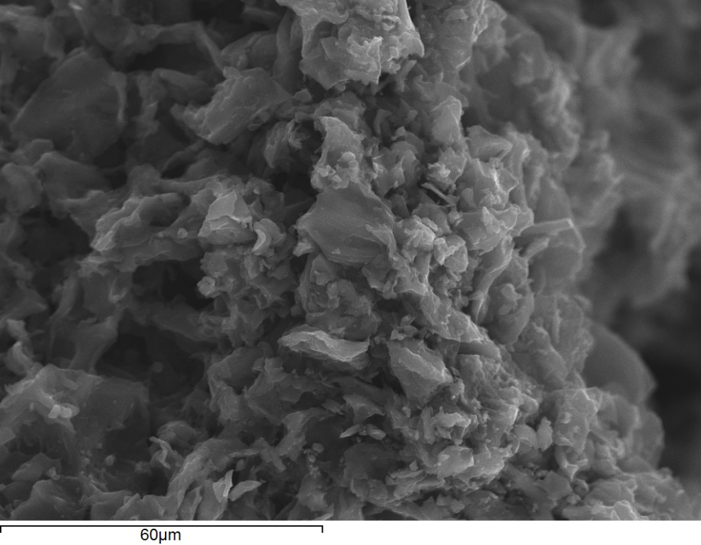
SEM
2/3
Biochar SCG activated with H₂SO₄
(SCG-S)
Biochar SCG activated with H₃PO₄
(SCG-P)

Slide 23
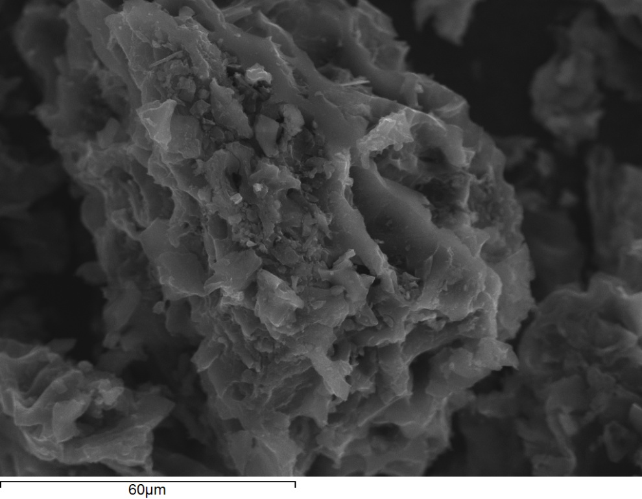
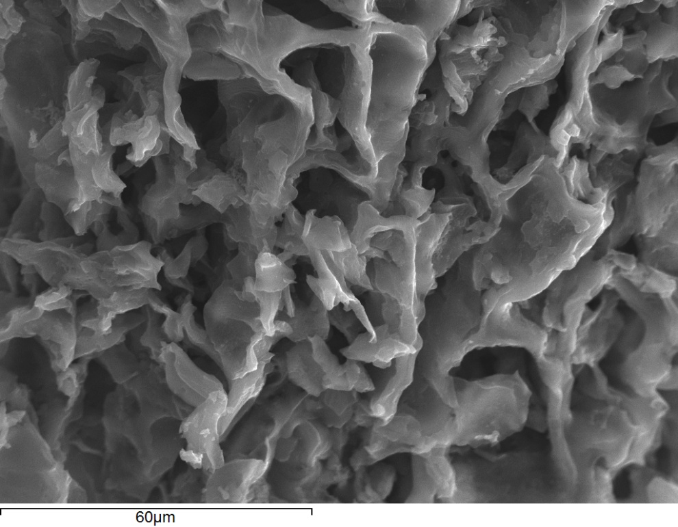
SEM
3/3
Biochar SCG activated with NaOH
(SCG-ALK)
Biochar SCG activated with H₂O
(W-SCG)
X

Slide 24
SEM Surface Elemental Analysis
Surface Elemental Analyses of raw SCG (left) and biochar SCG (right), respectively.
X

Slide 25
SCG-S
Model solution (H₂SO₄)
Concentration 2 M
Into Round Bottom Flask Double Neck
m biochar / V solution: 1 g / 20 mL
at 80ºC
4 h
Activated biochar heated over night at 110ºC
X

Slide 26
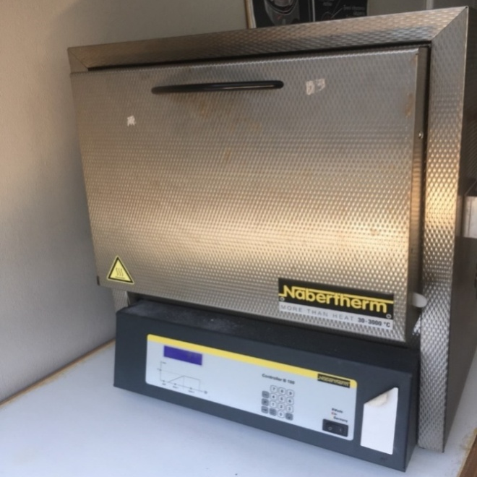
Pyrolysis
A fireproof ceramic vessel of 265 cm³ was used.
Samples were:
  Heated at 850ºC under limited
  oxygen conditions.
  Placed in an oven with operating
  range 30-1100ºC.
X

Slide 27
Suspension pH
X

Slide 28
Conclusions
Biochars SCG are mainly microporous materials with high specific surface area; 63% of the pore volume of the resulted biochar was due to micropores.
The activation of biochars with warm distilled H₂O and aqueous acidic or alkaline solutions, led to a significant increase of specific surface area.
Micrographs of materials showed obvious differences in morphology between raw SCG and biochar SCG. Many pores (macropores) were formed on the surface of biochar.
The activated SCG-P shows an increase of micropore area compared to SCG-S, SCG-ALK, W-SCG.
Biochars SCG obtained at 850ºC are alkaline in nature.
A few peaks occurred at SCG and activated biochar FTIR spectra compared to the raw SCG FTIR spectrum.
The FTIR spectra for SCG-ALK and W-SCG were similar.
1/2

Slide 29
General Conclusions
Among the various types of pyrolized and activated samples (biochars) obtained from raw spent coffee grains, statistically there was no significant difference on their physicochemical properties.
The results of the present study can be used by industries who deal with these byproducts. The new materials can be used as sorbents for water purification by the same industries.
For the five biochar samples, the characterization results indicated that the W-SCG and SCG-P is more favourable to be tested for their sorption capacity and catalytic activities in future studies due to their environmentally friendly and cost-effective activation.
X
2/2

Slide 30

Acknowlegment
We acknowledge support of this work by the project “Research Infrastructure on Food Bioprocessing Development and Innovation Exploitation – Food Innovation RI” (MIS 5027222), which is implemented under the Action “Reinforcement of the Research and Innovation Infrastructure”, funded by the Operational Programme "Competitiveness, Entrepreneurship and Innovation" (NSRF 2014-2020) and co-financed by Greece and the European Union (European Regional Development Fund).
X

