Slide 1




Geochemical Significance and Formation of Suçatı Pb – Zn Deposits – Easterns Taurides
2020

Slide 2

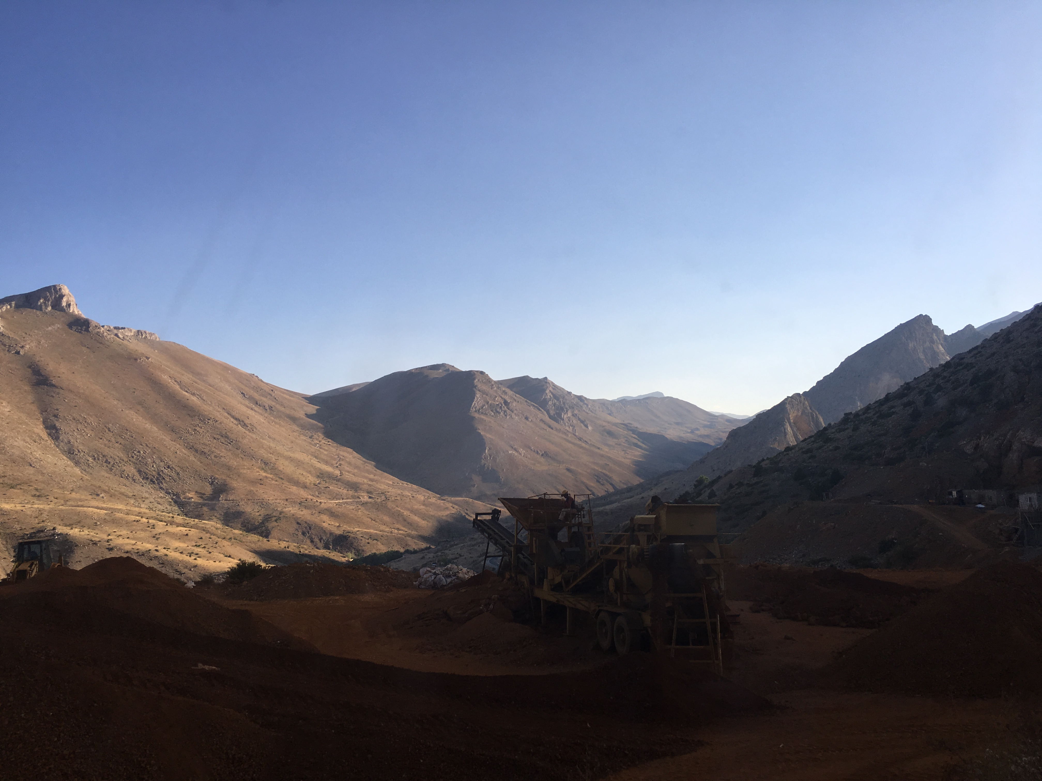
Geochemical Significance and Formation of Suçatı Pb – Zn Deposits – Easterns Taurides
Ali Erdem Bakkalbasi, Hatice Nur Bayram, Mustafa Kumral, and Ali Tugcan Unluer
Istanbul Technical University
IMPORTANT EXPLANATION
First of all, we are very grateful for your interest in our work. This study is carried out by us (Hatice Nur Bayram & Ali Erdem Bakkalbaşı) and with us under the supervision of research assistant Ali Tuğcan Ünlüer and Assoc. Prof. Dr. Mustafa Kumral as part of a graduation design project. After the field study carried out in September 2019, our studies have been continuing until now, but as you know, our physical relationship with the University has been cut since 15 March 2020 due to the COVID-19 outbreak. This big obstacle has finished the possibility of using the laboratories at the university and also paused our work with our thesis advisor (Assoc. Prof. Mustafa KUMRAL).
Although our research process is incomplete, we are happy to convey our field observations and what we have done up to this time.
Hatice Nur Bayram & Ali Erdem Bakkalbaşı (Undergraduate Students, 4th grade.)
Istanbul Technical University, Geological Engineering Department, Istanbul

Slide 3
Geochemical Significance and Formation of Suçatı Pb – Zn Deposits – Easterns Taurides
Ali Erdem Bakkalbasi, Hatice Nur Bayram, Mustafa Kumral, and Ali Tugcan Unluer
Istanbul Technical University
Abstract
The Middle Tauride Orogenic Belt is a productive enviroment in terms of Pb-Zn ore deposits, mostly associated with Permian aged dolomitized, shallow marine platform type carbonate rocks. There have been many studies on the origin of the ore deposits in the region, there are two important approaches that stand out for the formation of the ore deposits: the first theory is hydrothermal deposits with magmatic origin, and the other theory is Missisippi Valley-type (MVT) deposits related with the carbonate rocks commonly found in the region. Field studies at the Suçatı (Kayseri – Yahyalı, Central Anatolia, Turkey, East of Aladağlar extension of the Taurides) ore district in the Aladağ geologic unit indicate that the deposits in the region are associated with Paleo-Tethys limestones, fossiliferous limestones and dolomitic limestones. Mineralization is related to Lower Permian aged carbonate rocks include primary mineralization ore minerals as galena, sphalerite, smithsonite and goethite and as a product of hydrothermal activity, calcite mineral filled within fractures and cracks represents gangue minerals. As a result of geochemical analysis of the samples collected from the ore zones, PbO values range between 25.93% - 0.012%, ZnO values range between 51.01% - 0.042%, Fe2O3 values range between 42.81% - 10.21%. In conclusion hydrothermal activities closely related with compressional and extentional tectonic regimes took place in multiphase mineralization.
Keywords: Pb-Zn Deposits, MVT, Taurides, Yahyalı

Slide 4
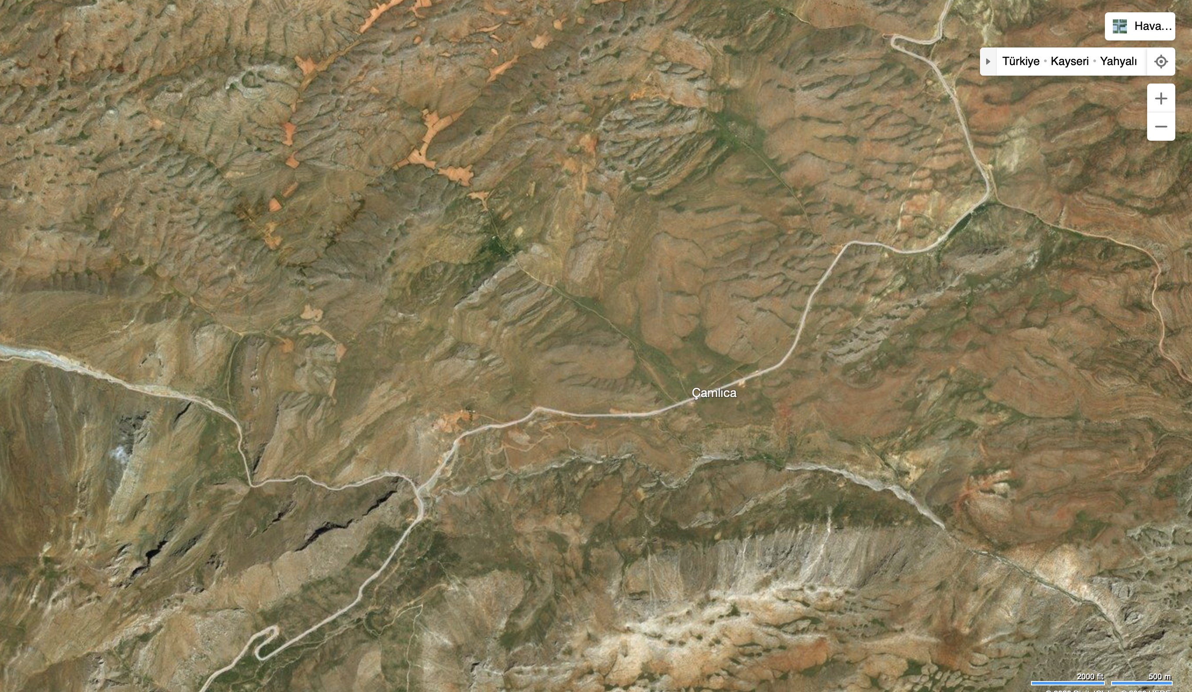
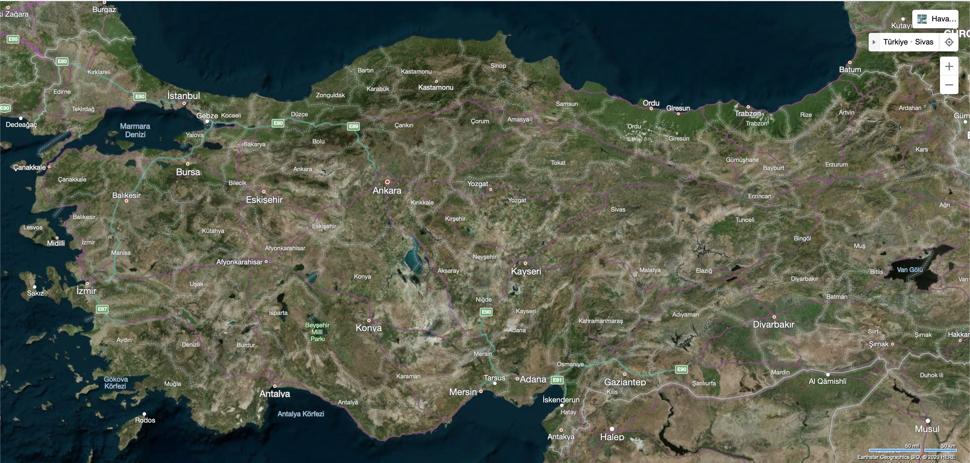
Geochemical Significance and Formation of Suçatı Pb – Zn Deposits – Easterns Taurides
Ali Erdem Bakkalbasi, Hatice Nur Bayram, Mustafa Kumral, and Ali Tugcan Unluer
Istanbul Technical University
Figure 1: Location of the study field.

Slide 5
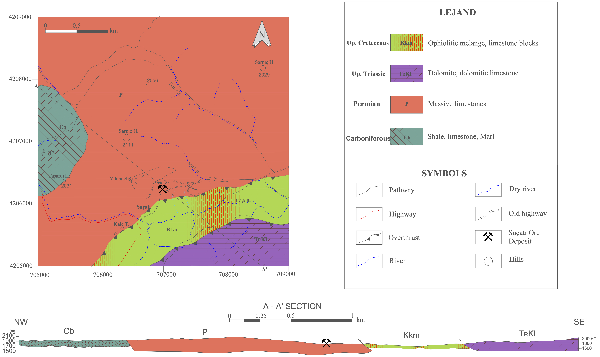
Geochemical Significance and Formation of Suçatı Pb – Zn Deposits – Easterns Taurides
Ali Erdem Bakkalbasi, Hatice Nur Bayram, Mustafa Kumral, and Ali Tugcan Unluer
Istanbul Technical University
General Geology – Stratigraphy
The study area covers the Central Anatolia region, Central Taurus Mountains, south of Kayseri - Yahyalı. The first geological investigations, including the study area and around it, were carried out by Blumenthal (1941, 1946, 1952). Other studies related to the region are as follows: Van Der Kleyn (1968), Bingöl (1978), Çakır (1978), Yetiş (1978), Tekeli et al. (1981,1984,1987), Atabey et al. (1990) and Alan et al. 2007.
Figure 2: Geological map of the study area

Slide 6
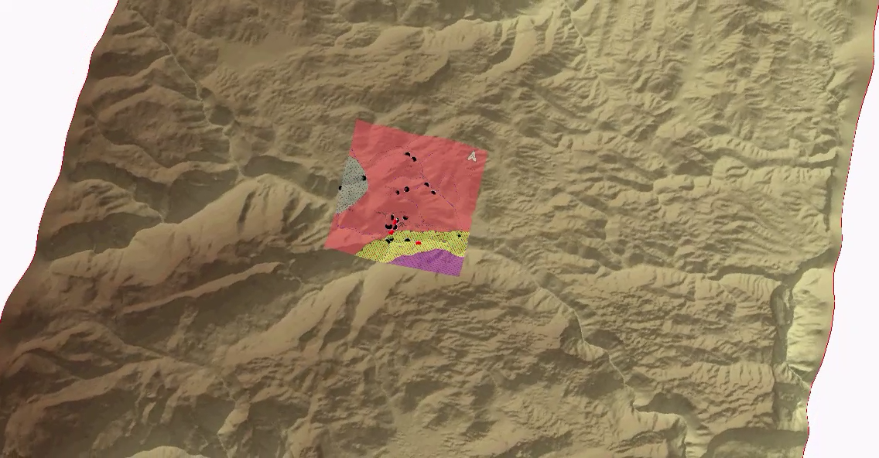
Geochemical Significance and Formation of Suçatı Pb – Zn Deposits – Easterns Taurides
Ali Erdem Bakkalbasi, Hatice Nur Bayram, Mustafa Kumral, and Ali Tugcan Unluer
Istanbul Technical University
General Geology – Stratigraphy- 3D model video of the study field.
Analyzed samples
Collected samples

Slide 7
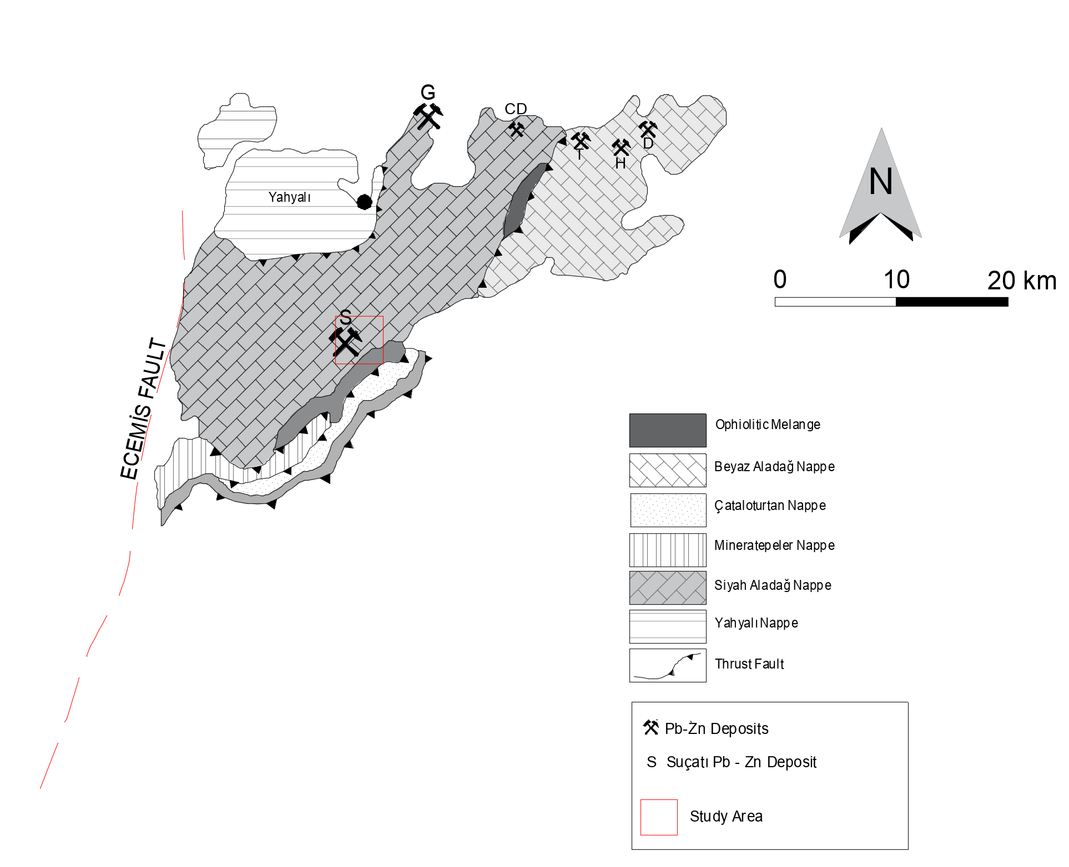
Geochemical Significance and Formation of Suçatı Pb – Zn Deposits – Easterns Taurides
Ali Erdem Bakkalbasi, Hatice Nur Bayram, Mustafa Kumral, and Ali Tugcan Unluer
Istanbul Technical University
General Geology – Stratigraphy
There are two important geological units covering the study area. Aladağ Units, whose age range varies from Devonian to Upper Cretaceous, takes its name from Aladağ, which is an extension of the Middle Taurus, and was named Aladağ Units by Özgül (1976) for the first time. The first study on the unit was made by Blumenthal (1941) and was also named as Siyah Aladağ Nappe. In addition, the formations that are observed in the study area and belong to Aladag Units are Belemedik (Carboniferous) formation and Undifferentiated Permian (Permian). Another unit, the Bozkır Unit, was named for the first time by Özgül (1976) and contains different types of limestones and ophiolitic melange deposited in the Triassic-Cretaceous age range. The formations seen in the study area within this unit are Lorutdağı (Upper Triassic) and Kızılcadağ Ophiolitic Melange and Olistostrome (Upper Cretaceous).
Figure 2.1: Tectonic Units of Aladağlar (Originated from Tekeli, 1980).

Slide 8
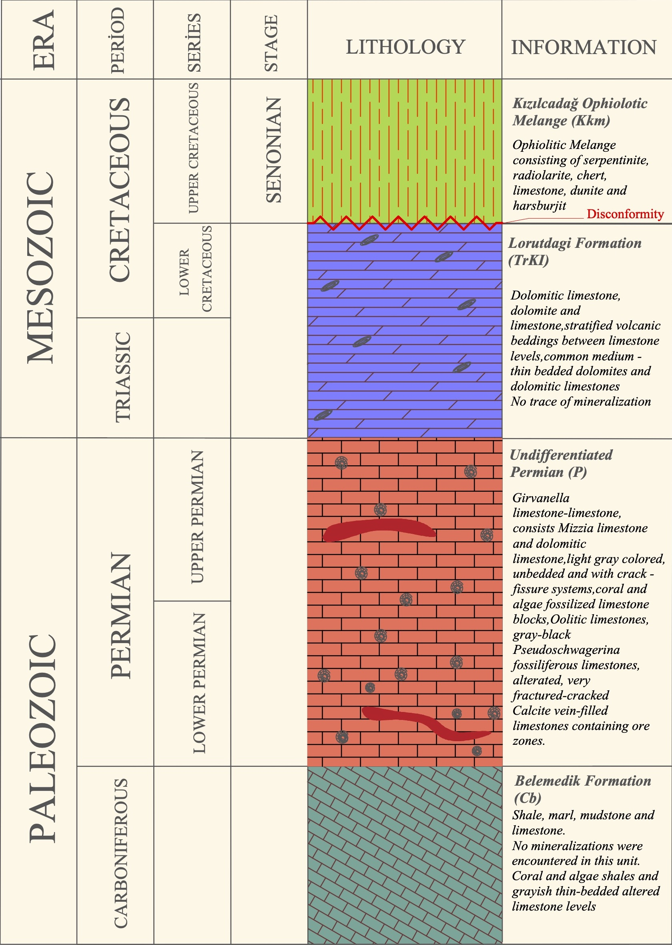
Geochemical Significance and Formation of Suçatı Pb – Zn Deposits – Easterns Taurides
Ali Erdem Bakkalbasi, Hatice Nur Bayram, Mustafa Kumral, and Ali Tugcan Unluer
Istanbul Technical University
General Geology – Stratigraphy
ALADAĞ UNIT
BELEMEDİK FORMATION (Cb)
Formation was named by Gül et al. (1984). It consists mainly of shale, marl, mudstone and limestone. No mineralizations were encountered in this unit. The unit contains very thin bedded, dark brown shales with broken structure at the beginning of sequence and continues with coral and algae shales and grayish thin-bedded altered limestone levels. The sequence is intercalated. Thin – medium bedded marls and thin bedded mudstones are rearly seen in this continious sequence. The formation, which has a transitive contact with Early Permian aged Sarıoluk formation (part of Undifferentiated Permian) at the top of the formation, has a visible thickness of 300-350 m (Alan et. al., 2007.). Alan et al. (2007) determined the age of the unit as Carboniferous with the fossil community they compiled.
UNDIFFERENTIATED PERMIAN (P)
This Formation is a combination of Sarıoluk formation which consists Girvanella limestone-limestone named by Ayhan and Langeranlı (1986) and Yellice formation (Özgül, 1977) which consists Mizzia limestone and dolomitic limestone. Considering the complex structure and lithology in this formation, it can be said that the general dominant lithology consists of Permian aged limestones with different properties. Within the scope of this research, this formation has been accepted as Permian aged massive limestones.
The formation covers more than half of the study area of approximately 17 km². All of the ores observed were associated with limestones of this formation. The most common limestones are light gray colored, unbedded and with crack – fissure systems. There are coral and algae fossilized limestone blocks in the north of the formation. Oolitic limestones are observed in the south. Again, in the south of the formation, gray-black Pseudoschwagerina fossiliferous limestones are observed. Apart from these, there are also alterated, very fractured-cracked, calcite vein-filled limestones containing ore zones, which occupy a large area in the part of the formation. Looking at all these limestones, a generally micritic texture can be seen. The sedimentation environment of the formation is thought to be shallow marine. The formation has a tectonic contact with Kızılcadağ Ophiolitic Melange and Olistostrome, which was later dragged along the southeast border.
Figure 2.2: Stratigraphic column of the study area.

Slide 9
Geochemical Significance and Formation of Suçatı Pb – Zn Deposits – Easterns Taurides
Ali Erdem Bakkalbasi, Hatice Nur Bayram, Mustafa Kumral, and Ali Tugcan Unluer
Istanbul Technical University
General Geology – Stratigraphy
BOZKIR UNIT
KIZILCADAG OPHIOLITHIC MELANGE and OLISTOSTROM (Kkm)
The unit named by Poisson (1977) has a rock community consisting of serpentinite, radiolarite, chert, limestone, dunite and harsburjit (MTA, 2010). The age of Kizilcadag ophiolitic melange and olistostrome is considered to be Late Senonian and included limestones in the shelf area in the ophiolitic region settled in this period. There are gravel-sized serpentines which are common and likely to belong to the melange in the Köşk River in the south of the study area. Kizilcadag ophiolitic melange and olistostrome tectonically overlie the units belonging to Aladag Units and tectonically overlain by units of Bozkır Units. However, due to tectonism, it is possible to observe the unit in nappe contacts and other units belonging to Bozkır unit (MTA, 2010).
LORUTDAĞI FORMATION (TRKI)
The unit was named by Alan et al. (2007). It consists mainly of dolomitic limestone, dolomite and limestone. Although the unit rarely shows layered volcanic interbedded limestone levels, the most common ones are medium - thin bedded dolomites and dolomitic limestones. The thickness of the unit could not be determined precisely, but Alan et al. (2007) have determined 700 - 800 m of visible thickness. The unit, located in the south-eastern part of the study area, is tectonically overlain by the Kızılcadağ ophiolitic melange and olistostrome at the top and base. In the remaining part of the study area, there is no trace of mineralization related to formation. The lower levels of the formation show similar characteristics with the medium to low energy platform limestones in Permian. The lower levels of the formation show similar characteristics with the low-energy platform limestones found in Undifferentiated Permian. The upper parts are thought to represent a higher energy, deep marine environment.

Slide 10
Geochemical Significance and Formation of Suçatı Pb – Zn Deposits – Easterns Taurides
Ali Erdem Bakkalbasi, Hatice Nur Bayram, Mustafa Kumral, and Ali Tugcan Unluer
Istanbul Technical University
Tectonic Evolution
Aladağlar region is a region where carbonate sediments between Devonian and Cretaceous and Cretaceous ophiolitic rocks are quite common. The carbonate rocks in the region generally consist of shelf-type limestones and their ages vary between Devonian and Jurassic. In the Senonian, the region has taken its present form by dragging the ophiolitic complex into limestones. This tectonic evolution of Aladaglar carbonate platform gives important ideas about the formation mechanism of Pb - Zn mineralizations in the region. In the researches it is said that the region is a shelf type stable carbonate platform until Maastrichtian. Later, the region underwent block faulting and napping, respectively. The fragmentation caused by the tectonic regime in the region still continues today (Koçyiğit, 1981). The first studies on the structural evolution of Aladaglar and the existence of a napped structure were first revealed by Blumenthal (1952) and Metz (1956). The structural evolution of Aladaglar was examined by Tekeli (1980) in 3 stages. These stages are 1) Stable Continent Edge Period, 2) Continental Edge Disruption and Ophiolite Settlement, 3) Napping and Orogeny.

Slide 11
Geochemical Significance and Formation of Suçatı Pb – Zn Deposits – Easterns Taurides
Ali Erdem Bakkalbasi, Hatice Nur Bayram, Mustafa Kumral, and Ali Tugcan Unluer
Istanbul Technical University
Tectonic Evolution
It is possible to say that until the Senonian there was a stable, low slope and low erosion period of continental margin. In this period, carbonated autochthonous rock groups belonging to the Tetis ocean constitute the region. The main studies of this period are Argyriadis, 1974; Belov, 1973 and Ricou et al. (Figure 2.3).
One of the important elements in the period of stable continental edge disruption and ophiolitic settlement that started in Senonian is block faulting. The shelf type carbonate platform in the Upper Triassic-Lower Cretaceous space collapsed by block faulting and the ophiolitic material overlying the Senonian basin -formed on the collapsed platform- formed the Aladağ ophiolite melange. Although no precise explanation can be made for the ophiolitic rocks in the Senonian basin and the disruption of the continental margin, opinions of this problem have been gathered in two groups: The idea of diapiric rise of the ocean crust and the upper mantle near the continental edge supported by Gass et al. (1975) and Stonoley (1975). Another approach is that connects settlement of the ophiolite to tectonic movements. This approach is supported by Coleman (1971) and Dewey-Bird (1971). (Figure 2.3).
When it came to Maastrichtian, the carbonate platform collapsed due to block faulting in Senonian and the new reservoir formed on it were stuck under the compressive forces and formed the nappes that went down to the depth of the platform. Above these, Aladağ peridotite nappe and the metamorphic slice beneath it are located. Different tectonostratigraphic units formed as a result of this event were named by Özgül et al. (1973) (Tekeli, 1980). (Figure 2.1).

Slide 12
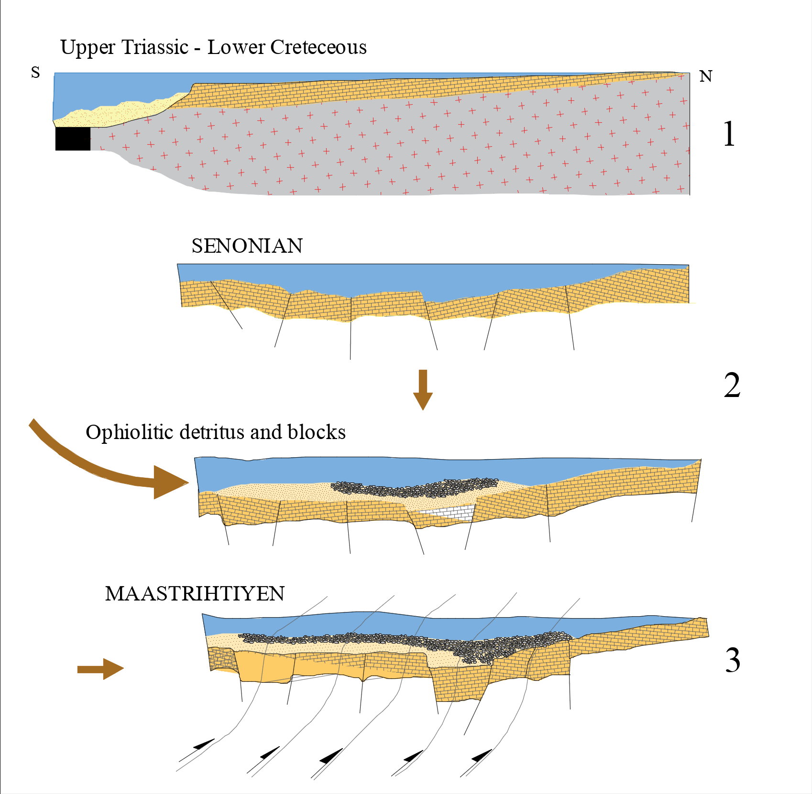
Geochemical Significance and Formation of Suçatı Pb – Zn Deposits – Easterns Taurides
Ali Erdem Bakkalbasi, Hatice Nur Bayram, Mustafa Kumral, and Ali Tugcan Unluer
Istanbul Technical University
Tectonic Evolution
Figure 2.3: Tectonic evolution of Aladağlar (Originated from Tekeli, 1980).

Slide 13
Geochemical Significance and Formation of Suçatı Pb – Zn Deposits – Easterns Taurides
Ali Erdem Bakkalbasi, Hatice Nur Bayram, Mustafa Kumral, and Ali Tugcan Unluer
Istanbul Technical University
Geochemistry and Mineralization
In general terms, the region has common mineralization which are lead-zinc mineralization. Göynük, Celaldere, Tekke, Havadan and Suçatı lead-zinc mineral deposits, which are known to exist in the surrounding regions and which are also subject to academic studies, are available.
The mineralization observed in the Suçatı region are found within the shallow marine limestones in the Permian-Jurassic age range. These limestones in the region have crack sets systematically and the faults compatible with regional tectonics. The study area is located in the Black Aladağ Nappe and the presence of the nappe has great importance for ore mineralization. Considering that nap descended to the depths, the fractures and faults caused by it, carried sea water and mixed and heated in Pb and Zn rich solutions. These solutions settled in the karstic cavities and formed mineralization. As a result of geochemical analysis of the samples collected from the ore zones, PbO values range between 25.93 % - 0.012 %, ZnO values range between 51.01 % - 0.042 %, Fe₂O₃ values range between 42.81 % - 10.21 %.

Slide 14
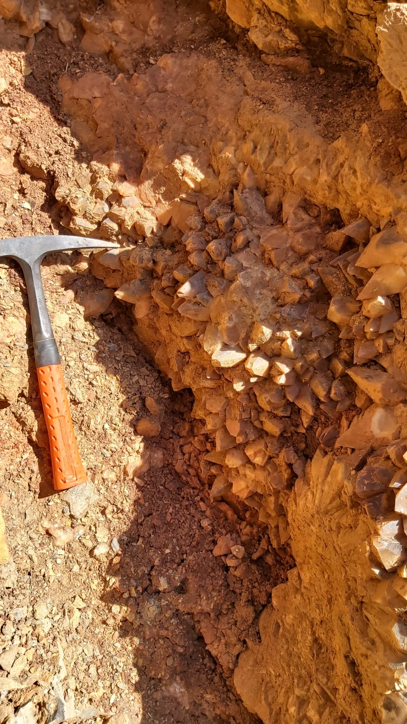
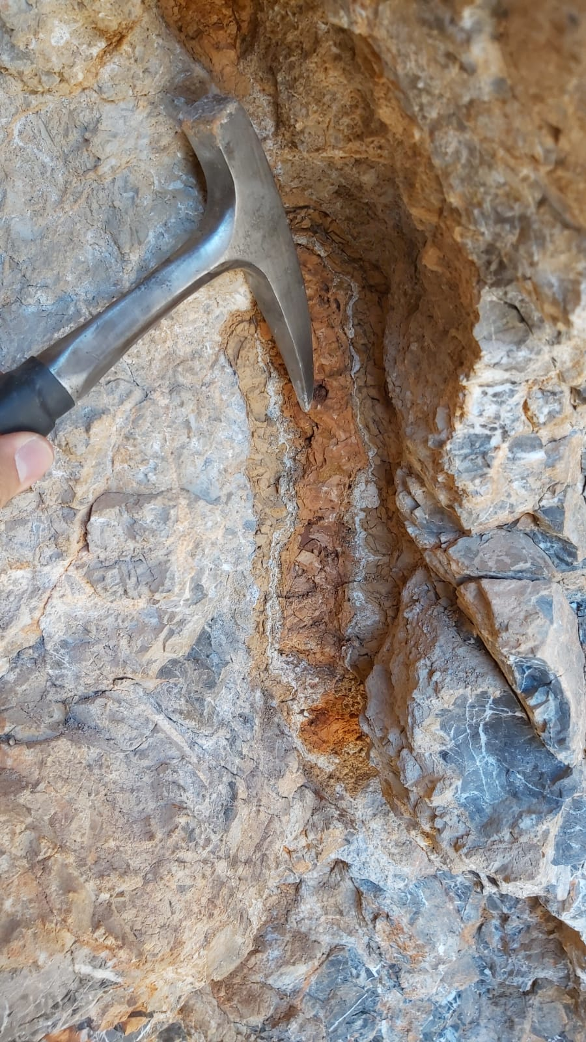
Geochemical Significance and Formation of Suçatı Pb – Zn Deposits – Easterns Taurides
Ali Erdem Bakkalbasi, Hatice Nur Bayram, Mustafa Kumral, and Ali Tugcan Unluer
Istanbul Technical University
Geochemistry and Mineralization
A
B
Figure 3: Calcite claster (A), Zn ore settled in small karstic cavity (B)

Slide 15
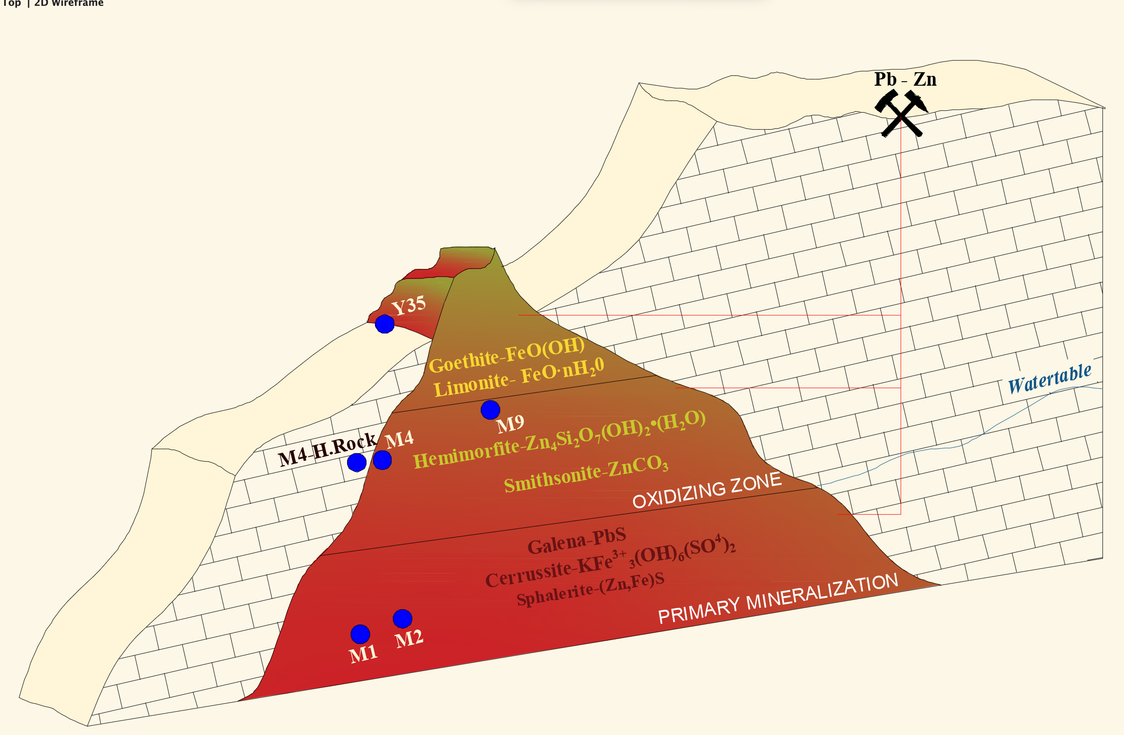
Geochemical Significance and Formation of Suçatı Pb – Zn Deposits – Easterns Taurides
Ali Erdem Bakkalbasi, Hatice Nur Bayram, Mustafa Kumral, and Ali Tugcan Unluer
Istanbul Technical University
Geochemistry and Mineralization
The stages of the Suçatı mineralization can be examined in 3 zones; alteration zone, oxidation zone and zone where primary mineralization occur. As seen in the figure, samples taken from the alteration zone showed that this zone contains Limonite (FeO(OH) · nH₂O) and Goethite (FeO(OH)) minerals, and these samples are at the top of the mineralization zones. Oxidation zone consist of Hemimorphite (Zn₄Si₂O₇(OH)₂· (H₂O)) and Smithsonite (ZnCO₃) minerals and are beneath under the alteration zone. The geochemical analysis of the samples taken from the mine and where the primary mineralization occurred contains; Galena (PbS), Sphalerite (ZnS) and Jarosite (KFe³⁺ ₃(OH)₆(SO₄)₂) minerals. Another result of hydrothermal activities are calcite minerals that are abundant in karstic cavities. These minerals observed in the field as calcite cluster, can be described as gangue minerals accompanying mineralization.
Samples were representatively placed in zones according to geochemical and mineralogical data obtained from XRD and XRF analysis. It is not their real location.
The figure is a representative and scaleless drawing of mineralization in the study area.
Samples
Figure 3.1: Mineralization zones.

Slide 16
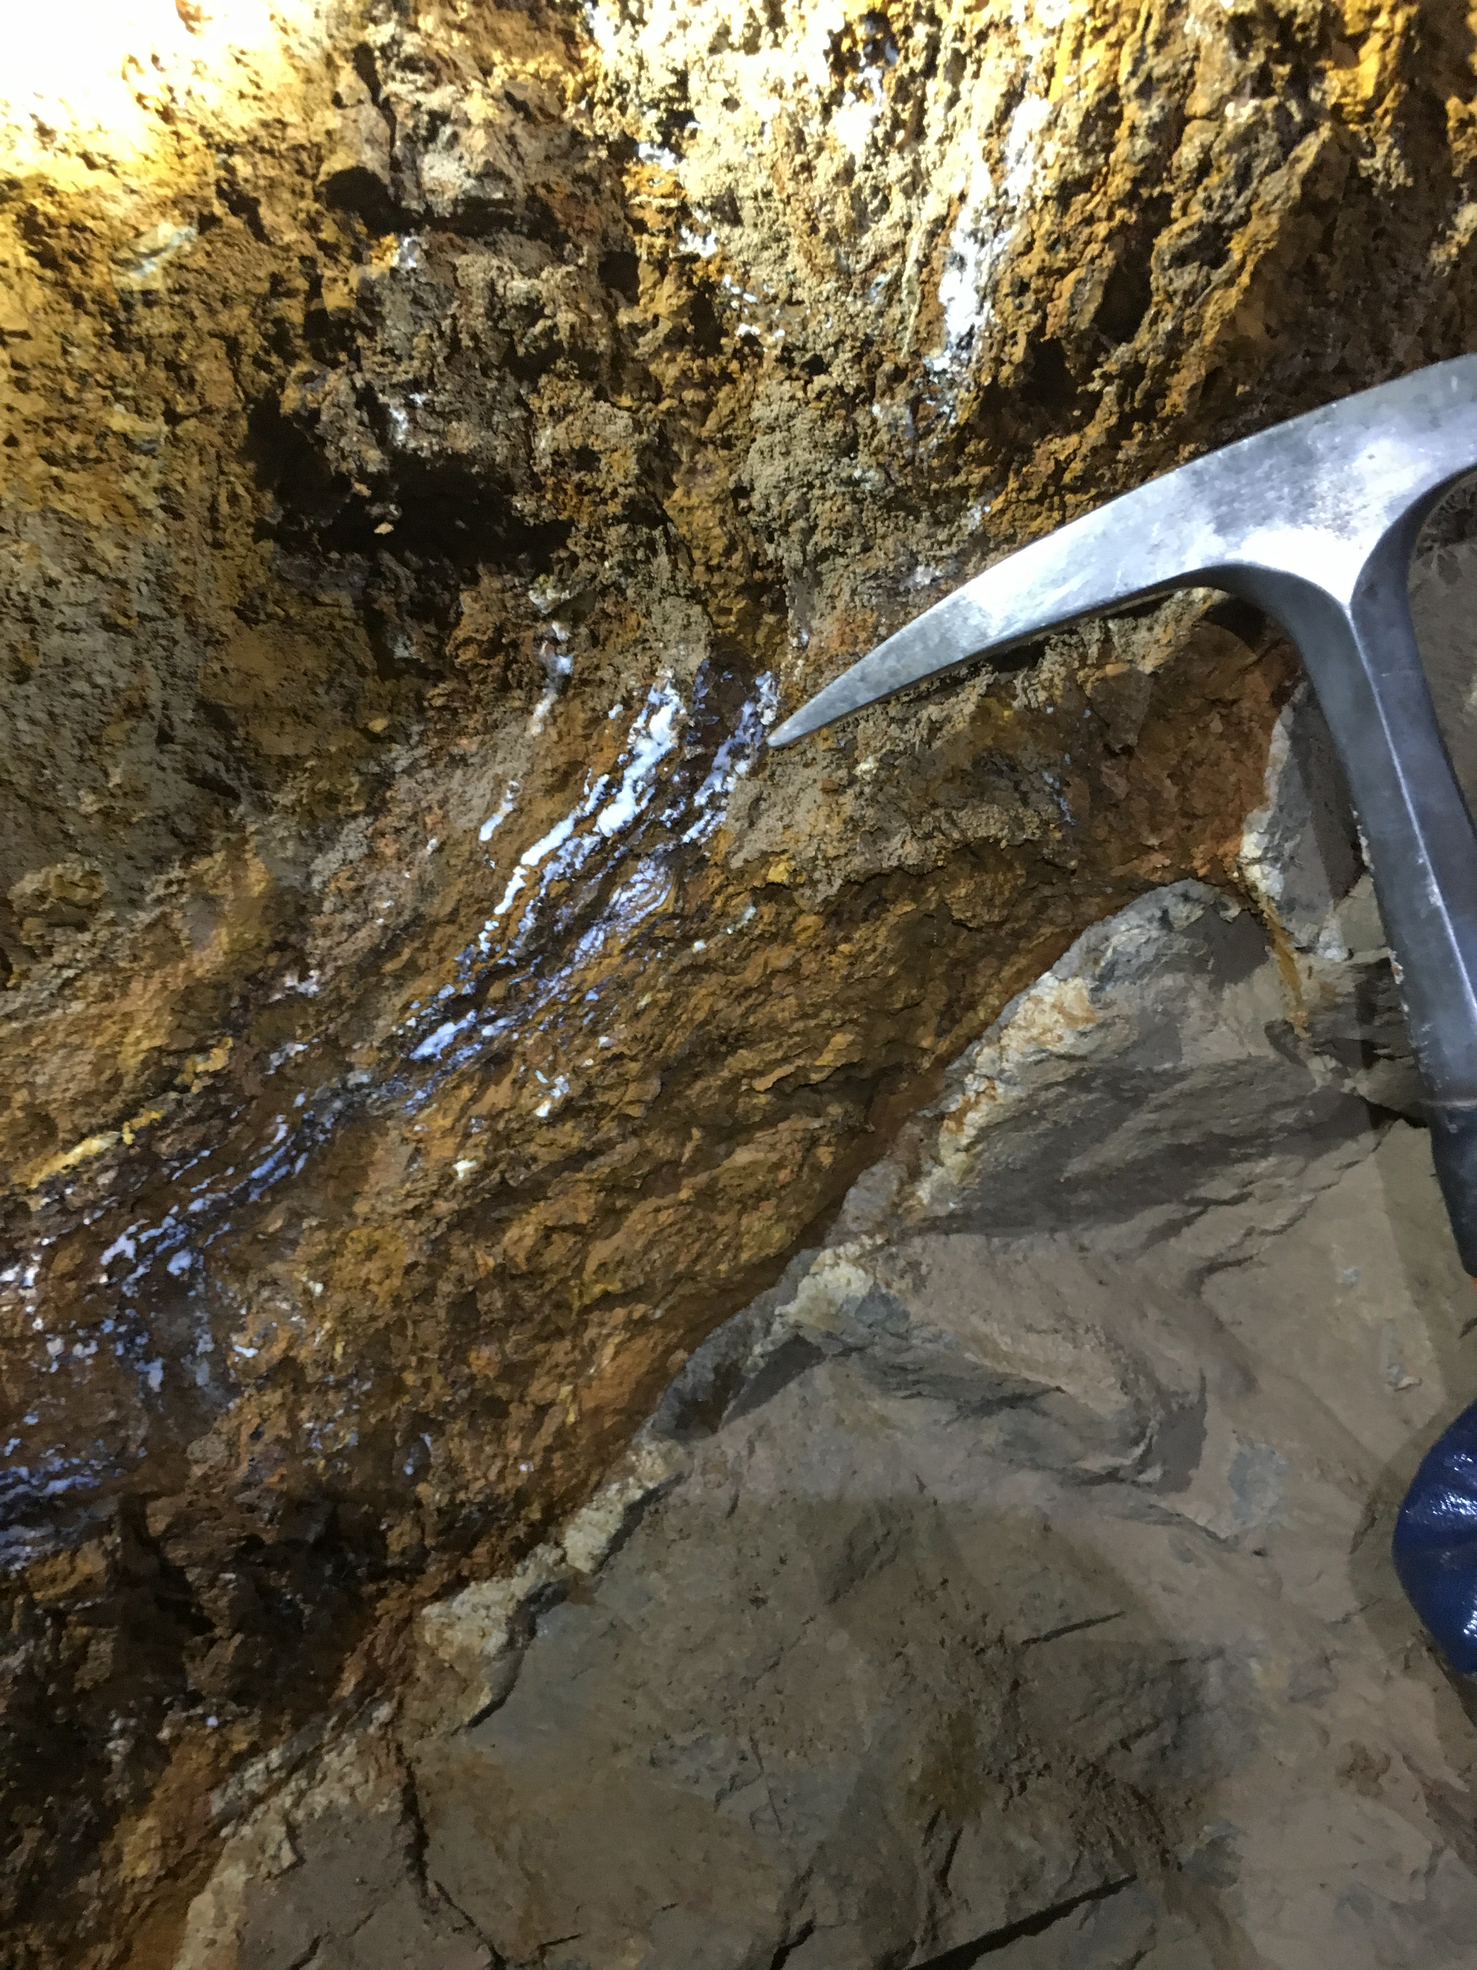
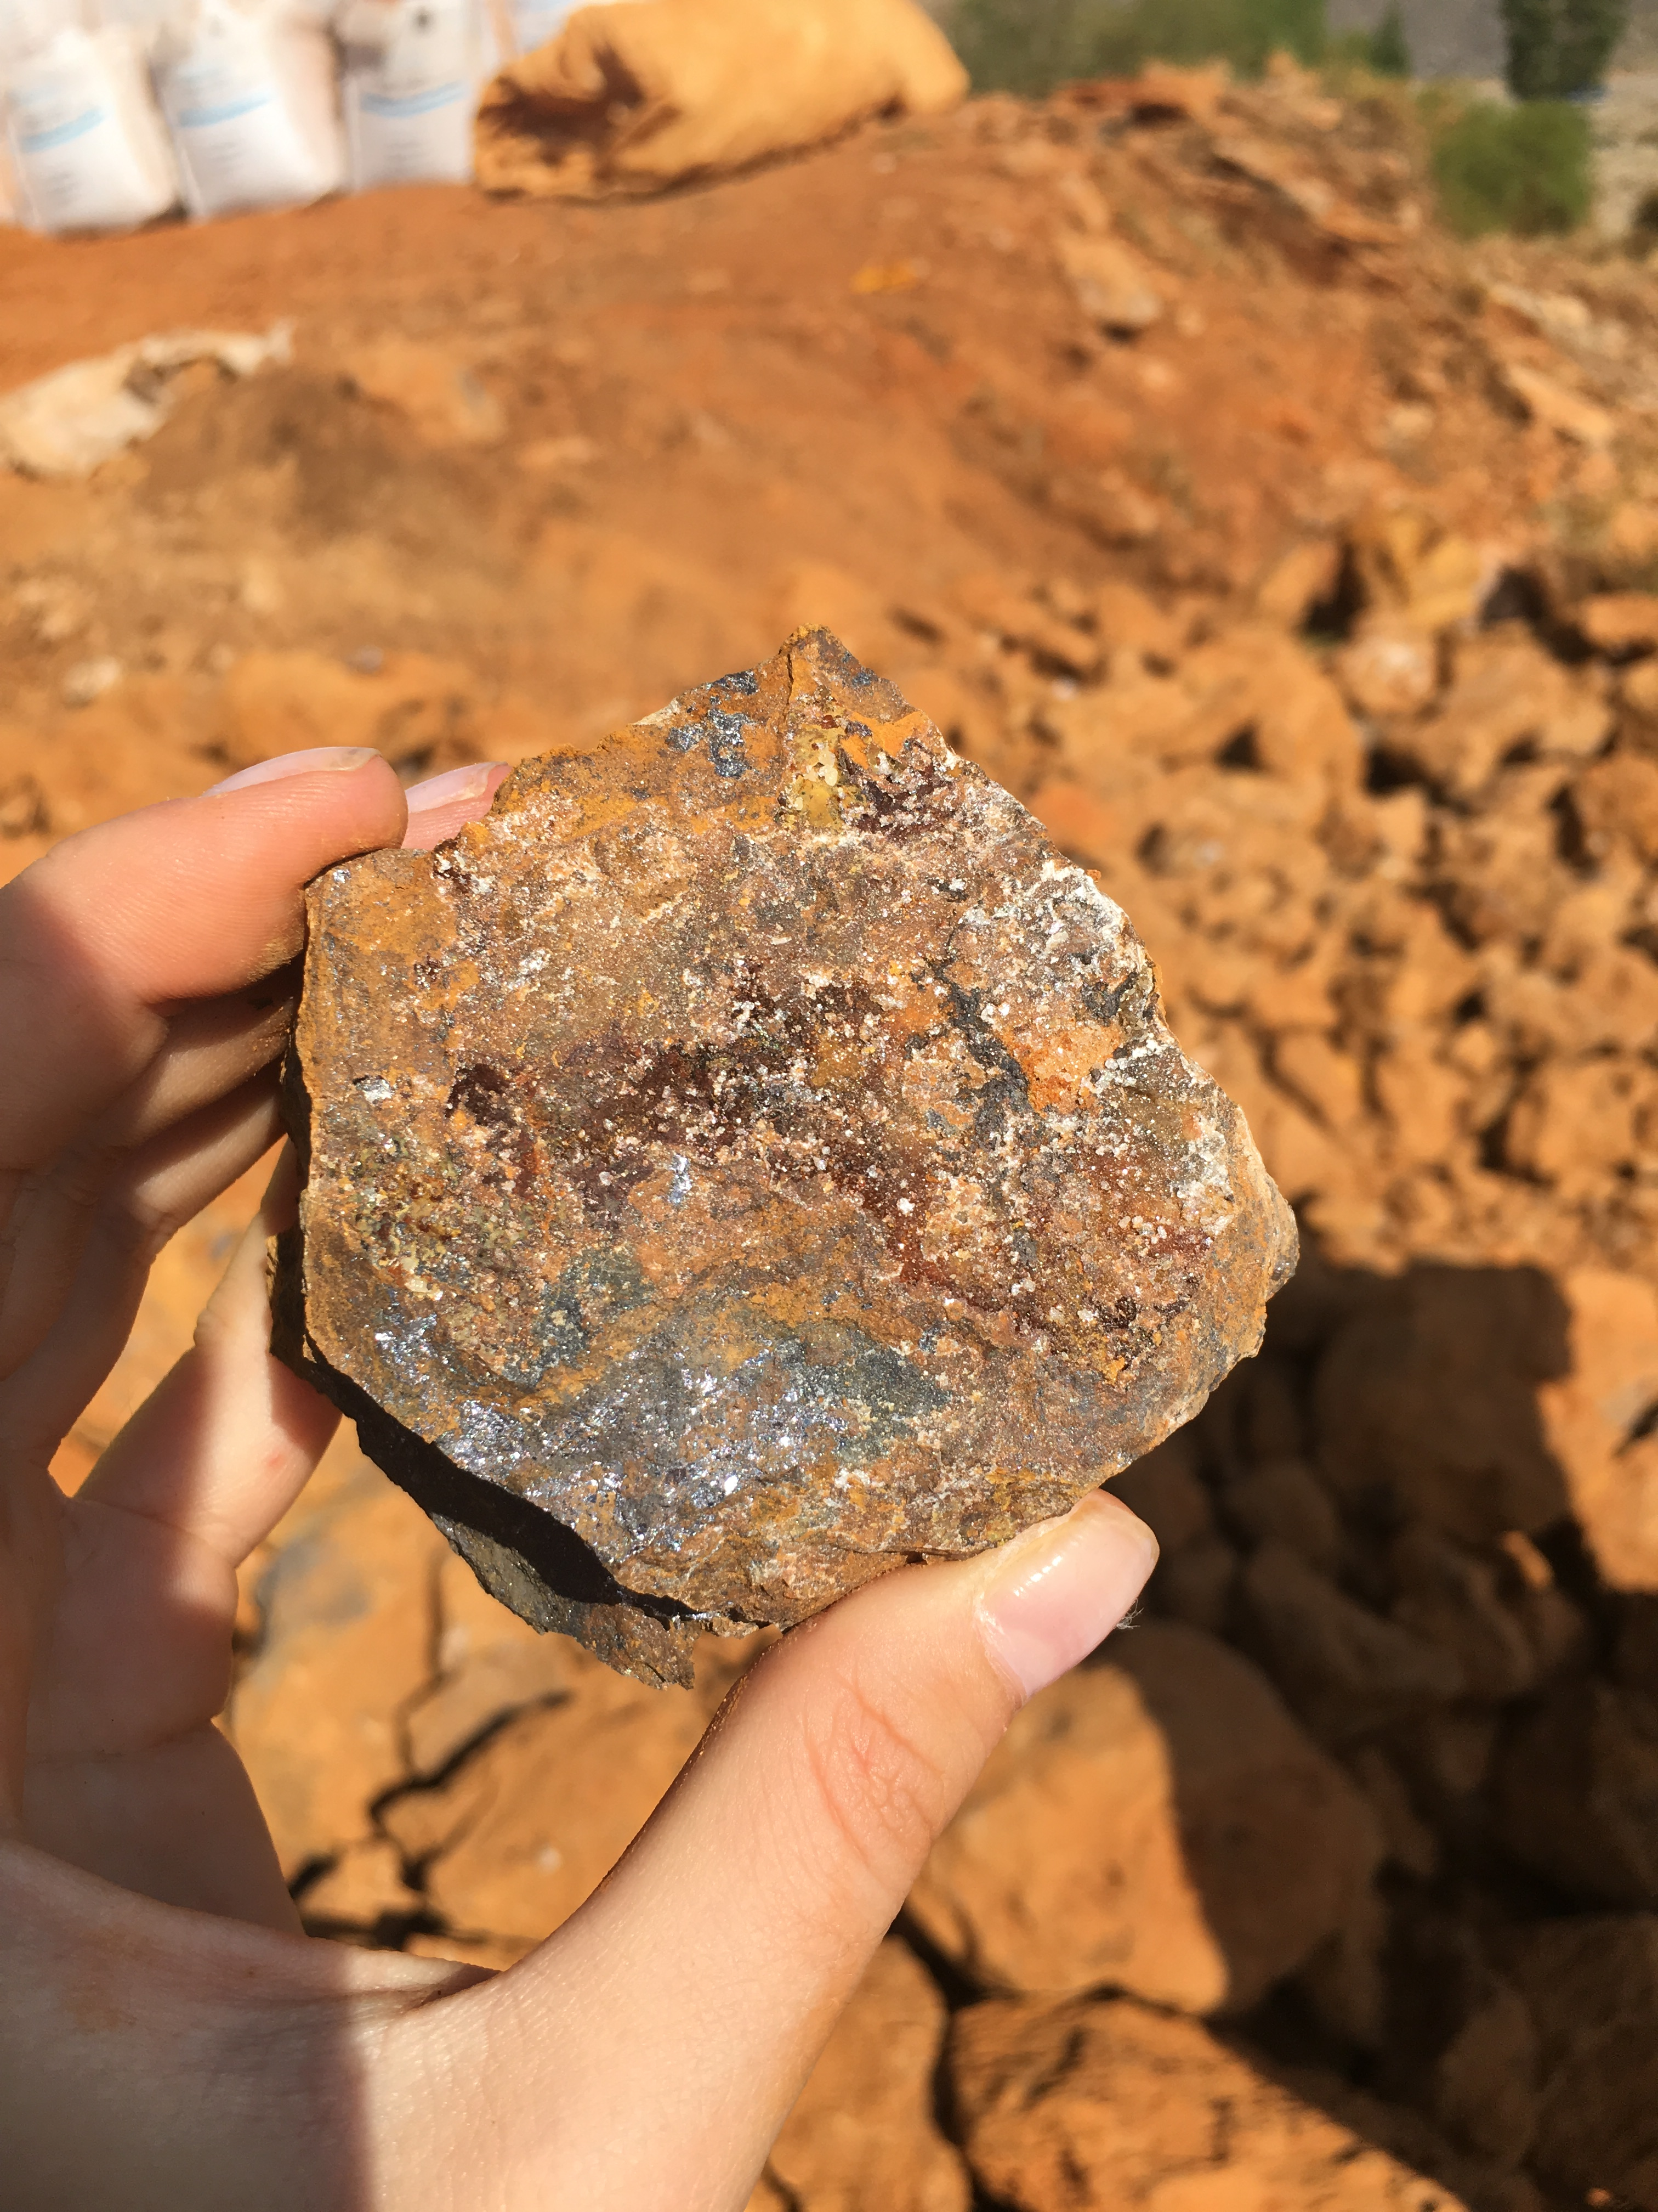
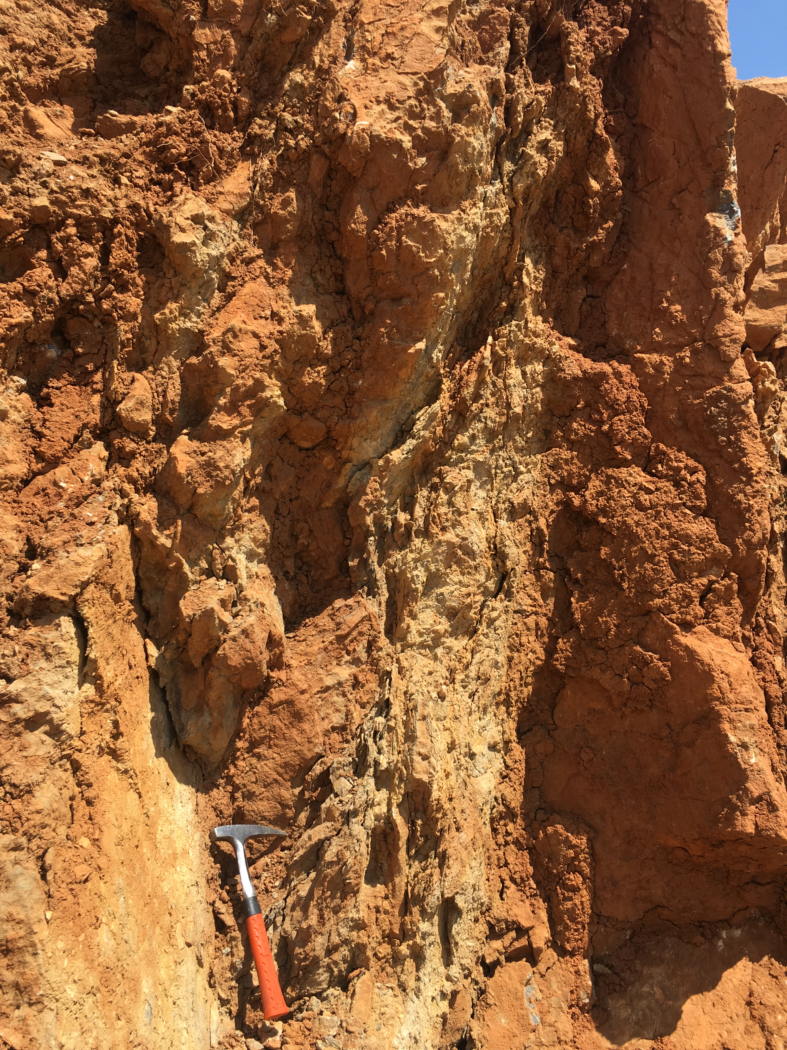
Geochemical Significance and Formation of Suçatı Pb – Zn Deposits – Easterns Taurides
Ali Erdem Bakkalbasi, Hatice Nur Bayram, Mustafa Kumral, and Ali Tugcan Unluer
Istanbul Technical University
Geochemistry and Mineralization
Ore
Limestone
A
B
C
Figure 3.2: Zn ore zone (A), relationship between ore zone and wall-rock (B), M1 sample (C).

Slide 17
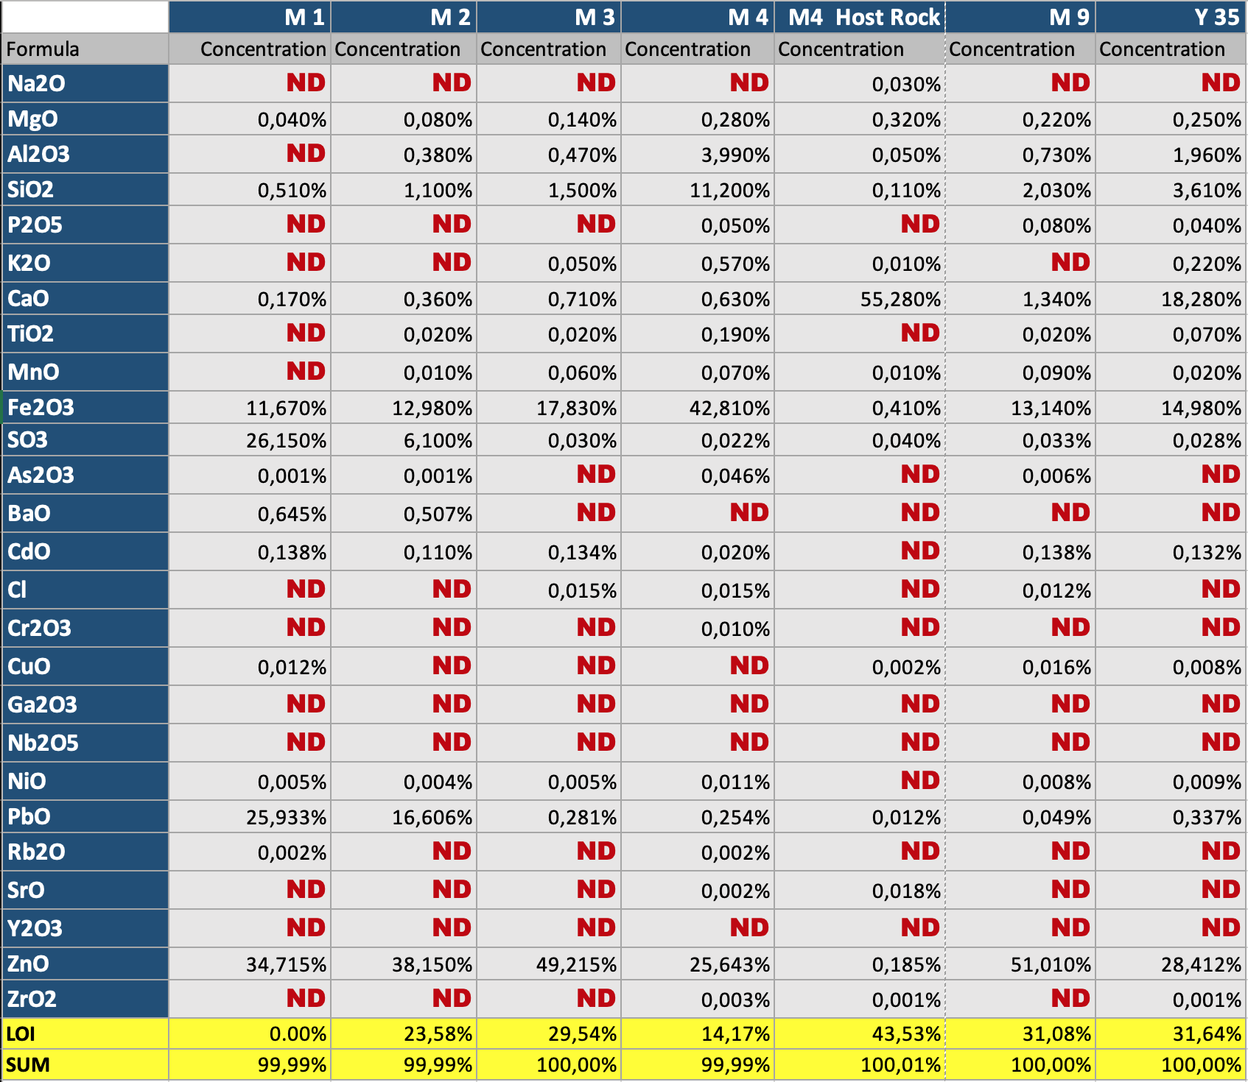
Geochemical Significance and Formation of Suçatı Pb – Zn Deposits – Easterns Taurides
Ali Erdem Bakkalbasi, Hatice Nur Bayram, Mustafa Kumral, and Ali Tugcan Unluer
Istanbul Technical University
Geochemistry and Mineralization
After the samples were ground in ITU Geochemistry Research Laboratory, major and minor element analyzes were performed with XRF (X-Ray Fluorescence) device. The analyzed samples are M1, M2, M3, M4, M4 - Host Rock, M9, Y35, respectively.
Figure 3.3: XRF analysis results of the samples

Slide 18
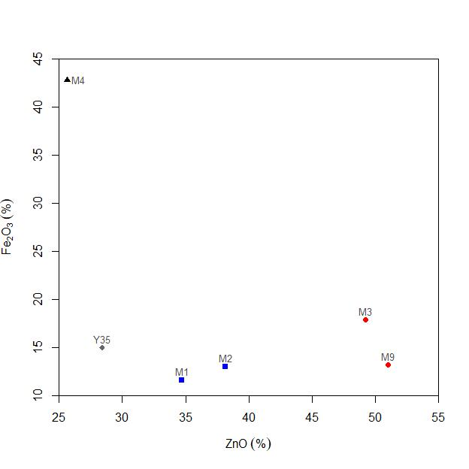
Geochemical Significance and Formation of Suçatı Pb – Zn Deposits – Easterns Taurides
Ali Erdem Bakkalbasi, Hatice Nur Bayram, Mustafa Kumral, and Ali Tugcan Unluer
Istanbul Technical University
Geochemistry and Mineralization
A
B
Figure 3.4: Ternary PbO-Fe₂O₃-ZnO (A), Binary ZnO-Fe₂O₃ (B)

Slide 19
Geochemical Significance and Formation of Suçatı Pb – Zn Deposits – Easterns Taurides
Ali Erdem Bakkalbasi, Hatice Nur Bayram, Mustafa Kumral, and Ali Tugcan Unluer
Istanbul Technical University
Conclusion
Mineralizations that can be evaluated economically in the region are Pb-Zn mineralizations.
The maximum ZnO value as a result of the geochemical analysis is 51% (M9), and the highest PbO value is 25.9%.
As a result of the field study, it is seen that the mineralizations have settled in karstic cavities and completed their formation. It is also observed that the mineralizations occur in the form of vein fillings due to the fractured-cracked structure of the massive limestones, which are hostrocks.
Since the mineralizations on the surface are exposed to weathering, they show a high degree of alteration and Fe₂O₃. The Goethite and limonite minerals seen in the samples are proof of this.
The primary ore minerals of mineralization are Sphalerite for zinc, Galen and Cerrusite for lead. The ore minerals observed in the samples thought to belong to the oxidation zone are Smitsonite, Goethite and Hemimorphite.
It is thought that the nappe structure in the region plays a very important role in mineralization. The faulted and fractured structure of these nappes, which go down to the depths of the formation, causes sea water to be carried, heated and mixed with solutions enriched in Pb and Zn. It is thought that the waters, which are heated and rich in Pb - Zn ions, settled in karstic cavities that have occurred previously and cause Pb - Zn mineralizations.
In conclusion, the mineralizations observed in the study area are thought to occur as a result of hydrothermal activity directly related to the compressional and extensional tectonic regime in the region. Karst structures and fractures in the region have created the necessary area for the settlement of mineralization. Considering all these formation conditions, it can be said that the Suçatı ore deposit fits MVT.

Slide 20

Geochemical Significance and Formation of Suçatı Pb – Zn Deposits – Easterns Taurides
Ali Erdem Bakkalbasi, Hatice Nur Bayram, Mustafa Kumral, and Ali Tugcan Unluer
Istanbul Technical University
Thank you for your attention

