Slide 1
Detection of explosion-induced dynamic phenomena using time-lapse seismic surveying
Shaji Mathew¹, Colin MacBeth¹, Maria-Daphne Mangriotis² & Jenny Stevanovic³
¹ Heriot Watt University, United Kingdom
² University of Edinburgh, United Kingdom
³ AWE Blacknest, Reading , United Kingdom
EGU 2020
4 – 8 May 2020

Slide 2
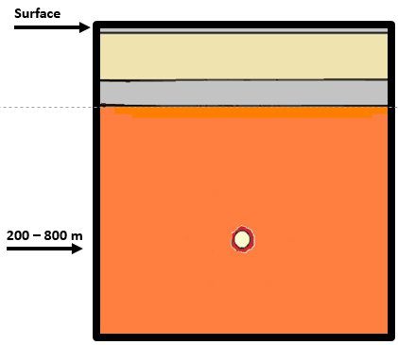
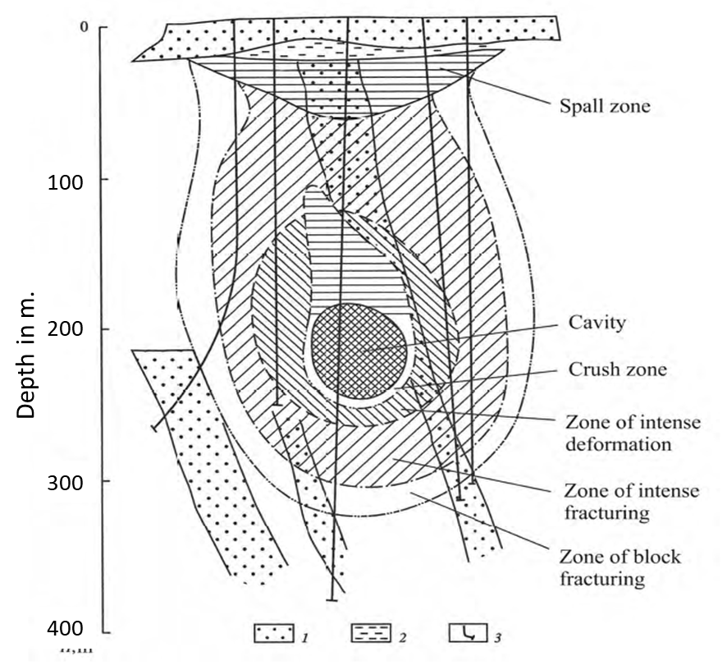
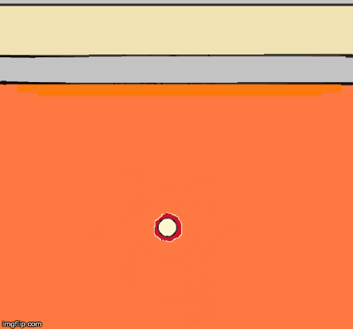
Research Motivation
The objective for this project is to detect subsurface changes induced by underground explosion using time lapse seismic monitoring.
Animation shows sequence of characteristic events following underground explosion
Characteristic static signature
Adushkin & Leith (2001)
Objective | 4D Signature & Repeatability | Application of Machine Learning | Summary
Notes:
The research motivation is to study the potential of applying Oil & Gas industry trusted technology ‘4D seismic’ to monitor near surface changes due to underground nuclear explosion.
The animation shows the sequence of changes that happens following an explosion. The image to the right is the schematic representation of the characteristic static signature found near the emplacement zone.
This includes a cavity at the centre and a rubble chimney. Then radially away from cavity we see a crushed zone, zone of intense rock fracturing and zone of block fracturing. Literatures confirm that P wave velocity near the cavity drops 50-80% below the original background velocity following an explosion.

Slide 3
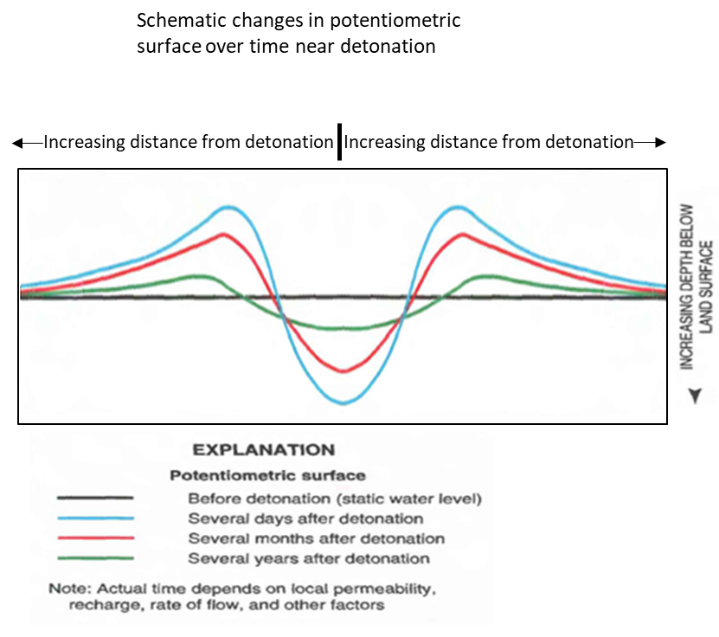
Dynamic Phenomena: Changes in groundwater level
Depth (m)
Distance (m)
Laczniak et al. (1996)
Objective | 4D Signature & Repeatability | Application of Machine Learning | Summary
Notes:
In addition to the static phenomena, characteristic dynamic phenomena is also observed following UNE.
Following an underground explosion due to the shock waves, water from the existing pore are pushed away to form groundwater mound. After the chimney collapse, a dip in the GWM occurs due to increase in permeability in the chimney. The dip in GWM is observed to be about 80 - 100 m and height of GWM away from the cavity is about few 100s of meters. GWM then slowly depletes and it takes several months – years before the groundwater level returns to pre-test level.
This characteristic phenomena is observed even if explosion is carried out above or below the water table.

Slide 4
Dynamic Phenomena: Cheshire Test
Pressure
Saturation
Temperature
Carle et al. (2003)
Objective | 4D Signature & Repeatability | Application of Machine Learning | Summary
Notes:
Changes in pressure, saturation and temperature following the Cheshire test in Nevada, US carried out in 1976 is presented. The water saturation level returns to the pre-test level after 154 days but high temperature is still observable even after 2 years.
Recovery of Pressure, Saturation and Temperature condition to pre-test level depends on the yield strength of the device and also on the geology of medium.

Slide 5
Dynamic phenomena due to redistribution of stress, temperature and saturation is observable for a prolonged period, even up to several decades.
This causes changes in rock properties, which could be detectable as changes in amplitude or time-shift, if seismic monitoring is carried out over the same area with same acquisition parameters.
Objective | 4D Signature & Repeatability | Application of Machine Learning | Summary

Slide 6
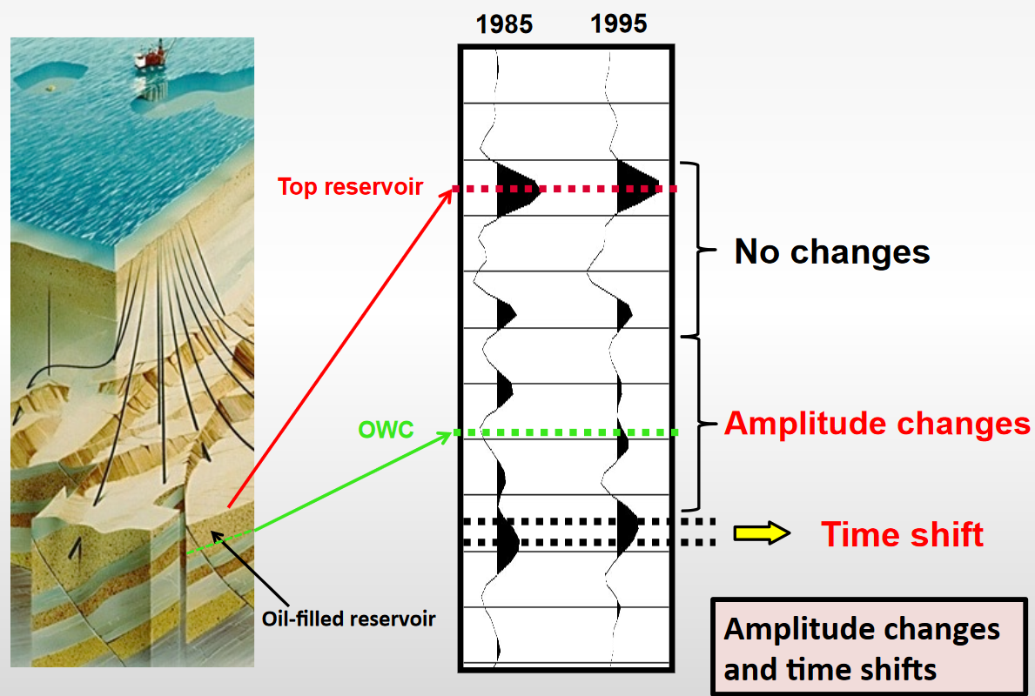
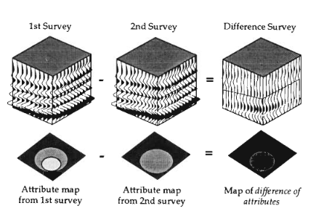
Time-lapse(4D) seismic
Time lapse seismic is used as surveillance tool for reservoir and asset management in oil and gas industry for last few decades.
The key to seismic surveillance is the concept of differential imaging using time-lapse measurements.
Objective | 4D Signature & Repeatability | Application of Machine Learning | Summary

Slide 7
Factors affecting Land 4D repeatability
Categories | Factors likely to affect repeatability | Impact factor
Near-surface conditions | Saturation Changes, Temperature, Variations in statics, Receiver coupling, Industrial/agricultural activity
Source (coupling and type) | Coupling and various source type such as Vibroseis, Weight drop, Piezo electric,
Acquisition geometry differences | Source – Receiver spacing Source – Receiver depth
Urosevic et al. ( 2007)
Objective | 4D Signature & Repeatability | Application of Machine Learning | Summary
Notes:
The table shows the factors affecting land 4D repeatability. Main factors affecting are near-surface conditions and source coupling. These factors decreases the chance of detection of dynamic heterogeneous cavity.

Slide 8
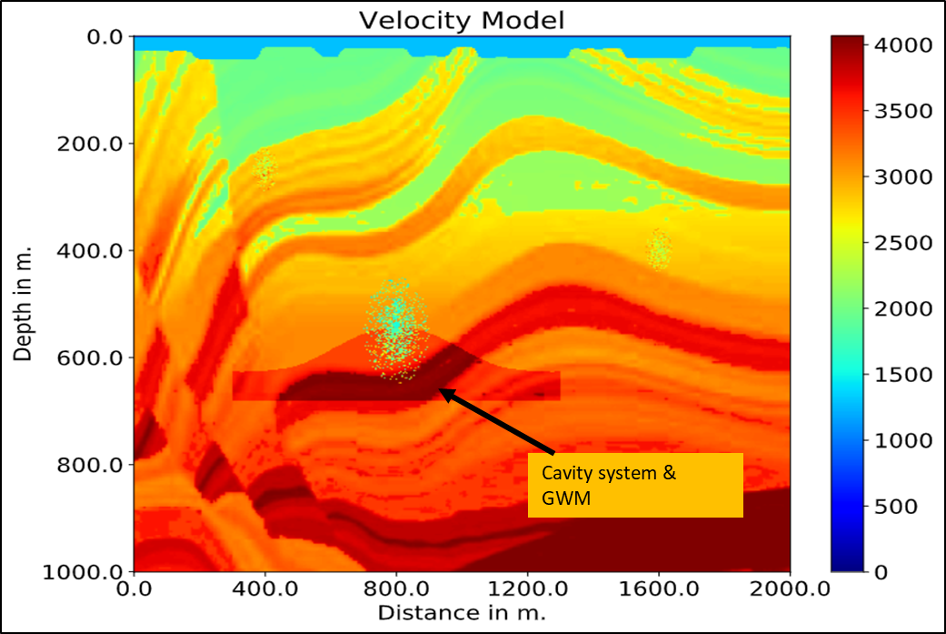
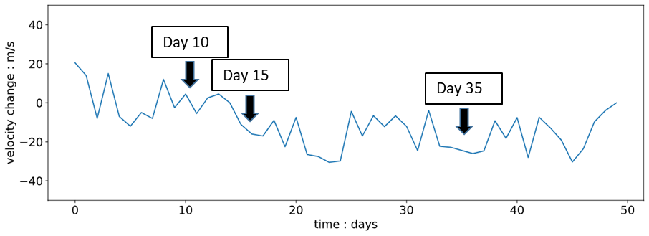
Velocity model with near surface variation
Near surface velocity variation in the model
Objective | 4D Signature & Repeatability | Application of Machine Learning | Summary
Notes:
Snapshot of velocity model used for synthetic study. The model includes heterogeneous cavity system along with groundwater mound dissipation. 50 days observation is modelled. Near surface velocity variation which represents changes due to near-surface condition and changes in source and receiver coupling is shown. 4D difference of day 10 , 15 and 35 as indicated here is displayed on next slide.

Slide 9
Difficult to detect 4D signature due to near- surface changes
Objective | 4D Signature & Repeatability | Application of Machine Learning | Summary
Notes:
Time-lapse signal due to change in groundwater mounding is not very evident in the seismic section.

Slide 10
Workflow for Machine Learning
Objective | 4D Signature & Repeatability | Application of Machine Learning | Summary
Notes:
A workflow using Self-Organising Map is proposed which would help to detect obscure time-lapse signature.

Slide 11
Results: Regions of time-lapse change is highlighted
Potential zone of interest
Objective | 4D Signature & Repeatability | Application of Machine Learning | Summary
Notes:
The results of the synthetic test is displayed, which highlights the regions of 4D-changes in the model.

Slide 12
Results: 4D indicator
High
Probability
Low
Potential zone of interest
Objective | 4D Signature & Repeatability | Application of Machine Learning | Summary
Notes:
The workflow generates a 4D indicator map which highlights the region, that has high probability of time-lapse change.

Slide 13
Summary
Though the time-lapse signature due to underground explosion is prominent, its detection in the presence of heterogeneous background is very challenging.
The proposed workflow based on Self-Organizing Map highlights the regions of time-lapse in a seismic section.
In OSI, the 4D indicator map would highlight potential zone of interest.
Objective | 4D Signature & Repeatability | Application of Machine Learning | Summary

Slide 14
THANK YOU

