Slide 1





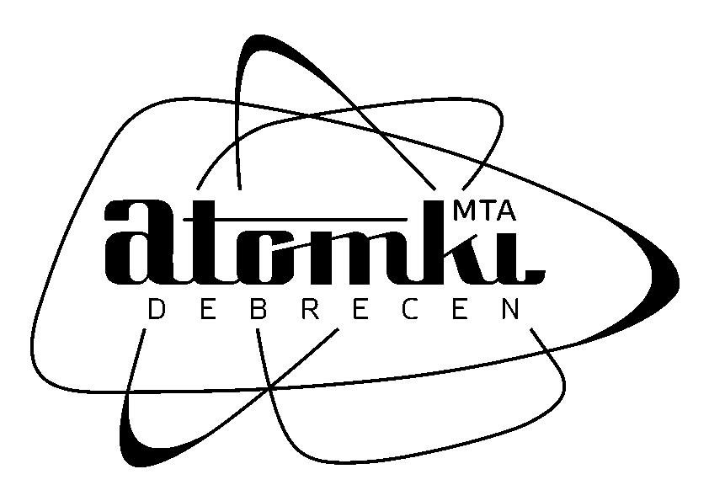



Permian magmatism in the Carpathian-Pannonian region (Hungary and Romania)
New geochronological and geochemical results
Máté Szemerédi^{1,2}, Réka Lukács^{1,2}, Andrea Varga¹, István Dunkl³, Ioan Seghedi⁴, Mihai Tatu⁴, Elemér Pál-Molnár^{1,2}, János Szepesi^{2,5}, Szabolcs Harangi^{2,6}
¹University of Szeged, Department of Mineralogy, Geochemistry and Petrology, ‘Vulcano’ Petrology and Geochemistry Research Group, Szeged, Hungary (szemeredi.mate@gmail.com)
²MTA-ELTE Volcanology Research Group, Budapest, Hungary
³University of Göttingen, Geoscience Center, Department of Sedimentology & Environmental Geology, Göttingen, Germany
⁴Institute of Geodynamics, Romanian Academy, Bucharest, Romania
⁵Isotope Climatology and Environmental Research Centre (ICER), Institute of Nuclear Research, Hungarian Academy of Sciences, Debrecen, Hungary
⁶Eötvös Loránd University, Department of Petrology and Geochemistry, Budapest, Hungary
EGU2020: Sharing Geoscience Online

Slide 2
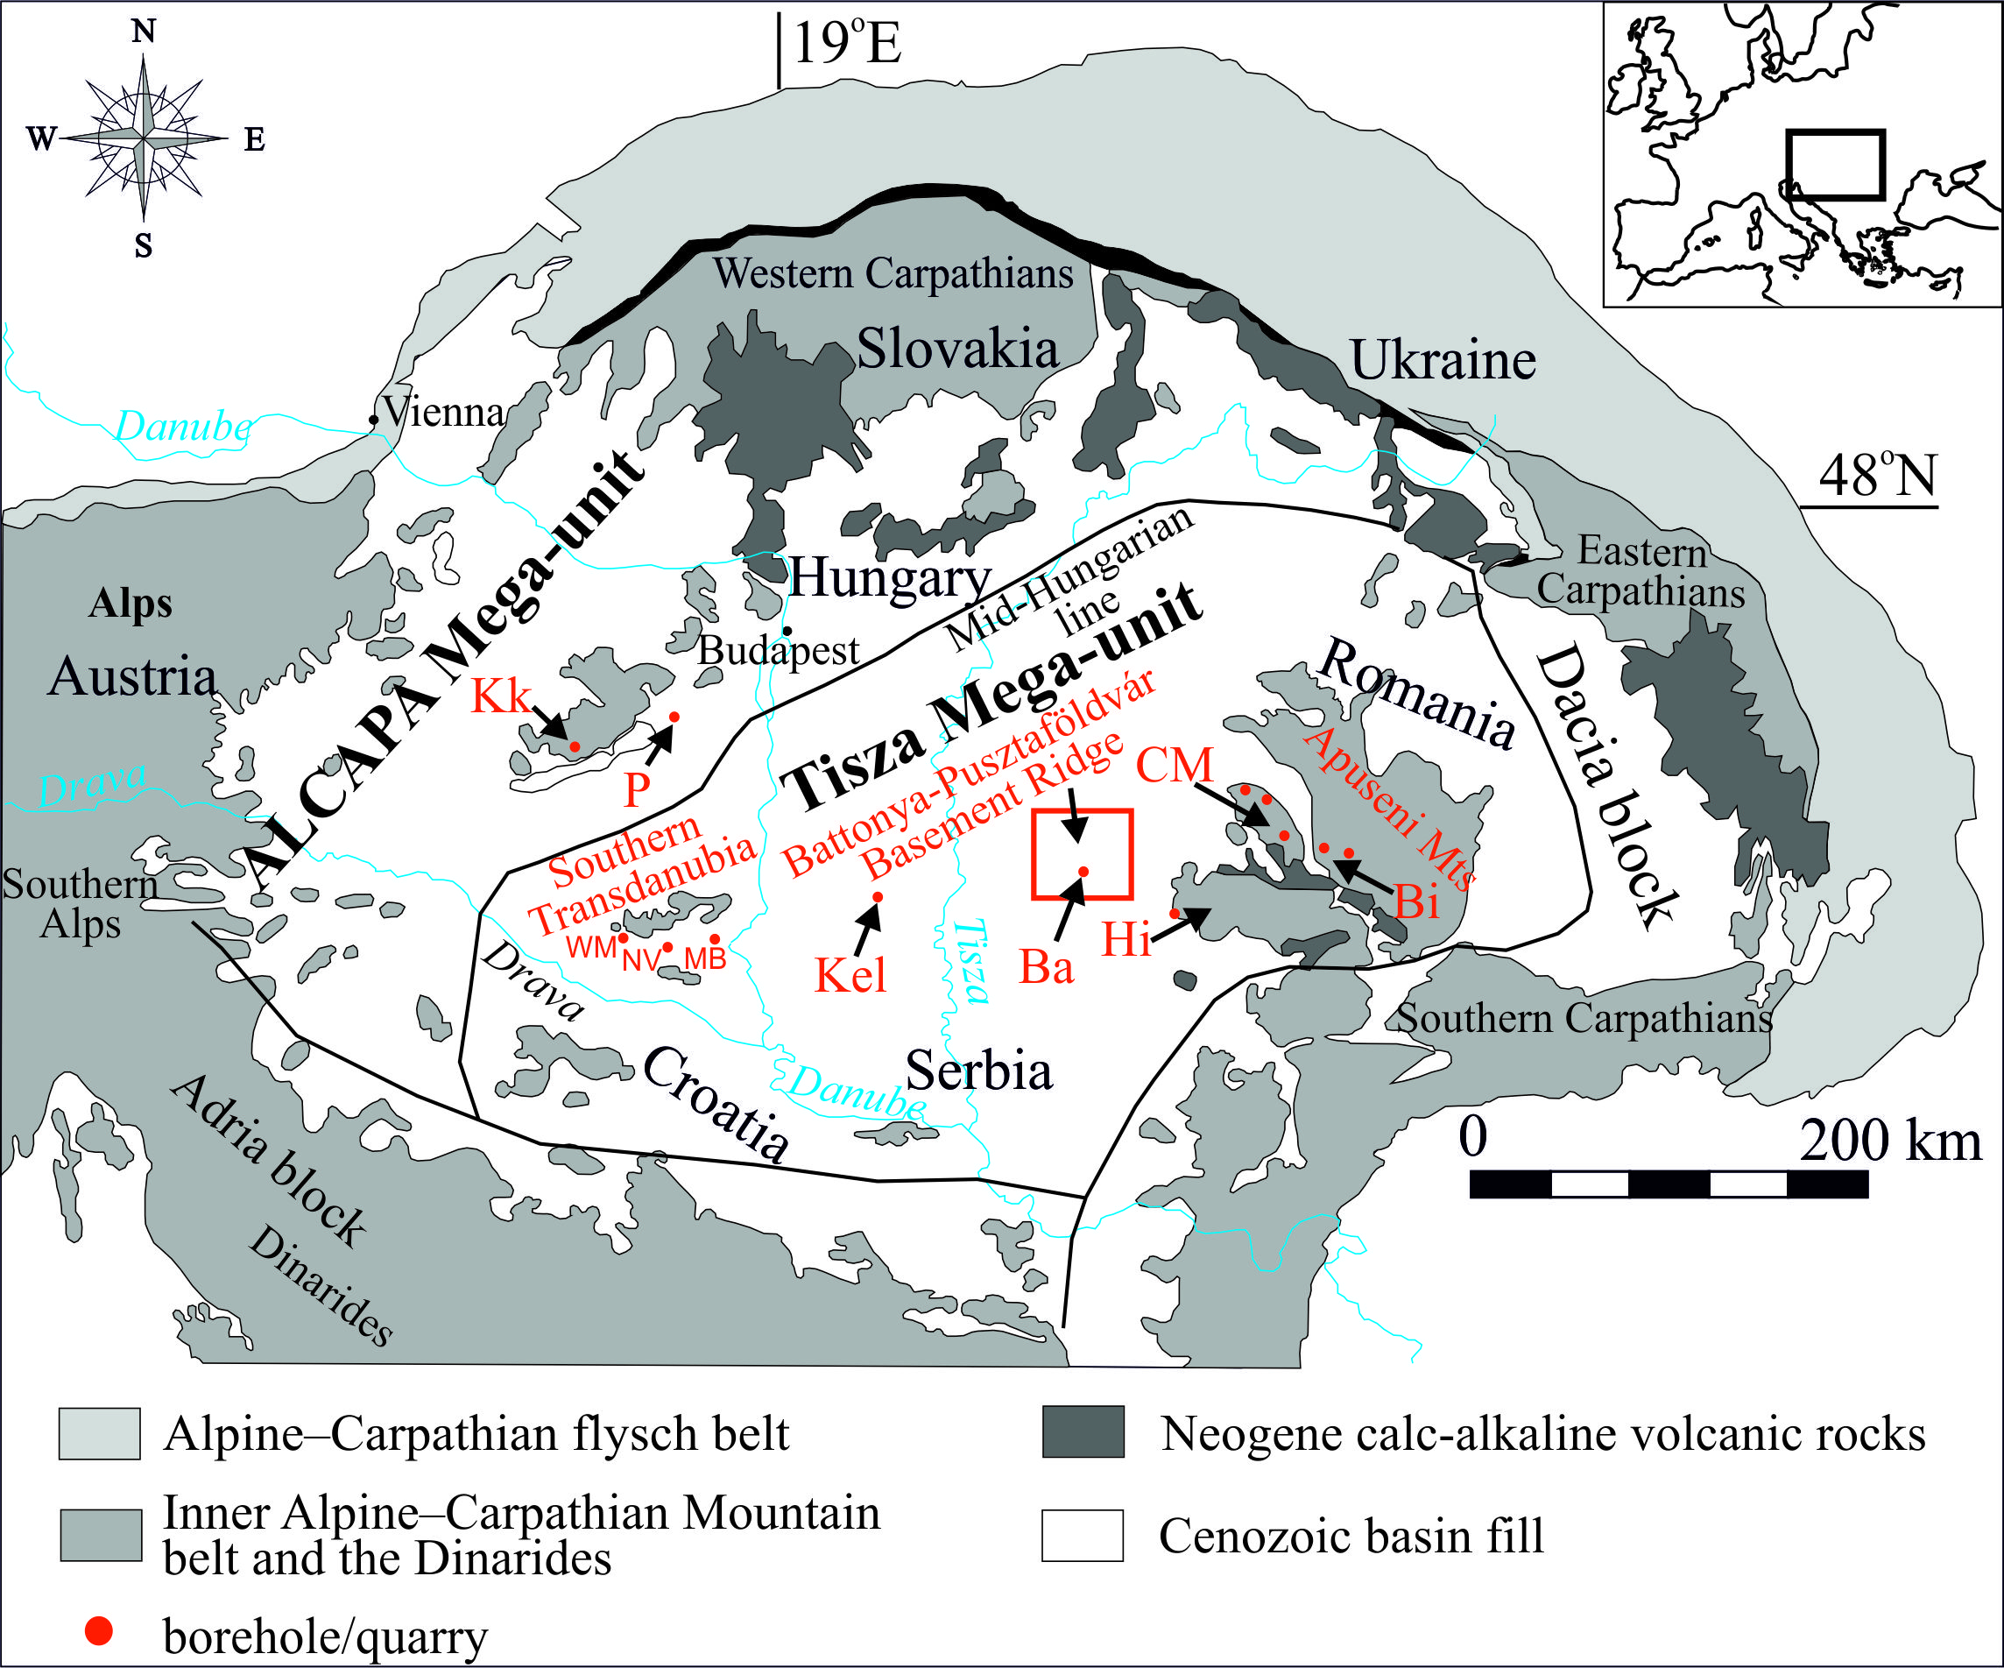
Permian magmatism in the Carpathian-Pannonian region (Hungary and Romania) – Studied areas
Pannonian Basin (Hungary)
Apuseni Mts (Romania)
ALCAPA Mega-unit
Tisza Mega-unit
Mecsek, Villány-Bihor, and Békés-Codru Units
Biharia and Codru Nappe Systems (Arieşeni, Gârda, Highiş-Muncel and Finiş, Dieva, Moma Nappes, resp.)
Central Trasdanubia (outcrop and boreholes)
Southern Transdanubia (ST) and the eastern Pannonian Basin (ePB) (outcrop and boreholes)
Codru-Moma,
Bihor, and
Highiş Mts (outcrops)
Polgárdi quarry (as dykes) and Kékkút-4 borehole
ST: Western Mecsek Mts (outcrop and boreholes), northern foreland of the Villány Mts (boreholes), and Máriakéménd-Báta Basement Range (boreholes);
ePB: Kelebia area and Battonya-Pusztaföldvár Basement Ridge (boreholes)
The distribution of the studied Permian felsic magmatic rocks in the Carpathian-Pannonian region (Hungary and Romania). Ba Battonya, Bi Bihor Mts, CM Codru-Moma Mts, Hi Highiş Mts, Kel Kelebia, Kk Kékkút, MB Máriakéménd-Báta Basement Range, NV northern foreland of the Villány Mts, P Polgárdi, WM Western Mecsek Mts
Máté Szemerédi et al. - Permian magmatism in the Carpathian-Pannonian region (Hungary and Romania)
in EGU2020: Sharing Geoscience Online

Slide 3
Aims and methods
The major reasons of studying Permian magmatism in the Carpathian-Pannonian region (Hungary and Romania) were the following:
(1) Most of the present knowlegde about the Late Palaeozoic igneous formations in Hungary is associated with the previous reports of uranium ore and hydrocarbon exploration. Our recent studies (e.g., Hidasi et al. 2015; Szemerédi et al. 2016, 2017, 2020b) pointed out that most of the archive descriptions and interpretations are not completely reliable and should be reconsidered in the light of modern volcanological views;
(2) Whole-rock geochemical analyses (including rare earth elements and other immobile trace elements) were lacking so far, excepting the Permian volcanic rocks in the Apuseni Mts (Nicolae et al. 2014);
(3) Zircon U-Pb age determinations were lacking so far, excepting plutonic rocks of the Highiş Igneous Complex (SW Apuseni Mts; Pană et al. 2002) and felsic volcanites in Central Transdanubia (Lelkes-Felvári & Klötzli 2004). Previous K-Ar datings are inefficient as proved to be younger (Triassic) due to the subsequent alteration of the rocks (e.g., K-metasomatism);
(4) Local to regional correlation of the studied rocks with the analogous formations in the Central European Variscides has been an open question as well. Based on immobile element and zircon U-Pb geochronological data, we tried to answer the latter
Reinterpretation of archive reports, new local to regional correlation, plutonic-volcanic connections in the studied areas, update the geochronological framework of the magmatism
Outcrop rock samples and all available archive drill cores of the Permian felsic magmatic rocks
Petrography, major and trace element geochemistry, zircon U-Pb geochronology
Máté Szemerédi et al. - Permian magmatism in the Carpathian-Pannonian region (Hungary and Romania)
in EGU2020: Sharing Geoscience Online

Slide 4
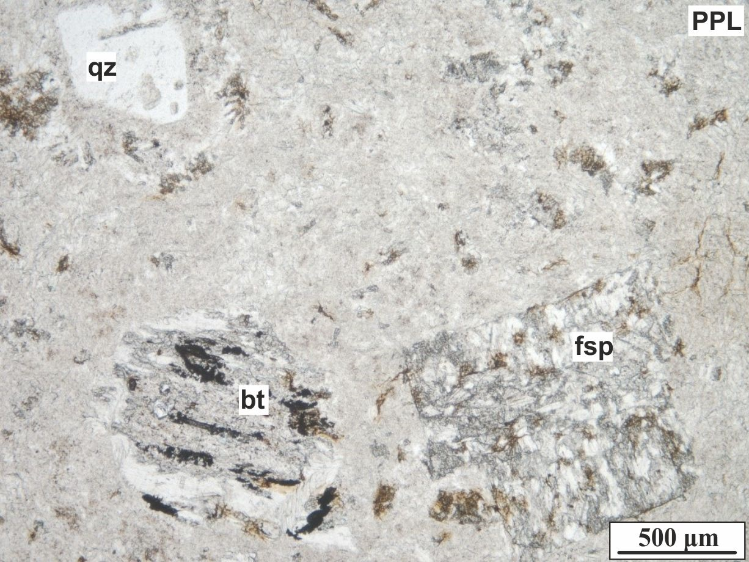
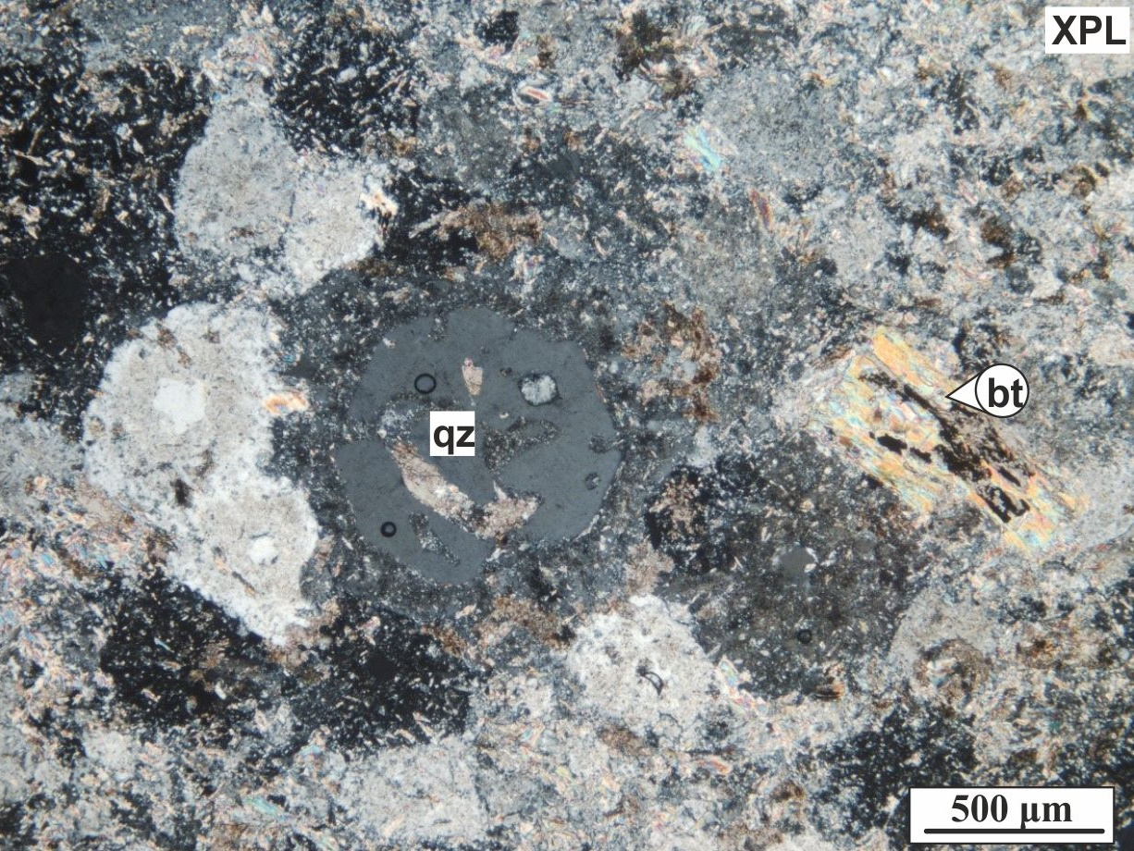
Central Transdanubia (ALCAPA Mega-unit, W Hungary)
Dacitic dykes crosscutting the Devonian crystalline limestone quarry, Polgárdi, Central Transdanubia
Samples are fine-grained, non-porous, and homogeneous without any orientation. Porphyric components (10-15 vol%) are strongly resorbed isometric quartz (4-5 vol%); dominantly euhedral feldspar crystals (5-10 vol%) altered totally to muscovite and calcite; and pseudomorphs of calcite and muscovite after biotite. The groundmass is secondarily holocrystalline, and filled by mosaic texture of equigranular quartz and a few sericite, muscovite, calcite, and siderite scattered in and between them.
Dacitic lavas having similar mineralogical composition and textural features were studied in the Kékkút-4 borehole (see details in Lelkes-Felvári & Klötzli 2004; Szemerédi et al. 2020a).
Máté Szemerédi et al. - Permian magmatism in the Carpathian-Pannonian region (Hungary and Romania)
in EGU2020: Sharing Geoscience Online

Slide 5
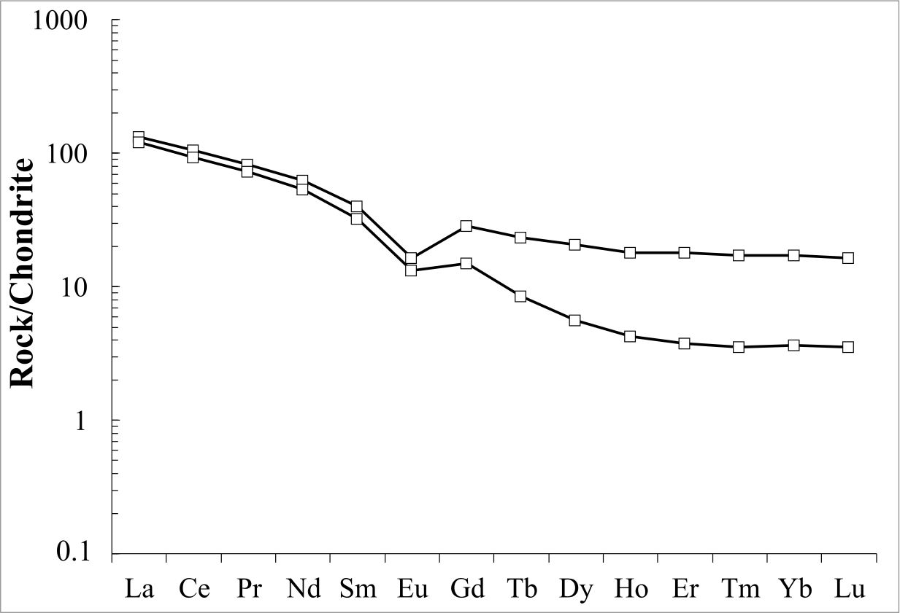
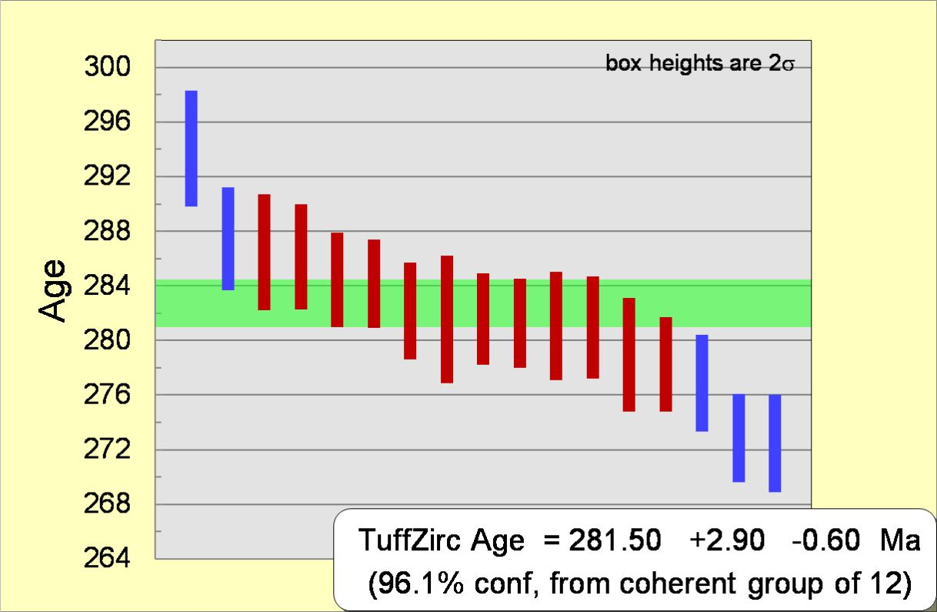
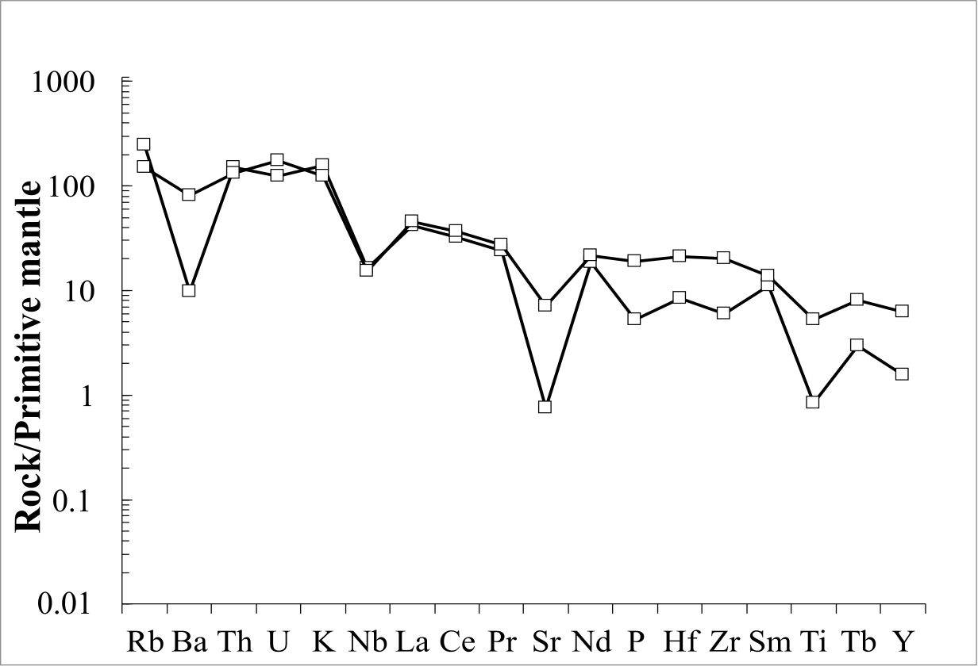
Central Transdanubia (ALCAPA Mega-unit, W Hungary)
According to the major element based rock classification (TAS diagram), Permian felsic volcanic rocks in Central Transdanubia are dacites, while they were classified as rhyodacites/dacites based on immobile elements (Zr/TiO₂ vs. Nb/Y).
The samples display enriched light and near-flat heavy REE patterns with slightly negative Eu anomaly. On the other hand, the Polgárdi sample is depleted in HREEs. In the multi-element spider diagrams, the samples are characterized by enrichment in Rb, K, Th, and U and depletion in Ba, Nb, Sr, and Ti. However, the Polgárdi sample shows relative depletion to the Kékkút core sample not only in HREEs, but also in immobile elements.
Zircon U-Pb dating of the Permian dacitic dykes crosscutting the Polgárdi quarry
35 spots were measured during the age determinations, but only 18 proved to be concordant. 12 spots give a 281.5 + 2.9 – 0.6 Ma TuffZirc Age. The interpreted eruption age of this sample is 281.0 ± 2.9 Ma taking into account the external errors.
This age proved to be significantly younger than that one published by Lelkes-Felvári & Klözli (2004):
zircon U-Pb age: 291.4 ± 4.7 Ma.
Máté Szemerédi et al. - Permian magmatism in the Carpathian-Pannonian region (Hungary and Romania)
in EGU2020: Sharing Geoscience Online

Slide 6
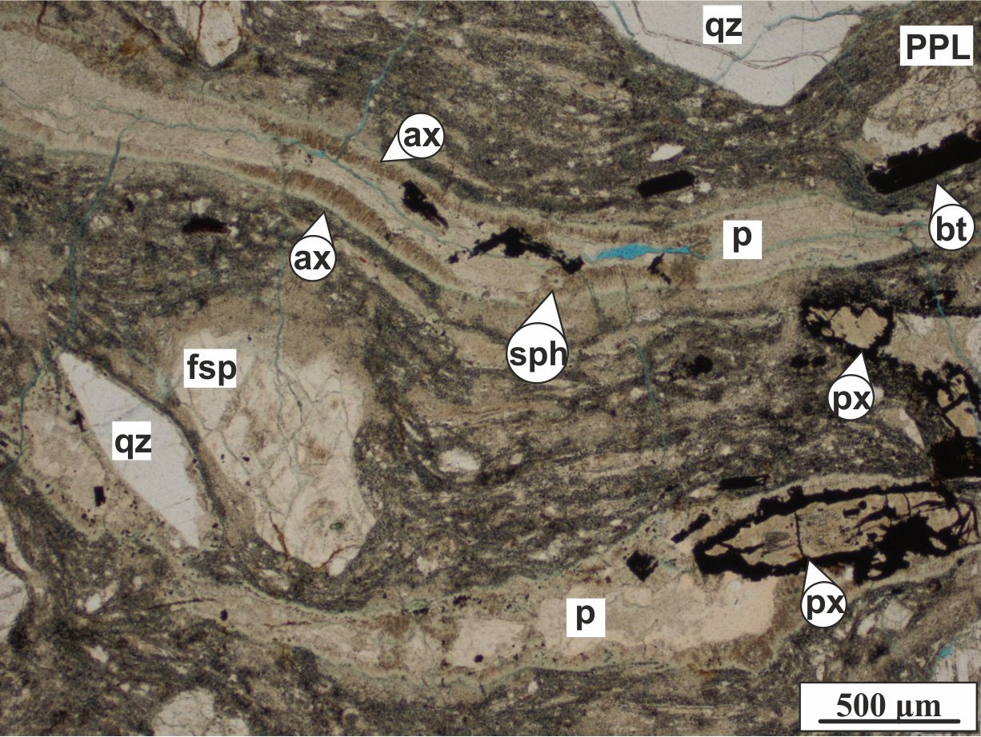
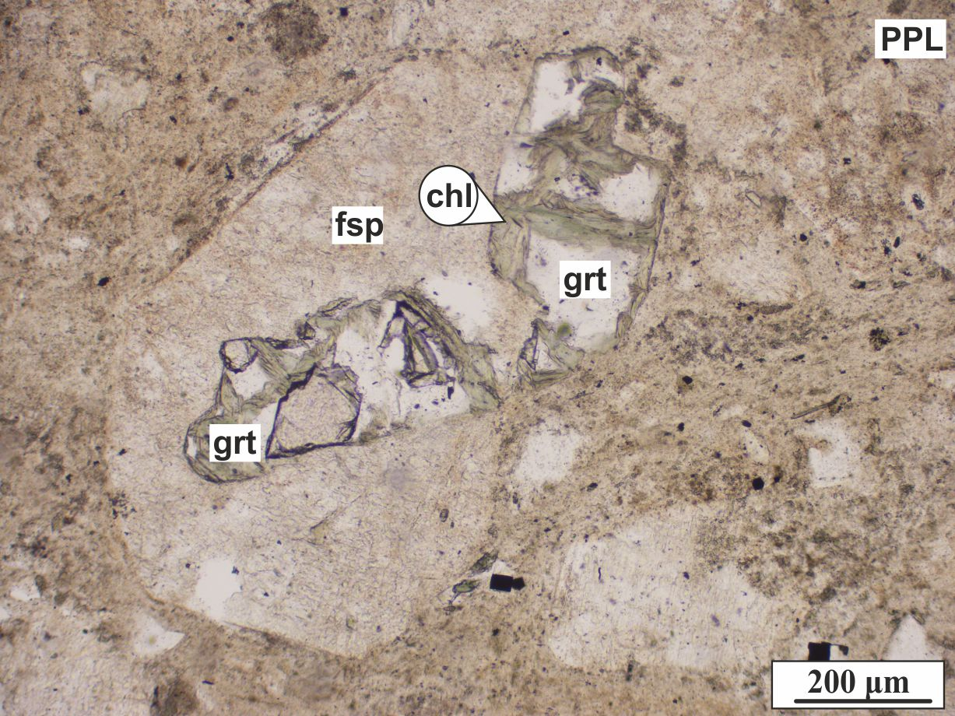
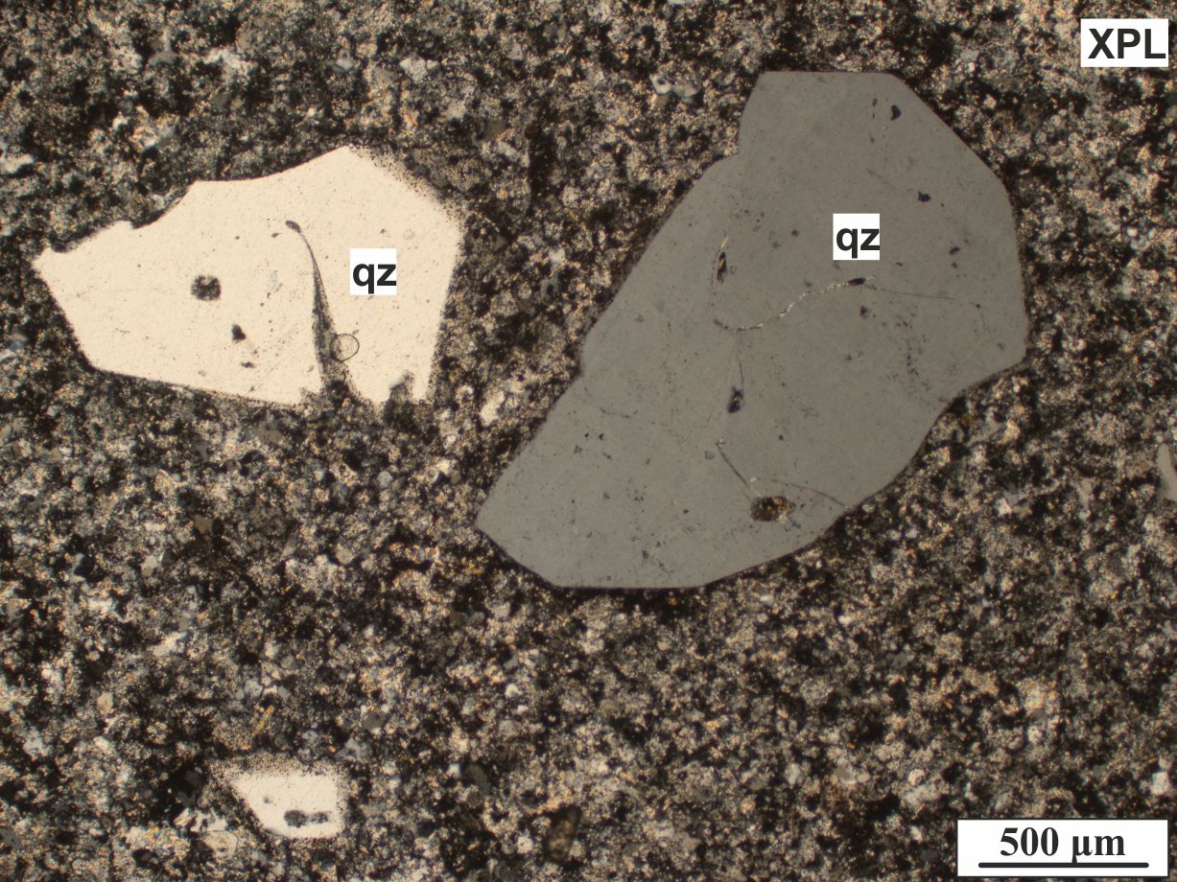
Southern Transdanubia (Tisza Mega-unit, SW Hungary)
Rhyodacitic/dacitic lavas from S Transdanubia
Felsic lavas are subordinate in the area occuring in some boreholes at the northern foreland of the Villány Mts. The porphyric rocks are dominated by subhedral, resorbed quartz (10-15 vol%), altered K-feldspar and plagioclase (10-25 vol%), and rare, altered biotite (1-3 vol%). The textures are microholocrystalline or felsitic, rarely relict perlitic, spherulitic, or granophyric.
Massive, compacted rhyodacitic/dacitic lapilli tuffs from S Transdanubia
Samples are rich in mm-cm-sized flattened, deformed pumices and various poorly sorted fragmented crystals (30-45 vol%). Major components are resorbed, subhedral quartz (10-20 vol%) and altered, euhedral or subhedral feldspars (dominantly K-feldspar, subordinate plagioclase). Mafic components are hematitized or chloritized biotite (1-5 vol%) and strongly altered pyroxene (< 1 vol%). Some samples of the northern foreland of the Villány Mts (boreholes Egerág-7 and Szalánta-3) contain tourmaline and subhedral garnet crystals. The rocks are variably foliated, the foliation being formed on altered, devitrified pumices and glass shards. Pumices contain high-temperature crystallization domains on their margins and inside them (HTCDs: axiolites, spherulites).
Máté Szemerédi et al. - Permian magmatism in the Carpathian-Pannonian region (Hungary and Romania)
in EGU2020: Sharing Geoscience Online

Slide 7
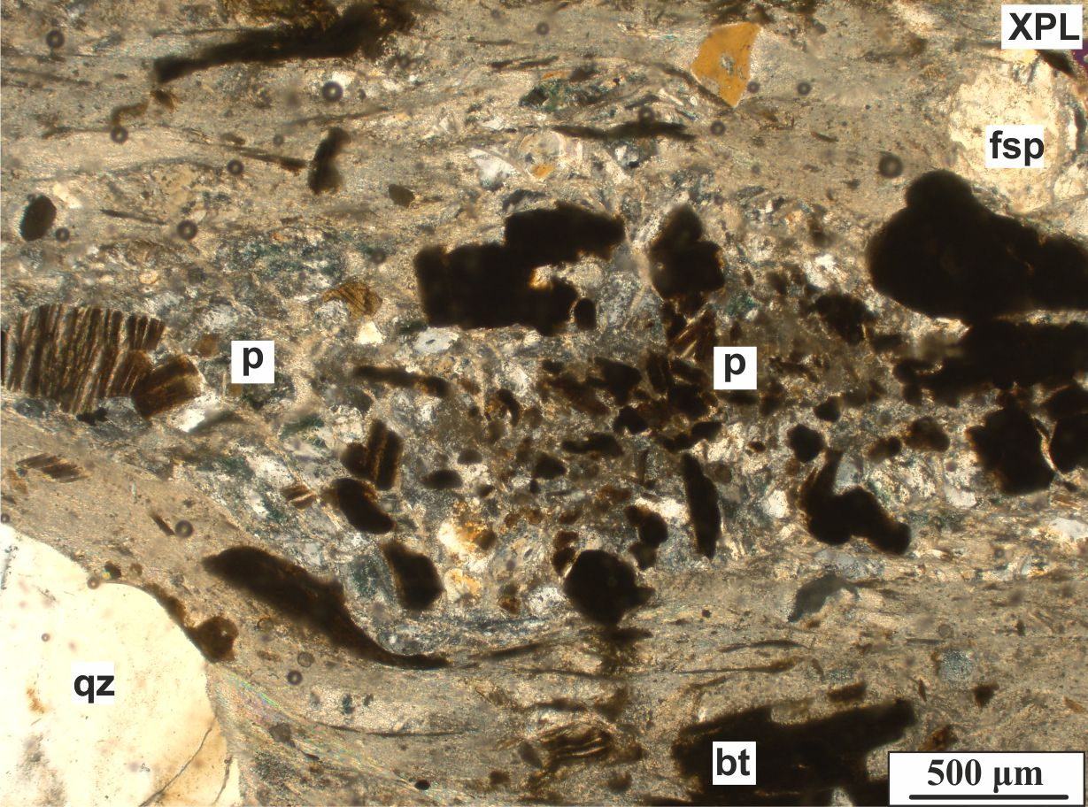
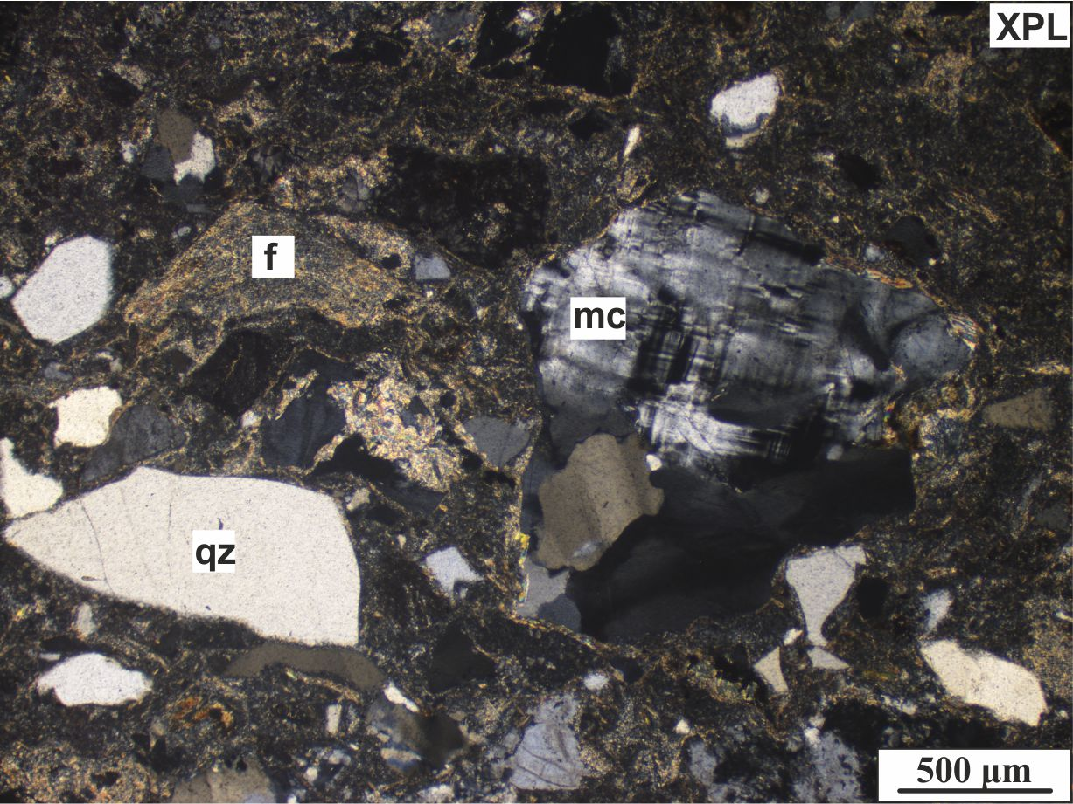
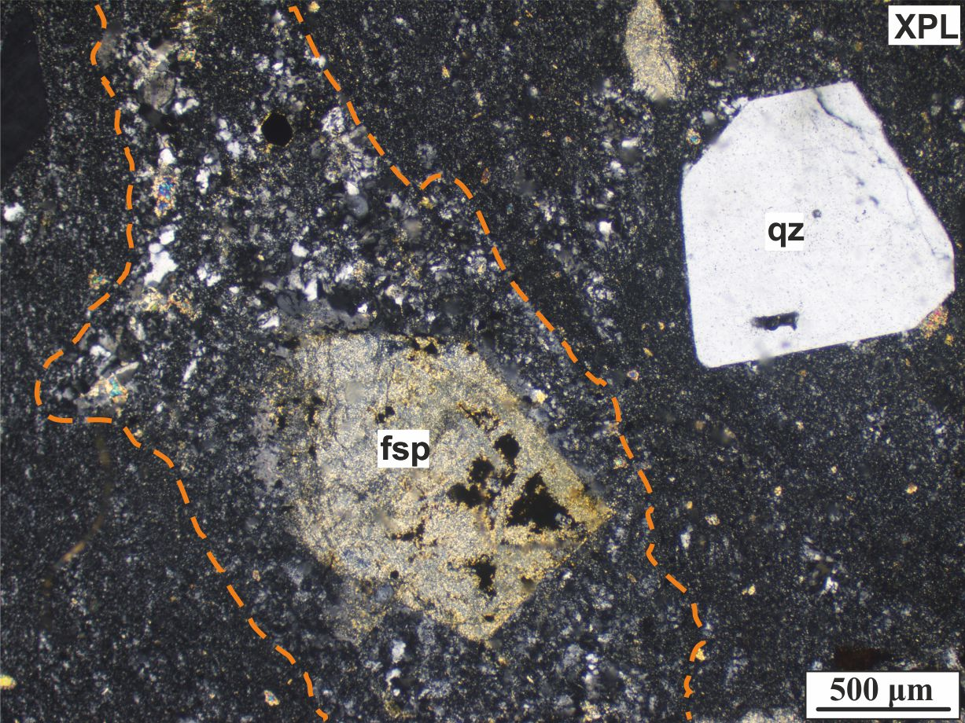
Eastern Pannonian Basin (Tisza Mega-unit, SE Hungary)
Crystal-poor (8-20 vol%) rhyolitic pyroclastites from the Battonya area
These samples are usually massive, matrix-supported altered fiamme-bearing lapilli tuffs with eutaxitic texture (welded ignimbrites). Some samples lack vitroclastic matrix and show low crystal breakage, but consist of devitrified fiammes (orange, dashed lines), too. The latter could be high-grade rheoignimbrites.
Low-grade metavolcanites from the Kelebia area
Such samples contain oriented, sericitized pumices and broken, subhedral crystals (15-20 vol% quartz, 10-15 vol% plagioclase, ~ 5 vol% altered biotite and pyroxene), referring to dacitic composition. However, they differ from the other felsic volcanic rocks of this area by having quartz with deformation lamellae and phenocrysts with quartz and K-mica pressure shadow.
Resedimented pyroclastic or volcanogenic sedimentary rocks from the Tótkomlós area (Battonya-Pusztaföldvár Basement Ridge)
These samples consist of sericitized fiammes and glass shards, various fragmented crystals (11-14 vol%), and subrounded lithics with a wide range of origin in a fine matrix (69-76 vol%) of sericite, quartz, and feldspar. Such core samples suggest that at the same time sedimentation and volcanic activity could occur.
Máté Szemerédi et al. - Permian magmatism in the Carpathian-Pannonian region (Hungary and Romania)
in EGU2020: Sharing Geoscience Online

Slide 8
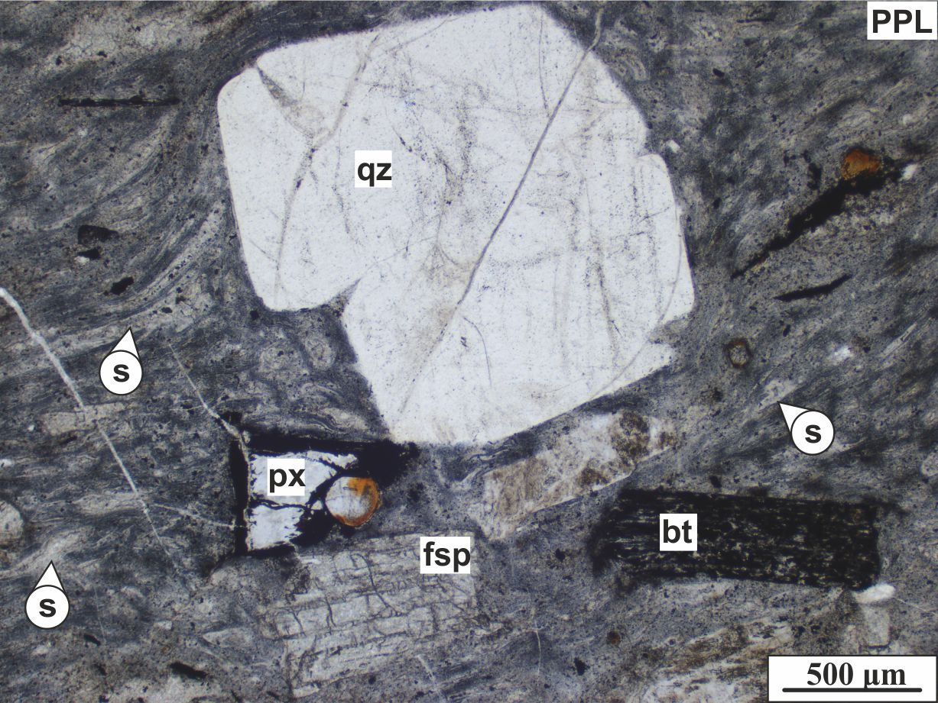
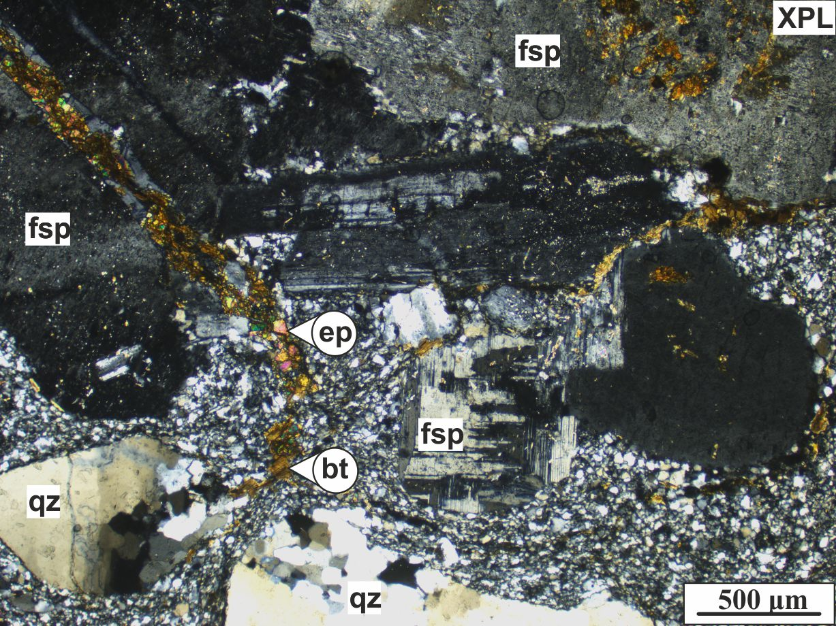
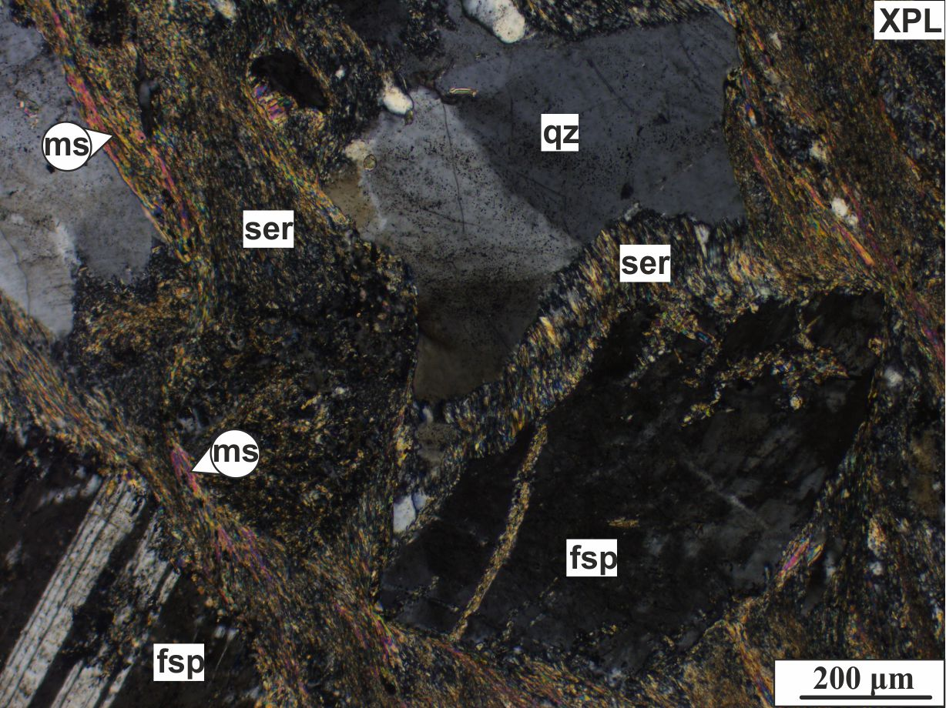
Apuseni Mts (Tisza Mega-unit, W Romania)
Low-grade metavolcanites from the Bihor Mts
This rock type is crystal-rich (~ 20 vol% quartz and feldspar) and contains oriented, devitrified fiammes, replaced by secondary minerals in a recrystallized fine-grained matrix of quartz, feldspar, sericite, and muscovite. These samples differ from the felsic lapilli tuffs by bearing a stronger foliation, defined by continuous, coherent bands of sericite and muscovite.
Rhyodacitic/dacitic, dominantly welded lapilli tuffs from the Codru-Moma and the Bihor Mts)
Such samples are massive, non-porous and consist of fragmented quartz (7-18 vol%), altered feldspar (9-18 vol%, dominanted by K-feldspar), hematitized biotite (1 vol%), altered pyroxene, devitrified fiammes (4-16 vol%) and glass shards in a fine-grained matrix (58-72 vol%). In some samples, garnet is a common accessoric mineral.
Rhyolitic dykes from Highiş Mts
Such samples have porphyric microholocrystalline texture that consists of 28-42 vol% phenocrysts in a fine-grained equigranular, oriented matrix (58-72 vol%) of quartz and feldspar and furhermore 1-10 foliated lithics (phyllite). Quartz (7-9 vol%) and feldspar (19-35 vol%) crystals are euhedral or subhedral, resorbed, the latter are dominated by K-feldspars.
Máté Szemerédi et al. - Permian magmatism in the Carpathian-Pannonian region (Hungary and Romania)
in EGU2020: Sharing Geoscience Online

Slide 9
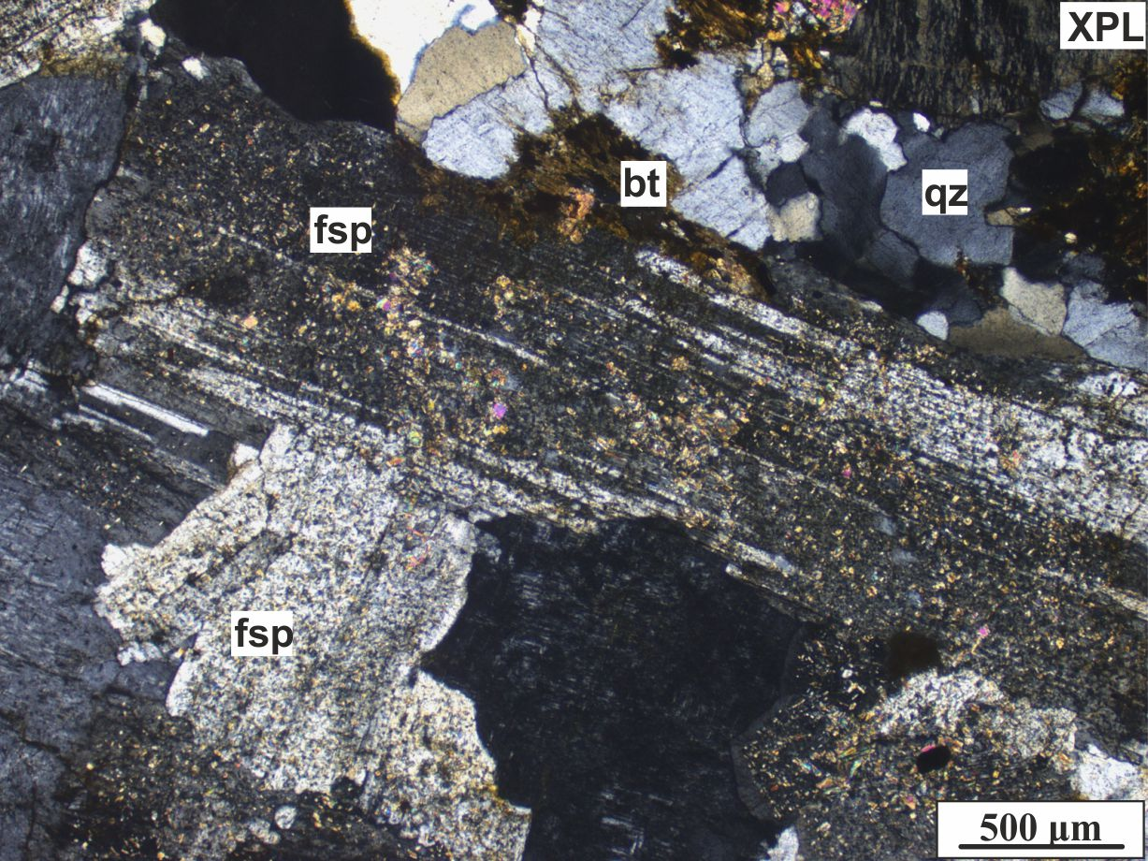
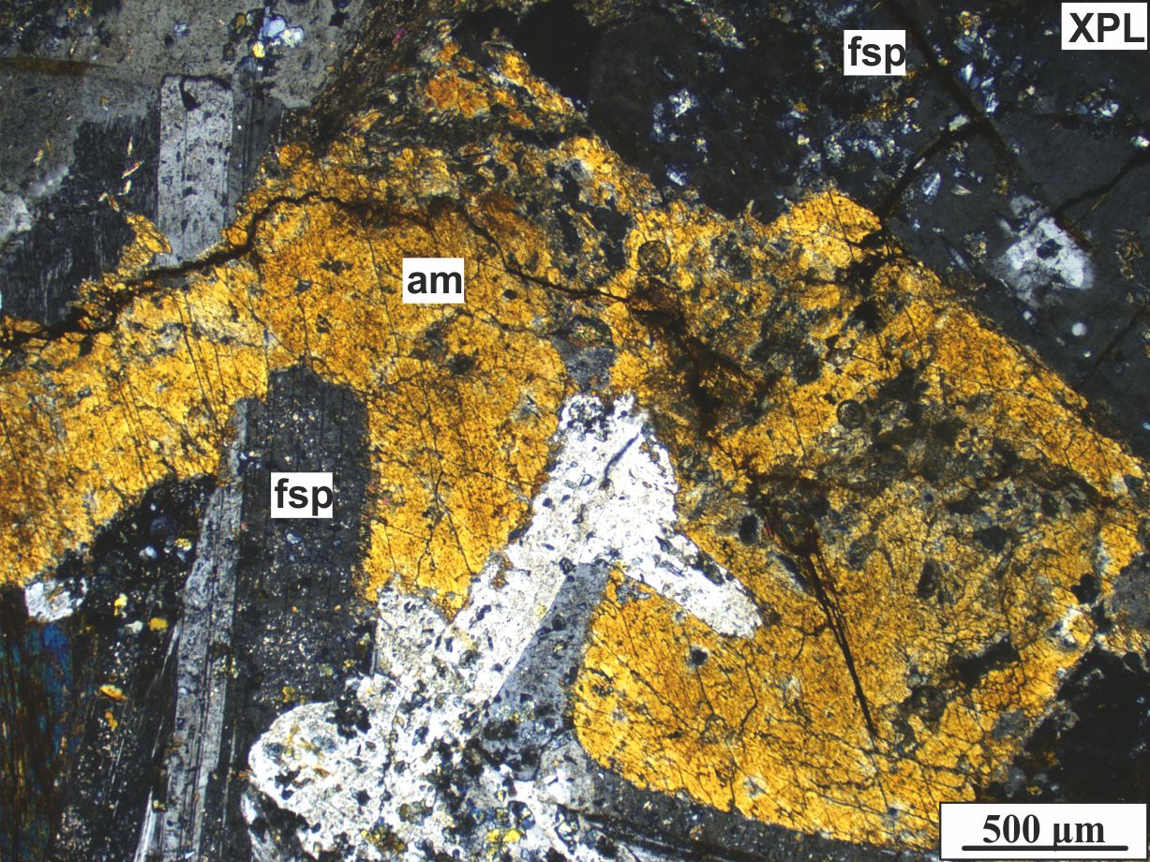
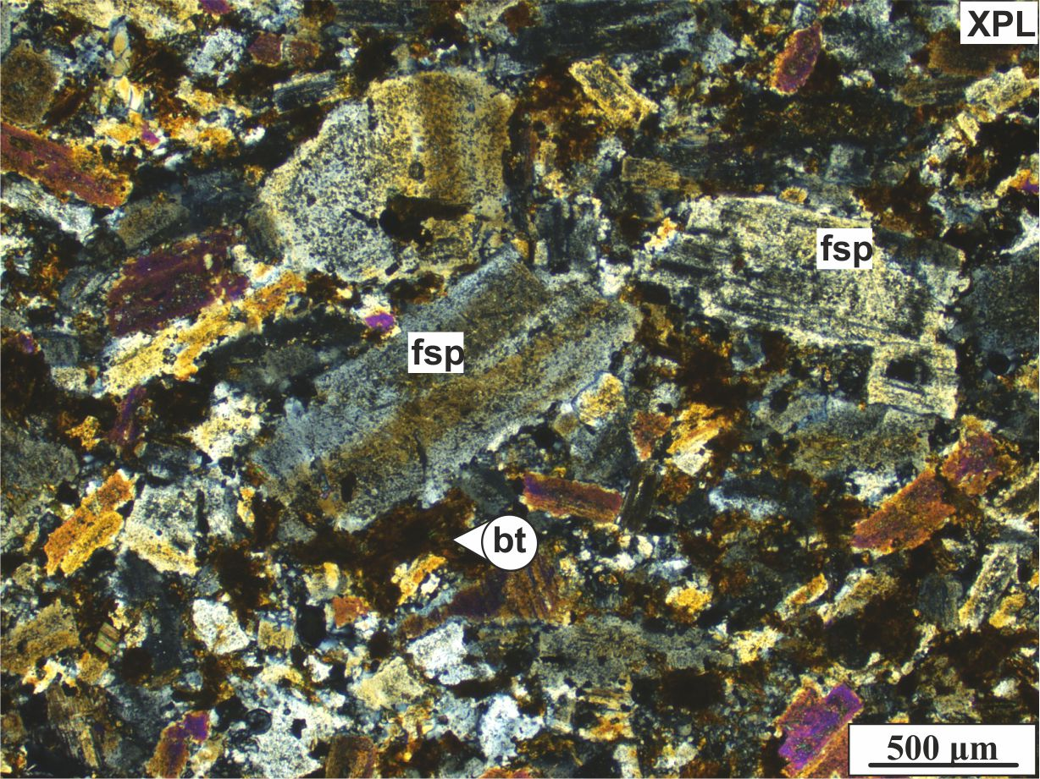
Apuseni Mts (Tisza Mega-unit, W Romania)
Intermediate dykes from the Highiş Mts
These subvolcanic samples crosscut plutonic rocks (gabbros, granites) in the Highiş massif, showing medium to fine-grained hypidiomorphic-granular, serial texture of sericitized plagioclase (right) and K-feldspar (left), amphibole, and biotite crystals. Such rocks compositionally resemble to the intermediate plutonic rocks of the so-called Cladova diorite.
Granitic rocks from the Highiş massif (SW Apuseni Mts)
Such rocks (classified into the so-called Highiş granite) occur as medium to coarse-grained granites as well as aplites having hypidiomorphic-granular texture with euhedral to subhedral, sericitized K-feldspar (below) and plagioclase (above), subhedral to anhedral quartz, and (chloritized) biotite crystals.
Dioritic rocks from the Highiş massif (SW Apuseni Mts)
These rocks (classified into the so-called Cladova diorite) have coarse-grained hypidiomorphic-granular texture with dominant euhedral to subhedral (sericitized) plagioclase (below), subhedral amphibole, and subordinate subhedral sericitized K-feldspar.
Máté Szemerédi et al. - Permian magmatism in the Carpathian-Pannonian region (Hungary and Romania)
in EGU2020: Sharing Geoscience Online

Slide 10








Permian magmatic rocks and associated zircon U-Pb ages in the Tisza Mega-unit
Studied rock types
Symbols
U-Pb TuffZirc ages (No. of the youngest coherent age group)
W Mecsek Mts: 267.4 + 0.6 – 1.4 Ma (17)
Tótkomlós-K-3 borehole: 259.4 + 0.9 – 1.5 Ma (22)
Báta-3 borehole: 268.0 + 2.1 – 1.9 Ma (19)
Tótkomlós-K-3 borehole: 259.4 + 2.3 – 1.8 Ma (11)
Felsic pyroclastic rocks (S Transdanubia, eastern Pannonian Basin, Apuseni Mts), including (rheo)ignimbrites, metavolcanites, and volcanic sediments
Kelebia-7 borehole: 263.7 + 2.4 – 0.7 Ma (19)
Nagyszénás borehole: 259.9 + 1.3 – 0.6 Ma (8)
Kelebia-11 borehole: 263.3 + 4.1 – 5.3 Ma (7)
Codru-Moma Mts: 268.7 + 1.3 – 0.9 Ma (11)
Tótkomlós-I borehole: 268.1 + 1.0 – 3.0 Ma (9)
Codru-Moma Mts: 267.7 + 1.1 – 2.0 Ma (21)
Battonya-18 borehole: 266.2 + 1.1 – 1.5 Ma (19)
Codru-Moma Mts: 266.8 + 2.0 – 0.9 Ma (17)
Battonya area boreholes: 264.5 + 2.7 – 1.1 Ma (13)
Bihor Mts: 266.1 + 3.2 – 2.0 Ma (18)
Battonya area boreholes: 264.4 + 1.4 – 1.4 Ma (17)
Felsic lavas (S Transdanubia)
Szava-1 borehole: 266.5 + 1.2 – 1.9 Ma (14)
Felsic dykes (Apuseni Mts, Highiş Mts)
Highiş Mts (Păuliş): 263.6 + 0.9 – 2.1 Ma (21)
Felsic plutonic rocks (Apuseni Mts, Highiş Mts)
Highiş Mts (Păuliş): 268.0 + 2.0 – 3.8 Ma (8)
Intermediate lavas (Apuseni Mts, Codru-Moma Mts)*
Intermediate dykes (Apuseni Mts, Highiş Mts)
Intermediate plutonic rocks (Apuseni Mts, Highiş Mts)
Highiş Mts (Cladova): 264.8 + 1.7 – 1.1 Ma (25)
Mafic lavas (Apuseni Mts, Codru-Moma Mts)*
*All information in the slides derive from Nicolae et al. (2014)
Máté Szemerédi et al. - Permian magmatism in the Carpathian-Pannonian region (Hungary and Romania)
in EGU2020: Sharing Geoscience Online

Slide 11
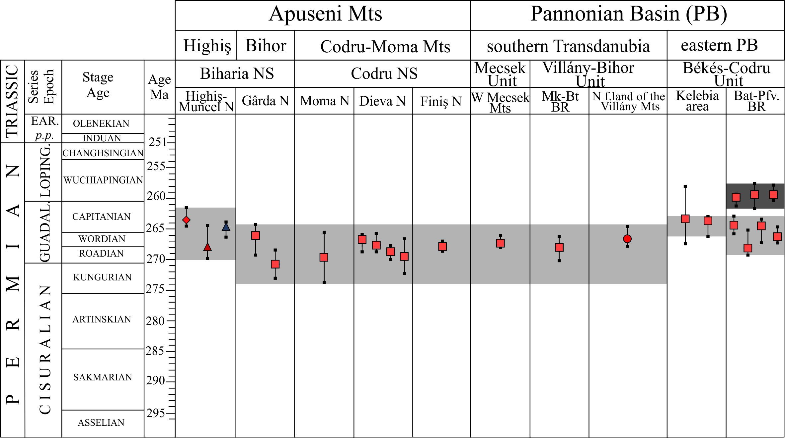
Permian magmatism in the Tisza Mega-unit – A geochronological summary
Zircon U-Pb age data of all of the studied Permian magmatic rocks in the Tisza Mega-unit (Pannonian Basin and Apuseni Mts) pointing out an older, dominant (~ 271–263 Ma, light grey) and a younger (~ 260–259 Ma, dark grey) magmatic episodes. Age data are dominantly TuffZirc ages, excepting some pyroclastic samples from the Apuseni Mts (with low number of analyzed spots) for those weighted mean ages were given
Máté Szemerédi et al. - Permian magmatism in the Carpathian-Pannonian region (Hungary and Romania)
in EGU2020: Sharing Geoscience Online

Slide 12
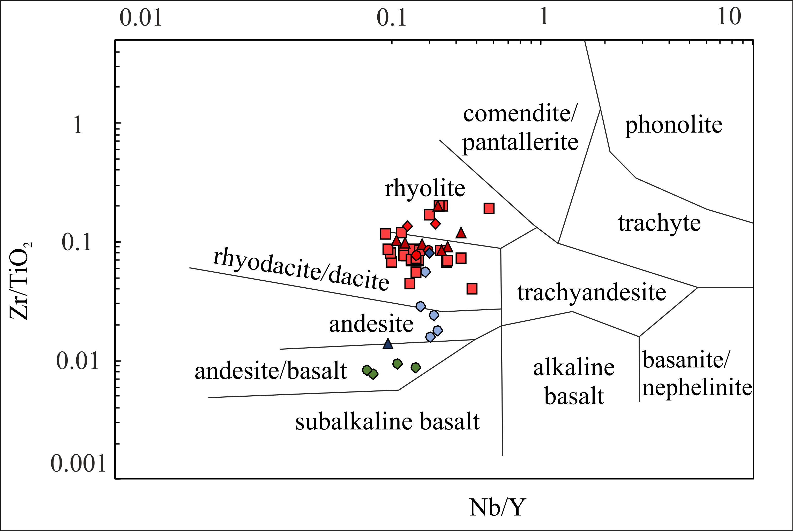
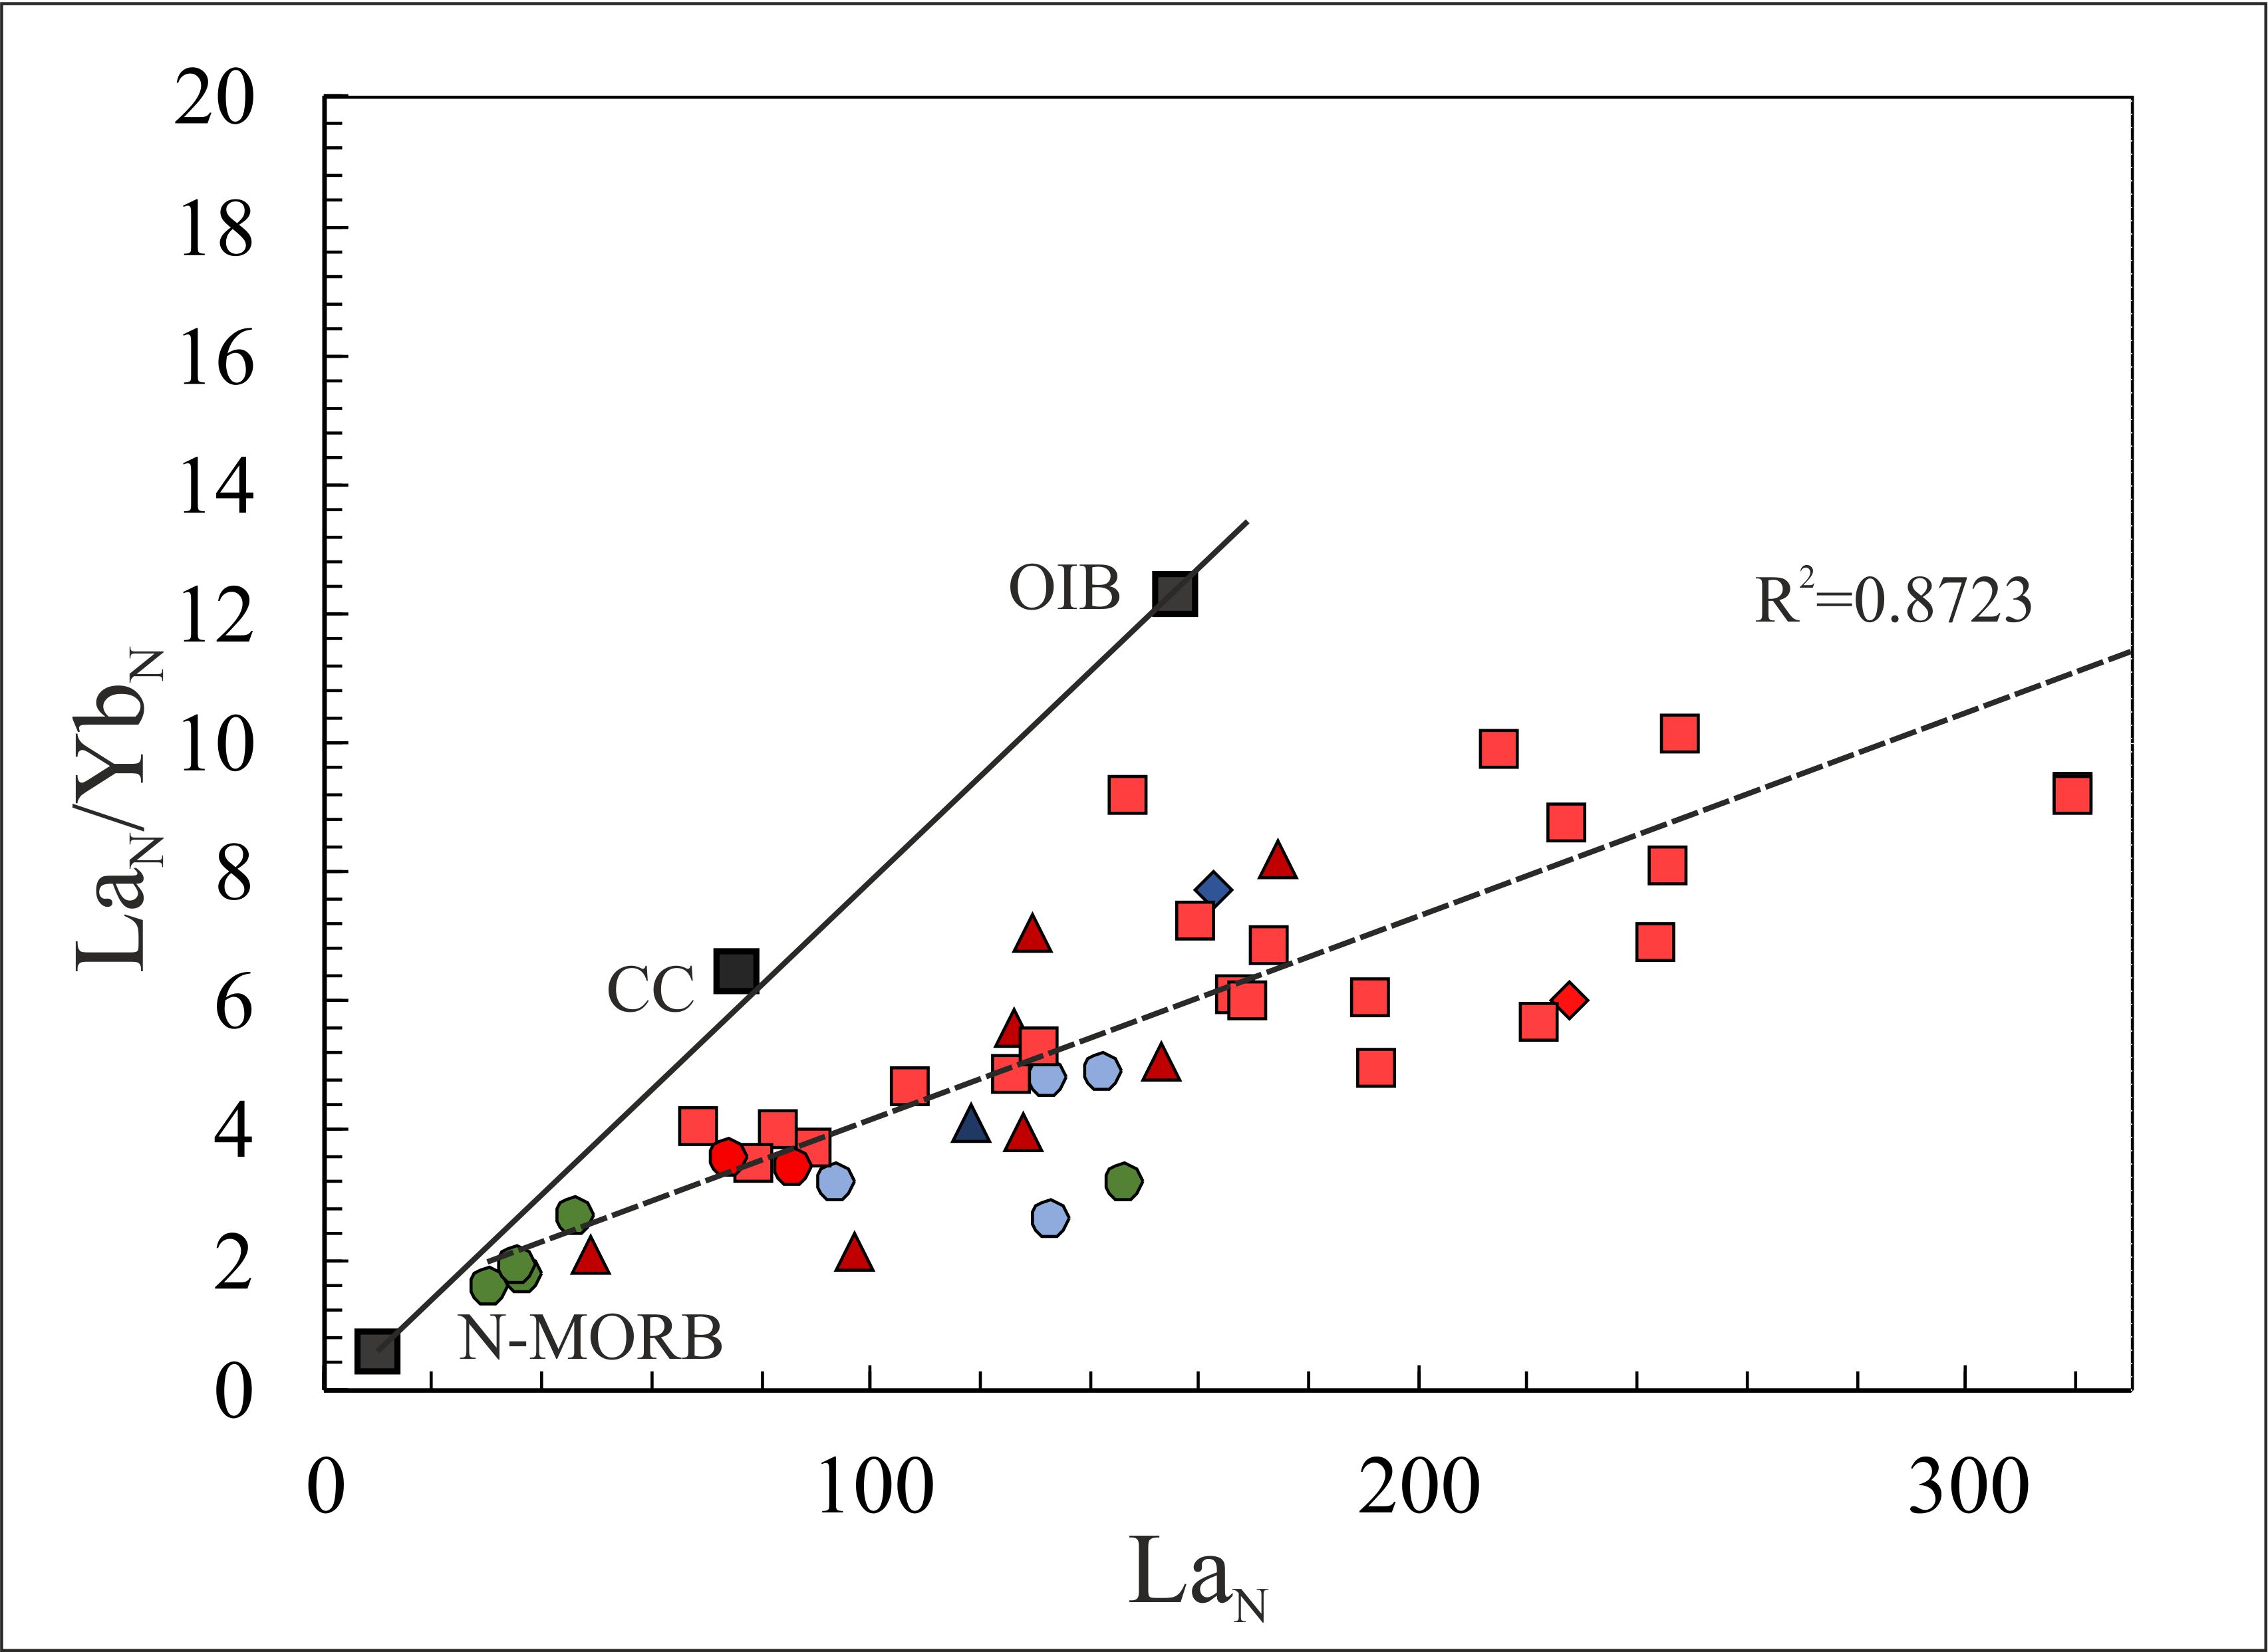
A Permian plutonic-volcanic system in the Tisza Mega-unit (immobile element geochemistry)
Classification of the Permian magmatic rocks in the Tisza Mega-unit (Pannonian Basin and Apuseni Mts) in the Zr/TiO₂ vs. Nb/Y diagram (modified after Winchester & Floyd 1977)
The La_{N} vs. La_{N}/Yb_{N} diagram of the Permian magmatic rocks in the Tisza Mega-unit showing their potential source and fractional crystallization trend. Mid Ocean Ridge Basalt (N-MORB) and Ocean Island Basalt (OIB) data are from Sun & McDonough (1989) and average continental crust (CC) data from Rudnick & Fountain (1995)
Máté Szemerédi et al. - Permian magmatism in the Carpathian-Pannonian region (Hungary and Romania)
in EGU2020: Sharing Geoscience Online

Slide 13
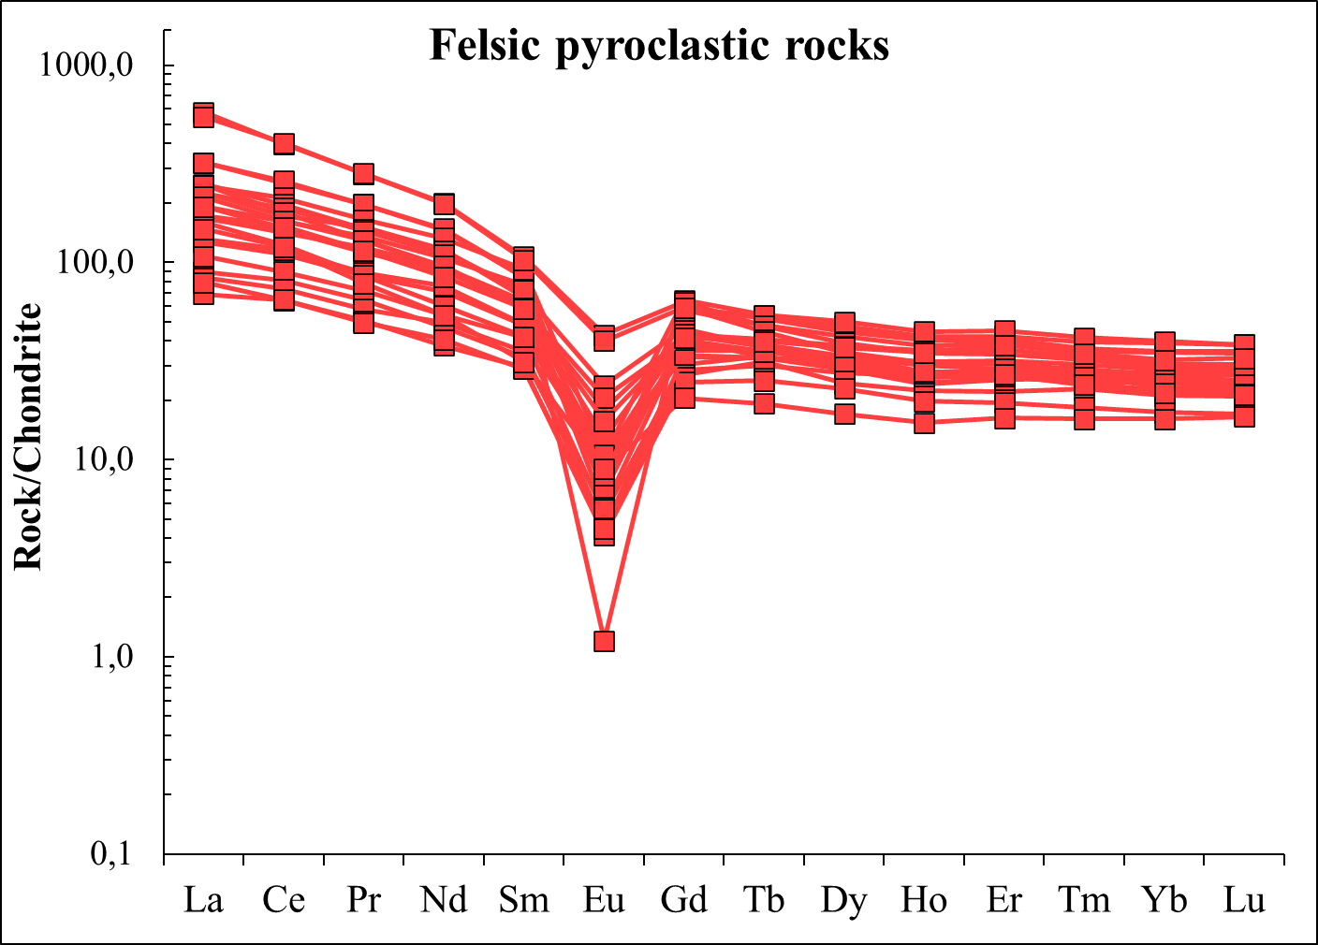
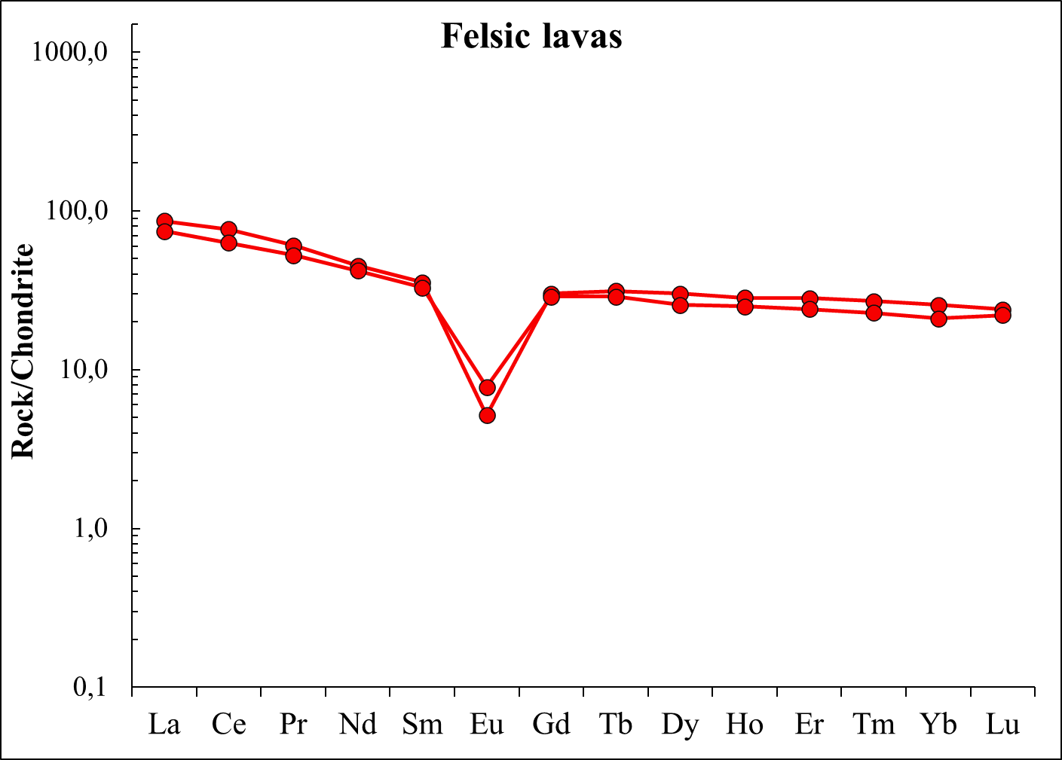
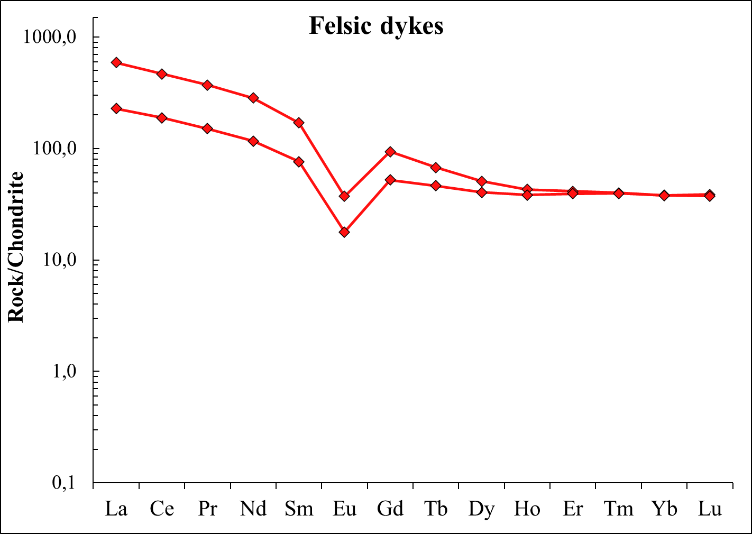
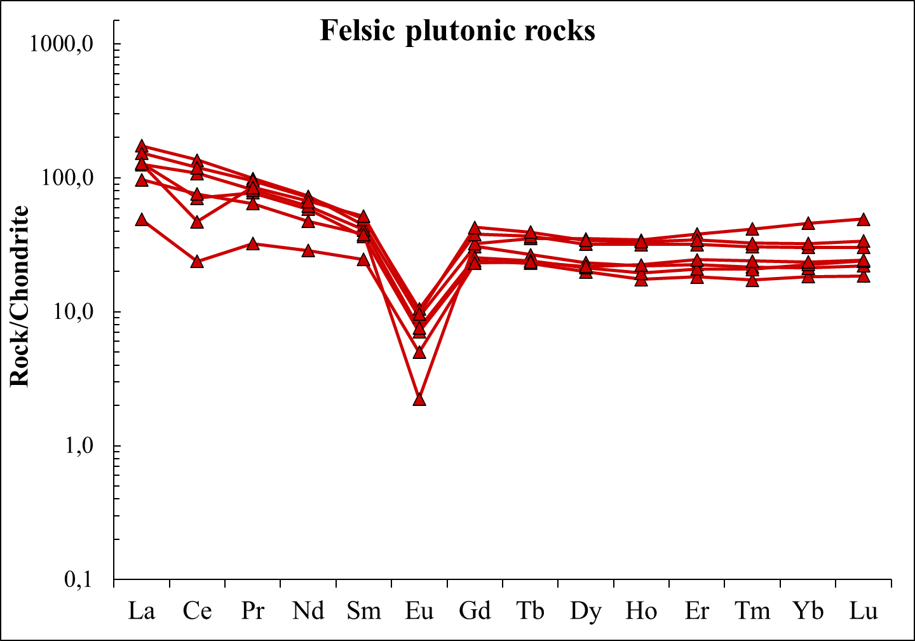
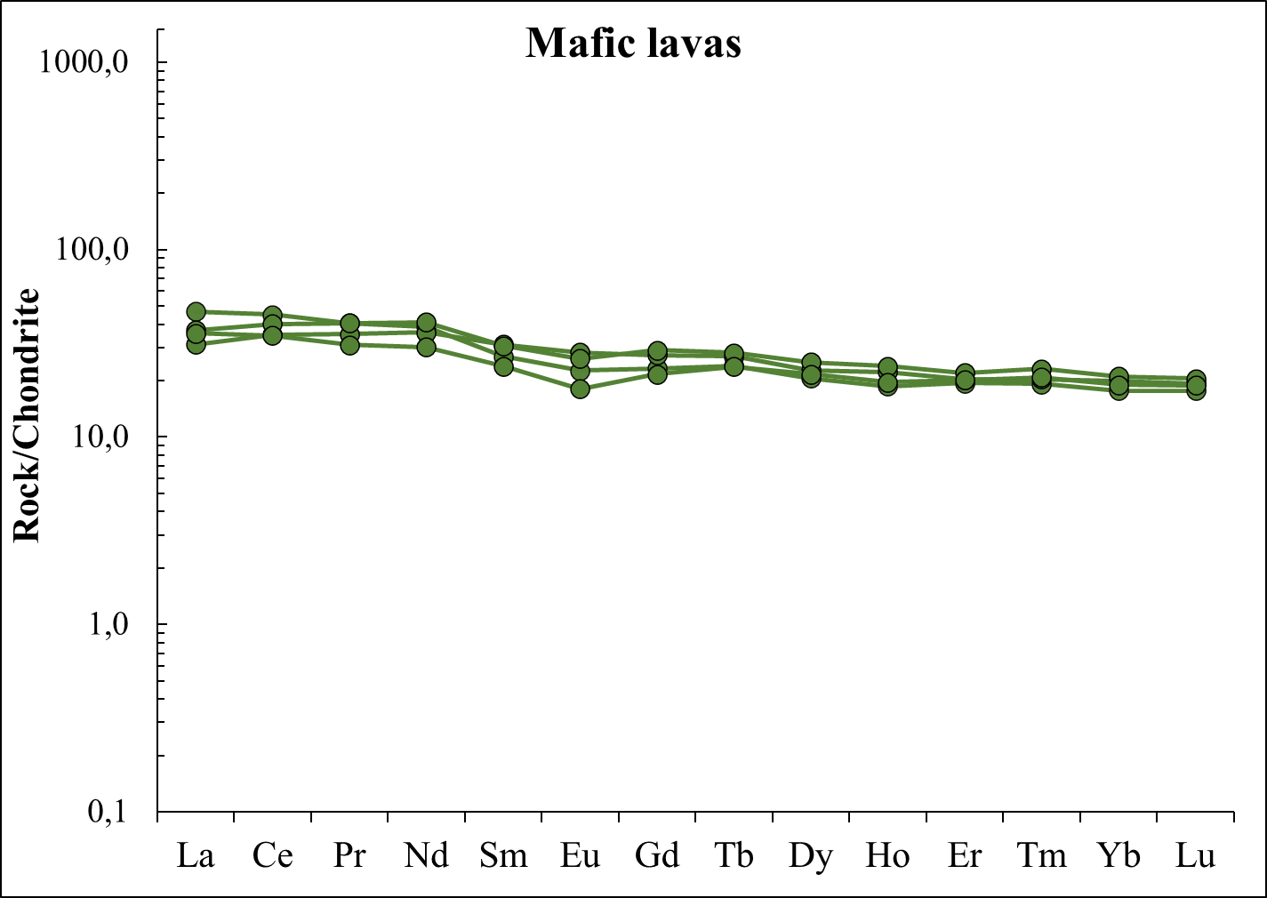
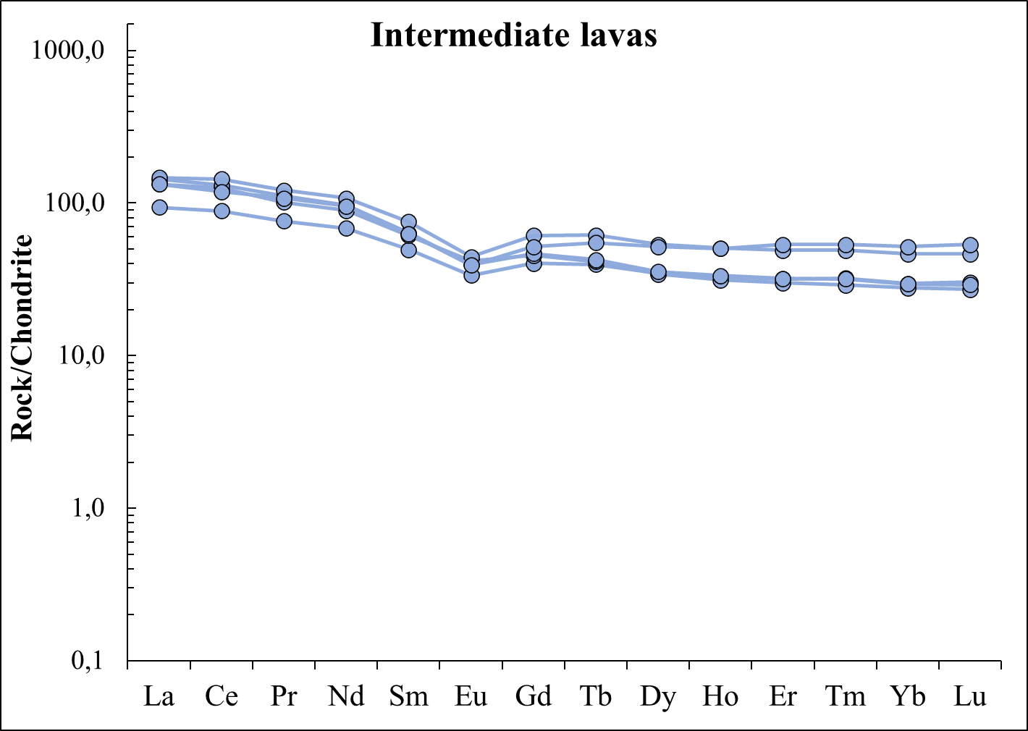
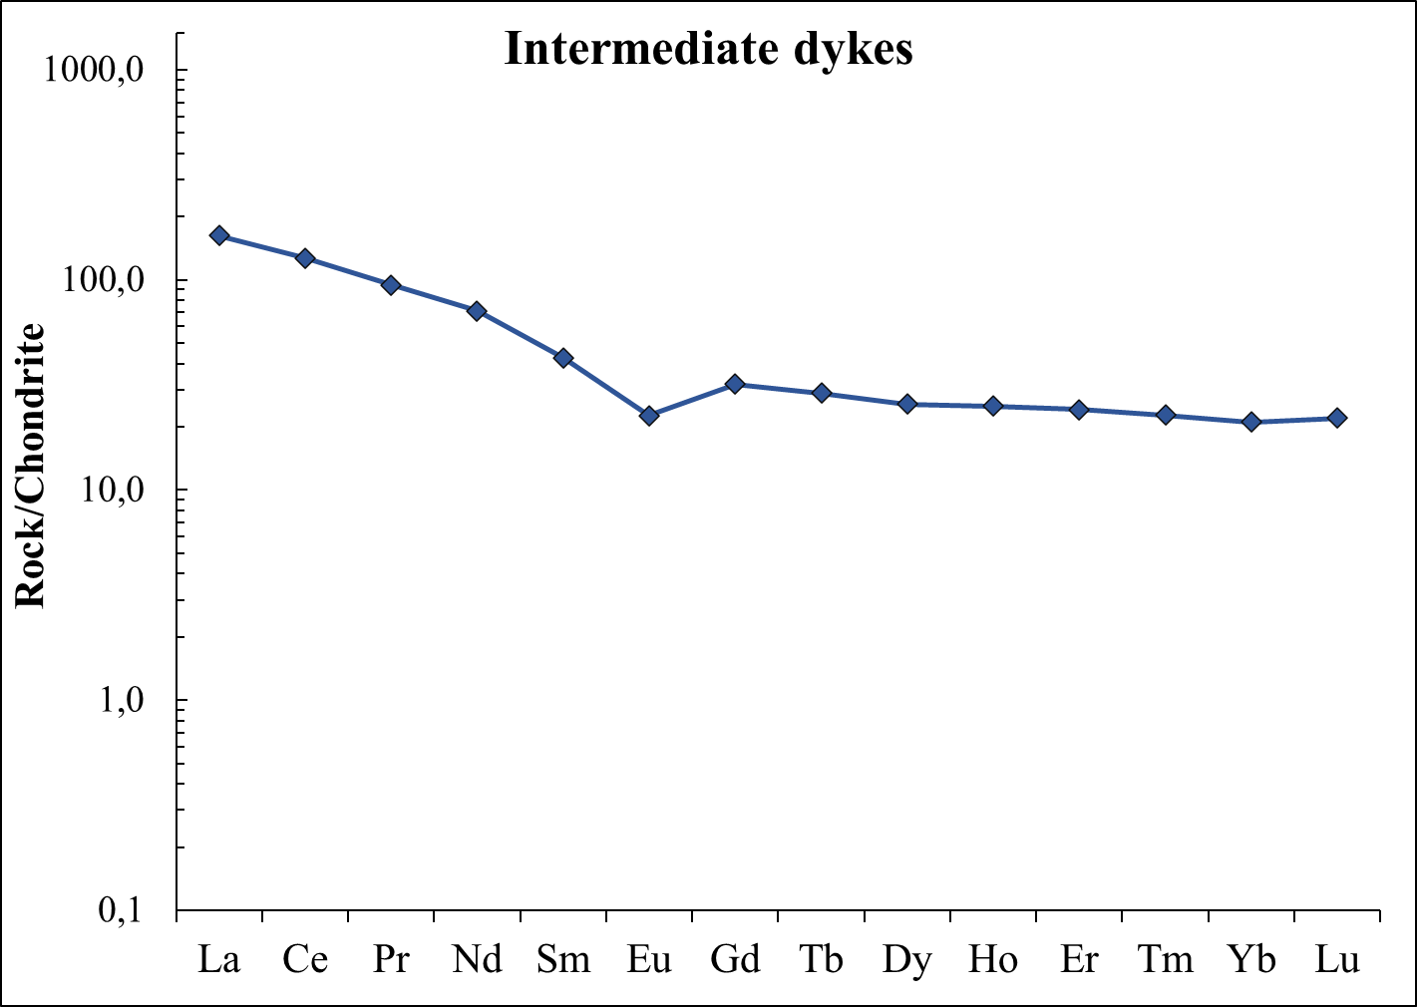
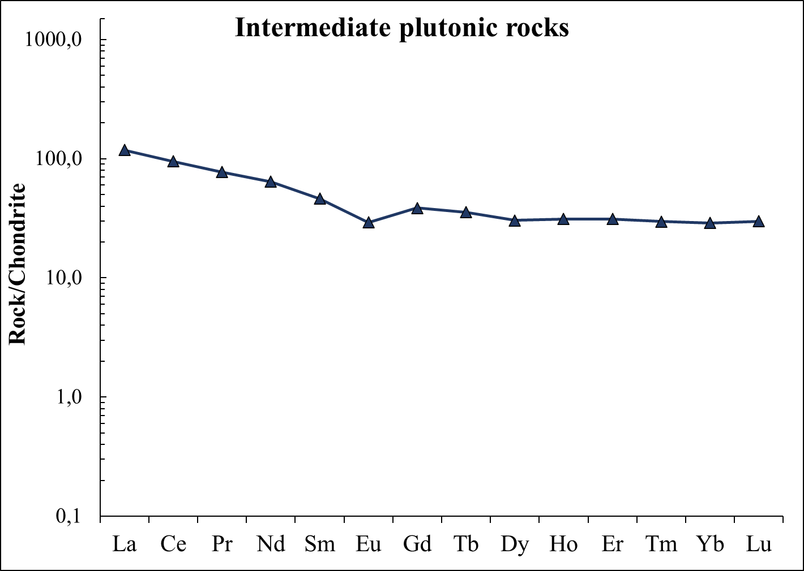
A Permian plutonic-volcanic system in the Tisza Mega-unit (REE geochemistry)
Chondrite-normalized rare earth element (REE) patterns (Sun & McDonough 1989) of the Permian magmatic rocks in the Tisza Mega-unit (Pannonian Basin and Apuseni Mts). Felsic rocks – note fractionated light (L)REE, negative Eu anomaly, and nearly flat HREE pattern (‘seagull’ pattern). Intermediate and mafic rocks – note slighter enrichment in LREEs and insignificant Eu anomaly resulting a more flat pattern. Geochemical data of intermediate and mafic lavas derive from Nicolae et al. (2014)
Máté Szemerédi et al. - Permian magmatism in the Carpathian-Pannonian region (Hungary and Romania)
in EGU2020: Sharing Geoscience Online

Slide 14
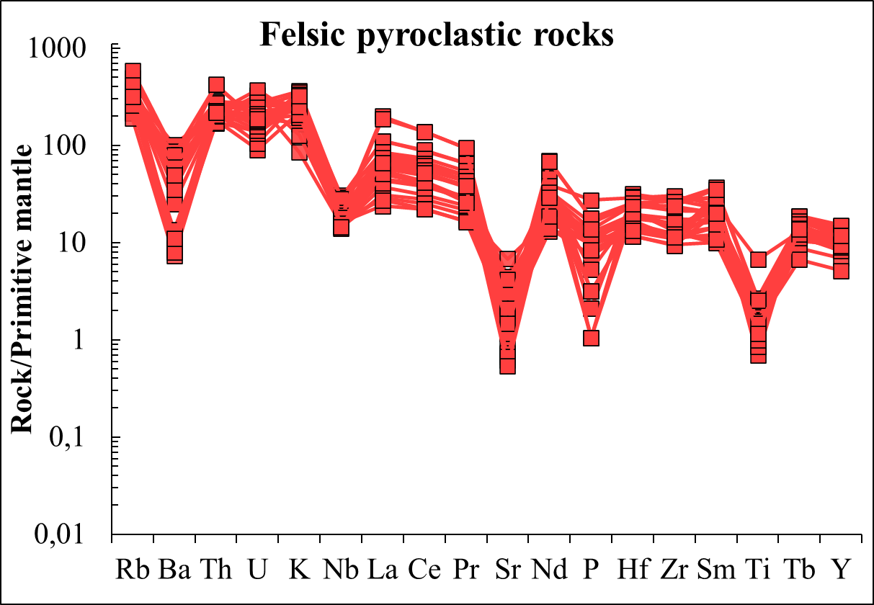
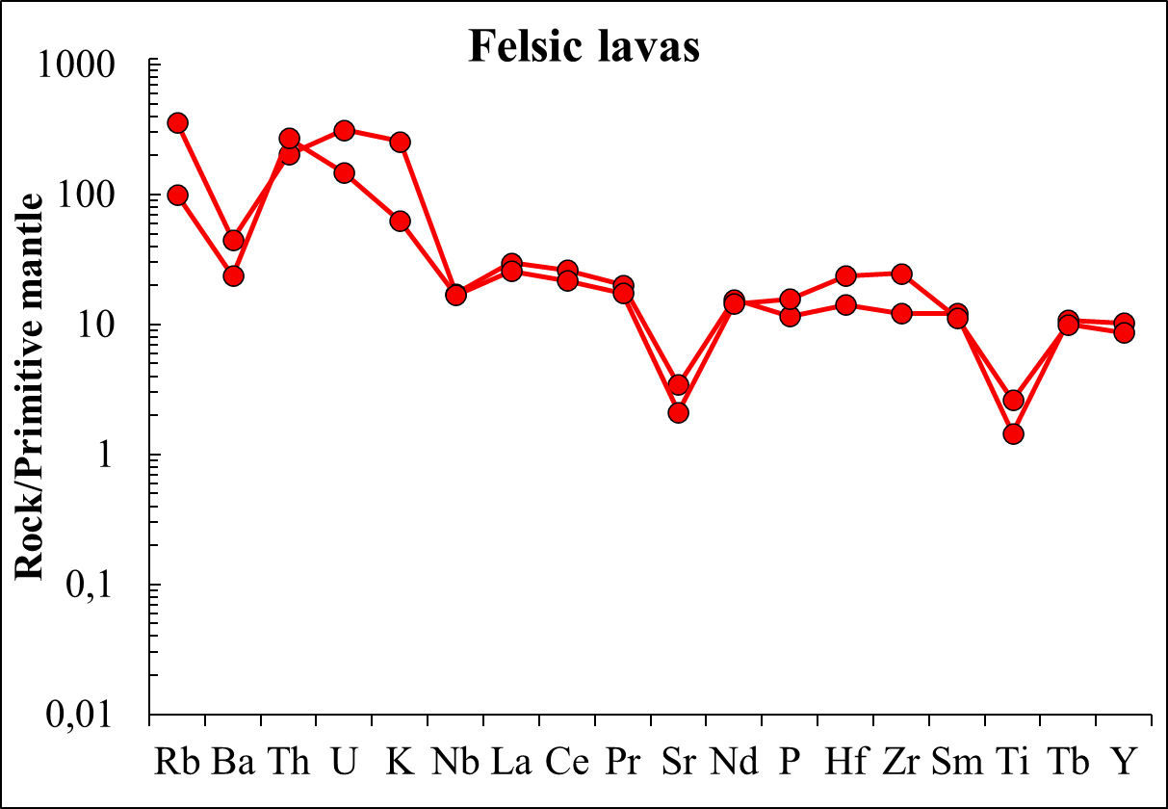
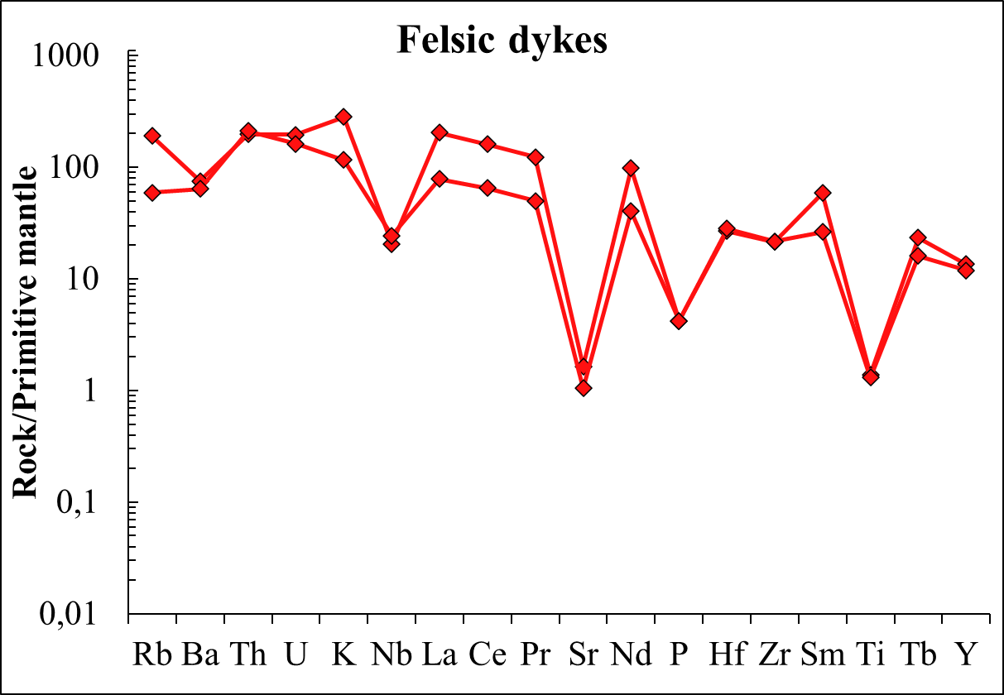
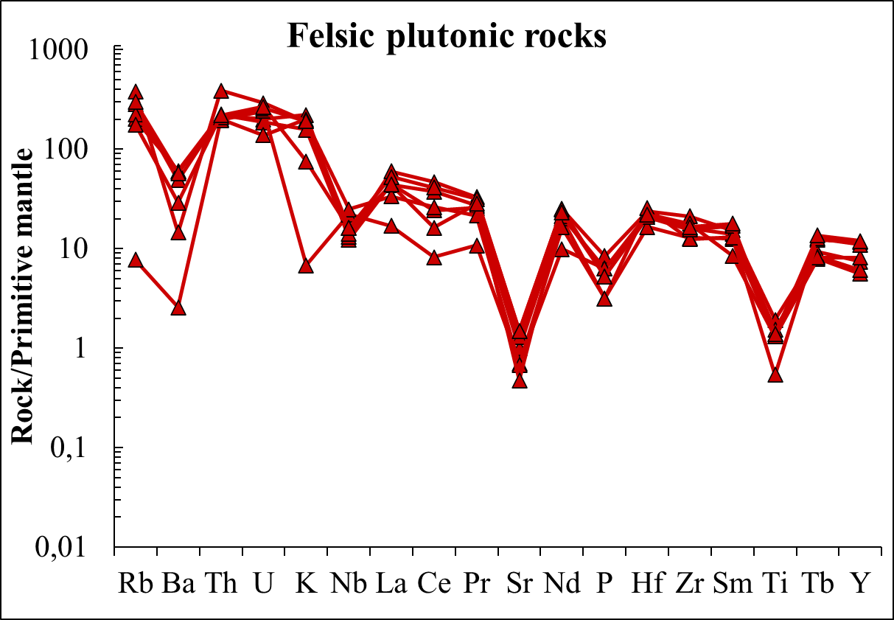
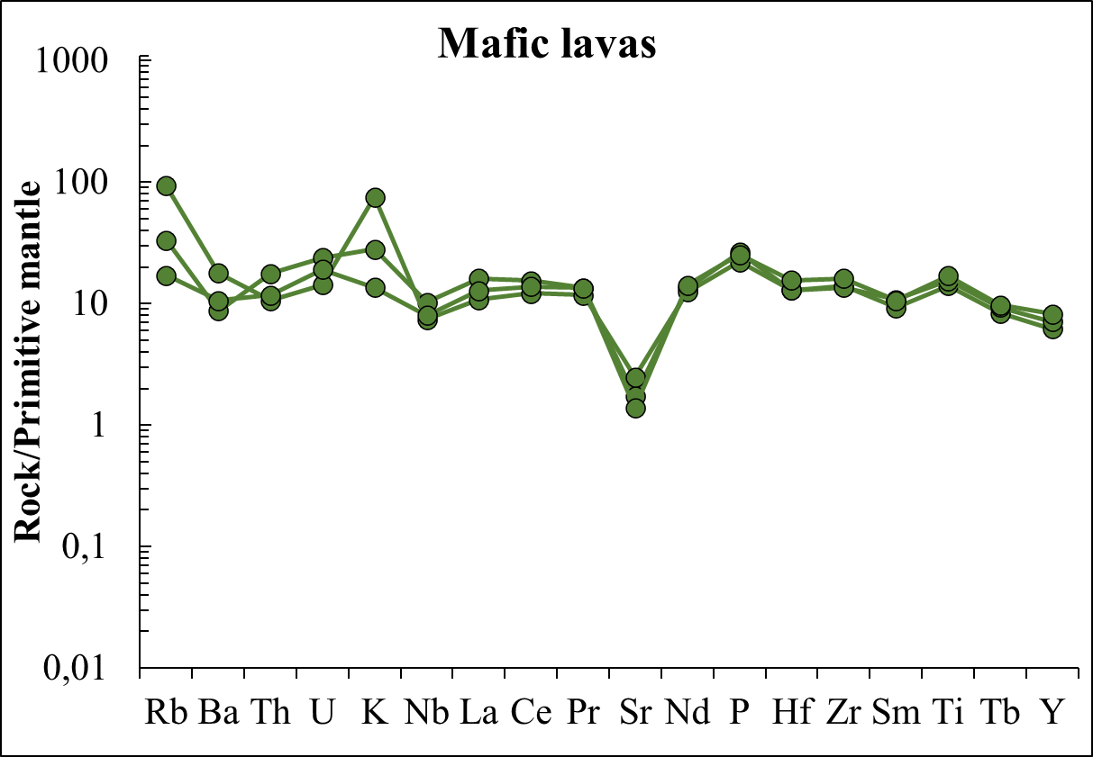
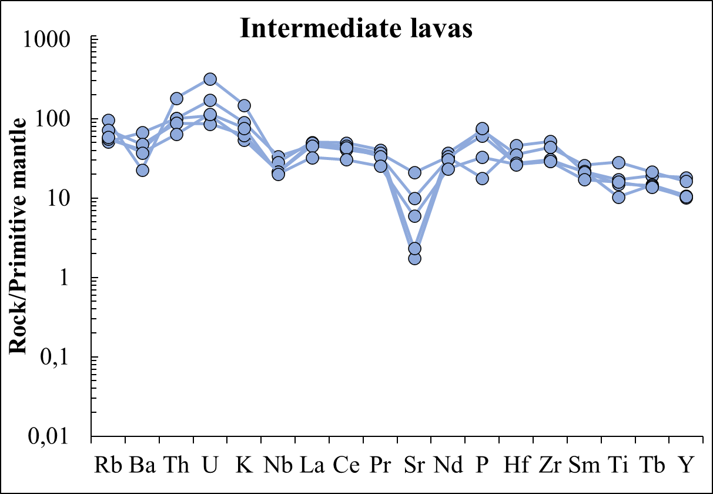
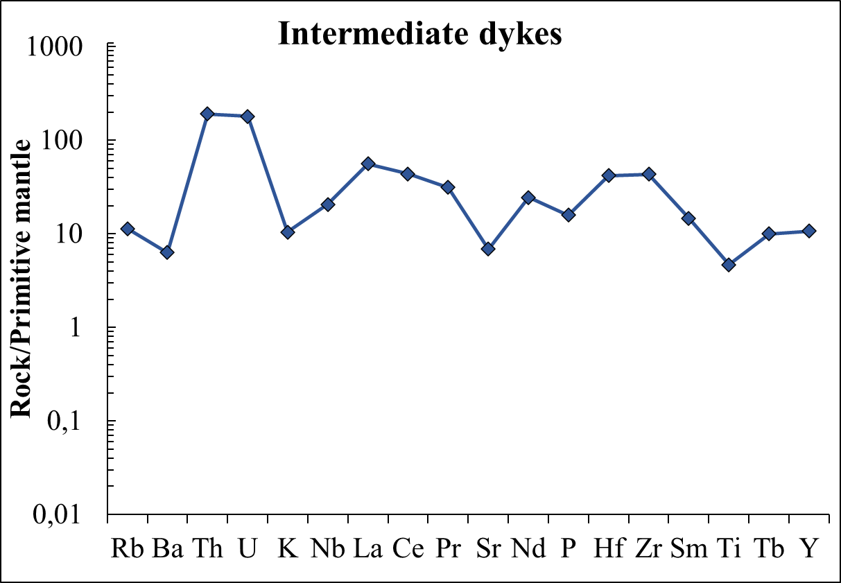
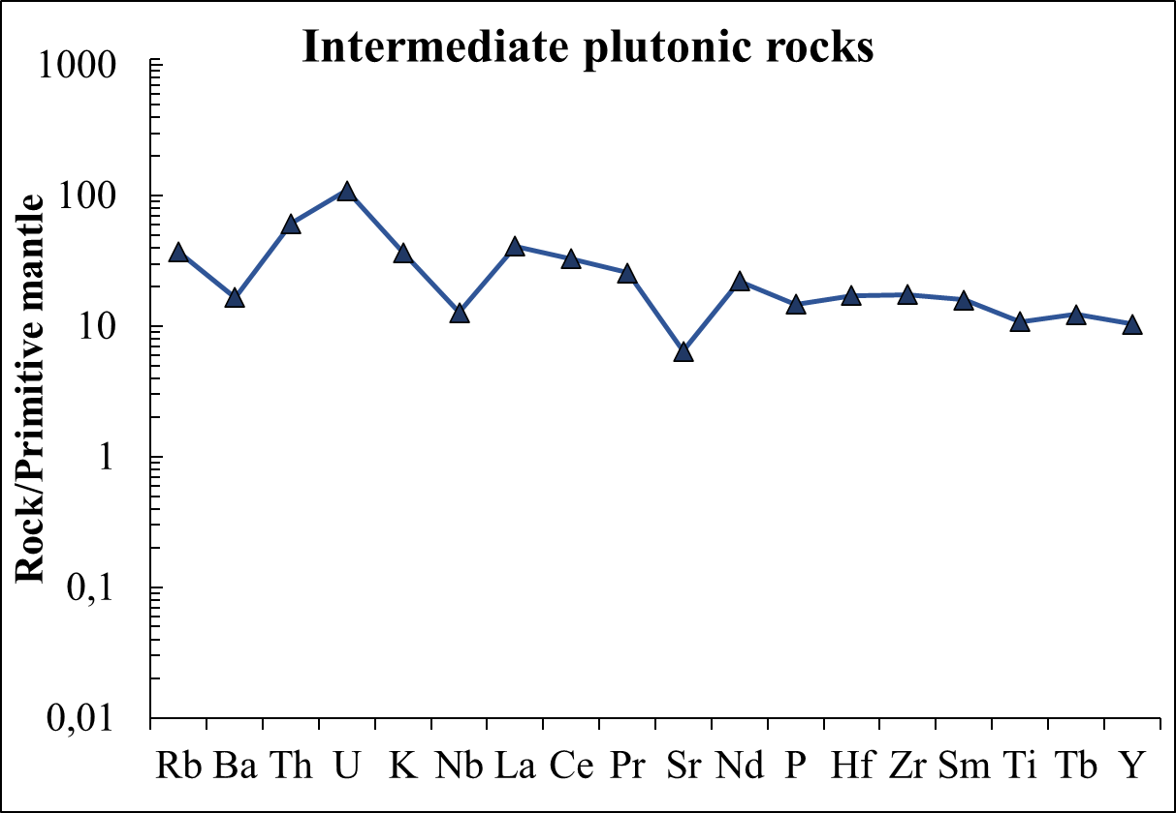
A Permian plutonic-volcanic system in the Tisza Mega-unit (immobile element geochemistry)
Primitive mantle-normalized multi element spider diagrams (Sun & McDonough 1989) of the Permian magmatic rocks in the Tisza Mega-unit (Pannonian Basin and Apuseni Mts). Felsic rocks – note enrichment in Rb, Th, and U and depletion in Ba, Nb, Sr, and Ti. Intermediate and mafic rocks – note less significant degree of the aforementioned enrichments and depletions. Geochemical data of intermediate and mafic lavas derive from Nicolae et al. (2014)
Máté Szemerédi et al. - Permian magmatism in the Carpathian-Pannonian region (Hungary and Romania)
in EGU2020: Sharing Geoscience Online

Slide 15
A Permian plutonic-volcanic system in the Tisza Mega-unit (summary)
(1) Permian volcanic, subvolcanic, and plutonic rocks having mafic to felsic compositions occur in distinct tectonic units in the western-central part of the Apuseni Mts (Romania) as well as in the basement of the Pannonian Basin (Hungary, including all the three Alpine facies zones) dominantly as felsic pyroclastic rocks; however, their relationship have not been observed yet.
(2) Petrography and major element geochemistry revealed that these rocks were affected by significant post-magmatic alterations, thus immobile elements were used for rock classifications and petrogenetic implications.
(3) Immobile element patterns (REE patterns and spider diagrams) are similar for all rock types suggesting fractional crystallization from a common or similar source.
(4) Zircon U-Pb ages of this Permian cogenetic rock assemblage overlap each other and fall within a relatively brief, ~ 10 Myr long time-span (~ 269-259 Ma, Guadalupian) suggesting a short-lived complex magmatic system.
(5) Regarding a broader correlation, the radiometric ages of the studied Permian magmatic formations in the Tisza Mega-unit are significantly younger than the zircon ages of other well-studied parts of the Central European Variscides (e.g., Intra-Sudetic Basin, NE Germany), where much older ages were detected (~ 300-280 Ma; Breitkreuz & Kennedy 1999; Wilson et al. 2004; Awdankiewicz & Krzya 2010; Repstock et al. 2017; Słodcyzk et al. 2018). However, the observed Permian magmatic rocks show geochemical and geochronological similarity with those of the Western Carpathians (see details in the next slides).
Máté Szemerédi et al. - Permian magmatism in the Carpathian-Pannonian region (Hungary and Romania)
in EGU2020: Sharing Geoscience Online

Slide 16
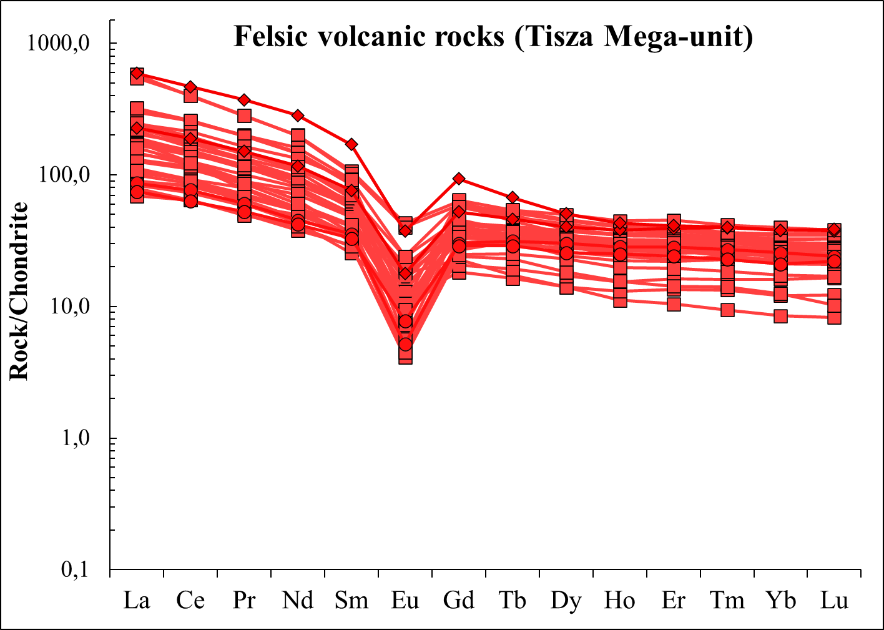
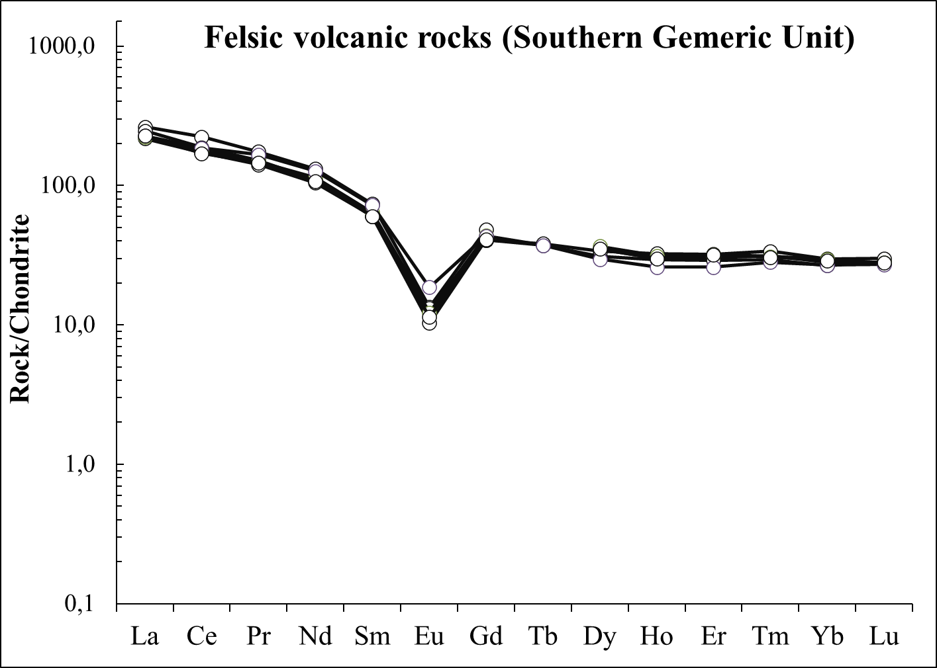
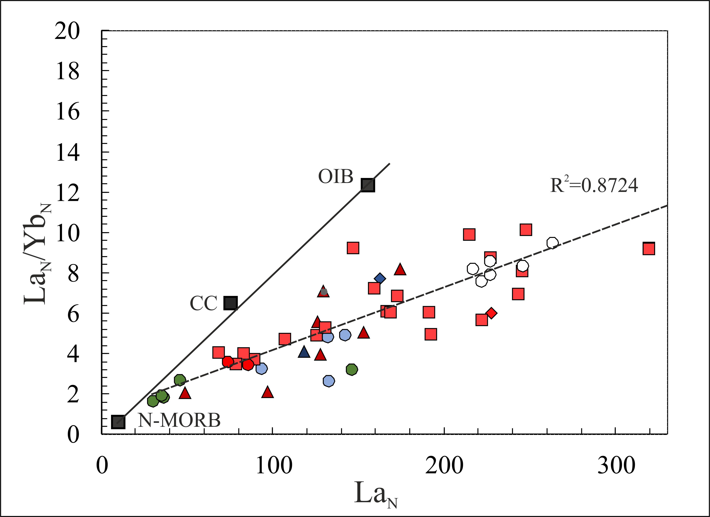
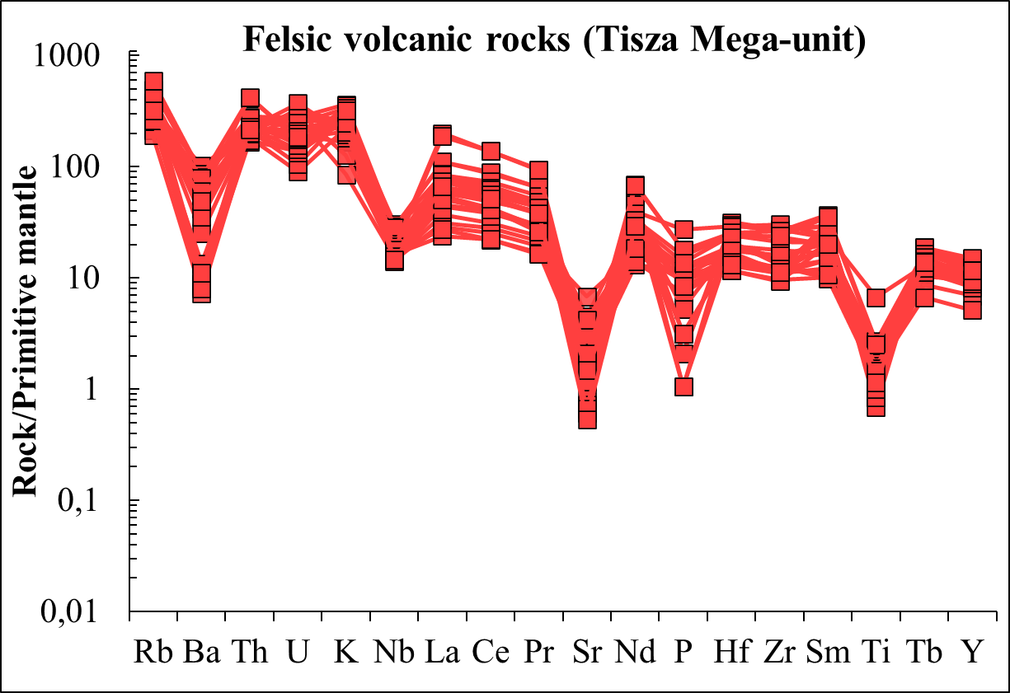
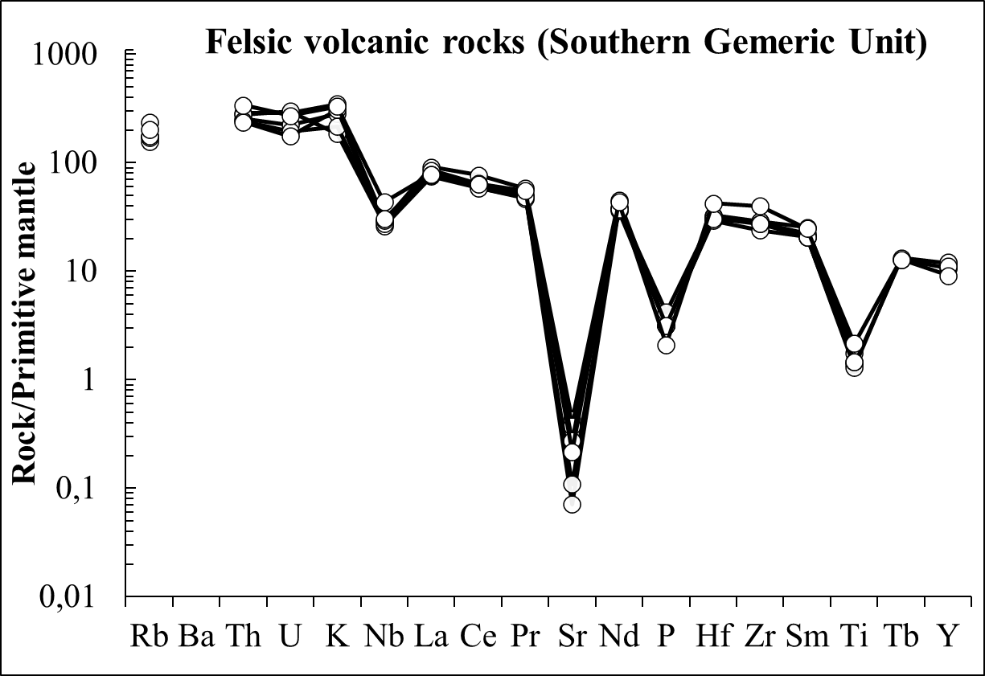
Geochemistry and correlation in the Carpathian-Pannonian region
Correlations between the Permian felsic volcanic rocks in the Tisza Mega-unit (Pannonian Basin and Apuseni Mts) and similar rocks in the Southern Gemeric Unit, Central Western Carpathians (Slovakia). Geochemical data of the latter area derive from Vozárová et al. (2009). Note similar REE fractionations as well as enrichments and depletions in immobile elements
Máté Szemerédi et al. - Permian magmatism in the Carpathian-Pannonian region (Hungary and Romania)
in EGU2020: Sharing Geoscience Online

Slide 17
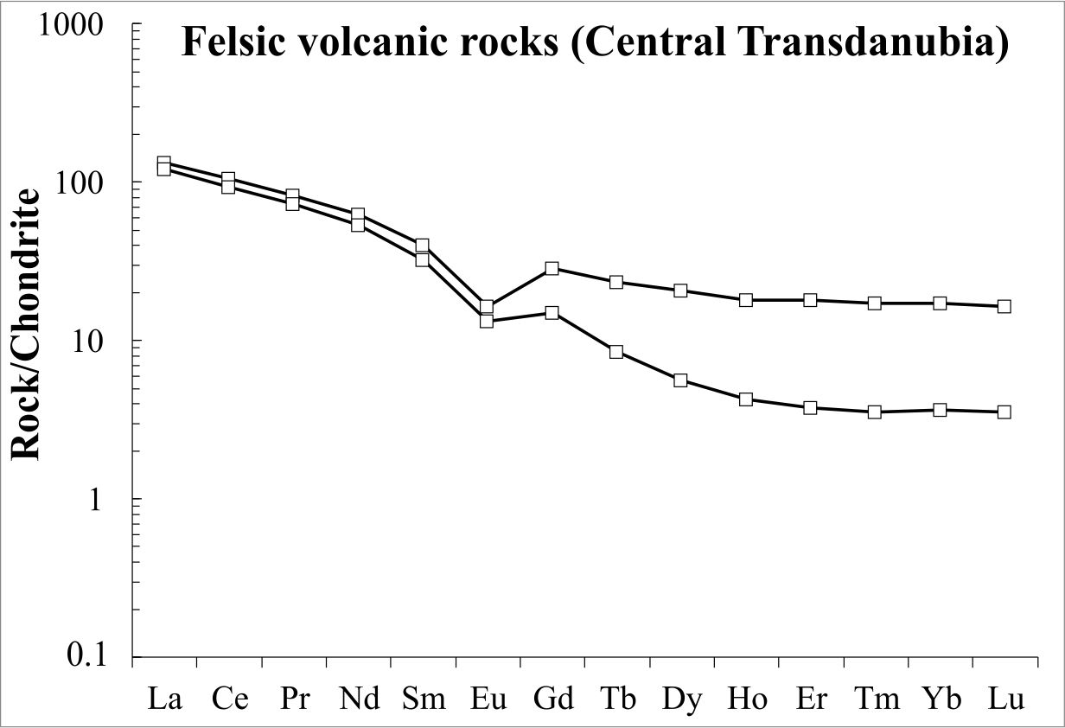
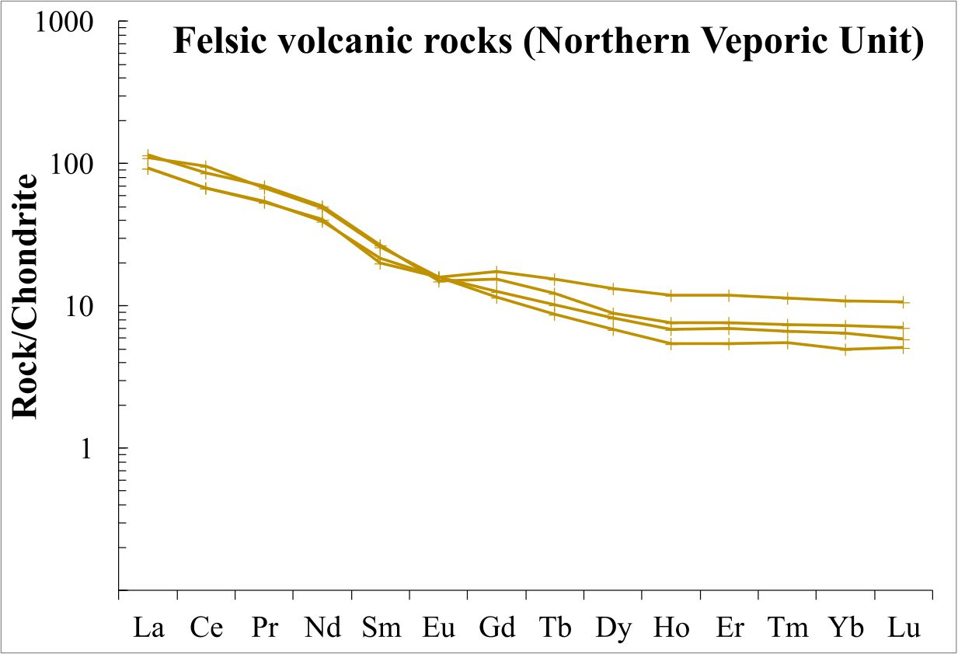
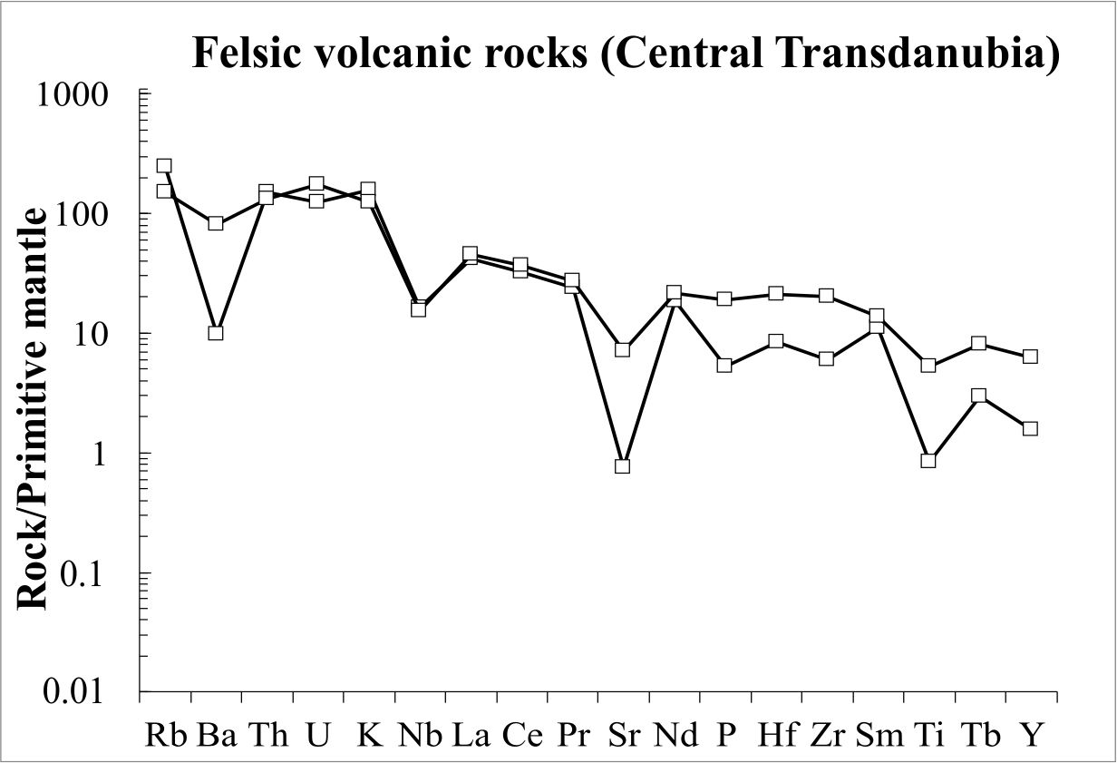
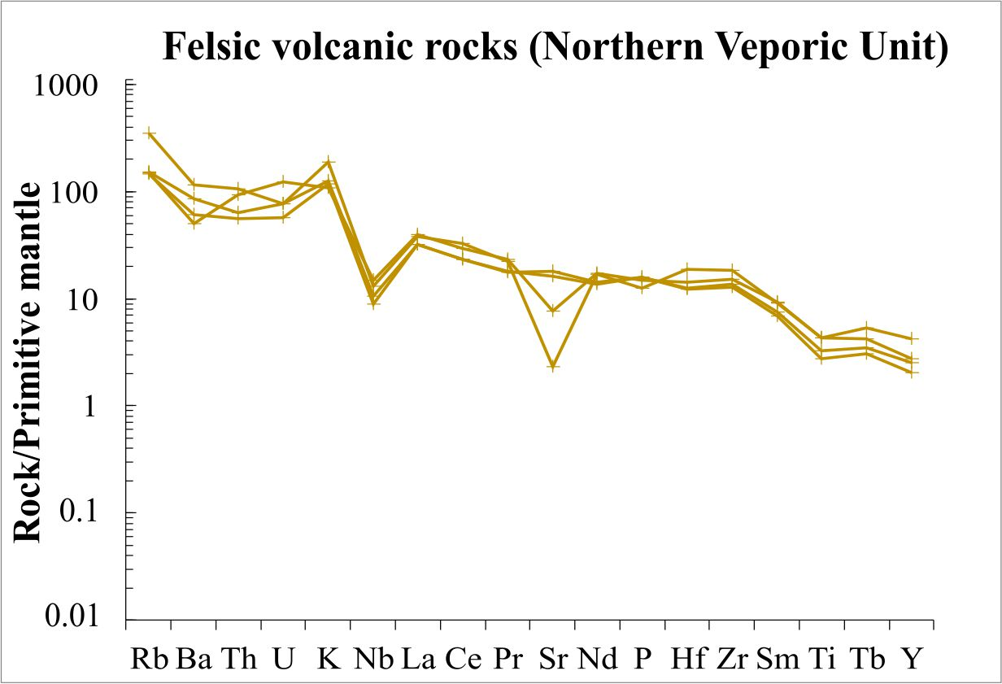
Geochemistry and correlation in the Carpathian-Pannonian region
Correlations between the Permian felsic volcanic rocks in Central Transdanubia (ALCAPA Mega-unit, Hungary) and similar rocks in the Northern Veporic Unit, Central Western Carpathians (Slovakia). Geochemical data of the latter area derive from Vozárová et al. (2016). Note similar enrichments and depletions in immobile elements and insignificant Eu anomaly in case of the samples of both areas
Máté Szemerédi et al. - Permian magmatism in the Carpathian-Pannonian region (Hungary and Romania)
in EGU2020: Sharing Geoscience Online

Slide 18
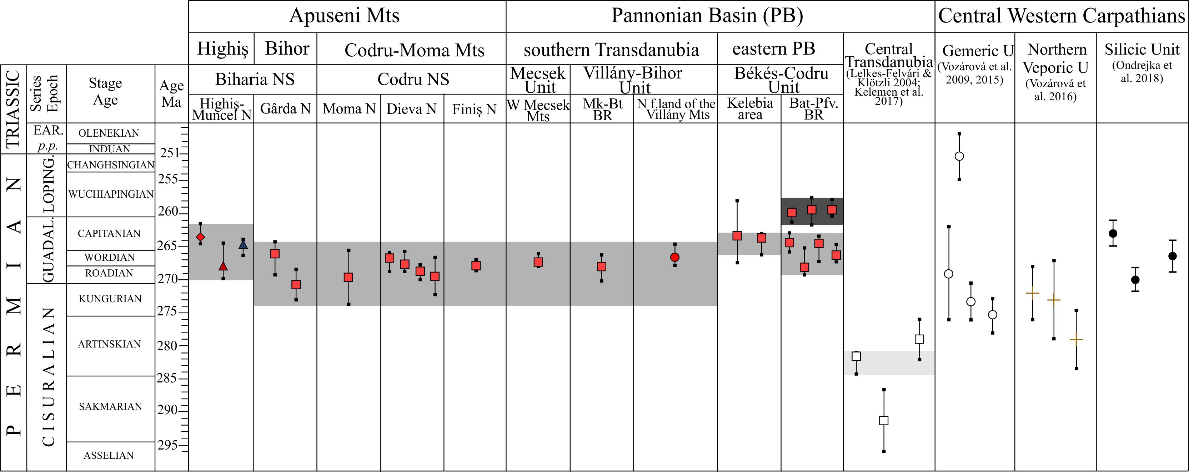
Geochronology and correlation in the Carpathian-Pannonian region
Permian magmatic episodes in the Carpathian-Pannonian region, including our new results and recent zircon U-Pb datings from the felsic volcanites in the ALCAPA Mega-unit (Lelkes-Felvári & Klötzli 2004; Vozárová et al. 2009, 2015, 2016; Kelemen et al. 2017; Ondrejka et al. 2018). Permian magmatism in the Tisza Mega-unit proved to be separate from that one occured in Central Transdanubia (an older, geochemically distinct volcanic activity); however, the zircon datings overlap with those of the other superunits in the Central Western Carpathians. The latter was supported by whole-rock geochemistry, too, between the felsic volcanic rocks of the Tisza Mega-unit and the Southern Gemeric Unit
Máté Szemerédi et al. - Permian magmatism in the Carpathian-Pannonian region (Hungary and Romania)
in EGU2020: Sharing Geoscience Online

Slide 19
Acknowledgements
This study was supported by the Bolyai Research Scolarship of the Hungarian Academy of Sciences to Réka Lukács and Andrea Varga as well as by the UNKP-17-4, UNKP-18-4-SZTE-16, and UNKP-18-3-I-SZTE-90 New National Excellence Program of the Ministry of Human Capacities (Hungary) to Andrea Varga and Máté Szemerédi. Additionally, some parts of this research were financed by the Hungarian Scientific Research Fund projects PD 83511, PD 121048, K 108375, and K 131690 (Hungary).
Samplings were accomplished by the assistance of Ioan Seghedi and Mihai Tatu (Codru-Moma Mts, 2017) and Béla Raucsik, Andrea Varga, and Előd Mészáros (Highiş Mts, 2018).
We are grateful to Gyöngyi Lelkes-Felvári for providing samples from the Kékkút-4 borehole (Central Transdanubia, ALCAPA Mega-unit).
We would like to say many thanks to the staffs of the MTA-ELTE Volcanology Research Group, the ‘Vulcano’ Petrology and Geochemistry Research Group, University of Szeged, and the Department of Sedimentology and Environmental Geology, University of Göttingen for their help in sample preparations and all analyses related to this study.
Abbreviations in the photomicrographs
am amphibole, ax axiolite, bt (pseudomorph after) biotite, chl chlorite, ep epidote, f altered fiamme, fsp feldspar, grt garnet, mc microcline, ms muscovite, p altered pumice, px pseudomorph after pyroxene, qz quartz, s altered glass shard, ser sericite, sph spherulite, PPL plane polarized lights, XPL crossed polars
Máté Szemerédi et al. - Permian magmatism in the Carpathian-Pannonian region (Hungary and Romania)
in EGU2020: Sharing Geoscience Online

Slide 20
References
Awdankiewicz M, Kryza R (2010) Mineralogia Special Papers 37:19
Breitkreuz C, Kennedy A (1999) Tectonophysics 302:307–326.
Hidasi T, Varga A, Pál-Molnár E (2015) Földtani Közlöny 145(1):3–22.
Kelemen P, Dunkl I, Csillag G, Mindszenty A, von Eynatten H, Józsa S (2017) Sediment Geol 358:84–96.
Lelkes-Felvári Gy, Klötzli U (2004) Acta Geologica Hungarica, 47(2–3):139–149.
Nicolae I, Seghedi I, Boboş I, Azevedo MR, Ribeiro S, Tatu M (2014) Chem Erde-Geochem 74:125–137.
Ondrejka M, Li XH, Vojtko R, Putiš M, Uher P, Sobocký T (2018) Geol Carpath, 69(2):187–198.
Pană DI, Heaman LM, Creaser RA, Erdmer P (2002) J Geol 110:341–354.
Repstock A, Breitkreuz C, Lapp M, Schulz B (2017) Int J Earth Sci 107:1485–1513.
Rudnick RL, Fountain DM (1995) Rev Geophys 33:267–309.
Słodczyk E, Pietranik A, Glynn S, Wiedenbeck M, Breitkreuz C, Dhuime B (2018) Int J Earth Sci 107:2065.
Sun SS, McDonough WF (1989) In: Saunders AD, Norry MJ (eds) Magmatism in ocean basins, 42. Geological Society London Special Publication, London, pp 312–345
Szemerédi M, Varga A, Lukács R, Pál-Molnár E (2016) Földtani Közlöny 146(4):335–354.
Szemerédi M, Varga A, Lukács R, Pál-Molnár E (2017) Földtani Közlöny 147(4):357–382.
Szemerédi M, Lukács R, Varga A, Dunkl I, Józsa S, Tatu M, Pál-Molnár E, Szepesi J, Guillong M, Szakmány Gy, Harangi Sz (2020a) Int J Earth Sci 109:101–125.
Szemerédi M, Varga A, Szepesi J, Pál-Molnár E, Lukács R (2020b) Central European Geology (in press)
Vozárová A, Šmelko M, Paderin I (2009) Geol Carpath 60(6):439–448.
Vozárová A, Presnyakov S, Šarinová K, Šmelko M (2015) Geol Carpath 66:375–391.
Vozárová A, Rodionov N, Vozár J, Lepekhina E, Šarinová K (2016) Geol Carpath 61:221–237.
Wilson M, Neumann ER, Davies GR, Timmerman MJ, Heermans M, Larsen BT (2004) Geological Society Special Publication No. 223, London
Winchester JA, Floyd PA (1977) Chem Geol 20:325–343.
Máté Szemerédi et al. - Permian magmatism in the Carpathian-Pannonian region (Hungary and Romania)
in EGU2020: Sharing Geoscience Online

