Slide 1




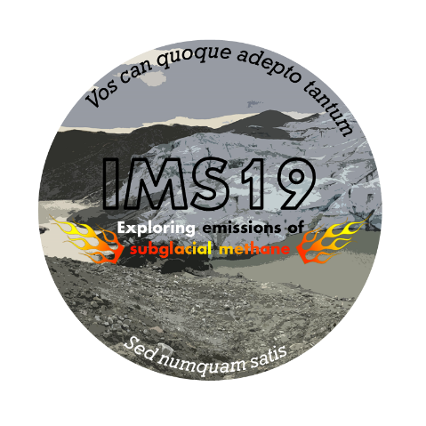
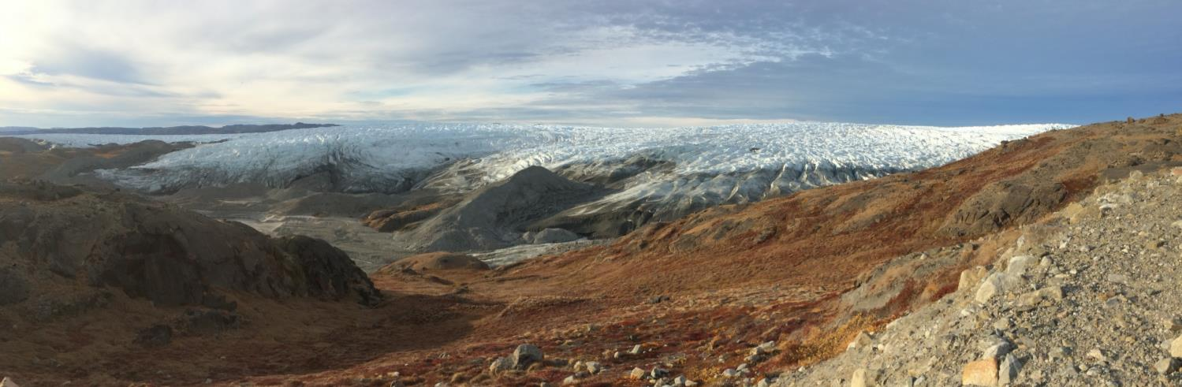
Jesper Riis Christiansen
Celia Sapart
Carina van der Veen
Thomas Röckmann
Elena Popa
Christian Juncher Jørgensen
Revealing the unknown subglacial carbon turnover processes using high frequency gas measurements and stable isotopes
Greenland Ice Sheet 2016
Kangerlussuaq
© Authors. All rights reserved

Slide 2
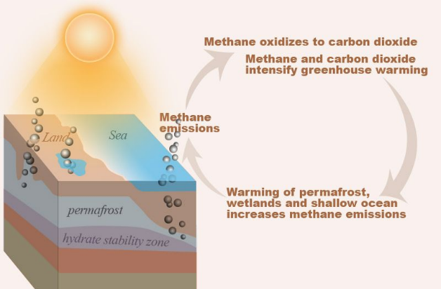
Scientific & Climatic background
Concern about short/long term stability of GHG-reserves in the Arctic in a warming climate
➔ Mobilization of permafrost carbon
➔ Destabilization of marine gas hydrates
➔ Increased emissions from Arctic wetlands
Initiation of a positive feedback loop

Slide 3
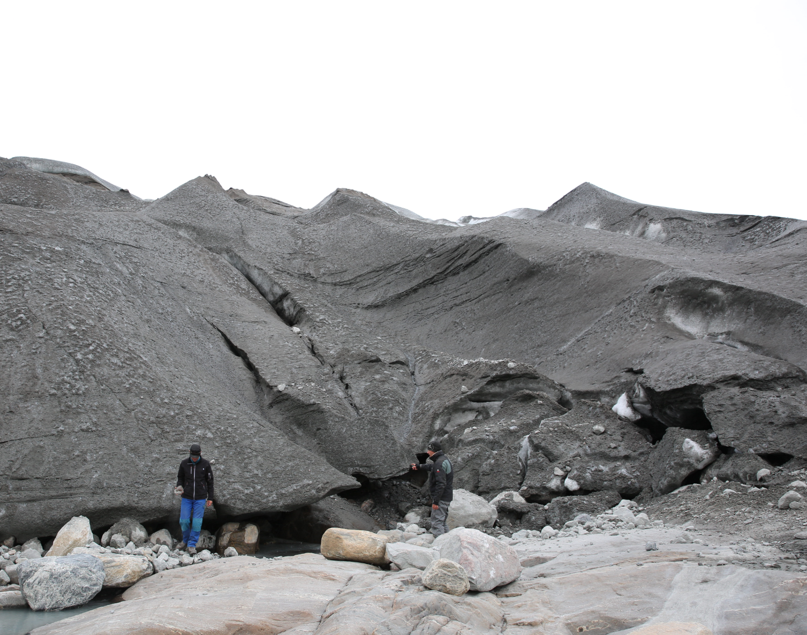
Back in 2016...
The ice front
Caves and cracks
Meltwater
© Authors. All rights reserved

Slide 4
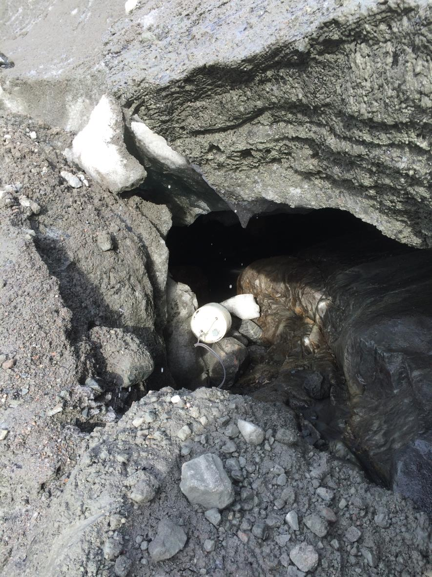
Subglacial wind with CH₄!

Slide 5
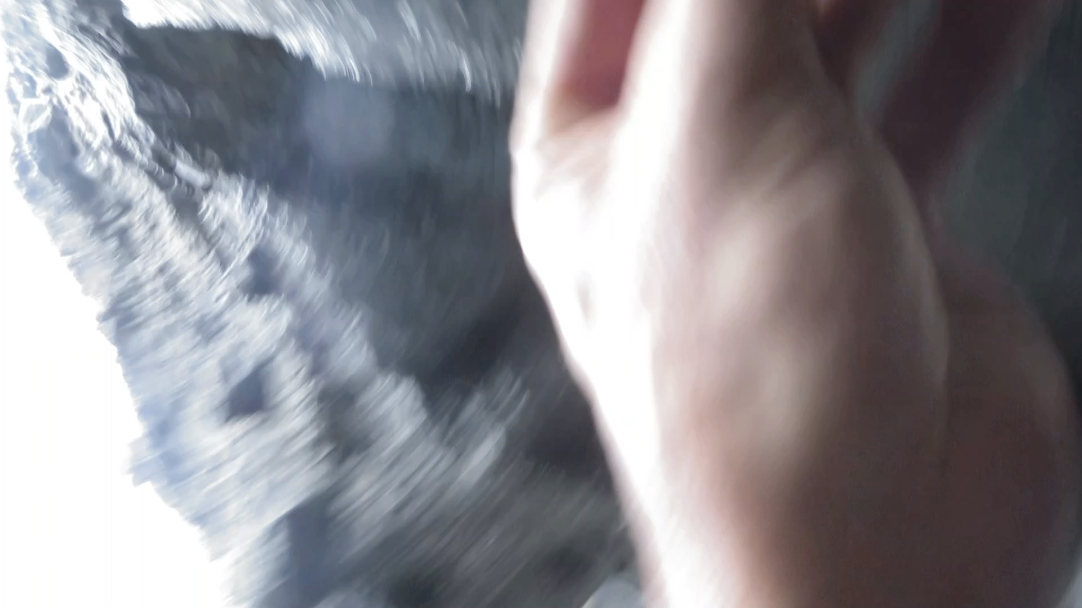
Subglacial wind! (movie)
Detected with a “homemade” wind sensor...

Slide 6
Significantly elevated CH₄ concetrations in subglacial air → emission to the atmosphere
© Authors. All rights reserved

Slide 7
Cycling of CH₄ below glaciers
Biotic CH₄ production from organic carbon below glaciers (e.g. Boyd et al. (2010) Environ. Microbiol. Rep. 2; Stibal et al. (2012) Glob. Chang. Biol. 18)
Methanotrophy of biotic subglacial CH₄ (e.g. Dieser et al. (2014) ISME J. 8; Michaud et al. (2017) Nat. Geosci. 10)
Dissolved subglacial CH₄ found at center of Greenland Ice sheet (Christner et al. (2012) Polar Biol. 35)
CH₄ hydrates can accumulate below glaciers (e.g. Wadham et al. (2012) Nature,Winsborrow et al. (2016) Nat. Geosci. 9)
Indicating potentially globally important coupling between subglacial and atmospheric C cycle...
Notes:
Slide 2 og 3 er intro til vores viden I grove træk. Hovedpointen er, at få understreget overfor tilhørerne at CH4 under isen er velkendt, men der er ingen beskrivelser af størrelsesordner af emissioner af eller mekanismer til frigivelse denne CH4 til atmosfæren. Vi har vist at der kommer CH4 ud i smeltevandsløb

Slide 8
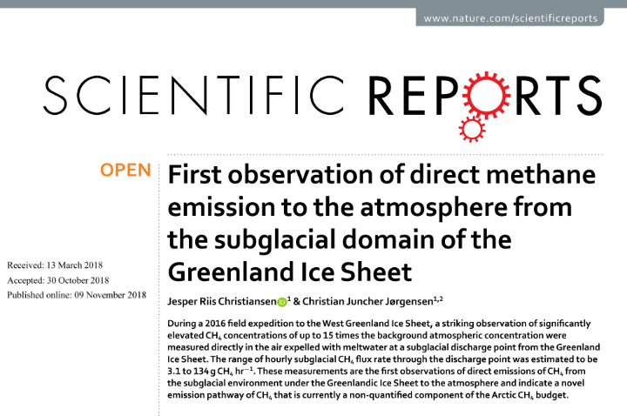
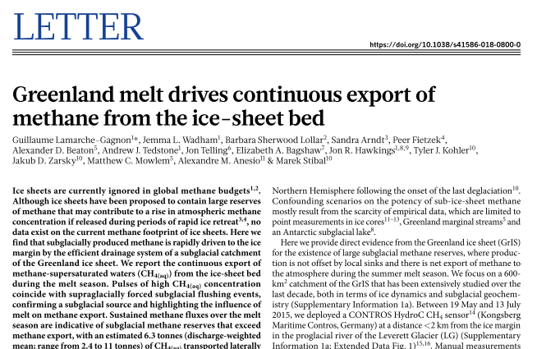
CH₄ Emission from the Greenland Ice Sheet
CH₄ export in meltwater and air from below the ice (Lamarche-Gagnon et al. (2019) Nature, Burns et al. (2018) Sci. Rep., Christiansen & Jørgensen (2018) Sci. Rep.)
Large CH₄ emissions from an unknown and unaccounted source

Slide 9
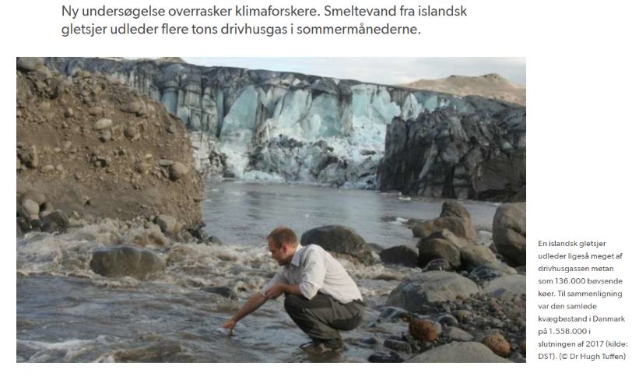
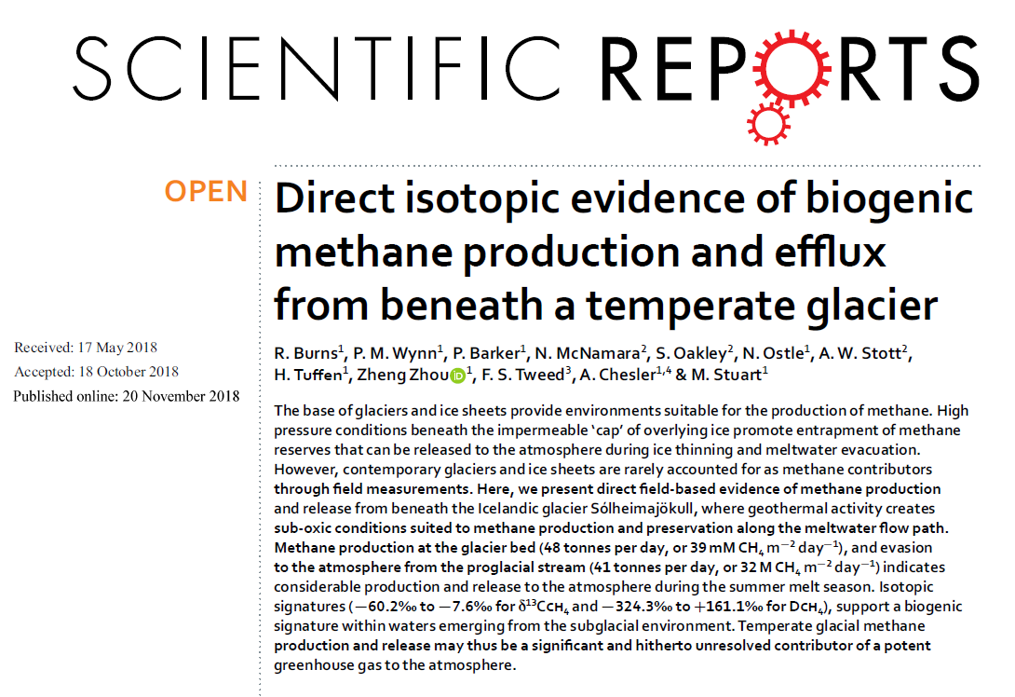
Identical phenomena in Iceland

Slide 10
A common, yet unknown, cryosphere-atmosphere interaction? What we do not know...
Is this an important source of CH₄ to the atmosphere?
Duration and spatial distribution along glacier margins
Where does the subglacial methane originate from?
Biogenic, thermogenic, clathrates or all
Marginal or deep subglacial sources
How is the CH₄ emission related to supraglacial processes?
Climatological drivers, surface melt
Field work in 2018 & 2019
© Authors. All rights reserved
Notes:
Et oprids af de største knowledge gaps, hvor jeg har forsøgt at sammenskrive dem du allerede har givet
Jeg håber selvfølgelig at dette kan give anledning til diskussion

Slide 11

Why do we need to know the origin of this CH₄? It’s importance as a climate amplifier in a warming cryosphere
Release from CH₄ hydrates
Destabilization due to thinning of ice sheet
Rapid
release
Augmented with global warming?
Microbial source of CH₄ → degradation of organic C
Isotopic composition
In situ production of buried carbon in “young” sediments
Microbial activity constrained by available carbon
Business as usual

Slide 12
Concluding summary
Larger scope
Discovery of an unknown emission pathway of CH₄ to the atmosphere
Ice sheets overlie extensive biologically active wetlands
CH₄ from the subglacial domain should probably be included in the Arctic carbon budget

Slide 13
Concluding summary
Scientific findings and challenges
CH₄ is likely microbially produced
Subglacial meltwater appears to be the main regulator of CH₄ emissions
Future changes in surface melt could influence net annual CH₄ emissions
More studies needed to understand the relative and absolute climatic importance:
  Process understanding: Full season continuous monitoring at known point source
  Spatial understanding: Expanded geographical survey & sampling

Slide 14
Options for collaboration in the future
The challenge (a big one): Continuous monitoring of isotope composition of subglacial CH₄ and CO₂ at the Greenland Ice Sheet in 2021-2023
Three questions to you...
Do you or your lab have an isotope analyser for CH₄ and/or CO₂?
Would you dare to take it to Greenland and do measurements that have never been done before?
...and collaborate with us in a potentially groundbreaking research project on subglacial carbon cycling?

Slide 15
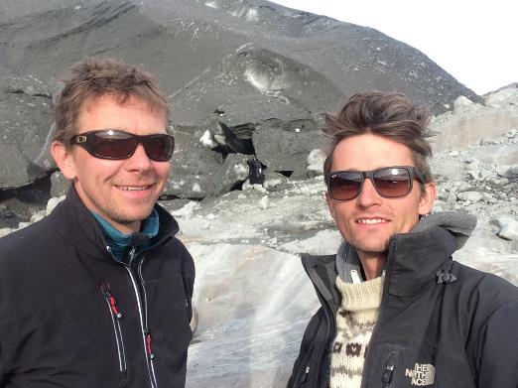
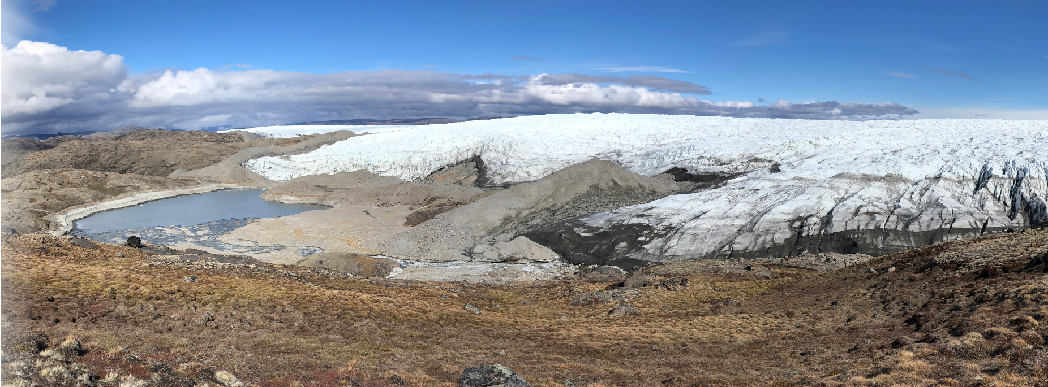
Thanks for your attention
Do not hesitate to contact us!
cjj@bios.au.dk
jrc@ign.ku.dk

