Slide 1
Salinity-driven centennial variability in the Arctic and North Atlantic
Weimin Jiang, Guillaume Gastineau, Francis Codron, et al.
VARCLIM, LOCEAN, Sorbonne Université, Paris

Slide 2
Previous work
AMOC multi-decadal to multi-centennial variability comes from:
Arctic:
- release of Arctic freshwater through Fram Strait in MPI-OM model (Jungclaus et al., 2005);
Southern Ocean:
- salinity anomalies propagating from the Southern Ocean in GFDL coupled model (Delworth & Zeng, 2012)
Tropics:
- freshwater imposed by north shifted and increased ITCZ in HadCM3 model (Vellinga & Wu, 2004)
Our research
New IPSL-CMIP6-LR (Boucher et al., 2020); pre-industrial control simulation (1850 - 3049)
Atm: 2.5x1.5° (144x142) L79 Oce: 1° L75
Improvements: more sea ice categories; better boundary layers and temperatures; oceanic resolution from 2º to 1º
CMIP6: Coupled Model Intercomparison Project (CMIP) phase 6

Slide 3
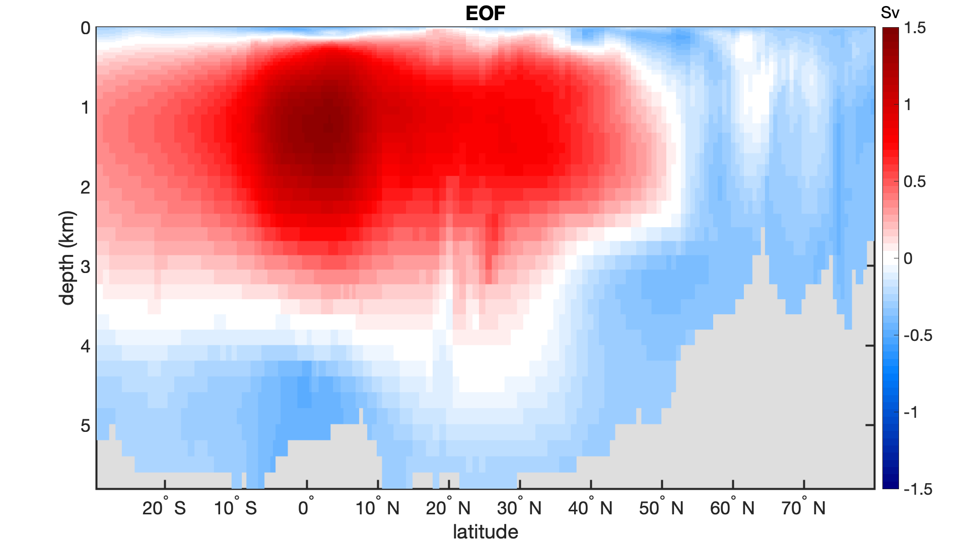
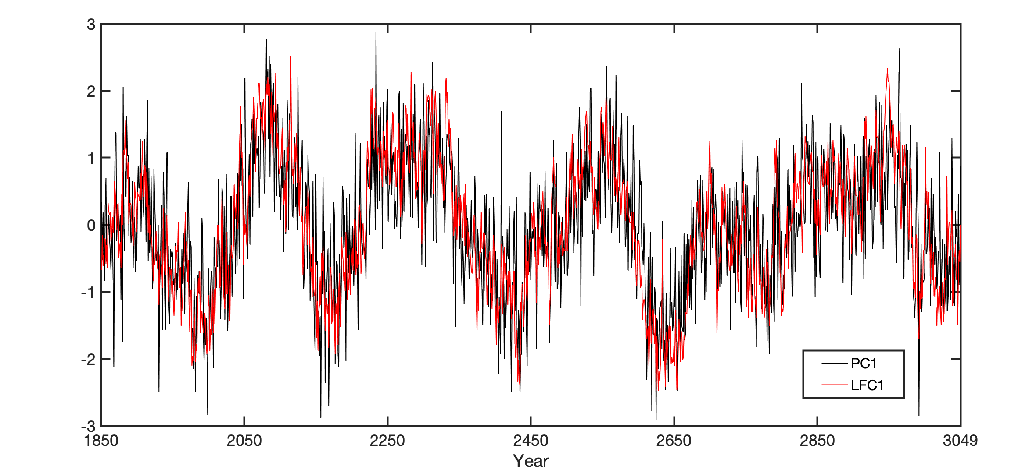
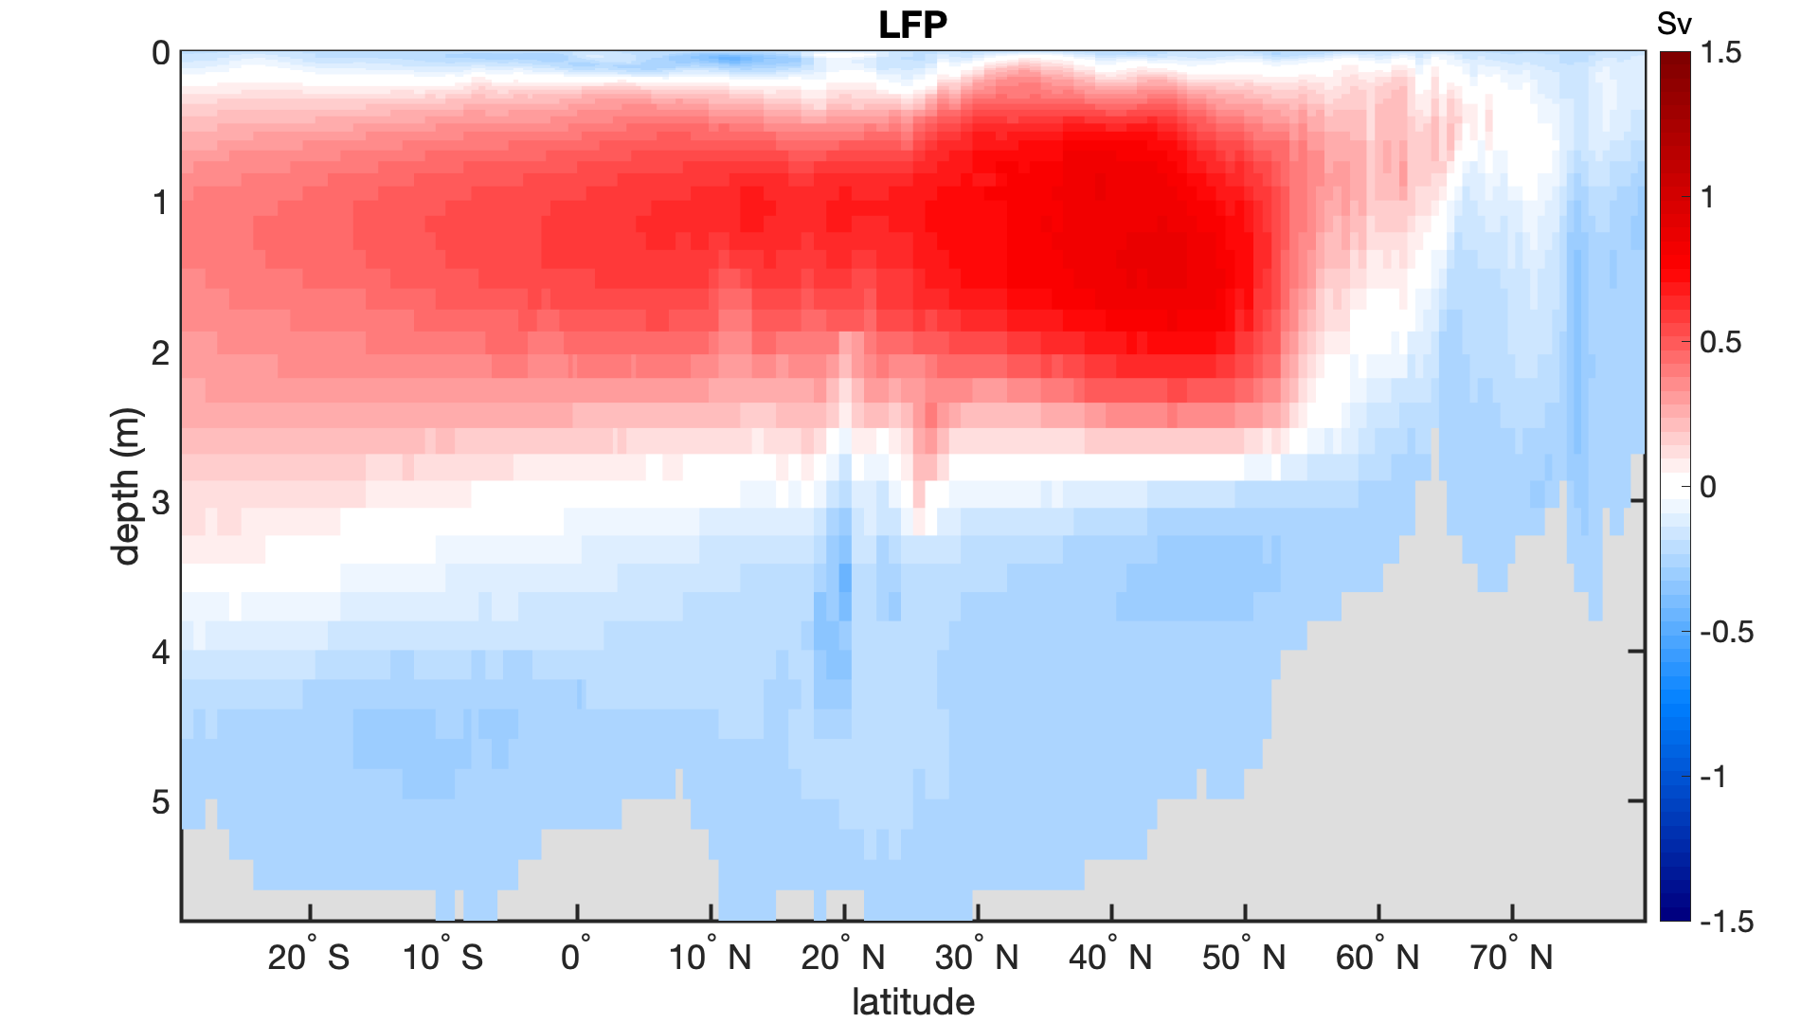
EOF and low frequency analysis of AMOC streamfunction
First 8 EOFs: 74% of total variance
EOF1
21.7% of total variance
A 20-year cutoff Butterworth lowpass filter
LFP1
48.6% of low frequency variance
(Wills et al., 2018)
Dominant centennial variabiliy of AMOC is isolated with LFC
from high frequncy variance at tropics.
Notes:
Data:
Our study is based on a 1200-year pre-industrial (1850 - 3049) control simulation of the IPSL-CM6 (Coupled Model Intercomparison Project, Phase 6)-LR (which uses a relatively low resolution of $2.5°×1.5°$ for the horizontal atmosphere and $1°$ for the ocean) atmosphere-ocean coupled model.
Method:
We use classical Empirical Orthogonal Function (EOF) Analysis and novel Low Frequency Analysis (Wills et al., 2018) to study the temporal and spatial patterns of AMOC streamfunction from $30°$ S to $80°$N. First 8 EOFs explain 74% of the total variance. We use a Butterworth lowpass filter with a cutoff period of 20 years to those first 8 EOFs and find the pattern (Fig.1 a) which explains the largest portion of low frequency variance.
Figures:
EOF1: first mode of Empirical Orthogonal Function
LFP1: first mode of Low Frequency Analysis (Wills et al., 2018)
Timeseries: PC1 (corresponding to EOF1) and LFC1 (corresponding to LFP1)

Slide 4
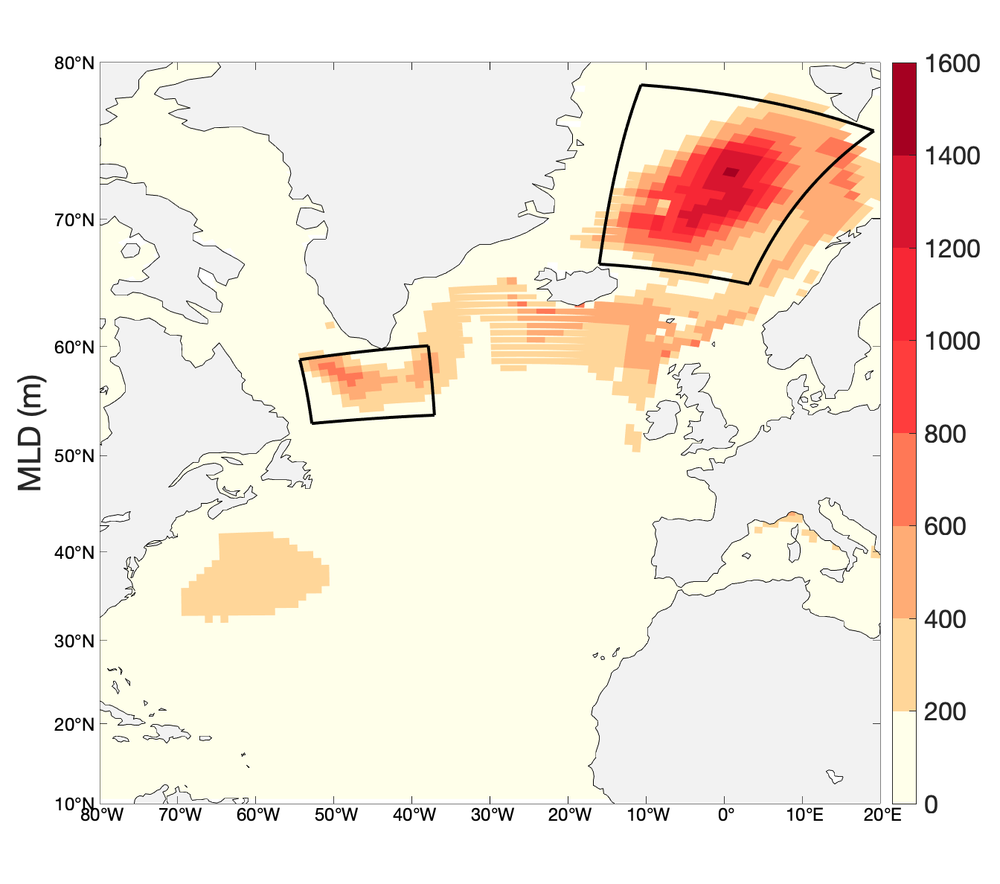
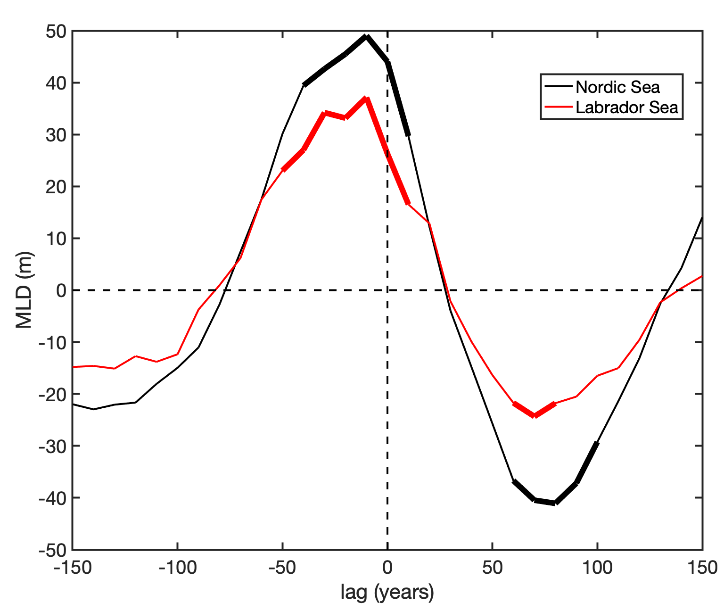






Regressed MLD(m), density onto AMOC LFC1
a)
c)
d)
$$ρ(t)$$
$$ρ(s)$$
$$ρ(t)$$
$$ρ(s)$$
Nordic
Labrador
$$ρ(s,t)$$
$$ρ(s,t)$$
Nordic
Climatological MLD
Labrador
b)
AMOC leads
5% significance level in bold (solid)
- Density anomalies are dominated dy salinity
- Surface (0-200m) is more variable
Notes:
Fig. a: climatological mean mixed layer depth. We choose two convective sites at Nordic seas and Labrador Sea and regress mixed layer depth at those two sites onto AMOC LFC1.
Fig. b: regressed mixed layer depth at two convective sites (labelled in Fig.a) with lags (AMOC leads when lag is positive)
Fig. c, d: regressed density at lag -10 int Nordic seas and Labrador Sea, respectively. Black lines are density anomalies, red lines are density anomalies caused by changes of salinity and blue lines by changes of temperature.

Slide 5
Regression of 0-150m temperature, salinity and density onto AMOC-LFC1
Temperature (ºC)
Salinity (psu)
Density (kgm⁻³)
density anomalies dominated by salinity
Notes:
Regressed temperature, salinity and density from surface to 155m deep at lag 0, respectively.

Slide 6
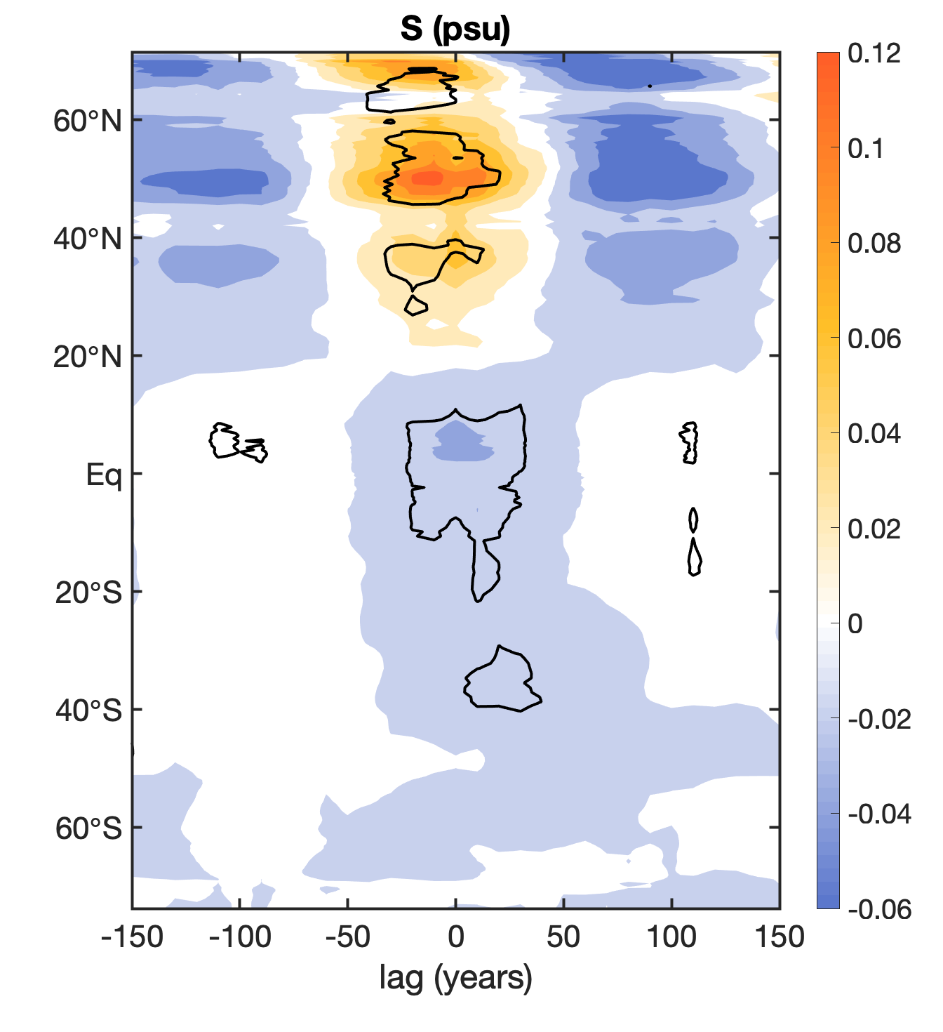
Zonally mean 0-150m salinity anomalies in the Atlantic basin
salinity anomalies come more from Arctic and high-latitude North Atlantic, not tropics
No significant atrmospheric impacts:
- Sea level pressure
- Wind stress
Notes:
Regression of zonally mean salinity over the Atlantic basin at top 150m. Variance concentrates on the northern hemisphere. There is no significant oscillation from Southern Ocean.
We also checked the influences of sea level pressure and wind stress. We did not find any significant signals.
Centennial variability in the Arctic and high-latitude North Atlantic is mainly driven by salinty.

Slide 7
Climatological 0-150m salinity and currents
Regressed 0-150m salinity and currents
Notes:
Left panel: climatological mean 0-150m salinity and currents in the Arctic
Right panel: regressed 0-150m salinity and currents at lag -30

Slide 8
Notes:
Regressed 0-150m salinity and currents at lag 0 and 20

Slide 9
Freshwater transport toward Arctic (positive northward)
Regression onto LFC1 (in mSv)
Bering
Fram
AMOC leads
Bering
Total
Davis
Fram
Surface
Barents
Barents
Davis
Lag (in yr)
Notes:
Left panel:
Right panel: regressed 0-150m salinity and currents at lag 40. Black lines indicate the positions of cross-sections
Right panel:
Regressed freshwater transport with lags at each section. The solid black line is the sum of four sections and dashed black line is freshwater flux through surface.

Slide 10


$$\overline{S}∗V^{′}$$
$$S^{′}∗\overline{V}$$
AMOC leads
Fram
AMOC leads
Fram
Bering
Bering
Surface
Barents
Surface
Barents
Davis
Davis
Notes:
Left panel: freshwater transport calculated with mean salinity and currents anomalies
Right panel: freshwater transport calculated with salinity anomalies and mean current
Surface term (dashed black line) should be reversed.

Slide 11
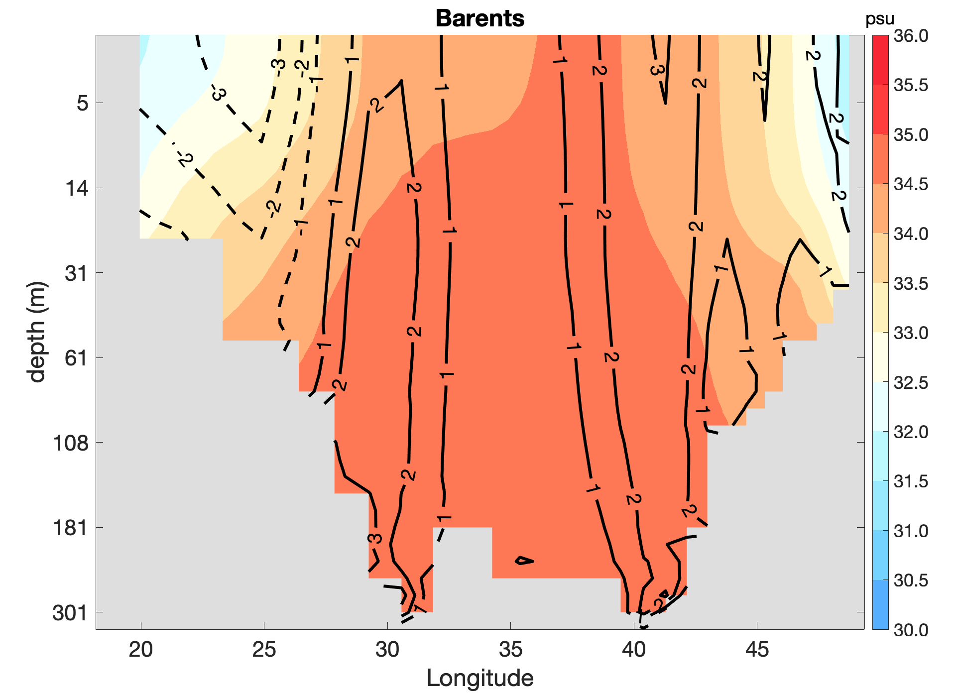
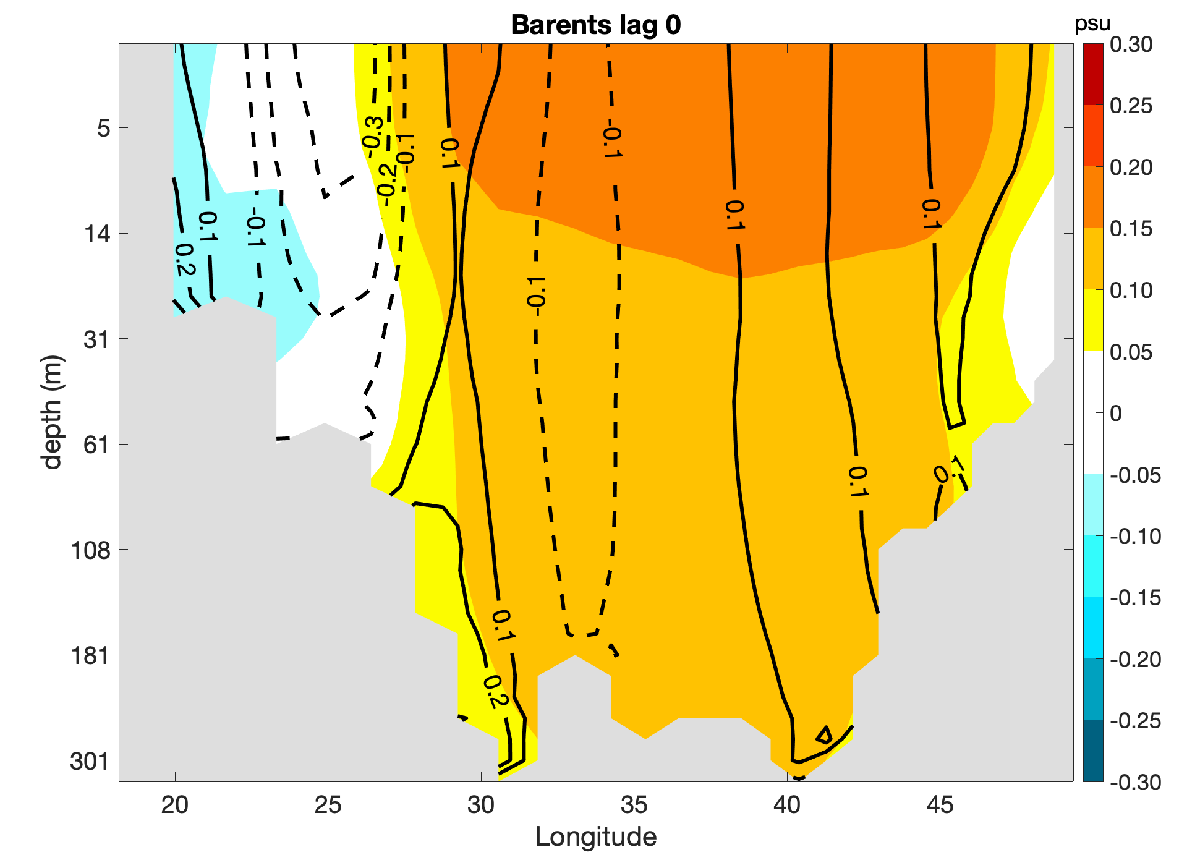
Salinity and meridional velocity (cm/s)
Barents cross-section
climatology
lag 0
Notes:
Salinity (in psu) and meridional velocity (in cm/s) at Barents cross-section. Left panel is climatology and the right one is regression at lag 0 when freshwater transport anomaly at Barents is maximum.

Slide 12
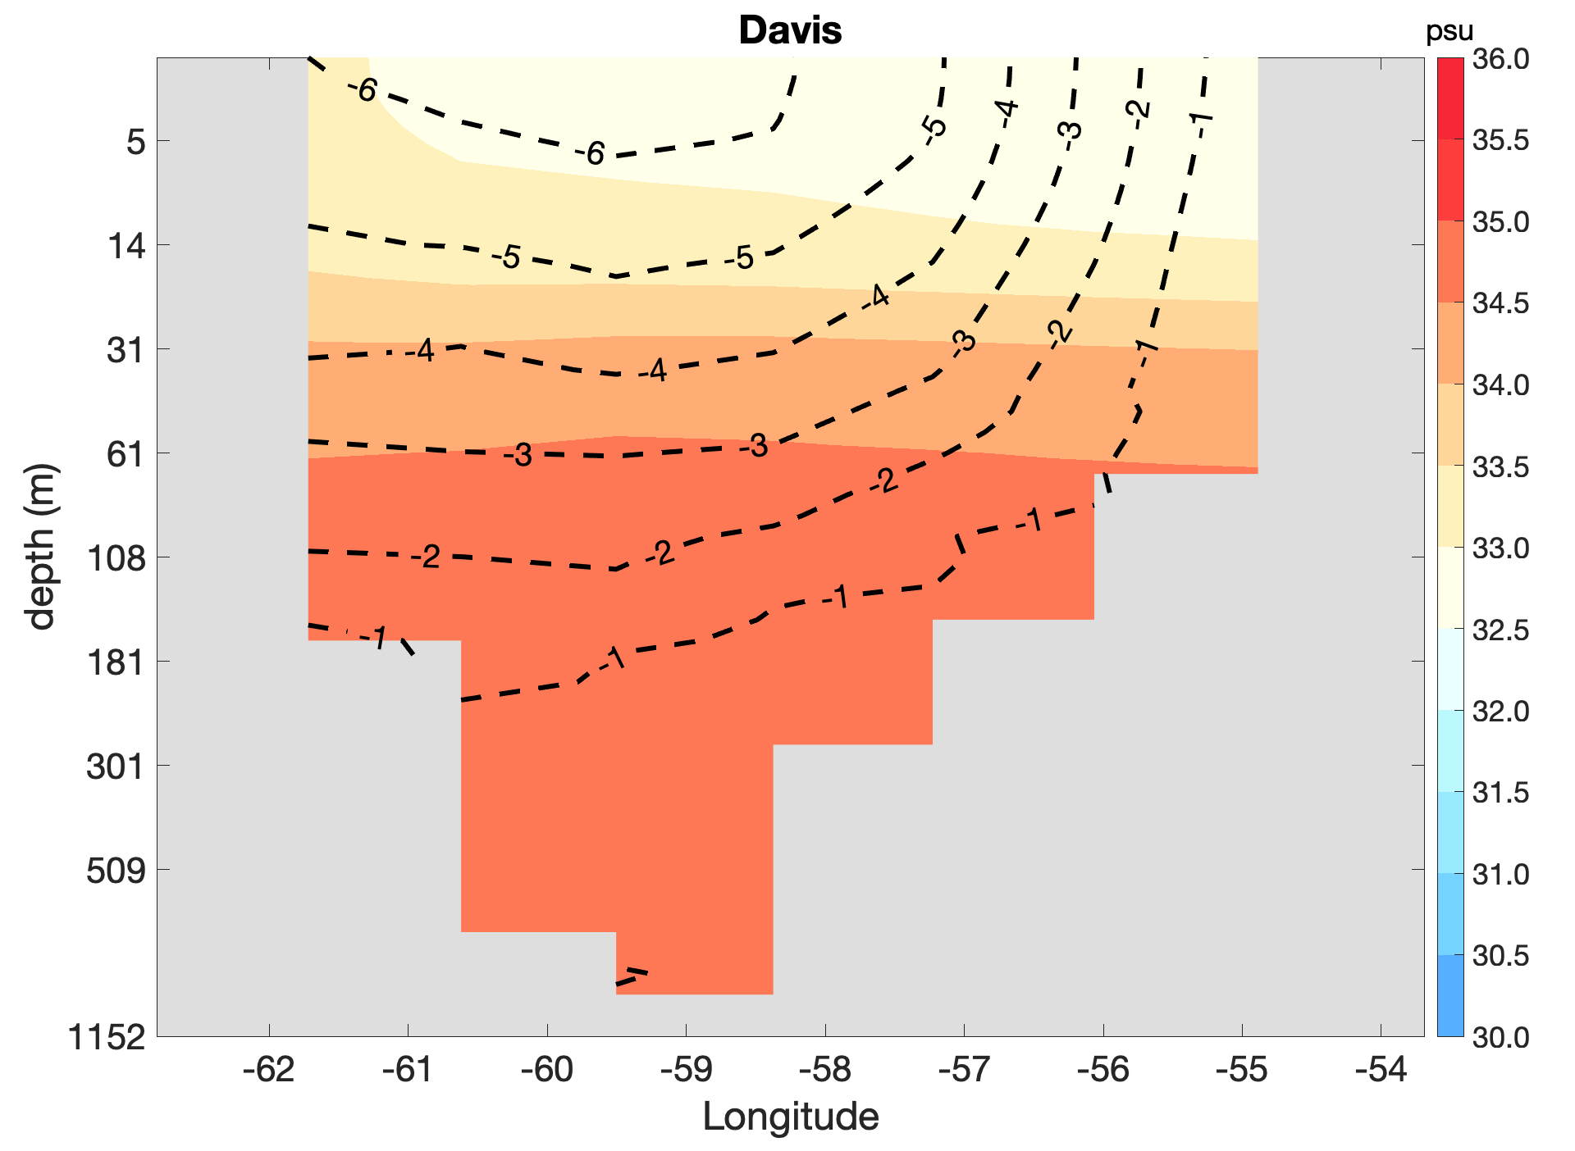
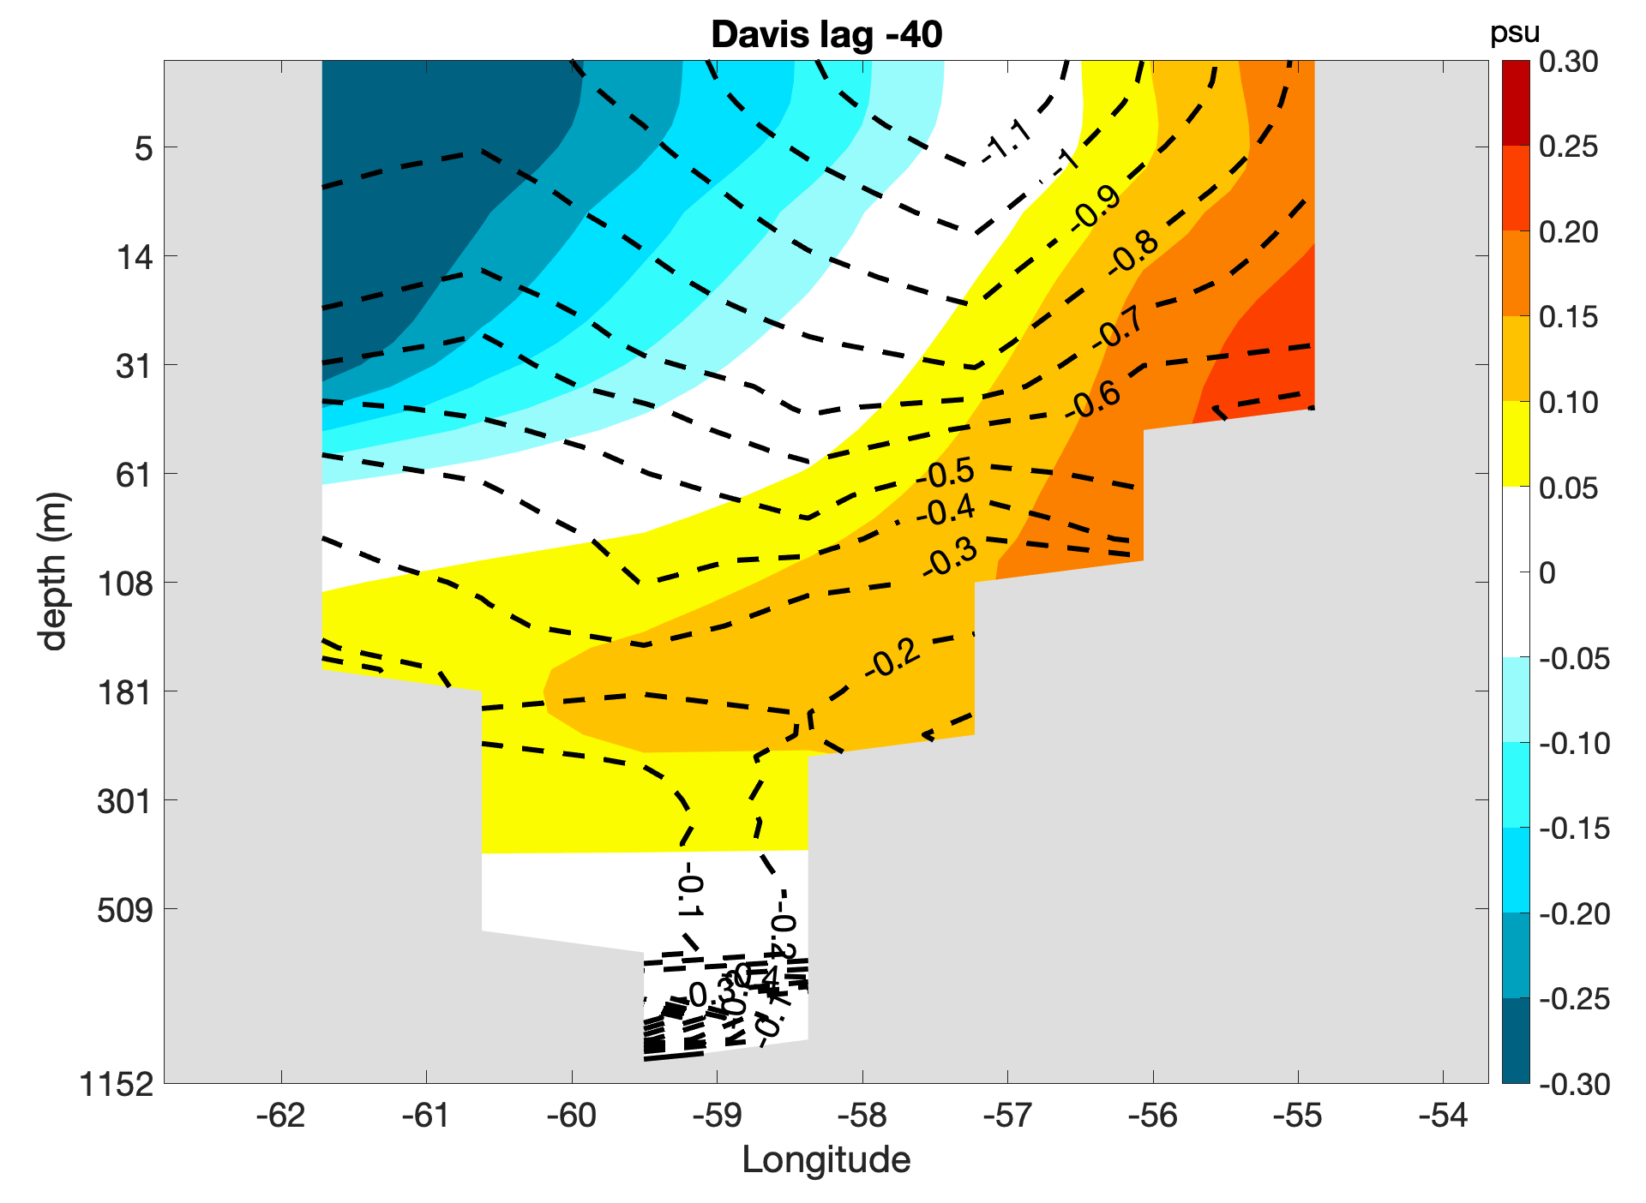
Davis cross-section
climatology
lag -40
Reference salinity: 34.8
Notes:
Salinity (in psu) and meridional velocity (in cm/s) at Davis cross-section. Left panel is climatology and the right one is regression at lag -40 when freshwater transport anomaly at Davis is maximum.

Slide 13
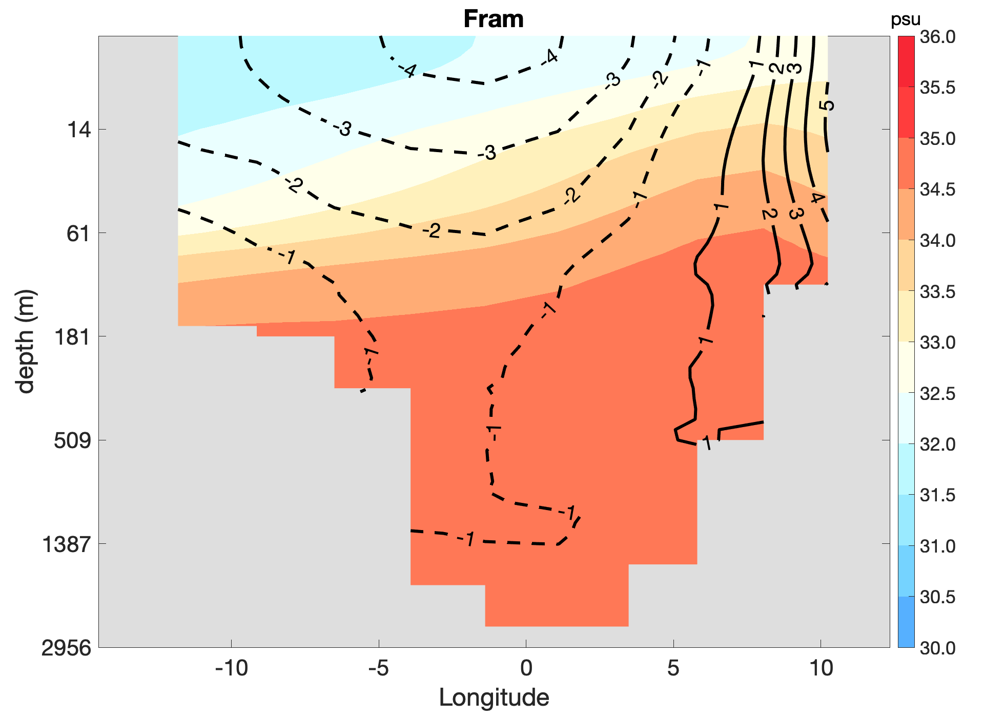
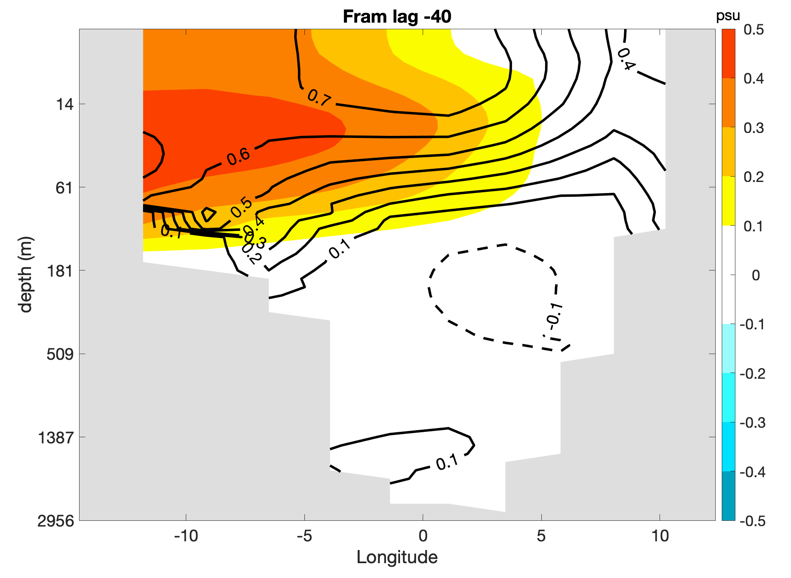
Fram cross-section
Climatology
lag -40
Notes:
Salinity (in psu) and meridional velocity (in cm/s) at Fram cross-section. Left panel is climatology and the right one is regression at lag 0 when freshwater transport anomaly at Fram is maximum.

Slide 14
Mechanism of AMOC centennial variability in our research
(+ internal salinity feedback)
Strong AMOC
+ Nordic seas salinity
Weak Greenland current
+ Less sea ice export
Barents sea more salty
+ More recirculation ?
+ Anomalous advection of mean salinity
Central Arctic stratified & fresh surface
N. Greenland salinity
- Advection of anomalies by mean flow

