Slide 1
A theory of palaeoclimate reconstruction
Mengmeng Liu, Imperial College London
Iain Colin Prentice, Imperial College London
Cajo J. F. ter Braak, Wageningen University & Research
Sandy P. Harrison, University of Reading

Slide 2
Introduction
Can’t go back to 10000 years ago to measure directly
Picture source: Google images

Slide 3
We have to infer
Introduction
Unfortunate organisms buried in sediments
chironomid
diatom
pollen
WA-PLS
(Weighted Averaging Partial Least Squares)
Picture sources: Wikipedia

Slide 4
Compression bias
Introduction
(Data source: SMPDS data set)

Slide 5
Introduction
A more rigorous method is needed!

Slide 6
Assumption (a)
Methods
The theoretical abundance of each taxon follows a Gaussian (unimodal) curve with respect to each climate variable considered
$$p_{ik}^{∗}=e^{a_{k}−\frac{{\left(x_{i}−u_{k}\right)}^{2}}{2t_{k}^{2}}}$$
where $p_{ik}^{∗}$ is the theoretical abundance of the k^{th} taxon at the i^{th} site; a_{k} is the log-value of theoretical maximum abundance of the k^{th} taxon; x_{i} is the value of the climate variable at the i^{th} site; u_{k} is the optimum (the most suitable climate value) of the k^{th} taxon; and t_{k} is the tolerance (a measure of the breadth of the climatic distribution) of the k^{th} taxon.
ter Braak CJF, Prentice IC. 1988

Slide 7
Assumption (b)
Methods
The actual abundances of taxa, being compositional data, follow a multinomial distribution
$$f=\frac{1}{\prod_{k=1}^{m}{y_{ik}!}}\prod_{k=1}^{m}{{p_{ik}}^{y_{ik}}}$$
where f is the probability function of the multinomial distribution, y_{ik} is the actual relative abundance of the k^{th} taxon at the i^{th} site; m is the total number of taxa; p_{ik} can be expressed by
$$p_{ik}=\frac{p_{ik}^{∗}}{\sum_{k′=1}^{m}{p_{ik′}^{∗}}}$$
Forbes C, et al. 2010

Slide 8
Assumption (c)
Methods
The best estimate of the climate value at a given site and time minimizes the difference between the theoretical and actual abundances as assessed by the likelihood criterion, i.e. it maximizes the log-likelihood function.
$$l=\log{f}≈−\sum_{k=1}^{m}{\log{y_{ik}!}}+\sum_{k=1}^{m}{y_{ik}}\left(a_{k}−\frac{{\left(x_{i}−u_{k}\right)}^{2}}{2t_{k}^{2}}\right)$$
$${\hat{x}}_{i}=\frac{\sum_{k=1}^{m}{\frac{y_{ik}u_{k}}{t_{k}^{2}}}}{\sum_{k=1}^{m}{\frac{y_{ik}}{t_{k}^{2}}}}$$
Solving $\frac{∂ l}{∂ x_{i}}$ = 0 yields
Zacks S. 1971; Millar RB. 2011

Slide 9
Equation comparison
Methods
The new method
WA-PLS
$${\hat{x}}_{i}=\frac{\sum_{k=1}^{m}{\frac{y_{ik}u_{k}}{t_{k}^{2}}}}{\sum_{k=1}^{m}{\frac{y_{ik}}{t_{k}^{2}}}}$$
$${\hat{x}}_{iWA}=\frac{\sum_{k=1}^{m}{y_{ik}u_{k}}}{\sum_{k=1}^{m}{y_{ik}}}$$
WA-PLS is a special case of the new approach when taxa tolerances (t_{k}) are equal.
ter Braak CJF, Prentice IC. 1988

Slide 10
Are tolerances equal?
Methods
(Data source: SMPDS data set)

Slide 11
Cause of compression
Methods
In the simple case of two taxa (n = 2)
$${\hat{x}}_{iWA}−{\hat{x}}_{i}=\frac{y_{1k}y_{2k}}{t_{1}^{2}t_{2}^{2} \left(y_{1k}+y_{2k}\right)\left(\frac{y_{1k}}{t_{1}^{2}}+\frac{y_{2k}}{t_{2}^{2}}\right)}\left(u_{1}−u_{2}\right)\left(t_{1}^{2}−t_{2}^{2}\right)$$
When u₁ > u₂, t₁ > t₂, ${\hat{x}}_{iWA}$ > ${\hat{x}}_{i}$; when u₁ < u₂, t₁ < t₂, ${\hat{x}}_{iWA}$ > ${\hat{x}}_{i}$;
when u₁ > u₂, t₁ < t₂, ${\hat{x}}_{iWA}$ < ${\hat{x}}_{i}$; when u₁ < u₂, t₁ > t₂, ${\hat{x}}_{iWA}$ < ${\hat{x}}_{i}$.
In all the four cases, ${\hat{x}}_{iWA}$ is always closer to the optimum of wide-spread taxon than ${\hat{x}}_{i}$

Slide 12
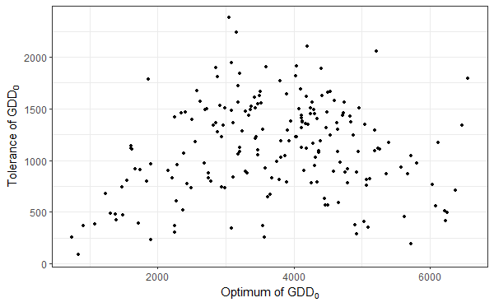
Cause of compression
Methods
Wide-
spread
Narrow-
spread
Narrow-
spread
Narrow-
spread
There are more wide-spread taxa in the centre, so ${\hat{x}}_{iWA}$ is closer to the centre
(Data source: SMPDS data set)

Slide 13
Results
Compression reduced using the new method TWA-PLS (right) compared to WA-PLS (left), using the last significant number of components
(Data source: SMPDS data set)

Slide 14
Results
Assessment of fitness of WA-PLS and the new method TWA-PLS, showing results for all the components.
 |  | WA-PLS |  |  |  |  | Tolerance weighted WA-PLS
 |  | comp1 | comp2 | comp3 | comp4 | comp5 | comp1 | comp2 | comp3 | comp4 | comp5
MTCO | slope | 0.63 | 0.68 | 0.70 | 0.71 | 0.71 | 0.74 | 0.77 | 0.80 | 0.83 | 0.83
 | slope_se | 0.01 | 0.01 | 0.01 | 0.01 | 0.01 | 0.01 | 0.01 | 0.01 | 0.01 | 0.01
 | intercept | -0.95 | -0.83 | -0.77 | -0.75 | -0.75 | 1.60 | 1.88 | 1.99 | 2.14 | 2.20
 | intercept_se | 0.05 | 0.05 | 0.05 | 0.05 | 0.05 | 0.06 | 0.05 | 0.06 | 0.06 | 0.07
 | R² | 0.61 | 0.65 | 0.66 | 0.66 | 0.66 | 0.67 | 0.70 | 0.64 | 0.60 | 0.55
 | RMSE | 5.42 | 5.12 | 5.04 | 5.04 | 5.09 | 5.51 | 5.40 | 5.97 | 6.55 | 7.15
 | p-value | 0.001 | 0.001 | 0.001 | 0.549 | 0.92 | 0.001 | 0.018 | 1.000 | 1.000 | 1.000
GDD₀ | slope | 0.61 | 0.66 | 0.68 | 0.68 | 0.68 | 0.82 | 0.90 | 0.94 | 0.95 | 0.97
 | slope_se | 0.01 | 0.01 | 0.01 | 0.01 | 0.01 | 0.01 | 0.01 | 0.01 | 0.01 | 0.01
 | intercept | 1332.91 | 1162.52 | 1097.11 | 1079.81 | 1068.72 | 457.07 | 144.15 | 26.27 | -28.30 | -67.11
 | intercept_se | 22.64 | 22 | 21.69 | 21.6 | 21.54 | 26.30 | 27.16 | 28.34 | 28.93 | 29.44
 | R² | 0.59 | 0.63 | 0.64 | 0.64 | 0.63 | 0.66 | 0.68 | 0.65 | 0.62 | 0.57
 | RMSE | 999.83 | 947.86 | 939.04 | 944.62 | 959.83 | 958.35 | 982.51 | 1091.43 | 1186.17 | 1327.16
 | p-value | 0.001 | 0.001 | 0.040 | 0.800 | 0.971 | 0.001 | 0.988 | 1.000 | 1.000 | 1.000
α | slope | 0.62 | 0.66 | 0.68 | 0.68 | 0.69 | 0.78 | 0.82 | 0.84 | 0.87 | 0.88
 | slope_se | 0.01 | 0.01 | 0.01 | 0.01 | 0.01 | 0.01 | 0.01 | 0.01 | 0.01 | 0.01
 | intercept | 0.3 | 0.26 | 0.25 | 0.24 | 0.24 | 0.19 | 0.16 | 0.15 | 0.13 | 0.12
 | intercept_se | 0.00 | 0.00 | 0.00 | 0.00 | 0.00 | 0.01 | 0.01 | 0.01 | 0.01 | 0.01
 | R² | 0.59 | 0.63 | 0.64 | 0.64 | 0.64 | 0.64 | 0.67 | 0.66 | 0.64 | 0.61
 | RMSE | 0.17 | 0.17 | 0.16 | 0.16 | 0.16 | 0.17 | 0.17 | 0.17 | 0.18 | 0.19
 | p-value | 0.001 | 0.001 | 0.002 | 0.154 | 0.969 | 0.001 | 0.001 | 0.998 | 1.000 | 1.000
(Data source: SMPDS data set)

Slide 15
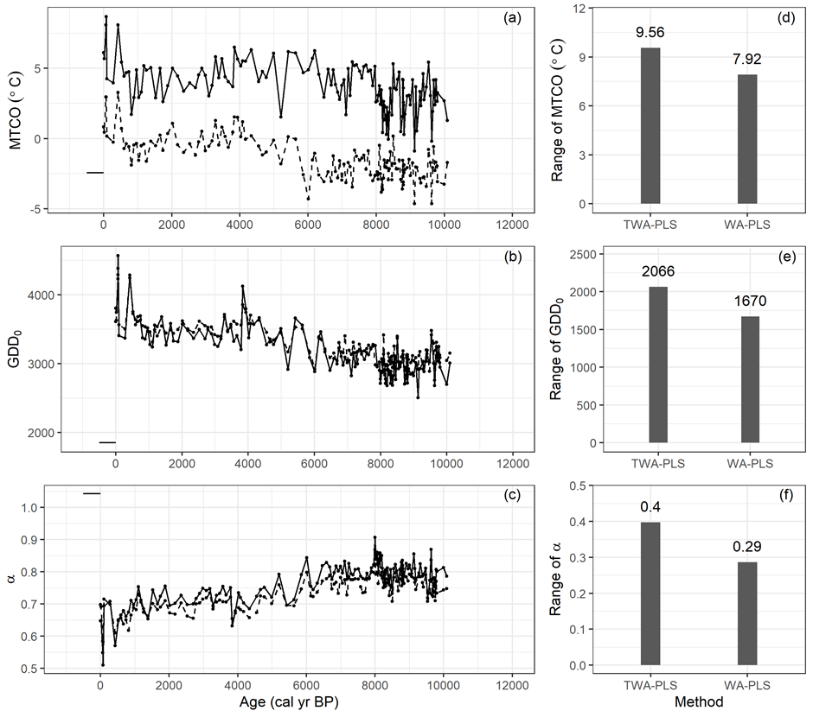
Results
Example:
Basa de la Mora core reconstruction results using WA-PLS (dashed line) and the new method TWA-PLS (solid line)
(Data source: Pérez-Sanz A et al. 2013 )

Slide 16
References
Harrison SP. 2020 Climate reconstructions for the SMPDS v1 modern pollen data set. (doi:doi: 10.5281/zenodo.3605003)
ter Braak CJF, Prentice IC. 1988 A theory of gradient analysis. Adv. Ecol. Res. 18, 271–317. (doi:10.1016/S0065-2504(08)60183-X)
Forbes C, Evans M, Hastings N, Peacock B. 2010 Multinomial Distribution. In Statistical distributions, pp. 135–136. Oxford: Wiley-Blackwell.
Millar RB. 2011 Maximum likelihood estimation and inference with examples in R, SAS, and ADMB. Chichester, Sussex, U.K.: Wiley.
Zacks S. 1971 The theory of statistical inference. New York (N.Y.) : Wiley. See http://lib.ugent.be/catalog/rug01:000474697.
ter Braak CJF, Juggins S. 1993 Weighted averaging partial least squares regression (WA-PLS): An improved method for reconstructing environmental variables from species assemblages. Hydrobiologia 269, 485–502. (doi:10.1007/BF00028046)
Pérez-Sanz A et al. 2013 Holocene climate variability, vegetation dynamics and fire regime in the central Pyrenees: the Basa de la Mora sequence (NE Spain). Quat. Sci. Rev. 73, 149–169. (doi:https://doi.org/10.1016/j.quascirev.2013.05.010)

